Slide 1

2CS503 Design & Analysis of Algorithm
Recurrence Relation
Unit-3
Divide and Conquer Algorithm
Disclaimer: Content in the PPT is prepared from Books, videos and blogs

Slide 2
Topics to be covered
Introduction to Recurrence Equation
Different methods to solve recurrence
Divide and Conquer Technique
Multiplying large Integers Problem
Problem Solving using divide and conquer algorithm –
  Binary Search
  Sorting (Merge Sort, Quick Sort)
  Matrix Multiplication
  Exponential

Slide 3
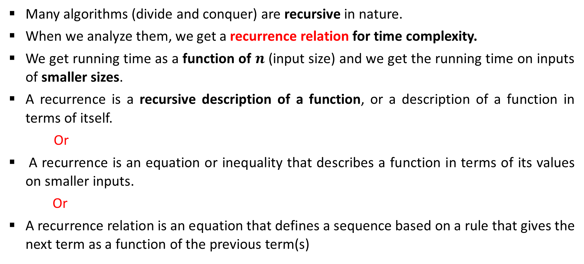
Introduction
Many algorithms (divide and conquer) are recursive in nature.
When we analyze them, we get a recurrence relation for time complexity.
We get running time as a function of $n$ (input size) and we get the running time on inputs of smaller sizes.
A recurrence is a recursive description of a function, or a description of a function in terms of itself.
Or
A recurrence is an equation or inequality that describes a function in terms of its values on smaller inputs.
Or
A recurrence relation is an equation that defines a sequence based on a rule that gives the next term as a function of the previous term(s)

Slide 4
Methods to Solve Recurrence
Substitution
Homogeneous (characteristic equation)
Non-homogeneous
Master method
Recurrence tree
Intelligent guess work
Change of variable
Range transformations

Slide 5

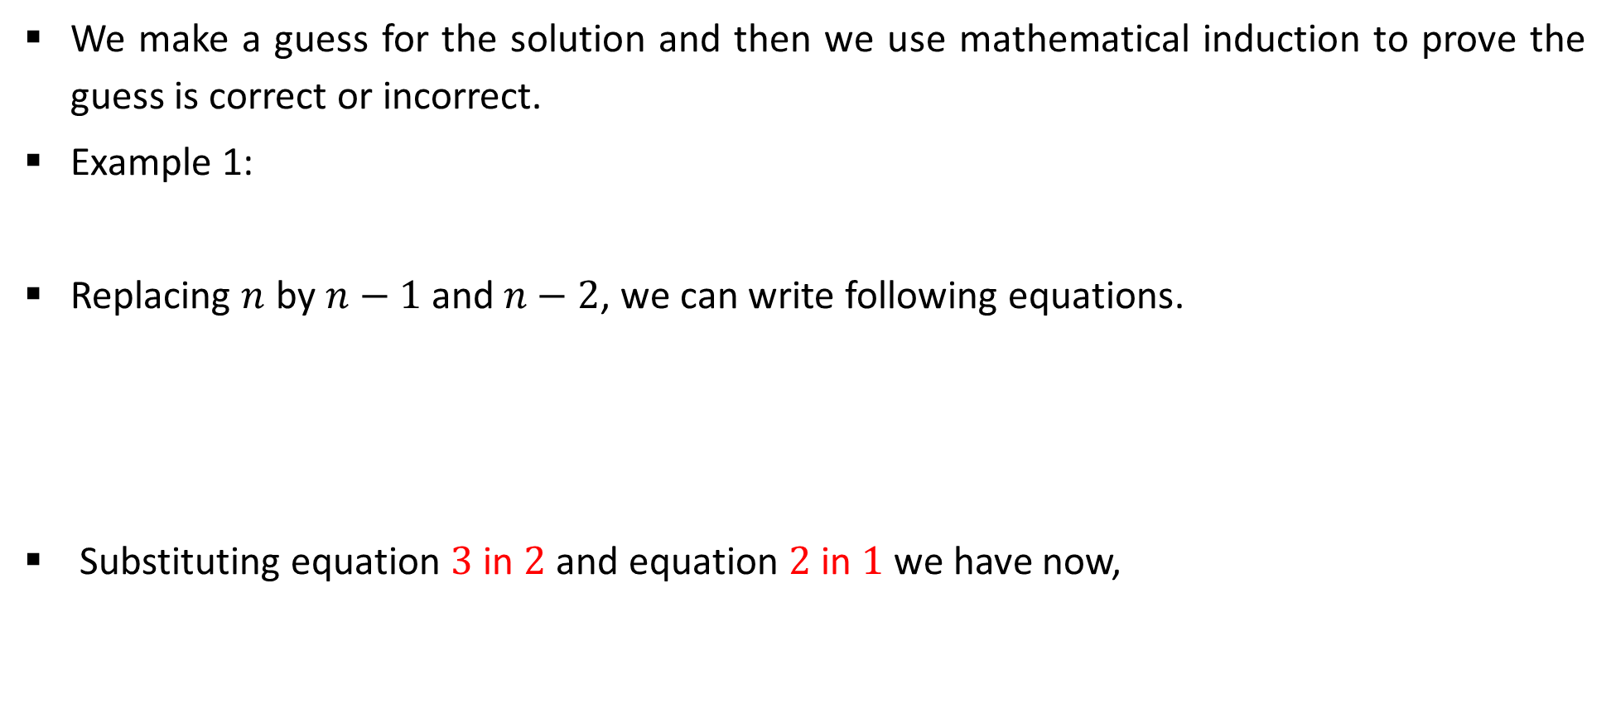



Substitution Method
We make a guess for the solution and then we use mathematical induction to prove the guess is correct or incorrect.
Example 1:
Replacing $n$ by $n−1$ and $n−2$, we can write following equations.
Substituting equation $3$ in $2$ and equation $2$ in $1$ we have now,
$$T(n)=T(n−1)+n$$
1
$$T(n−1)=T(n−2)+n−1$$
2
$$T(n−2)=T(n−3)+n−2$$
3
$$T(n)=T(n−3)+n−2+n−1+n$$
4

Slide 6

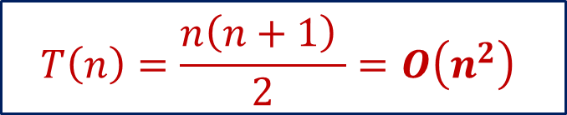
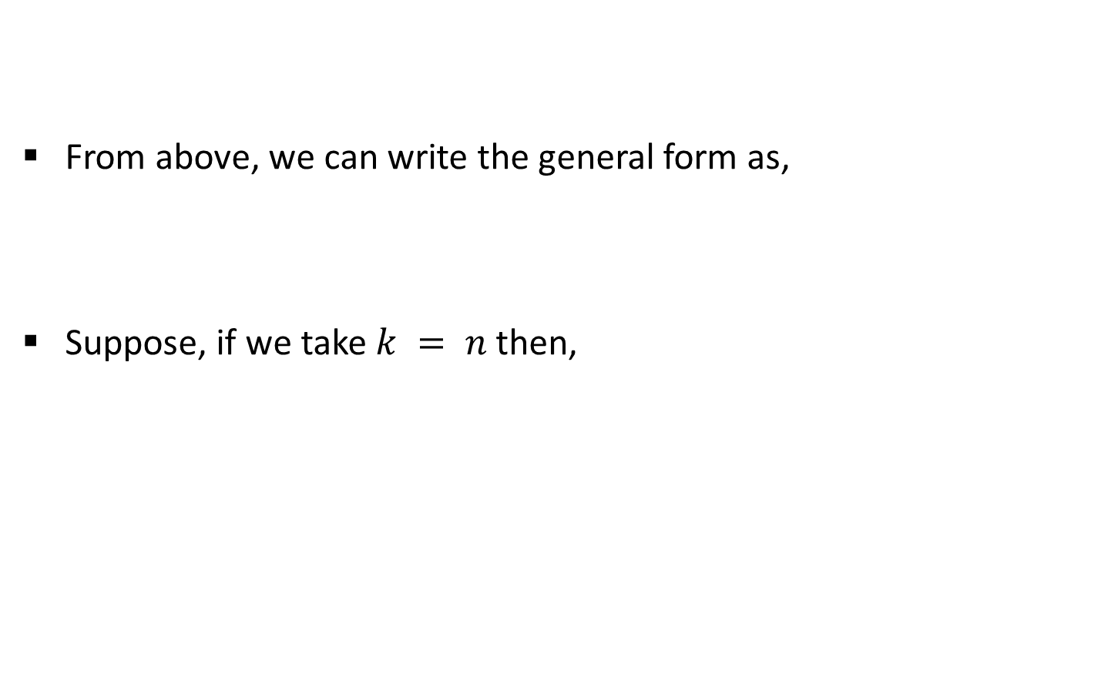

Substitution Method
From above, we can write the general form as,
Suppose, if we take $k = n$then,
$$T(n)=T(n−3)+n−2+n−1+n$$
4
$$T\left(n\right)=T\left(n−k\right)+(n−k+1)+(n−k+2)+ …+n$$
$$T(n)=T(n−n)+n−n+1+n−n+2+ …+n$$
$$T\left(n\right)=0+1+2+ …+n$$
$$T\left(n\right)=\frac{n\left(n+1\right) }{2}=O\left(n^{2}\right)$$

Slide 7
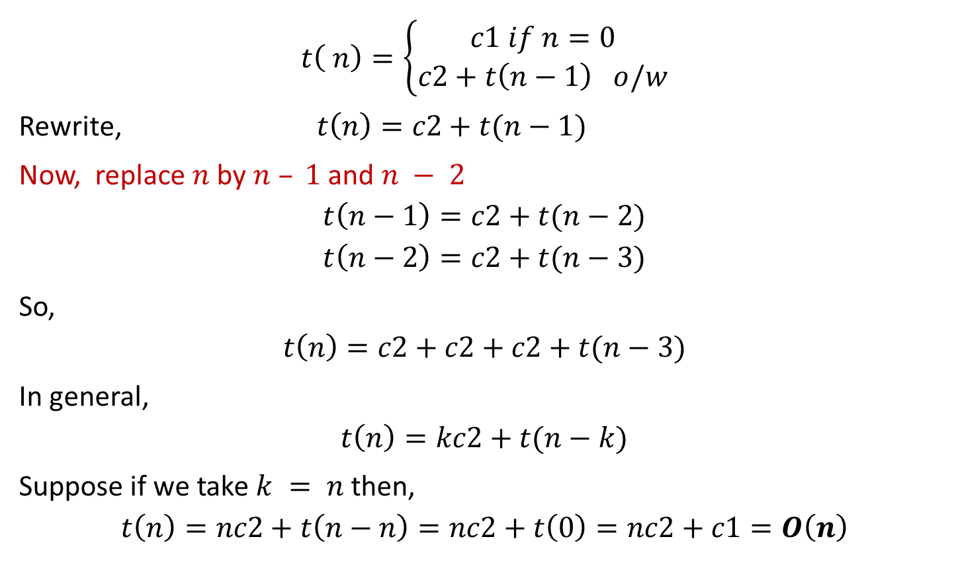
Exercise 1
$$t\left( n\right)=\left\{\begin{aligned}c1 if n=0 \\ c2+t\left(n−1\right) o/w\end{aligned}\right.$$
Rewrite, $t\left(n\right)=c2+t(n−1)$
Now, replace $n$ by $n – 1$and $n − 2$
$$t\left(n−1\right)=c2+t(n−2)$$
$$t\left(n−2\right)=c2+t(n−3)$$
So,
$$t\left(n\right)=c2+c2+c2+t(n−3)$$
In general,
$$t\left(n\right)=kc2+t(n−k)$$
Suppose if we take $k = n$then,
$$t\left(n\right)=nc2+t\left(n−n\right)=nc2+t\left(0\right)=nc2+c1=O\left(n\right)$$

Slide 8
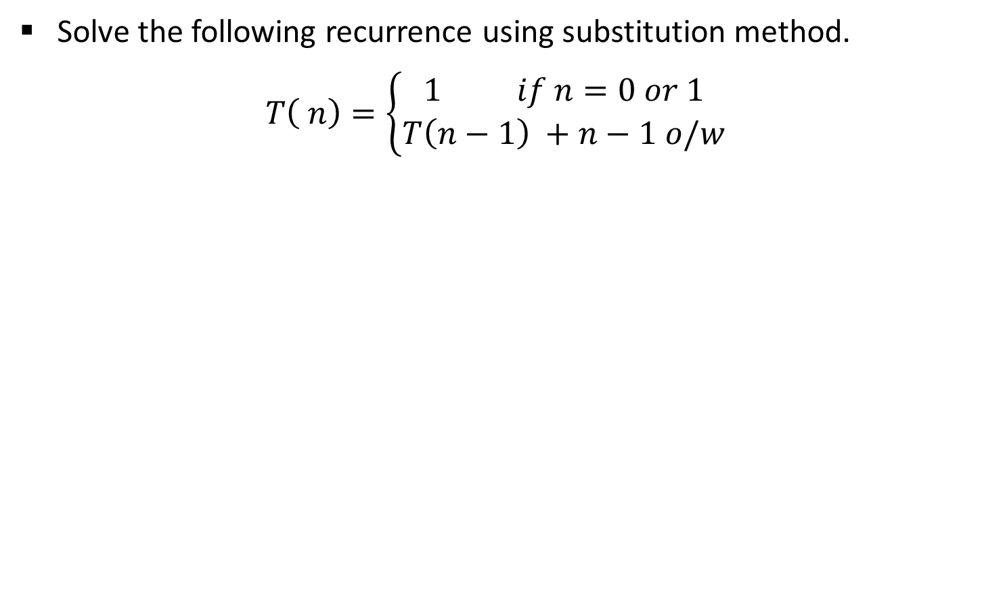
Exercise 2
Solve the following recurrence using substitution method.
$$T\left( n\right)=\left\{\begin{aligned}1 if n=0 or 1 \\ T\left(n−1\right) +n−1 o/w\end{aligned}\right.$$

Slide 9
Solving recurrence relation
  Iteration (already discussed in previous slids)
  Characteristics root
  Generating function

Slide 10
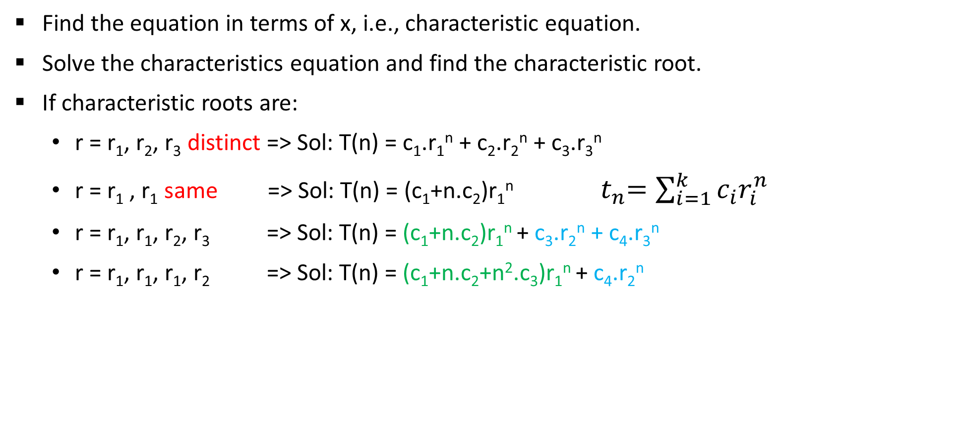
Homogeneous Recurrence
Find the equation in terms of x, i.e., characteristic equation.
Solve the characteristics equation and find the characteristic root.
If characteristic roots are:
  r = r₁, r₂, r₃ distinct => Sol: T(n) = c₁.r₁^{n} + c₂.r₂^{n} + c₃.r₃^{n}
  r = r₁ , r₁ same => Sol: T(n) = (c₁+n.c₂)r₁^{n} ${ t}_{n}=\sum_{i=1}^{k}{c_{i}r_{i}^{n}}$
  r = r₁, r₁, r₂, r₃ => Sol: T(n) = (c₁+n.c₂)r₁^{n} + c₃.r₂^{n} + c₄.r₃^{n}
  r = r₁, r₁, r₁, r₂ => Sol: T(n) = (c₁+n.c₂+n².c₃)r₁^{n} + c₄.r₂^{n}

Slide 11

Homogeneous Recurrence
Recurrence equation
$a_{0}T(n)+ a_{1}T(n−1)+ a_{2}T(n−2)+⋯+a_{k}T(n−k)=0$
The equation of degree $k$in $x$ is called the characteristic equation of the recurrence,
$p\left(x\right)=a_{0}x^{k}+ a_{1}x^{k−1}+⋯+ a_{k} x^{0}$ {order=n-(n-k)=>k i.e. difference between highest and lowest}

Slide 12

Example
T(n)= T(n-1) + 2 T(n-2) , n>=2, T(0) = 0, T(1) = 1
T(n) - T(n-1) - 2 T(n-2) = 0
$x^{2} −x −2=0$
$x=2, −1$
T(n) = c₁.2^{n} + c₂.(-1)^{n}
T(0) = 0, c₁ + c₂=0
T(1) = 1, 2.c₁ - c₂=1
c₁= 1/3, c₂= -1/3
T(n)= 4(T(n-1) - T(n-2)) , n>=2, T(0) = 1, T(1) = 1

Slide 13
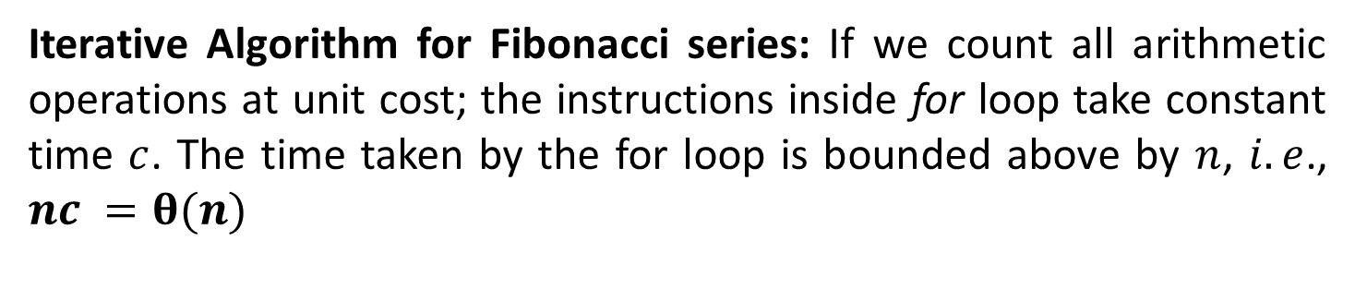
Analysis: Fibonacci series
Function fibiter(n)
i ← 1; j ← 0;
for k ← 1 to n do
j ← i + j;
i ← j – i;
return j
Iterative Algorithm for Fibonacci series: If we count all arithmetic operations at unit cost; the instructions inside for loop take constant time $c$. The time taken by the for loop is bounded above by $n$, $i.e$., $nc =θ(n)$

Slide 14
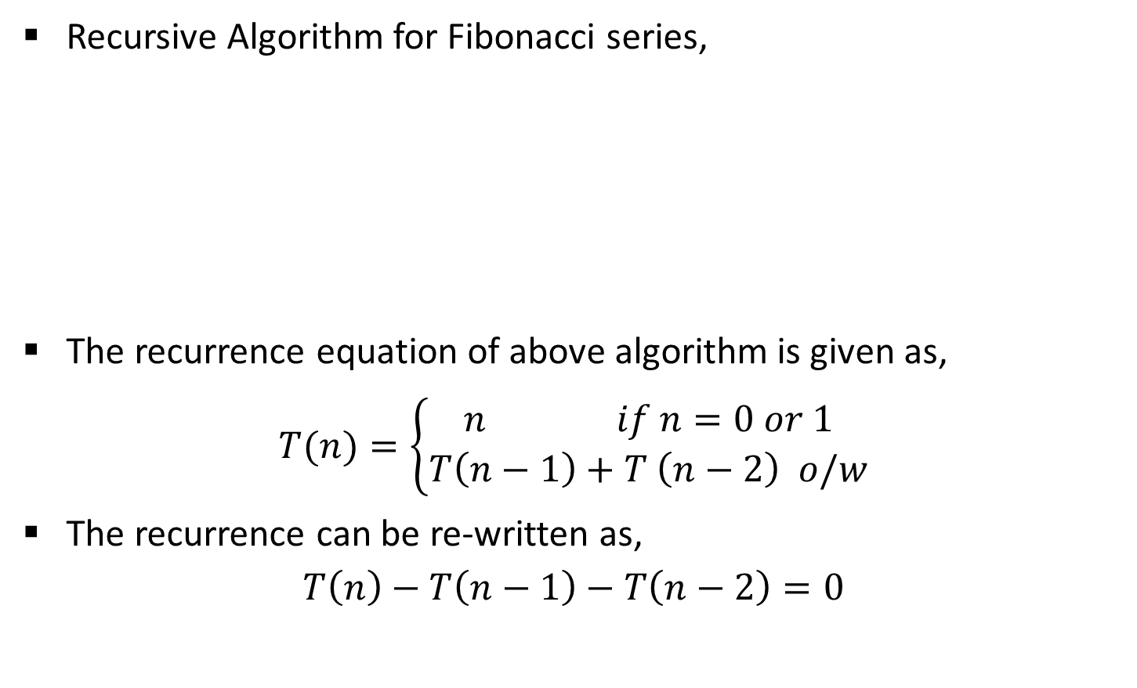
Analysis: Fibonacci series
Recursive Algorithm for Fibonacci series,
The recurrence equation of above algorithm is given as,
$$T(n)=\left\{\begin{aligned}n if n=0 or 1 \\ T\left(n−1\right)+T \left(n−2\right) o/w\end{aligned}\right.$$
The recurrence can be re-written as,
$$T\left(n\right)−T\left(n−1\right)−T\left(n−2\right)=0$$
Function fibrec(n)
if n < 2 then return n
else return fibrec (n – 1) + fibrec (n – 2)

Slide 15

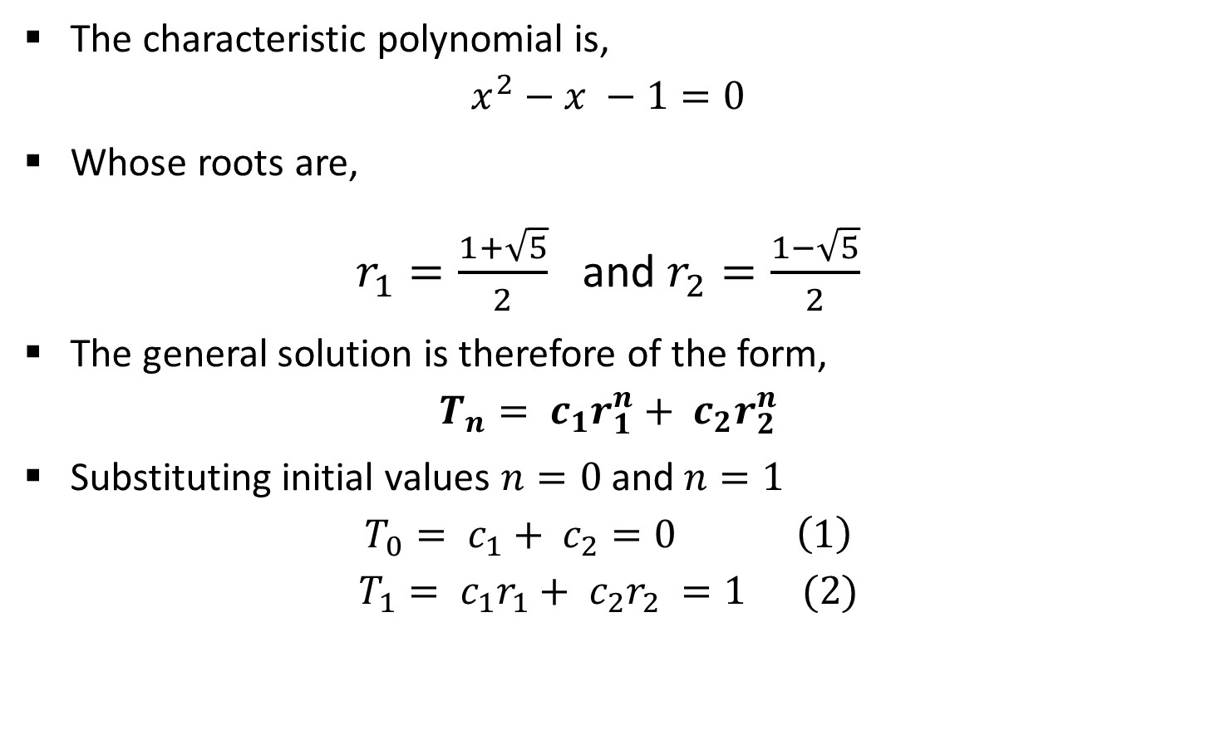

Analysis: Fibonacci series
The characteristic polynomial is,
$$x^{2}−x −1=0$$
Whose roots are,
$r_{1}=\frac{1+\sqrt{5}}{2}$ and $r_{2}=\frac{1−\sqrt{5}}{2}$
The general solution is therefore of the form,
$$T_{n}= c_{1}r_{1}^{n}+ c_{2}r_{2}^{n}$$
Substituting initial values $n=0$and $n=1$
$$T_{0}= c_{1}+ c_{2}=0 \left(1\right)$$
$$T_{1}= c_{1}r_{1}+ c_{2}r_{2} =1 (2)$$
$$x =\frac{−b±\sqrt{b^{2}−4ac}}{2a}$$
$$t_{n}=\sum_{i=1}^{k}{c_{i}r_{i}^{n}}$$

Slide 16
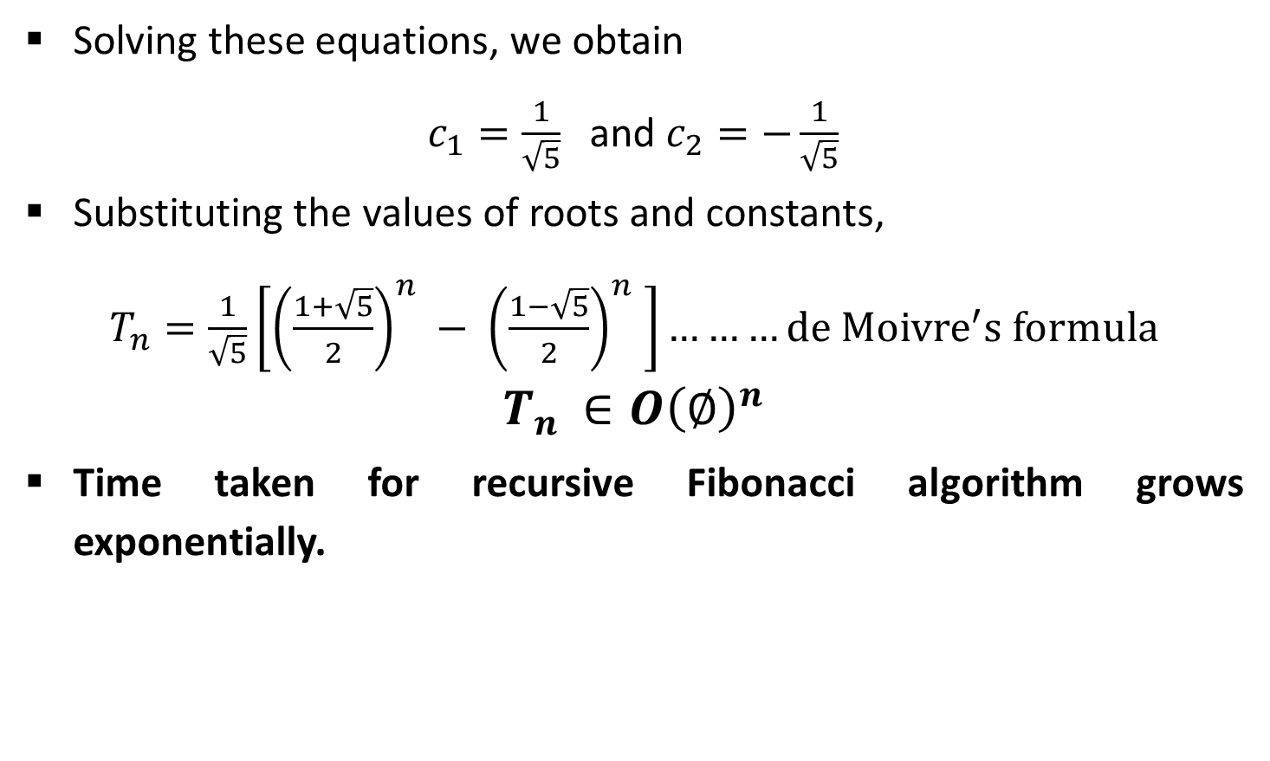
Analysis: Fibonacci series
Solving these equations, we obtain
$c_{1}=\frac{1}{\sqrt{5}}$ and $c_{2}=−\frac{1}{\sqrt{5}}$
Substituting the values of roots and constants,
$T_{n}=\frac{1}{\sqrt{5}}\left[{\left(\frac{1+\sqrt{5}}{2}\right)}^{n} − {\left(\frac{1−\sqrt{5}}{2}\right)}^{n} \right]………de {Moivre}^{′}s formula$
$$T_{n }∈O{\left(∅\right)}^{n}$$
Time taken for recursive Fibonacci algorithm grows exponentially.

Slide 17
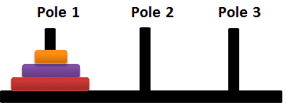



Analysis: Tower of Hanoi

Slide 18



Analysis: Tower of Hanoi

Slide 19
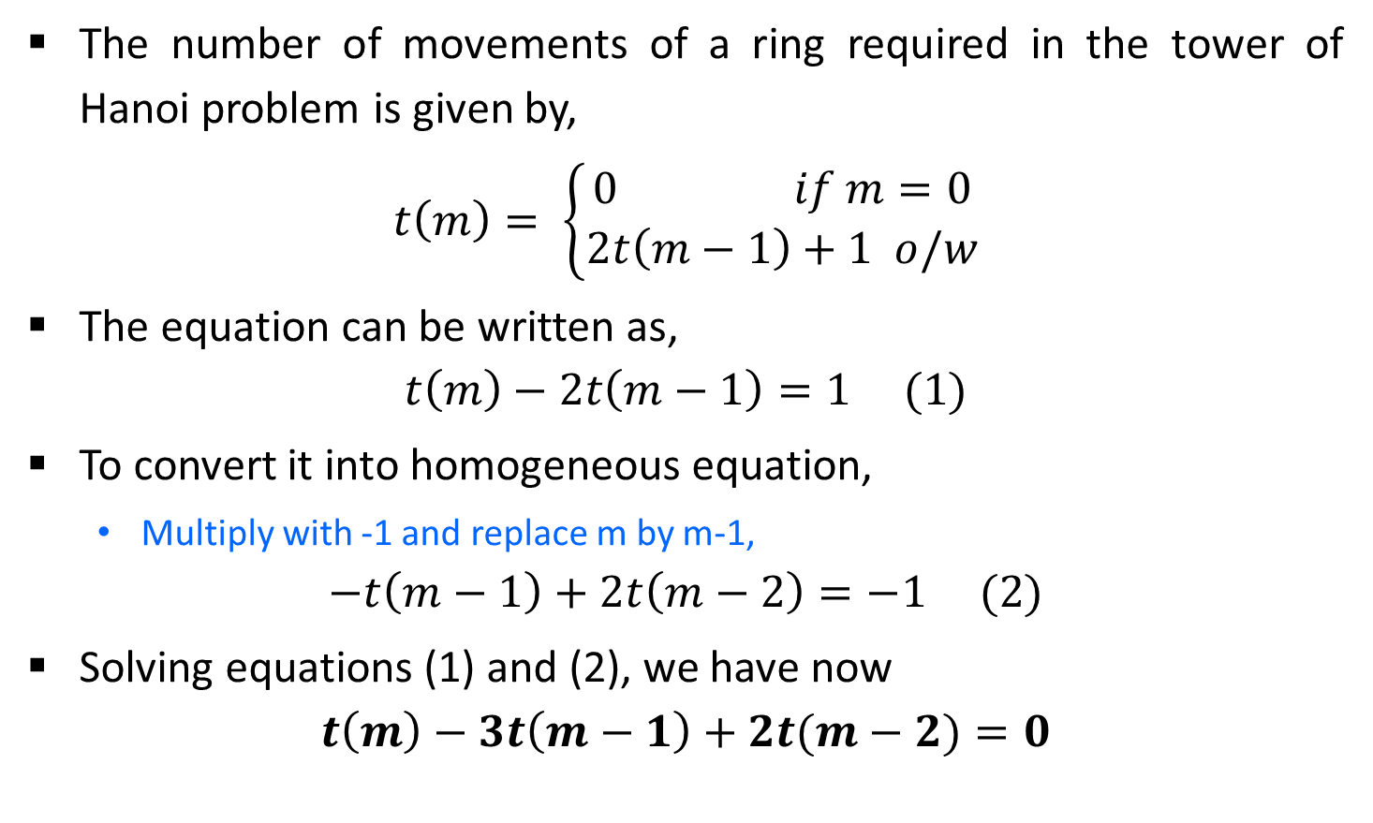
Analysis: Tower of Hanoi
The number of movements of a ring required in the tower of Hanoi problem is given by,
$$t\left(m\right)= \left\{\begin{aligned}0 if m=0 \\ 2t\left(m−1\right)+1 o/w\end{aligned}\right.$$
The equation can be written as,
$$t\left(m\right)−2t\left(m−1\right)=1 (1)$$
To convert it into homogeneous equation,
  Multiply with -1 and replace m by m-1,
$$−t\left(m−1\right)+2t\left(m−2\right)=−1 (2)$$
Solving equations (1) and (2), we have now
$$t\left(m\right)−3t\left(m−1\right)+2t(m−2)=0$$

Slide 20
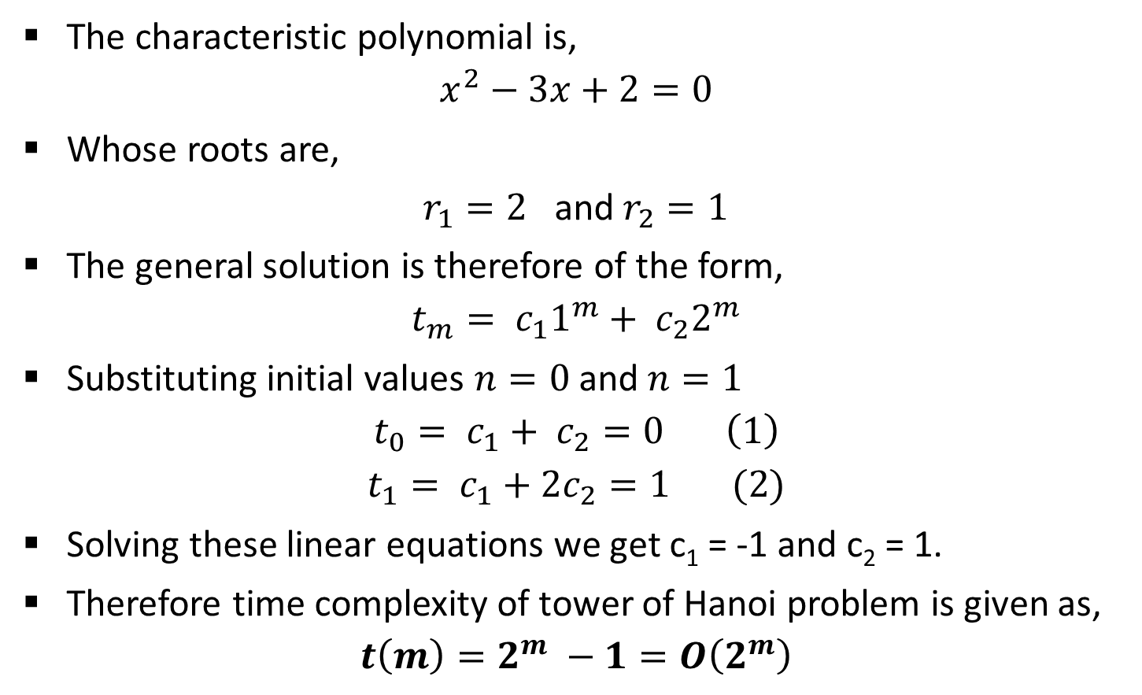
Analysis: Tower of Hanoi
The characteristic polynomial is,
$$x^{2}−3x+2=0$$
Whose roots are,
$r_{1}=2$ and $r_{2}=1$
The general solution is therefore of the form,
$$t_{m}= c_{1}1^{m}+ c_{2}2^{m}$$
Substituting initial values $n=0$and $n=1$
$$t_{0}= c_{1}+ c_{2}=0 \left(1\right)$$
$$t_{1}= c_{1}+2c_{2}=1 (2)$$
Solving these linear equations we get c₁ = -1 and c₂ = 1.
Therefore time complexity of tower of Hanoi problem is given as,
$$t\left(m\right)=2^{m} −1=O\left(2^{m}\right)$$

Slide 21
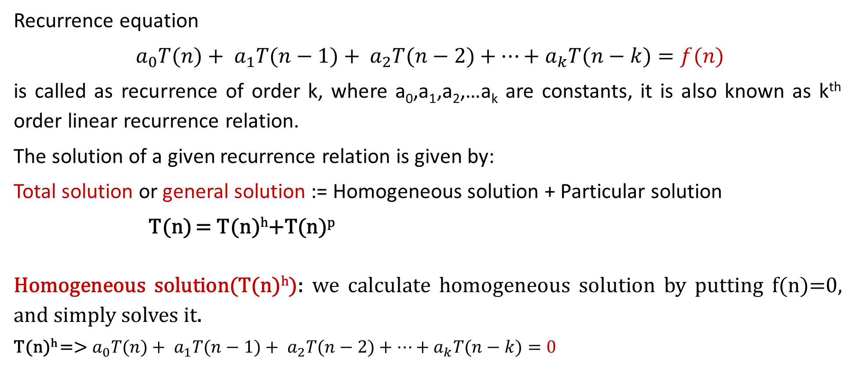
Non-homogeneous recurrence
Recurrence equation
$a_{0}T(n)+ a_{1}T(n−1)+ a_{2}T(n−2)+⋯+a_{k}T(n−k)=f(n)$
is called as recurrence of order k, where a₀,a₁,a₂,…a_{k} are constants, it is also known as k^{th} order linear recurrence relation.
The solution of a given recurrence relation is given by:
Total solution or general solution := Homogeneous solution + Particular solution
T(n) = T(n)^{h}+T(n)^{p}
Homogeneous solution(T(n)^{h}): we calculate homogeneous solution by putting f(n)=0, and simply solves it.
T(n)^{h} =>${ a}_{0}T(n)+ a_{1}T(n−1)+ a_{2}T(n−2)+⋯+a_{k}T(n−k)=0$

Slide 22
Particular solution(T(n)^{p}): it exist only when RHS of recurrence relation is non-zero. i.e. f(n)≠0.
If f(n)≠0 we consider three possibility:
  Case1: f(n) is constant
  Case2: f(n) is polynomial of degree n
  Case3: f(n) is exponential

Slide 23
Particular solution(T(n)^{p})
  Case1: f(n) is constant
      find p by putting T(n)=p,
      If fails, put T(n)=np
      If fails, put T(n)=n²p…
T(n)-2T(n-1)+T(n-2)=1
=> To calculate Particular solution
=> put T(n)=P
=> P-2(P)+P=1
=> 0=1 fail
=> put T(n)=nP
=> nP-2(n-1)P+(n-2)P=1
=> 0=1 fail
=> put T(n)=n²P
=> n²P – 2(n-1)²P+(n-2)²P=1
=> p=1/2
=> Now put the value of P in solution
T(n)^{p}=n²P=>n²/2

Slide 24
Particular solution(T(n)^{p})
  Case2: f(n) is polynomial
      T(n)=d₀+d₁n+d₂n²…d_{m}n^{m}
      Find d0, d1, d2.. by comparing the co-efficient
T(n)-8T(n-1) =14n+5
=> To calculate Particular solution
=> put T(n)= d₀+d₁n
=> d₀+d₁n – 8(d₀+d₁(n-1))=14n+5
=> -7d₀ – 7d₁n+8d₁=5 + 14n
=> By comparing the coefficient of n⁰, n¹ term
=> -7d₁=14 => d₁=-2
=> -7d₀+8d₁=5 =>d₀= -3
Now put the value of d₀ and d₁ to get the solution
T(n)^{p}=d₀+d₁n
T(n)^{p}= -3 + (-2)n

Slide 25
Particular solution(T(n)^{p})
f(n) is exponential function
Case3: (a)if a is not the characteristic root
find d by putting T(n)=d₀*a^{n},
find d by putting T(n)= (d₀+d₁n) a^{n} if f(n) contain 1 order polynomial
Case3: (b) if a is a characteristic root
find d by putting T(n)=n^{t} *d₀*a^{n},
find d by putting T(n)= n^{t} (d₀+d₁n) a^{n} if f(n) contain 1 order polynomial
t is the multiplicity of the root, i.e. 3, 3 are the root => n² as 3 repeat 2 times so value of t=2
T(n)-8T(n-1) =5 * 2^{n}
=> To calculate Particular solution
=> put T(n)= da^{n {a=2}}
=> d*2^{n} – 8*d2^{n-1}=5*2^{n}
=> d*2^{n} – 4*2¹*d2^{n-1}=5*2^{n}
=> d*2^{n} – 4*d2^{n}=5*2^{n}
=>2^{n}(d-4d)=5*2^{n}
=> By comparing the coefficient of 2^{n}
=> d=-5/3
Now put the value of d to get the solution
T(n)^{p}=da^{n}
T(n)^{p}= -5/3* 2^{n}

Slide 26
T(n)-7T(n-1)+12T(n-2) = 4^{n}
T(n)-7T(n-1)+12T(n-2) = n.4^{n}

Slide 27
Find the total solution: T(n)-8T(n-1) =14n+5
1. Homogeneous solution(T(n)^{h})
T(n)-8T(n-1)=0
characteristic equation
X-8=0 , roots=(8)
T(n)^{h} = c₁8^{n}
2. Particular solution(T(n)^{p})
=> put T(n)= d₀+d₁n
=> d₀+d₁n – 8(d₀+d₁(n-1))=14n+5
=> -7d₀ – 7d₁n+8d₁=5 + 14n
=> By comparing the coefficient of n⁰, n¹ term
=> -7d₁=14 => d₁=-2
=> -7d₀+8d₁=5 =>d₀= -3
Now put the value of d₀ and d₁ to get the solution
T(n)^{p}=d₀+d₁n
T(n)^{p}= -3 + (-2)n
Total solution(T(n))=(T(n)^{h}) + (T(n)^{h})
T(n) = c₁8^{n} -3 + (-2).n

Slide 28
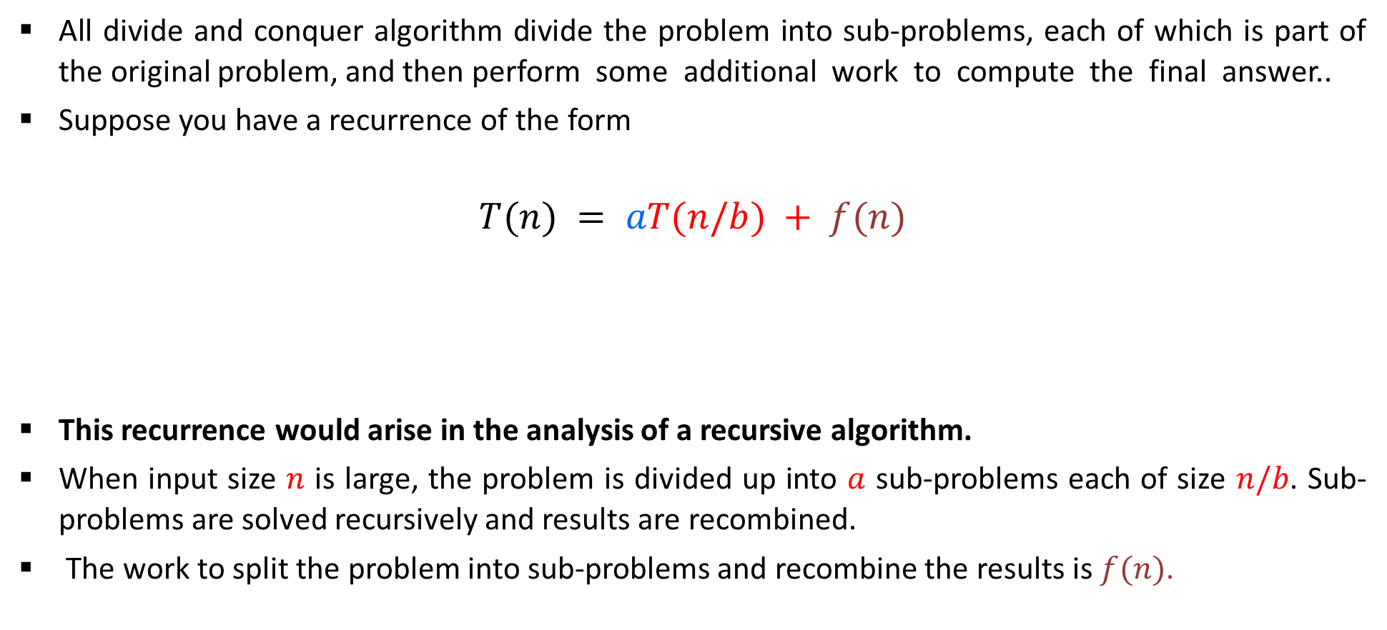
Master Method(for divide and conquer recurrence)
All divide and conquer algorithm divide the problem into sub-problems, each of which is part of the original problem, and then perform some additional work to compute the final answer..
Suppose you have a recurrence of the form
$$T(n) = aT(n/b) + f(n)$$
This recurrence would arise in the analysis of a recursive algorithm.
When input size $n$ is large, the problem is divided up into $a$ sub-problems each of size $n/b$. Sub-problems are solved recursively and results are recombined.
The work to split the problem into sub-problems and recombine the results is $f(n)$.
Time to divide & recombine
Number of sub-problems
Time required to solve a sub-problem

Slide 29

Master Method(for divide and conquer recurrence)
As an example, a merge sort algorithm operates on two sub-problems, each of which is half the size of the original, and then performs O(n) additional work for merging. This gives the running time equation:
T(n) = 2T (n/2) + O(n)
The following theorem can be used to determine the running time of divide and conquer algorithms. For a given program (algorithm), first we try to find the recurrence relation for the problem. If the recurrence is of the below form, then we can directly give the answer without fully solving it. If the recurrence is of the form

Slide 30
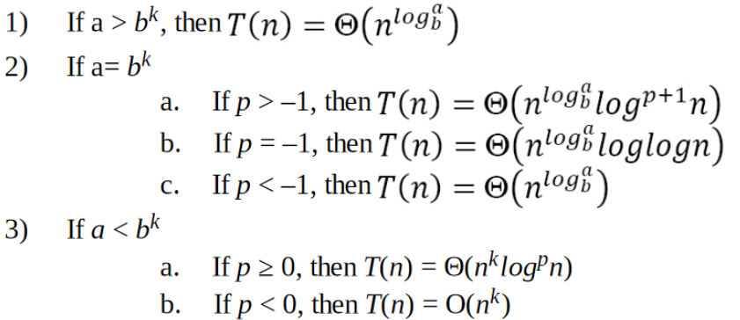
Master Method(for divide and conquer recurrence)
where a ≥ 1, b >1, k ≥ 0 and p is a real number, then:

Slide 31

1.

Slide 32

2.

Slide 33

3.

Slide 34

4.

Slide 35

5.

Slide 36

6.

Slide 37

7.

Slide 38

8.

Slide 39

9.

Slide 40



10.
We can not apply master method in such cases

Slide 41

Master Method
Example 4: $T(n)=4T(n/2) + n2$
Example 5: $T(n)=4T(n/2) + n3$
Example 6: $T(n)=9T(n/3) + n$
Example 7: $T(n)=T(2n/3) + 1$
Example 8: $T\left(n\right)=7T\left(n/2\right)+n3$
Example 9: $T(n)=27T(n^{2}) +16n$
$$\sqrt{2}$$

Slide 42
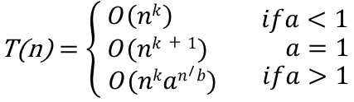

Master Theorem for Subtract and Conquer Recurrences
Let T(n) be a function defined on positive n, and having the property
T(n)$=\left\{\begin{aligned}c if n≤1 \\ aT\left(n−b\right)+f\left(n\right) if n>1\end{aligned}\right.$
for some constants c,a > 0,b ≥ 0,k ≥ 0, and function f(n). If f(n) is in O(n^{k} ), then

Slide 43
Recurrence Tree Method
Steps to solve recurrence relations using recursion tree method:
Step-01: Draw a recursion tree based on the given recurrence relation.
Step-02: Determine-
    Cost of each level
    Total number of levels in the recursion tree
    Number of nodes in the last level
    Cost of the last level
Step-03: total cost = cost of leaf node + cost of internal node
total cost = (cost of 1 leaf node* total leaf node) + sum of cost at each level of internal node
total cost = L_{c} + I_{c}

Slide 44
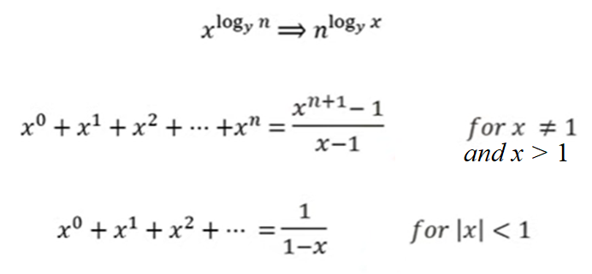
Important formula

Slide 45

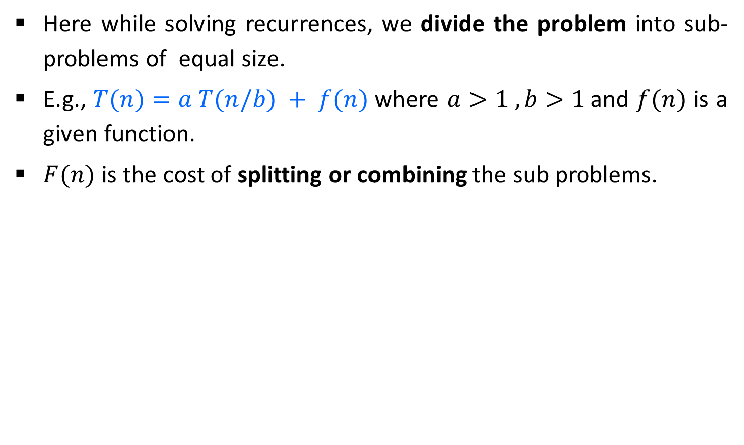
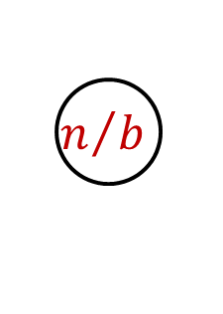
Recurrence Tree Method
Here while solving recurrences, we divide the problem into sub-problems of equal size.
E.g., $T(n)=a T(n/b) + f(n)$where $a>1 ,b>1$and $f(n)$ is a given function.
$F(n)$ is the cost of splitting or combining the sub problems.
$$n$$
$$n/b$$
$$n/b$$

Slide 46
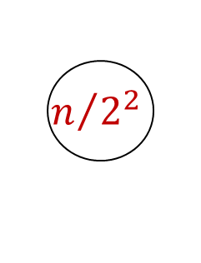


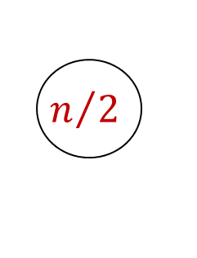

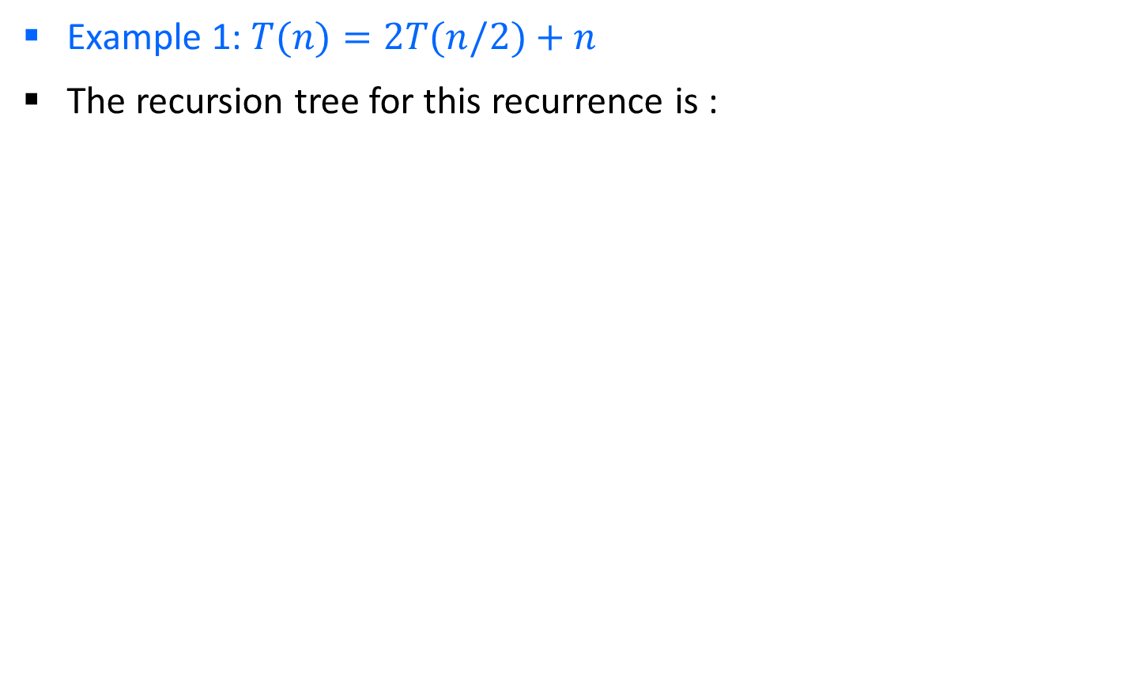

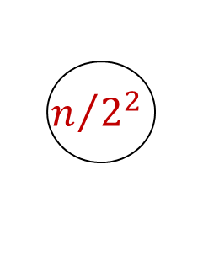




Recurrence Tree Method
Example 1: $T(n)=2T(n/2)+n$
The recursion tree for this recurrence is :
$$n$$
$$n/2$$
$$n/2$$
$$n$$
$$log2 n$$
$$n/{2^{2}}$$
$$n/{2^{2}}$$
$$n/{2^{2}}$$
$$n/{2^{2}}$$
$$n$$
$$1$$
$$1$$
$$1$$
$$1$$
$$1$$

Slide 47
Step-01:
  Draw a recursion tree based on the given recurrence relation.
  The given recurrence relation shows-
  A problem of size n will get divided into 2 sub-problems of size n/2.
  Then, each sub-problem of size n/2 will get divided into 2 sub-problems of size n/4 and so on.
  At the bottom most layer, the size of sub-problems will reduce to 1.
  The given recurrence relation shows-
  The cost of dividing a problem of size n into its 2 sub-problems and then combining its solution is n.
  The cost of dividing a problem of size n/2 into its 2 sub-problems and then combining its solution is n/2 and so on.
Step-02:
  Determine cost of each level-
  Cost of level-0 = n
  Cost of level-1 = n/2 + n/2 = n
  Cost of level-2 = n/4 + n/4 + n/4 + n/4 = n and so on.

Slide 48
Step-03:
  Determine total number of levels in the recursion tree-
  Size of sub-problem at level-0 = n/2⁰
  Size of sub-problem at level-1 = n/2¹
  Size of sub-problem at level-2 = n/2²
  Continuing in similar manner, we have- Size of sub-problem at level-i = n/2^{i}
  Suppose at level-x (last level), size of sub-problem becomes 1. Then- n / 2^{x} = 1
  2^{x} = n
  Taking log on both sides, we get- xlog₂2 = log₂n
  x = log₂n
  ∴ Total number of levels in the recursion tree = log₂n + 1
Step-04:
  Determine number of nodes in the last level-
    Level-0 has 2⁰ nodes i.e. 1 node
    Level-1 has 2¹ nodes i.e. 2 nodes
    Level-2 has 2² nodes i.e. 4 nodes
  Continuing in similar manner, we have- Level-log₂n, has 2^{log}₂^{n} nodes i.e. n nodes

Slide 49

Step-05: Determine cost of last level-
Cost of last level = n x T(1) = θ(n)
Step-06:
Add costs of all the levels of the recursion tree and simplify the expression so obtained in terms of asymptotic notation-
= n x log₂n + θ (n)
= nlog₂n + θ (n)
= θ (nlog₂n)

Slide 50
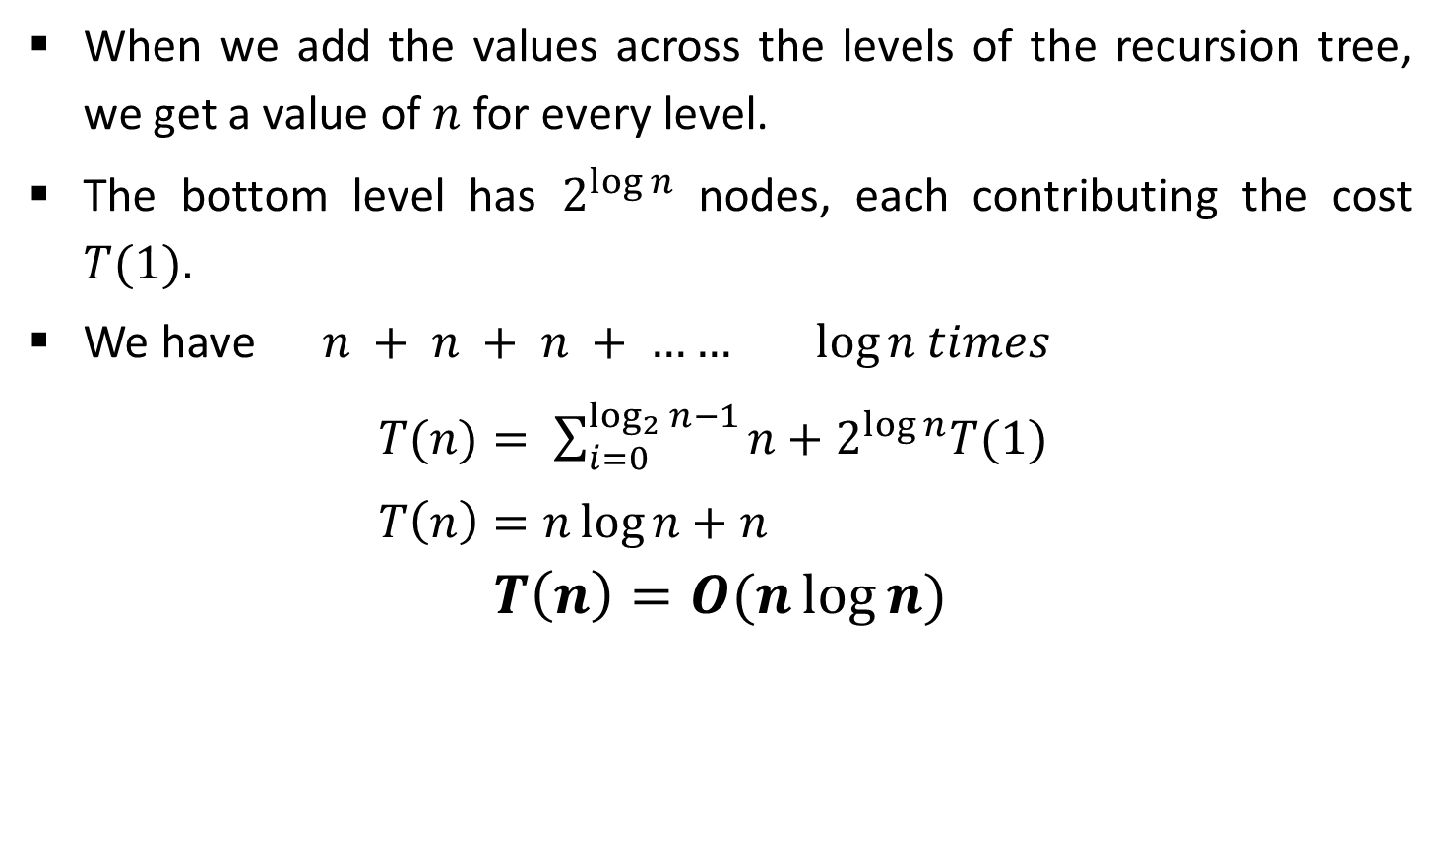
Recurrence Tree Method
When we add the values across the levels of the recursion tree, we get a value of $n$ for every level.
The bottom level has $2^{\log{n}}$ nodes, each contributing the cost $T(1).$
We have $n + n + n + …… log⁡n$ $times$
$T(n)= \sum_{i=0}^{\log_{2}{n}−1}{n+2^{\log{n}}T(1)}$
$T\left(n\right)=n\log{n}+n$
$$T\left(n\right)=O(n\log{n)}$$

Slide 51





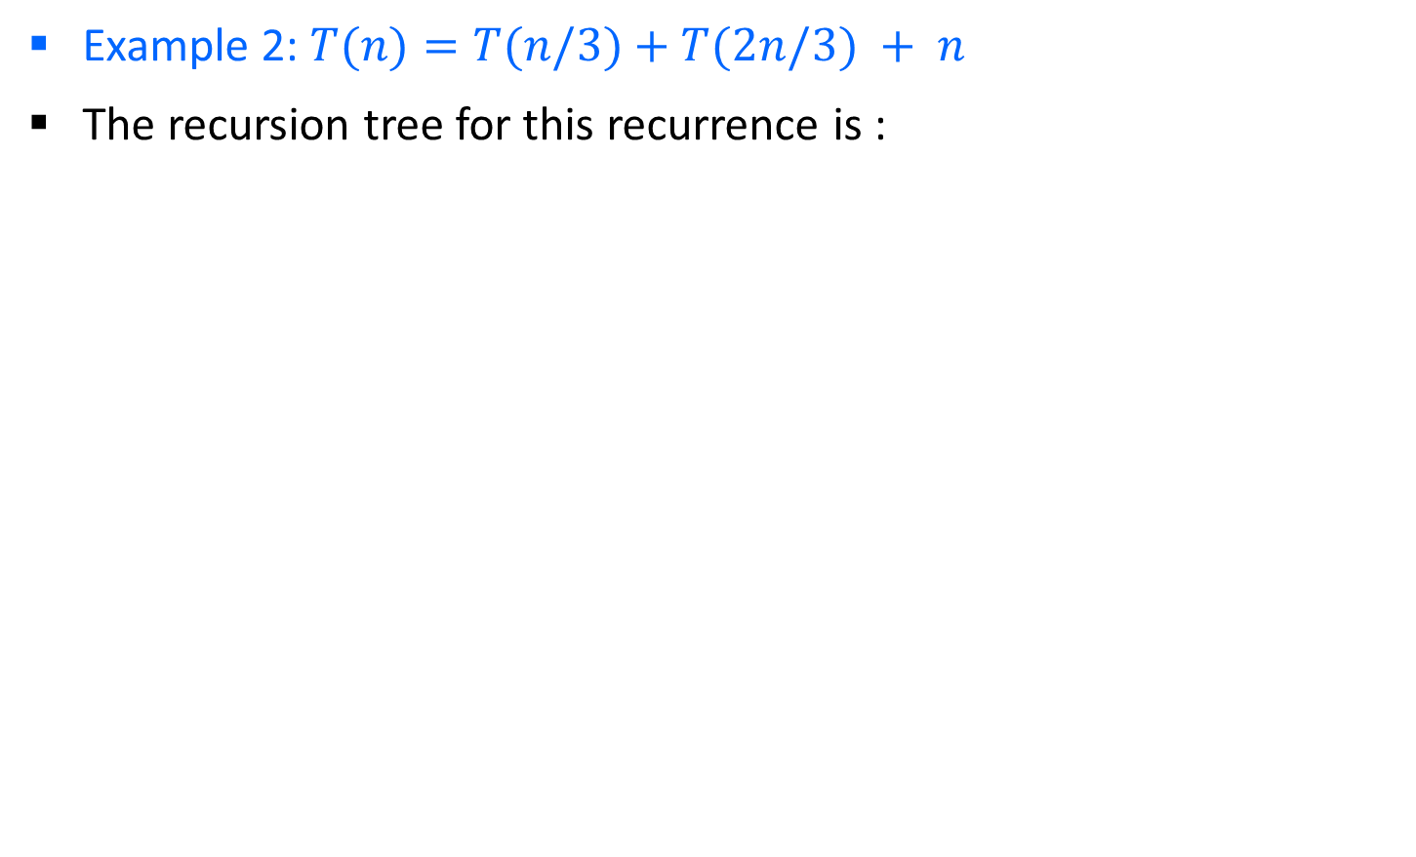






Recurrence Tree Method
Example 2: $T(n)=T(n/3)+T(2n/3) + n$
The recursion tree for this recurrence is :
$$n$$
$$n/3$$
$${2n}/3$$
$$n$$
$$log3 n$$
$$log3/2 n$$
$$\frac{1}{3}\frac{n}{3}$$
$$\frac{2}{3}\frac{n}{3}$$
$$\frac{1}{3}\frac{2n}{3}$$
$$\frac{2}{3}\frac{2n}{3}$$
$$n$$

Slide 52
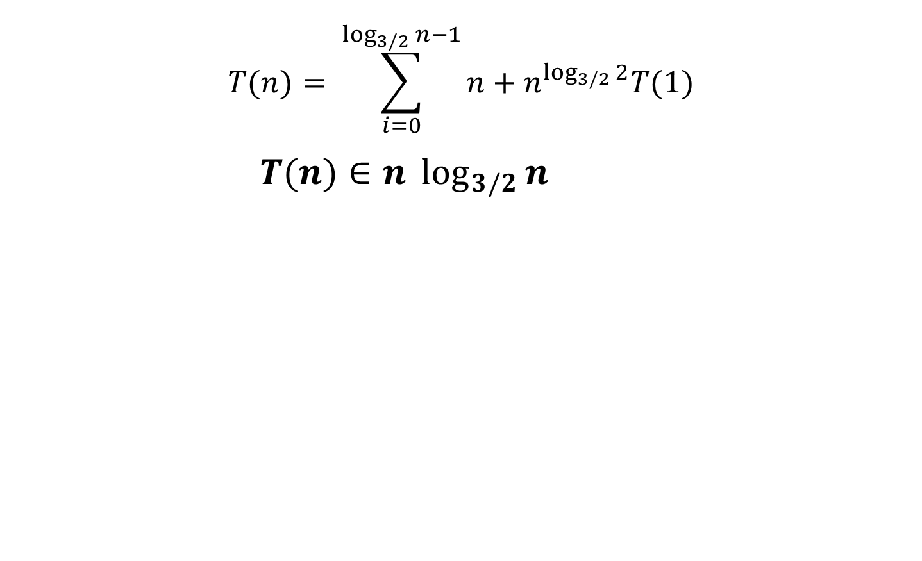
Recurrence Tree Method
$$T(n)= \sum_{i=0}^{\log_{3/2}{n}−1}{n+n^{\log_{3/2}{2}}T(1)}$$
$T(n)∈n \log_{3/2}{n}$

Slide 53
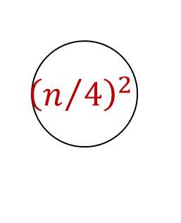




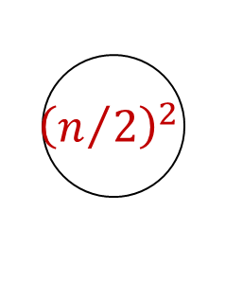
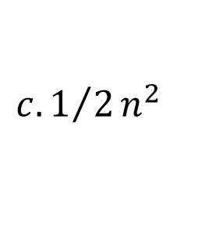
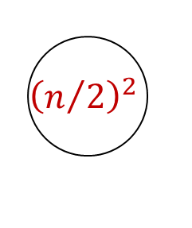
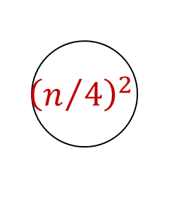


Recurrence Tree Method
Example 2: $T(n)=2T(n/2)+c.n2$
The recursion tree for this recurrence is :
$$n^{2}$$
$${\left(n/2\right)}^{2}$$
$${\left(n/2\right)}^{2}$$
$${c.n}^{2}$$
$${\left(n/4\right)}^{2}$$
$${\left(n/4\right)}^{2}$$
$${\left(n/4\right)}^{2}$$
$${\left(n/4\right)}^{2}$$
$${{c.1}/2n}^{2}$$
$$O\left(n^{2}\right)$$
53

Slide 54
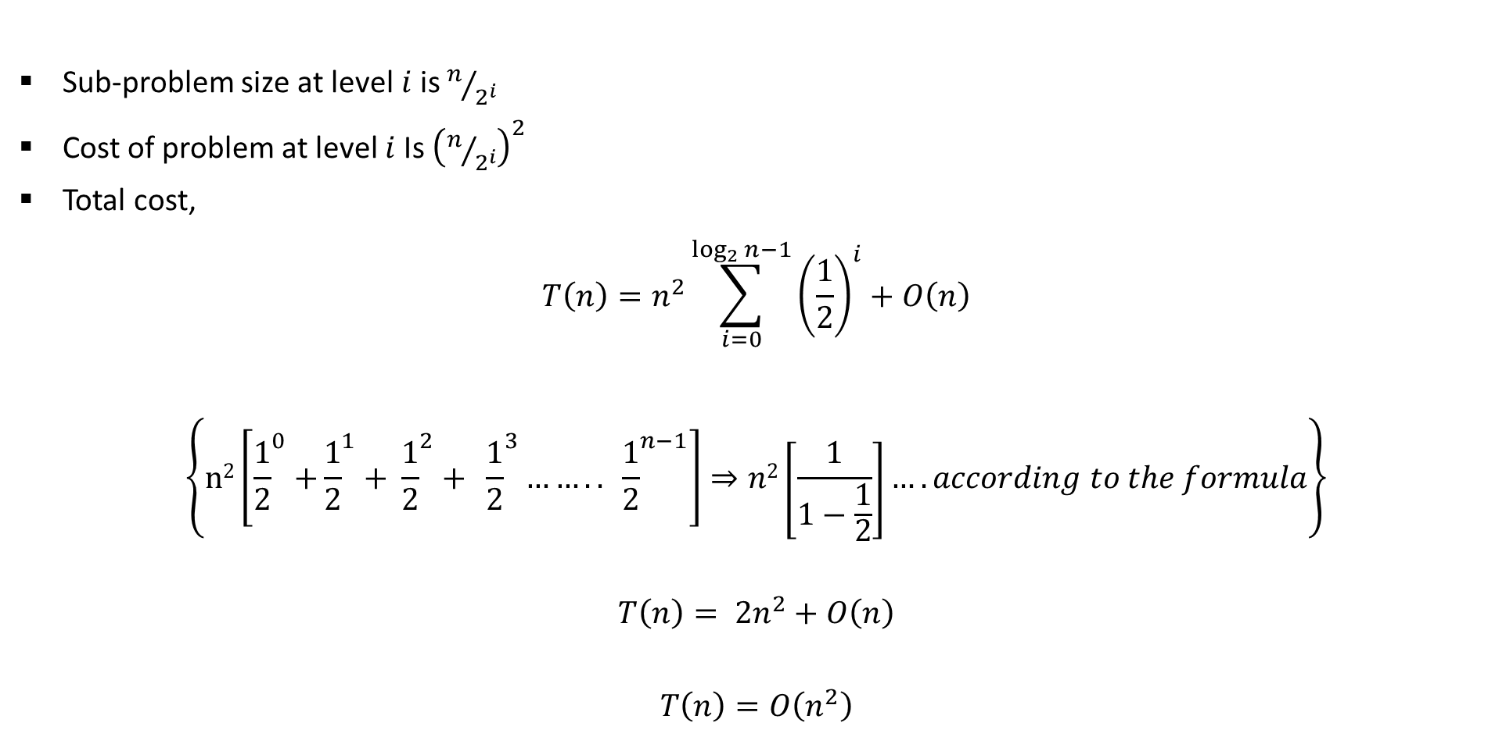
Recurrence Tree Method
Sub-problem size at level$i$is $n/{2^{i}}$
Cost of problem at level $i$Is ${\left(n/{2^{i}}\right)}^{2}$
Total cost,
$$T\left(n\right)=n^{2}\sum_{i=0}^{\log_{2}{n−1}}{{\left(\frac{1}{2}\right)}^{i}}+O\left(n\right)$$
$$\left\{\text{n}\text{2}\left[{\frac{1}{2}}^{0}{+\frac{1}{2}}^{1}+ {\frac{1}{2}}^{2}+ {\frac{1}{2}}^{3}…….. {\frac{1}{2}}^{n−1}\right]⇒n2\left[\frac{1}{1−\frac{1}{2}}\right]….according to the formula\right\}$$
$$T\left(n\right)= {2n}^{2}+O\left(n\right)$$
$$T\left(n\right)=O\left(n^{2}\right)$$

Slide 55

Recurrence Tree Method
Example 3: $T(n)= T(n/4)+T(3n/4)+c.n$
Example 4: $T(n)=3T(n/4)+c.n2$
Example 5: $T(n)=T(n/4)+T(n/2)+n2$
$\text{Example}\text{ 6:} T(n)=T(n/3)+T(2n/3) + n$

Slide 56
Method of Guessing and Confirming
“guess the answer; and then prove it correct by induction”
What if the given recurrence doesn’t seem to match with any of these (master theorem) methods? If we guess a solution and then try to verify our guess inductively, usually either the proof will succeed (in which case we are done), or the proof will fail (in which case the failure will help us refine our guess).

Slide 57


Example
Let’s start by trying to prove an upper bound T(n) < c.nlogn:
The last inequality assumes only that 1 ≤ c.logn. This is correct if n is sufficiently large and for any constant c, no matter how small. From the above proof, we can see that our guess is correct for the upper bound.

Slide 58
Change of variable-Method
There are many ways to solve a recurrence relation runtime. One way to do this is a method called “change of variable”.
Domain transformations can sometimes be used to substitute a function for the argument of the relation and make it easier to solve.
The idea is to select a function for S(m), when given T(n).

Slide 59

Example
m=logn
2^{m}=2^{log}2^{n}
2^{m/2}=2^{(log}2^{n/2)}
2^{m/2}=n^{1/2}
n=2^{m} , The reason to put n=2^{m} is as the original function consists of √𝐧 , i.e. the problem of size n is decreasing with factor n^{1/2}
T(2^{m})= S(m) meaning the rate of growth for different value of m is same for T and S
T(n)=2T$\sqrt{n}$ +logn
Let’s rewrite the equation by substituting m=log n, and then plug it back in to the recurrence to get the following:
T(2^{m})=2T(2^{m/2})+m
Now we will create a new function called ‘S’ that takes in a parameter ‘m’ such that S(m) = T(2^{m}).
Which means : S(m) = 2T(2^{m/2})+m.
If S(m) = T(2^{m}) then S(m-1) = T(2^{(m-1})) and S(m/2) = T(2^{(m/2)}),
so we can rewrite our function to get the following:
S(m)=2S(m/2)+m
Using master theorem we can write the solution of recurrence ‘S’: O(mlogm).
This means that our original function ‘T’ belongs to O(log n * log ( log n) ), since we can simply replace ‘m’ with ‘log n’ because m=log n
Let S(m) = T(2^{m})
S(1) = T(2¹)
S(2) = T(2²)
S(m-1) = T(2^{m-1}) S(m/2) = T(2^{m/2})

Slide 60

Example
T(n)=$\sqrt{n}$T($\sqrt{n}$) +n
=>First substitute n = 2^{m}
T(2^{m})=2^{m/2}T(2^{m/2})+2^{m}
Now divide both side by 2^{m}
$\frac{\text{T}\text{(2}\text{m}\text{)} }{\text{2}\text{m}}$ =$\frac{\text{2}\text{m}\text{/2}\text{T}\text{(2}\text{m}\text{/2)}}{\text{2}\text{m}}$+$\frac{\text{2}\text{m}}{\text{2}\text{m}}$
$\frac{\text{T}\text{(2}\text{m}\text{)} }{\text{2}\text{m}}$ =$\frac{\text{2}\text{m}\text{/2}\text{T}\text{(2}\text{m}\text{/2)} }{\text{2}\text{m}}$+$1$ {$\frac{\text{T}\text{(2}\text{m}\text{)} }{\text{2}\text{m}}$ =$\frac{\text{T}\text{(2}\text{m}\text{/2)} }{\text{2}\text{m}\text{/2}}$+$1$}
=>second substitution S(m)=$\frac{\text{T}\text{(2}\text{m}\text{)} }{\text{2}\text{m}}$
S(m)=S(m/2)+1
By applying masters method we get : S(m)= log m
Now back substitution => $\frac{\text{T}\text{(2}\text{m}\text{)} }{\text{2}\text{m}}$=log m
T(2^{m})=2^{m} log m
Again back-substitute: T(n)=n log log n

Slide 61
T(n)=3T(n/2) +n
Substitute n=2^{m}
T(2^{m})=3T(2^{m}/2)+2^{m}
T(2^{m})=3T(2^{m-1})+2^{m}
Substitute S(m)=T(2^{m})
S(m)=3S(m-1)+2^{m}
S(m)-3S(m-1)=2^{m}
By characteristic equation
x-3=0, x=3
T(m)^{h}=c₁3^{m}
T(m)^{p}=(-3/2)2^{m}
Total Solution of S(m)=c₁3^{m}-(3/2)2^{m}
By back substitution
T(n)=c₁3^{logn}-(3/2)2^{logn}
=c₁n^{log3}-(3/2)₂n^{log2}

Slide 62
Range transformation
When we make a change of variable, we transform the domain of the recurrence.
Instead, it may be useful to transform the range to obtain a recurrence in a form that we know how to solve. Both transformations can sometimes be used together.
Consider the following recurrence, which defines T(n) when n is a power of 2.
T(n)=nT²(n/2)
The first step is a change of variable: n=2^{m}, S(m)=T(2^{m})
T(2^{m})= 2^{m} T²(2^{m}/2)=> T²(2^{m-1})
S(m)=2^{m} S²(m-1)
At first glance, none of the techniques we have seen applies to this recurrence since it is not linear; To transform the range, we create yet another recurrence by using U(m) to denote log S(m).

Slide 63
S(m)=2^{m} S²(m-1)
Substitute U(m)=log(S(m))
=log(2^{m} S²(m-1))
=log2^{m} + log S²(m-1)
=m+2log S(m-1)
=m+2U(m-1)
U(m)= m+2U(m-1)
U(m)-2U(m-1)=m
Solve this by applying Characteristic equation:

Slide 64
Divide & Conquer (D&C) Technique
Many useful algorithms are recursive in structure: to solve a given problem, they call themselves recursively one or more times.
These algorithms typically follow a divide-and-conquer approach:
The divide-and-conquer approach involves three steps at each level of the recursion:
  Divide: Break the problem into several sub problems that are similar to the original problem but smaller in size.
  Conquer: Solve the sub problems recursively. If the sub problem sizes are small enough, just solve the sub problems in a straightforward manner.
  Combine: Combine these solutions to create a solution to the original problem.

Slide 65



D&C: Running Time Analysis
The running-time analysis of such divide-and-conquer (D&C) algorithms is almost automatic.
Let $g(n)$ be the time required by D&C on instances of size $n$.
The total time $t(n)$ taken by this divide-and-conquer algorithm is given by recurrence equation,
$$t\left(n\right)=a∗t\left(n/b\right)+g\left(n\right)$$
The solution of equation is given as,
$$t\left(n\right)=\left\{\begin{aligned}θ\left(n^{k}\right) if a< b^{k} \\ θ\left(n^{k}logn\right) if a= b^{k} \\ θ\left(n^{\log_{b}a}\right) if a >b^{k}\end{aligned}\right.$$
  $$T(n) = aT(n/b) + f(n)$$
$k$ is the power of $n$ in $g(n)$

