Slide 1

2CS503 Design & Analysis of Algorithm
Unit-3
Divide and Conquer Algorithm

Slide 2
Divide & Conquer (D&C) Technique
Many useful algorithms are recursive in structure: to solve a given problem, they call themselves recursively one or more times.
These algorithms typically follow a divide-and-conquer approach:
The divide-and-conquer approach involves three steps at each level of the recursion:
  Divide: Break the problem into several sub problems that are similar to the original problem but smaller in size.
  Conquer: Solve the sub problems recursively. If the sub problem sizes are small enough, just solve the sub problems in a straightforward manner.
  Combine: Combine these solutions to create a solution to the original problem.

Slide 3

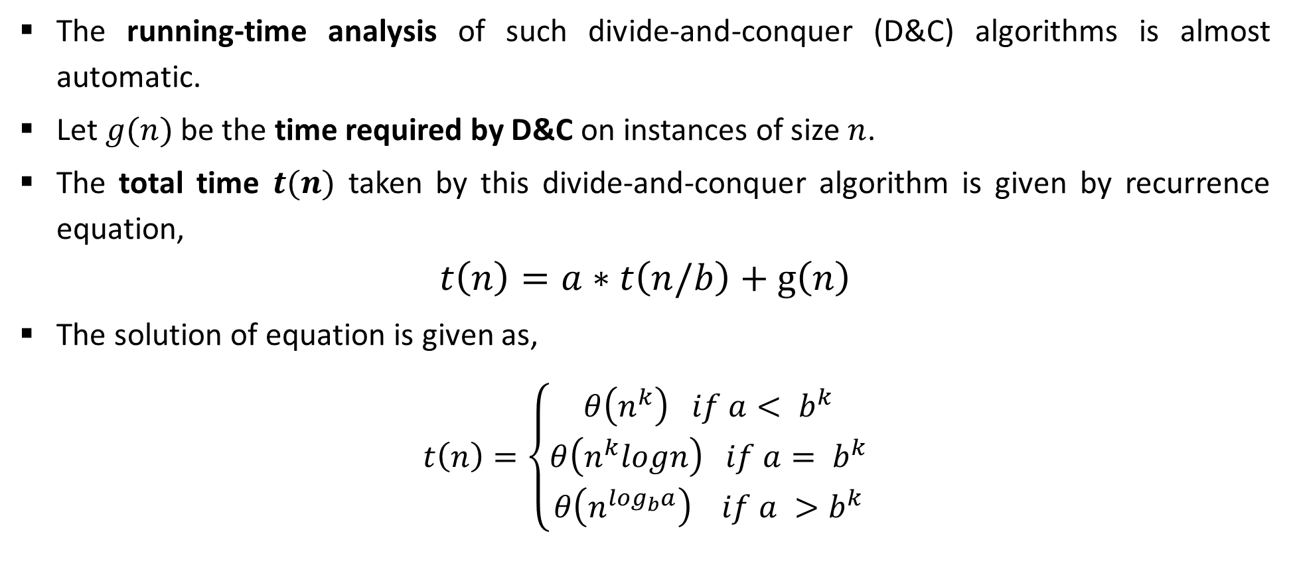
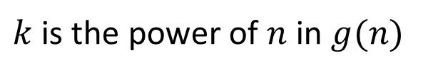
D&C: Running Time Analysis
The running-time analysis of such divide-and-conquer (D&C) algorithms is almost automatic.
Let $g(n)$ be the time required by D&C on instances of size $n$.
The total time $t(n)$ taken by this divide-and-conquer algorithm is given by recurrence equation,
$$t\left(n\right)=a∗t\left(n/b\right)+g\left(n\right)$$
The solution of equation is given as,
$$t\left(n\right)=\left\{\begin{aligned}θ\left(n^{k}\right) if a< b^{k} \\ θ\left(n^{k}logn\right) if a= b^{k} \\ θ\left(n^{\log_{b}a}\right) if a >b^{k}\end{aligned}\right.$$
  $$T(n) = aT(n/b) + f(n)$$
$k$ is the power of $n$ in $g(n)$

Slide 4
Binary Search

Slide 5
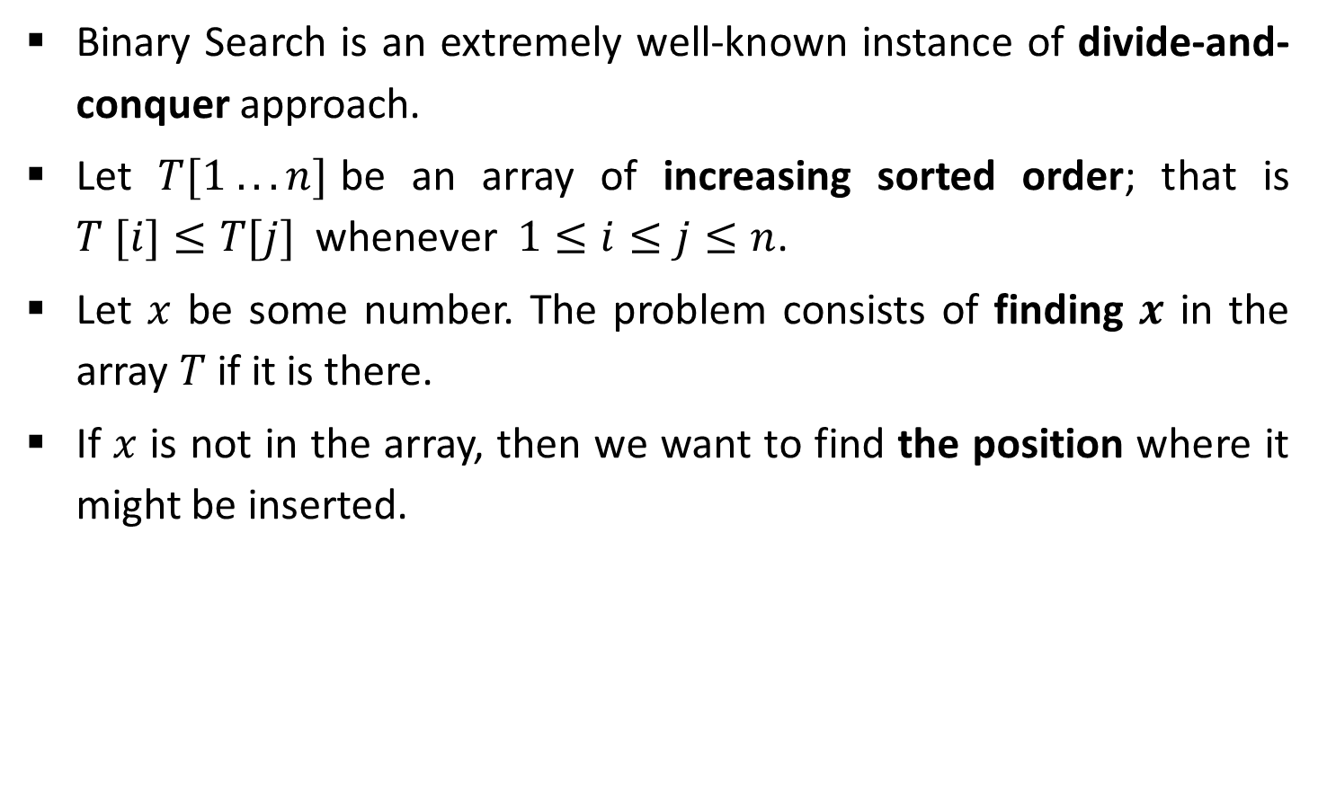
Binary Search
Binary Search is an extremely well-known instance of divide-and-conquer approach.
Let $T[1 . . . n]$be an array of increasing sorted order; that is $T [i]≤T[j]$ whenever $1≤i≤j≤n$.
Let $x$ be some number. The problem consists of finding $x$ in the array $T$ if it is there.
If $x$ is not in the array, then we want to find the position where it might be inserted.

Slide 6
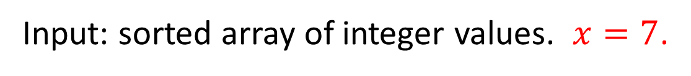
Binary Search - Example
Input: sorted array of integer values. $x=7$.
[ 0 ]
[ 1 ]
[ 2 ]
[ 3 ]
[ 4 ]
[ 5 ]
[ 6 ]
3
6
7
11
32
33
53
[ 0 ]
[ 1 ]
[ 2 ]
[ 3 ]
[ 4 ]
[ 5 ]
[ 6 ]
3
6
7
11
32
33
53
Find approximate midpoint

Slide 7
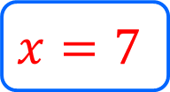
Binary Search - Example
[ 0 ]
[ 1 ]
[ 2 ]
[ 3 ]
[ 4 ]
[ 5 ]
[ 6 ]
$$x=7$$
3
6
7
11
32
33
53
Is 7 = midpoint key? NO.
Is 7 < midpoint value? YES.
[ 0 ]
[ 1 ]
[ 2 ]
[ 3 ]
[ 4 ]
[ 5 ]
[ 6 ]
3
6
7
11
32
33
53
Search for the target in the area before midpoint.

Slide 8
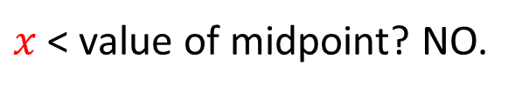
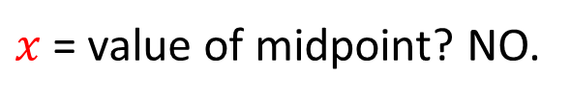
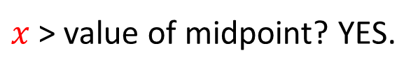
Binary Search - Example
[ 0 ]
[ 1 ]
[ 2 ]
[ 3 ]
[ 4 ]
[ 5 ]
[ 6 ]
$$x=7$$
3
6
7
11
32
33
53
Find approximate midpoint
[ 0 ]
[ 1 ]
[ 2 ]
[ 3 ]
[ 4 ]
[ 5 ]
[ 6 ]
3
6
7
11
32
33
53
$x$ > value of midpoint? YES.
$x$ = value of midpoint? NO.
$x$ < value of midpoint? NO.

Slide 9
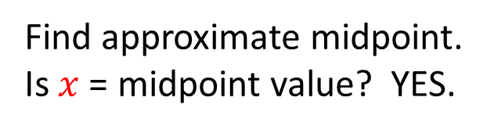

Binary Search - Example
[ 0 ]
[ 1 ]
[ 2 ]
[ 3 ]
[ 4 ]
[ 5 ]
[ 6 ]
$$x=7$$
3
6
7
11
32
33
53
Search for the $x$ in the area after midpoint.
[ 0 ]
[ 1 ]
[ 2 ]
[ 3 ]
[ 4 ]
[ 5 ]
[ 6 ]
3
6
7
11
32
33
53
Find approximate midpoint.
Is $x$ = midpoint value? YES.

Slide 10
Binary Search – Iterative Algorithm
Algorithm: BinarySearch(T[1,…,n], x)
    if x > T[n] then return n+1
    i ← 1;
    j ← n;
    while i < j do
    k ← (i + j ) ÷ 2
      if x ≤ T [k] then j ← k
        else i ← k + 1
    return i A[j] ← A[j+1] A[j+1] ← temp
n=7
i
3
6
7
k
11
32
33
j
53
j

Slide 11
Binary Search – Recursive Algorithm
BinarySearch(arr, item, beg, end)
    if beg<=end
    midIndex = (beg + end) / 2
    if item == arr[midIndex]
    return midIndex
    else if item < arr[midIndex]
    return binarySearch(arr, item, midIndex + 1, end)
    else
    return binarySearch(arr, item, beg, midIndex – 1)
    return -1

Slide 12
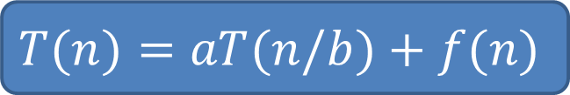
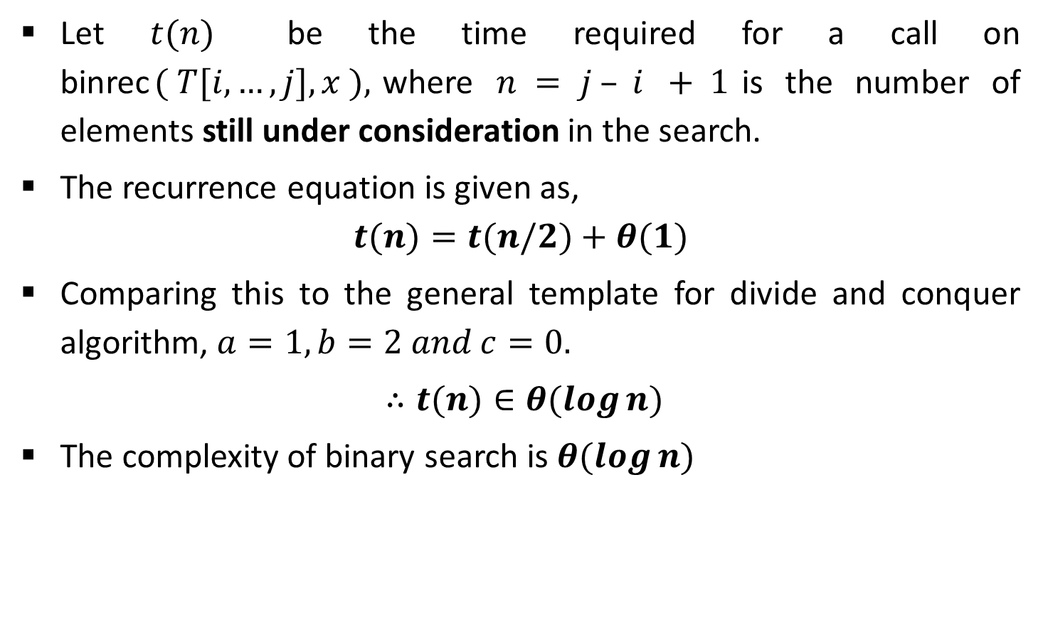
Binary Search - Analysis
Let $t(n)$ be the time required for a call on binrec$( T[i,…,j], x ),$where $n = j – i + 1$is the number of elements still under consideration in the search.
The recurrence equation is given as,
$$t(n)=t(n/2)+θ(1)$$
Comparing this to the general template for divide and conquer algorithm, $a=1, b=2 and c=0.$
$∴t(n)∈θ(log⁡n)$
The complexity of binary search is $θ(log⁡n)$
  $$T(n)=aT(n/b)+f(n)$$

Slide 13
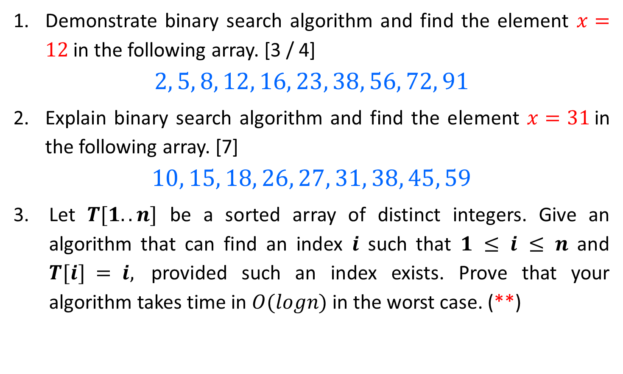
Binary Search – Examples
Demonstrate binary search algorithm and find the element $x=12$in the following array. [3 / 4]
$$2, 5, 8, 12, 16, 23, 38, 56, 72, 91$$
Explain binary search algorithm and find the element $x=31$in the following array. [7]
$$10, 15, 18, 26, 27, 31, 38, 45, 59$$
Let $T[1..n]$ be a sorted array of distinct integers. Give an algorithm that can find an index $i$ such that $1 ≤ i ≤ n$ and $T[i] = i,$ provided such an index exists. Prove that your algorithm takes time in $O(logn)$in the worst case. (**)

Slide 14
Merge Sort

Slide 15
Merge Sort - Example
Unsorted Array
724 | 521 | 2 | 98 | 529 | 31 | 189 | 451
1 | 2 | 3 | 4 | 5 | 6 | 7 | 8
Step 1: Split the selected array
1
2
3
4
5
6
7
8
724
521
2
98
529
31
189
451
724
521
2
98
529
31
189
451
1
2
3
4
1
2
3
4

Slide 16
Merge Sort - Example
Select the left subarray and Split
Select the right subarray and Split
1
2
3
4
1
2
3
4
724
521
2
98
529
31
189
451
1
2
1
2
Split
1
2
1
2
724
521
2
98
529
31
189
451
1
1
1
1
1
1
1
1
724
521
2
98
529
31
189
451
521
724
2
98
31
529
189
451
Merge
2
98
521
724
31
189
451
529
2
31
98
189
451
521
529
724

Slide 17
Merge Sort – Example (HW)
  Sort given numbers into descending order using merge sort.
38, 27, 43, 3, 9, 82, 10, 67, 71, 54, 97

Slide 18
Merge Sort - Algorithm
Merge Sort is an example of divide and conquer algorithm.
It is based on the idea of breaking down a list into several sub-lists until each sub list consists of a single element.
Merging those sub lists in a manner that results into a sorted list.
Procedure
  Divide the unsorted list into N sub lists, each containing 1 element
  Take adjacent pairs of two singleton lists and merge them to form a list of 2 elements. N will now convert into N/2 lists of size 2
  Repeat the process till a single sorted list of obtained

Slide 19
Merge Sort - Algorithm
merge(U[p..q],V[q+1..r],T[])
    i ← 1;
    j ← 1;
    U[q+1], V[r+1] ← ∞;
    for k ← 1 to q + r do
    if U[i] < V[j]
    T[k] ← U[i];
    i ← i + 1;
    else
    T[k] ← V[j];
    j ← j + 1;] A[j+1← temp
MergeSort(A, p, r):
if p > r
return
q = (p+r)/2
mergeSort(A, p, q)
mergeSort(A, q+1, r)
merge(A, p, q, r)

Slide 20

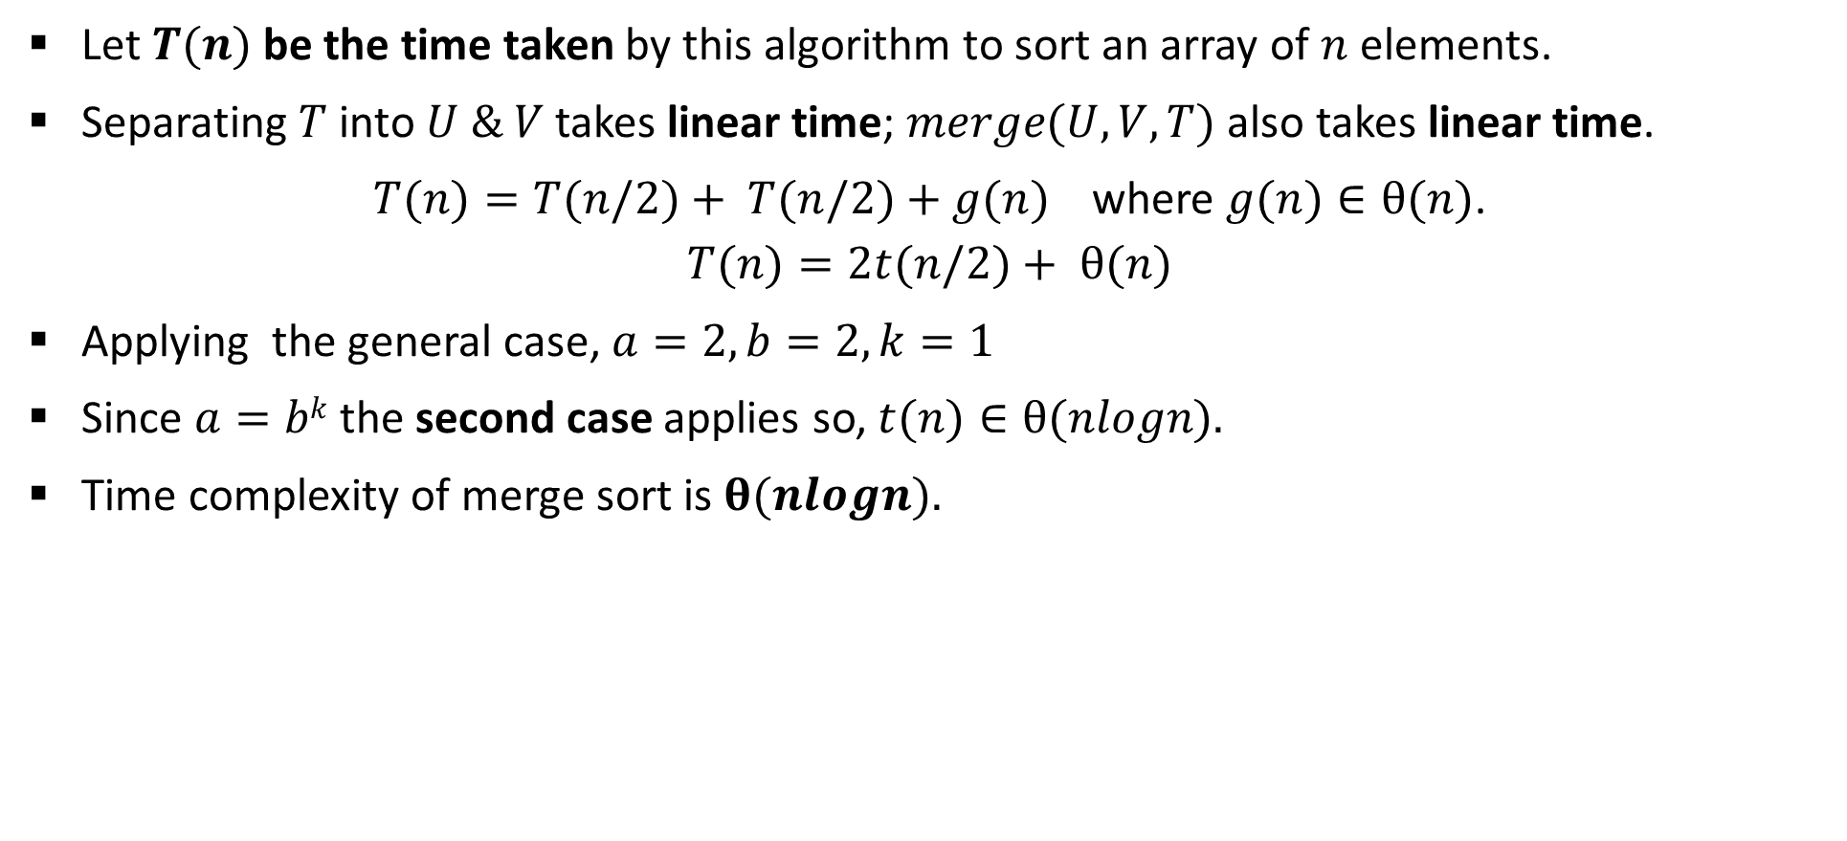

Merge Sort - Analysis
Let $T(n)$ be the time taken by this algorithm to sort an array of $n$ elements.
Separating $T$ into $U \& V$takes linear time; $merge(U, V, T)$also takes linear time.
$T(n)=T(n/2)+ T(n/2)+g(n)$where $g(n)∈θ(n)$.
$$T(n)=2t(n/2)+ θ(n)$$
Applying the general case, $a=2, b=2, k=1$
Since $a=bk$the second case applies so, $t(n)∈θ(nlogn).$
Time complexity of merge sort is $θ(nlogn).$
$$t\left(n\right)=at\left(n/b\right)+g\left(n\right)$$
$$t\left(n\right)=\left\{\begin{aligned}θ\left(n^{k}\right) if a < b^{k} \\ θ\left(n^{k}logn\right) if a= b^{k} \\ θ\left(n^{\log_{b}a}\right) if a >b^{k}\end{aligned}\right.$$

Slide 21
Quick Sort

Slide 22
Quick Sort – Example(Inplace)
Quick sort chooses the first element as a pivot element, a lower bound is the first index and an upper bound is the last index.
The array is then partitioned on either side of the pivot.
Elements are moved so that, those greater than the pivot are shifted to its right whereas the others are shifted to its left.
Each Partition is internally sorted recursively.
Pivot
Element
0
1
2
3
4
5
6
7
6
7
42
23
74
11
65
58
94
36
99
87
LB
UB

Slide 23
Quick Sort - Example
Procedure pivot(T[i,…,j]; var l)
p ← T[i]
k ← i; l ← j+1
Repeat
k ← k+1 until T[k] > p or k ≥ j
Repeat
l ← l-1 until T[l] ≤ p
While k < l do
Swap T[k] and T[l]
Repeat k ← k+1 until
T[k] > p
Repeat l ← l-1 until
T[l] ≤ p
Swap T[i] and T[l]
0
1
2
3
4
5
6
7
8
9
42
23
74
11
65
58
94
36
99
87
k
l
Swap
42
23
74
36
11
65
58
94
36
74
99
87
k
l
Swap
42
11
23
36
11
42
65
58
94
74
99
87
k
l
LB = 0, UB = 9
p = 42
k =
0
l =
10

Slide 24
Quick Sort - Example
Procedure pivot(T[i,…,j]; var l)
p ← T[i]
k ← i; l ← j+1
Repeat
k ← k+1 until T[k] > p or k ≥ j
Repeat
l ← l-1 until T[l] ≤ p
While k < l do
Swap T[k] and T[l]
Repeat k ← k+1 until
T[k] > p
Repeat l ← l-1 until
T[l] ≤ p
Swap T[i] and T[l]
LB
UB
0
1
2
3
4
5
6
7
8
9
11
23
36
42
65
58
94
74
99
87
11
11
23
36
k
l
LB
UB
11
23
36
42
65
58
94
74
99
87
23
23
36
k
l
11
23
36
36
42
65
58
94
74
99
87

Slide 25
Quick Sort - Example
LB
UB
Procedure pivot(T[i,…,j]; var l)
p ← T[i]
k ← i; l ← j+1
Repeat
k ← k+1 until T[k] > p or k ≥ j
Repeat
l ← l-1 until T[l] ≤ p
While k < l do
Swap T[k] and T[l]
Repeat k ← k+1 until
T[k] > p
Repeat l ← l-1 until
T[l] ≤ p
Swap T[i] and T[l]
4
5
6
7
8
9
11
23
36
42
65
58
94
72
99
87
Swap
65
65
58
58
65
94
72
99
87
k
l
65
65
58
58
65
94
72
99
87
LB
UB
11
23
36
42
65
65
58
65
94
72
99
87

Slide 26
Quick Sort - Example
LB
UB
Procedure pivot(T[i,…,j]; var l)
p ← T[i]
k ← i; l ← j+1
Repeat
k ← k+1 until T[k] > p or k ≥ j
Repeat
l ← l-1 until T[l] ≤ p
While k < l do
Swap T[k] and T[l]
Repeat k ← k+1 until
T[k] > p
Repeat l ← l-1 until
T[l] ≤ p
Swap T[i] and T[l]
Swap
94
94
72
99
87
87
99
k
l
Swap
94
94
87
72
87
94
99
k
l
LB
UB
Swap
87
87
72
72
87
94
99
k
l
11
23
36
42
58
65
72
72
87
94
99
99

Slide 27
Quick Sort - Examples
Sort the following array in ascending order using quick sort algorithm.
  5, 3, 8, 9, 1, 7, 0, 2, 6, 4
  3, 1, 4, 1, 5, 9, 2, 6, 5, 3, 5, 8, 9 (HW)
  9, 7, 5, 11, 12, 2, 14, 3, 10, 6 (HW)

Slide 28
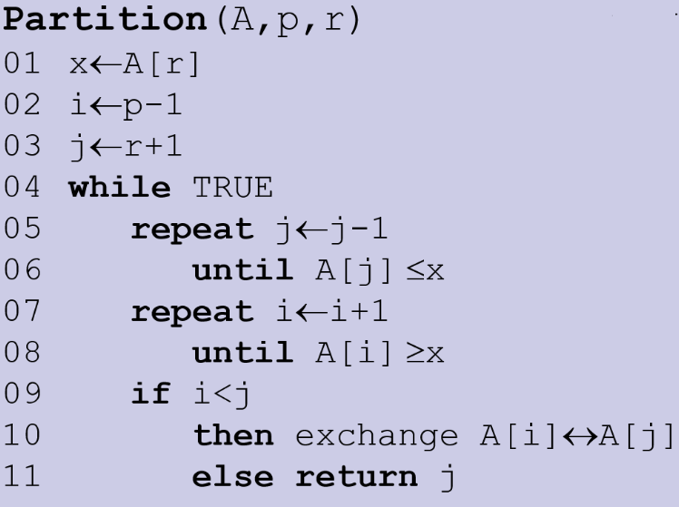
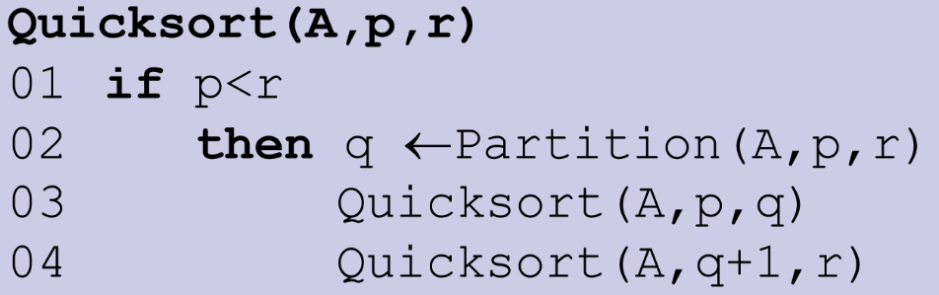
Quick Sort - Algorithm

Slide 29
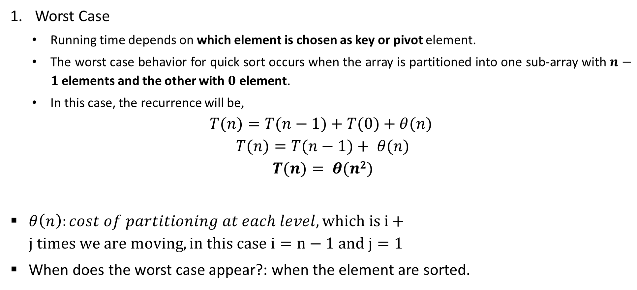
Quick Sort - Analysis
Worst Case
  Running time depends on which element is chosen as key or pivot element.
  The worst case behavior for quick sort occurs when the array is partitioned into one sub-array with $n−1$ elements and the other with $0$ element.
  In this case, the recurrence will be,
$$T(n)=T(n−1)+T(0)+θ(n)$$
$$T(n)=T(n−1)+ θ(n)$$
$$T(n)= θ(n2)$$
$θ\left(n\right):cost of partitioning at each level, which is i+j times we are moving, in this case i=n−1 and j=1$
When does the worst case appear?: when the element are sorted.

Slide 30
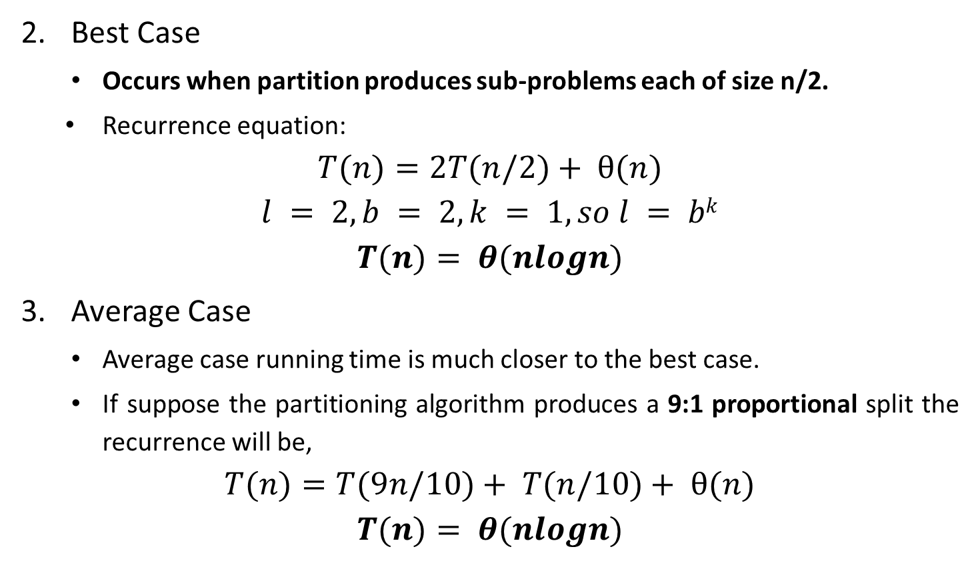
Quick Sort - Analysis
Best Case
  Occurs when partition produces sub-problems each of size n/2.
  Recurrence equation:
$$T(n)=2T(n/2)+ θ(n)$$
$$l = 2, b = 2, k = 1, so l = bk$$
$$T(n)= θ(nlogn)$$
Average Case
  Average case running time is much closer to the best case.
  If suppose the partitioning algorithm produces a 9:1 proportional split the recurrence will be,
$$T(n)=T(9n/10)+ T(n/10)+ θ(n)$$
$$T(n)= θ(nlogn)$$

Slide 31
Multiplying Large Integers

Slide 32



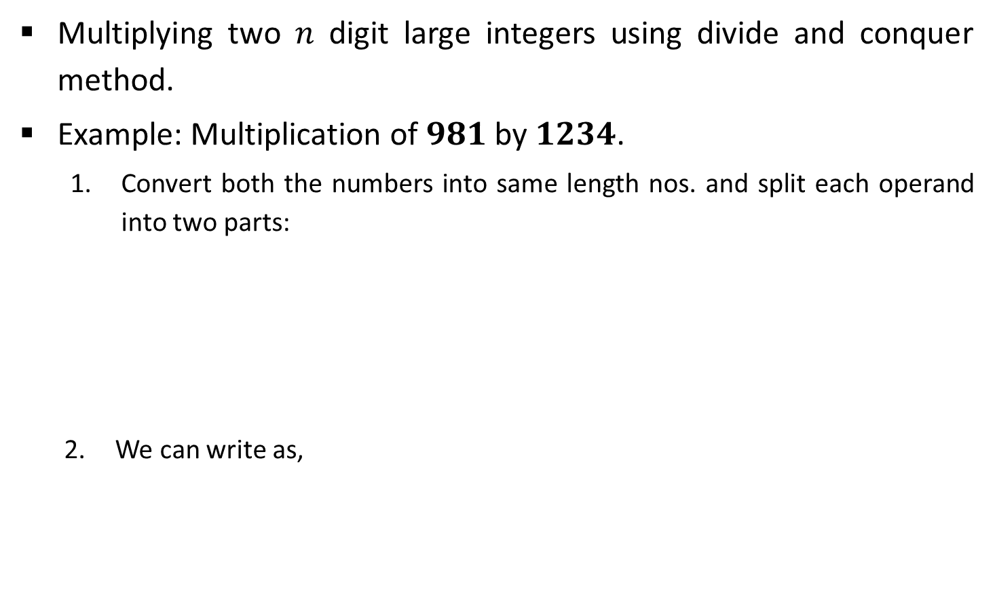

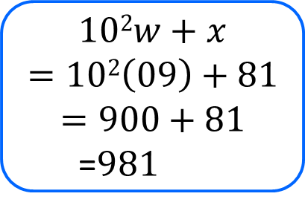

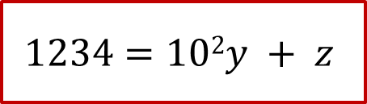

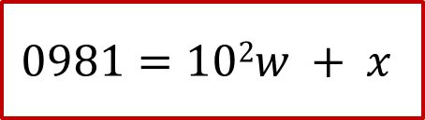
Multiplying Large Integers Problem
Multiplying two 𝑛 digit large integers using divide and conquer method.
Example: Multiplication of $981$ by $1234$.
  Convert both the numbers into same length nos. and split each operand into two parts:
  We can write as,
$$0981$$
$$1234$$
$$w=09$$
$$x=81$$
$$y=12$$
$$z=34$$
$$102w+x$$
$$=102\left(09\right)+81$$
$$=900+81$$
  =$981$
$$0981=102w + x$$
$$1234=102y + z$$

Slide 33
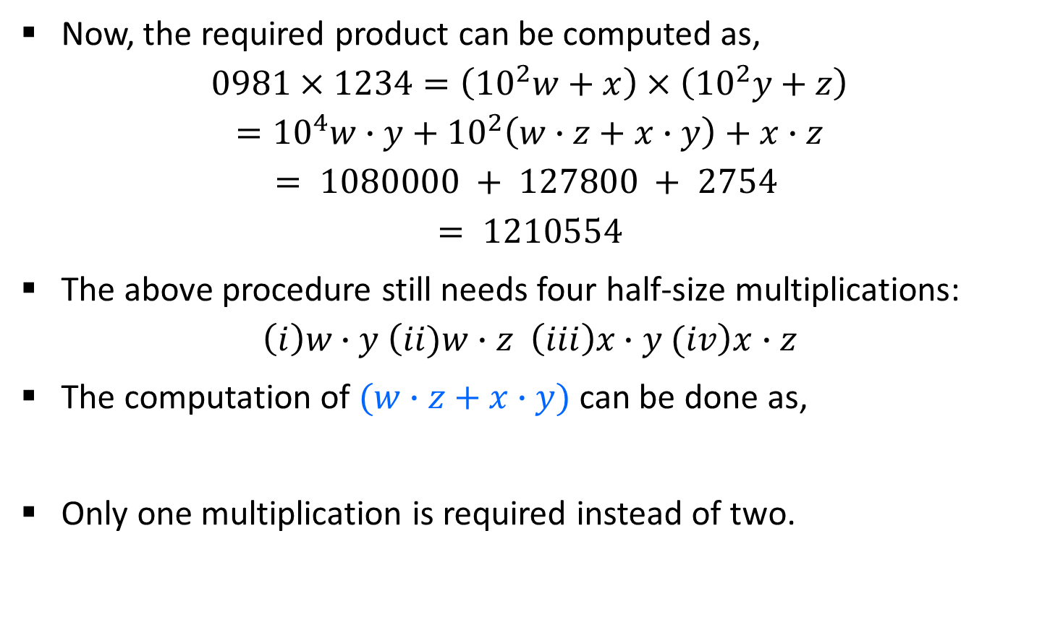



Multiplying Large Integers Problem
Now, the required product can be computed as,
$$0981×1234=\left({10}^{2}w+x\right)×\left({10}^{2}y+z\right)$$
$$={10}^{4}w∙y+{10}^{2}\left(w∙z+x∙y\right)+x∙z$$
$$= 1080000 + 127800 + 2754$$
$$= 1210554$$
The above procedure still needs four half-size multiplications:
$$\left(i\right)w∙y \left(ii)w∙z \left(iii\right)x∙y (iv\right)x∙z$$
The computation of $(w∙z+x∙y)$ can be done as,
Only one multiplication is required instead of two.
$$w=09$$
$$x=81$$
$$y=12$$
$$z=34$$
$$r=\left(w+x\right)×\left(y+z\right)$$
$$=w∙y+\left(w∙z+x∙y\right)+x∙z$$
Additional terms

Slide 34




Multiplying Large Integers Problem
Now we can compute the required product as follows:
$$w=09$$
$$x=81$$
$$y=12$$
$$z=34$$
$$p = w∙y = 09∙12 =108$$
$$q =x∙z =81∙34 =2754$$
$$r=\left(w+x\right)×\left(y+z\right)=90∙46=4140$$
$$r=\left(w+x\right)×\left(y+z\right)$$
$$=w∙y+\left(w∙z+x∙y\right)+x∙z$$
$${10}^{4}w∙y+{10}^{2}\left(w∙z+x∙y\right)+x∙z$$
$$981×1234 = 104p + {10}^{2} (r − p − q) + q$$
$$= 1080000 + 127800 + 2754$$
$$= 1210554.$$

Slide 35

for Binary Number
a=
b=
a_{L} | a_{R}
b_{L} | b_{R}
$$w=aL$$
$$x=aR$$
$$y=bL$$
$$z=bR$$
$$p = w∙y =aL∗bL$$
$$q =x∙z =aR∗bR$$
$$r=\left(w+x\right)×\left(y+z\right)=\left(aL+aR\right)×\left(bL+bR\right)$$
$$r=\left(w+x\right)×\left(y+z\right)$$
$$=w∙y+\left(w∙z+x∙y\right)+x∙z$$
$${a∙b=2}^{n}aL∙bL+2^{n/2}\left(aL∙bR+aR∙bL\right)+aR∙bR$$
$$a×b =2np + 2^{n/2} (r − p − q) + q$$

Slide 36
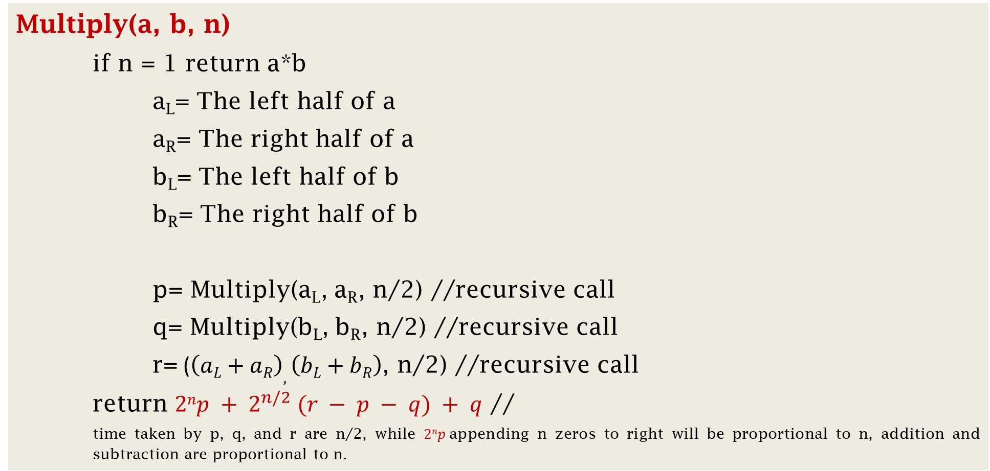
Algorithm
Multiply(a, b, n)
    if n = 1 return a*b
    a_{L}= The left half of a
    a_{R}= The right half of a
    b_{L}= The left half of b
    b_{R}= The right half of b
    p= Multiply(a_{L}, a_{R}, n/2) //recursive call
    q= Multiply(b_{L}, b_{R}, n/2) //recursive call
    r= ($\left(aL+aR\right),\left(bL+bR\right)$, n/2) //recursive call
    return $2np + 2^{n/2} (r − p − q) + q$ //
    time taken by p, q, and r are n/2, while $2np$appending n zeros to right will be proportional to n, addition and subtraction are proportional to n.

Slide 37
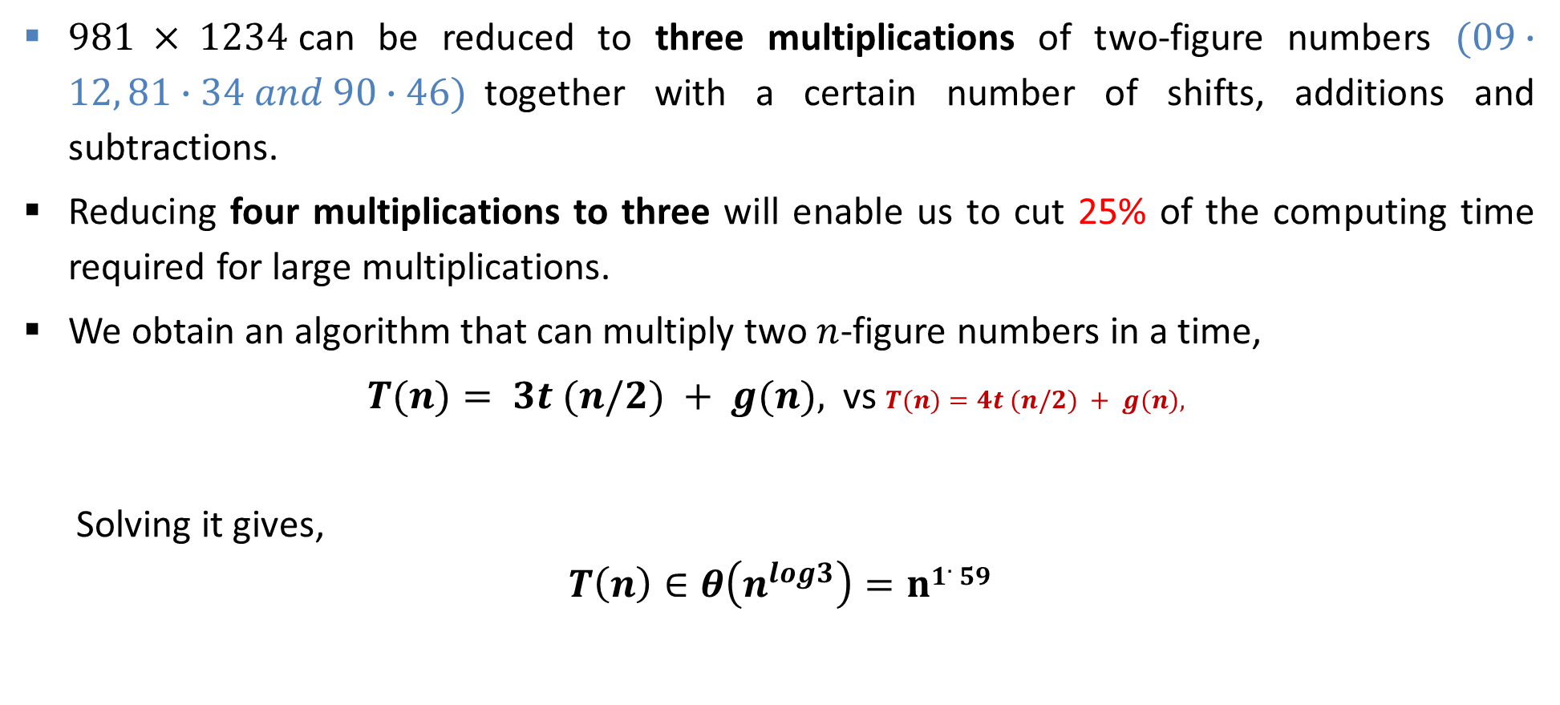
Analysis of Time Complexity
$981 × 1234$can be reduced to three multiplications of two-figure numbers $(09∙12, 81∙34 and 90∙46)$together with a certain number of shifts, additions and subtractions.
Reducing four multiplications to three will enable us to cut 25% of the computing time required for large multiplications.
We obtain an algorithm that can multiply two $n$-figure numbers in a time,
$T(n)= 3t (n/2) + g(n),$ vs $T(n)=4t (n/2) + g(n),$
  Solving it gives,
$$T\left(n\right)∈θ\left(n^{log3}\right)=n1.59$$

Slide 38


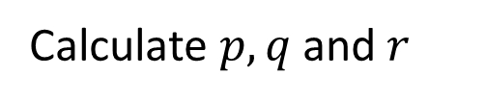
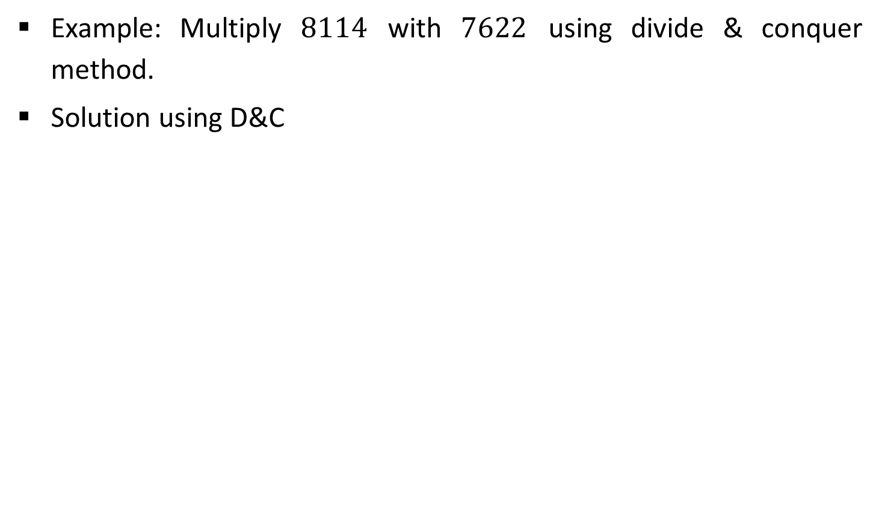



Multiplying Large Integers Problem
Example: Multiply $8114$ with $7622$ using divide & conquer method.
Solution using D&C
Step 1:
$$w=81$$
$$x=14$$
$$y=76$$
$$z=22$$
Step 2:
Calculate $p, q$and $r$
$$p=w∙y=81∙76=6156$$
$$q=x∙z=14∙22=308$$
$r=(w+x)∙(y+z)=95∙98=931$0
$$8114×7622=104p+{10}^{2} (r−p−q)+q$$
$$= 61560000+284600+308$$
$$=61844908$$

Slide 39
Strassen’s Algorithm for Matrix Multiplication

Slide 40
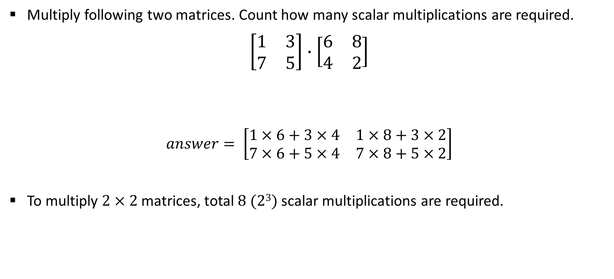
Matrix Multiplication
Multiply following two matrices. Count how many scalar multiplications are required.
$$\left[\begin{matrix}1 & 3 \\ 7 & 5\end{matrix}\right]∙\left[\begin{matrix}6 & 8 \\ 4 & 2\end{matrix}\right]$$
$$answer= \left[\begin{matrix}1×6+3×4 & 1×8+3×2 \\ 7×6+5×4 & 7×8+5×2\end{matrix}\right]$$
To multiply $2×2$matrices, total $8 (23)$scalar multiplications are required.

Slide 41
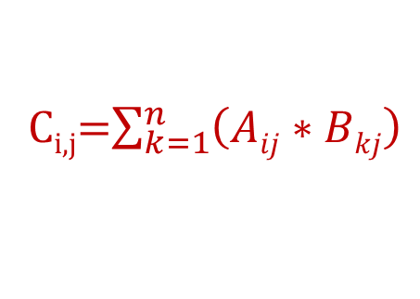
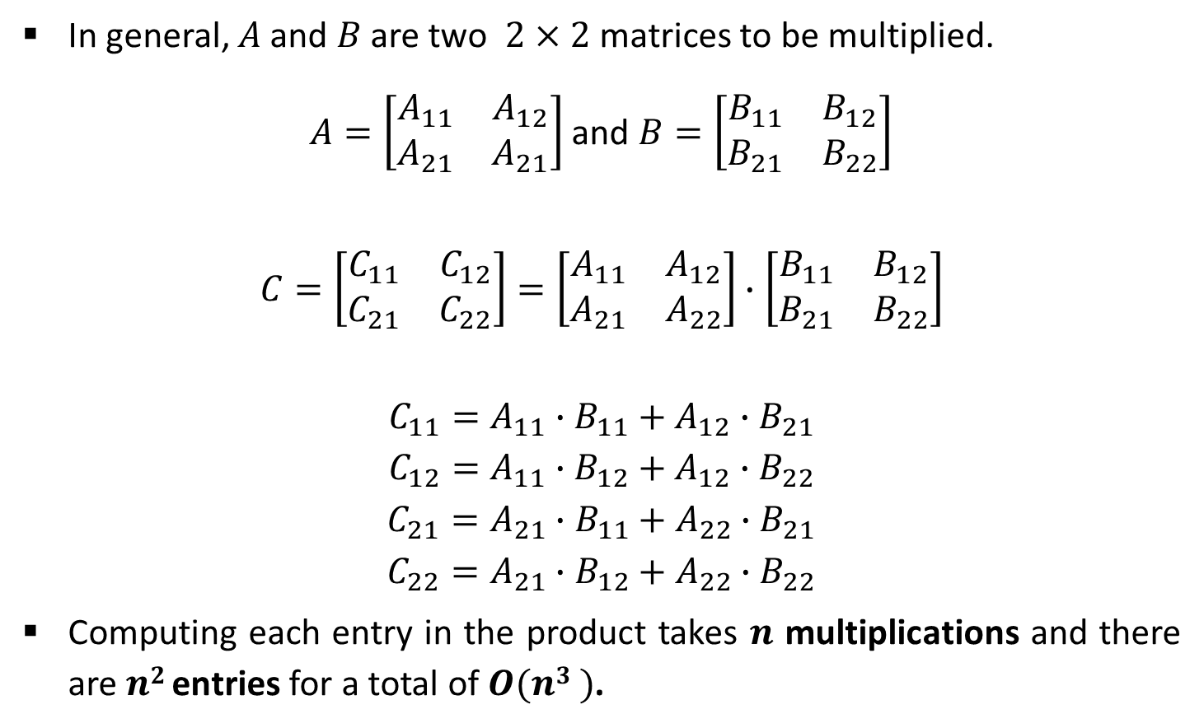
Matrix Multiplication
In general, $A$ and $B$ are two $2×2$ matrices to be multiplied.
$A=\left[\begin{matrix}A_{11} & A_{12} \\ A_{21} & A_{21}\end{matrix}\right]$ and $B=\left[\begin{matrix}B_{11} & B_{12} \\ B_{21} & B_{22}\end{matrix}\right]$
$$C=\left[\begin{matrix}C_{11} & C_{12} \\ C_{21} & C_{22}\end{matrix}\right]=\left[\begin{matrix}A_{11} & A_{12} \\ A_{21} & A_{22}\end{matrix}\right]∙\left[\begin{matrix}B_{11} & B_{12} \\ B_{21} & B_{22}\end{matrix}\right]$$
$$C_{11}=A_{11}∙B_{11}+A_{12}∙B_{21}$$
$$C_{12}=A_{11}∙B_{12}+A_{12}∙B_{22}$$
$$C_{21}=A_{21}∙B_{11}+A_{22}∙B_{21}$$
$$C_{22}=A_{21}∙B_{12}+A_{22}∙B_{22}$$
Computing each entry in the product takes $n$ multiplications and there are $n2$ entries for a total of $O(n3 )$.
C_{i,j}=$\sum_{k=1}^{n}{\left(Aij∗Bkj\right)}$

Slide 42
Algorithm for simple Addition
Addition(A,B) //A,B,C are two dimensional matrices.
N ← rows[A]
Let C be the matrix having A+B of size n*n.
for i← 0 to n
for j← 0 to n
C[i][j] ← (A[i][k]+B[k][j])
return C
    A[j+1← temp
Time Complexity of above method is O(n²).

Slide 43
Algorithm for simple multiplication
Naive_square_multiply(A,B) //A,B,C are two dimensional matrices.
n ← rows[A]
Let C be the matrix having A*B of size n*n.
for i← 0 to n
for j← 0 to n
for k← 0 to n
C[i][j] ← C[i][j] +(A[i][k]*B[k][j])
return C
    A[j+1← temp
Time Complexity of above method is O(n³).

Slide 44
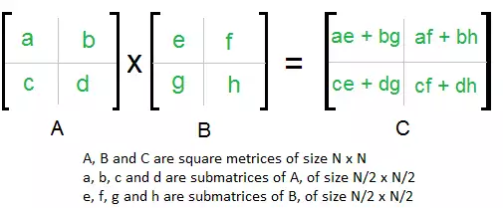
Divide and Conquer Approach
Let us first assume that n is an exact power of 2 in each of the n x n matrices for A and B. This simplifying assumption allows us to break a big n x n matrix into smaller blocks or quadrants of size n/2 x n/2, while also ensuring that the dimension n/2 is an integer.
We calculate following values recursively. ae + bg, af + bh, ce + dg and cf + dh.

Slide 45
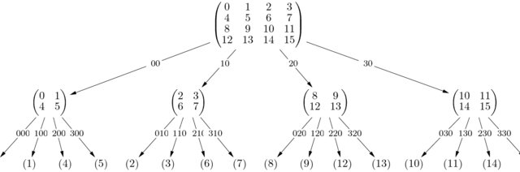
In the above method, we do 8 multiplications for matrices of size N/2 x N/2 and 4 additions. Addition of two matrices takes O(N²) time. So the time complexity can be written as
T(N) = 8T(N/2) + O(N²)
O(N³)(no better than naïve algorithm)

Slide 46

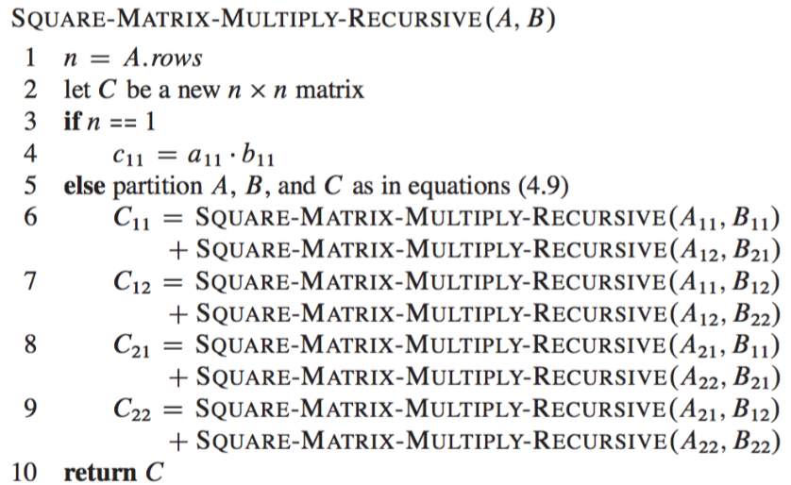

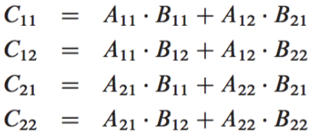

Slide 47

Logic
For multiplying two matrices of size n x n, we make 8 recursive calls above, each on a matrix/subproblem with size n/2 x n/2. Each of these recursive calls multiplies two n/2 x n/2 matrices, which are then added together. For the addition, we add two matrices of size n²/4 , so each addition takes Θ(n²/4)
time. We can write this recurrence in the form of the following equations
Hence, recurrence T(N) = 8T(N/2) + O(N²) i.e O(N³)

Slide 48
MOTIVATION BEHIND STRASSEN ALGORITHM
Simple Divide and Conquer also leads to O(N³), can there be a better way?
In the above divide and conquer method, the main component for high time complexity is 8 recursive calls. The idea of Strassen’s method is to reduce the number of recursive calls to 7. Multiplication is more costly operation than addition.
Addition and Subtraction of two matrices takes O(N²) time. So time complexity can be written as
T(N) = 7T(N/2) + O(N²)
From Master's Theorem, time complexity of above method is O(N^{log}₂⁷) which is approximately O(N^{2.8074}) i.e O(N^{2.81})

Slide 49
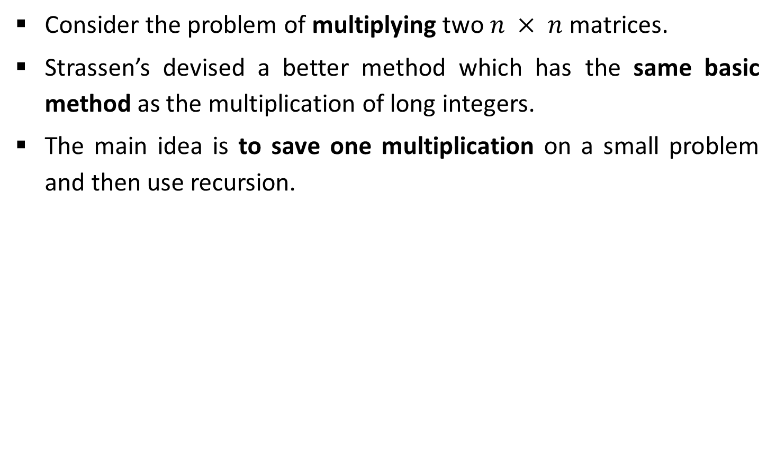
Strassen’s Algorithm for Matrix Multiplication
Consider the problem of multiplying two $n × n$matrices.
Strassen’s devised a better method which has the same basic method as the multiplication of long integers.
The main idea is to save one multiplication on a small problem and then use recursion.

Slide 50
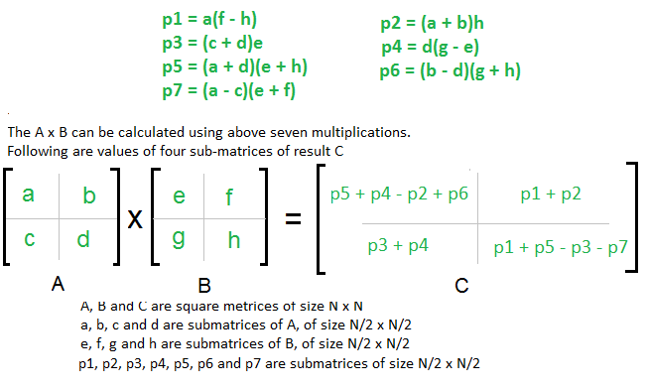
Strassen’s Algorithm for Matrix Multiplication

Slide 51
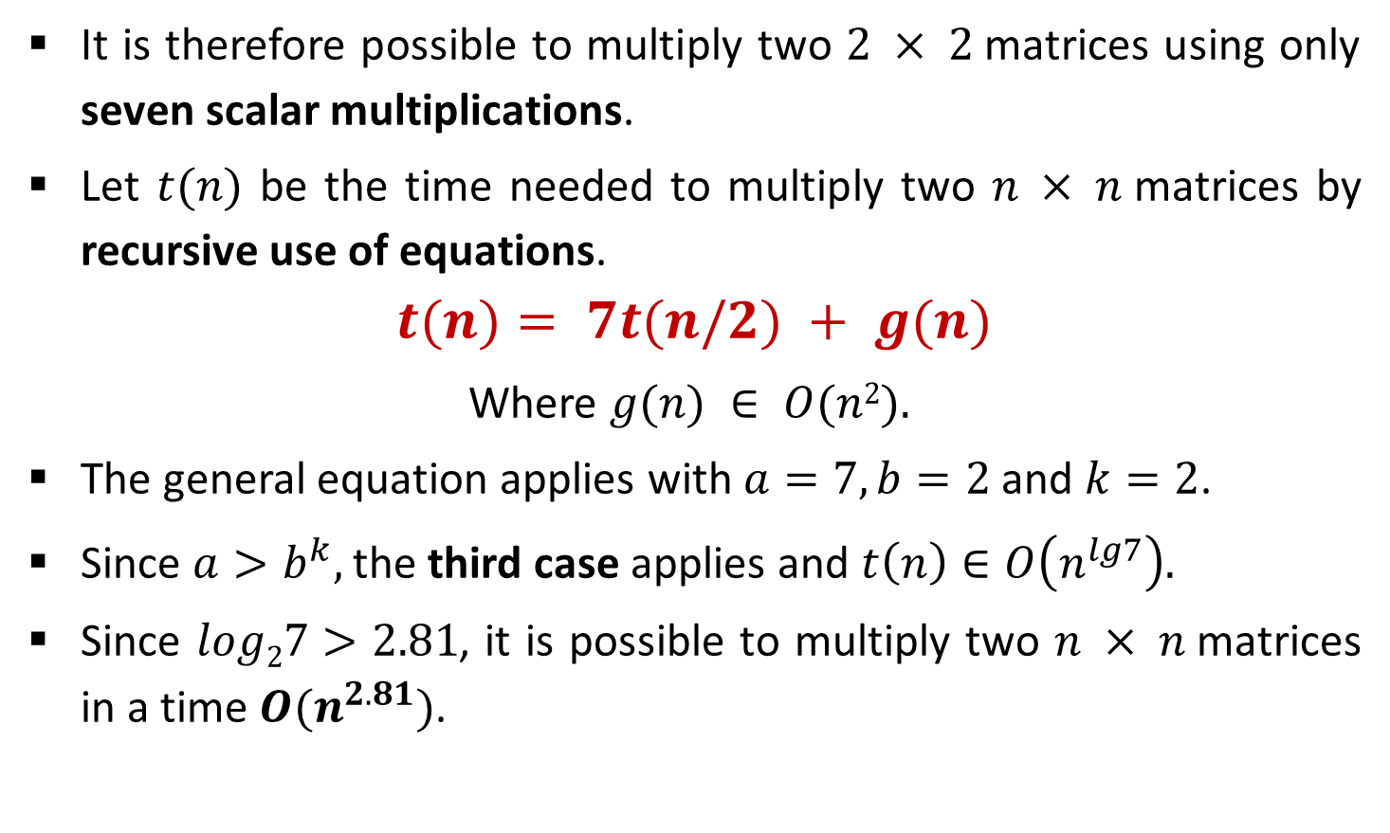
Strassen’s Algorithm - Analysis
It is therefore possible to multiply two $2 × 2$matrices using only seven scalar multiplications.
Let $t(n)$ be the time needed to multiply two $n × n$matrices by recursive use of equations.
$$t(n)= 7t(n/2) + g(n)$$
Where $g(n) ∈ O(n2).$
The general equation applies with $a=7, b=2$and $k=2$.
Since $a>b^{k},$the third case applies and $t\left(n\right)∈O\left(n^{lg7}\right).$
Since $log27>2.81$, it is possible to multiply two $n × n$matrices in a time $O(n^{2.81})$.

Slide 52
Exponentiation

Slide 53

Exponentiation - Sequential
Let $a$ and $n$ be two integers. We wish to compute the exponentiation $x=a^{n}$.
Algorithm using Sequential Approach:
This algorithm takes a time in $θ(n)$ since the instruction $r= a ∗ r$ is executed exactly $n−1$ times, provided the multiplications are counted as elementary operations.
function exposeq(a, n)
  r ← a
  for i ← 1 to n - 1 do
    r ← a * r
  return r

Slide 54
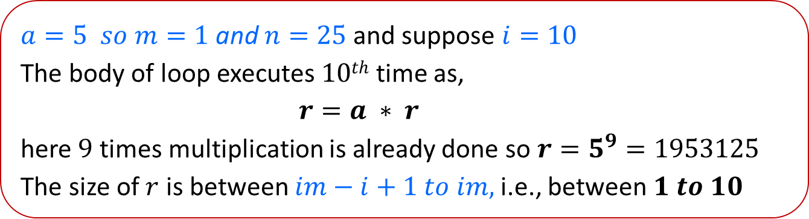
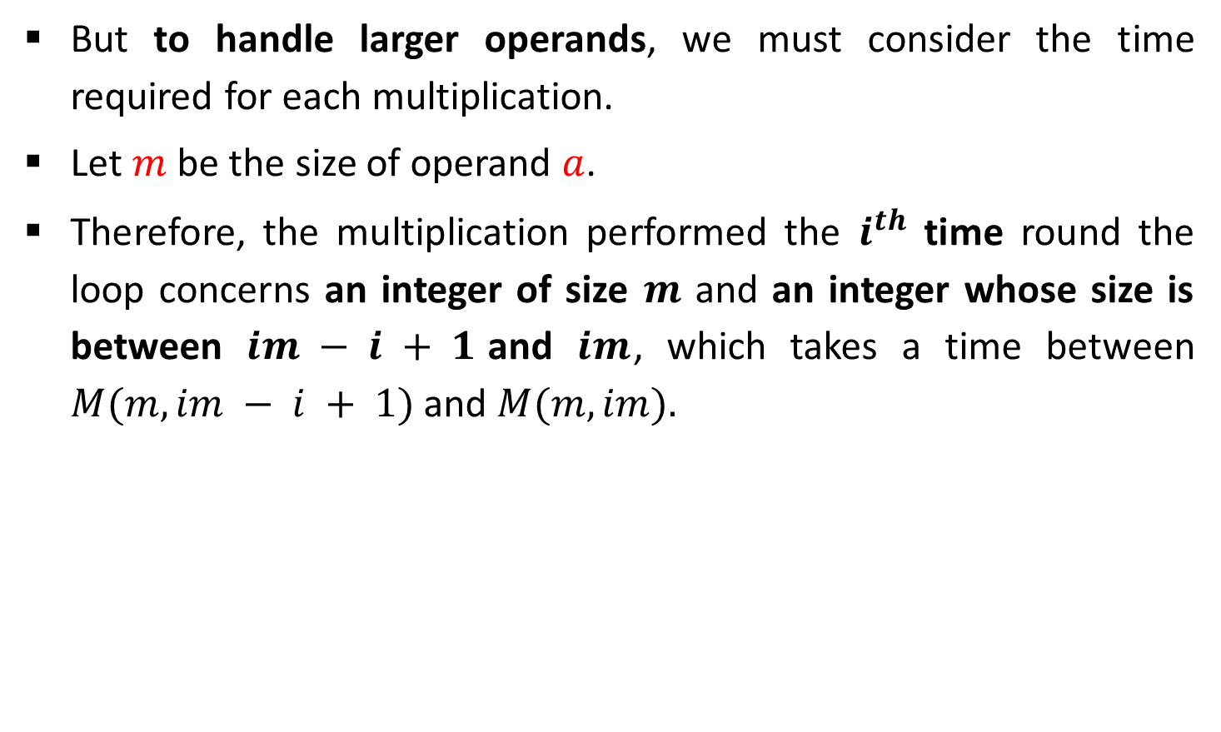
Exponentiation - Sequential
But to handle larger operands, we must consider the time required for each multiplication.
Let $m$ be the size of operand $a$.
Therefore, the multiplication performed the $i^{th}$ time round the loop concerns an integer of size $m$ and an integer whose size is between $im − i + 1$and $im$, which takes a time between $M(m, im − i + 1)$ and $M(m, im).$
$a=5 so m=1$ and $n=25$and suppose $i=10$
The body of loop executes $10th$ time as,
    $$r=a ∗ r$$
here $9$ times multiplication is already done so $r=5^{9}=1953125$
The size of $r$ is between $im−i+1 to im,$i.e., between $1 to 10$

Slide 55
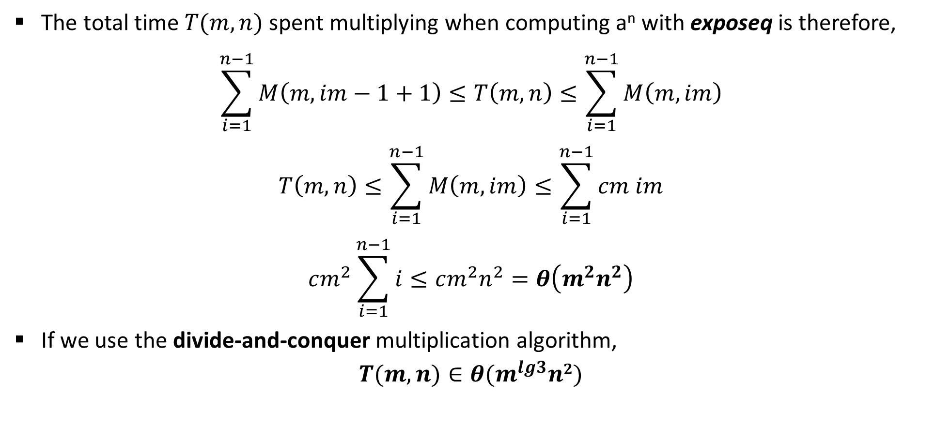
Exponentiation - Sequential
The total time $T(m, n)$spent multiplying when computing a^{n} with exposeq is therefore,
$$\sum_{i=1}^{n−1}{M\left(m,im−1+1\right)≤T\left(m,n\right)≤\sum_{i=1}^{n−1}{M\left(m,im\right)}}$$
$$T\left(m,n\right)≤\sum_{i=1}^{n−1}{M\left(m,im\right)≤\sum_{i=1}^{n−1}{cm im}}$$
$$cm^{2}\sum_{i=1}^{n−1}{i≤cm^{2}n^{2}}=θ\left(m^{2}n^{2}\right)$$
If we use the divide-and-conquer multiplication algorithm,
$$T(m, n)∈θ(m^{lg3}n2)$$

Slide 56
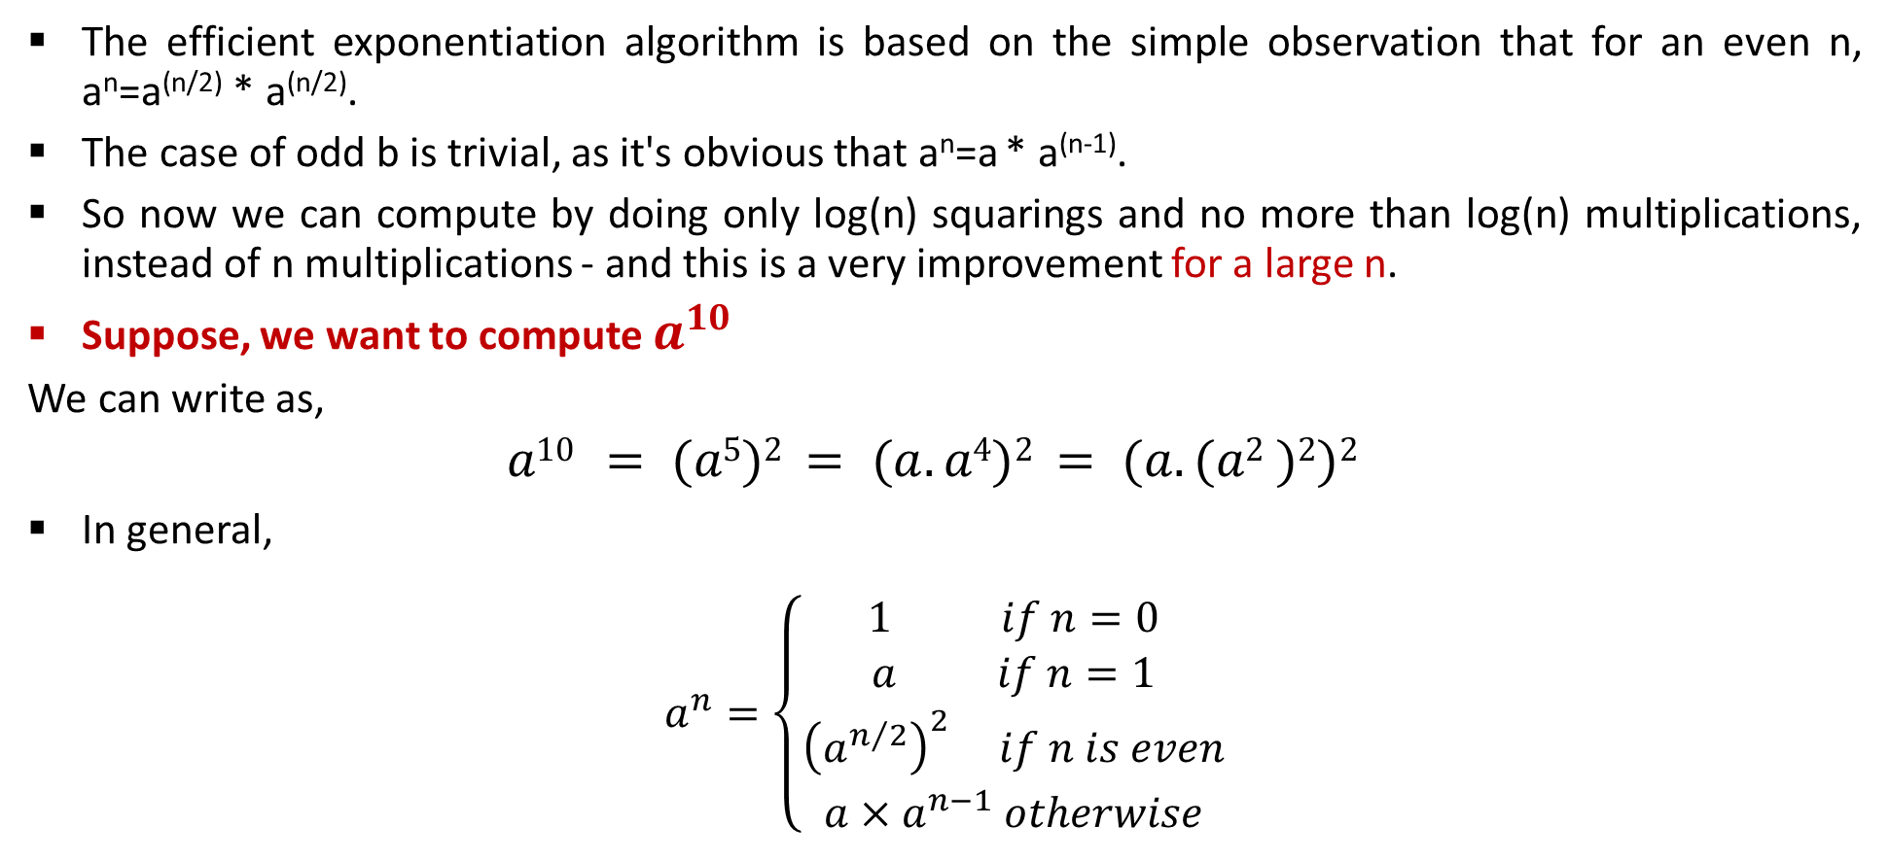
Exponentiation – D & C
The efficient exponentiation algorithm is based on the simple observation that for an even n, a^{n}=a^{(n/2)} * a^{(n/2)}.
The case of odd b is trivial, as it's obvious that a^{n}=a * a^{(n-1)}.
So now we can compute by doing only log(n) squarings and no more than log(n) multiplications, instead of n multiplications - and this is a very improvement for a large n.
Suppose, we want to compute $a^{10}$
We can write as,
$$a10 = (a5)2 = (a.a4)2 = (a.(a2 )2)2$$
In general,
$$a^{n}=\left\{\begin{matrix}\begin{aligned}1 if n=0 \\ a if n=1\end{aligned} \\ {\left(a^{n/2}\right)}^{2} if n is even \\ a×a^{n−1} otherwise\end{matrix}\right.$$

Slide 57

Exponentiation – D & C
Algorithm using Divide & Conquer Approach:
Number of operations performed by the algorithm is given by,
T$\left(n\right)=\left\{\begin{matrix}\begin{aligned}0 if n=0 \\ 0 if n=1\end{aligned} \\ 2T\left(n/2\right)+1 if n is even \\ 2T\left(({n−1)}/2\right)+T\left(1\right)+1 otherwise\end{matrix}\right.$
function expoDC(a, n)
if n = 0 then return 1
if n = 1 then return a
if n is even then return [expoDC(a, n/2)]²
else return a * expoDC(a, n - 1)

Slide 58
Exponentiation – D & C
a^{n}
a^{n/2}
a^{n/2}
a^{n/4}
a^{n/4}
N/2^{x} = 1
N = 2^{x}
logN = x
O(logN)
N=2¹²
Speed of the machine is 2¹⁰ / second
a^{n/8}
a^{n/8}
a¹
a¹

Slide 59
Thank You!

