Slide 1
Red-Black Tree
Source: Internet, reference books, NPTEL

Slide 2
Definition
Binary search trees are a fundamental data structure, but their performance can suffer if the tree becomes unbalanced.
Red Black Trees are a type of balanced binary search tree that use a set of rules to maintain balance, ensuring logarithmic time complexity for operations like insertion, deletion, and searching, regardless of the initial shape of the tree.
Red Black Trees are self-balancing, using a simple color-coding scheme to adjust the tree after each modification.
A Red-Black Tree is a self-balancing binary search tree where each node has an additional attribute: a color, which can be either red or black.
The primary objective of these trees is to maintain balance during insertions and deletions, ensuring efficient data retrieval and manipulation.

Slide 3
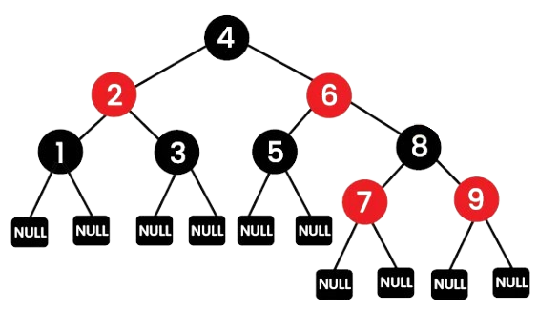
Properties of Red-Black Trees
A Red-Black Tree have the following properties:
Node Color: Each node is either red or black.
Root Property: The root of the tree is always black.
Red Property: Red nodes cannot have red children (no two consecutive red nodes on any path).
Black Property: Every path from a node to its descendant null nodes (leaves) has the same number of black nodes.
Leaf Property: All leaves (NIL nodes) are black and do not store any data. They are placeholders used to maintain the tree structure.

Slide 4
Red-Black Trees vs AVL Tree
Most of the BST operations (e.g., search, max, min, insert, delete.. etc) take O(log n) time where log n is the height of the BST.
The cost of these operations may become O(n) for a skewed Binary tree. If we make sure that the height of the tree remains O(log n) after every insertion and deletion, then we can guarantee an upper bound of O(log n) for all these operations.
The height of a Red-Black tree is always O(log n) where n is the number of nodes in the tree.
The AVL trees are more balanced compared to Red-Black Trees, but they may cause more rotations during insertion and deletion.
  So if your application involves frequent insertions and deletions, then Red-Black trees should be preferred.
  And if the insertions and deletions are less frequent and search is a more frequent operation, then AVL tree should be preferred.

Slide 5
Operation: Insertion
Inserting a new node in a Red-Black Tree involves a two-step process: performing a standard binary search tree (BST) insertion, followed by fixing any violations of Red-Black properties.
Step 1: Insert the new node with red color
Step 2:
  a) Node is root recolor it to black
  b) [Red-Red violation]
    Case 1: Uncle is Red: Recolor the parent and uncle to black and the grandparent to red. Then move up the tree to check for further violations.
    Case 2: Uncle is Black or Null:
      Perform rotations to balance the tree.
      Recolor the nodes accordingly.

Slide 6
Example: Insertion
10, 20, 30, 15, 25, 5, 12, 35, 40, 32, 50
10
10
20
30

Slide 7
Example: Insertion
10, 20, 30, 15, 25, 5, 12, 35, 40, 32, 50
20
10
10
10
30
10
30
10
30
30
5
15
25
5
15
25
35
35
35
40
12
32
40
32
50

Slide 8
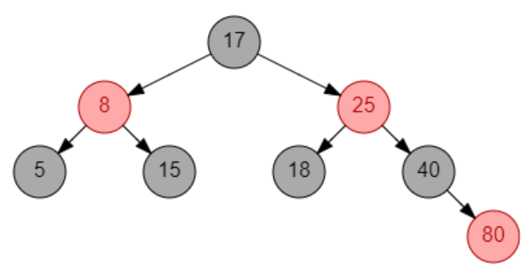
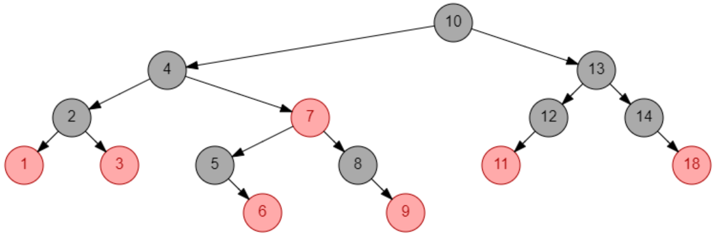
Example
Create red-black tree with following elements
  8, 18, 5, 15, 17, 25, 40, 80
  13, 3, 4, 12, 14, 10, 5, 1, 8, 2, 7, 9, 11, 6, 18

Slide 9
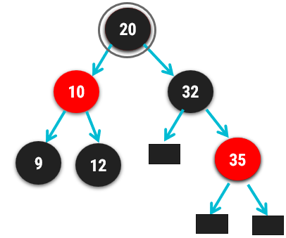
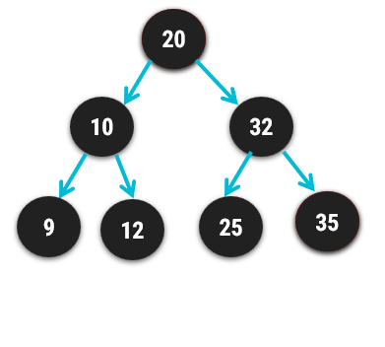
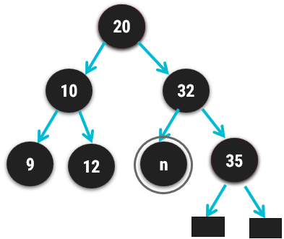
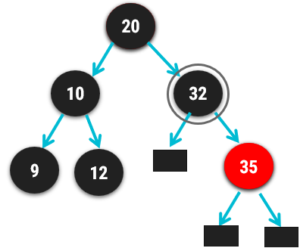
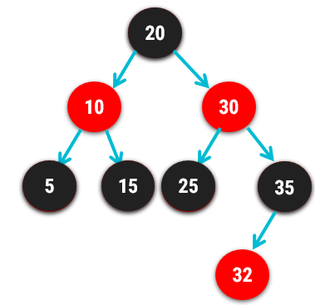
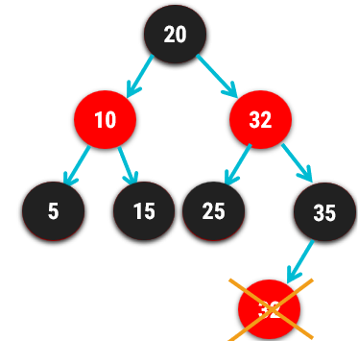
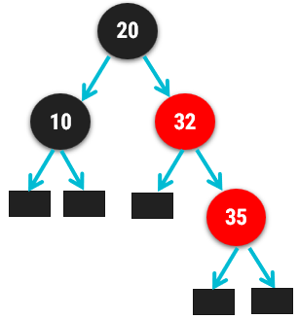
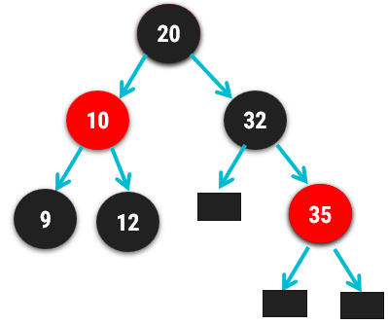
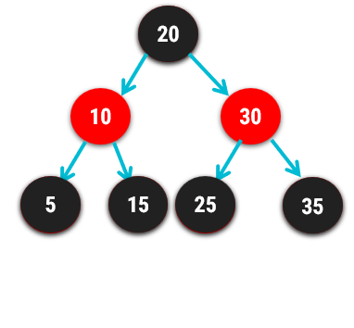
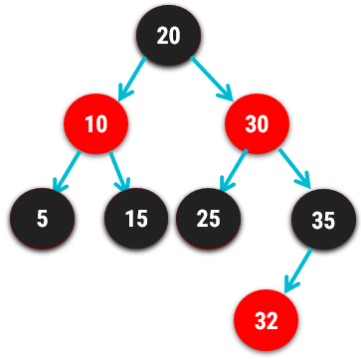
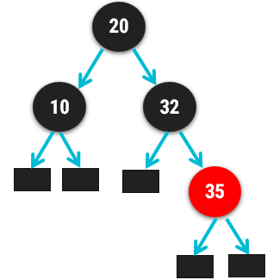
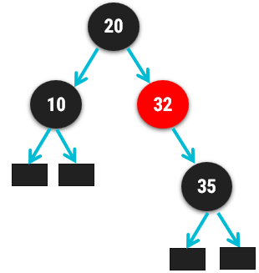
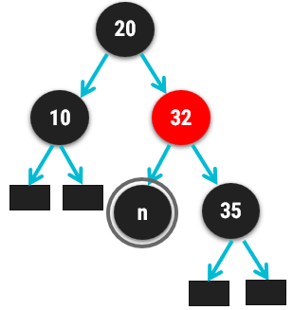
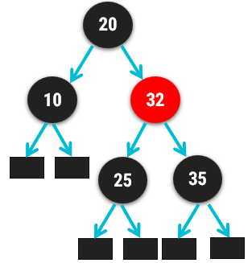
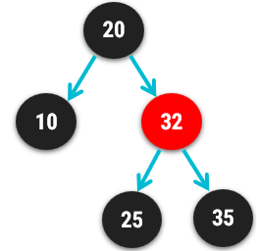
Deletion operation
Choose the node to be deleted as in BST
Perform the suitable case
  Case 1: if the node to be deleted is red, just delete it and exit
  Case 2: if DB is root, remove DB
  Case 3: if DB’s sibling is black and both nephews are also black
  (a) remove DB(if DB is null delete it, if DB is not null remove DB sign)
  (b) make sibling red
  (b) make DB’s parent black (if DB’s parent [ was black→ make it DB], if red → make it black), apply suitable case
Delete 32
Delete 30
Delete 25
Delete 25
Case 1
Case 3

Slide 10
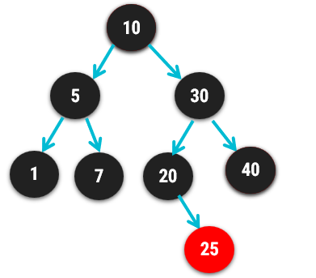
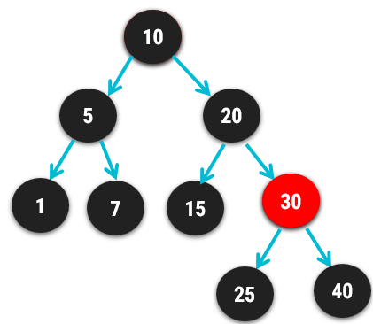
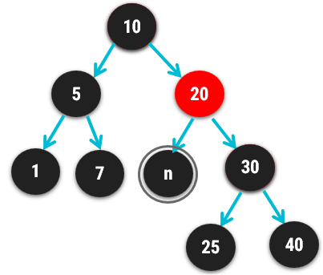
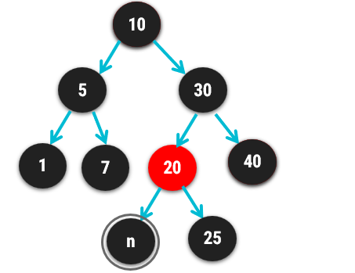
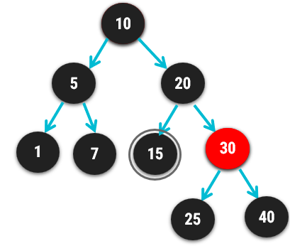
Deletion…continue
Delete 15
  Case 4: if DB’s sibling is red
    Swap colors of DB’s parent and DB’s sibling
    Rotate parents in DB’s direction
    Reapply the suitable case
Case 3

Slide 11
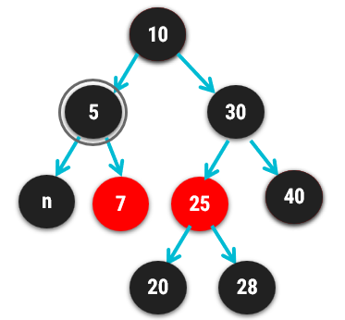
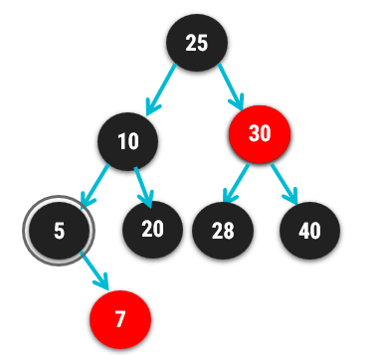
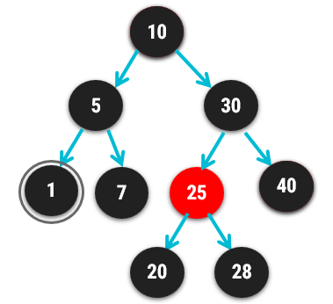
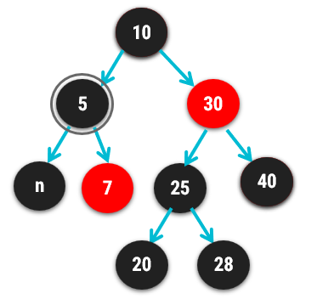
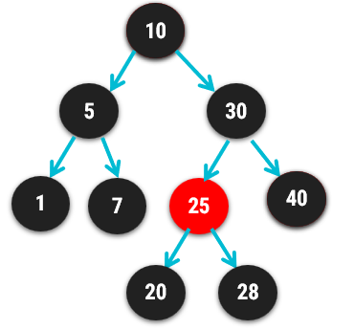
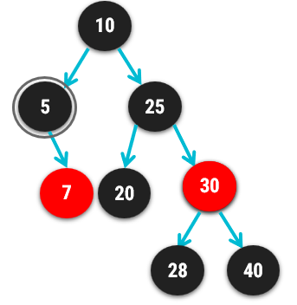
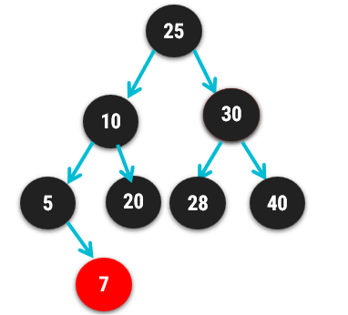
Deletion…continue
  Case 5: if DB’s sibling is black, near nephew is red and far nephew is black,
    Swap color’s of DB’s sibling and DB’s near nephew
    Rotate DB’s sibling in the opposite direction of DB
    Apply case 6
Delete 1
Case 3
Case 6
  Case 6: if DB’s sibling is black and far nephew is red
    Swap color of DB’s parent and DB’s sibling
    Rotate DB’s parent in DB’s direction
    Change color of red nephew to black
    Remove DB

Slide 12
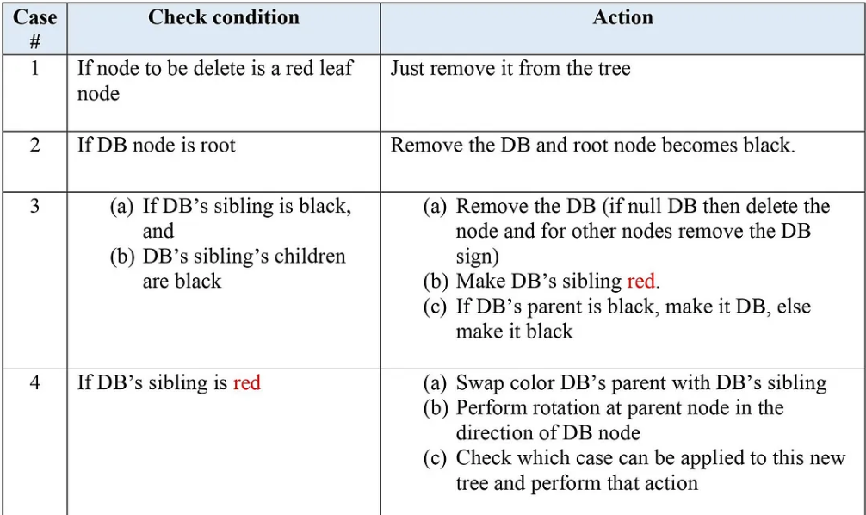
Summary

Slide 13
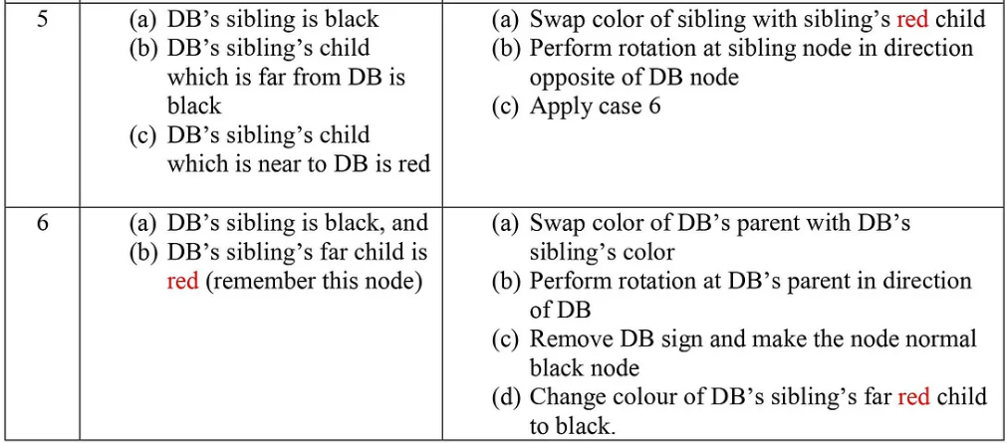
https://www.cs.csubak.edu/~msarr/visualizations/RedBlack.html

Slide 14
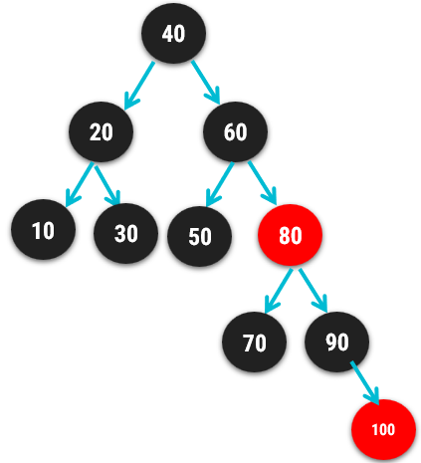
Exercise
Delete 50, 20, 100, 90, 40, 60, 30, 10, 17, 80

Slide 15
10
40
20
60
10
30
50
80
7
70
90
n
100

Slide 16
Heap & Heap Sort Algorithm

Slide 17
Introduction
A heap data structure is a binary tree with the following two properties.
  It is a complete binary tree: Each level of the tree is completely filled, except possibly the bottom level. At this level it is filled from left to right.
  It satisfies the heap order property: the data item stored in each node is greater than or equal to the data item stored in its children node.
a
a
9
9
b
c
b
c
6
7
6
7
d
e
f
d
e
f
2
4
8
2
4
1
Binary Tree but not a Heap
Complete Binary Tree - Heap
Not a Heap
Heap

Slide 18
Array Representation of Heap
Heap can be implemented using an Array.
An array 𝐴 that represents a heap is an object with two attributes:
  𝑙𝑒𝑛𝑔𝑡ℎ[𝐴], which is the number of elements in the array, and
  ℎ𝑒𝑎𝑝−𝑠𝑖𝑧𝑒[𝐴], the number of elements in the heap stored within array 𝐴
16
14
10
8
7
9
3
Array representation of heap
2
4
1
16
14
10
8
7
9
3
2
4
1
Heap

Slide 19

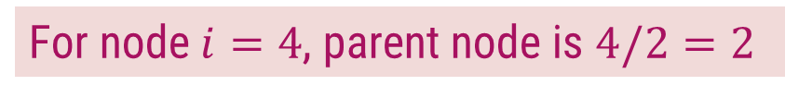









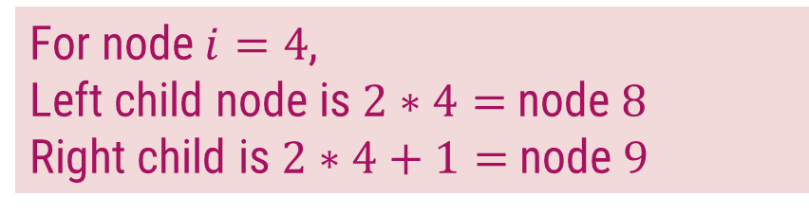
Array Representation of Heap
In the array 𝐴, that represents a heap
  length[𝐴] = heap-size[𝐴]
  For any node 𝒊 the parent node is 𝒊/𝟐
  For any node 𝒊, its left child is 𝟐𝒊 and right child is 𝟐𝒊 +𝟏
For node $i=4$, parent node is $4/2=2$
$$1$$
16
For node $i=4$,
Left child node is $2∗4=$node $8$
Right child is $2∗4+1=$node $9$
$$2$$
$$3$$
14
10
$$4$$
$$5$$
$$6$$
$$7$$
8
7
9
3
$$1$$ | $$2$$ | $$3$$ | $$4$$ | $$5$$ | $$6$$ | $$7$$ | $$8$$ | $$9$$ | $$10$$
$$8$$
$$9$$
$$10$$
14
8
2
4
2
4
1
16
14
10
8
7
9
3
2
4
1
Heap

Slide 20
Types of Heap
Max-Heap − Where the value of the root node is greater than or equal to either of its children.
9
6
7
2
4
1
1
Min-Heap − Where the value of the root node is less than or equal to either of its children.
2
4
6
7
9

Slide 21
Introduction to Heap Sort
Build the complete binary tree using given elements.
Create Max-heap to sort in ascending order.
Once the heap is created, swap the last node with the root node and delete the last node from the heap.
Repeat step 2 and 3 until the heap is empty.

Slide 22

Heap Sort – Example 1
Sort the following elements in Ascending order
4 | 10 | 3 | 5 | 1
Step 1 : Create Complete Binary Tree
4
$$1$$ | $$2$$ | $$3$$ | $$4$$ | $$5$$
4 | 10 | 3 | 5 | 1
10
3
Now, a binary tree is created and we have to convert it into a Heap.
5
1

Slide 23
Heap Sort – Example 1
Sort the following elements in Ascending order
4 | 10 | 3 | 5 | 1
Step 2 : Create Max Heap
4
10
10 is greater than 4
So, swap 10 & 4
$$1$$ | $$2$$ | $$3$$ | $$4$$ | $$5$$
4 | 10 | 3 | 5 | 1
10
4
10
3
4
Swap
In a Max Heap, parent node is always greater than or equal to the child nodes.
5
1

Slide 24
Heap Sort – Example 1
Sort the following elements in Ascending order
4 | 10 | 3 | 5 | 1
Step 2 : Create Max Heap
10
5 is greater than 4
So, swap 5 & 4
$$1$$ | $$2$$ | $$3$$ | $$4$$ | $$5$$
10 | 4 | 3 | 5 | 1
5
4
4
3
5
Swap
In a Max Heap, parent node is always greater than or equal to the child nodes.
5
1
4
Max Heap is created

Slide 25
Heap Sort – Example 1
Sort the following elements in Ascending order
4 | 10 | 3 | 5 | 1
Step 3 : Apply Heap Sort
10
1
$$1$$ | $$2$$ | $$3$$ | $$4$$ | $$5$$
10 | 5 | 3 | 4 | 1
1
10
5
3
Swap
Swap the first and the last nodes and
Delete the last node.
4
1
10

Slide 26
Heap Sort – Example 1
Sort the following elements in Ascending order
4 | 10 | 3 | 5 | 1
Step 3 : Apply Heap Sort
1
5
Max Heap Property is violated so, create a Max Heap again.
$$1$$ | $$2$$ | $$3$$ | $$4$$ | $$5$$
1 | 5 | 3 | 4 | 10
5
1
1
4
5
3
1
4
Swap
4
1

Slide 27
Heap Sort – Example 1
Sort the following elements in Ascending order
4 | 10 | 3 | 5 | 1
Step 3 : Apply Heap Sort
5
1
Max Heap is created
$$1$$ | $$2$$ | $$3$$ | $$4$$ | $$5$$
5 | 4 | 3 | 1 | 10
1
5
4
3
Swap
Swap the first and the last nodes and
Delete the last node.
1
5

Slide 28
Heap Sort – Example 1
Sort the following elements in Ascending order
4 | 10 | 3 | 5 | 1
Step 3 : Apply Heap Sort
1
Create Max Heap again
3
4
$$1$$ | $$2$$ | $$3$$ | $$4$$ | $$5$$
1 | 4 | 3 | 5 | 10
4
1
4
3
Max Heap is created
4
3
1
4
Swap
Swap the first and the last nodes and
Delete the last node.

Slide 29
Heap Sort – Example 1
Sort the following elements in Ascending order
4 | 10 | 3 | 5 | 1
Step 3 : Apply Heap Sort
3
Already a Max Heap
1
$$1$$ | $$2$$ | $$3$$ | $$4$$ | $$5$$
3 | 1 | 4 | 5 | 10
1
3
1
3
Swap
Swap the first and the last nodes and
Delete the last node.

Slide 30
Heap Sort – Example 1
Sort the following elements in Ascending order
4 | 10 | 3 | 5 | 1
Step 3 : Apply Heap Sort
1
Already a Max Heap
$$1$$ | $$2$$ | $$3$$ | $$4$$ | $$5$$
1 | 3 | 4 | 5 | 10
1
Remove the last element from heap and the sorting is over.

Slide 31
Heap Sort – Example 2
Sort given element in ascending order using heap sort. 19, 7, 16, 1, 14, 17
19 | 7 | 16 | 1 | 14 | 17
14
17
7
16
Step 1: Create binary tree
Step 2: Create Max-heap
19
19
7
16
7
16
14
17
1
14
17
1
14
17
7
16

Slide 32
Heap Sort – Example 2
Step 3
Step 4
19 | 14 | 17 | 1 | 7 | 16
16 | 14 | 17 | 1 | 7 | 19
16
19
17
16
19
16
Create Max-heap
16
17
Swap & remove the last element
14
17
14
17
16
1
7
16
1
7
19

Slide 33
Heap Sort – Example 2
Step 5
Step 6
17 | 14 | 16 | 1 | 7 | 19
7 | 14 | 16 | 1 | 17 | 19
7
17
16
7
17
7
Create Max-heap
7
16
Swap & remove the last element
14
16
14
16
7
1
7
1
17

Slide 34
Heap Sort – Example 2
Step 7
Step 8
16 | 14 | 7 | 1 | 17 | 19
1 | 14 | 7 | 16 | 17 | 19
1
16
14
1
16
1
Create Max-heap
1
14
Swap & remove the last element
14
7
14
7
1
1
16

Slide 35
Heap Sort – Example 2
Step 9
Step 10
14 | 1 | 7 | 16 | 17 | 19
7 | 1 | 14 | 16 | 17 | 19
7
14
1
7
14
7
Already a Max-heap
7
Swap & remove the last element
1
Swap & remove the last element
1
7
1
14
7
Step 11
1 | 7 | 14 | 16 | 17 | 19
1 | 7 | 14 | 16 | 17 | 19
1
Remove the last element
The entire array is sorted now.

Slide 36
Exercises
Sort the following elements using Heap Sort Method.
  34, 18, 65, 32, 51, 21
  20, 50, 30, 75, 90, 65, 25, 10, 40
Sort the following elements in Descending order using Hear Sort Algorithm.
  65, 77, 5, 23, 32, 45, 99, 83, 69, 81

Slide 37
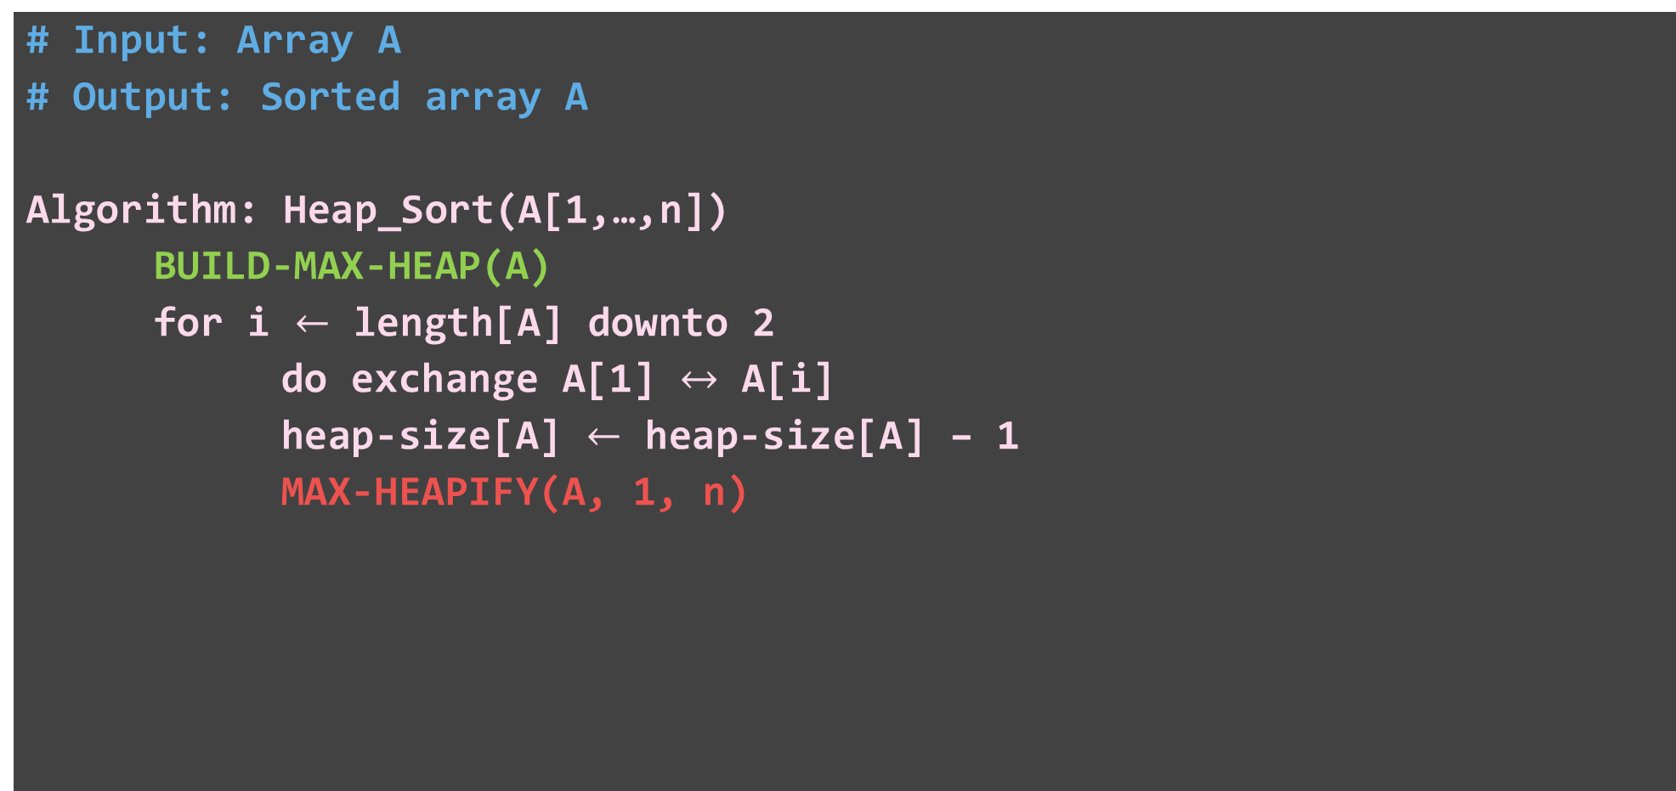
Heap Sort – Algorithm
# Input: Array A
# Output: Sorted array A
Algorithm: Heap_Sort(A[1,…,n])
BUILD-MAX-HEAP(A)
for i $←$ length[A] downto 2
do exchange A[1] $↔$ A[i]
heap-size[A] $←$ heap-size[A] – 1
MAX-HEAPIFY(A, 1, n)

Slide 38
Heap Sort – Algorithm
Algorithm: BUILD-MAX-HEAP(A)
heap-size[A] ← length[A]
for i ← ⌊length[A]/2⌋ downto 1
  do MAX-HEAPIFY(A, i)
4 | 1 | 3 | 2 | 9 | 7
1
4
2
3
1
3
4
5
6
heap-size[A] = 6
2
9
7
4 | 1 | 7 | 2 | 9 | 3
4 | 9 | 7 | 2 | 1 | 3
9 | 4 | 7 | 2 | 1 | 3
i = 3
1
4
i = 2
1
i = 1
1
4
4
9
2
3
2
3
2
3
1
3
7
9
7
7
1
9
4
4
5
6
4
5
6
4
5
6
2
9
7
2
9
3
2
1
3
3
1

Slide 39
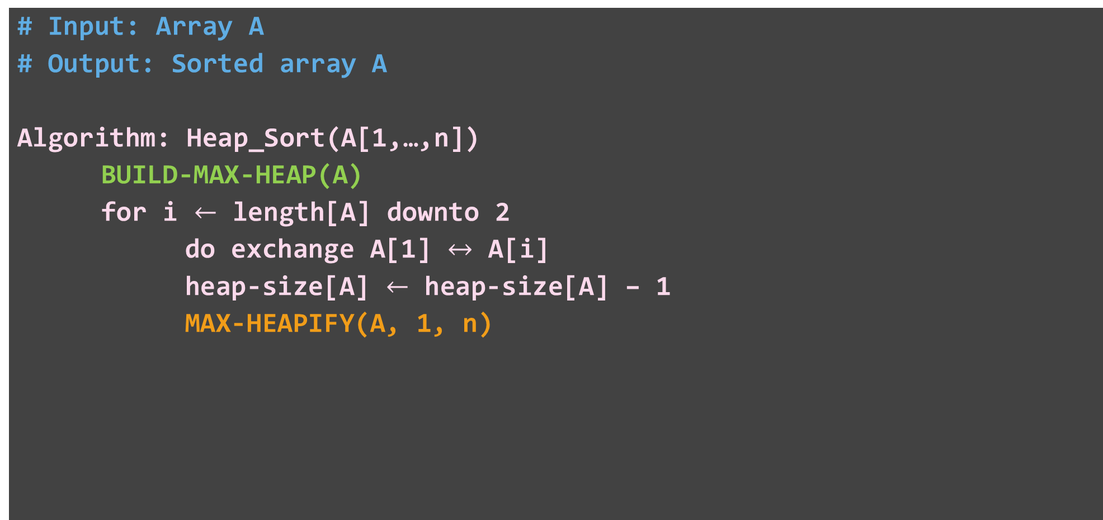
Heap Sort – Algorithm
# Input: Array A
# Output: Sorted array A
Algorithm: Heap_Sort(A[1,…,n])
BUILD-MAX-HEAP(A)
for i $←$ length[A] downto 2
do exchange A[1] $↔$ A[i]
heap-size[A] $←$ heap-size[A] – 1
MAX-HEAPIFY(A, 1, n)
3 | 4 | 7 | 2 | 1 | 9
9 | 4 | 7 | 2 | 1 | 3
1
9
2
3
4
7
4
5
6
2
1
3

Slide 40

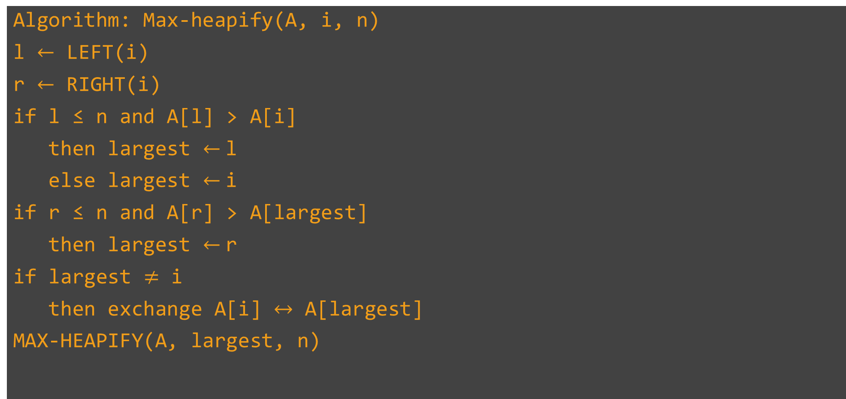



Heap Sort – Algorithm
Algorithm: Max-heapify(A, i, n)
l $←$ LEFT(i)
r $←$ RIGHT(i)
if l ≤ n and A[l] > A[i]
then largest $←$l
else largest $←$i
if r ≤ n and A[r] > A[largest]
then largest $←$r
if largest $≠$ i
then exchange A[i] $↔$ A[largest]
MAX-HEAPIFY(A, largest, n)
3 | 4 | 7 | 2 | 1 | 9
l $←$ 2
1
r $←$ 3
1
3
Yes
2
3
largest $←$ 2
4
7
4
5
Yes
2
1
largest $←$ 3
Yes

Slide 41
Heap Sort – Algorithm
# Input: Array A
# Output: Sorted array A
Algorithm: Heap_Sort(A[1,…,n])
BUILD-MAX-HEAP(A)
for i $←$ length[A] downto 2
do exchange A[1] $↔$ A[i]
heap-size[A] $←$ heap-size[A] – 1
MAX-HEAPIFY(A, 1, n)
3 | 4 | 7 | 2 | 1 | 9
1
7
2
3
4
3
4
5
2
1

Slide 42
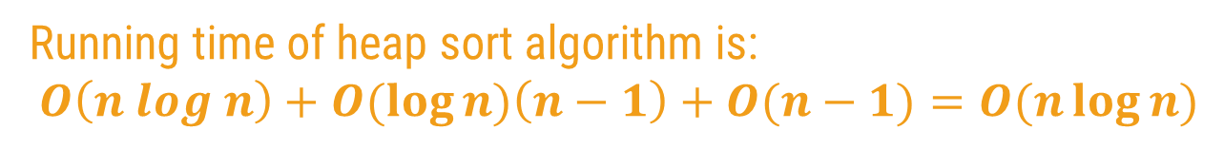



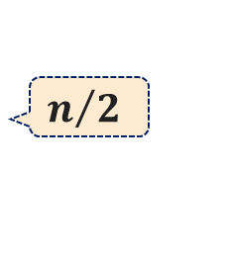

Heap Sort Algorithm – Analysis
# Input: Array A
# Output: Sorted array A
Algorithm: Heap_Sort(A[1,…,n])
BUILD-MAX-HEAP(A)
for i $←$ length[A] downto 2
do exchange A[1] $↔$ A[i]
heap-size[A] $←$ heap-size[A] – 1
MAX-HEAPIFY(A, 1, n)
heap-size[A] ← length[A]
for i ← ⌊length[A]/2⌋ downto 1
do MAX-HEAPIFY(A, i)
$$n/2$$
$$O(n log⁡n)$$
$$O( log⁡n)$$
$$n−1$$
$$O(n−1) (logn)$$
Running time of heap sort algorithm is:
$$O\left(n log n\right)+O(\log{n)\left(n−1\right)+O(n−1)=O(n\log{n)}}$$

Slide 43
Binomial Heap

Slide 44
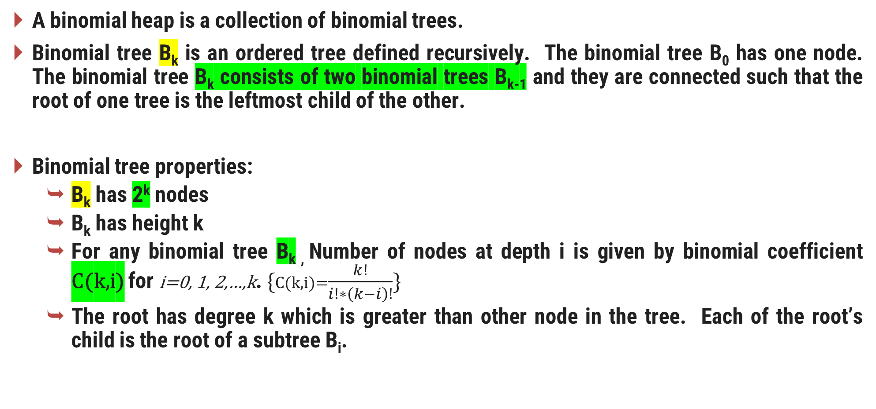
Binomial Tree
A binomial heap is a collection of binomial trees.
Binomial tree B_{k} is an ordered tree defined recursively. The binomial tree B₀ has one node. The binomial tree B_{k} consists of two binomial trees B_{k-1} and they are connected such that the root of one tree is the leftmost child of the other.
Binomial tree properties:
  B_{k} has 2^{k} nodes
  B_{k} has height k
  For any binomial tree B_{k ,} Number of nodes at depth i is given by binomial coefficient C(k,i) for i=0, 1, 2,…,k. {C(k,i)=$\frac{k!}{i!∗\left(k−i\right)!}$}
  The root has degree k which is greater than other node in the tree. Each of the root’s child is the root of a subtree B_{i}.

Slide 45
Binomial Tree Example
B₀
B₁
B₂
B₃
Depth i in B₃​:
Depth 0: C(3,0) = 1 node (the root).
Depth 1: C(3,1) =3 nodes.
Depth 2: C(3,2) =3 nodes.
Depth 3: C(3,3) =1 node (the deepest leaf node).
6
5
10
15
23
7
4
7
20
8
15
10
11
6
25
B₄
4
21
11
6
4
32
34
3
5
23
31
33
7
14
22
9

Slide 46
Binomial Heap Properties
Binomial heap(H) is a set of Binomial Trees.
Each binomial tree in H obeys the min heap property: key of a node is greater or equal to the key of its parent. The root has the smallest key in the tree.
There can be at most one Binomial Tree of any degree. {i.e. no two binomial tree of same degree}
The binomial trees in the binomial heap are arranged in increasing order of degree
Example:
head[H]
5
1
2
7
10
12
10
13
3
15
15
10
12
16

Slide 47
Binomial Heap Implementation
Each node has the following fields:
  p: parent
  child: leftmost child
  sibling
  Degree
  Key (data)
Roots of the trees are connected using linked list.

Slide 48
Binomial Heap Implementation
a)
p
c)
key
degree
child
sibling
NIL
NIL
2
1
0
2
head[H]
NIL
NIL
b)
10
12
head[H]
2
1
1
0
NIL
NIL
10
12
15
15
0
NIL
NIL

Slide 49
Binomial Heap Operations
Create heap
Find minimum key
Union two binomial heap
Insert a node
Extract minimum node
Decrease a key
Delete a node

Slide 50
Create A New Binomial Heap
The operation simply creates a new pointer and sets it to NIL.
Pseudocode:
  Binomial-Heap-Create()
  1 head[H] <- NIL
  2 return head[H]
Run time is θ(1).

Slide 51
Find Minimum Key
Since the binomial heap is a min-heap-order, the minimum key of each binomial tree must be at the root. This operation checks all the roots to find the minimum key.
Pseudocode: this implementation assumes that there are no keys with value ∞
  Binomial-Heap-Minimum(H)
  1 y <- NIL
  2 x <- head[H]
  3 min <- ∞
  4 while x is not NIL
  5 do if key[x] < min then
  6 min <- key[x]
  7 y <- x
  8 x <- sibling[x]
  9 return y
Run time: The run time is in the order of O(log n) since the most number of roots in binomial heap is |_(log n)_| +1

Slide 52
Find Minimum Key Example
a)
b)
head[H]
2
5
1
head[H]
2
5
1
7
10
12
7
10
12
15
15
c)
d)
head[H]
2
5
1
head[H]
2
5
1
7
10
12
7
10
12
15
15

Slide 53
Union Two Binomial Heaps
This operation consists of the following steps
  Merge two binomial heaps. The resulting heap has the roots in increasing order of degree
  For each tree in the binomial heap H, if it has the same order with another tree, link the two trees together such that the resulting tree obeys min-heap-order.
Case1: degree[x] ≠ degree[next-x].
The pointer move one position further down to the list.
Case2: degree[x] = degree[next-x] = degree[sibling[next-x]].
Again pointer move one position further down to the list, and next iteration executes either case 3 or case 4.
Case3: degree[x] = degree[next-x] ≠ degree[sibling[next-x]] and key[x] <= key[next-x].
We remove next-x from the root list and link to the x.
Case4: degree[x] = degree[next-x] ≠ degree[sibling[next-x]] and key[x] >= key[next-x].
We remove x from the root list and link it to next-x.

Slide 54
Union Two Binomial Heaps
a)
head[H1]
2
11
1
head[H2]
3
4
20
10
12
9
15
b)
head[H1]
2
3
11
4
1
20
9
10
12
15

Slide 55
Union Two Binomial Heaps
c)
head[H1]
2
4
1
3
11
9
10
12
20
15
d)
head[H1]
2
1
3
4
10
12
11
9
15
20

Slide 56
Union two Binomial Heap
  Binomial-Heap-Union(H1,H2)
  H <- Make-Binomial-Heap()
  Head[H] <- Binomial-Merge(H1,H2)
  Free the objects H1 and H2 but not the lists they point to
  If head[H] = NIL
  then return H
  Prev-x <-NIL
  X <- head[H]
  Next-x <- sibling[x]
  while next-x not NIL
  do if(degree[x] not degree[next-x]) or
  (sibling[next-x not NIL and degree[sibling[next-x]]=degree[x])
  then prev-x <-x
  x <- next-x
  else if key[x] <= key[next-x]
  then sibling[x] <- sibling[next-x]
  Binomial-Link(next-x,x)
  else if prev-x = NIL
  then head[H] <-next-x
  else sibling[prev-x] <- next-x
  Binomial-Link(x,next-x)
  x <- next-x
  next-x <- sibling[x]
  return H

Slide 57
Union Two Binomial Heaps
Pseudocode:
  Binomial-Link(y,z)
  1 p[y] <- z
  2 sibling[y] <- child[z]
  3 child[z] <- y
  degree[z] <- degree[z] + 1
Example: link node 5 to node 1
5
1
1
7
12
5
12
child
parent
7
sibling

Slide 58
Union Two Binomial Heaps
Binomial-Heap-Merge(H1,H2)
  P ← Head[H];
  P1 ← Head[H1];
  P2 ← Head[H2]
  while P1 ≠ NIL OR P2 ≠ NIL do
  if degree[P1] < degree[P2] then
  sibling [P]← P1;
  P1 ← sibling[P1]
  P<-sibling[p]
  else
  sibling[P] ← P2;
  P2 ← sibling[P2]
  P<-sibling[p]
Run time: The running time is O (log n)
The total number of combined roots is at most |_logH1_| + |_logH2_| +2. Binomial-Heap-Merge is O (log n) + the while loop is O (log n). Thus, the total time is O(log n).

Slide 59
Insert New Node
Create a new heap H’ and set head[H’] to the new node.
Union the new heap H’ with the existing heap H.
Pseudocode:
  Binomial-Heap-Insert(H,x)
  H’ <- Make-Binomial-Heap()
  p[x] <- NIL
  child[x] <- NIL
  sibling[x] <- NIL
  degree[x] <- 0
  head[H’] <- x
  H <- Binomial-Heap-Union(H,H’)
Run time: O(log n)

Slide 60
Insert New Node Example
New node:
5
head[H]
1
head[H’]
5
10
12
15
head[H]
5
1
10
12
15

Slide 61
Insert 4, 6, 3, 11, 9, 5, 14, 10, 21, 7, 13, 20, 2

Slide 62
Extract Node With Minimum Key
This operation is started by finding and removing the node x with minimum key from the binomial heap H. Create a new binomial heap H’ and set to the list of x’s children in the reverse order. Unite H and H’ to get the resulting binomial heap.
Pseudocode
Binomial-Heap-Extract-Min(H)
1 find the root x with the minimum key in the root list of H,
and remove x from the root list of H.
2 H’ <- Make-Binomial-Heap()
3 reverse the order of the linked list of x’s children,
and set head[H’] to point to the head of the resulting list.
4 H <- Binomial-Heap-Union(H,H’)
5 Return x
Run time: O(log n)

Slide 63
Extract Minimum Key Example
head[H]
5
1
2
7
10
12
10
12
3
15
15
10
12
15
head[H]
5
2
1
7
10
12
10
12
3
15
15
10
12
15

Slide 64
Extract Minimum Key Example
head[H]
5
2
head[H’]
12
10
7
10
12
15
2
10
12
15
15
head[H]
12
5
2
10
7
10
12
2
15
15
10
12
15

Slide 65
Decreasing a key
The current key is replaced with a new key. To maintain the min-heap property, it is then compared to the key of the parent. If its parent’s key is greater then the key and data will be exchanged. This process continues until the new key is greater than the parent’s key or the new key is in the root.
Pseudocode:
  Binomial-Heap-Decrease-Key(H,x,k)
  1 if k > key[x]
  2 then error “new key is greater than current key”
  3 key[x] <-k
  4 y <-x
  5 z <-p[y]
  6 while z not NIL and key[y] < key[z]
  7 do exchange key[y] <-> key[z]
  8 if y and z have satellite fields, exchange them, too.
  9 y <- z
  10 z <- p[y]

Slide 66
Decreasing a key
Execution time: This procedure takes O(log n) since the maximum depth of x is |_log n_|.
head[H]
5
2
head[H]
5
2
10
12
10
12
15
1
head[H]
5
2
head[H]
5
1
1
12
2
12
10
10

Slide 67
Delete a Node
With assumption that there is no node in H has a key of -∞.
The key of deleting node is first decreased to -∞.
This node is then deleted using extracting min procedure.
Pseudocode: (from book)
Binomial-Heap-Delete(H,x)
1 Binomial-Heap-Decrease-Key(H,x,-∞)
2 Binomial-Heap-Extract-Min(H)
Run time: O(log n) since the run time of both Binomial-Heap-Decrease-Key and Binomial-Heap-Extract-Min procedures are in order of O(log n).

Slide 68
Example
a)
b)
head[H]
5
2
head[H]
5
2
10
12
-∞
12
15
15
c)
d)
head[H]
5
-∞
head[H]
5
2
12
head[H’]
12
2
15
15

Slide 69
e)
f)
head[H]
5
12
2
head[H]
5
2
15
12
15
g)
head[H]
2
5
15
12

Slide 70
Compare With Binary Heap
Procedure | Binomial Heap | Binary Heap
Make-Heap | O (1) | O (1)
Insert | O (log n) | O (log n)
Minimum | O (log n) | O (1)
Extract-Min | O (log n) | O (log n)
Union | O (log n) | O (n)
Decrease-Key | O (log n) | O (log n)
Delete | O (log n) | O (log n)

Slide 71
Fibonacci Heap
Heaps are mainly used for implementing priority queue. We have discussed below heaps:
Binary Heap
Binomial Heap
In terms of Time Complexity, Fibonacci Heap beats both Binary and Binomial Heaps.
1) Find Min: Θ(1) [Same as both Binary and Binomial]
2) Delete Min: O(Log n) [Θ(Log n) in both Binary and Binomial]
3) Insert: Θ(1) [Θ(Log n) in Binary and Θ(1) in Binomial]
4) Decrease-Key: Θ(1) [Θ(Log n) in both Binary and Binomial]
5) Merge: Θ(1) [Θ(m Log n) or Θ(m+n) in Binary and Θ(Log n) in Binomial]

Slide 72
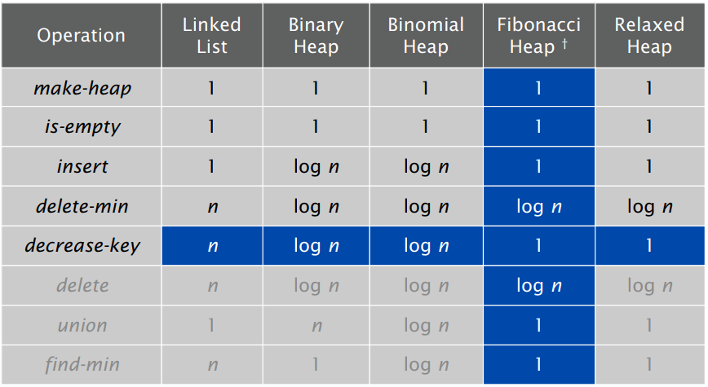
Priority Queues Performance Cost Summary

Slide 73
Original motivation: improve Dijkstra's shortest path algorithm from O(E log V ) to O(E + V log V ).
Basic idea.
  Similar to binomial heaps, but less rigid structure.
  Binomial heap: eagerly consolidate trees after each insert.
  Fibonacci heap: lazily defer consolidation until next delete-min.
Fibonacci Heap is a collection of trees with min-heap or max-heap property. In Fibonacci Heap, trees can have any shape even all trees can be single nodes (This is unlike Binomial Heap where every tree has to be Binomial Tree).

Slide 74
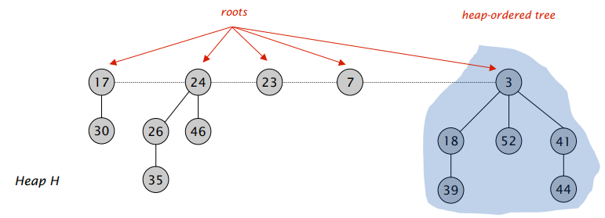
Fibonacci Heaps: Structure
Fibonacci heap.
  Set of heap-ordered trees. (each parent larger than its children)
  Maintain pointer to minimum element.
  Set of marked nodes

Slide 75
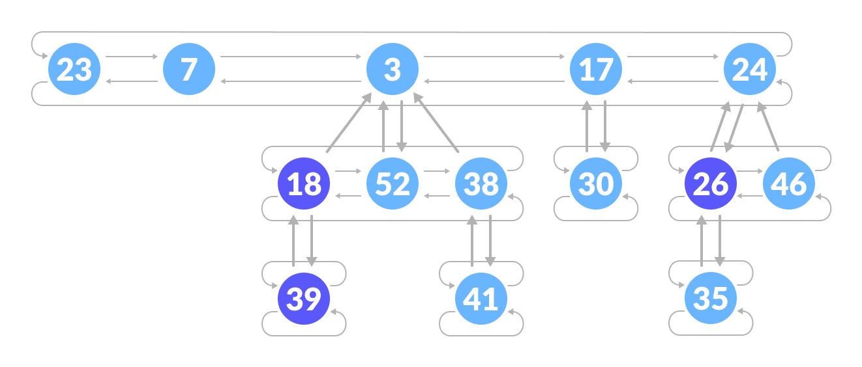
Memory Representation of the Nodes in a Fibonacci Heap
The roots of all the trees are linked together for faster access. The child nodes of a parent node are connected to each other through a circular doubly linked list as shown below.
In Fibonacci heap, each tree of degree n has atleast F_{n+2} nodes in it.{}
There are two main advantages of using a circular doubly linked list.
  Deleting a node from the tree takes O(1) time.
  The concatenation of two such lists takes O(1) time.
p
key
degree
L-sibling
R-sibling
mark
Any child
Mark(18) = 1 (lost one of its children)
Mark(38) = 0 (lost no chilld)

Slide 76
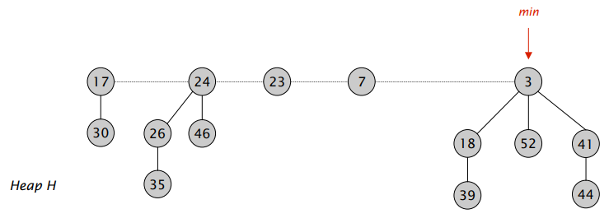
Fibonacci Heaps: Structure
Fibonacci heap.
  Set of heap-ordered trees. (each parent larger than its children)
  Maintain pointer to minimum element. (find-min takes O(1) time)
  Set of marked nodes

Slide 77
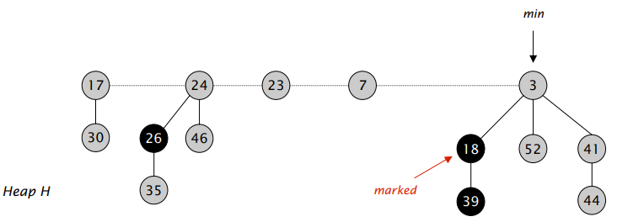
Fibonacci Heaps: Structure
Fibonacci heap.
  Set of heap-ordered trees. (each parent larger than its children)
  Maintain pointer to minimum element.
  Set of marked nodes

Slide 78
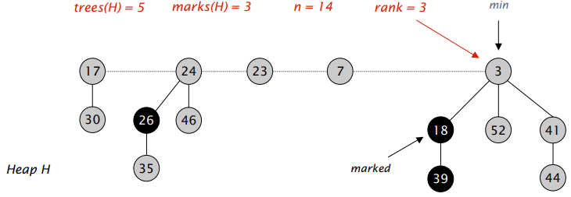
Fibonacci heap: Notations
Notation.
  n = number of nodes in heap.
  rank(x) or degree(x) = number of children of node x.
  rank(H) = max rank of any node in heap H.
  trees(H) = number of trees in heap H.
  marks(H) = number of marked nodes in heap H

Slide 79
Fibonacci heap operation
Insert
Link
Delete min
Decrease Key
Union
Delete

Slide 80
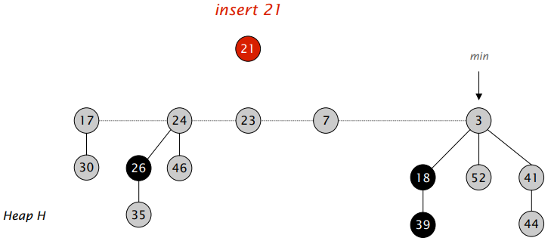
1. Fibonacci Heaps: Insert
Insert.
  Create a new singleton tree.
  Add to root list(left child of min[h]); update min pointer (if necessary).

Slide 81
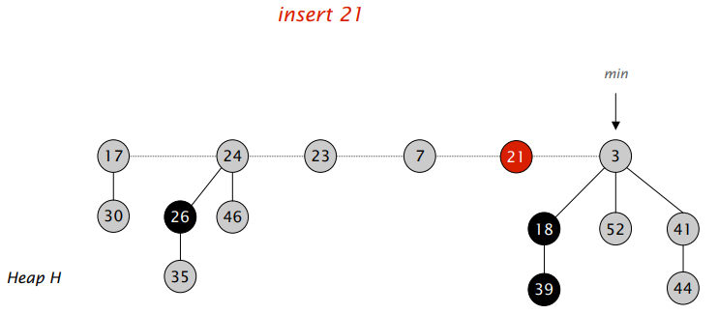
Insert => O(1)
Insert.
  Create a new singleton tree.
  Add to root list (left child of min[h]); update min pointer (if necessary).

Slide 82
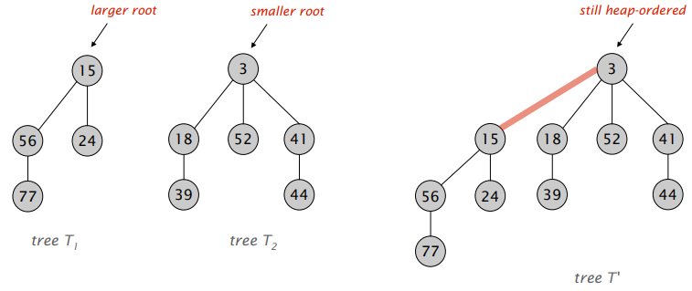
2. Fibonacci Heap: Linking Operation
Linking operation: Make larger root be a child of smaller root.

Slide 83

3. Fibonacci Heaps: Delete Min
Delete min.
  Delete min; meld its children into root list; update min.
  Consolidate trees so that no two roots have same rank.

Slide 84

Delete Min
Delete min.
  Delete min; meld its children into root list; update min.
  Consolidate trees so that no two roots have same rank.

Slide 85














Delete Min
Delete min.
  Delete min; meld its children into root list; update min.
  Consolidate trees so that no two roots have same rank.

Slide 86

4. Fibonacci Heaps: Decrease Key
Intuition for deceasing the key of node x.
  If heap-order is not violated, just decrease the key of x.
  Otherwise, cut tree rooted at x and meld into root list.
  To keep trees flat: as soon as a node has its second child cut, cut it off and meld into root list (and unmark it).

Slide 87

Decrease Key
Case 1. [heap order not violated]
  Decrease key of x.
  Change heap min pointer (if necessary).

Slide 88

Decrease Key
Case 2a. [heap order violated]
  Decrease key of x.
  Cut tree rooted at x, meld into root list, and unmark.
  If parent p of x is unmarked (hasn't yet lost a child), mark it;
  Otherwise, cut p, meld into root list, and unmark (and do so recursively for all ancestors that lose a second child)

Slide 89


Decrease Key
Case 2a. [heap order violated]
  Decrease key of x.
  Cut tree rooted at x, meld into root list, and unmark.
  If parent p of x is unmarked (hasn't yet lost a child), mark it;
  Otherwise, cut p, meld into root list, and unmark (and do so recursively for all ancestors that lose a second child)

Slide 90

Decrease Key
Case 2a. [heap order violated]
  Decrease key of x.
  Cut tree rooted at x, meld into root list, and unmark.
  If parent p of x is unmarked (hasn't yet lost a child), mark it;
  Otherwise, cut p, meld into root list, and unmark (and do so recursively for all ancestors that lose a second child)

Slide 91

Decrease Key
Case 2b. [heap order violated]
  Decrease key of x.
  Cut tree rooted at x, meld into root list, and unmark.
  If parent p of x is unmarked (hasn't yet lost a child), mark it; Otherwise, cut p, meld into root list, and unmark (and do so recursively for all ancestors that lose a second child).

Slide 92

Decrease Key
Case 2b. [heap order violated]
  Decrease key of x.
  Cut tree rooted at x, meld into root list, and unmark.
  If parent p of x is unmarked (hasn't yet lost a child), mark it; Otherwise, cut p, meld into root list, and unmark (and do so recursively for all ancestors that lose a second child).

Slide 93




Decrease Key
Case 2b. [heap order violated]
  Decrease key of x.
  Cut tree rooted at x, meld into root list, and unmark.
  If parent p of x is unmarked (hasn't yet lost a child), mark it; Otherwise, cut p, meld into root list, and unmark (and do so recursively for all ancestors that lose a second child).

Slide 94


5. Fibonacci Heaps: Union
Union Combine two Fibonacci heaps.

Slide 95
6. Fibonacci Heaps: Delete
Delete node x.
decrease-key of x to ∞
delete-min element in heap.

Slide 96
Disjoint set data structure
What is a Disjoint set data structure?
  Two sets are called disjoint sets if they don’t have any element in common, the intersection of sets is a null set

Slide 97
Disjoint set data structure
  Consider a situation with a number of persons and the following tasks to be performed on them:
  Add a new friendship relation, i.e. a person x becomes the friend of another person y i.e adding new element to a set.
  Find whether individual x is a friend of individual y (direct or indirect friend)
We are given 10 individuals say, a, b, c, d, e, f, g, h, i, j
Following are relationships to be added:
a <-> b , b <-> d , c <-> f, c <-> I, j <-> e, g <-> j
Given queries like whether a is a friend of d or not. We basically need to create following 4 groups and maintain a quickly accessible connection among group items:
G1 = {a, b, d}
G2 = {c, f, i}
G3 = {e, g, j}
G4 = {h}

Slide 98
Find whether x and y belong to the same group or not, i.e. to find if x and y are direct/indirect friends.
Partitioning the individuals into different sets according to the groups in which they fall. This method is known as a Disjoint set Union which maintains a collection of Disjoint sets and each set is represented by one of its members.
To answer the above question two key points to be considered are:
  How to Resolve sets? Initially, all elements belong to different sets. After working on the given relations, we select a member as a representative. There can be many ways to select a representative, a simple one is to select with the biggest index.
  Check if 2 persons are in the same group? If representatives of two individuals are the same, then they’ll become friends.

Slide 99
A disjoint–set is a data structure that keeps track of a set of elements partitioned into several disjoint (non-overlapping) subsets. Operations on Disjoint set are:
Find: It determines in which subset a particular element is in and returns the representative of that particular set. An item from this set typically acts as a “representative” of the set.
Union: It merges two different subsets into a single subset, and the representative of one set becomes representative of another.
The disjoint–set also supports one other important operation called MakeSet, which creates a set containing only a given element in it.

Slide 100
How to Implement Disjoint Sets?
Disjoint–set forests are data structures where each set is represented by a tree data in which each node holds a reference to its parent and the representative of each set is the root of that set’s tree.
  Find follows parent nodes until it reaches the root.
  Union combines two trees into one by attaching one tree’s root into the root of the other.

Slide 101

Example
  For example, consider five disjoint sets S1, S2, S3, S4, and S5 represented by a tree. Each set initially contains only one element each, so their parent pointer points to itself or NULL.
  S1 = {1}, S2 ={2}, S3 = {3}, S4 ={4} and S5 = {5}
  The Find operation on element i will return representative of S^{i}, where 1 <= i <= 5, i.e., Find(i) = i.

Slide 102

If we do Union (S3, S4), S3 and S4 will be merged into one disjoint set, S3. Now,
S1 = {1}, S2 ={2}, S3 = {3, 4} and S5 = {5}.
Find(4) will return representative of set S3, i.e., Find(4) = 3

Slide 103

If we do Union (S1, S2), S1 and S2 will be merged into one disjoint set, S1. Now,
S1 = {1, 2}, S3 = {3, 4} and S5 = {5}.
Find(2) or Find(1) will return the representative of set S1, i.e., Find(2) = Find(1) = 1

Slide 104

If we do Union (S3, S1), S3 and S1 will be merged into one disjoint set, S3. Now,
S3 = {1, 2, 3, 4} and S5 = {5}.

Slide 105

Implementation

Slide 106
Complexity analysis
Find – The time complexity of the Find operation is O(n) in the worst case (consider the case when all the elements are in the same set and we need to find the parent of a given element then we may need to make n recursive calls).
Union - For the union query (say Union(u, v)) we need to find the parents of u and v making its time complexity O(n).
This approach is not much efficient, so to get the full-fledged advantage of Disjoint Set Union we will look for some minor modifications that can make our code efficient.

Slide 107

Optimization-1: Path compression
Let u be a node and p be its parent. When we are finding parent of u recursively, we are also finding parent of all those intermediate nodes which we visit in the path u → p.
The trick here is to shorten the path to the parent of all those intermediate nodes by directly connecting them to the leader of the set.
You can see that in the process of finding the parent of node 8 we have attached all the intermediate nodes to 1.

Slide 108
To achieve this, we just need to modify our find function a bit and that minor modification is - During the recursive call of finding parent of parent[u] we will also pass the result to parent[u] (please refer to the last line of underlying pseudocode for better understanding)
This is firstly finding the root of the set and in the process of stack unwinding, we are attaching all the intermediate nodes to their representative. Yes by modifying that line we reduced the time complexity from O(n) to O(log(n))
Find(u):
If(parent[u]==u):
return u
return parent[u]=Find(parent[u])

Slide 109

Optimization-2: Union by size
In this optimization we will change the union_set operation. To be precise, we will change which tree gets attached to the other one. In the naive implementation the second tree always got attached to the first one. In practice that can lead to trees containing chains of length O(n) .
With this optimization we will avoid this by choosing very carefully which tree gets attached.
Time complexity: O(logn)

Slide 110
if we combine both optimizations - path compression with union by size - we will reach nearly constant time queries. It turns out, that the final amortized time complexity is O(α(n)) , where α(n) is the inverse Ackermann function, which grows very slowly. In fact it grows so slowly, that it doesn't exceed 4 for all reasonable n (approximately n < 10⁶⁰⁰ ).
Amortized complexity is the total time per operation, evaluated over a sequence of multiple operations. The idea is to guarantee the total time of the entire sequence, while allowing single operations to be much slower then the amortized time. E.g. in our case a single call might take log n in the worst case, but if we do m such calls back to back we will end up with an average time of α(n)

Slide 111
Applications of Disjoint Set
It is used to find Cycle in a graph as in Kruskal's algorithm, DSUs are used.
Checking for connected components in a graph.
Searching for connected components in an image.

Slide 112
Median-of-median finding Algorithm
Median-finding algorithms (also called linear-time selection algorithms) use a divide and conquer strategy to efficiently compute the i^{th} smallest number in an unsorted list of size n, where i is an integer between 1 and n.
Given an array A = [1,...,n] of n numbers and an index i, where 1 ≤ i ≤ n, find the i^{th} smallest element of A. {n/2th element}.
Solution1: This problem can certainly be solved using a sorting algorithm to sort a list of numbers and return the value of n/2th index. But naïve approach will take O(n log n) to sort the array first and get the median.
Solution2: Another solution to solve the problem in O(n) time, which is based on Quick sort algorithm.

Slide 113
1. Choose a pivot
  Re-arrange smaller number in the left and greater number in the right to the pivot element
  Check if the pivot index if median
  If pivot index is less than median index, recursively search for the median in the right sub array.
  If pivot index is greater than median index, recursively search for the median in the left sub array.
In worst case the pivot divides the array in 1 and n-1 element, which eventually forms a chain and takes O(n²)

Slide 114
Median-of-median ( A, i )
  Divide the list into sublists each of length five (if there are fewer than five elements available for the last list, that is fine)
  Sort each sublist and determine the median.(Sorting very small lists takes linear time since these sublists have five elements, and this takes O(n) time.)
  Use the median-of-median algorithm to recursively determine the median of the set of all the medians
  Use this median as the pivot element, x. The pivot is an approximate median of the whole list and then each recursive step approximate the correct true median

Slide 115
Example:
A=[25, 21, 98, 100, 76, 22, 43, 60, 89, 87]
First, we break the list into lists of five elements:
A₁ = [25,21,98,100,76] and A₂=[22,43,60,89,87]
Sort each list:
A₁ = [21,25,76,98,100 ] and A₂ = [22,43,60,87,89]
Then, get the median out of each list and put them in a list of medians, M: = [76, 60]
Sort this: M = [60,76], pick median 2/2=1 => M[1]=76
Use this as the pivot element and put all elements in A that are less than 76 to the left and all elements greater than 76 to the right:
A = [25,22,43,60,21,76,100,89,87,98].
Find the index of 76, which is 5, median =>76

Slide 116
Thank You!

