Slide 1
Greedy Algorithms
Source: Internet, reference books, NPTEL

Slide 2

Outline
  General Characteristics of greedy algorithms
  Elements of Greedy Strategy
  Make change Problem
  Minimum Spanning trees (Kruskal’s algorithm, Prim’s algorithm)
  The Knapsack Problem
  Job Scheduling Problem
  Huffman code
Looping

Slide 3
Characteristics of Greedy Algorithms
Greedy : always makes the choice that seems to be the best at that moment
Greedy algorithms are characterized by the following features.
  Greedy approach forms a set or list of candidates 𝑪.
  Once a candidate is selected in the solution, it is there forever: once a candidate is excluded from the solution, it is never reconsidered.
  To construct the solution in an optimal way, Greedy Algorithm maintains two sets.
  One set contains candidates that have already been considered and chosen, while the other set contains candidates that have been considered but rejected.
The greedy algorithm consists of four functions.
  Selection Function:- The selection function tells which of the candidates is the most promising.
  Feasible Function:- A function that checks the feasibility of the candidate.(Used to determine whether a candidate can be used to contribute to the solution)
  Objective Function:- An objective function, used to assign a value to a solution or a partial solution
  Solution Function:- A function that checks whether a complete solution has been reached.

Slide 4
Some common algorithms and protocols that use a greedy approach are:
Prim-Jarnik's and Kruskal's Minimal Spanning Tree (MST) algorithms
Djikstra's Shortest Path algorithm
Activity selection problem
Huffman Coding (used for lossless data compression)
Open-Shortest-Path-First routing protocol (it uses Djikstra's algorithm)
Graph - Map Coloring
Knapsack Problem
Job Scheduling Problem

Slide 5
Pseudo code of Greedy Algorithm
Algorithm Greedy (a, n)
{
Solution : = 0;
for i = 0 to n do
{
x: = select(a);
if feasible(solution, x)
{
Solution: = union(solution , x)
}
return solution;
}
}

Slide 6
Coin Change Problem

Slide 7
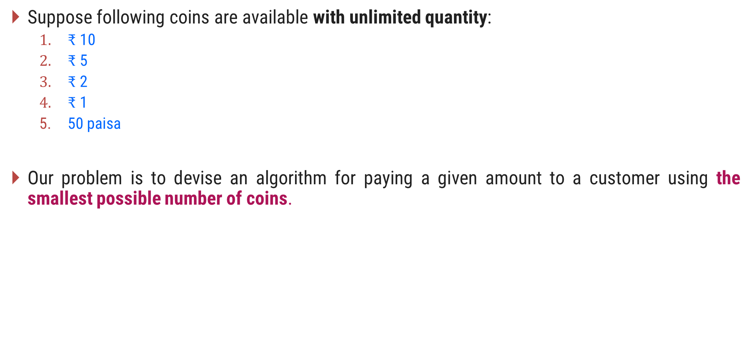
Problem Definition
Suppose following coins are available with unlimited quantity:
  $₹$ 10
  $₹$ 5
  $₹$ 2
  $₹$ 1
  50 paisa
Our problem is to devise an algorithm for paying a given amount to a customer using the smallest possible number of coins.

Slide 8

Make Change – Greedy Solution
If suppose, we need to pay an amount of $₹$ 28/- using the available coins.
Here we have a candidate (coins) set $C = \{10, 5, 2, 1, 0.5\}$
The greedy solution is,
Selected coins are
Amount
Total required coins = 5
Selected coins = {10, 5, 2, 1}
coins
quantity
0
20
25
27
28
10
2
5
1
2
1
1
1

Slide 9
Make Change - Algorithm
# Input: C = {10, 5, 2, 1, 0.5} //C is a candidate set
# Output: S: set of selected coins
Function make-change(n): set of coins
S ← Ø {S is a set that will hold the solution}
sum ← 0 {sum of the items in solution set S}
while sum ≠ n do
  x ← the largest item in C such that sum + x ≤ n
  if there is no such item then
    return "no solution found"
  S ← S U {a coin of value x}
  sum ← sum + x
return S

Slide 10
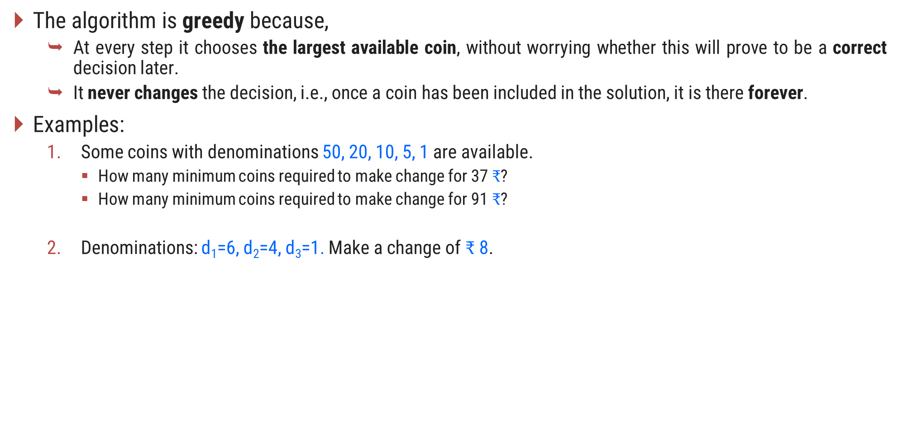
Make Change – The Greedy Property
The algorithm is greedy because,
  At every step it chooses the largest available coin, without worrying whether this will prove to be a correct decision later.
  It never changes the decision, i.e., once a coin has been included in the solution, it is there forever.
Examples:
  Some coins with denominations 50, 20, 10, 5, 1 are available.
    How many minimum coins required to make change for 37 $₹$?
    How many minimum coins required to make change for 91 $₹$?
  Denominations: d₁=6, d₂=4, d₃=1. Make a change of $₹$8.
5
4
3
The minimum coins required are
2

Slide 11
Knapsack Problem

Slide 12
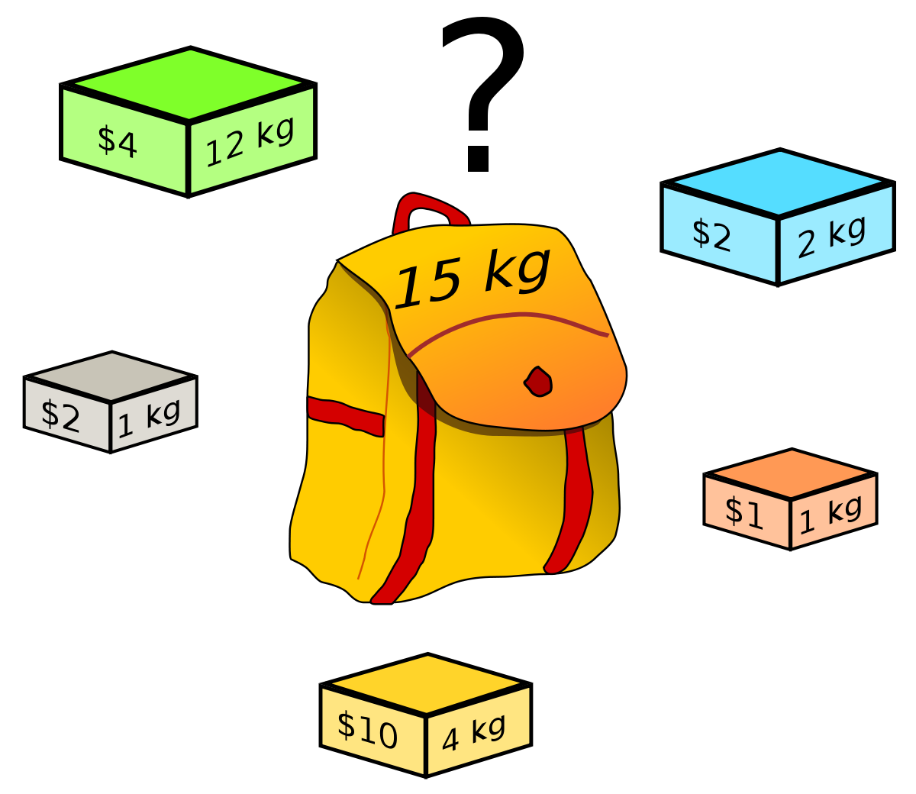
Knapsack Problem

Slide 13
Fractional Knapsack Problem

Slide 14
Introduction
We are given $n$ objects and a knapsack.
Object $i$ has a positive weight $w_{i}$and a positive value $v_{i}$ for $i = 1, 2… n.$
The knapsack can carry a weight not exceeding $W$.
Our aim is to fill the knapsack in a way that maximizes the value of the included objects, while respecting the capacity constraint.
In a fractional knapsack problem, we assume that the objects can be broken into smaller pieces.
So we may decide to carry only a fraction $x_{i}$of object $i$, where $0≤x_{i}≤1.$
In this case, object $i$ contribute $x_{i}w_{i}$ to the total weight in the knapsack, and $x_{i}v_{i}$ to the value of the load.
Symbolic Representation of the problem can be given as follows:
maximize $\sum_{i=1}^{n}{x\text{i}}v\text{i}$ subject to $\sum_{i=1}^{n}{x\text{i}}w\text{i}$ $≤W$
Where$, v_{i}>0$, $wi>0$and $0≤x_{i}≤1$for $1≤ i≤n$.

Slide 15
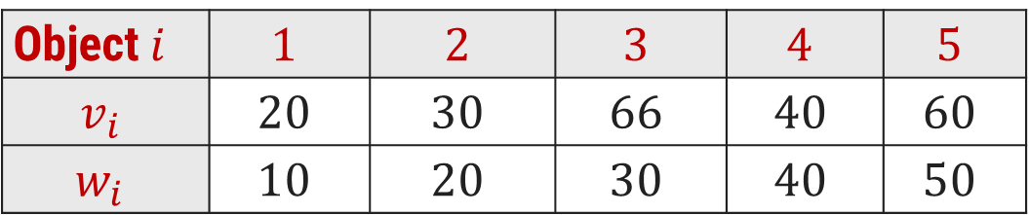
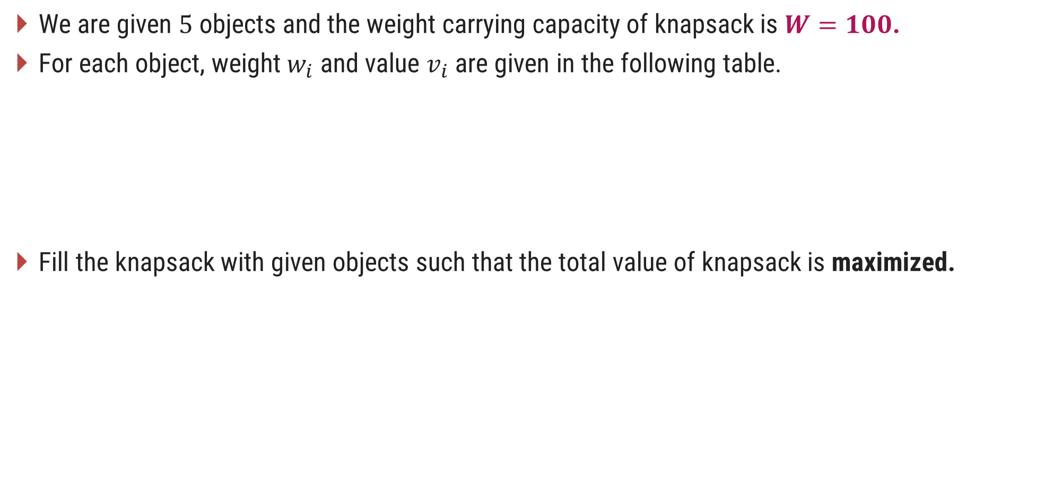
Fractional Knapsack Problem - Example
We are given $5$ objects and the weight carrying capacity of knapsack is $W=100$.
For each object, weight $w_{i}$ and value $v_{i}$are given in the following table.
Fill the knapsack with given objects such that the total value of knapsack is maximized.
Object$i$ | $$1$$ | $$2$$ | $$3$$ | $$4$$ | $$5$$
$$v_{i}$$ | $$20$$ | $$30$$ | $$66$$ | $$40$$ | $$60$$
$$w_{i}$$ | $$10$$ | $$20$$ | $$30$$ | $$40$$ | $$50$$

Slide 16
Fractional Knapsack Problem - Greedy Solution
Three Selection Functions can be defined as,
  Sort the items in descending order of their values and select the items till weight criteria is satisfied.
  Sort the items in ascending order of their weight and select the items till weight criteria is satisfied.
  To calculate the ratio value/weight for each item and sort the item on basis of this ratio. Then take the item with the highest ratio and add it.

Slide 17
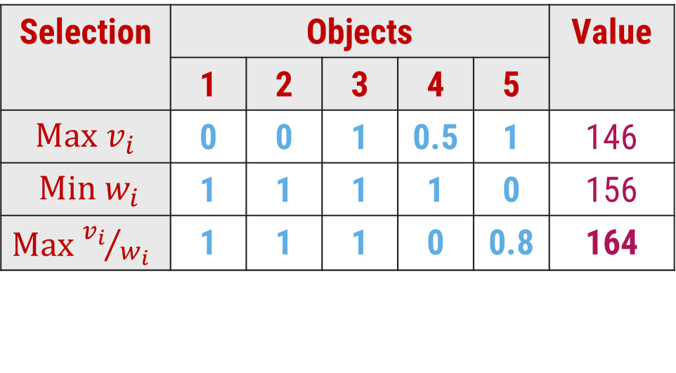
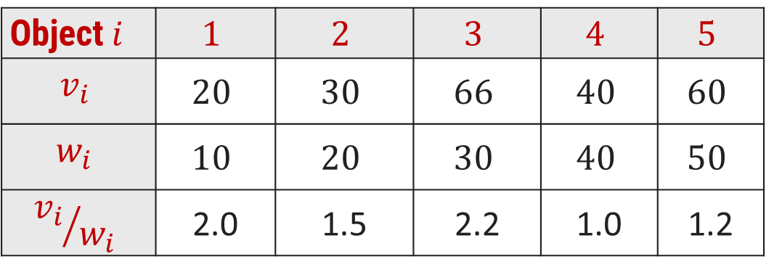
Fractional Knapsack Problem - Greedy Solution
Object$i$ | $$1$$ | $$2$$ | $$3$$ | $$4$$ | $$5$$
$$v_{i}$$ | $$20$$ | $$30$$ | $$66$$ | $$40$$ | $$60$$
$$w_{i}$$ | $$10$$ | $$20$$ | $$30$$ | $$40$$ | $$50$$
$${v_{i}}/{w_{i}}$$ | 2.0 | 1.5 | 2.2 | 1.0 | 1.2
Selection | Objects |  |  |  |  | Value
 | 1 | 2 | 3 | 4 | 5
$\text{Max}$ $v_{i}$ | 0 | 0 | 1 | 0.5 | 1 | 146
$\text{Min} w_{i}$ | 1 | 1 | 1 | 1 | 0 | 156
$\text{Max}$ ${v_{i}}/{w_{i}}$ | 1 | 1 | 1 | 0 | 0.8 | 164
Weight Capacity 100
30
50
20
10
20
30
40
30
10
20
40
Profit = 66 + 20 + 30 + 48 = 164
Profit = 66 + 60 + (40 * 0.5) = 146
Profit = 20 + 30 + 66 + 40 = 156

Slide 18
Fractional Knapsack Problem - Algorithm
Algorithm: Greedy-Fractional-Knapsack (w[1..n], p[1..n], W)
for i = 1 to n do
x[i] $←$ 0 ; weight $←$ 0
While weight < W do
i $←$ the best remaining object
if weight + w[i] ≤ W then
x[i] $←$1
weight $←$ weight + w[i]
else
x[i] $←$ (W - weight) / w[i]
weight $←$ W
return x
W = 100 and Current weight in knapsack= 60
Object weight = 50
The fraction of object to be included will be
(100 – 60) / 50 = 0.8

Slide 19
Exercises – Home Work
Consider Knapsack capacity $W=50$, $w = (10, 20, 40)$and $v = (60, 80,100)$find the maximum profit using greedy approach.
Consider Knapsack capacity $W = 10$, $w=(4, 8, 2, 6, 1)$and $v = (12, 32, 40, 30, 50)$. Find the maximum profit using greedy approach.

Slide 20
Activity Selection Problem

Slide 21
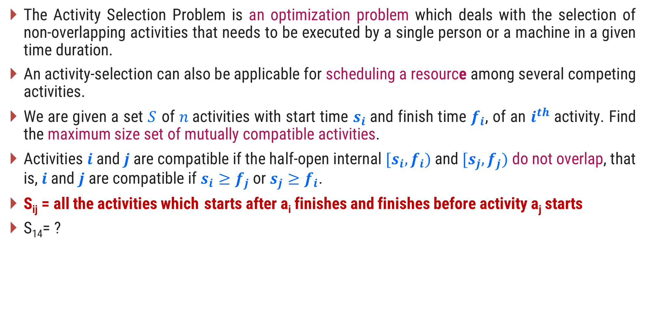
Introduction
The Activity Selection Problem is an optimization problem which deals with the selection of non-overlapping activities that needs to be executed by a single person or a machine in a given time duration.
An activity-selection can also be applicable for scheduling a resource among several competing activities.
We are given a set $S$ of $n$activities with start time $s_{i}$and finish time $f_{i}$, of an $i^{th}$ activity. Find the maximum size set of mutually compatible activities.
Activities $i$ and$j$are compatible if the half-open internal $[s_{i},f_{i})$and $[s_{j},f_{j})$do not overlap, that is, $i$ and $j$ are compatible if $s_{i}≥f_{j}$ or $s_{j}≥f_{i}$.
S_{ij} = all the activities which starts after a_{i} finishes and finishes before activity a_{j} starts
S₁₄= ?

Slide 22
Activity Selection Problem - Example
Example: 11 activities are given as,
Solution:
Step 1:
Sort the activities of set 𝑺 as per increasing finish time to directly identify mutually compatible activities by comparing finish time of first activity and start time of next activity
Sr. | Activity | ($s_{i}$, $f_{i}$)
1 | P | (1, 4)
2 | Q | (3, 5)
3 | R | (0, 6)
4 | S | (5, 7)
5 | T | (3, 8)
6 | U | (5, 9)
7 | V | (6, 10)
8 | W | (8, 11)
9 | X | (8, 12)
10 | Y | (2, 13)
11 | Z | (12, 14)

Slide 23
Activity Selection Problem - Example
Example: 11 activities are given as,
Solution:
Step 2:
A = {P}
A = {P, S}
A = {P, S, W}
A = {P, S, W, Z}
Answer: A = {P, S, W, Z}
Sr. | Activity | ($s_{i}$, $f_{i}$)
1 | P | (1, 4)
2 | Q | (3, 5)
3 | R | (0, 6)
4 | S | (5, 7)
5 | T | (3, 8)
6 | U | (5, 9)
7 | V | (6, 10)
8 | W | (8, 11)
9 | X | (8, 12)
10 | Y | (2, 13)
11 | Z | (12, 14)

Slide 24
Example:
a1 a2 a3 a4 a5 a6
S_{i}
F_{i}
1 | 2 | 3 | 4 | 5 | 6
4 | 3 | 5 | 6 | 9 | 8

Slide 25
Activity Selection - Algorithm
Algorithm: Activity Selection
Step I: Sort the input activities by increasing finishing time. f₁ ≤ f₂ ≤ . . . ≤ f_{n}
Step II: Call GREEDY-ACTIVITY-SELECTOR (s, f)
  n = length [s]
  A = {i}
  j = 1
  for i = 2 to n
do if s_{i} ≥ f_{j}
then A = A U {i}
j = i
  return set A

Slide 26
Example
Input: N = 3
arr[ ] = {{10, 20}, {12, 25}, {20, 30}}
Output: (10, 20) (20, 30)
Input: N = 4
arr[ ] = {{3, 4}, {2, 5}, {1, 3}, {5, 9}, {0, 7}, {11, 12}, {8, 10}}
Output: (1, 3) (3, 4) (5, 9) (11, 12)

Slide 27
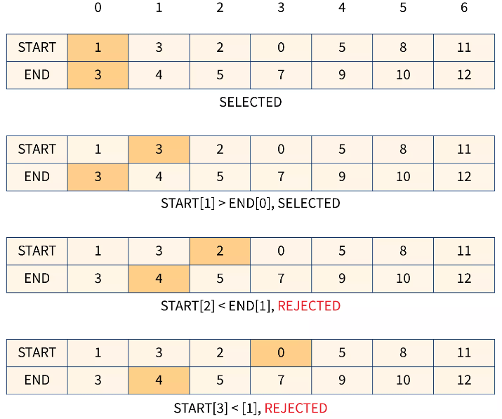

Slide 28
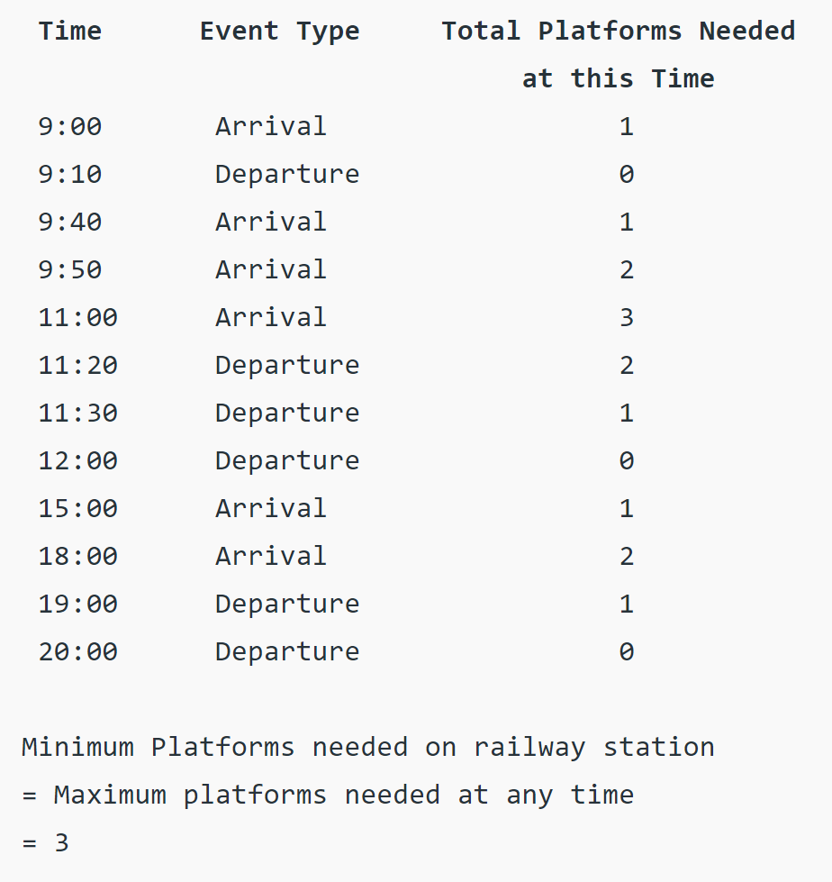
Exercise - HW
Given arrival and departure times of all trains that reach a railway station, find the minimum number of platforms required for the railway station so that no train waits. We are given two arrays which represent arrival and departure times of trains that stop. Arr[ ] = {9:00, 9:40, 9:50, 11:00, 15:00, 18:00} dep[ ] = {9:10, 12:00, 11:20, 11:30, 19:00, 20:00}

Slide 29
Complexity Analysis
Case 1: When the provided list of activities is already sorted by finish time, then no need for sorting it again. Therefore, Time Complexity in such a case will be O(n).
Case 2: When the provided list of activities is not sorted, then we will have to either write a sort() function from scratch or we can use the in-built Standard Template Library function. Therefore, Time Complexity, in this case, will be O(nlogn).
Space Complexity: O(1), Since no Auxiliary space is required.

Slide 30
Job Scheduling with Deadlines

Slide 31
Real-life example
suppose you are a content writer and have 4 articles to write. Each article takes a different amount of time to complete and has different payments. You want to earn the maximum amount by writing the articles.
So which article will you write first?
You have two options:
Article with maximum payment: In this case, the article can take a longer duration to complete but by writing this article, you may miss some other articles which can be completed in a shorter interval of time, and it can be unprofitable to you if the sum of the payments from the missed articles is greater than the payment of this single article which you are doing.
The article which takes less time: In this case, it may happen that you have written multiple articles in the given time but there could be the possibility that if you would have chosen the article with maximum payment, you could have earned more, even by writing a single article.

Slide 32
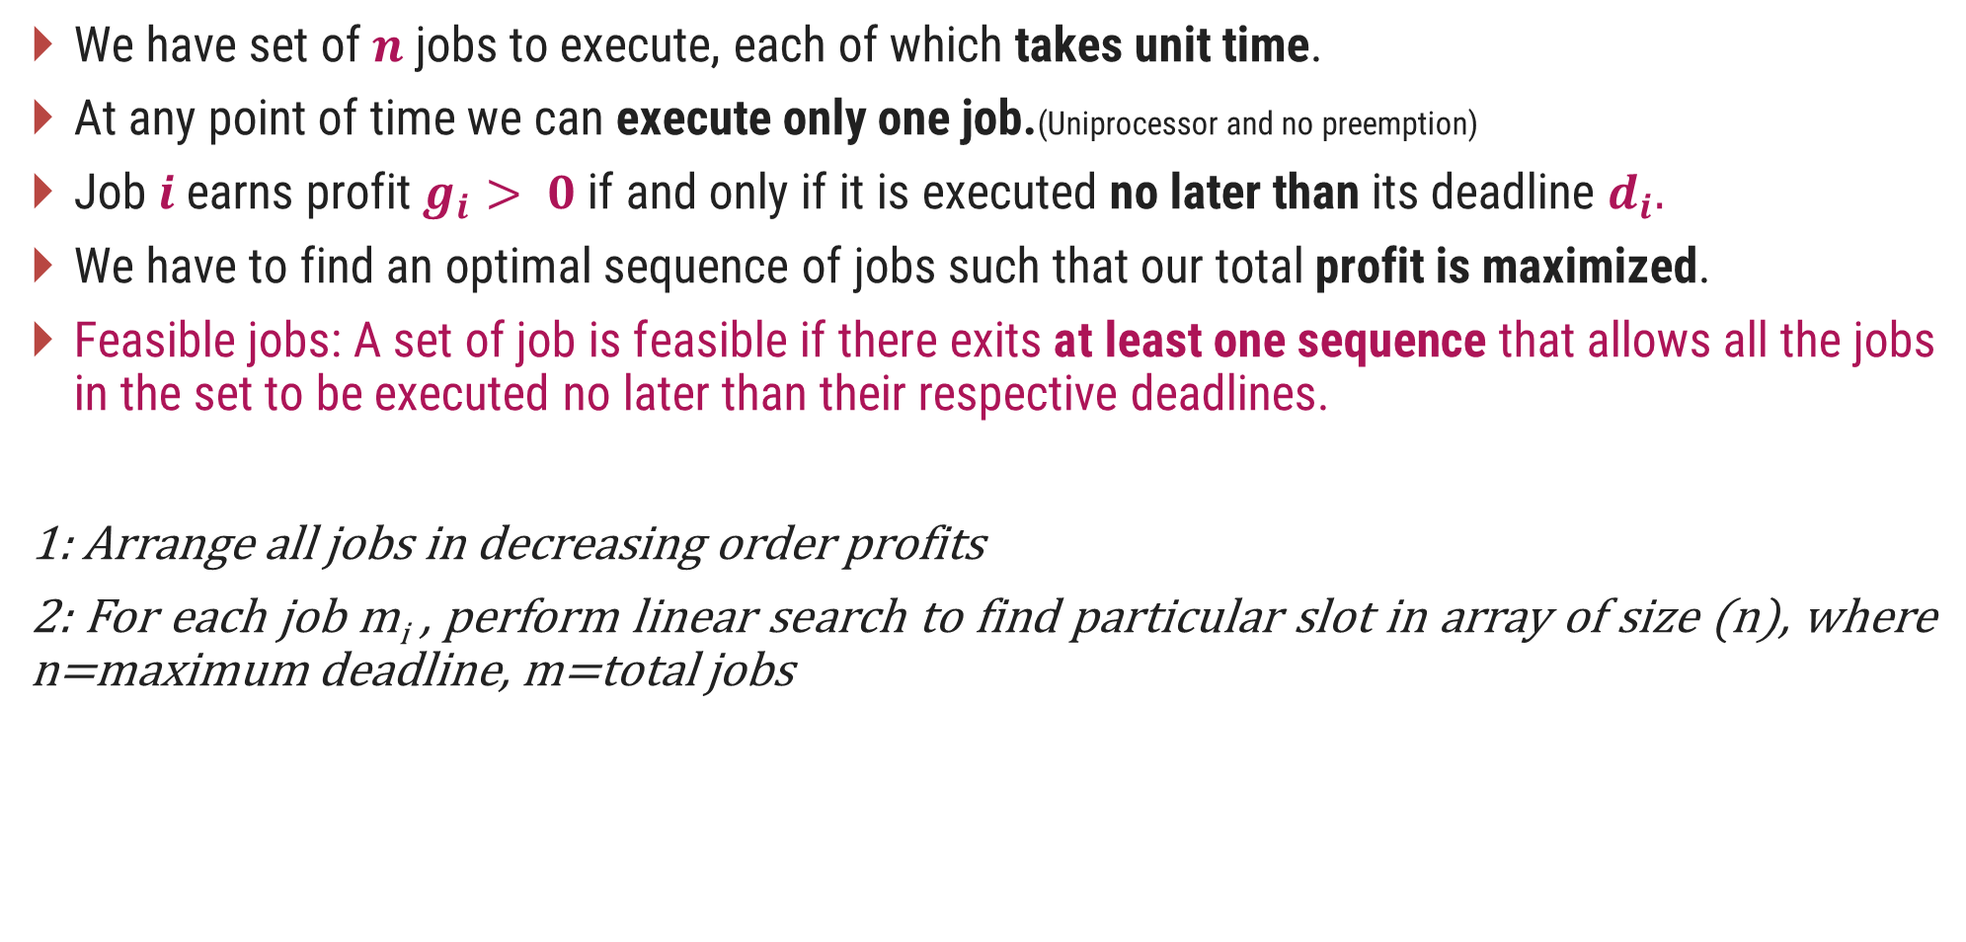
Introduction
We have set of $n$ jobs to execute, each of which takes unit time.
At any point of time we can execute only one job.(Uniprocessor and no preemption)
Job$i$earns profit $g_{i}> 0$if and only if it is executed no later than its deadline $d_{i}.$
We have to find an optimal sequence of jobs such that our total profit is maximized.
Feasible jobs: A set of job is feasible if there exits at least one sequence that allows all the jobs in the set to be executed no later than their respective deadlines.
1: Arrange all jobs in decreasing order profits
2: For each job m_{i} , perform linear search to find particular slot in array of size (n), where n=maximum deadline, m=total jobs

Slide 33
Brute-force approach
The simple and brute-force solution for this problem is to generate all the sequences of the given set of jobs and find the most optimal sequence that maximizes the profit.
Suppose, if there are n number of jobs, then to find all the sequences of jobs we need to calculate all the possible subsets and a total of 2^{n} subsets will be created. Thus, the time complexity of this solution would be O(2^{n}).
To optimize this algorithm, we can make use of a greedy approach that produces an optimal result, which works by selecting the best and the most profitable option available at the moment.

Slide 34
Greedy algorithm
Sort the jobs in decreasing order of their profit.
Find the highest deadline among all deadlines and draw a Gantt chart up to that deadline.
Now, we need to assign time slots to individual job ids.
Now pick each job one by one and check if the maximum possible time slot for the job, i.e., its deadline, is assigned to another job or not. If it is not filled yet, assign the slot to the current job id.
Otherwise, search for any empty time slot less than the deadline of the current job. If such a slot is found, assign it to the current job id and move to the next job id.
Continue this process until all the feasible jobs are allocated to their time slot.
In the end, we can calculate the profit for all the allocated feasible jobs.

Slide 35
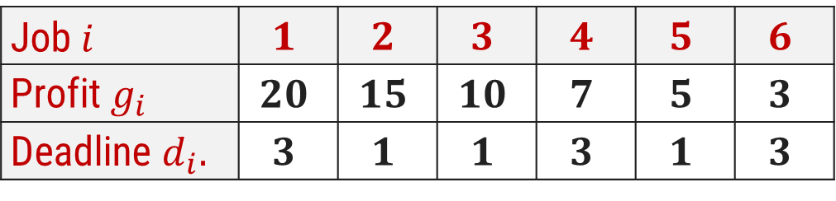

Job Scheduling with Deadlines - Example
Using greedy algorithm find an optimal schedule for following jobs with $n=6$.
Profits: $(P_{1},P_{2},P_{3},P_{4},P_{5},P_{6}) = (15,20,10,7,5,3)$&
Deadline: $(d_{1},d_{2},d_{3},d_{4},d_{5},d_{6}) = (1, 3, 1, 3, 1, 3)$
Solution:
  Sort the jobs in decreasing order of their profit.
Step 1:
Job $i$ | $$1$$ | $$2$$ | $$3$$ | $$4$$ | $$5$$ | $$6$$
Profit $g_{i}$ | $$20$$ | $$15$$ | $$10$$ | $$7$$ | $$5$$ | $$3$$
Deadline $d_{i}.$ | $$3$$ | $$1$$ | $$1$$ | $$3$$ | $$1$$ | $$3$$

Slide 36
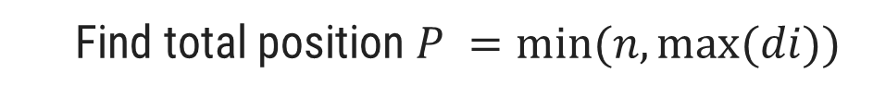
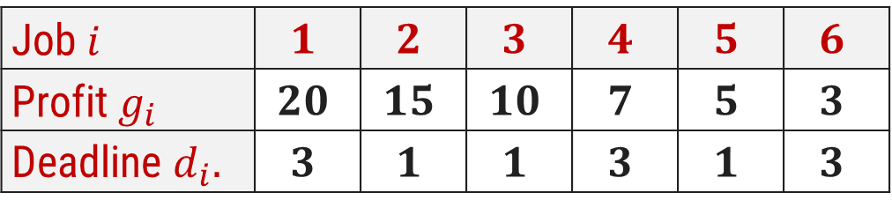
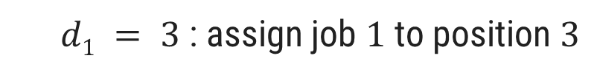
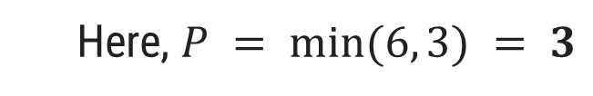
Job Scheduling with Deadlines - Example
Job $i$ | $$1$$ | $$2$$ | $$3$$ | $$4$$ | $$5$$ | $$6$$
Profit $g_{i}$ | $$20$$ | $$15$$ | $$10$$ | $$7$$ | $$5$$ | $$3$$
Deadline $d_{i}.$ | $$3$$ | $$1$$ | $$1$$ | $$3$$ | $$1$$ | $$3$$
Step 2:
  Find total position $P =min⁡(n, max⁡(di))$
  Here, $P = min⁡(6, 3) = 3$
P
1
2
3
Job selected
0
0
0
Step 3:
  $d1 = 3$: assign job $1$ to position $3$
P
1
2
3
Job selected
0
0
J1

Slide 37
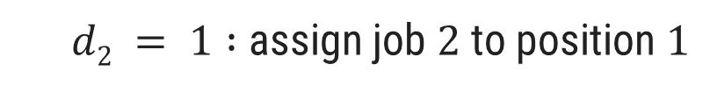
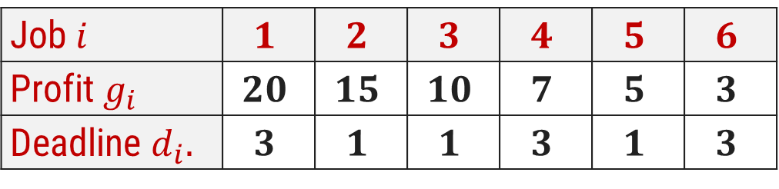
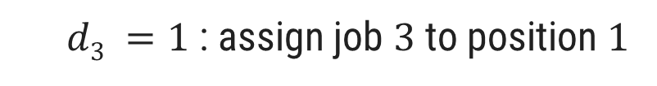
Job Scheduling with Deadlines - Example
Job $i$ | $$1$$ | $$2$$ | $$3$$ | $$4$$ | $$5$$ | $$6$$
Profit $g_{i}$ | $$20$$ | $$15$$ | $$10$$ | $$7$$ | $$5$$ | $$3$$
Deadline $d_{i}.$ | $$3$$ | $$1$$ | $$1$$ | $$3$$ | $$1$$ | $$3$$
Step 4:
  $d2 = 1 :$assign job $2$ to position $1$
P
1
2
3
Job selected
J2
0
J1
Step 5:
  $d3 =1$: assign job $3$ to position $1$
But position 1 is already occupied and two jobs can not be executed in parallel, so reject job 3

Slide 38
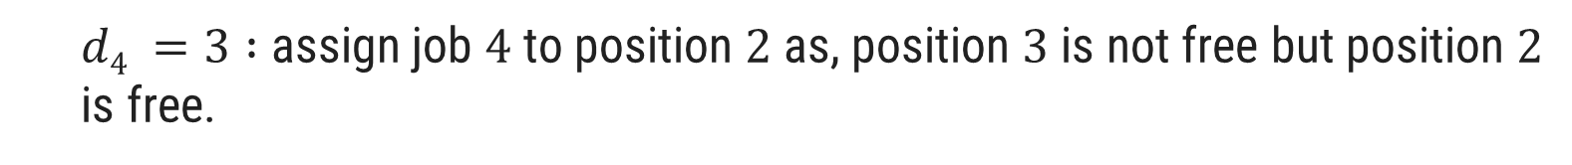
Job Scheduling with Deadlines - Example
Job $i$ | $$1$$ | $$2$$ | $$3$$ | $$4$$ | $$5$$ | $$6$$
Profit $g_{i}$ | $$20$$ | $$15$$ | $$10$$ | $$7$$ | $$5$$ | $$3$$
Deadline $d_{i}.$ | $$3$$ | $$1$$ | $$1$$ | $$3$$ | $$1$$ | $$3$$
Step 6:
  $d4 =3 :$assign job $4$ to position $2$as, position $3$ is not free but position $2$ is free.
P
1
2
3
Job selected
J2
J4
J1
Now no more free position is left so no more jobs can be scheduled.
The final optimal sequence:
Execute the job in order 2, 4, 1 with total profit value 42.

Slide 39
Exercises – Home Work
Using greedy algorithm find an optimal schedule for following jobs with 𝒏=4.
  Profits: (a, b, c, d) = (20,10,40,30) &
  Deadline: (d₁, d₂, d₃, d₄) = (4, 1, 1, 1)
Using greedy algorithm find an optimal schedule for following jobs with 𝒏=5.
  Profits: (a, b, c, d, e) = (100,19,27,25,15) &
  Deadline: (d₁, d₂, d₃, d₄, d₅) = (2, 1, 2, 1, 3)

Slide 40
Job Scheduling with Deadlines - Algorithm
int result[n]; // To store result (Sequence of jobs)
bool slot[n]; // To keep track of free time slots
// Initialize all slots to be free
for (int i = 0; i < n; i++)
slot[i] = false;
// Iterate through all given jobs
for (int i = 0; i < n; i++) {
// Find a free slot for this job (Note that we start from the last possible slot)
for (int j = min(n, arr[i].dead) - 1; j >= 0; j--) {
// Free slot found
if (slot[j] == false && arr[i].dead<=j) {
result[j] = i; // Add this job to result
slot[j] = true; // Make this slot occupied
break;
}
}

Slide 41
The time complexity for the above job scheduling algorithm is O(n² ) in the worst case when we will look for all the slots in the Gantt chart for a given job id.
On average, n jobs search n/2 slots. So, this would also take O(n² ) time approximately.

Slide 42
Huffman Codes

Slide 43
Intro
When you want to send files or store the files on a computer, if the size is very huge we generally compress it and store it.
One way of compressing these files is using Huffman Coding which is a greedy-based algorithm that is also known as variable-length coding or lossless data compression technique.

Slide 44
Prefix Code
Prefix code is used for encoding(compression) and Decoding(Decompression).
Prefix Code: Any code that is not prefix of another code is called prefix code.
Characters | Frequency | Code | Bits
a | 45 | 000 | 135
b | 13 | 111 | 39
c | 12 | 101 | 36
d | 16 | 110 | 48
e | 9 | 011 | 27
f | 5 | 001 | 15
Total bits |  |  | 300

Slide 45
Huffman code Introduction
Huffman Coding is a technique of compressing data to reduce its size without losing any of the details. It was first developed by David Huffman.
Huffman Coding is generally useful to compress the data where character comes frequently.
Huffman invented a greedy algorithm that constructs an optimal prefix code called a Huffman code.
Huffman coding is a lossless data compression algorithm.
It assigns variable-length codes to input characters.
Lengths of the assigned codes are based on the frequencies of corresponding characters.
The most frequent character gets the smallest code and the least frequent character gets the largest code.
The variable-length codes assigned to input characters are Prefix Codes.

Slide 46
Huffman Codes
In Prefix codes, the codes are assigned in such a way that the code assigned to one character is not a prefix of code assigned to any other character.
For example,
Now assume that the generated bitstream is 001, while decoding the code it can be written as follows:
0 0 1 = aab ..?
0 01 = ac ..?
This is how Huffman Coding makes sure that there is no ambiguity when decoding the generated bit stream.
There are mainly two major parts in Huffman Coding
  Build a Huffman Tree from input characters.
  Traverse the Huffman Tree and assign codes to characters.
a = 0, b = 1 and c = 01
Not a prefix code

Slide 47
Huffman Codes - Example
Find the Huffman codes for the following characters.
Characters | a | b | c | d | e | f
Frequency (in thousand) | 45 | 13 | 12 | 16 | 9 | 5
Step 1:
Arrange the characters in the Ascending order of their frequency. (These are stored in a priority queue Q/ min-heap.)
f:5
e:9
c:12
b:13
d:16
a:45

Slide 48
Huffman Codes - Example
Step 2:
Extract two nodes with the minimum frequency from min heap.
Create a new internal node with frequency equal to the sum of the two nodes frequencies.
Make the first extracted node as its left child and the other extracted node as its right child.
Add this node to the min-heap.
14
f:5
e:9
c:12
b:13
d:16
a:45

Slide 49
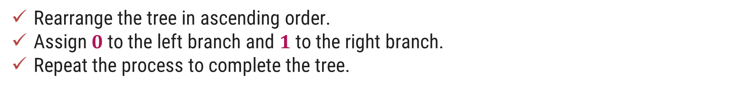
Huffman Codes - Example
Step 3:
Rearrange the tree in ascending order.
Assign $0$to the left branch and $1$to the right branch.
Repeat the process to complete the tree.
14
f:5
e:9
c:12
b:13
d:16
a:45
0
1

Slide 50
Huffman Codes - Example
25
Step 4:
c:12
b:13
14
d:16
a:45
0
1
f:5
e:9
14
d:16
25
a:45
0
1
0
1
f:5
e:9
c:12
b:13

Slide 51
Huffman Codes - Example
30
Step 5:
14
25
a:45
d:16
0
1
0
1
f:5
e:9
c:12
b:13
25
30
a:45
0
1
0
1
14
d:16
c:12
b:13
0
1
f:5
e:9

Slide 52
Huffman Codes - Example
Step 6:
55
0
1
25
30
a:45
0
1
0
1
14
d:16
c:12
b:13
0
1
f:5
e:9

Slide 53
Huffman Codes - Example
100
Step 7:
0
1
a:45
55
0
1
25
30
0
1
0
1
14
d:16
c:12
b:13
0
1
f:5
e:9

Slide 54
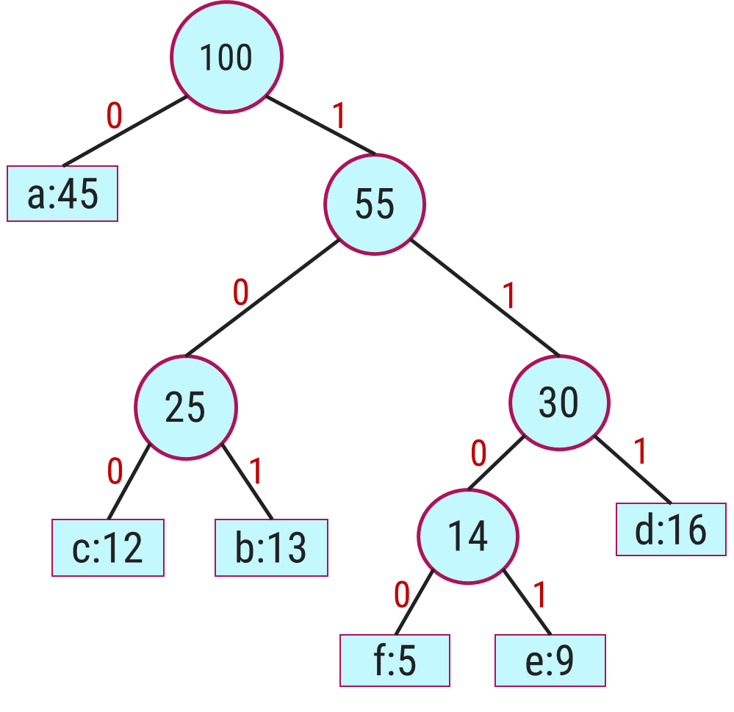
Huffman Codes - Example
Characters | a | b | c | d | e | f
Frequency (in thousand) | 45 | 13 | 12 | 16 | 9 | 5
Step 8:
0
101
100
111
1101
1100
Total bits: 224

Slide 55
Huffman Codes - Algorithm
Algorithm: HUFFMAN (C)
create a priority queue Q consisting of each unique character.
sort then in ascending order of their frequencies
n = |C|
Q = C
for i = 1 to n-1
allocate a new node z
z.left = x = EXTRACT-MIN(Q)
z.right = y = EXTRACT-MIN(Q)
z.freq = x.freq + y.freq
INSERT(Q,z)
return EXTRACT-MIN(Q) // return the root of the tree

Slide 56
Complexity analysis
Time complexity: O(N logN)
Sorting will take O(N logN)
The time taken for encoding each given unique character depending on its frequency is O(N logN) where N is the number of unique given characters.
Getting minimum from the priority queue(min-heap): time complexity is O(log N) since it calls minHeapify method.
extractmin() is called for 2*(N-1) times i.e. 2*(N-1)*log N
Inertnode() is called for (N-1) times i.e (N-1) * log N
Therefore, the overall complexity of Huffman Coding is considered to be O(N logN).
Space Complexity: O(N)
The space complexity is O(N) because there are N characters used for storing them in a map/array while calculating their frequency.

Slide 57
Exercises – Home Work
Find an optimal Huffman code for the following set of frequency.
a : 50, b : 20, c : 15, d : 30.
Frequency
Frequency
Characters | A | B | C | D | E | F
Frequency (in thousand) | 24 | 12 | 10 | 8 | 8 | 5
Characters | a | b | c | d | e | f | g
Frequency (in thousand) | 37 | 28 | 29 | 13 | 30 | 17 | 6

Slide 58
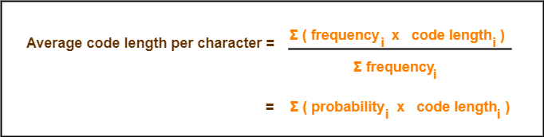
Important formula
Total number of bits in Huffman encoded message
= Total number of characters in the message x Average code length per character
= ∑ ( frequency_{i} x Avg Code length_{i} )

Slide 59
1. Huffman Code For Characters-
To write Huffman Code for any character, traverse the Huffman Tree from root node to the leaf node of that character.
Following this rule, the Huffman Code for each character is-
  a = 111 f:10
  e = 10 f:15
  i = 00 f:12
  o = 11001 f:3
  u = 1101 f:4
  s = 01 f:13
  t = 11000 f:1
From here, we can observe-
Characters occurring less frequently in the text are assigned the larger code.
Characters occurring more frequently in the text are assigned the smaller code.

Slide 60
2. Average Code Length-
Using formula-01, we have-
Average code length
= ∑ ( frequency_{i} x code length_{i} ) / ∑ ( frequency_{i} )
= { (10 x 3) + (15 x 2) + (12 x 2) + (3 x 5) + (4 x 4) + (13 x 2) + (1 x 5) } / (10 + 15 + 12 + 3 + 4 + 13 + 1)
= 2.52
3. Length of Huffman Encoded Message-
Using formula-02, we have-
Total number of bits in Huffman encoded message
= Total number of characters in the message x Average code length per character
= 58 x 2.52
= 146.16
≅ 147 bits

Slide 61
Applications of Huffman Coding
Huffman Coding is frequently used by conventional compression formats like PKZIP, GZIP, etc.
For data transmission using fax and text, Huffman Coding is used because it reduces the size and improves the speed of transmission.
Many multimedia storage like JPEG, PNG, and MP3 use Huffman encoding(especially the prefix codes) for compressing the files.
Image compression is mostly done using Huffman Coding.
It is more useful in some cases where there is a series of frequently occurring characters to be transmitted.

Slide 62
Minimum Spanning Tree

Slide 63
Spanning tree
A spanning tree is a sub-graph that connects all the vertices of a graph with the minimum possible number of edges. It may or may not be weighted and does not have cycles.
Let us understand what is spanning tree with an interesting example.
Consider a situation where a cable television network company is laying the cable to a new neighborhood. If the company is constrained to bury the cable only along certain paths for example along the roads then the problem is to find the minimum amount of cable that the company requires to complete the wiring of the television network

Slide 64
Spanning tree
A Spanning tree always contains n-1 edges, where n is the total number of vertices in the graph G.
The total number of spanning trees that a complete graph of n vertices can have is n(n-2).
We can construct a spanning tree by removing atmost e-n+1 edges from a complete graph G, where e is the number of edges and n is the number of vertices in graph G.

Slide 65
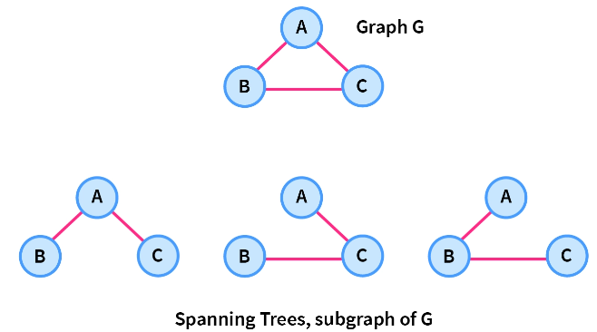
Spanning tree
A complete undirected graph G can have a maximum n^{n-2} number of spanning trees, where n is the number of nodes in a given graph G. Let us Consider a complete graph G with 3 vertices, then the total number of spanning trees this graph can have is 3⁽³⁻²⁾=3 which are shown in the image below.

Slide 66
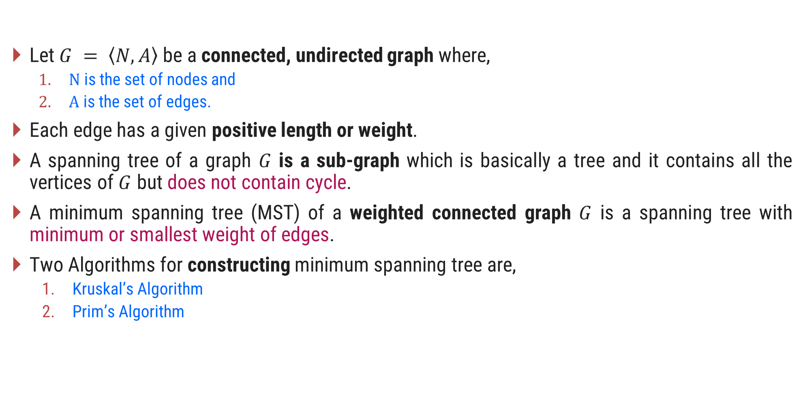
Introduction to Minimum Spanning Tree (MST)
Let $G = \left\langle N,\left.A\right\rangle \right.$be a connected, undirected graph where,
  $N$ is the set of nodes and
  $A$ is the set of edges.
Each edge has a given positive length or weight.
A spanning tree of a graph $G$ is a sub-graph which is basically a tree and it contains all the vertices of $G$ but does not contain cycle.
A minimum spanning tree (MST) of a weighted connected graph $G$ is a spanning tree with minimum or smallest weight of edges.
Two Algorithms for constructing minimum spanning tree are,
  Kruskal’s Algorithm
  Prim’s Algorithm

Slide 67
Spanning Tree Examples
Graph
A
Spanning Tree
A
B
C
B
C
D
E
F
G
D
E
F
G
H
H
Graph
Spanning Tree
A
A
B
C
E
B
C
E
D
F
D
F

Slide 68
Kruskal’s Algorithm for MST – Example 1
A
Step 2: Taking next
min edge (B,C)
4
5
Step 4: Taking next
min edge (A,B)
6
6
B
E
B
3
A
4
5
7
2
2
C
D
B
E
C
D
1
3
1
2
Step 3: Taking next
min edge (B,E)
C
D
Step 1: Taking min
edge (C,D)
B
E
1
3
So, we obtained a minimum
spanning tree of cost:
4 + 2 + 1 + 3 = 10
C
D
2
1
C
D
1

Slide 69
Kruskal’s Algorithm for MST – Example 2
Step:1
Sort the edges in increasing order of their weight.
Edges | Weight
{1, 2} | 1
{2, 3} | 2
{4, 5} | 3
{6, 7} | 3
{1, 4} | 4
{2, 5} | 4
{4, 7} | 4
{3, 5) | 5
{2, 4} | 6
{3, 6} | 6
{5, 7} | 7
{5, 6} | 8
1
1
2
2
3
4
6
4
5
6
4
5
6
3
8
7
4
3
7

Slide 70
Kruskal’s Algorithm for MST – Example 2
Step:2
Select the minimum weight edge but no cycle.
Edges | Weight
{1, 2} | 1
{2, 3} | 2
{4, 5} | 3
{6, 7} | 3
{1, 4} | 4
{2, 5} | 4
{4, 7} | 4
{3, 5) | 5
{2, 4} | 6
{3, 6} | 6
{5, 7} | 7
{5, 6} | 8
1
1
2
2
3
√
√
√
4
6
4
5
6
√
√
4
5
6
3
8
√
7
4
3
7

Slide 71
Kruskal’s Algorithm for MST – Example 2
Step:3
The minimum spanning tree for the given graph.
Edges | Weight
{1, 2} | 1
{2, 3} | 2
{4, 5} | 3
{6, 7} | 3
{1, 4} | 4
{4, 7} | 4
1
1
2
2
3
√
√
√
4
√
√
4
5
6
3
√
4
3
Total Cost = 17
7

Slide 72
Kruskal’s Algorithm – Example 2
Step | Edges considered - {u, v} | Connected Components
Init. | - | {1} {2} {3} {4} {5} {6} {7}
1 | {1,2} | {1,2} (3} {4} {5} {6} {7}
2 | {2,3} | {1,2,3} {4} {5} {6} {7}
3 | {4,5} | {1,2,3} {4,5} {6} {7}
4 | {6,7} | {1,2,3} {4,5} {6,7}
5 | {1,4} | {1,2,3,4,5} {6,7}
6 | {2,5} | Rejected
7 | {4,7} | {1,2,3,4,5,6,7}
Edges | Weight
{1, 2} | 1
{2, 3} | 2
{4, 5} | 3
{6, 7} | 3
{1, 4} | 4
{4, 7} | 4
Total Cost = 17

Slide 73
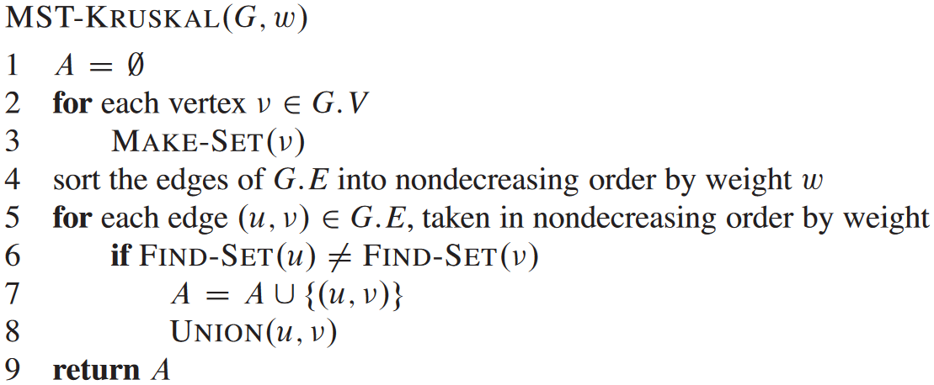
Kruskal’s Algorithm for MST
MAKE-SET(x) creates a new set whose only member (and thus representative) is x. Since the sets are disjoint, we require that x not already be in some other set.
FIND-SET(x) returns a pointer to the representative of the (unique) set containing x.
UNION(x,y) unites the dynamic sets that contain x and y

Slide 74
Complexity analysis
Implemented Using linear array/list
Initializing the set A in line 1 takes O(1) time
For vertex we need to call make_set() i.e. O(V)
Sorting edges O(E log E)
FIND_SET() and UNION() operation takes O(V) or improvised O(log V)
Total running time: O(E log E)
Implemented using Heap
If we use min_heap with E edges and we take out one edge and add in the spanning tree:
Best case: Total (V-1) edges we take out, and our spanning tree is completed
Worst case: All E edges we need to check
And each time we take out one edge from heap we need to adjust the heap in (log E) time
Best: V log E and Worst: E log E

Slide 75


Exercises – Home Work
Write the kruskal’s Algorithm to find out Minimum Spanning Tree. Apply the same and find MST for the graph given below.
$$1.$$
$$2.$$
3
A
1
10
F
C
3
A
B
C
4
4
3
7
2
4
5
8
5
B
6
D
E
F
G
4
D
H
4
2
3
2
8
1
9
3
G
E
3
H

Slide 76

Prim’s Algorithm
In Prim's algorithm, the minimum spanning tree grows in a natural way, starting from an arbitrary root.
At each stage we add a new branch to the tree already constructed; the algorithm stops when all the nodes have been reached.
The complexity for the Prim’s algorithm is $θ(n^{2})$ where $n$ is the total number of nodes in the graph $G$.

Slide 77
Prim’s Algorithm for MST – Example 1
Select an arbitrary node.
Step:1
Node - Set B | Edges
1
1
1
2
2
3
4
6
4
5
6
4
5
6
3
8
7
4
3
7

Slide 78
Prim’s Algorithm for MST – Example 1
Find an edge with minimum weight.
Step:2
Node - Set B | Edges
1
1
1
2
2
3
{1, 2}, {1, 4}
4
6
4
5
6
1, 2
{1, 4}, {2, 3} {2, 4}, {2, 5}
1, 2, 3
{1,4}, {2,4}, {2,5}, {3,5}, {3,6}
4
5
6
3
8
1, 2, 3, 4
{2,4} {2,5} {3,5} {3,6} {4,5} {4,7}
7
4
3
{2,4} {2,5} {3,5} {3,6} {4,7} {5,6} {5,7}
1, 2, 3, 4, 5
7
1, 2, 3, 4, 5, 7
{2,4} {2,5} {3,5} {3,6} {5,6} {5,7} {6,7}
1, 2, 3, 4, 5, 6, 7

Slide 79
Prim’s Algorithm for MST – Example 1
Step:3
The minimum spanning tree for the given graph.
Node | Edges
1
1, 2 | {1, 2}
1, 2, 3 | {2, 3}
1, 2, 3, 4 | {1, 4}
1, 2, 3, 4, 5 | {4, 5}
1, 2, 3, 4, 5, 7 | {4, 7}
1, 2, 3, 4, 5, 6, 7 | {6, 7}
1
1
2
2
3
4
4
5
6
3
4
3
7
Total Cost = 17

Slide 80
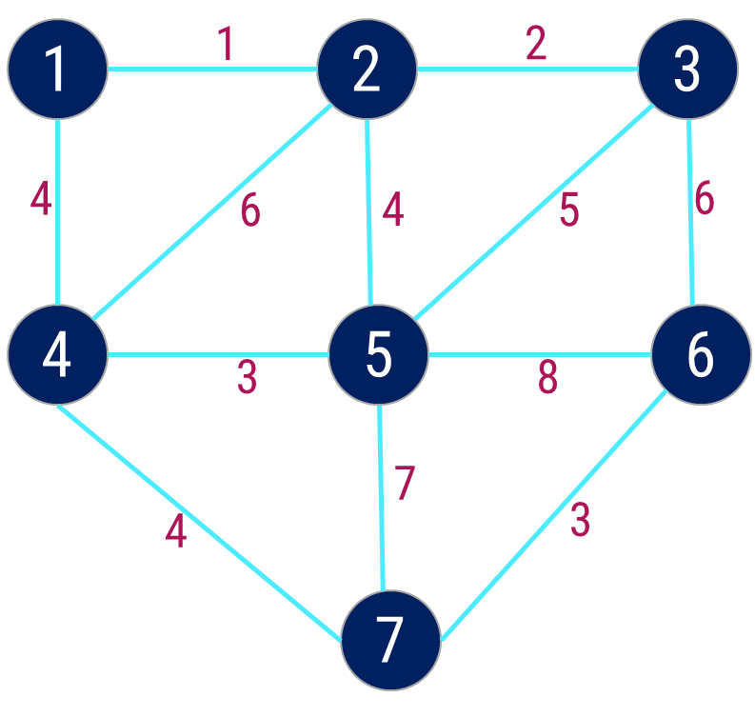
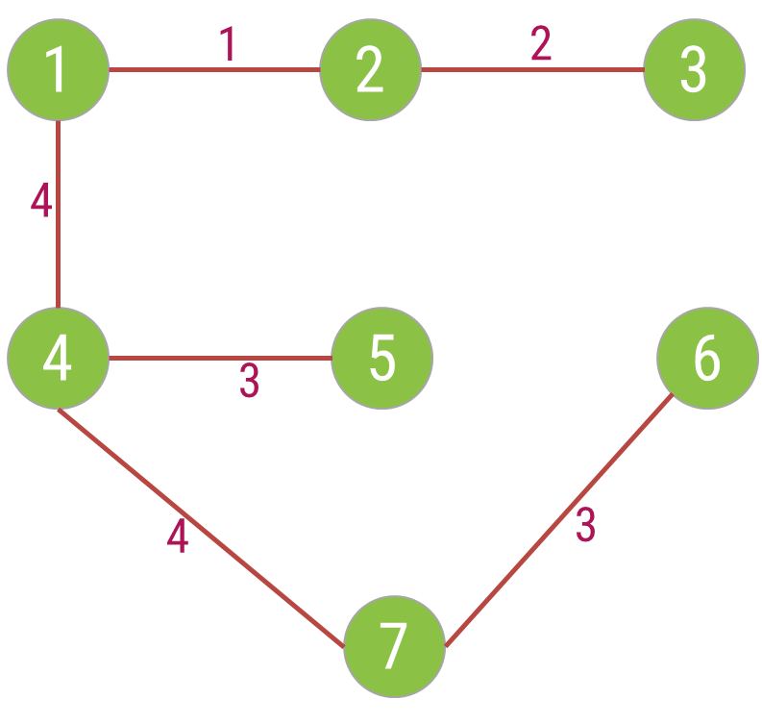
Prim’s Algorithm – Example 1
Cost = 17
Step | Edge Selected {u, v} | Set B | Edges Considered
Init. | - | {1} | --
1 | {1, 2} | {1,2} | {1,2} {1,4}
2 | {2, 3} | {1,2,3} | {1,4} {2,3} {2,4} {2,5}
3 | {1, 4} | {1,2,3,4} | {1,4} {2,4} {2,5} {3,5} {3,6}
4 | {4, 5} | {1,2,3,4,5} | {2,4} {2,5} {3,5} {3,6} {4,5} {4,7}
5 | {4, 7} | {1,2,3,4,5,7} | {2,4} {2,5} {3,5} {3,6} {4,7} {5,6} {5,7}
6 | {6,7} | {1,2,3,4,5,6,7} | {2,4} {2,5} {3,5} {3,6} {5,6} {5,7} {6,7}

Slide 81
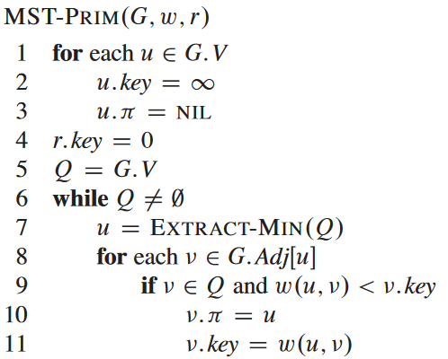
Prim’s Algorithm
Alternatively
Create an array parent[] of size V to store indexes of parent nodes in MST.
Also create an array key[] to store key values of all vertices.
Initialize all key values as INFINITE.
Assign key value as 0 for the first vertex so that it is picked first.
Create a boolean array mstSet[] to represent the set of vertices included in MST.
While mstSet doesn’t include all vertices
  Pick a vertex u which is not there in mstSet and has minimum key value.
  Include u to mstSet.
  Update the key value of all adjacent vertices of u according to the respective edge weights.
The parent array is the output array that is used to show the constructed MST.

Slide 82
Complexity analysis
Line 1-3: for each vertex --> O(V)
Line 4: O(1)
Line 5: Build heap O(V log V)
Line 6: O(V) times
Line 7: O (log V) to extract 1 min , so Line 6 and 7-: V (log V)
Line 8: worst case (V-1) vertices can be adjacent to any 1 so O(V-1) time i.e. for complete graph
  So line 6,8 → O(V²)
Line 11: actually calling decrease key function of Min_Heap → O(log v)
  So line 6,8,11 O(V² log V)
time complexity: V+VlogV+VlogV+V²log V
If graph is not complete: O(E log V) i.e. E=V² (dense) and E=V(sparse)
Overall time complexity: V+VlogV+VlogV+Elog V==> O((E+V) log V)

Slide 83


Exercises – Home Work
Write the Prim’s Algorithm to find out Minimum Spanning Tree. Apply the same and find MST for the graph given below.
$$1.$$
$$2.$$
3
A
1
10
F
C
3
A
B
C
4
4
3
7
2
4
5
8
5
B
6
D
E
F
G
4
D
H
4
2
3
2
8
1
9
3
G
E
3
H

Slide 84
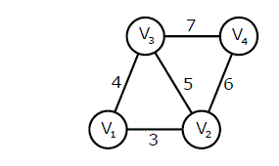
Exercise
An undirected graph G(V, E) contains n ( n > 2 ) nodes named v1 , v2 ,….vn. Two nodes vi , vj are connected if and only if 0 < |i – j| <= 2. Each edge (vi, vj ) is assigned a weight i + j. A sample graph with n = 4 is shown below
Create a graph for n=4 :

Slide 85
Single Source Shortest Path – Dijkstra’s Algorithm

Slide 86
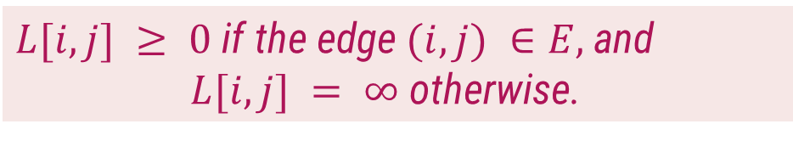
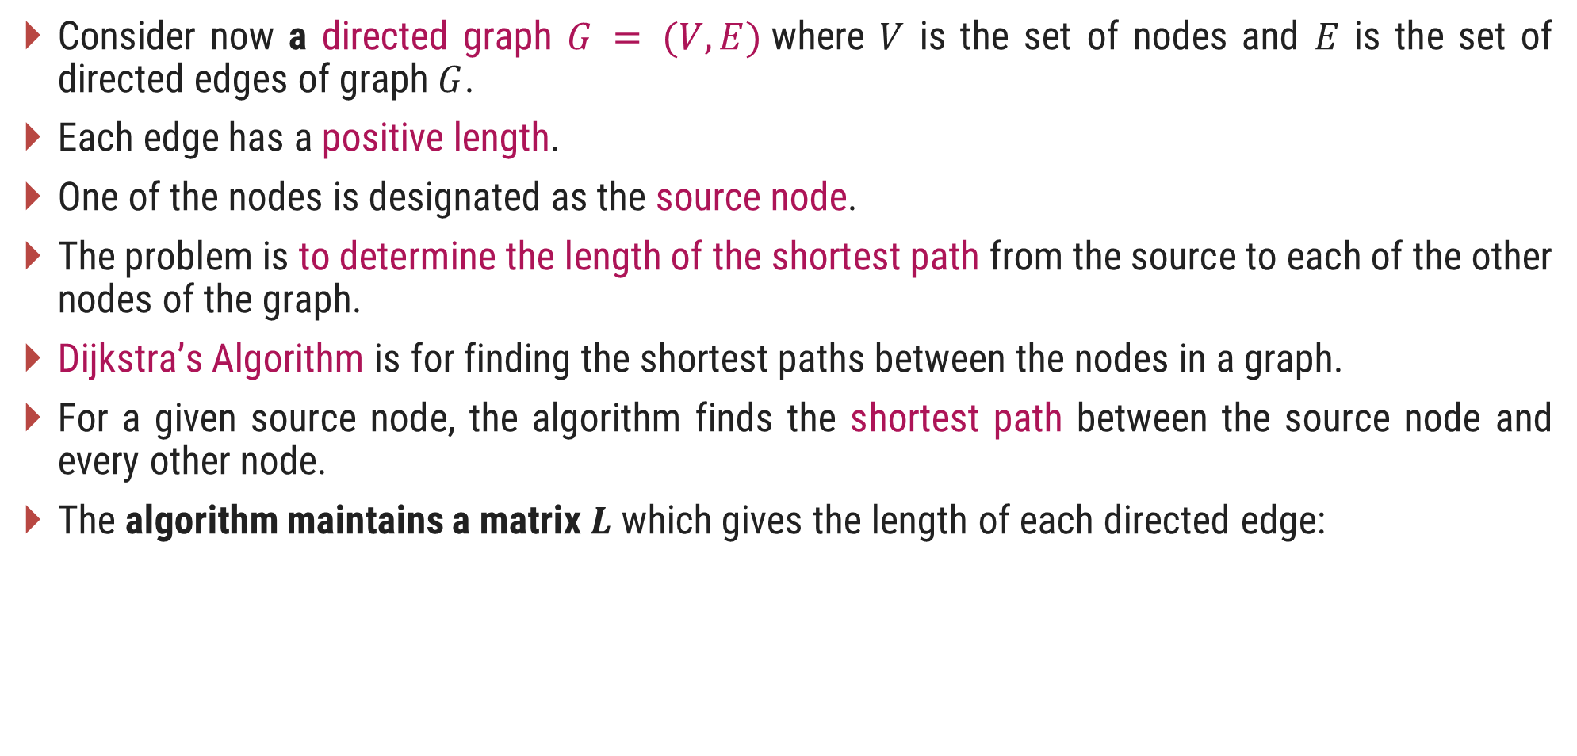
Introduction
Consider now a directed graph $G = (V,E)$where $V$ is the set of nodes and $E$ is the set of directed edges of graph $G$.
Each edge has a positive length.
One of the nodes is designated as the source node.
The problem is to determine the length of the shortest path from the source to each of the other nodes of the graph.
Dijkstra’s Algorithm is for finding the shortest paths between the nodes in a graph.
For a given source node, the algorithm finds the shortest path between the source node and every other node.
The algorithm maintains a matrix $L$ which gives the length of each directed edge:
$L[i, j] ≥ 0$ if the edge $(i, j) ∈E,$and
      $L[i, j] = ∞$otherwise.

Slide 87
Dijkstra’s Algorithm - Example
1
Single source shortest path algorithm
10
50
5
2
100
30
Source node = 1
10
5
Step
v
C
2
3
4
5
20
Init.
-
{2, 3, 4, 5}
50
30
100
10
4
3
50
1
5
{2, 3, 4}
50
30
20
10
Is there path from 1 - 5 - 2
No
Compare cost of 1–5–4 (20) and 1–4 (100)
Is there path from 1 - 5 - 4
Is there path from 1 - 5 - 3
Yes

Slide 88
Dijkstra’s Algorithm - Example
1
Single source shortest path algorithm
10
50
5
2
100
30
Source node = 1
10
5
Step
v
C
2
3
4
5
20
Init.
-
{2, 3, 4, 5}
50
30
100
10
4
3
50
1
5
{2, 3, 4}
50
30
20
10
2
4
{2, 3}
40
30
20
10
Is there path from 1 - 4 - 2
Yes
Compare cost of 1–4–2 (40) and 1–2(50)
Compare cost of 1–4–3 (70) and 1–3 (30)
Is there path from 1 - 4 - 5
No
Is there path from 1 - 4 - 3

Slide 89
Dijkstra’s Algorithm - Example
1
Single source shortest path algorithm
10
50
5
2
100
30
Source node = 1
10
5
Step
v
C
2
3
4
5
20
Init.
-
{2, 3, 4, 5}
50
30
100
10
4
3
50
1
5
{2, 3, 4}
50
30
20
10
2
4
{2, 3}
40
30
20
10
3
3
{2}
35
30
20
10
Is there path from 1 - 3 - 2
Yes
Compare cost of 1–3–2 and 1–2
Is there path from 1 - 3 - 4
No
Is there path from 1 - 3 - 5

Slide 90
Exercises – Home Work
Write Dijkstra’s Algorithm for shortest path. Use the algorithm to find the shortest path from the following graph.
$$1.$$
$$2.$$
A
2
B
B
2
D
10
4
1
3
10
A
1
4
8
7
9
C
2
D
2
E
3
2
5
8
4
6
C
E
F
1
G

Slide 91
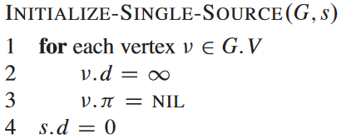
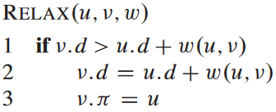
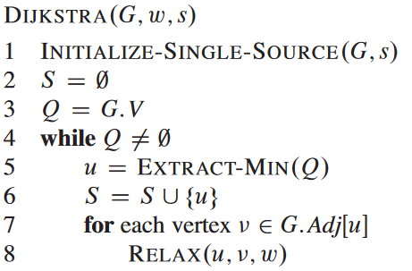
Dijkstra’s Algorithm
G=(V,E), w=weights, s= source
 | S | A | B | C | D
v.d
v.π
A
B
1
10
3
9
S
2
4
6
5
7
2
D
C

Slide 92
Time complexity
Adjacency matrix: O(V²)
  Adding all |V| vertices to Q takes O(V) time.
  Removing the node with minimal dist takes O(V) time, and we only need O(1) to relax the node
  For each vertex we are identifying the adjacent and try to relax the node take O(VxV)
Priority Queue: O(E log V)
  The given graph G=(V, E) is represented as an adjacency list.
  The priority queue Q is represented as a binary heap or a Fibonacci heap.
  It takes O(|V|) time to construct the initial priority queue of |V| vertices.
  With adjacency list representation, all vertices of the graph can be traversed using BFS in O(E) time
  The time taken for each iteration of the loop is O(|V|) and Extractmin take O(log V) time.
  Therefore, the time complexity becomes O(|V|) + O(|E| log|V|) + O(|V| log|V|),
  which is O((|E|+|V|) log|V|) = O(|E| log|V|), since |E| > |V| - 1 as G is a connected graph.

Slide 93
Optimal merge pattern
Optimal merge pattern is a pattern that relates to the merging of two or more sorted files in a single sorted file. This type of merging can be done by the two-way merging method.
If we have two sorted files containing n and m records, respectively, then they could be merged together to obtain one sorted file in time O(n+m).

Slide 94
Optimal merge pattern
Given n number of sorted files, the task is to find the minimum computations done to reach the Optimal Merge Pattern.
When two or more sorted files are to be merged altogether to form a single file, the minimum computations are done to reach this file are known as Optimal Merge Pattern.
Consider three sorted lists L1, L2 and L3 of size 30, 20 and 10 respectively.
  Two way merge compares elements of two sorted lists and put them in new sorted list.
  Case 1:
  If we first merge list L1 and L2, it does 30 + 20 = 50 comparisons and creates a new array L’ of size 50.
  L’ and L3 can be merged with 50 + 10 = 60 comparisons that forms a sorted list L of size 60.
  Thus total number of comparisons required to merge lists L1, L2 and L3 would be 50 + 60 = 110.
  Case 2:
  Alternatively, first merging L2 and L3 does 20 + 10 = 30 comparisons, which creates sorted list L’ of size 30.
  Now merge L1 and L’, which does 30 + 30 = 60 comparisons to form a final sorted list L of size 60. Total comparisons required to create L is thus 30 + 60 = 90.

Slide 95
In both the cases, final output is identical but first approach does 120 comparisons whereas second does only 90. Goal of optimal merge pattern is to find the merging sequence which results into minimum number of comparisons.
Let S = {s₁, s₂, …, s_{n}} be the set of sequences to be merged.
Greedy approach selects minimum length sequences s_{i} and s_{j} from S. The new set S’ is defined as, S’ = (S – {s_{i}, s_{j}}) ∪ {s_{i} + s_{j}}.
This procedure is repeated until only one sequence is left.

Slide 96
Algorithm
Algorithm OPTIMAL_MERGE_PATTERNS(S)
// S is set of sequences
Create min heap H from S
while H.length > 1 do
min1 ← minDel(H) // minDel function returns minimum element from H and delete it from H
min2 ← minDel(H)
NewNode.Data ← min1 + min2
NewNoode.LeftChild ← min1
NewNode.RightChild ← min2
Insert(NewNode, H) // Insert node NewNode in heap H
end

Slide 97
Complexity Analysis
In every iteration, two delete minimum and one insert operation is performed. Construction of heap takes O(logn) time.
The total running time of this algorithm is O(nlogn).
Standard recurrence:
T(n) = O(n – 1) * max(O(findmin), O(insert))
Case 2: If list is sorted
Case 2.1 : List is represented as an array
O(findmin) = O(1)
O(insert) = O(n)
So, T(n) = (n – 1) * n = O(n2)
Case 1 : If list is not sorted :
O(findmin) = O(n)
O(insert) = O(1)
So, T(n) = (n – 1) * n = O(n2)
Case 2.2 : List is represented as min-heap
O(findmin) = O(1)
O(insert) = O(logn)
So, T(n) = (n – 1) * logn = O(nlogn)

Slide 99
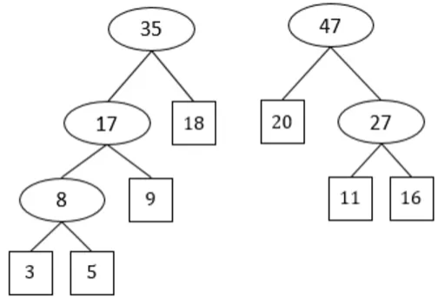
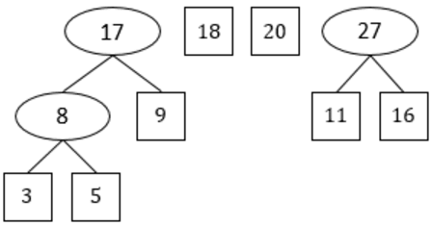

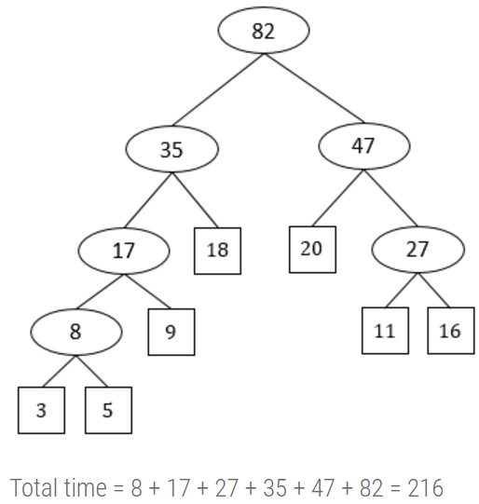
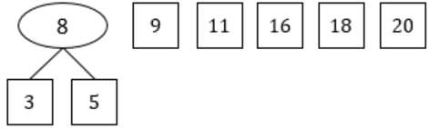
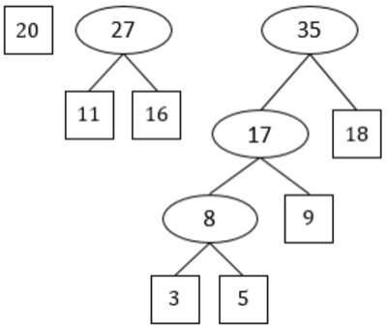
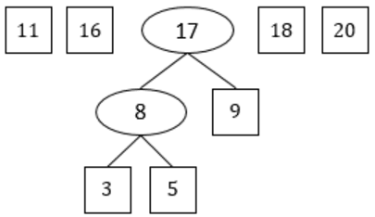
Example:
Example: Consider the sequence {3, 5, 9, 11, 16, 18, 20}. Find optimal merge patter for this data
Solution:
  At each step, merge the two smallest sequences

Slide 100
Thank You!

