Slide 1

Back Tracking and Branch & Bound

Slide 2

Outline
  Introduction
  The Eight queens problem
  Knapsack problem
  Travelling Salesman problem
Looping

Slide 3
Introduction

Slide 4
Backtracking
Backtracking can be defined as a general algorithmic technique that considers searching every possible combination in order to solve a problem.
In Dynamic programming we solve optimization problem where as back tracking is used when you have multiple solutions and you want all those solutions.
It is a Brut force approach, It generates state space tree for all possible solutions.
It traverse state space tree in the depth first order(while branch and bound follow breadth first search)
So, in a backtracking we attempt solving a sub-problem, and if we don't reach the desired solution, then undo whatever we did for solving that sub-problem, and try solving another sub-problem.
All the solutions require a set of constraints divided into two categories: explicit and implicit constraints.

Slide 5
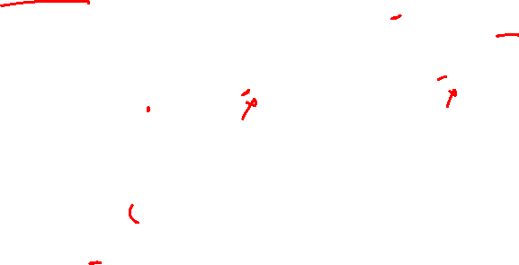
Example
In how many ways we can arrange 2 boys and 1 girl in a seating arrangement of 3 chair.
S
CONSTRAINT : girl should not sit in between
Apply bounding condition to kill the node
Once the bounding condition reached, no need to go further
B1
B2
G1
B2
G1
B1
G1
B1
B2
G1
B2
G1
B1
B2
B1

Slide 6

The N - Queens Problem
The $N$ - queen is the problem of placing N chess queens on an $N×N$ chessboard so that no two queens attack each other.
Two queens of same row, same column or the same diagonal can attack each other.
K-Promising solution: A solution is called k-promising if it arranges the k - queens such a way that, they can not threat each other.
Q
Q
Q
Q
 | Q
1 - Promising Solution
0 - Promising Solution
0 - Promising Solution
0 - Promising Solution

Slide 7
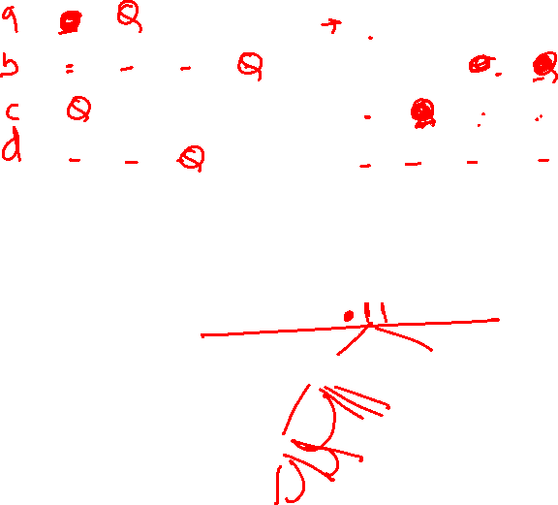
The 4 - queen Problem
C(16,4)
 | 1 | 2 | 3 | 4
 | Q
 | 1 | 2 | 3 | 4
 | Q
 | Q | Q | Q
 | Q | Q | Q | Q
 | 1 | 2 | 3 | 4
 |  |  | Q
 | Q
 | Q | Q | Q | Q
 | Q | Q
1 - Promising
2 - Promising
4 – Promising
<3, 1, 4, 2>
 | 1 | 2 | 3 | 4
1 |  | Q
2 |  |  |  | Q
3 | Q
4 |  |  | Q
Above 4-promising solution can be written as
<3, 1, 4, 2>
Another possible solution is
<2, 4, 1, 3>
4 – Promising <2, 4, 1, 3>

Slide 8
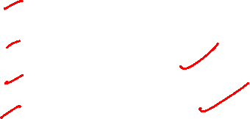
N - Queen Problem
Number of Queens | Possible Solutions
1 | 1
2 | 0
3 | 0
4 | 2
5 | 10
6 | 4
7 | 40
8 | 92
9 | 352
10 | 724

Slide 9
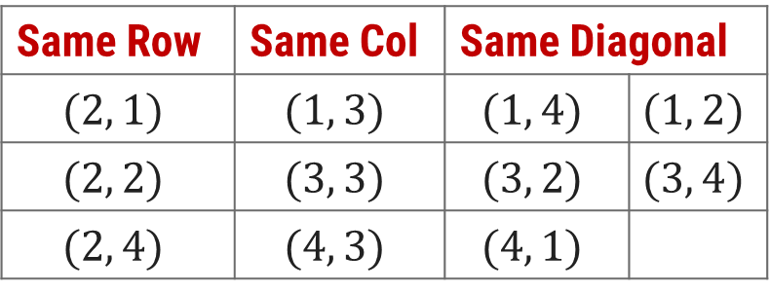


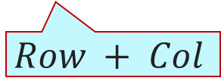
N - Queen Problem
Here, queen position is $(2, 3)$.
To identify the positions that can not be chosen, so that the queen does not attack.
The diagonal positions which are under attack are denoted as,
 | 1 | 2 | 3 | 4
1
2 |  |  | Q
3
4
Same Row | Same Col | Same Diagonal
$$(2, 1)$$ | $$(1, 3)$$ | $$(1, 4)$$ | $$(1, 2)$$
$$(2, 2)$$ | $$(3, 3)$$ | $$(3, 2)$$ | $$(3, 4)$$
$$(2, 4)$$ | $$(4, 3)$$ | $$(4, 1)$$
$$Row−Col$$
$$Row + Col$$

Slide 10
Algorithm
The algorithm is as follows -
Define a character array board of dimensions N\times NN×N and initialize all its entries with '.', where '.' represents the empty cell.
Start the process from the topmost row.
If all queens are placed return true.
Otherwise, for each of the columns in the current row do the following -
  If it is possible to place the queen in the current cell i.e.i.e. (row, col), place a queen in this cell.
  Check if placing the queen in the current cell leads to a valid solution. If yes, then print the solution and terminate the program.
  Otherwise, remove the queen from the current cell.
If all the columns are tried for a given row, Return false to trigger the backtracking.

Slide 11
Knapsack Problem
We are given a certain number of objects and a knapsack.
Instead of supposing that we have n objects available, we shall suppose that we have n types of object, and that an adequate number of objects of each type are available.
Our aim is to fill the knapsack in a way that maximizes the value of the included objects.
We may take an object or leave behind, but we may not take fraction of an object.

Slide 12
Knapsack Problem – Cont…
Initially solution is empty.
Left of the semicolon are weights of selected objects.
Right of the semicolon is the current total value of load.
Weight of objects
w = (2,3,4,5)
Corresponding value of each object
v = (3,5,6,10)
Capacity of Knapsack
W = 8
Now, apply depth first search
; 0
2 ; 3
3 ; 5
4 ; 6
5 ; 10
2,2; 6
2,3; 8
2,4; 9
2,5; 13
3,3; 10
3,4; 11
3,5; 15
4,4; 12
2,2,2; 9
2,2,3; 11
2,2,4; 12
2,3,3; 13
Store solution if optimal solution is found
2,2,2,2; 12

Slide 13
Knapsack Problem – Algorithm
function backpack(i, r)
{Calculates the value of the best load that can be constructed using items of type i to n and whose total weight does not exceed r}
b ← 0
{Try each allowed kind of item in turn}
for k ← i to n do
if w[k] ≤ r then
b ← max(b, v[k] + backpack (k, r – w[k]))
return b

Slide 14
Travelling Salesman Problem
Given a set of cities and distance between every pair of vertices the problem is to find the shortest possible route that visits every city once and returns to the starting city.
A
D
B
C
Notes:
http://www.techiedelight.com/travelling-salesman-problem-using-branch-and-bound/
https://www.youtube.com/watch?v=RR7GXoWiUw4

Slide 15
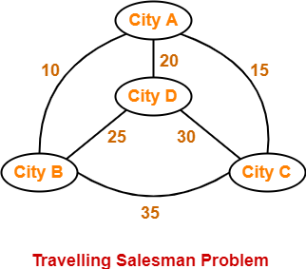
TSP
Travelling Salesman Problem states-
  A salesman has to visit every city exactly once.
  He has to come back to the city from where he starts his journey.
  What is the shortest possible route that the salesman must follow to complete his tour?
The following graph shows a set of cities and distance between every pair of cities-

Slide 16
If salesman starting city is A, then a TSP tour in the graph is-
A → B → D → C → A
Cost of the tour
= 10 + 25 + 30 + 15
= 80 units

Slide 17
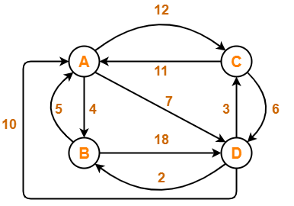
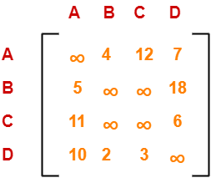
Problem:
Solve Travelling Salesman Problem using Branch and Bound Algorithm in the following graph-
Step-01:
Write the initial cost matrix and reduce it-

Slide 18
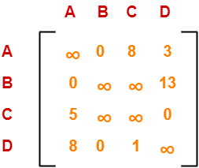
Rules
To reduce a matrix, perform the row reduction and column reduction of the matrix separately.
A row or a column is said to be reduced if it contains at least one entry ‘0’ in it.
Row Reduction-
Consider the rows of above matrix one by one.
If the row already contains an entry ‘0’, then-
  There is no need to reduce that row.
If the row does not contains an entry ‘0’, then-
  Reduce that particular row.
  Select the least value element from that row.
  Subtract that element from each element of that row.
  This will create an entry ‘0’ in that row, thus reducing that row.
Following this, we have-
  Reduce the elements of row-1 by 4.
  Reduce the elements of row-2 by 5.
  Reduce the elements of row-3 by 6.
  Reduce the elements of row-4 by 2.
Performing this, we obtain the following row-reduced matrix-

Slide 19
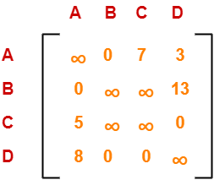
Column Reduction-
Consider the columns of above row-reduced matrix one by one.
If the column already contains an entry ‘0’, then-
  There is no need to reduce that column.
If the column does not contains an entry ‘0’, then-
  Reduce that particular column.
  Select the least value element from that column.
  Subtract that element from each element of that column.
  This will create an entry ‘0’ in that column, thus reducing that column.
Following this, we have-
  There is no need to reduce column-1.
  There is no need to reduce column-2.
  Reduce the elements of column-3 by 1.
  There is no need to reduce column-4.
Performing this, we obtain the following column-reduced matrix-
Finally, the initial distance matrix is completely reduced.
Now, we calculate the cost of node-1 by adding all the reduction elements.
Cost(1)
= Sum of all reduction elements
= 4 + 5 + 6 + 2 + 1
= 18

Slide 20
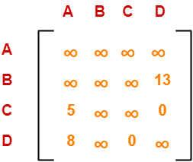

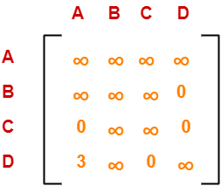
Step-02:
We consider all other vertices one by one.
We select the best vertex where we can land upon to minimize the tour cost.
Choosing To Go To Vertex-B: Node-2 (Path A → B)
From the reduced matrix of step-01, M[A,B] = 0
Set row-A and column-B to ∞
Set M[B,A] = ∞
Now, resulting cost matrix is-
We reduce this matrix.
Then, we find out the cost of node-02.
Cost(2)
= Cost(1) + Sum of reduction elements + M[A,B]
= 18 + (13 + 5) + 0
= 36
Column Reduction-
Reduce the elements of column-1 by 5.
We can not reduce column-2 as all its elements are ∞.
There is no need to reduce column-3.
There is no need to reduce column-4.
Row Reduction-
We can not reduce row-1 as all its elements are ∞.
Reduce all the elements of row-2 by 13.
There is no need to reduce row-3.
There is no need to reduce row-4.

Slide 21
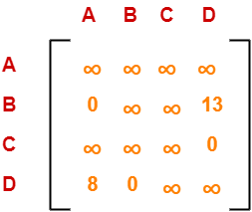
Choosing To Go To Vertex-C: Node-3 (Path A → C)
From the reduced matrix of step-01, M[A,C] = 7
Set row-A and column-C to ∞
Set M[C,A] = ∞
Now, resulting cost matrix is-
Cost(3)
= Cost(1) + Sum of reduction elements + M[A,C]
= 18 + 0 + 7
= 25
Row Reduction-
We can not reduce row-1 as all its elements are ∞.
There is no need to reduce row-2.
There is no need to reduce row-3.
There is no need to reduce row-4.
Thus, the matrix is already row-reduced.
Column Reduction-
There is no need to reduce column-1.
There is no need to reduce column-2.
We can not reduce column-3 as all its elements are ∞.
There is no need to reduce column-4.

Slide 22
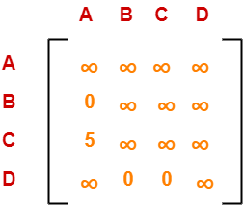
Choosing To Go To Vertex-D: Node-4 (Path A → D)
From the reduced matrix of step-01, M[A,D] = 3
Set row-A and column-D to ∞
Set M[D,A] = ∞
Now, resulting cost matrix is-
Cost(4)
= Cost(1) + Sum of reduction elements + M[A,D]
= 18 + 5 + 3
= 26
Row Reduction-
We can not reduce row-1 as all its elements are ∞.
There is no need to reduce row-2.
Reduce all the elements of row-3 by 5.
There is no need to reduce row-4.
Column Reduction-
There is no need to reduce column-1.
There is no need to reduce column-2.
There is no need to reduce column-3.
We can not reduce column-4 as all its elements are ∞.

Slide 23
Thus, we have-
Cost(2) = 36 (for Path A → B)
Cost(3) = 25 (for Path A → C)
Cost(4) = 26 (for Path A → D)
We choose the node with the lowest cost.
Since cost for node-3 is lowest, so we prefer to visit node-3.
Thus, we choose node-3 i.e. path A → C.

Slide 24
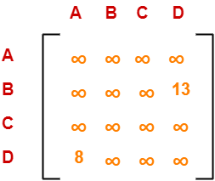
Step-03:
We explore the vertices B and D from node-3.
We now start from the cost matrix at node-3 which is-
Choosing To Go To Vertex-B: Node-5 (Path A → C → B)
From the reduced matrix of step-02, M[C,B] = ∞
Set row-C and column-B to ∞
Set M[B,A] = ∞
Now, resulting cost matrix is-
Cost(5)
= cost(3) + Sum of reduction elements + M[C,B]
= 25 + (13 + 8) + ∞
= ∞
Cost(3) = 25
Row Reduction-
We can not reduce row-1 as all its elements are ∞.
Reduce all the elements of row-2 by 13.
We can not reduce row-3 as all its elements are ∞.
Reduce all the elements of row-4 by 8.
Column Reduction-
There is no need to reduce column-1.
We can not reduce column-2 as all its elements are ∞.
We can not reduce column-3 as all its elements are ∞.
There is no need to reduce column-4.

Slide 25
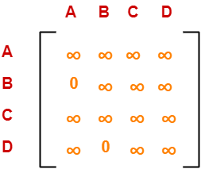
Choosing To Go To Vertex-D: Node-6 (Path A → C → D)
From the reduced matrix of step-02, M[C,D] = ∞
Set row-C and column-D to ∞
Set M[D,A] = ∞
Now, resulting cost matrix is-
Cost(6)
= cost(3) + Sum of reduction elements + M[C,D]
= 25 + 0 + 0
= 25
Row Reduction-
We can not reduce row-1 as all its elements are ∞.
There is no need to reduce row-2.
We can not reduce row-3 as all its elements are ∞.
We can not reduce row-4 as all its elements are ∞.
Column Reduction-
There is no need to reduce column-1.
We can not reduce column-2 as all its elements are ∞.
We can not reduce column-3 as all its elements are ∞.
We can not reduce column-4 as all its elements are ∞
Thus, we have-
Cost(5) = ∞ (for Path A → C → B)
Cost(6) = 25 (for Path A → C → D)
We choose the node with the lowest cost.
Since cost for node-6 is lowest, so we prefer to visit node-6.
Thus, we choose node-6 i.e. path C → D.

Slide 26
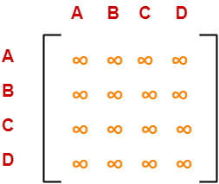
Step-04:
We explore vertex B from node-6.
We start with the cost matrix at node-6 which is-
Choosing To Go To Vertex-B: Node-7 (Path A → C → D → B)
From the reduced matrix of step-03, M[D,B] = 0
Set row-D and column-B to ∞
Set M[B,A] = ∞
Now, resulting cost matrix is-
Cost(6) = 25
Thus, the matrix is already column reduced: column and row reduced.
Cost(7)
= cost(6) + Sum of reduction elements + M[D,B]
= 25 + 0 + 0
= 25
Thus,
Optimal path is: A → C → D → B → A
Cost of Optimal path = 25 units

