Slide 1
Histopathologic Cancer Detection through Deep Learning and Big Data
Smith S Trivedi
3rd year project
LICET

Slide 2
Abstract
To detect cancer in early stages of its growth is a difficult and rare due to limitation of technology available in medical science therefore we can introduce a computerized and highly efficient system that can reduce the job of a pathologist by detecting metastatic cancer from the image patches taken from larger pathology scans. This idea is implemented by processing big data and applying machine learning algorithms such as CNN and statistical analysis to achieve the maximum accuracy out of it. This idea saves time and helps in detecting cancer before its too late.

Slide 3
About the domain
The histopathological images are glass slide microscope images of lymph nodes that are stained with hematoxylin and eosin (H&E).
Lymph nodes are small glands that filter the fluid in the lymphatic system and they are the first place a breast cancer is likely to spread. Histological assessment of lymph node metastases is part of determining the stage of breast cancer in TNM classification which is a globally recognized standard for classifying the extent of spread of cancer.

Slide 4
Problem faced
The diagnostic procedure for pathologists is tedious and time-consuming as a large area of tissue has to be examined and small metastases can be easily missed.

Slide 5
Problem solution
To identify metastatic cancer in small image patches taken from larger digital pathology scans.
Identify the presence of metastases from 96 x 96px digital histopathology images. One key challenge is that the metastases can be as small as single cells in a large area of tissue.

Slide 6
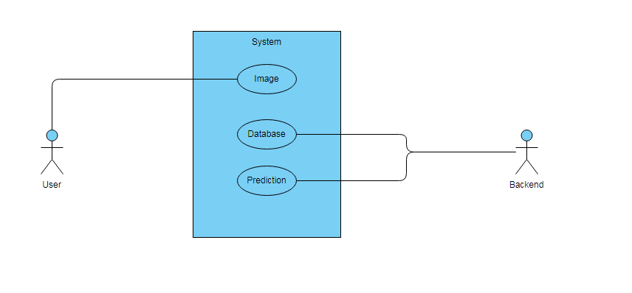
Use case diagram

Slide 7
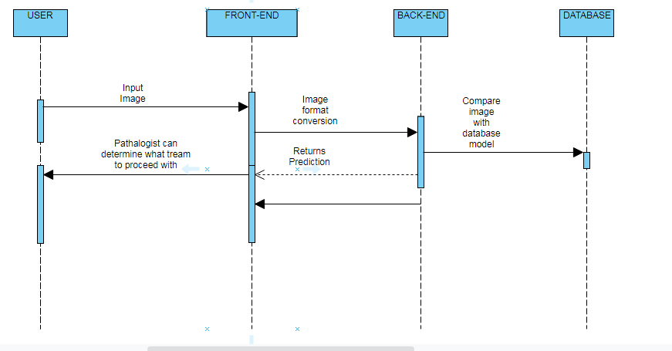
Sequence diagram

Slide 8
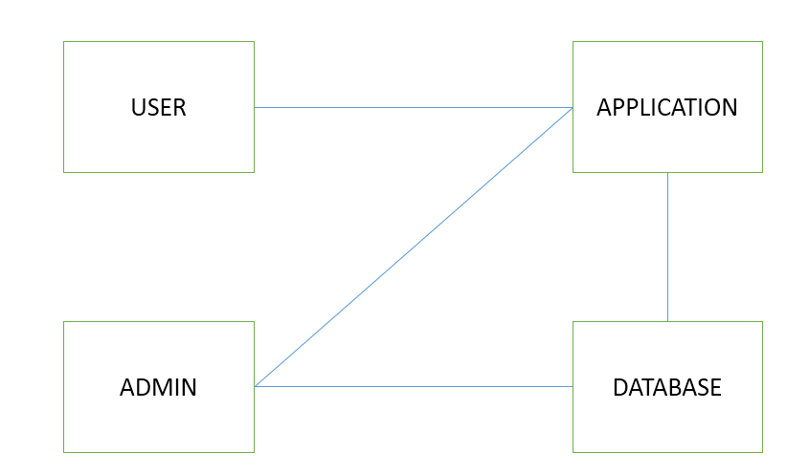
Collaboration Diagram
Histopathological Digital image
compare
Predict
Train

Slide 9
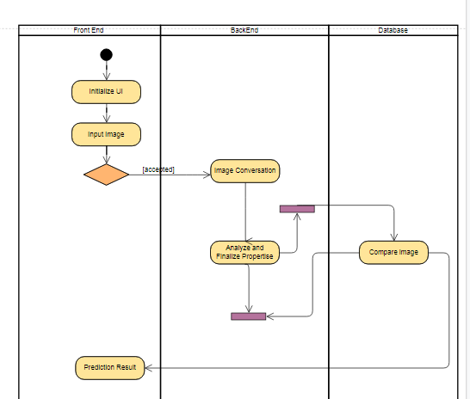
Activity Diagram

Slide 10
Techniques applied
Data Analysis – Preprocessing and analysis
Machine Learning – CNN
Statistic – ROC

Slide 11
Data understanding
What data do we have available?
220k training images and 57k evaluation images.
Training distribution 60/40(negative/positive)
A positive label means that there is at least one pixel of tumor tissue in the center region (32 x 32px) of the image. Tumor tissue in the outer region of the patch does not influence the label.

Slide 12
File description
Format | TIF
Size | 96 x 96
Channels | 3
Bits per channel | 8
Data type | Unsigned char
Compression | Jpeg

Slide 13
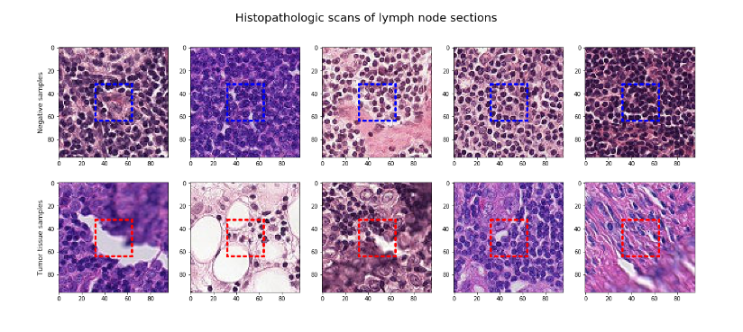
Data Visualization

Slide 14
Preprocessing Big Data - Augmentation
The augmentations we can use for this type of data:
random rotation
random crop
random flip (horizontal and vertical both)
random lighting

Slide 15
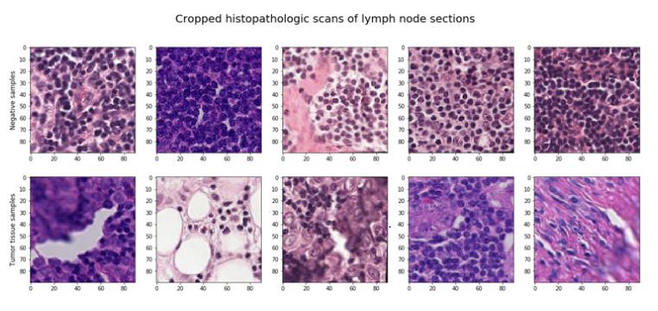
Augmented data

Slide 16
Modeling
Modeling with convolutional neural networks
Accuracy of 89% is achieved

