Slide 1

Containerizing Your Dev Env
Eric Smith
Principal Consultant
Strategic Data Systems Inc

Slide 2
What this talk is about
Running containers on developer’s local machines to support development efforts
Ensuring consistency across developer’s local environments
Speeding up local environment setup for new team members
Simplifying developing and testing changes in a distributed application

Slide 3
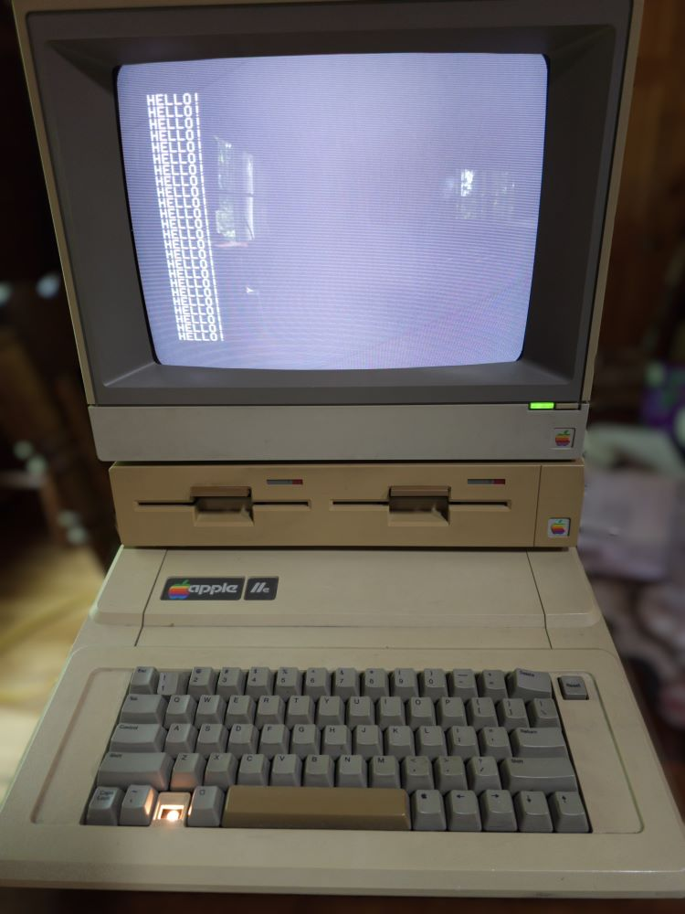
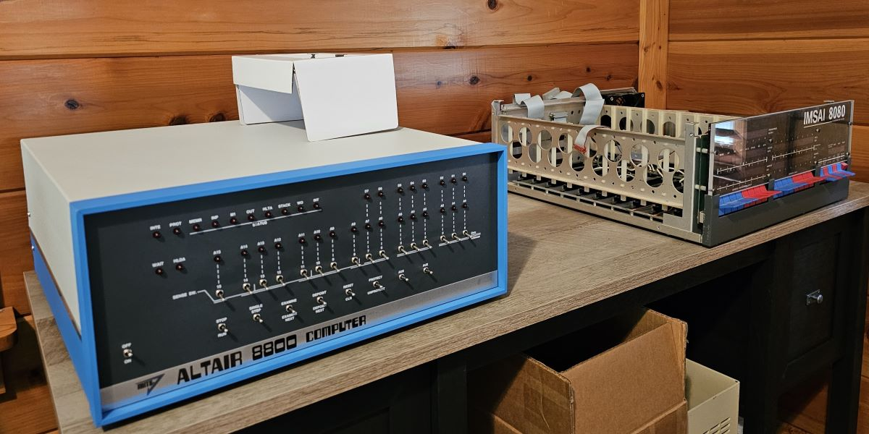
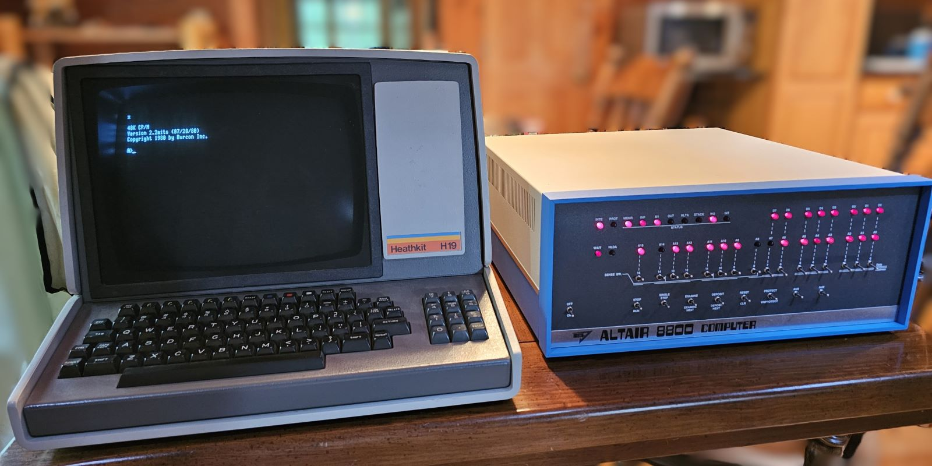
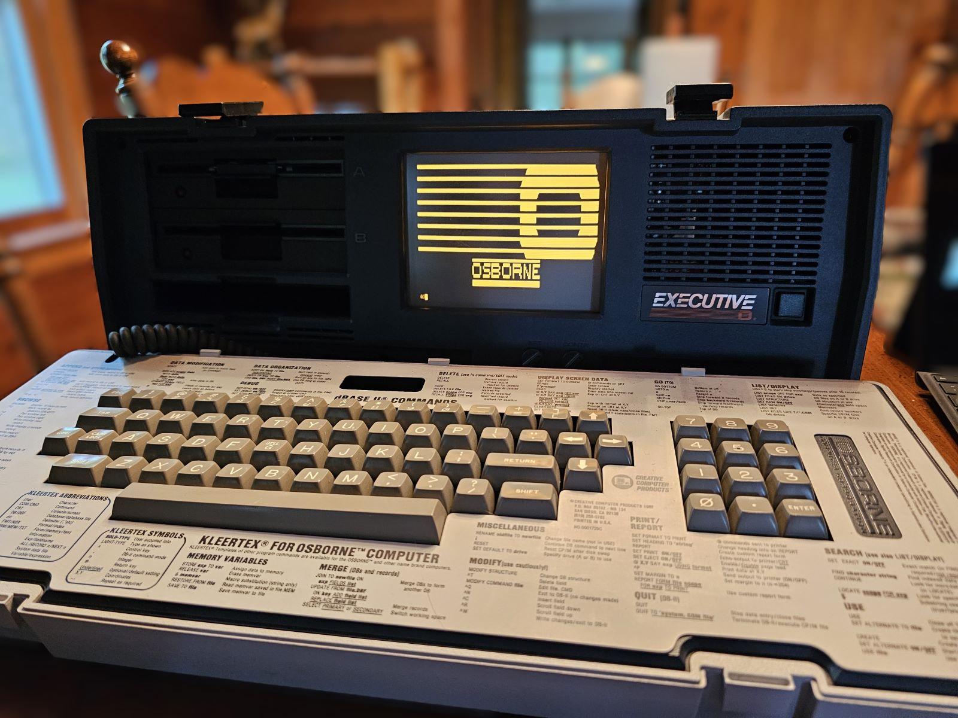
About me

Slide 4
The Problem Statement
Few applications truly stand alone.
Dependencies can be cumbersome to install and maintain.
Configurations can be many and difficult to maintain.
Environment issues can be difficult to detect and diagnose.
Huge time sink for maintenance that is repeated for new adds to the team, whenever hardware is replaced, or an environment becomes corrupt.

Slide 5
Containers

Slide 6
What are containers?
Self-contained execution environment
Deployable package with application, dependencies, and a virtualized operating system
Containers are not virtual machines
Should be “stateless”***
*** For some definitions of “stateless”

Slide 7
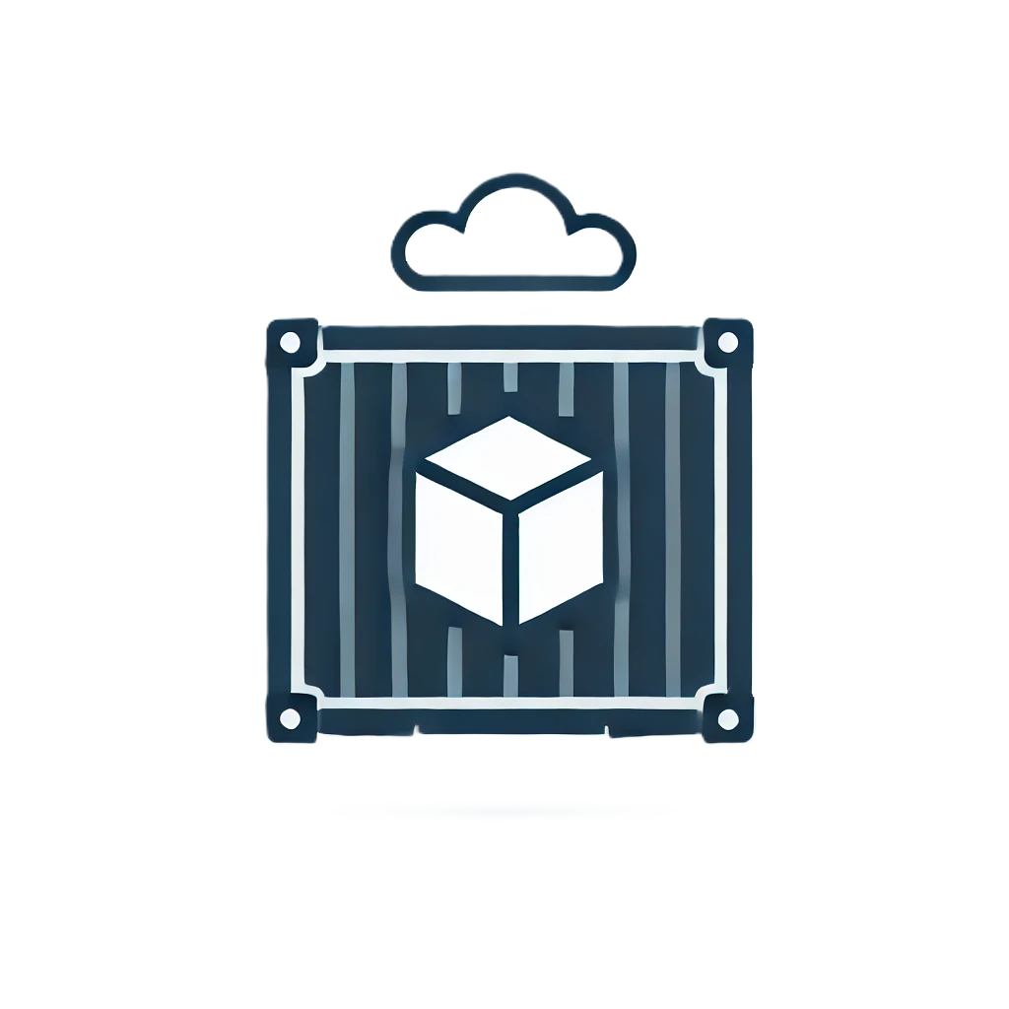
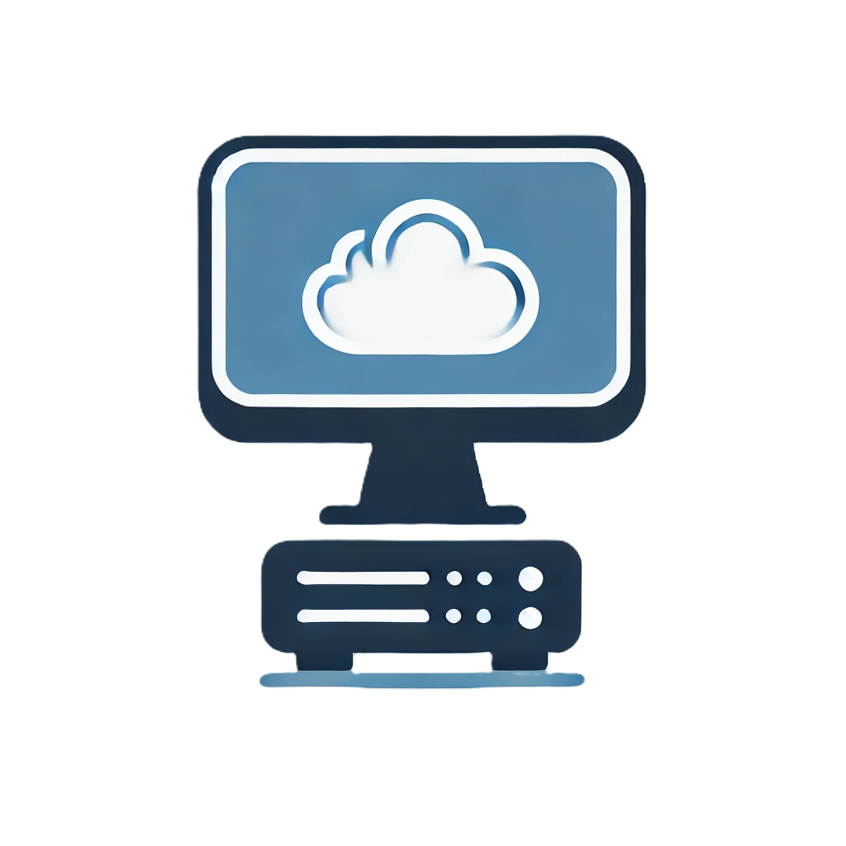
Containers vs. VMs

Slide 8
Why use containers?
Straightforward deployments
Consistent environments
Quick to start and stop
Conducive to “scaling out”

Slide 9
Docker
Docker Desktop – container management, host, etc.
Dockerfiles – recipe for building images
Images – packages ready to deploy as containers
Containers – an instance started from an image. A container can be started, stopped, and deleted independently from other application components

Slide 10
The Dockerfile
Basic Structure
Common Commands
Multi-stage Builds
Building an Image

Slide 11
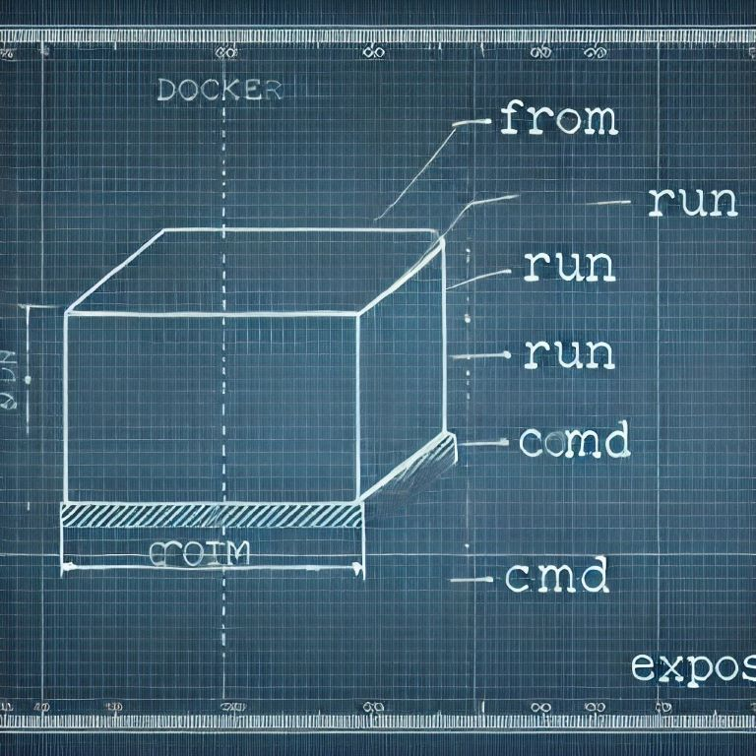
Demo 0 - Dockerfile

Slide 12
Basic Commands
FROM – Set the base image for each stage in the build and every stage must have a FROM instruction.
COPY – Copies files from the context source directory into the image’s destination directory
RUN – Executes commands to create a new layer in the image and the result is used in following layers.
CMD – Sets the command to run when the container runs
ENTRYPOINT – Alternative to CMD

Slide 13
Run our container
docker run --name weather -p 8080:54321 -p 8081:54322 -d weather.api
Creates the container from the weather.api image
-d starts detached
-p publishes ports on the host system
-P publishes all exposed ports on the host using Docker assigned port numbers

Slide 14
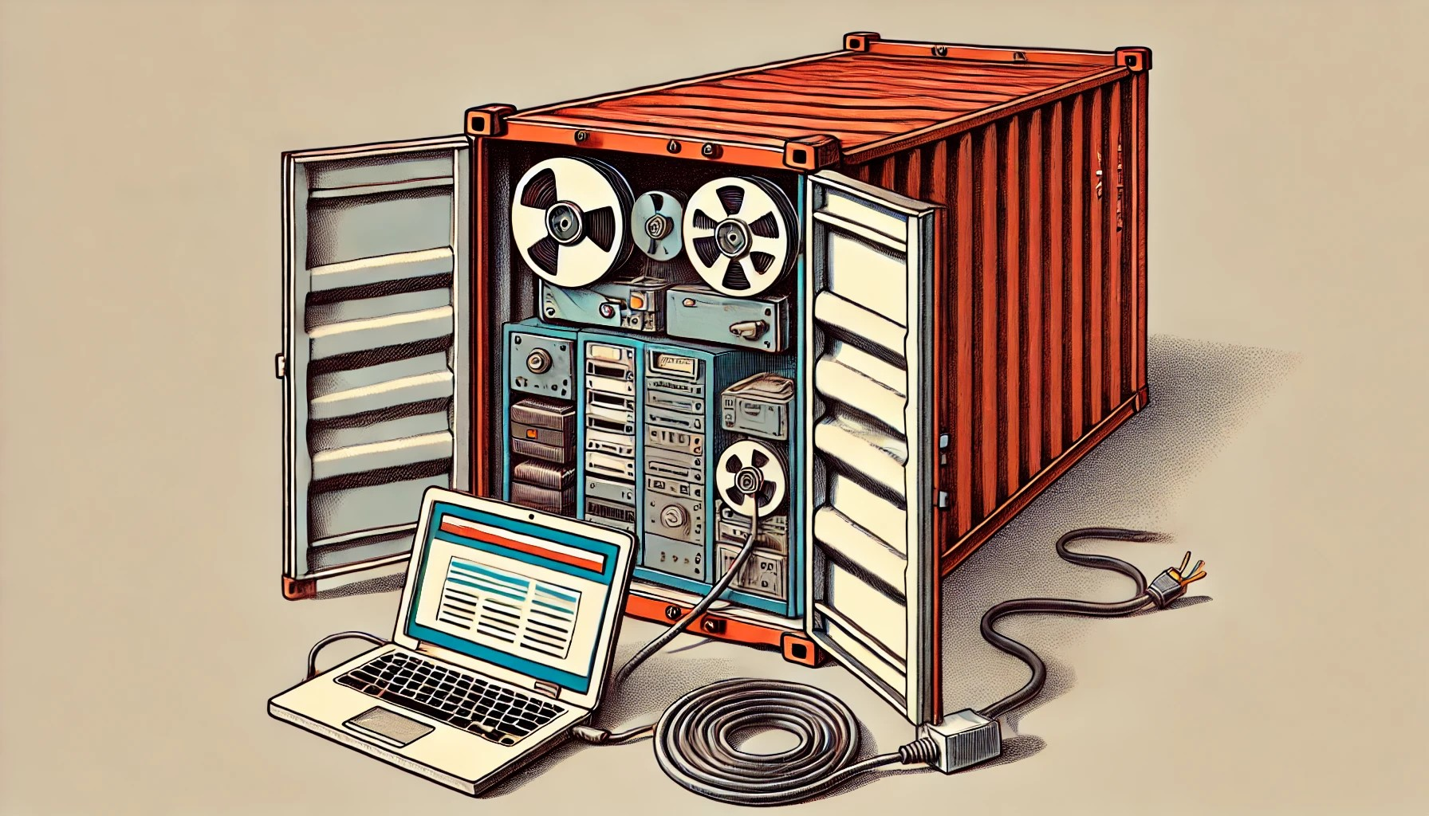
Scenario 1

Slide 15
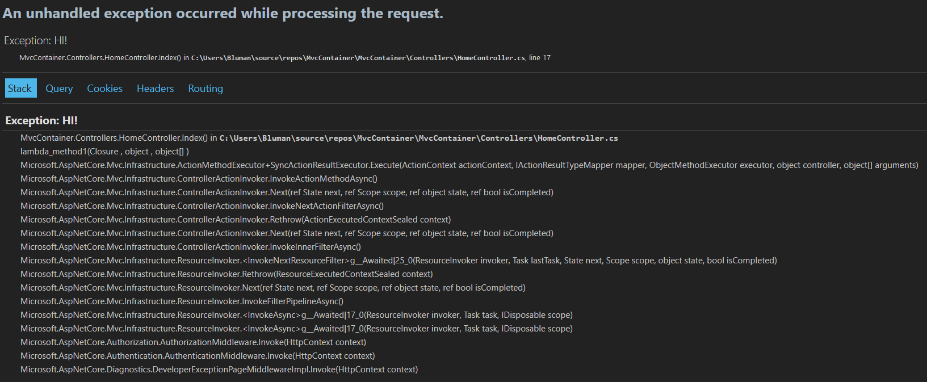
Integration testing with containers
But all the unit tests were green!

Slide 16
How do you integration test?

Slide 17
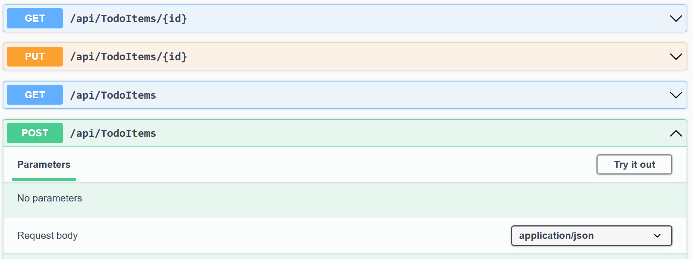
Does it look like this?

Slide 18
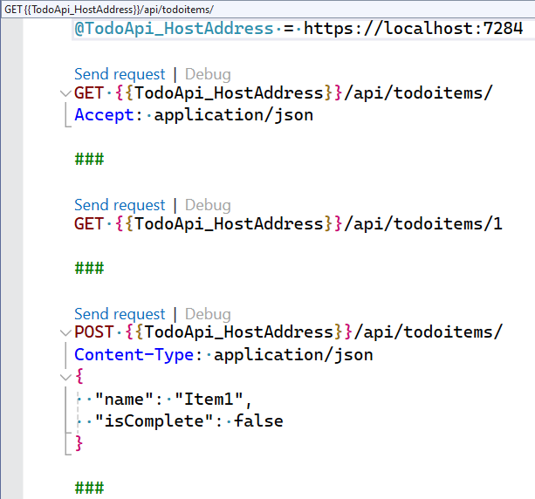
Or this?

Slide 19
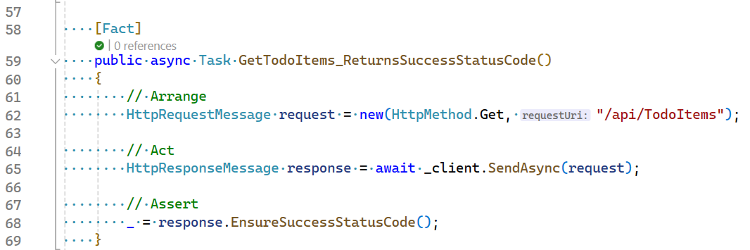
Should it look like this?

Slide 20
Managing state for tests
Are you constantly refreshing DB backups for testing?
Do you truncate and reseed identity?
Can you create your initial state using your application’s exposed APIs?
Should every test start from fresh?

Slide 21
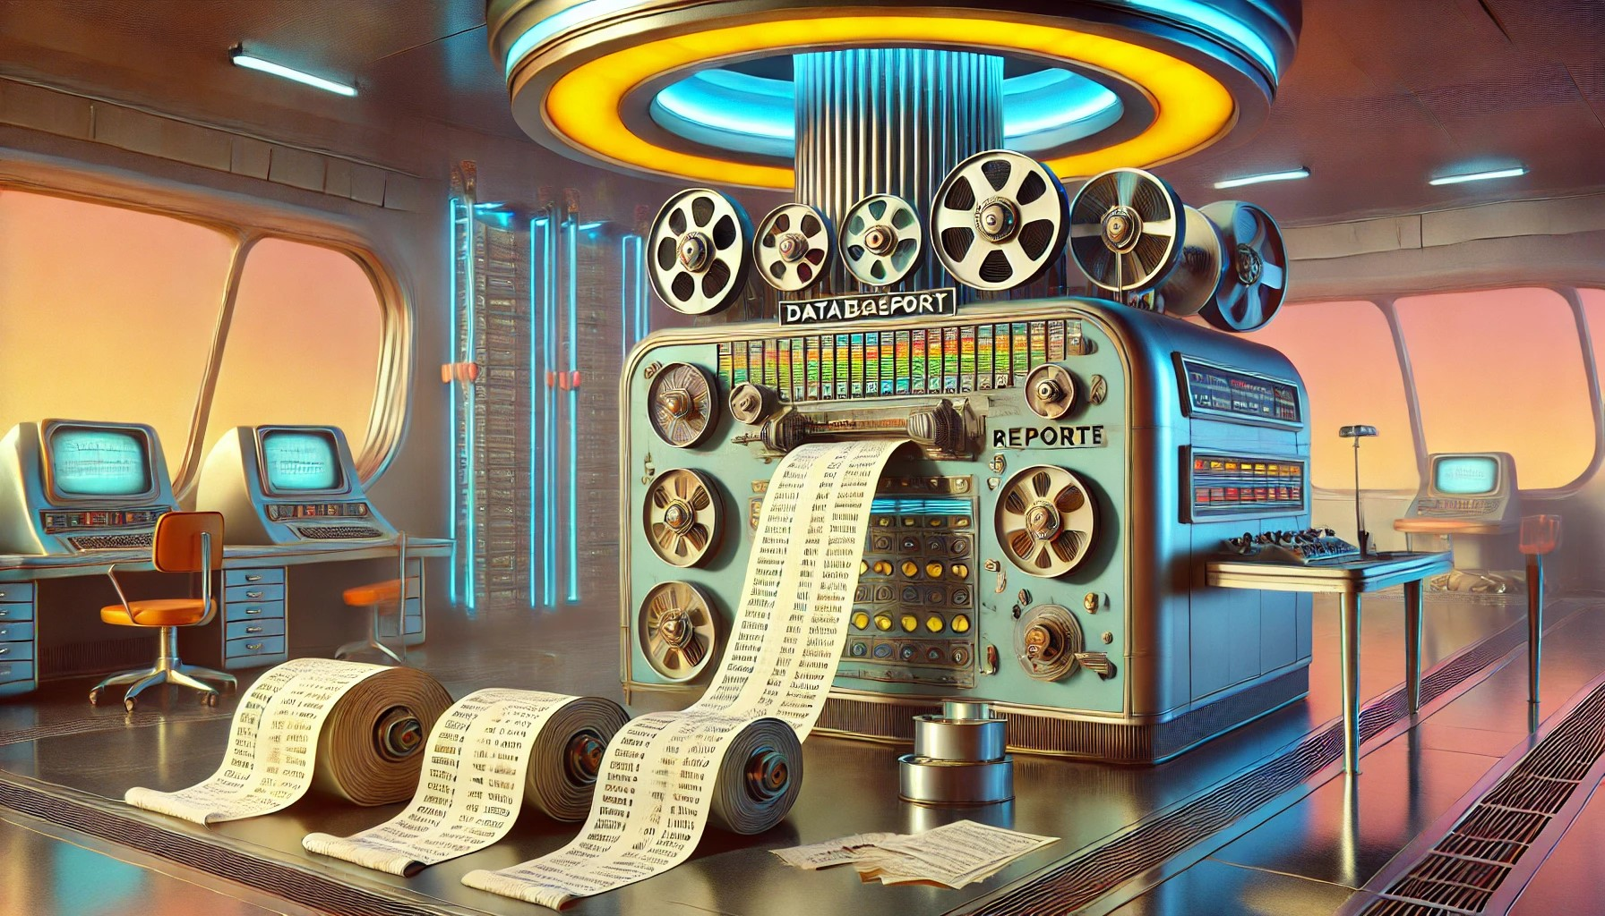
Demo 1 – Integration Testing

Slide 22
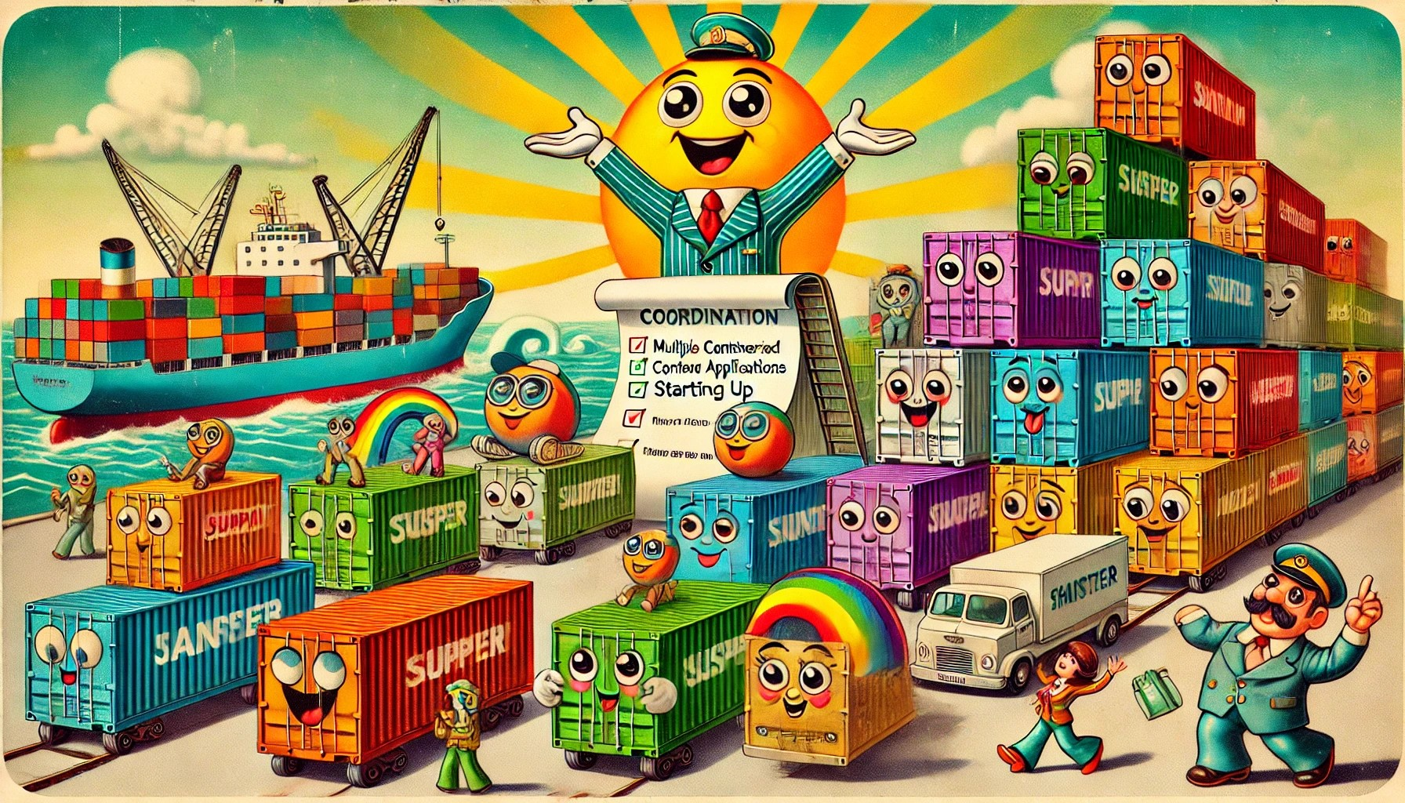
Scenario 2

Slide 23
Building more complex environments

Slide 24
Docker Compose
Tool that enables you to manage multiple containers through a single configuration
Start, stop, build
Coordinate start order
Apply health checks (if not in Dockerfile)

Slide 25
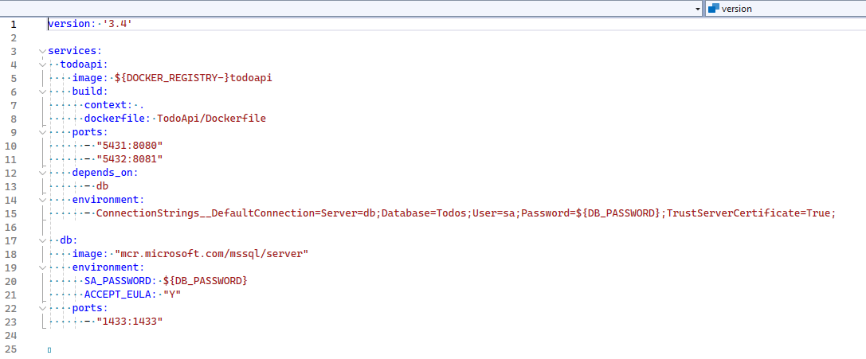
Starting multiple services

Slide 26
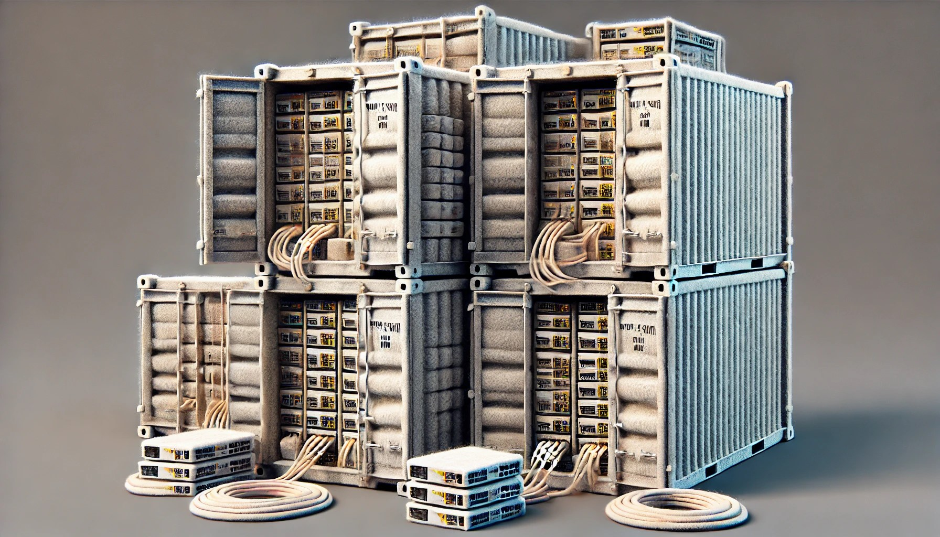
Demo 2 - Compose

Slide 27

Scenario 3

Slide 28
Ephemeral Containers
Called by a number of names: transient, worker, etc.
Execute briefly and then terminate, they are generally used to execute a single command or to achieve a specific state in a distributed application.
Example uses: seed or migrate databases, set configuration that can’t be set when a container is built or starting, query resources not exposed on the host, etc.

Slide 29

Demo 3 – Migration Service

Slide 30
.NET Aspire

Slide 31
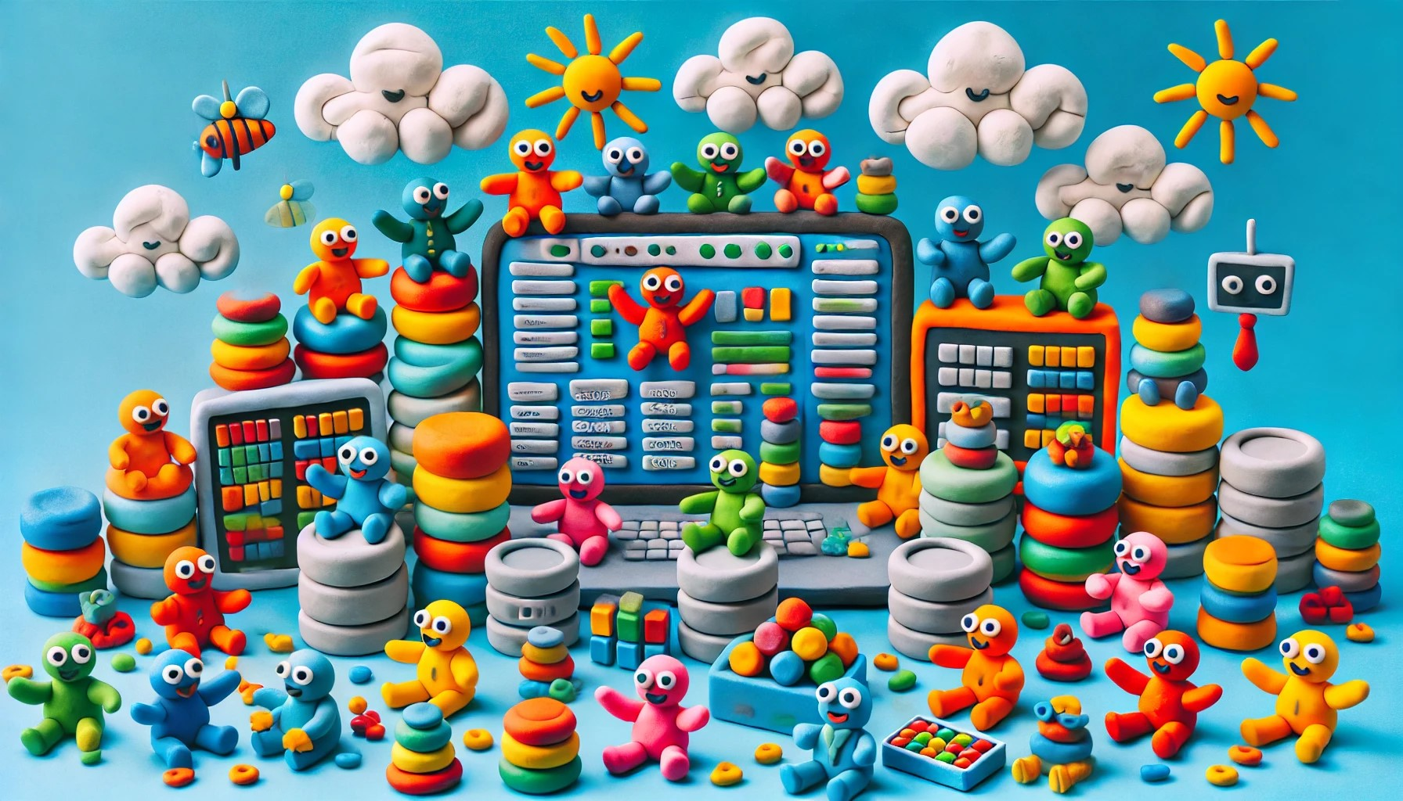
Demo 4

Slide 32
Scenario 5

Slide 33
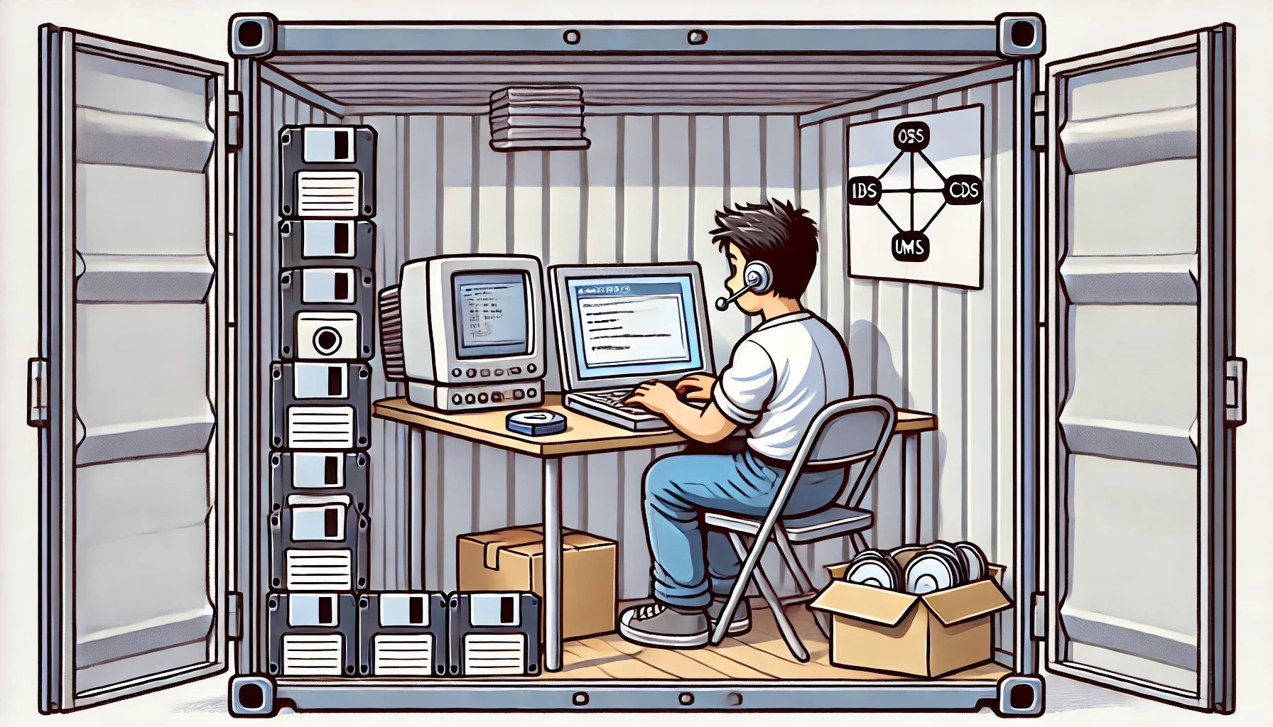
Demo 5

Slide 34
Discussion

