Slide 1
Containerizing Your Dev Env

Slide 2
What are containers?
Self-contained execution environment
Deployable package with application, dependencies, and a virtualized operating system
Containers are not virtual machines
Should be “stateless”***

Slide 3
Why use containers?
Straightforward deployments
Consistent environments
Quick to start and stop
Conducive to “scaling out”

Slide 4
Running a container
Pull an image
  docker pull docker/welcome-to-docker
Run the container
  docker run –name welcome -p 8090:80 -d docker/welcome-to-docker
It’s really that simple*
* Depending on configuration and external dependencies

Slide 5
Running our own container
Create our app
Write a Docker file
Build the image
Run our container

Slide 6
Create our app
We could create almost any ‘headless’ app
  .NET, Node.js, Java, C++, etc.
We’ll containerize the .NET Web API template
dotnet new webapi --use-controllers -o Weather.Api

Slide 7
Write a Docker file
Base images
Copy files
Run commands
Multistage builds
Compact images

Slide 8
Build the image
docker image build [OPTIONS] PATH | URL | -
Builds the image using specified Dockerfile and context

Slide 9
Run our container
docker run --name weather -p 8080:54321 -p 8081:54322 -d weather.api
Creates the container from the weather.api image
-d starts detached
-p publishes ports on the host system
-P publishes all exposed ports on the host using Docker assigned port numbers

Slide 10
Integration testing with containers

Slide 11
How do you integration test?

Slide 12
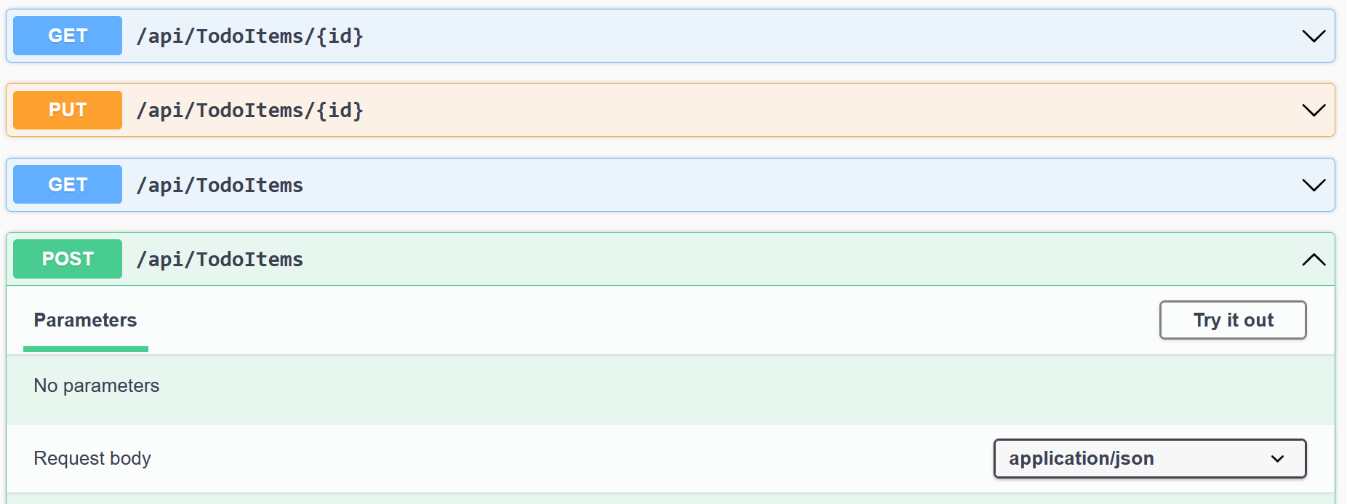
Does it look like this?

Slide 13
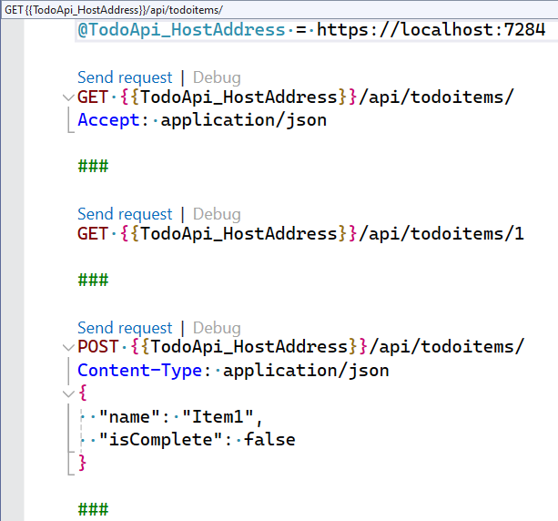
Or this?

Slide 14
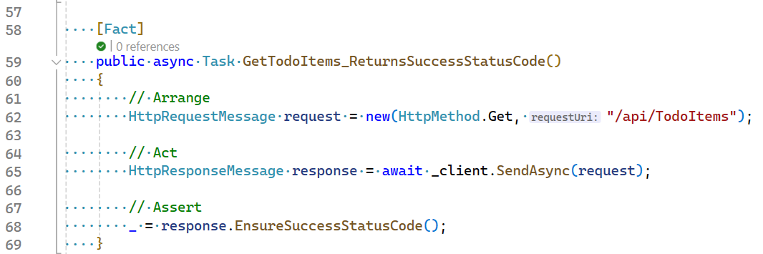
Should it look like this?

Slide 15
Managing state for tests
Are you constantly refreshing DB backups for testing?
Do you truncate and reseed identity?
Can you create your initial state using your application’s exposed APIs?

Slide 16
Building more complex environments

Slide 17
Docker Compose
Tool that enables you to manage multiple containers through a single configuration
Start, stop, build
Coordinate start order
Apply health checks (if not in Dockerfile)

