Slide 1
Performance Profiling
& Tuning Your C# Code

Slide 2
About Me
Principal Consultant at Strategic Data Systems
Professional software developer since 2018
Hobby programmer since mid-90s
Former and soon to be current again endurance cyclist 😅

Slide 3
What is performance?
Execution time?
Memory?
Data throughput?
…
…
What else?

Slide 4
When does performance matter?

Slide 5
Premature optimization is the root of all evil.
What does this even mean? When is optimization premature and why would it be evil?

Slide 6
Terminology
Hot Path – sections of code that are executed at high frequency
Allocation – specifically a heap allocation, requires finding and reserving memory space to store an object and may eventually require garbage collection

Slide 7
Measuring Performance

Slide 8
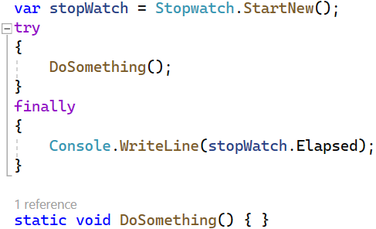
Timing
One of the simplest forms of runtime profiling
Often implemented with a try-finally, StopWatch, and a sink to record the timing

Slide 9
Benchmarking
Taking measurements from running code
Code is run through a test harness
Generally code is executed and measured in isolation but the entire application can still be benchmarked
Great tool for tuning performance critical code where nanoseconds count

Slide 10
How do we find where the problem lies?

Slide 11
Profiling
Sampling the entire application
Where your application spends the most time – hotpaths
What is taking memory, where, and when
When the Garbage Collector runs
See what gets collected and what survives
See thread usage or even when threads are blocked

