Slide 1
Refactoring With Design Patterns

Slide 2
Refactoring
“Cleaning up bad code.”
“Eliminating code smells.”
“Getting rid of duplicated code.”
“Making our code better.”
“Easier to use.”
“More maintainable”

Slide 3
What do we mean by better?
Readability
Maintainability
Testability

Slide 4
Design Patterns
Common approaches to typical software problems
Not concrete solutions to specific problems
Named patterns can increase or decrease software maintainability just like many of the code smells depending on implementation or nature of the specific problem
Common patterns: Builder, Strategy, Factory, Singleton, Facade, Decorator, Adapter, Command

Slide 5
SOLID
Single Responsibility Principle
Open-closed Principle
Liskov Substitution Principle
Interface Segregation Principle
Dependency Inversion Principle

Slide 6
DRY
Do not
Repeat
Yourself

Slide 7
YAGNI
You
Aren’t
Going to
Need
It

Slide 8
Code Smells & Caution
Code smells are often small patterns that hint at or are signs of deeper problems in a code base
Examples include: duplicated code, magic numbers, magic strings, complex boilerplate, large objects
Contrived complexity: trying to force a pattern to fit a problem in a way that increases complexity for little to negative benefit
Shotgun surgery: change in requirements needs many similar, small changes throughout the code base

Slide 9
Case Study 1
Simple Web API

Slide 10
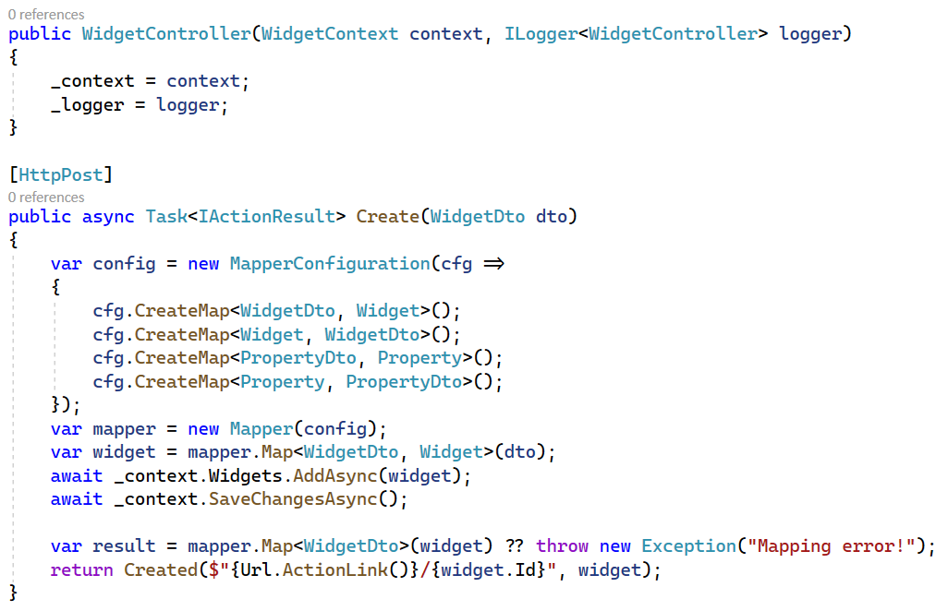
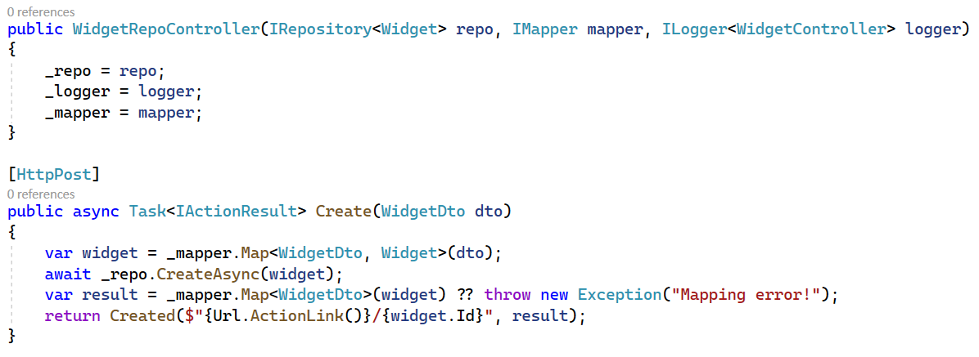
Dependency Inversion
Write to interfaces! “Depend upon abstractions, not concretions.”

Slide 11
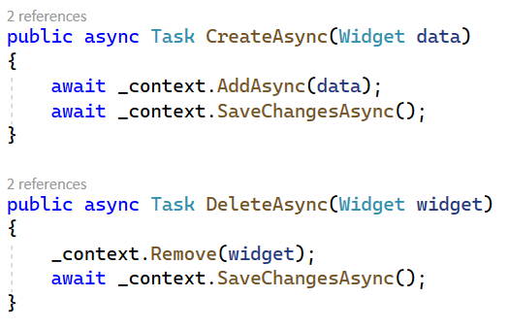
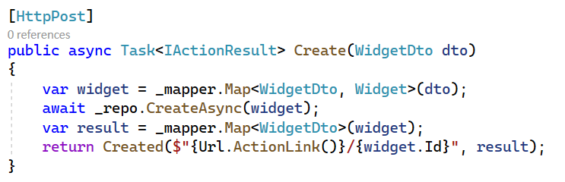
Repository Pattern
Abstraction over data layer
Centralized container for datastore operations
Consolidates data access code

Slide 12
Case Study 2
Word Counting Service

Slide 13
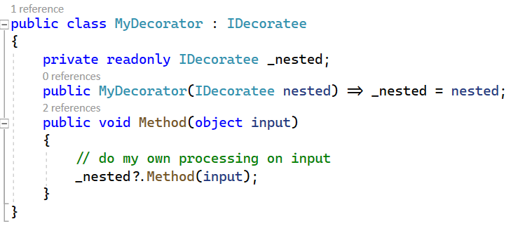
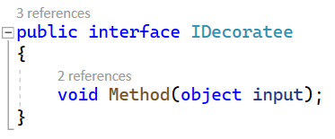
Decorator Pattern
Modifies the behavior of a type by wrapping the type and modifying inputs and/or outputs of nested type methods.
Can be used to chain calls or create a data processing pipeline

Slide 14
Case Study 3
Gilded Rose

