Slide 1
Type Driven Development

Slide 2
Phone Numbers
(800) 555-0137
1-800-555-0137
+1 (800) 555-0137
1 800 555 0137
18005550137
+1 (800) JKL-01DS
03-3224-9999
+1 03-3224-9999
011-81-3-3224-9999
+49 89 23548362
+30 21 0687 0099
+91 22 2630 4808

Slide 3
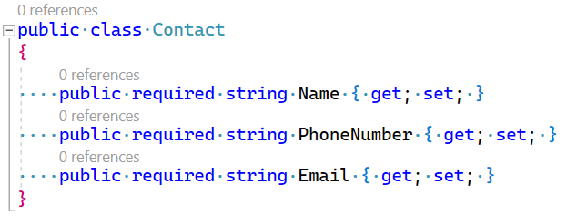
Phone Numbers in C#

Slide 4
What is Valid?

