Slide 1
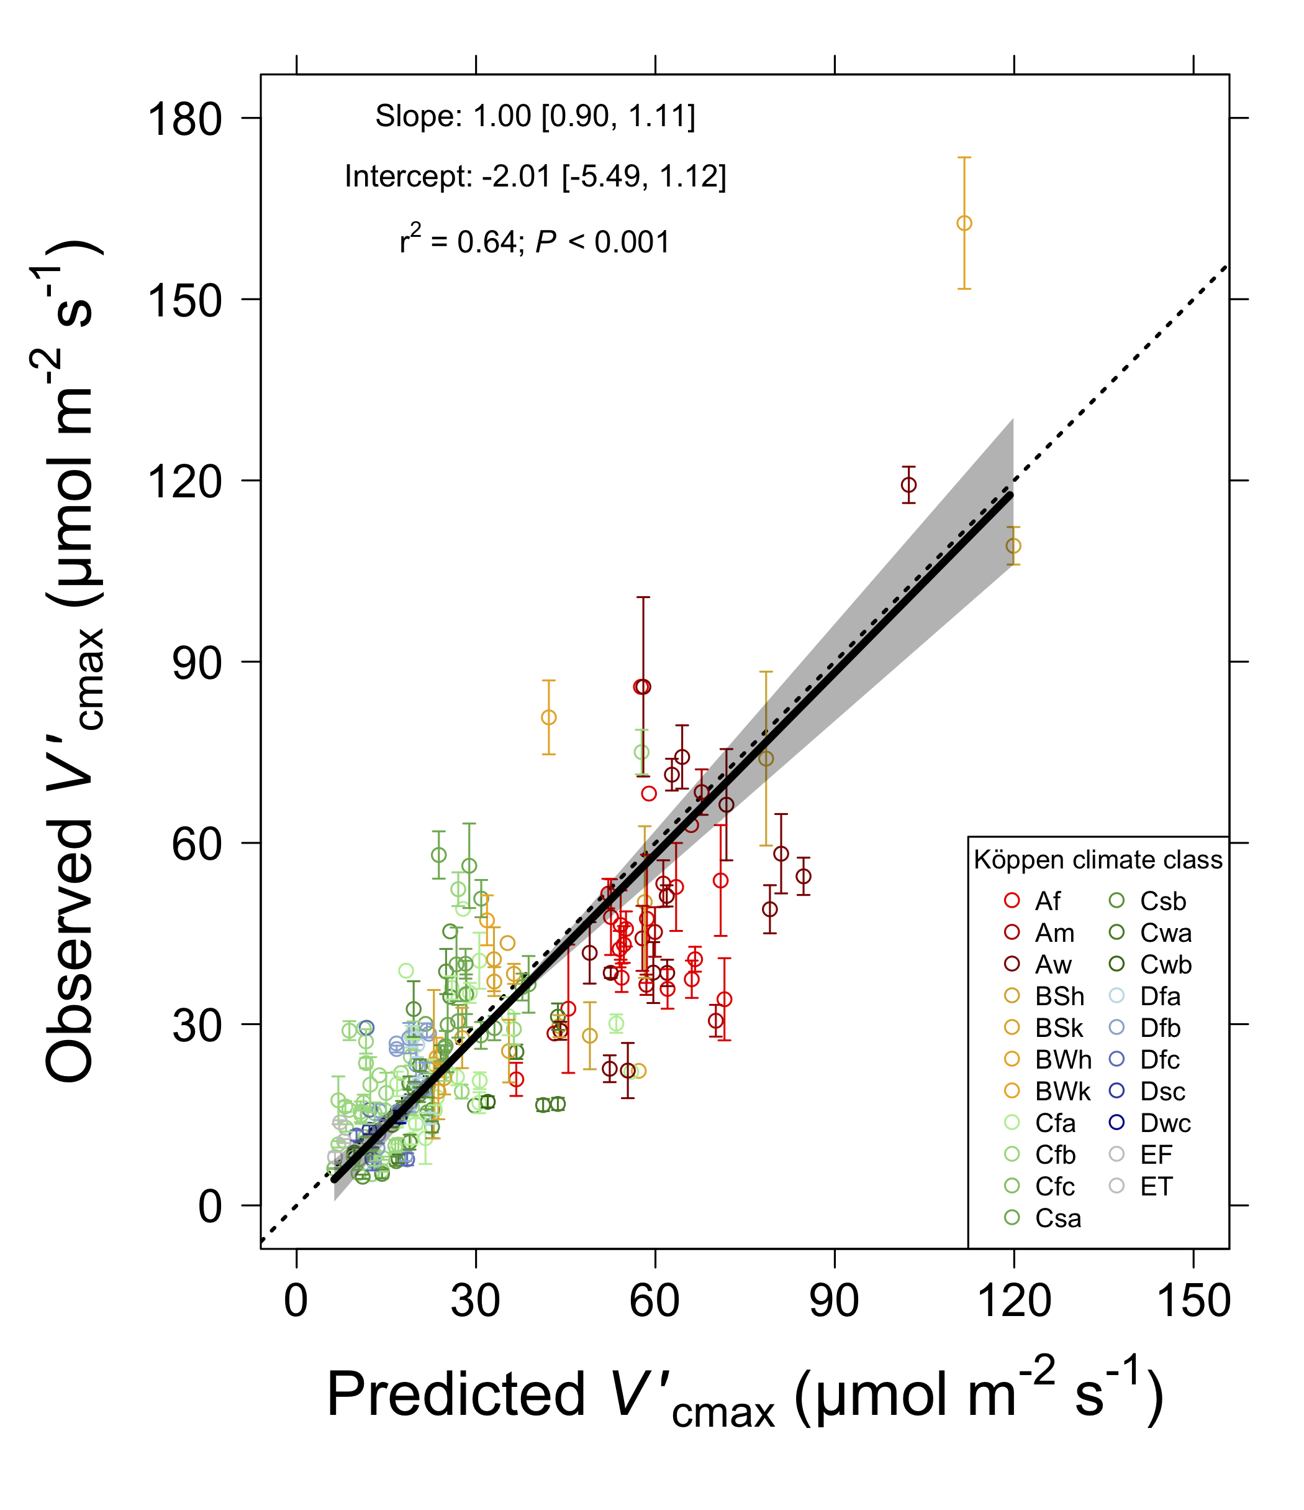
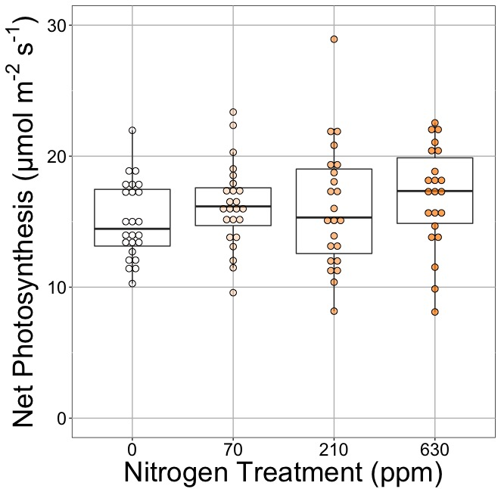
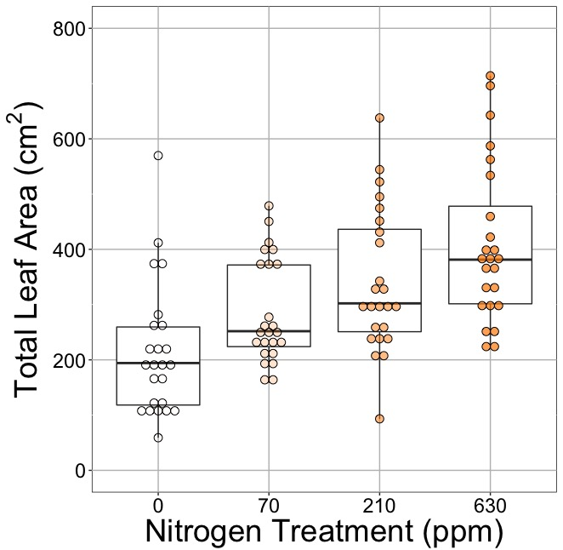
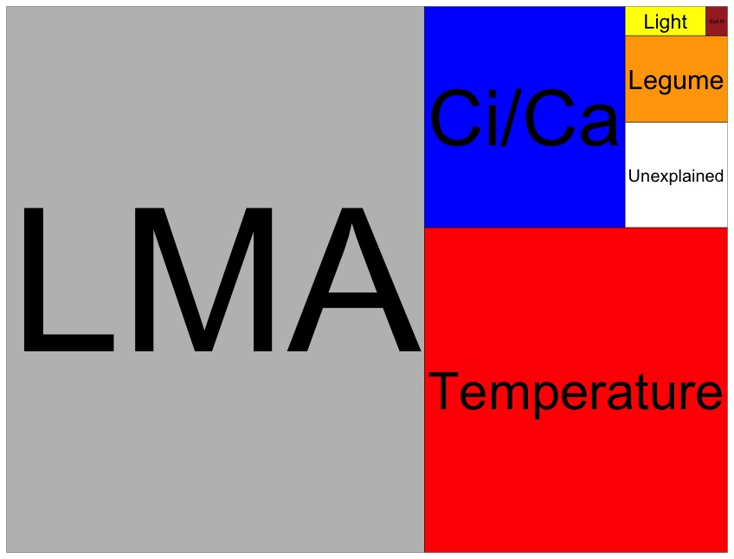
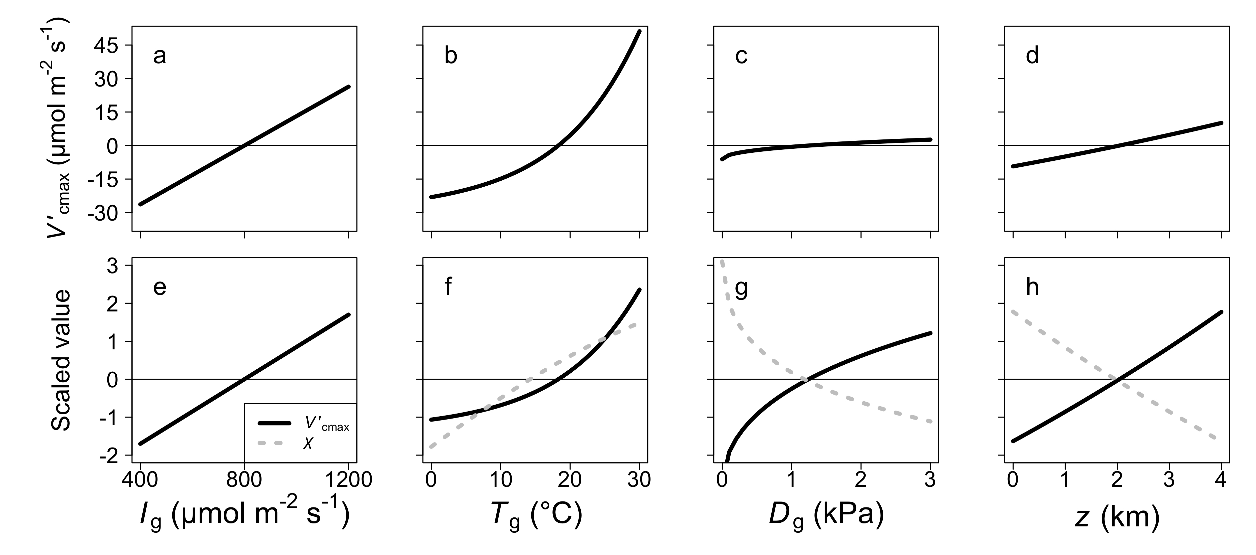
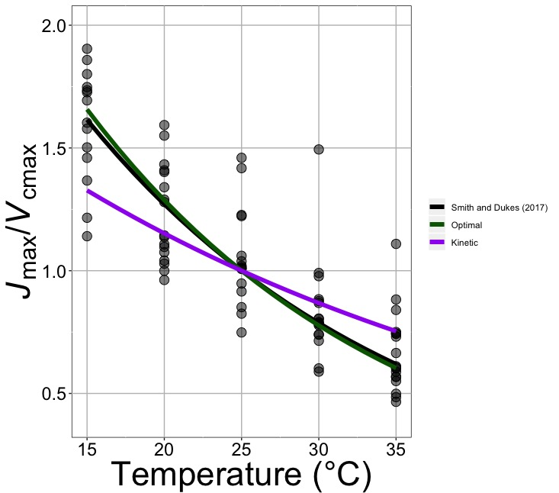
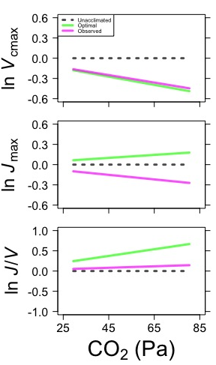
Using optimization theory to answer big questions in plant ecophysiology
Nick Smith, Texas Tech University
nick.smith@ttu.edu, @nick_greg_smith
Elizabeth Waring (TTU), Helen Scott (TTU), Trevor Keenan (Berkeley Lab), Han Wang (Tsinghua University), Colin Prentice (Imperial College)
Photosynthetic optimization: photosynthesis is maximized at the lowest cost, defined as water loss and nutrient use
Is photosynthesis optimized to the environment?
Do added nutrients increase photosynthesis?
Greenhouse grown cotton fertilization experiment
Drivers of leaf N_{area} at NutNet
(area proportional to variance explained)
Answer: Yes, photosynthetic capacity acclimates spatially as expected from optimization.
Answer: No. Soil nutrients act to increase biomass and/or storage, but not leaf photosynthesis.
Under what conditions do C4 species outcompete C3 species?
How will plants acclimate to future climates?
Red = C₄
Blue = C₃
Answer: With optimal acclimation, C4 plants have the strongest advantage over C3 plants in warm, dry, high light, and low CO2 environments
Answer: Higher temperatures → increase allocation to V_{cmax} and photosynthesis. Elevated CO2 → overinvestment in electron transport and higher, sub-optimal photosynthesis.

