Slide 1
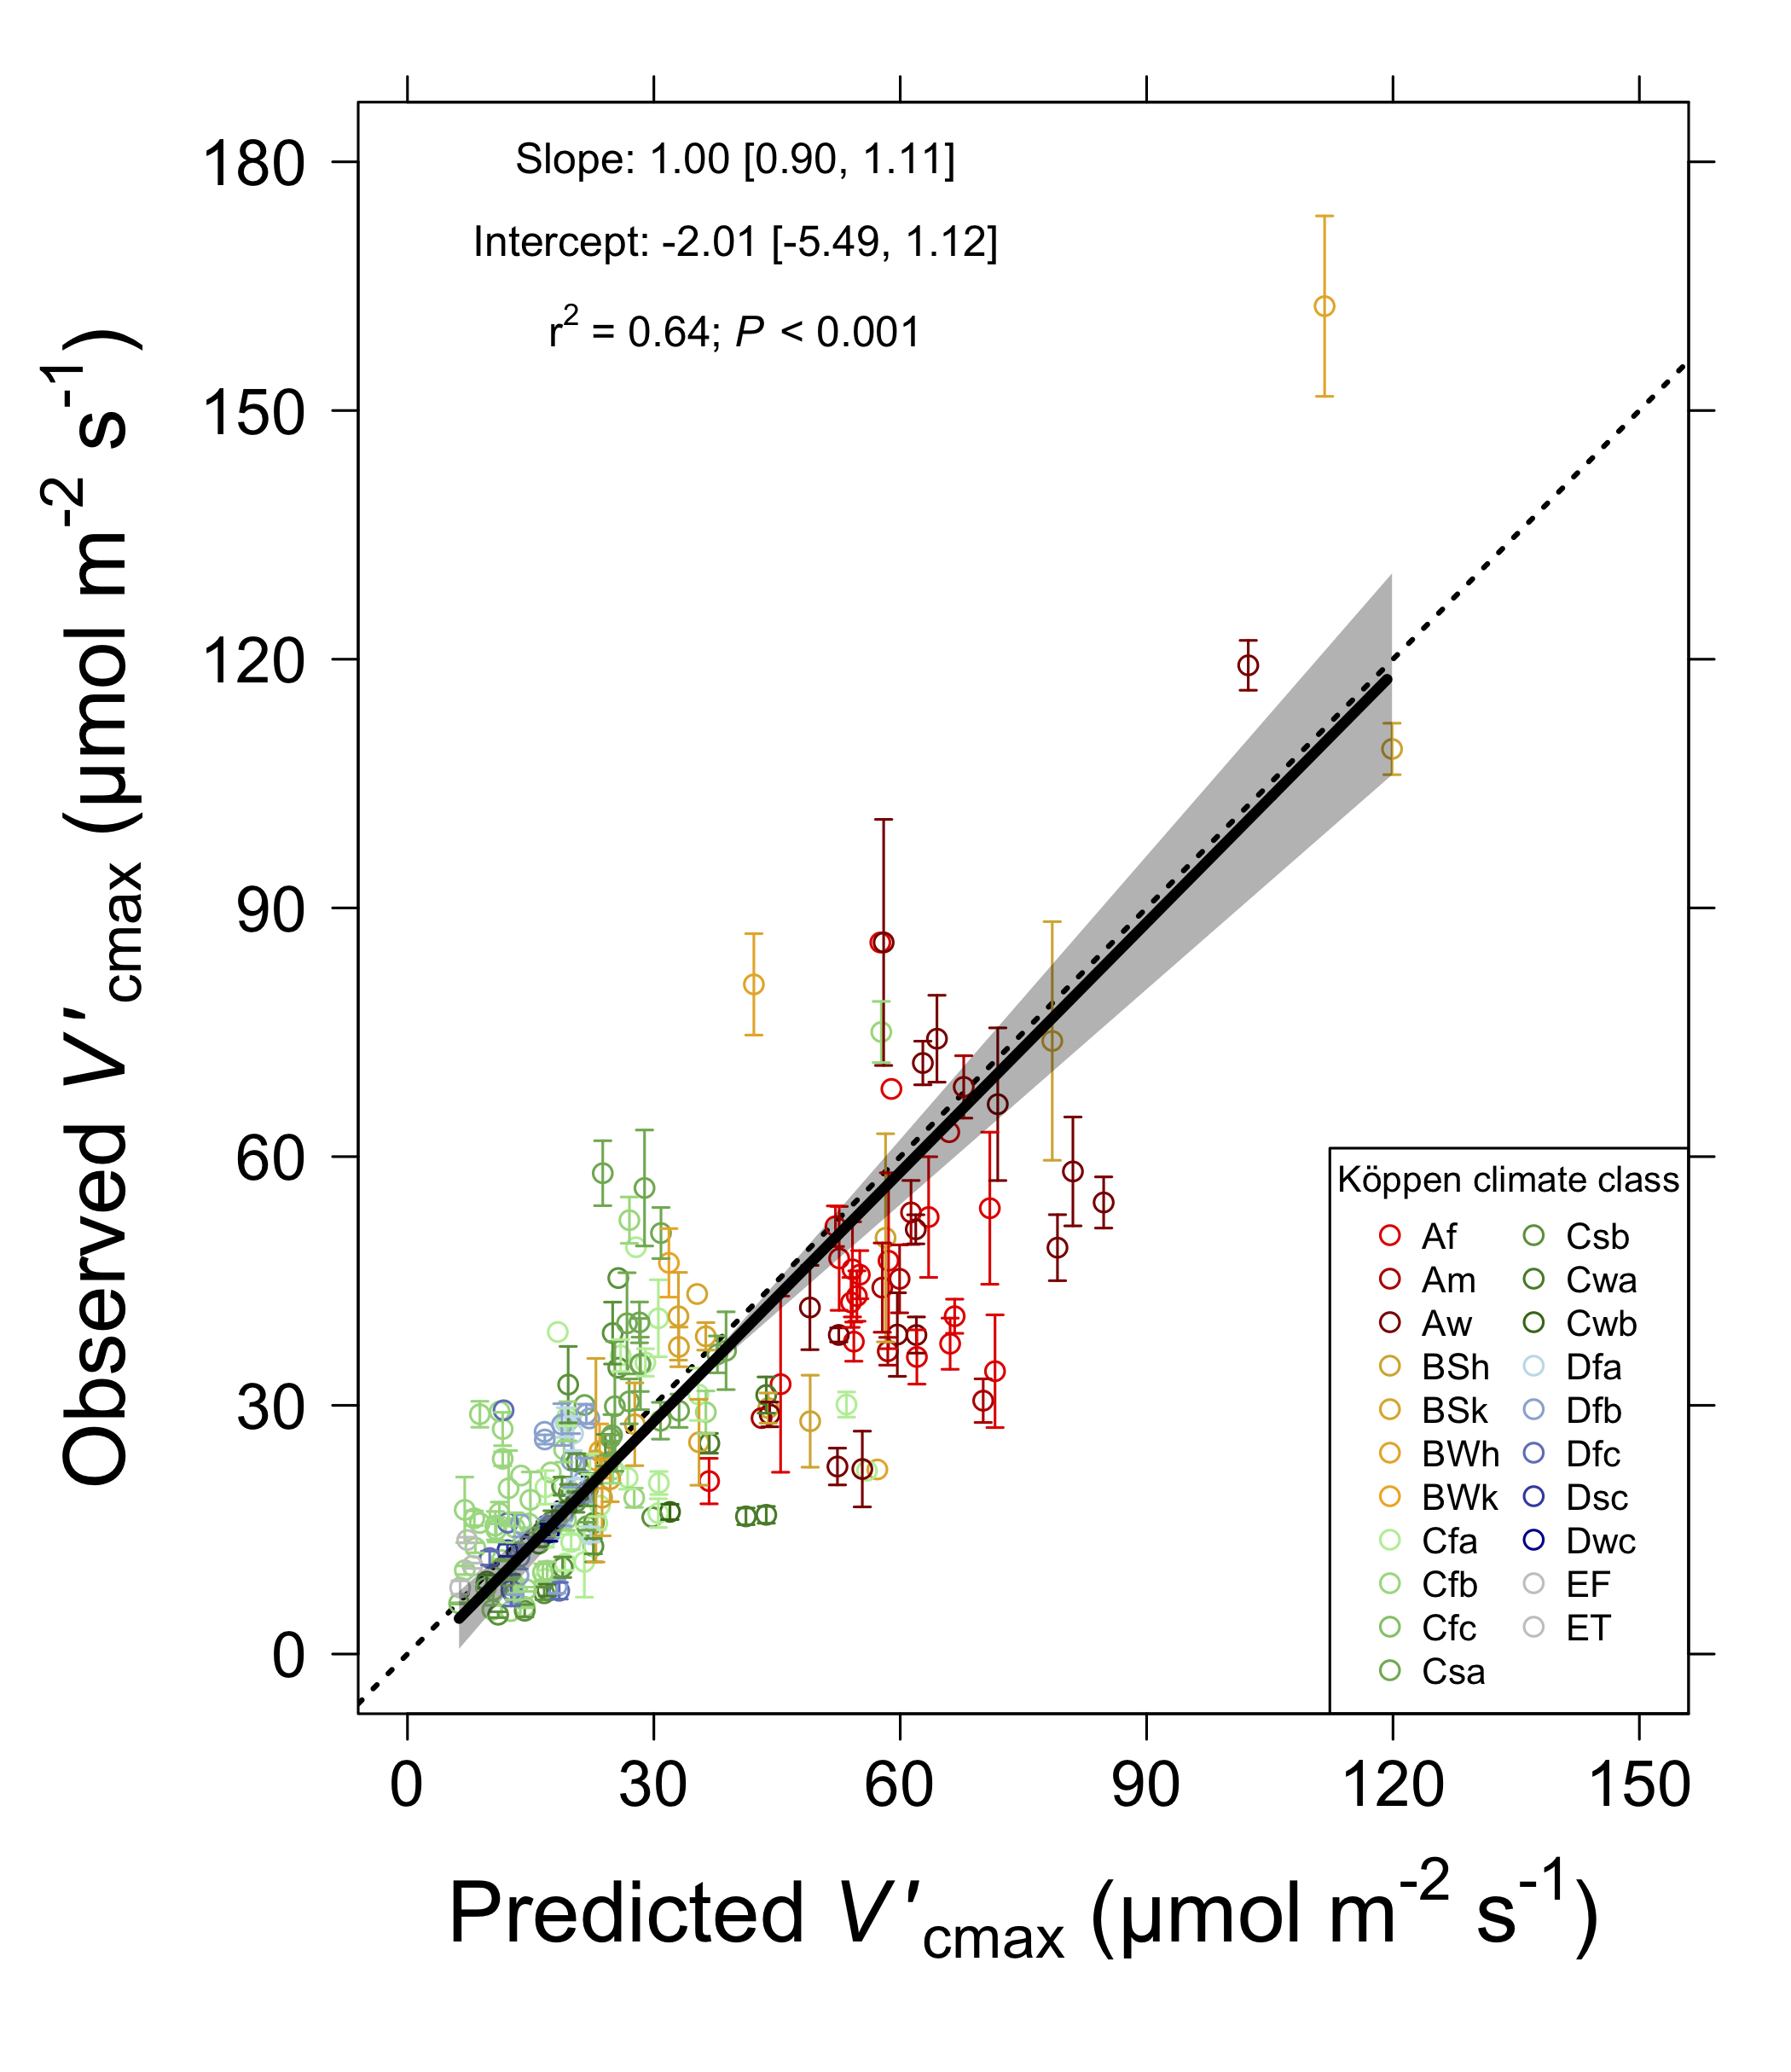
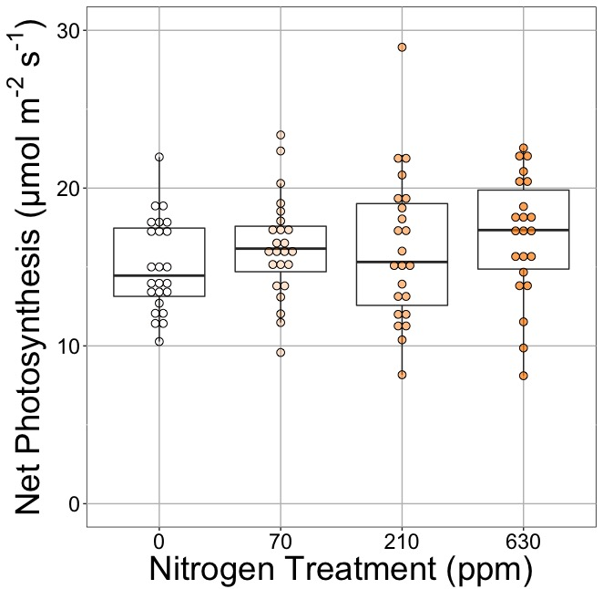
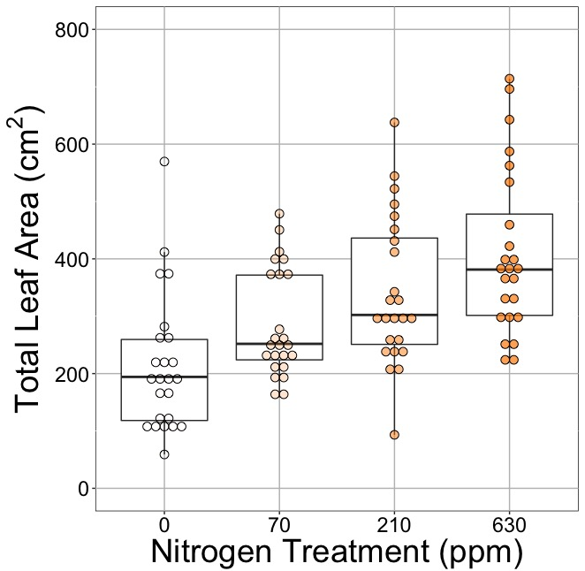
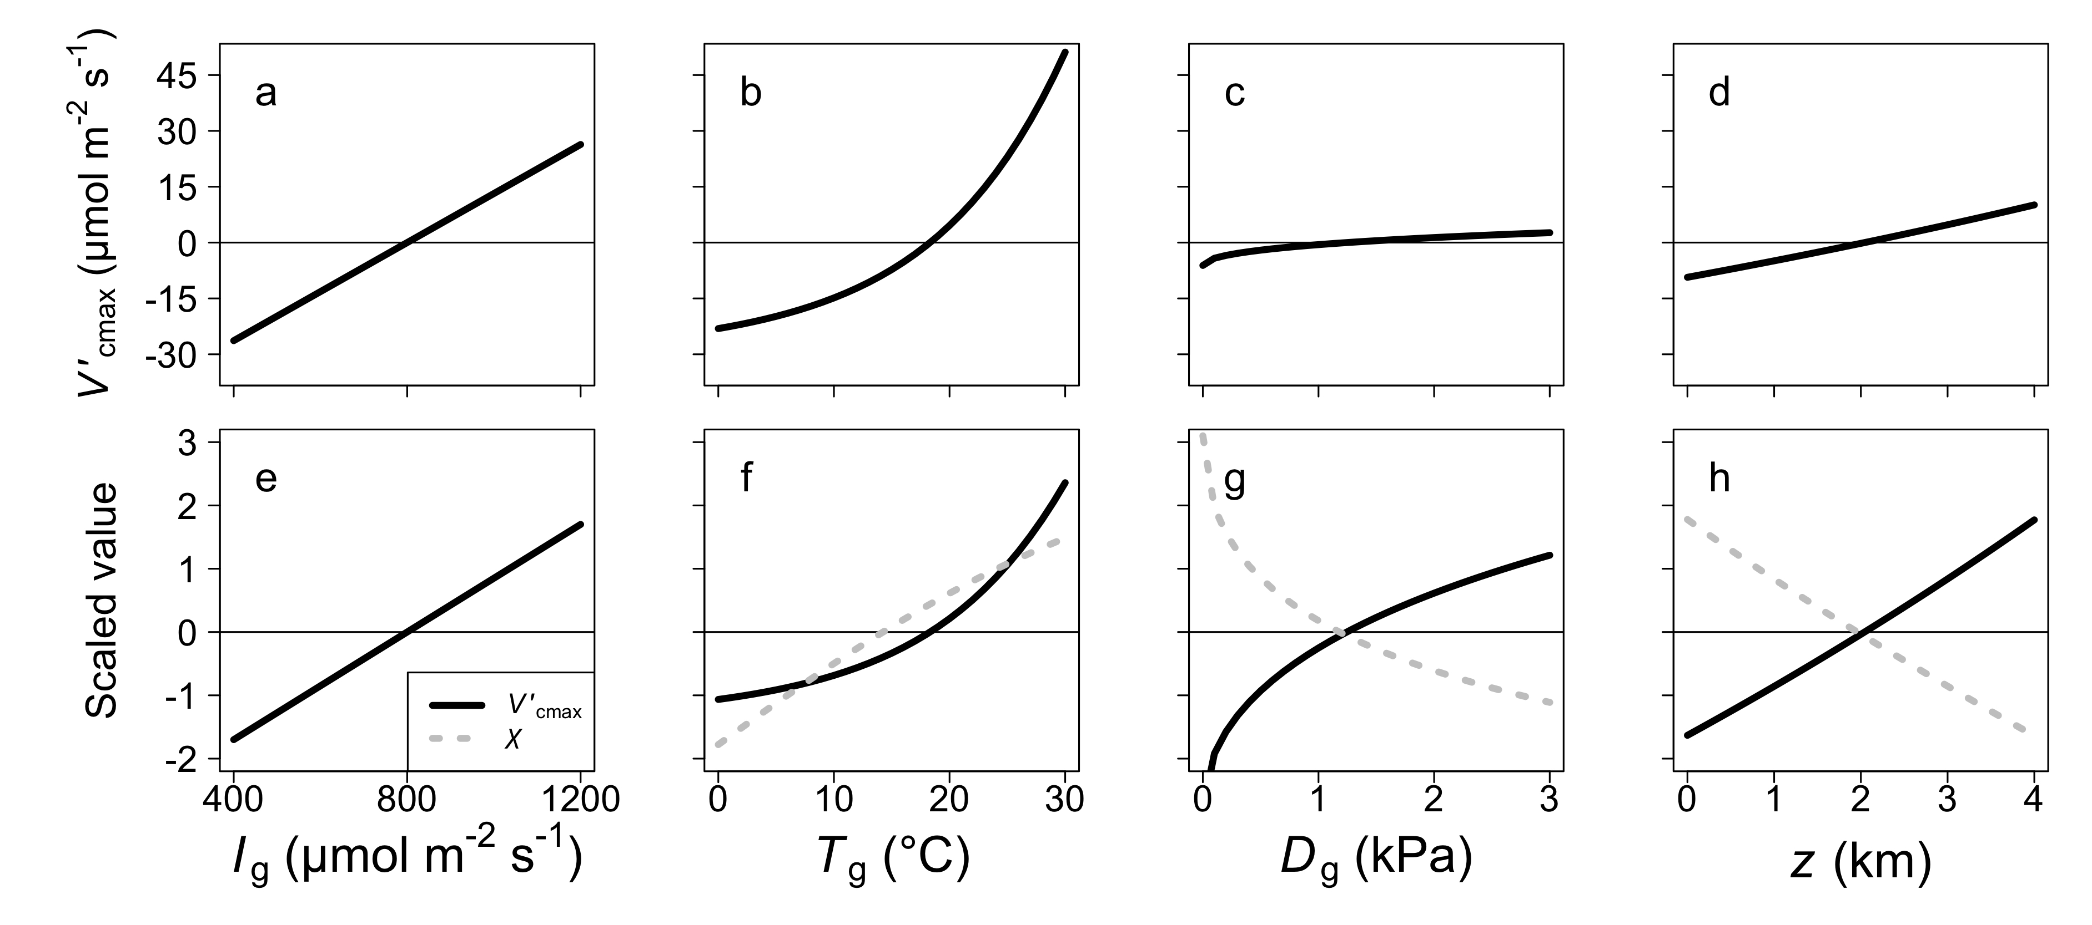
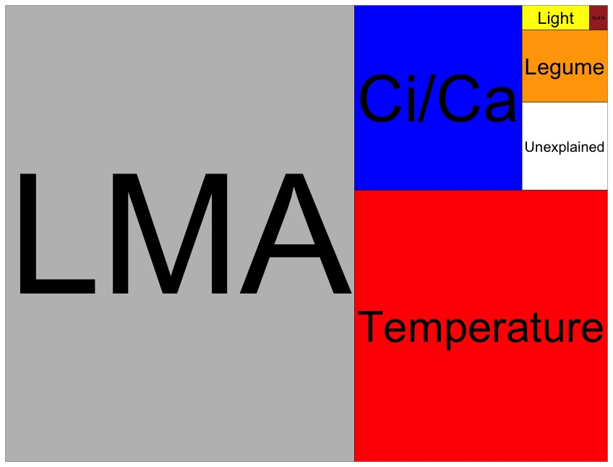
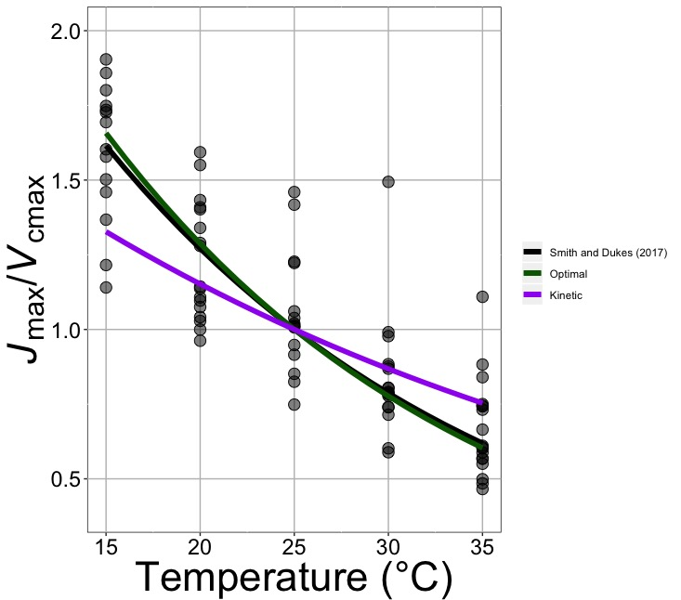
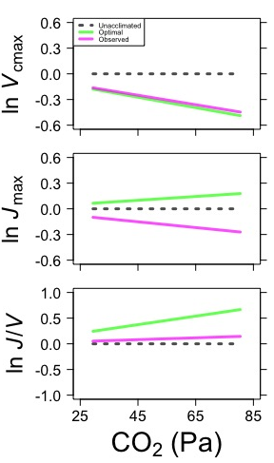
Using optimization theory to answer big questions in plant ecophysiology
Nick Smith, Texas Tech University
nick.smith@ttu.edu, @nick_greg_smith
Elizabeth Waring (TTU), Helen Scott (TTU), Trevor Keenan (Berkeley Lab), Han Wang (Tsinghua University), Colin Prentice (Imperial College)
Photosynthetic optimization: photosynthesis is maximized at the lowest cost, defined as water loss and nutrient use
Is photosynthesis optimized to the environment?
Do added nutrients increase photosynthesis?
Drivers of leaf N at NutNet
(Top) Expected environmental response of carboxylation capacity (V_{cmax}) and the ratio of intercellular to ambient CO2 (X).
(Right) globally observed versus optimality predicted V_{cmax}. From Smith et al. (2019) Ecology Letters.
(Top) Adding nitrogen had little impact on greenhouse-grown cotton (p>0.05), but had a large positive impact on leaf area (p<0.05).
(Right) Data from the NutNet experiment shows that soil N availability does not have a strong influence on leaf nitrogen (boxes proportional to leaf nitrogen variance explained by each factor).
Answer: Yes, photosynthetic capacity acclimates spatially as expected from optimization.
Answer: As optimization suggests, soil nutrient supply has little impact on leaf-level photosynthesis. This implies added soil nutrients act to increase biomass and/or storage.
Under what conditions do C4 species outcompete C3 species?
How will plants acclimate to future climates?
(Left) Increased temperatures reduces the J_{max}/V_{cmax} ratio, as expected from optimization.
(Right) Elevated CO2 reduces V_{cmax}, as expected from optimization, but also reduces J_{max}.
Red = C₄
Blue = C₃
Answer: With optimal acclimation, C4 plants have the strongest advantage over C3 plants in warm, dry, high light, and low CO2 environments
Answer: Increasing temperature alone will increase allocation to Rubisco carboxylation, generally increasing photosynthesis. Elevated CO2 may lead to an overinvestment in electron transport, resulting in higher, but sub-optimal photosynthesis.

