Slide 1
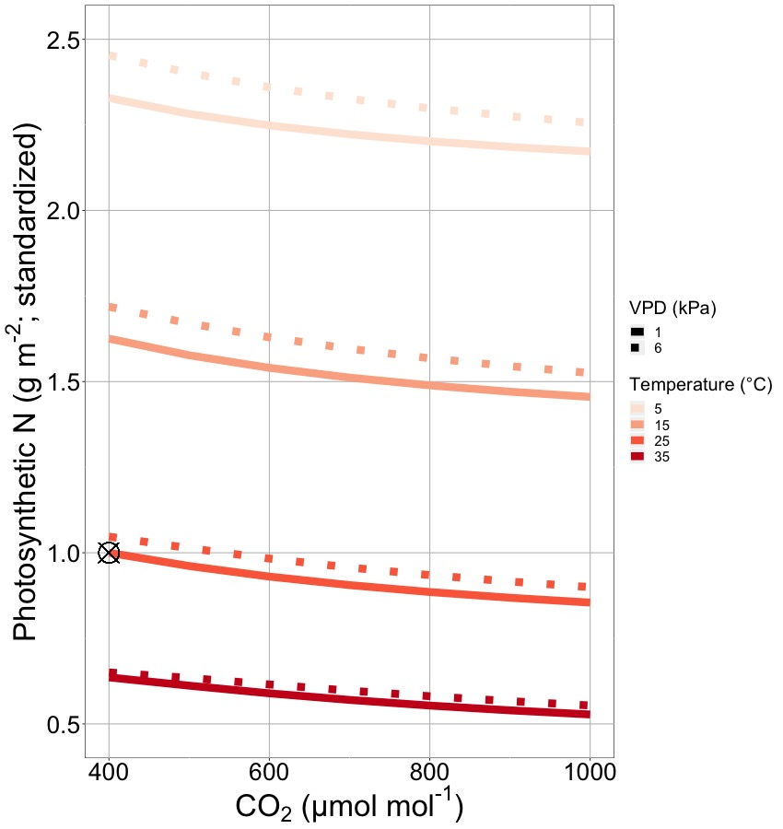
Importance: reductions in leaf nitrogen due to photosynthetic optimization under future warming are expected and predictable, but large scale consequences are unclear

Slide 2
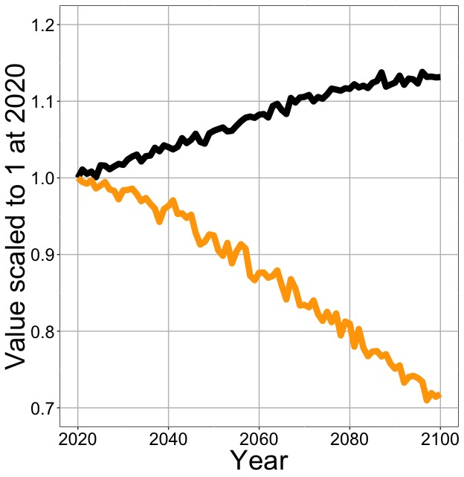
Results: least cost photosynthetic optimality reduces future leaf nitrogen demand

Slide 3
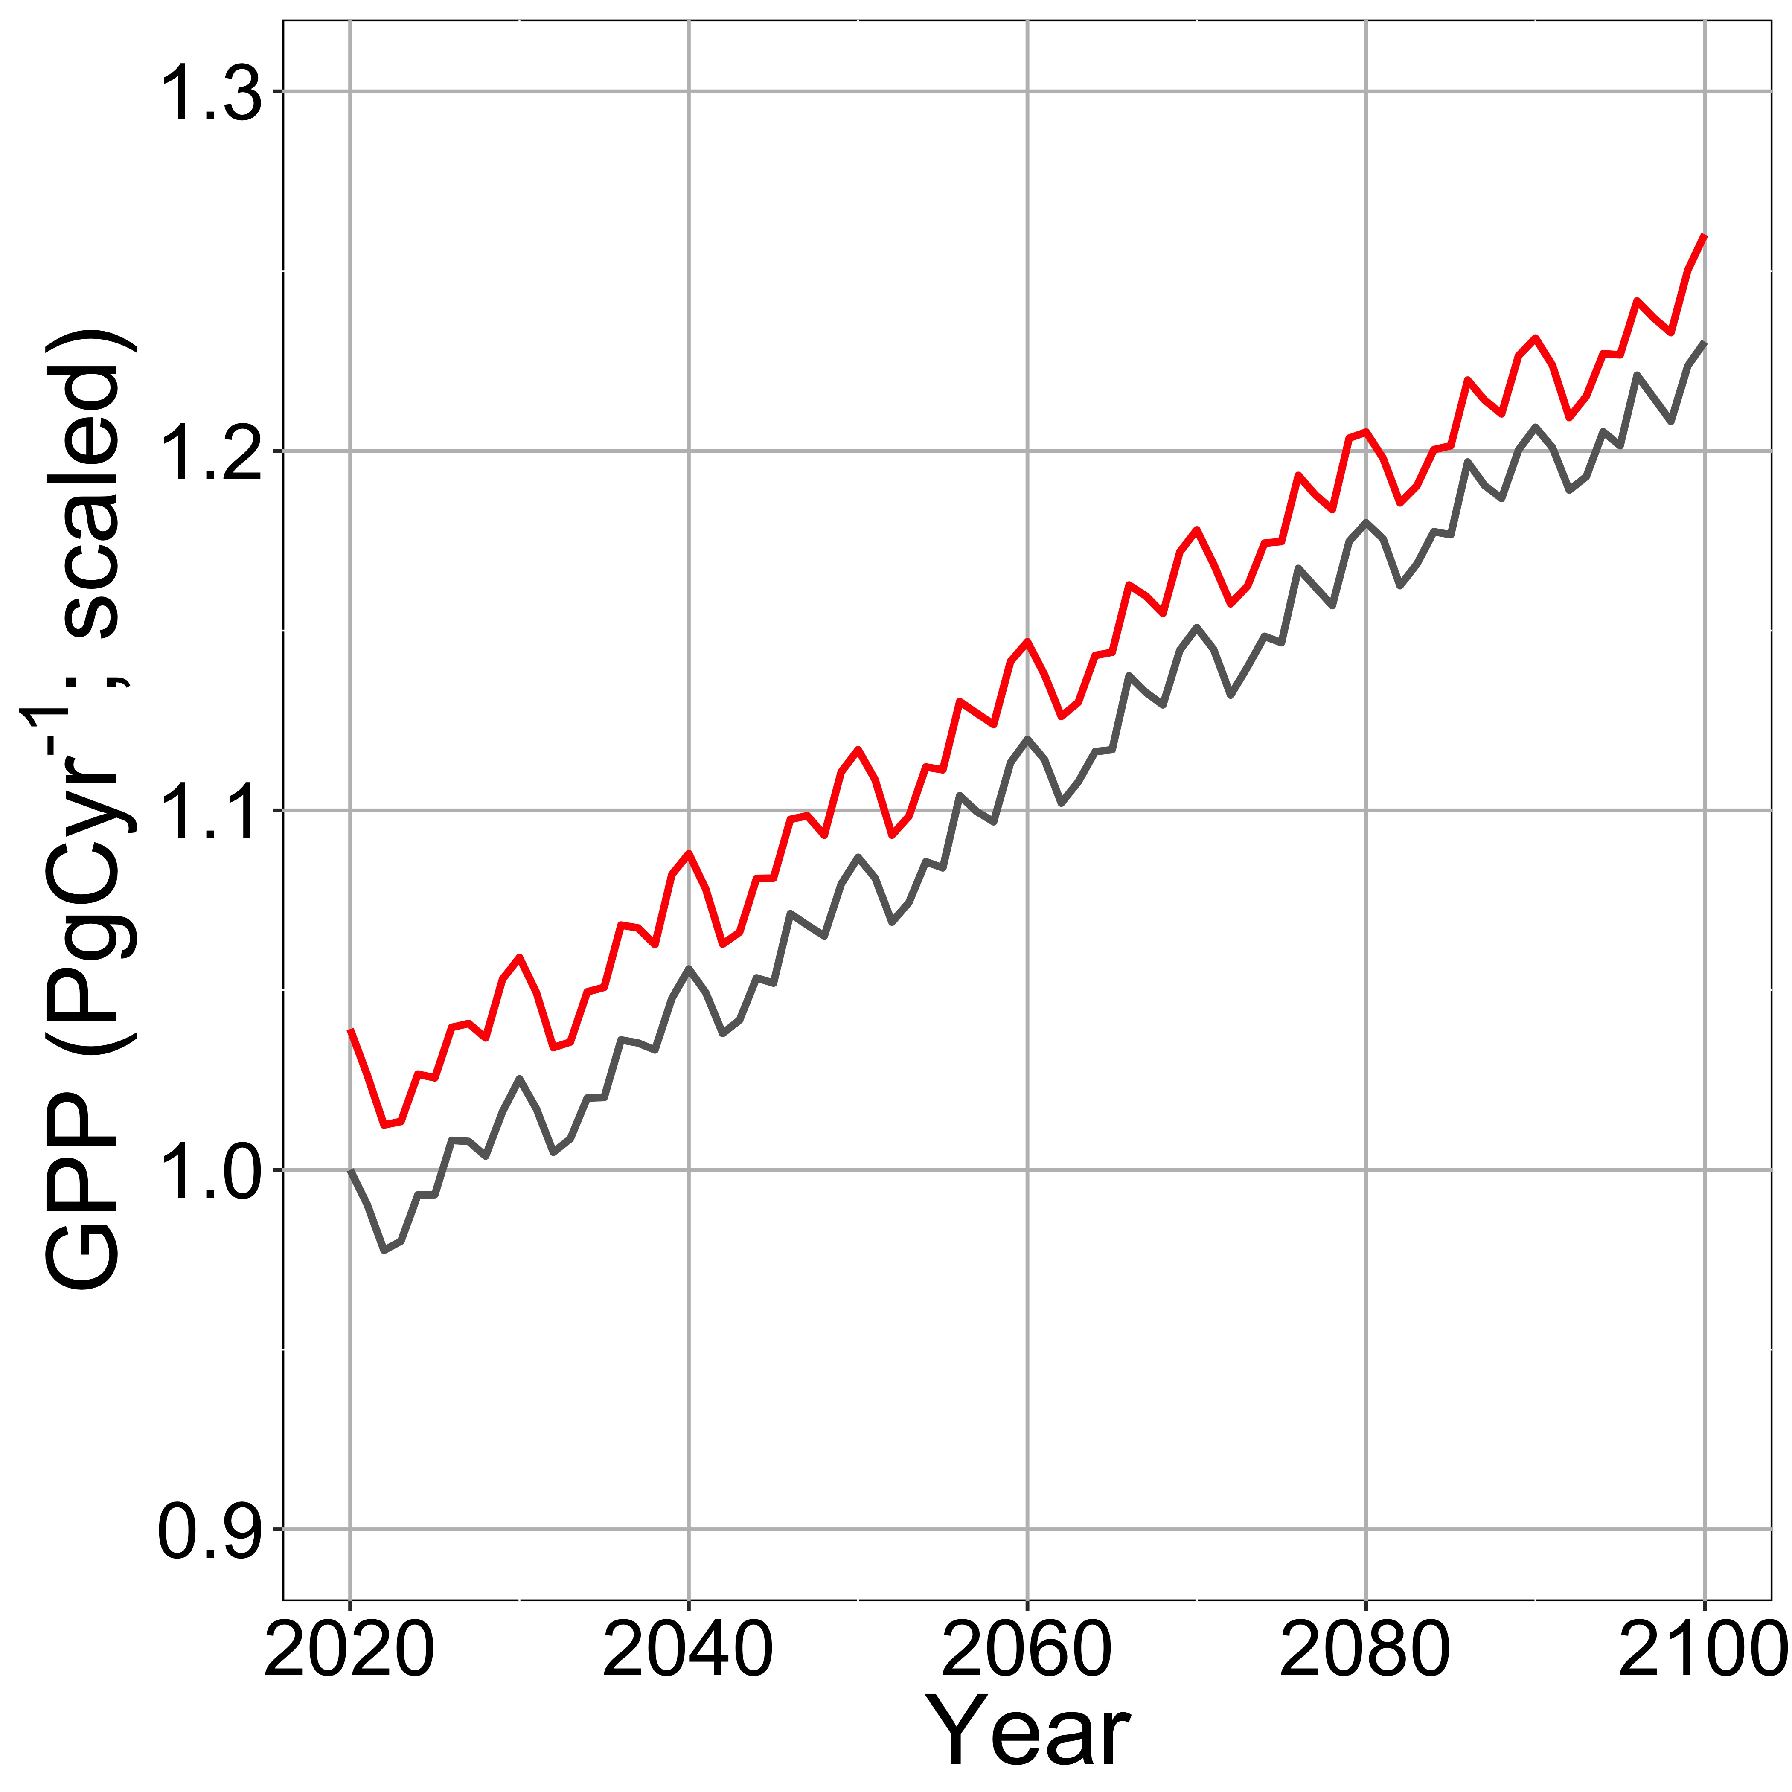
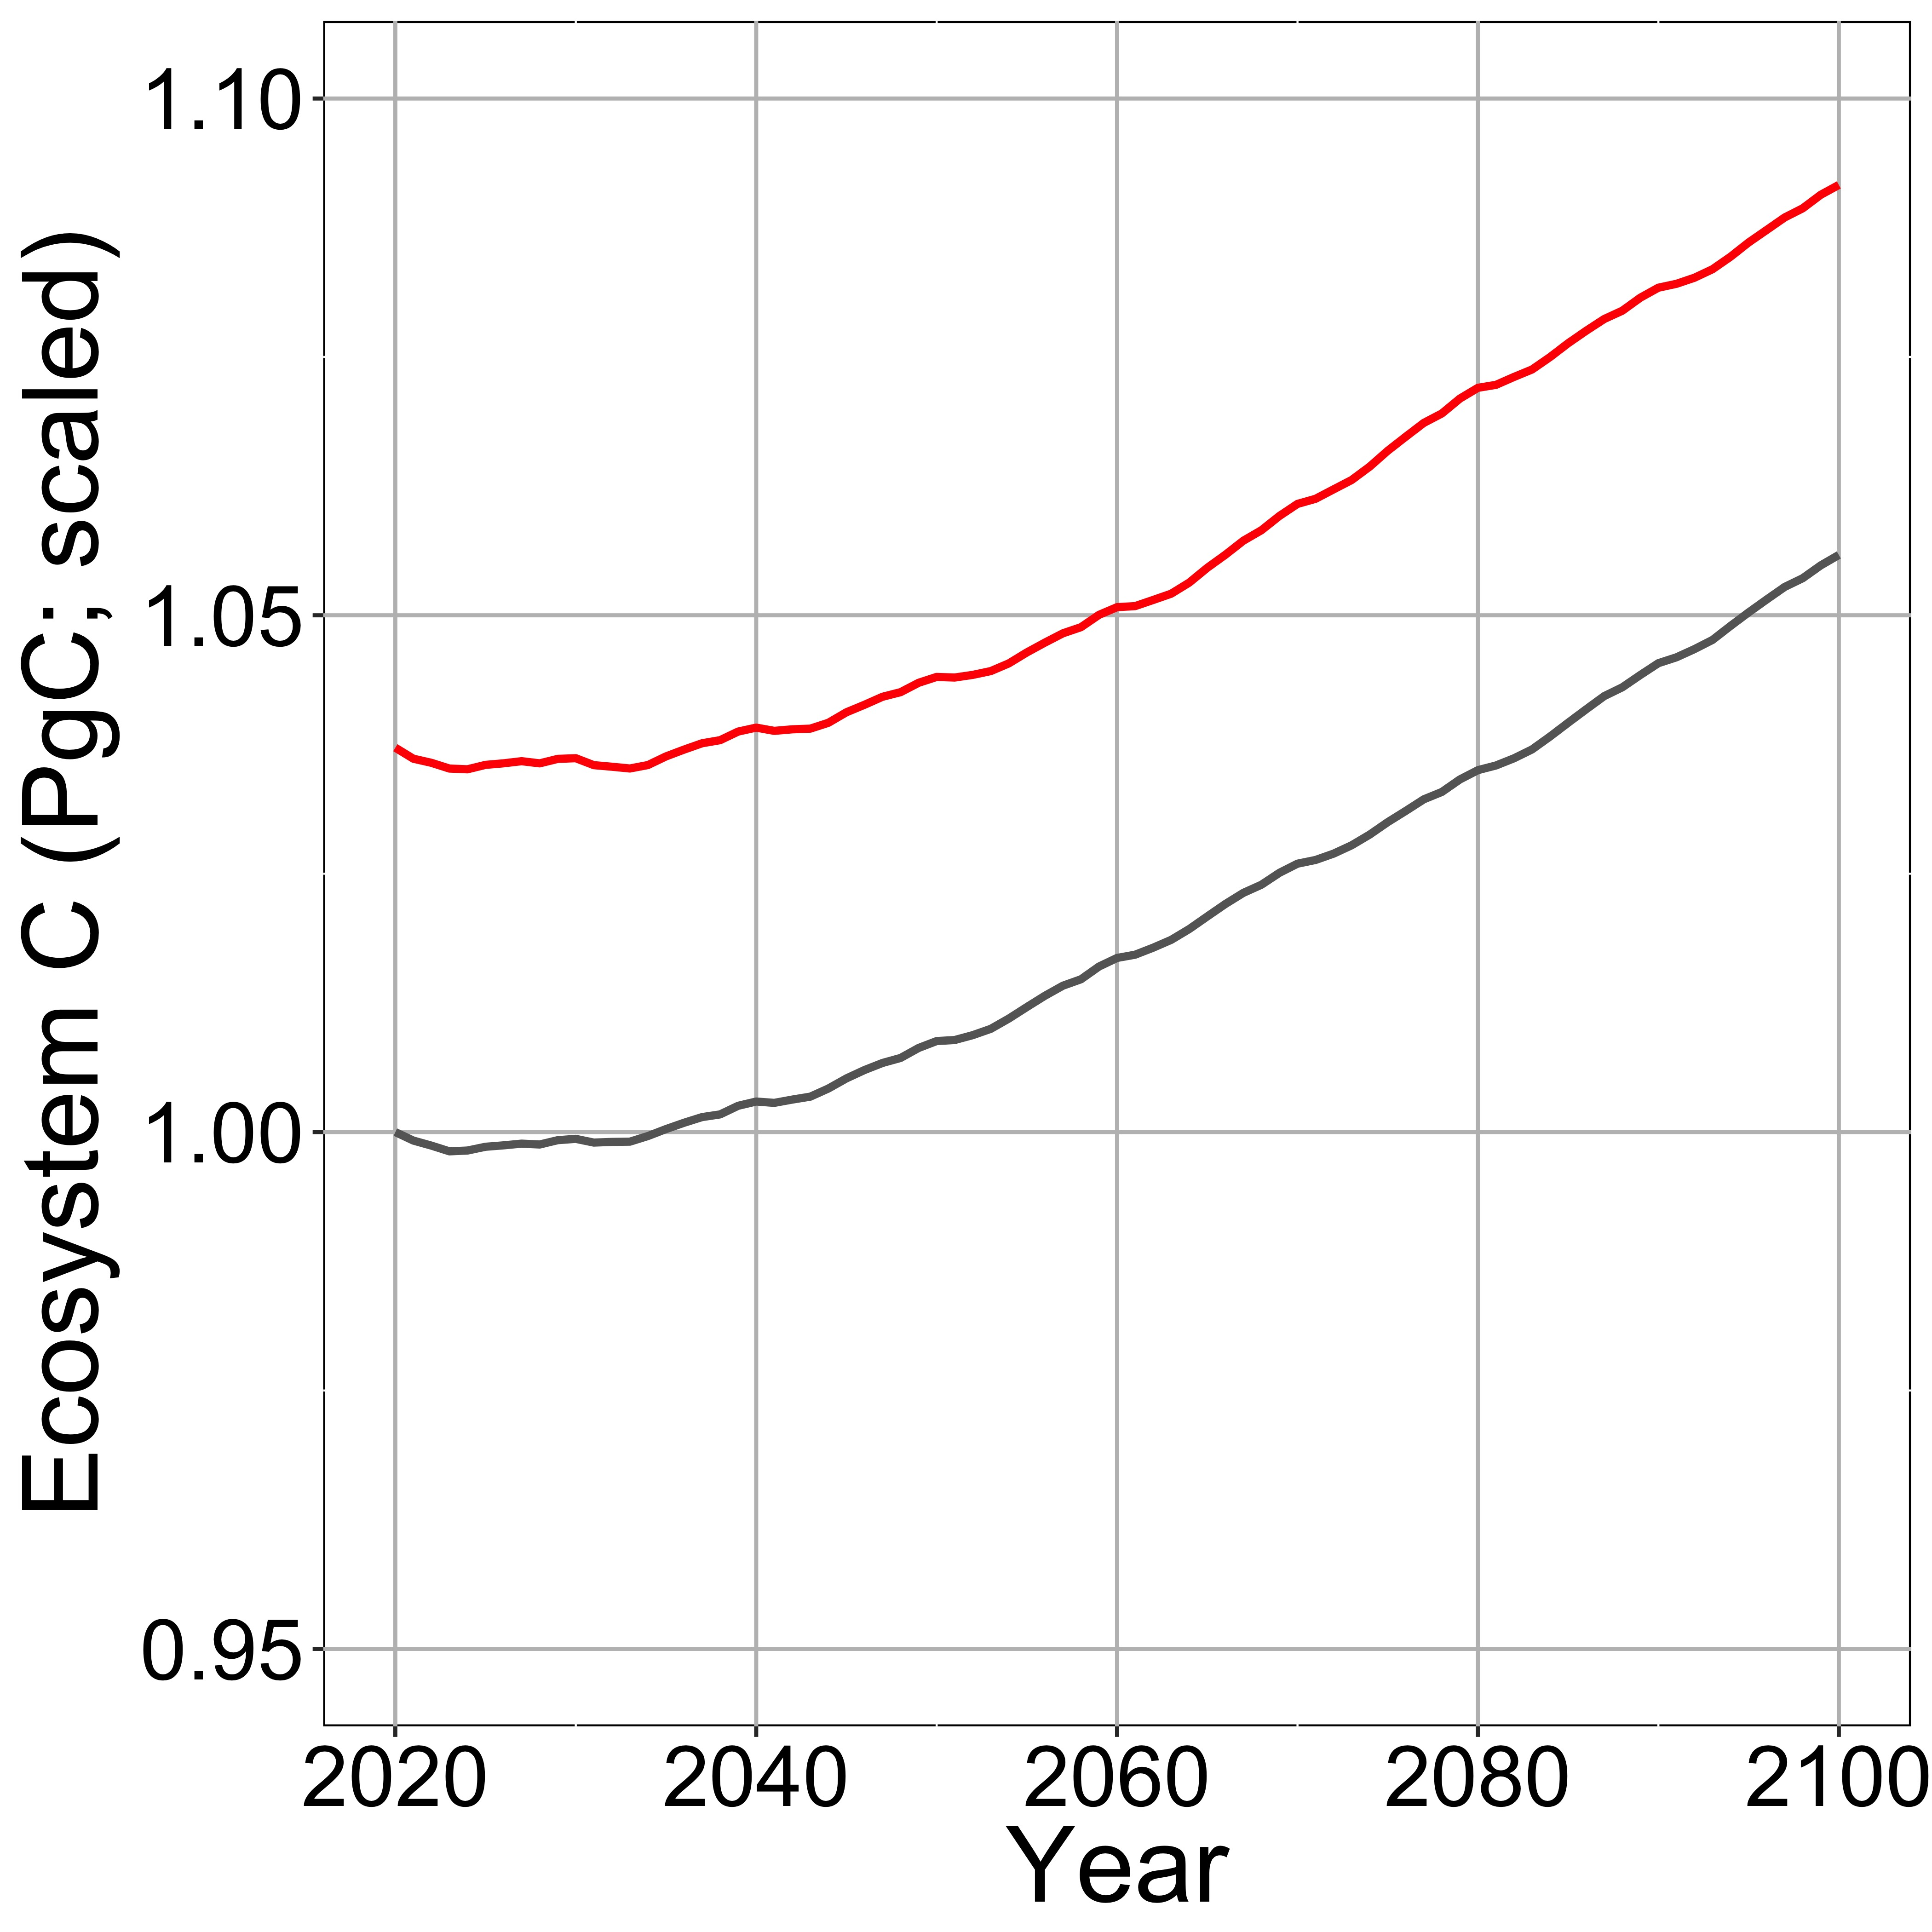
Significance: plants use saved N to build leaves and, increasing GPP and ecosystem carbon (red lines) as compared to models that do not allow for this effect (grey lines), indicating lower future N limitation

