Slide 1
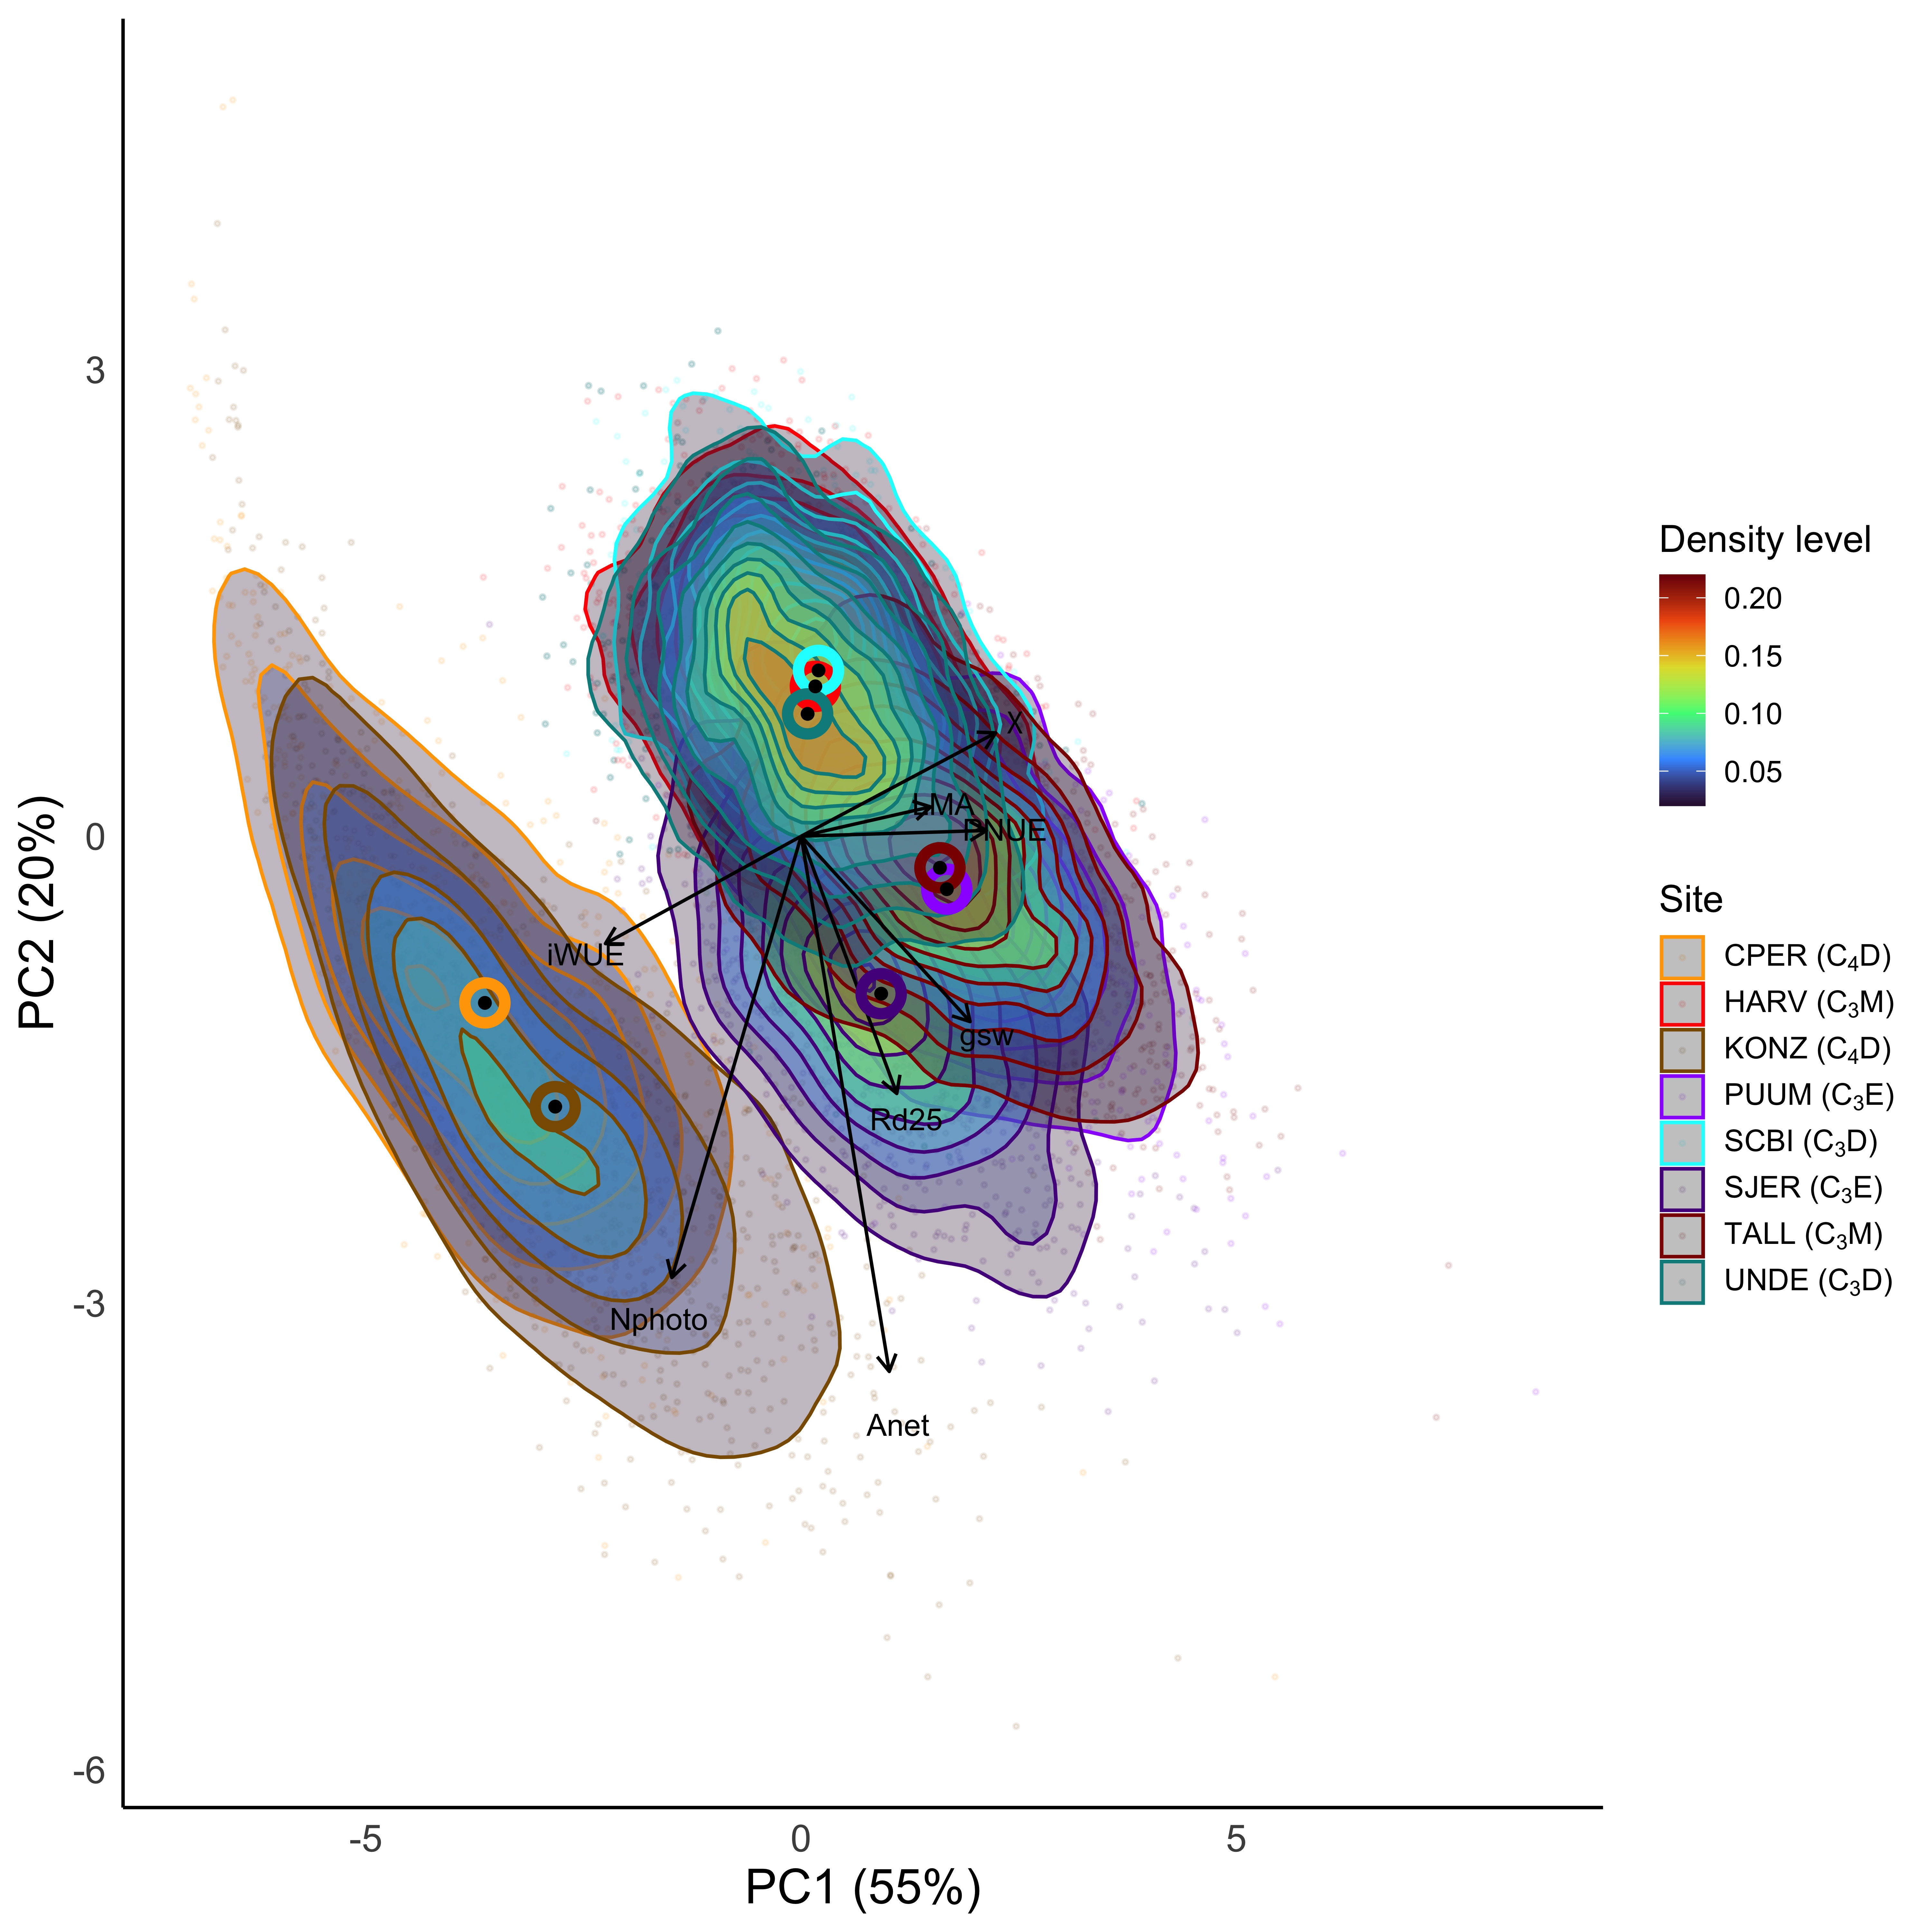
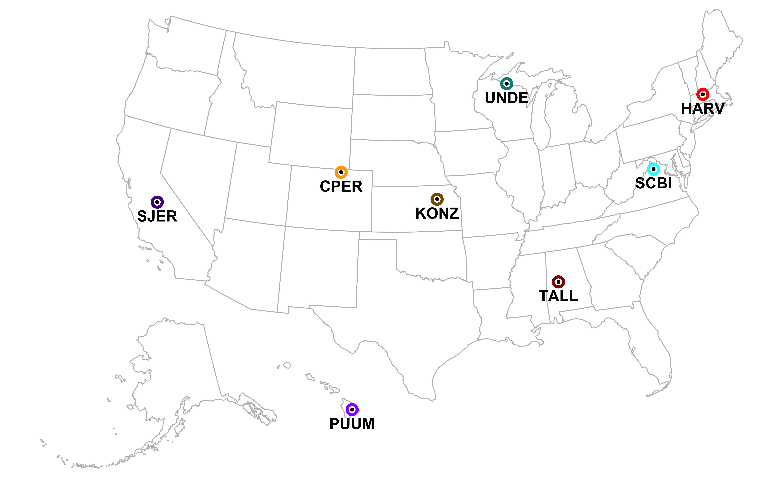
Global patterns of optimal photosynthetic strategies
Nick Smith (nick.smith@ttu.edu)
Texas Tech University
(a) Eco-evolutionary optimality theory can predict photosynthetic traits
(c) Global photosynthetic strategies are defined by plant type and climate
(e) Locally, there is greater within- than across-site variability in strategies
PC1: Water use efficiency (iWUE) x nitrogen use (N_{photo}) tradeoff axis
PC2: Nitrogen use efficiency (PNUE) x water use (g_{sw}) tradeoff axis, where we find net carbon assimilation (A_{net})
PC3: Carbon cost tradeoff axis (R_{d25}, LMA)
(b) I simulated multi-trait photosynthetic strategies at global and local scales
(d) Global trait variability is wide
(f) Locally, many optimal strategies exist

