Slide 1
Thermal acclimation and the dynamic response of plant respiration to temperature
Atkin and Tjoelker (2003). Trends in Plant Science

Slide 2
Let’s talk about acclimation

Slide 3
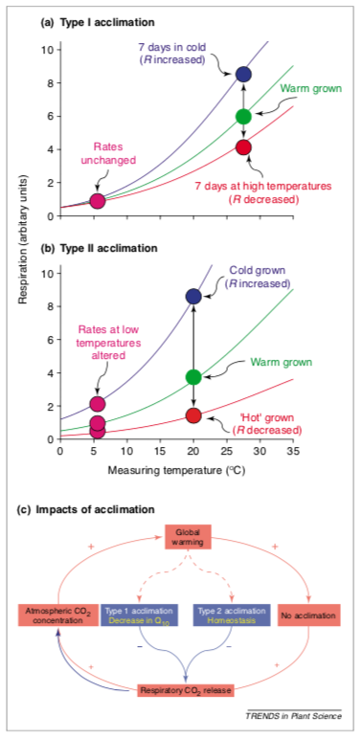
Seems pretty cut and dry!
Atkin & Tjoelker (2003)

Slide 4
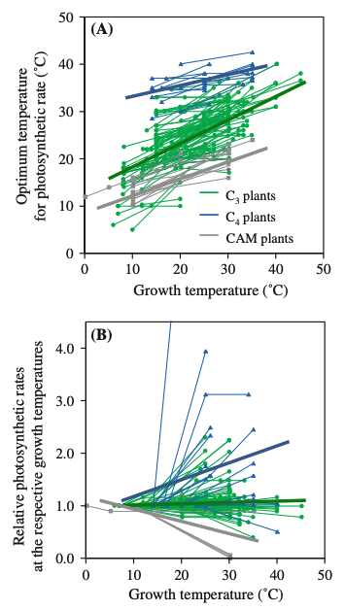
It turns out acclimation can be quite variable
Yamori et al. (2014)

Slide 5
Given what you know about temperature responses: Why would plants acclimate?

Slide 6
Figures for ease of viewing

Slide 7
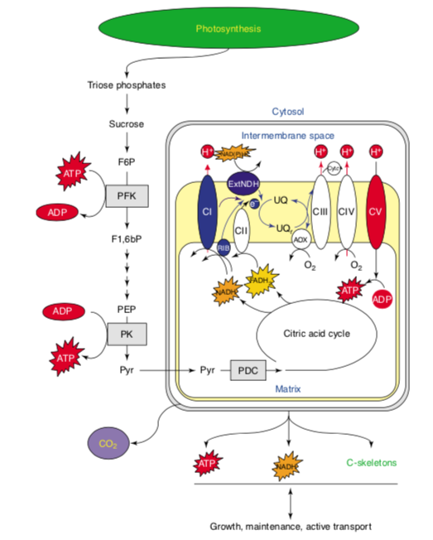

Slide 8
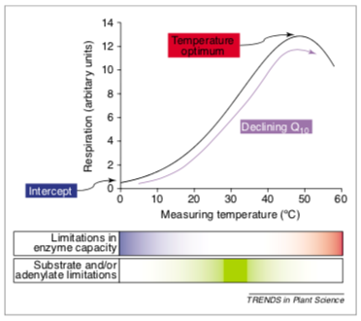

Slide 9
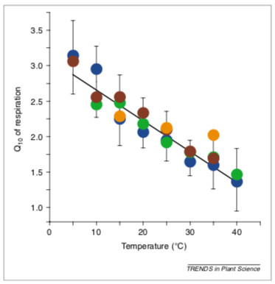

Slide 11
