Slide 1
Thermal acclimation and the dynamic response of plant respiration to temperature
Atkin and Tjoelker (2003). Trends in Plant Science

Slide 2
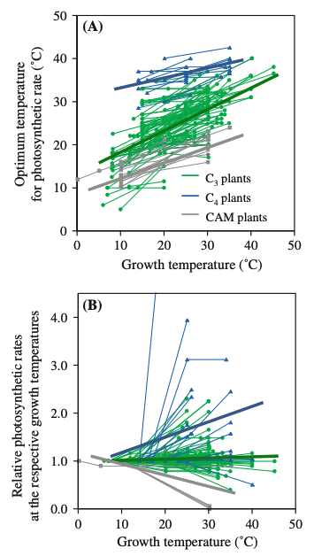
It turns out acclimation can be quite variable

Slide 3
Given what you know about temperature responses: Why would plants acclimate?

Slide 4
Figures for ease of viewing

Slide 5
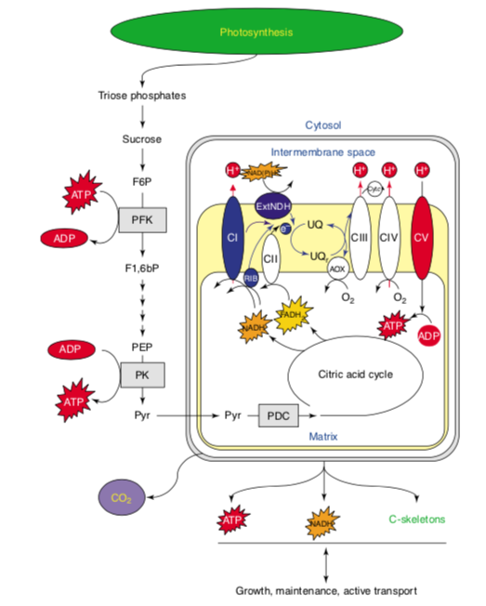

Slide 6
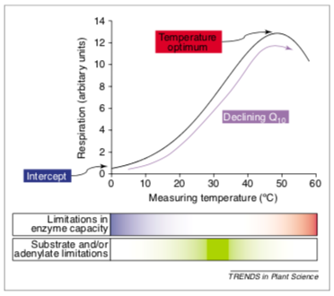

Slide 7
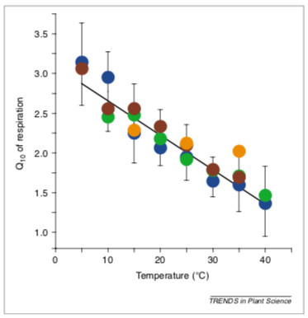

Slide 8
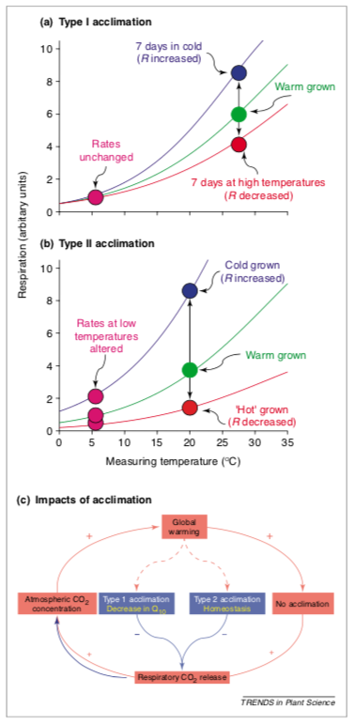

Slide 9
