Slide 1
Module Presentation Phosphorous Uptake
Ecosystem Modeling | Spring 2025 Monika Kelley

Slide 2
Goal:
Depict phosphorus uptake within a system

Slide 3
Goal: Depict phosphorus uptake within a system
Inputs
Output
Root length average of area
NPP (g C m-2 y-1) of:
Leaves
Stems
Roots
CP ratios
Of the individual organs
Climate modifier of P availability
Represented in %, ideally considers how wet/ hot the year was
P pools
Inorganic P (Pi) soluble
Organic P (Po) soluble
Inorganic P (Pi) insoluble
P uptake capability of the system
P pools available after P uptake

Slide 4


General Module Overview
Broken up into 3 submodules
P demand
The amount of P required for the amount of C in biomass per organ
P availability
Pool availability is modified by pH of the soil
Root length modifies the availability of P
P uptake
P uptake: P pool caps the P demand
P pool remaining after uptake: Starting P pool availability – P uptake
Notes:
C:P = Carbon-to-Phosphorous ratio for the leaf, how much carbon there is for each unit of phosphorous in the leaf biomass.
P Demand sensce of how much P needed to form the given amount of C in the leaf. Stoichiometry, for the plants metabolism plant needs a certain amount of P to build the C-based componeds (like surgar, proteints etc.)

Slide 5
P Demand: NPP / C:P
Explanation
Formula
Amount of P required to build C being produced in the organ’s biomass
p_demand[organ] = npp[organ] / cp_ratio[organ]
P_demand_total =
sum(pdemand_leaf, pdemand_stem, pdemand_root)

Slide 6
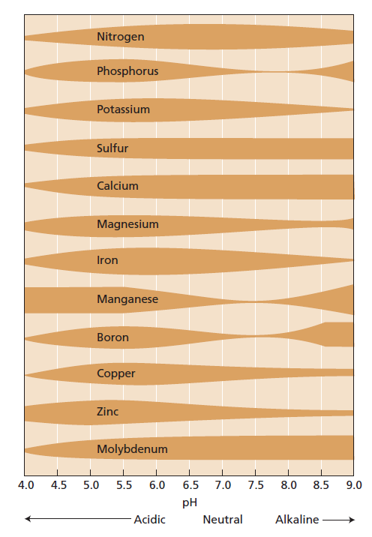
P availability: pH
Explanation
Formula
ph_mod <-
ifelse(soil_ph >= 6 & soil_ph <= 8, 1, 0.5)
p_pool_total_ph_mod = (p_pool_total) * ph_mod
P less available at extreme pH values
1:5 = P pool * 0.5
6:7 = P pool * 1
9:14 = P pool * 0.5
Taiz et al., 2015

Slide 7
P availability: root length
Explanation
Formula
Longer roots = able to acquire more P
Shorter roots = less P acquired
explore_depth <- 1.0 # meters
root_length_mod <- pmin(root_length_average / explore_depth, 1) # units cancel
p_annual_availablity_root_mod <- p_annual_availablity * root_length_mod
Notes:
Explore depth = how far plants can actually go. Roots reach to access P in the soil how far we thing them roots can go. Longer thant this = limited benefit maybe.
P_min = caps the value at 1 so we don’t exceed 100% efficiency. The 1 acts as the max, could make it higher or lower.

Slide 8
P uptake: P uptake
Explanation
Formula
If the demand is less than the pool the P uptake = P pool
If the demand is greater than the P pool the P uptake = P demand
If
(p_demand_total < p_pool_total){
p_uptake <- p_demand_total
}else{
p_uptake <- p_pool_total
}
Smith, 2025 – live and in action
Notes:
Explore depth = how far plants can actually go. Roots reach to access P in the soil how far we thing them roots can go. Longer thant this = limited benefit maybe.
P_min = caps the value at 1 so we don’t exceed 100% efficiency. The 1 acts as the max, could make it higher or lower.

Slide 9
P uptake: P pool remaining
Explanation
Formula
P pool (after P modifications) – P uptake
P_pool_modified – p_uptake = p_pool_leftover
Smith, 2025 – live and in action
Notes:
Explore depth = how far plants can actually go. Roots reach to access P in the soil how far we thing them roots can go. Longer thant this = limited benefit maybe.
P_min = caps the value at 1 so we don’t exceed 100% efficiency. The 1 acts as the max, could make it higher or lower.

Slide 10
Goal:
Depict phosphorus uptake within a system

Slide 11
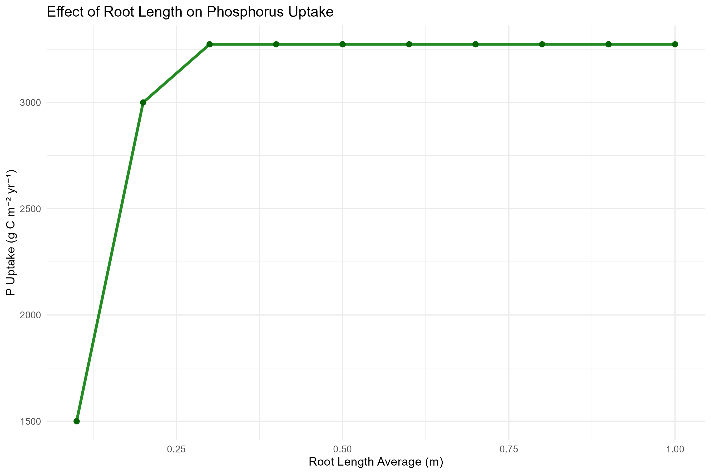

Slide 12
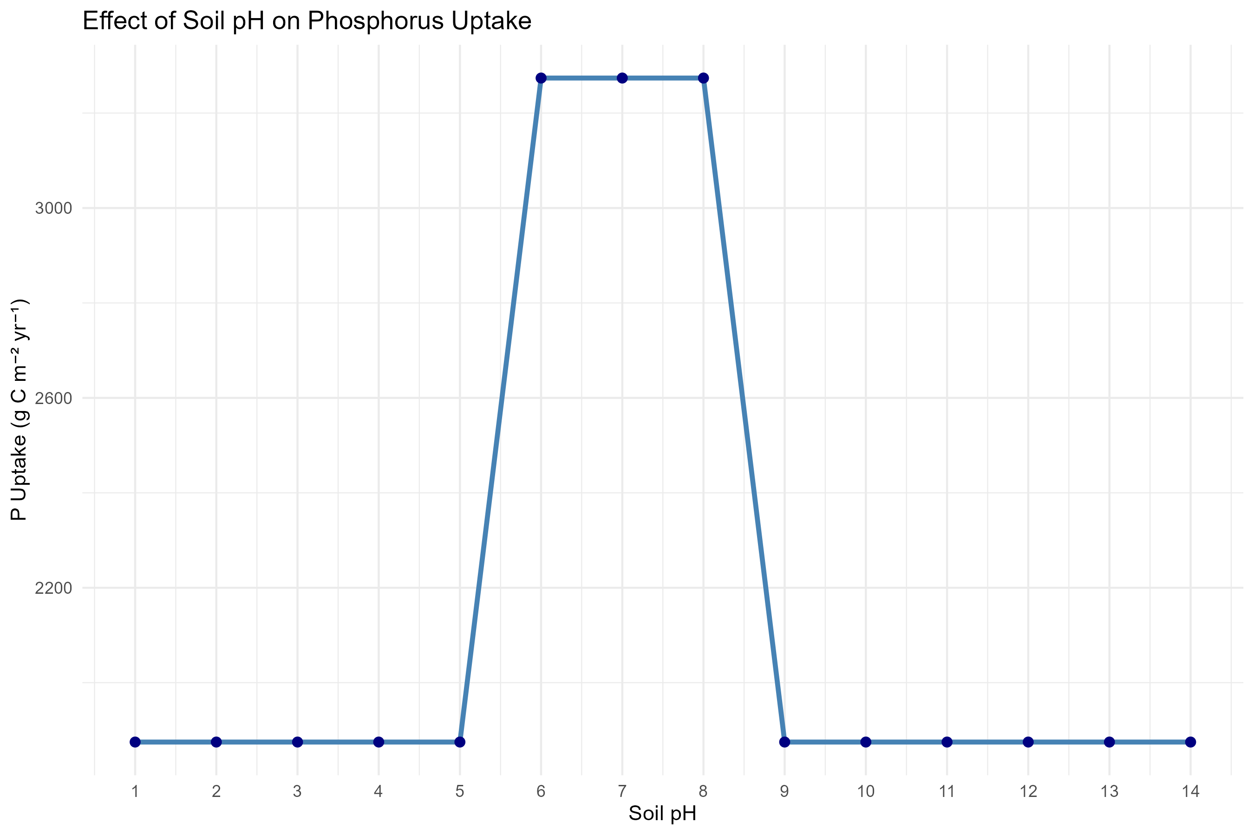

Slide 13
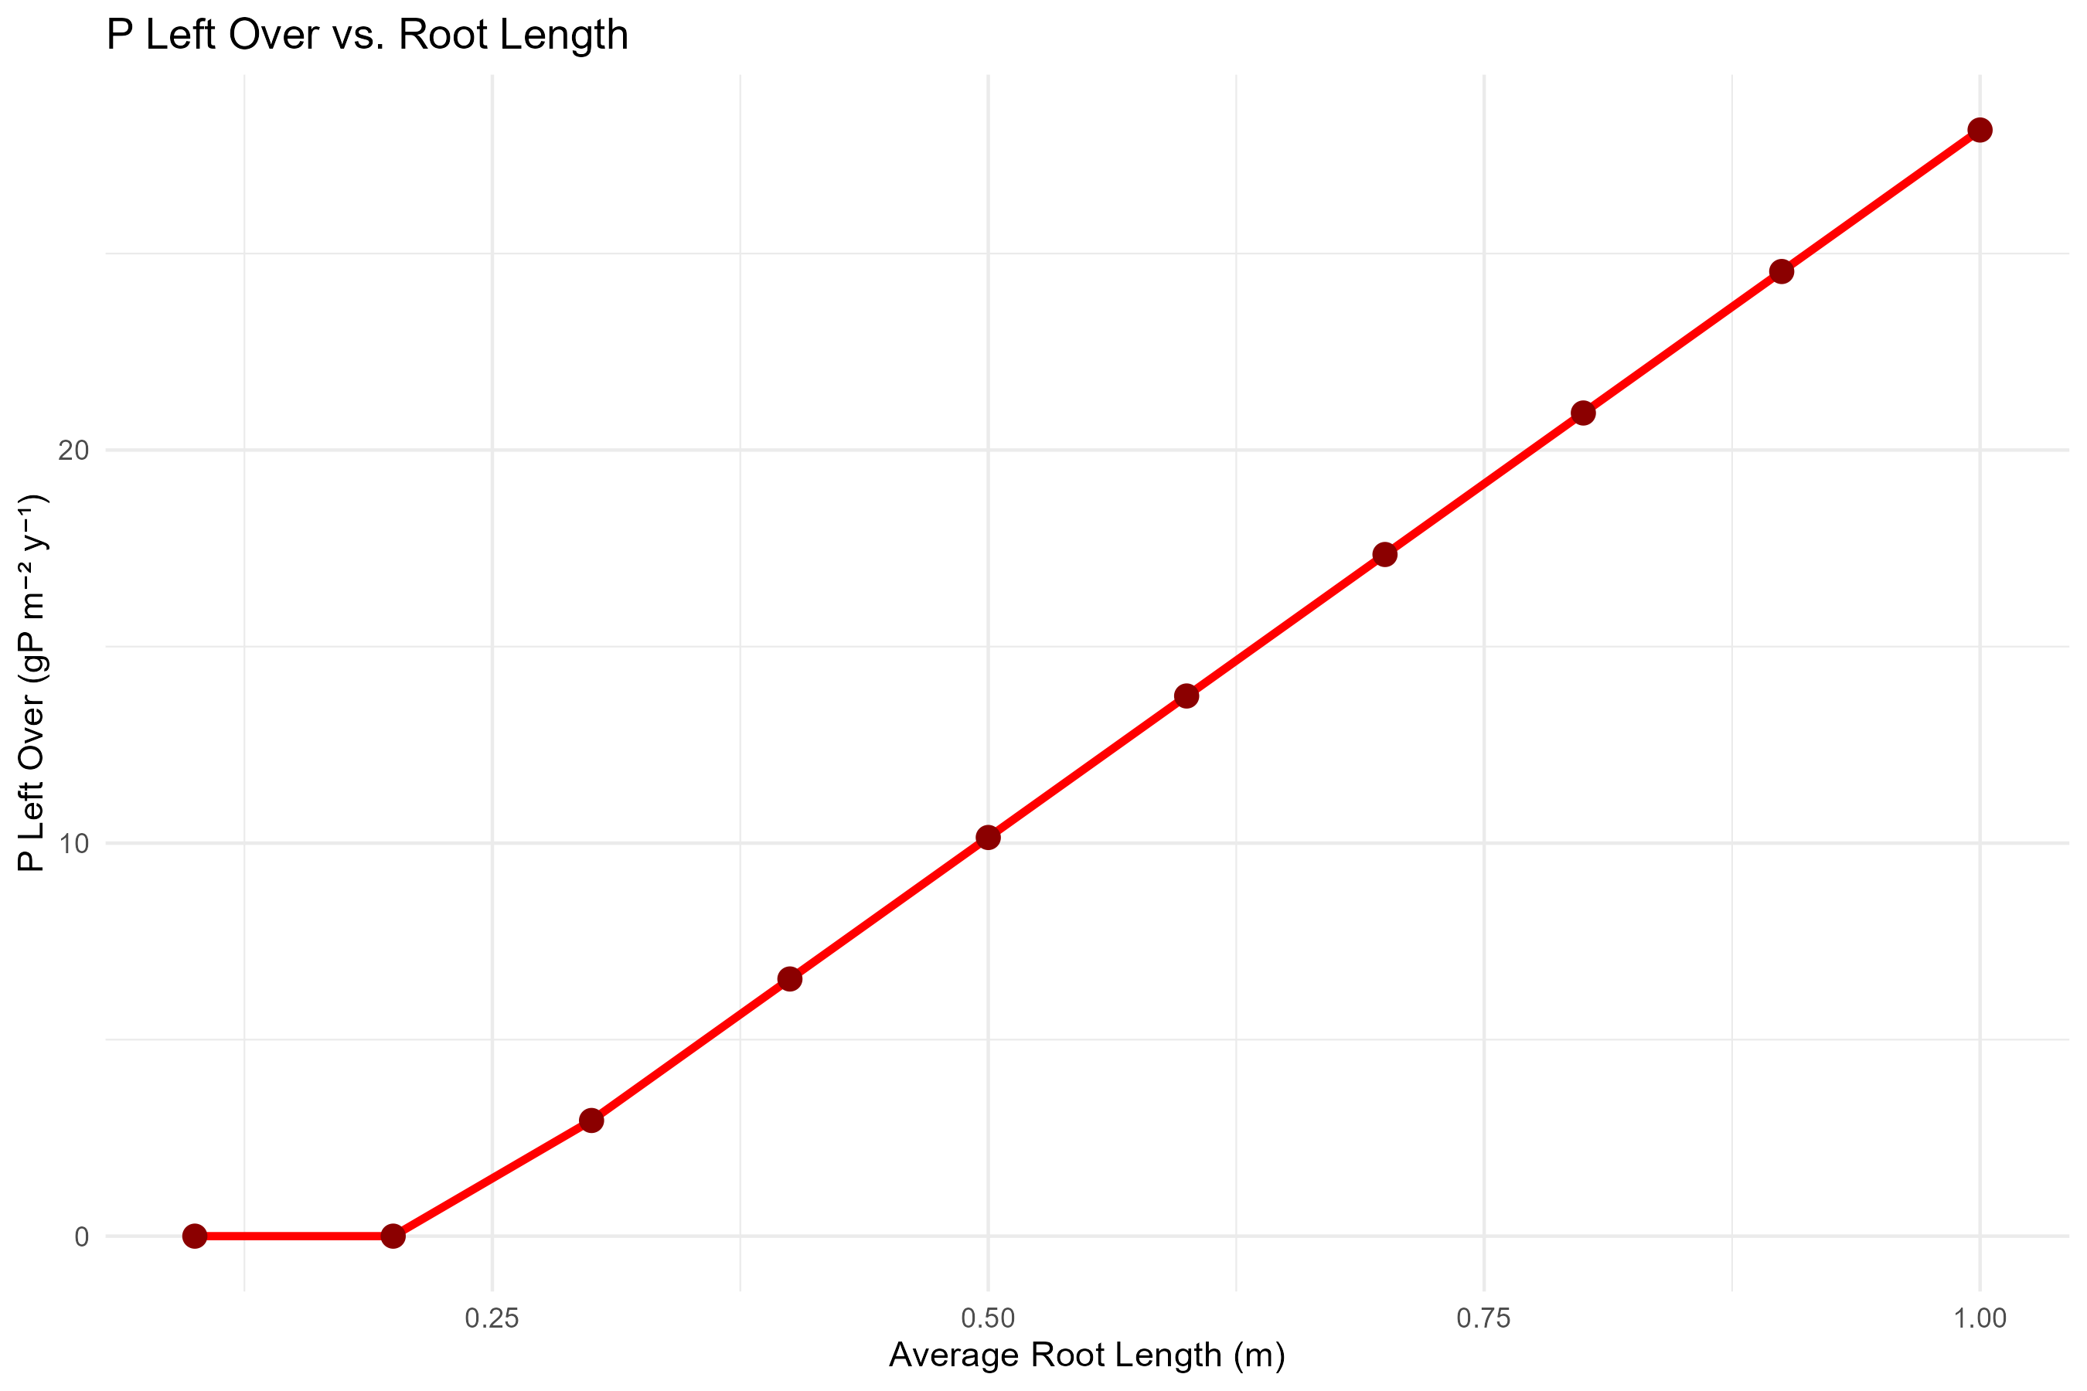

Slide 14


