Slide 1
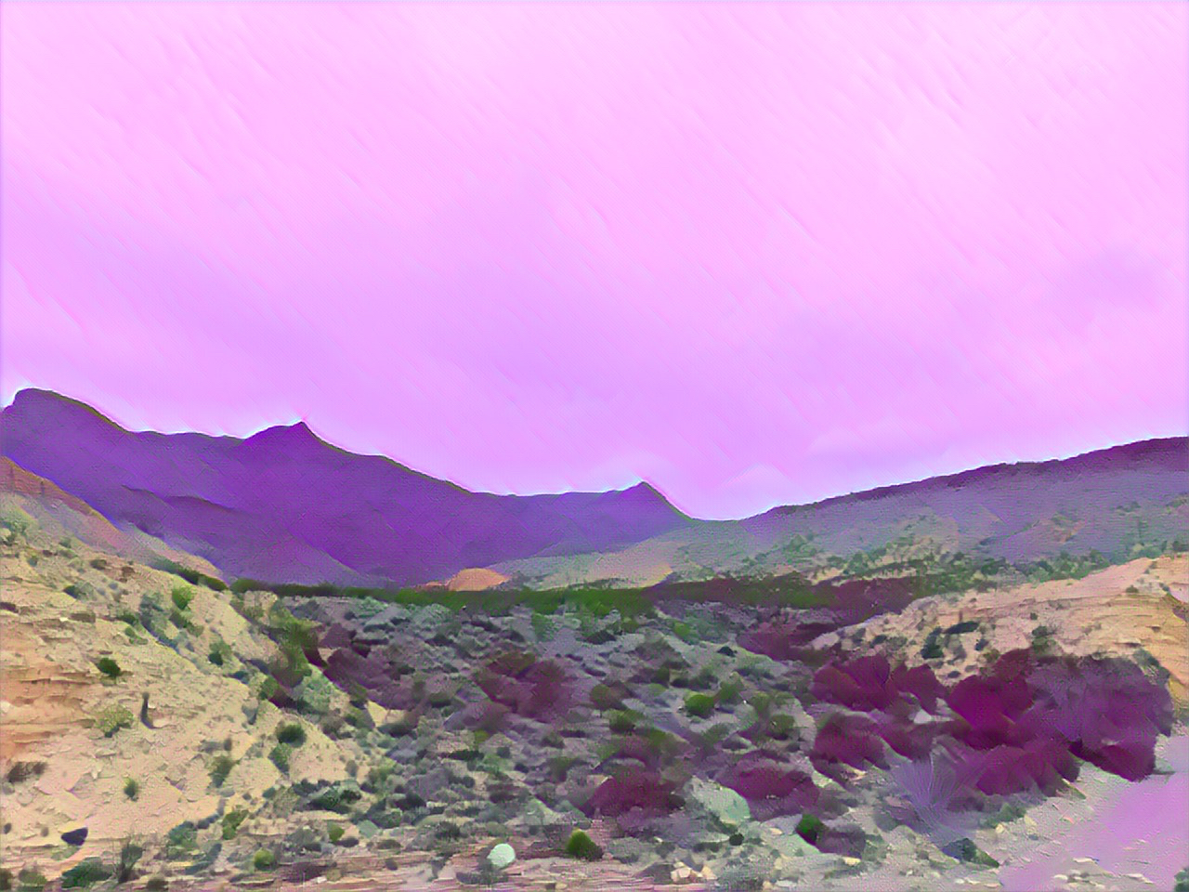
our world is a big puzzle
Learn how to fit the pieces together
Ecosystem Modeling (BIOS 998-002)
Offered Spring 2027
T/Th 12:30-13:45
All organisms welcome!
Collaborative & hands-on Learning!
Simulate hypotheses for a proposal!
Nick Smith
nsmith87@unl.edu
Add a modeling thesis chapter!
Become a systems thinker!
Gain Cv-ready skills!

