Slide 1
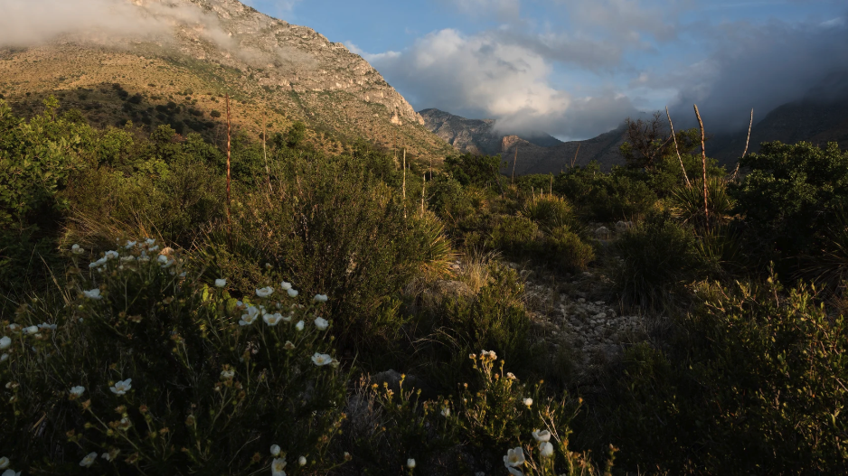
Optimal photosynthetic strategies
Nick Smith
Texas Tech University
nick.smith@ttu.edu

Slide 2
Outline
Eco-evolutionary optimality theory
Global optimal photosynthetic traits
Site-level trait variability
Implications

Slide 3
Outline
Eco-evolutionary optimality theory
Global optimal photosynthetic traits
Site-level trait variability
Implications

Slide 4
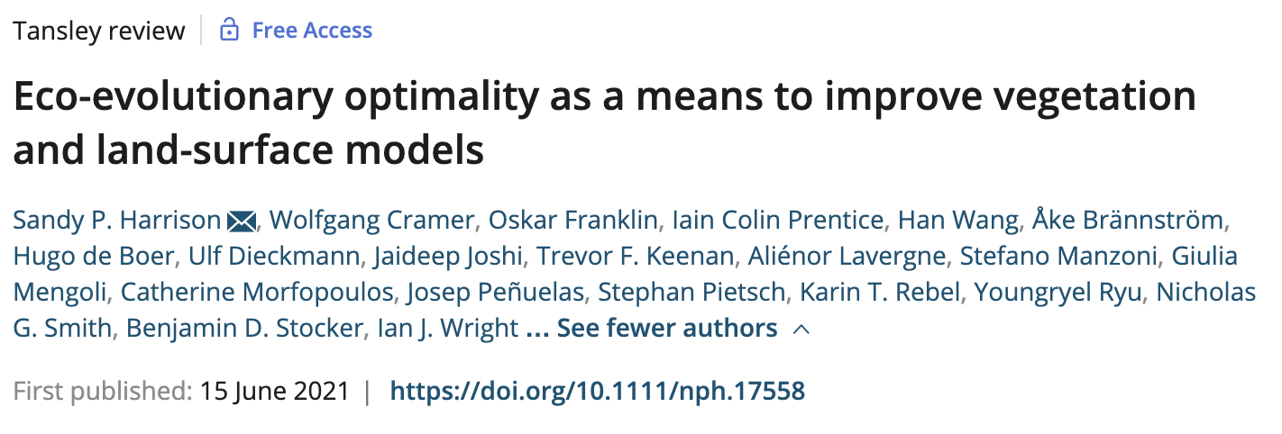
Eco-evolutionary optimality theory
“EEO invokes the power of natural selection to eliminate uncompetitive trait combinations, and thereby shape predictable, general patterns in vegetation”

Slide 5
Photosynthesis optimization: least cost
Optimally, plants will maintain fastest rate of photosynthesis at the lowest summed resource cost (water and nutrient use)

Slide 6
Optimal trait example The maximum rate of Rubisco carboxylation (V_{cmax})

Slide 7
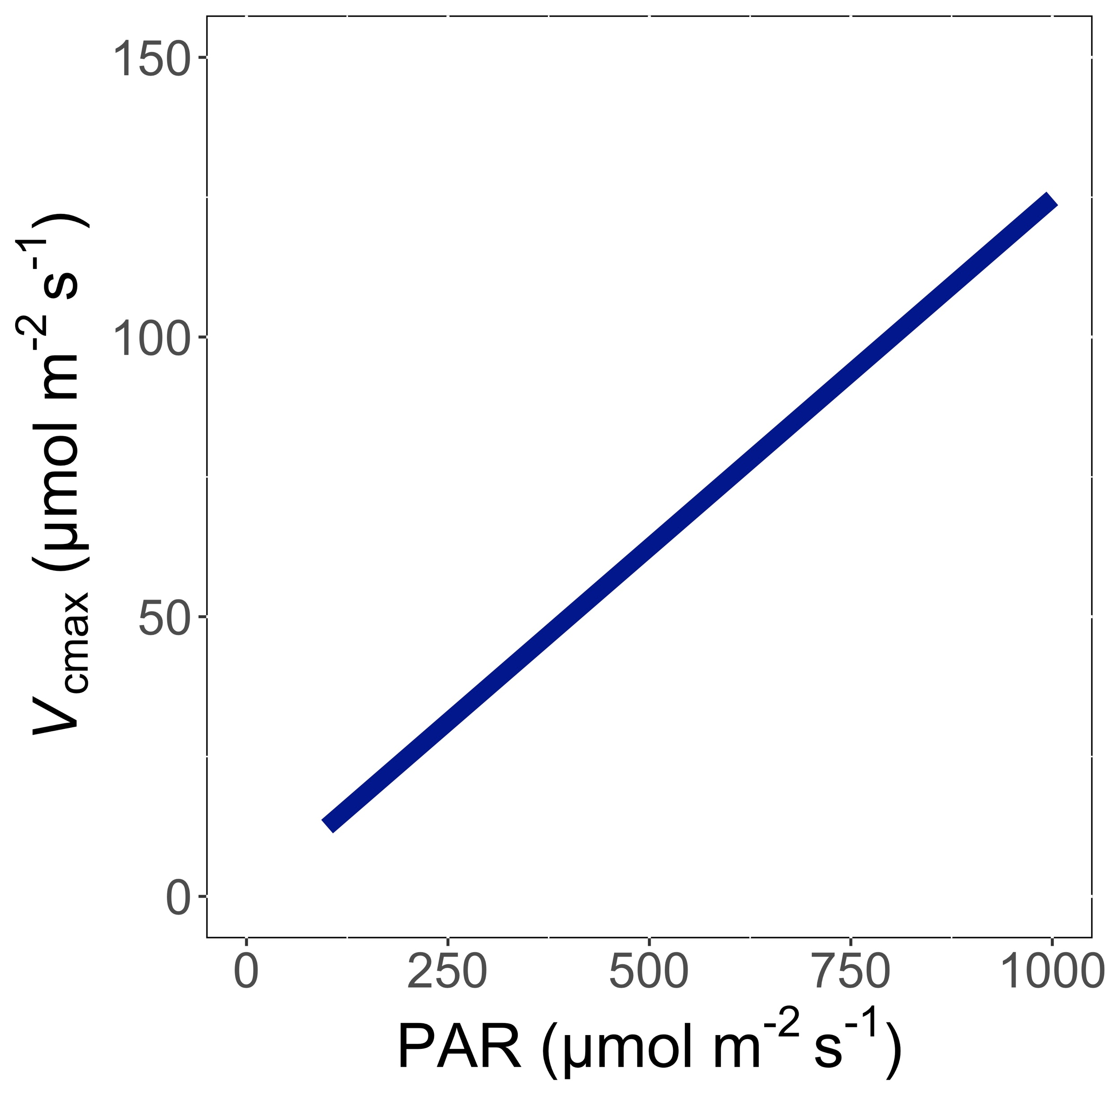
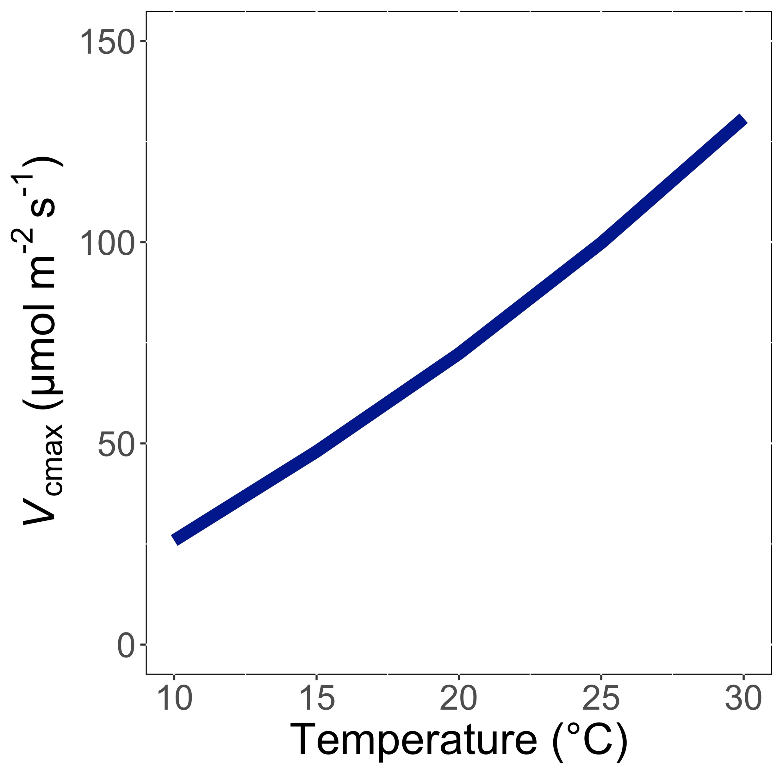
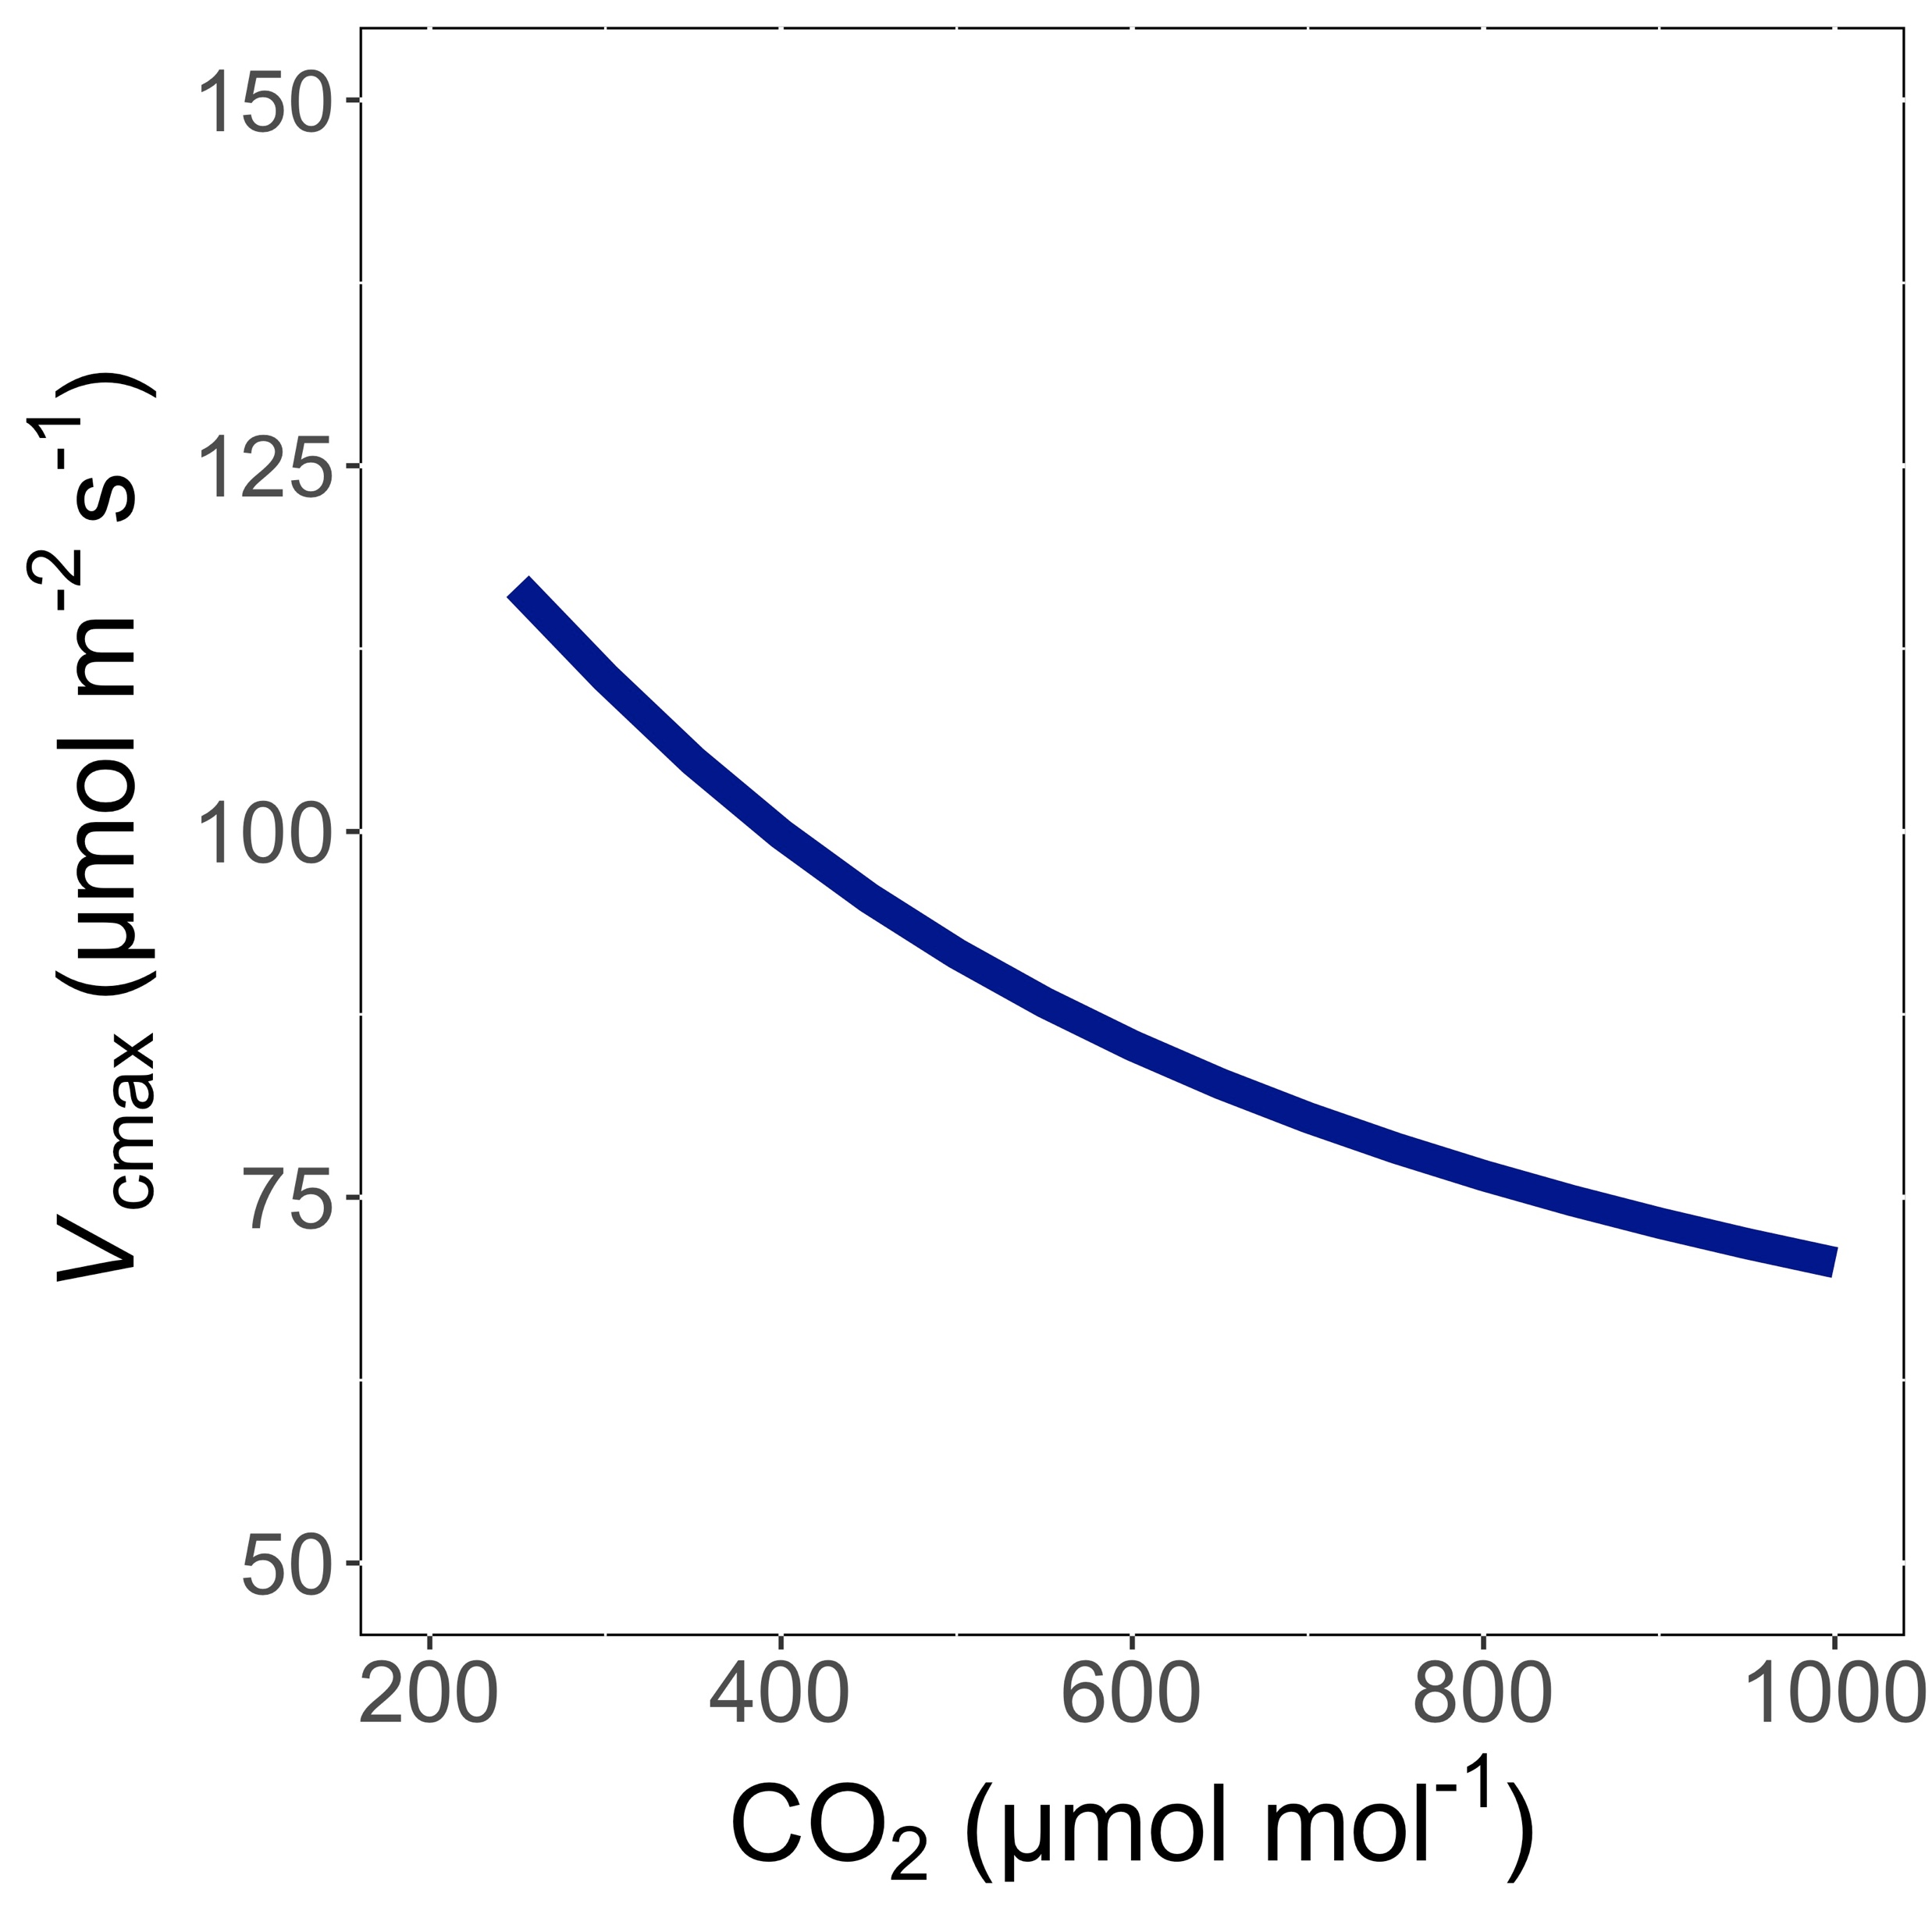
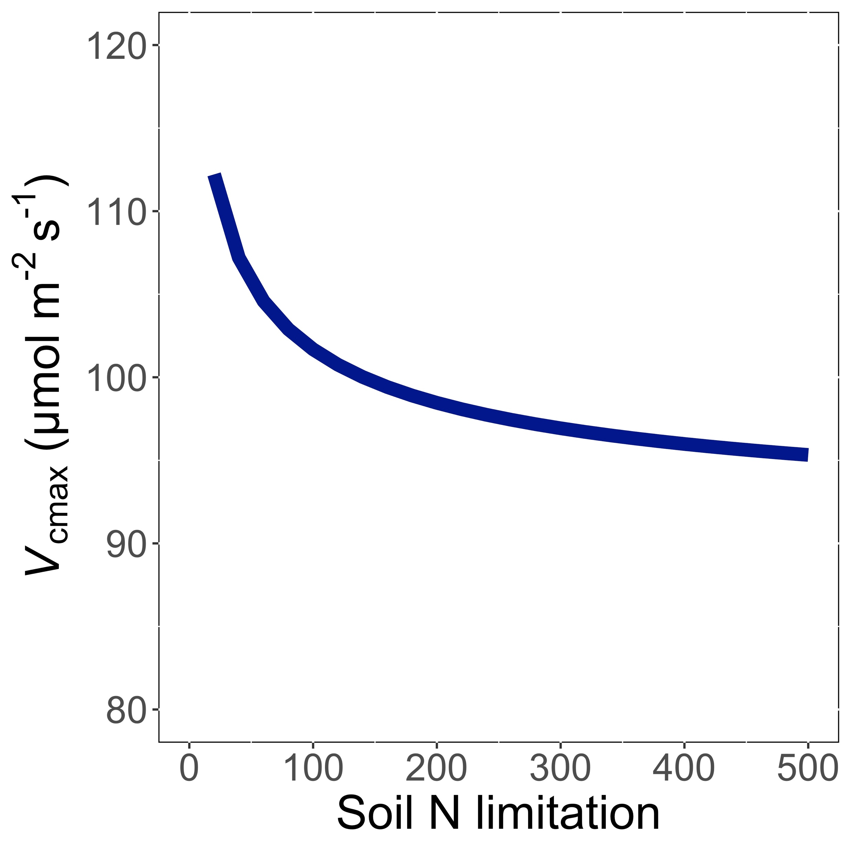
Trait-environment relationships can be predicted in ways that are:
Parameter-sparse
Mechanistically interpretable

Slide 8
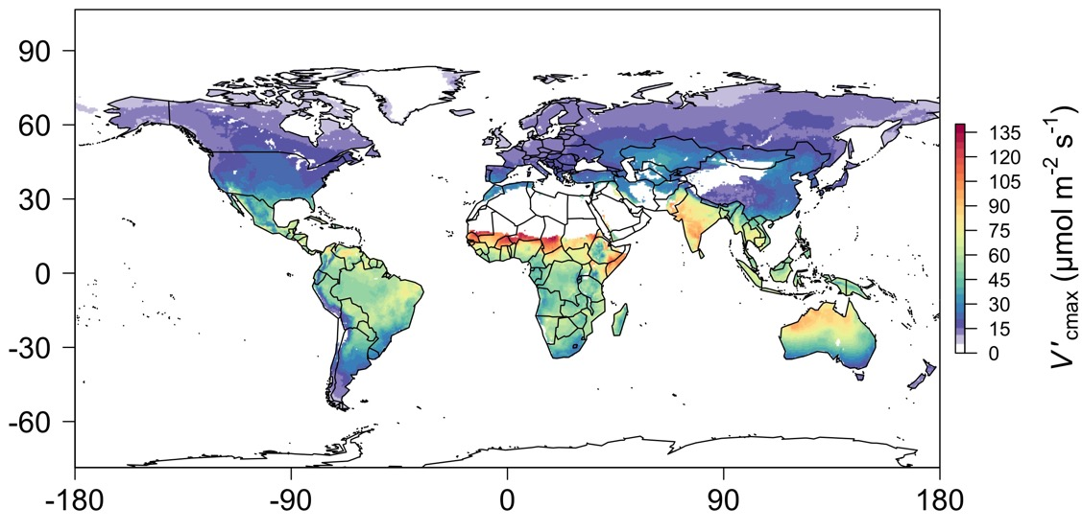
We can predict optimal traits in different environments

Slide 9
Outline
Eco-evolutionary optimality theory
Global optimal photosynthetic traits
Site-level trait variability
Implications

Slide 10
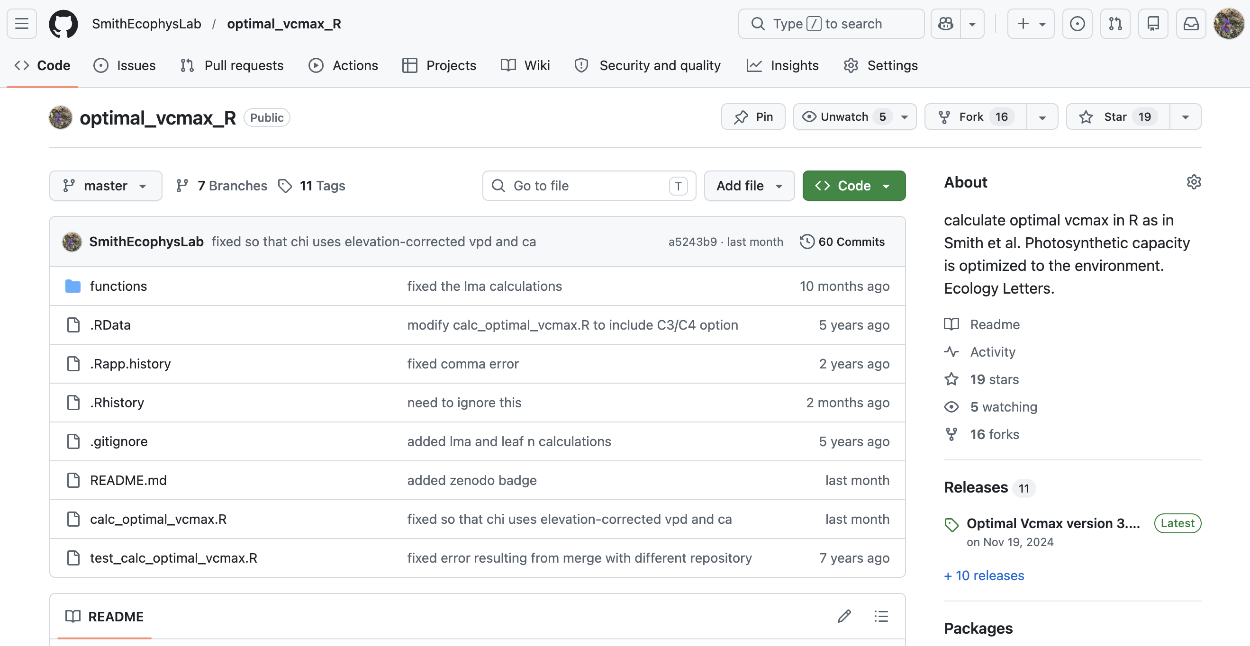
Global simulation strategy
Develop optimal photosynthesis model
Use globally gridded climate to simulate traits
Use PCA to explore trait relationships and clustering
Carbon uptake (A_{net})
Carbon loss (R_{d})
Water use for photosynthesis (g_{sw})
Nitrogen use for photosynthesis (N_{photo})
Leaf economics (LMA)
Least-cost theory (χ)
Photosynthetic efficiency (iWUE, PNUE)
github.com/smithecophyslab/optimal_vcmax_r

Slide 11
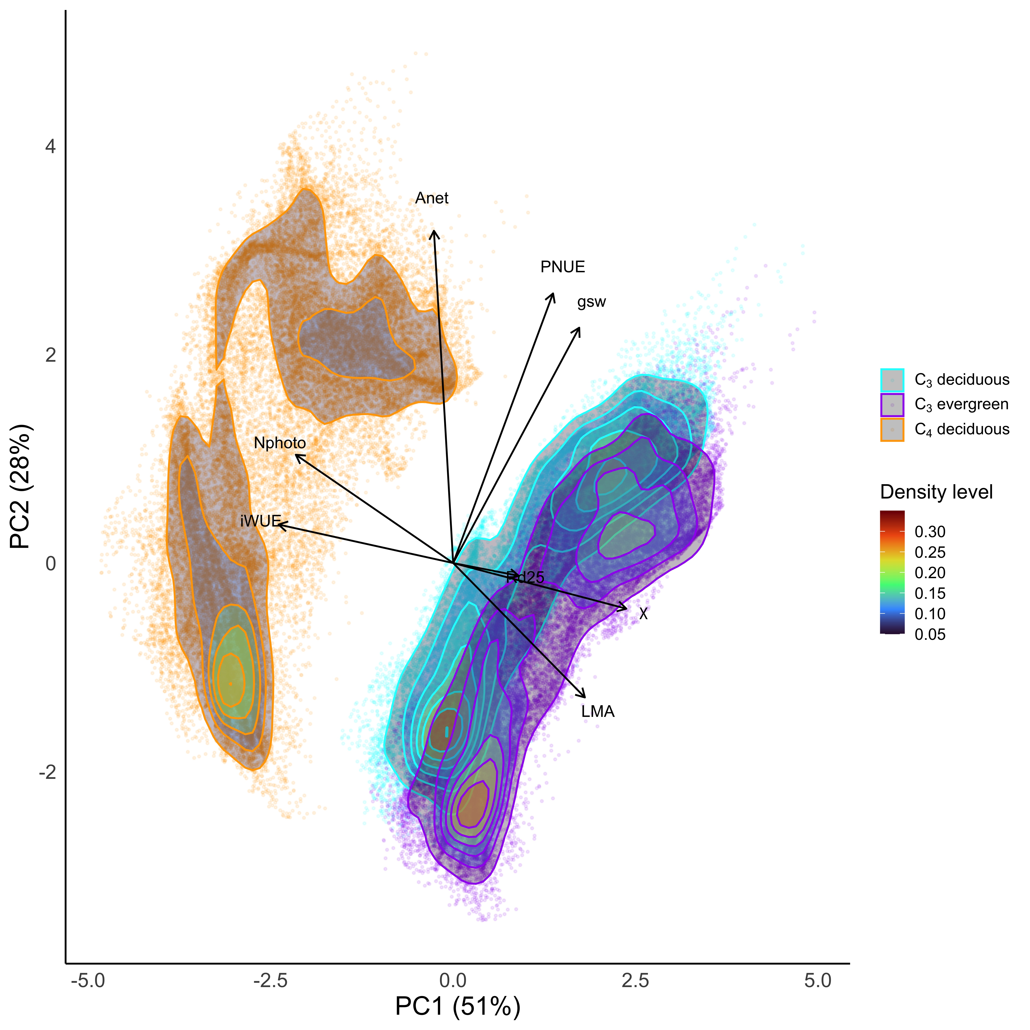
PC1
N use-WUE
C₃-C₄ divide

Slide 12
PC1
N use-WUE
C₃-C₄ divide
PC2
H₂O use-PNUE
A_{net}
wet-dry divide

Slide 13
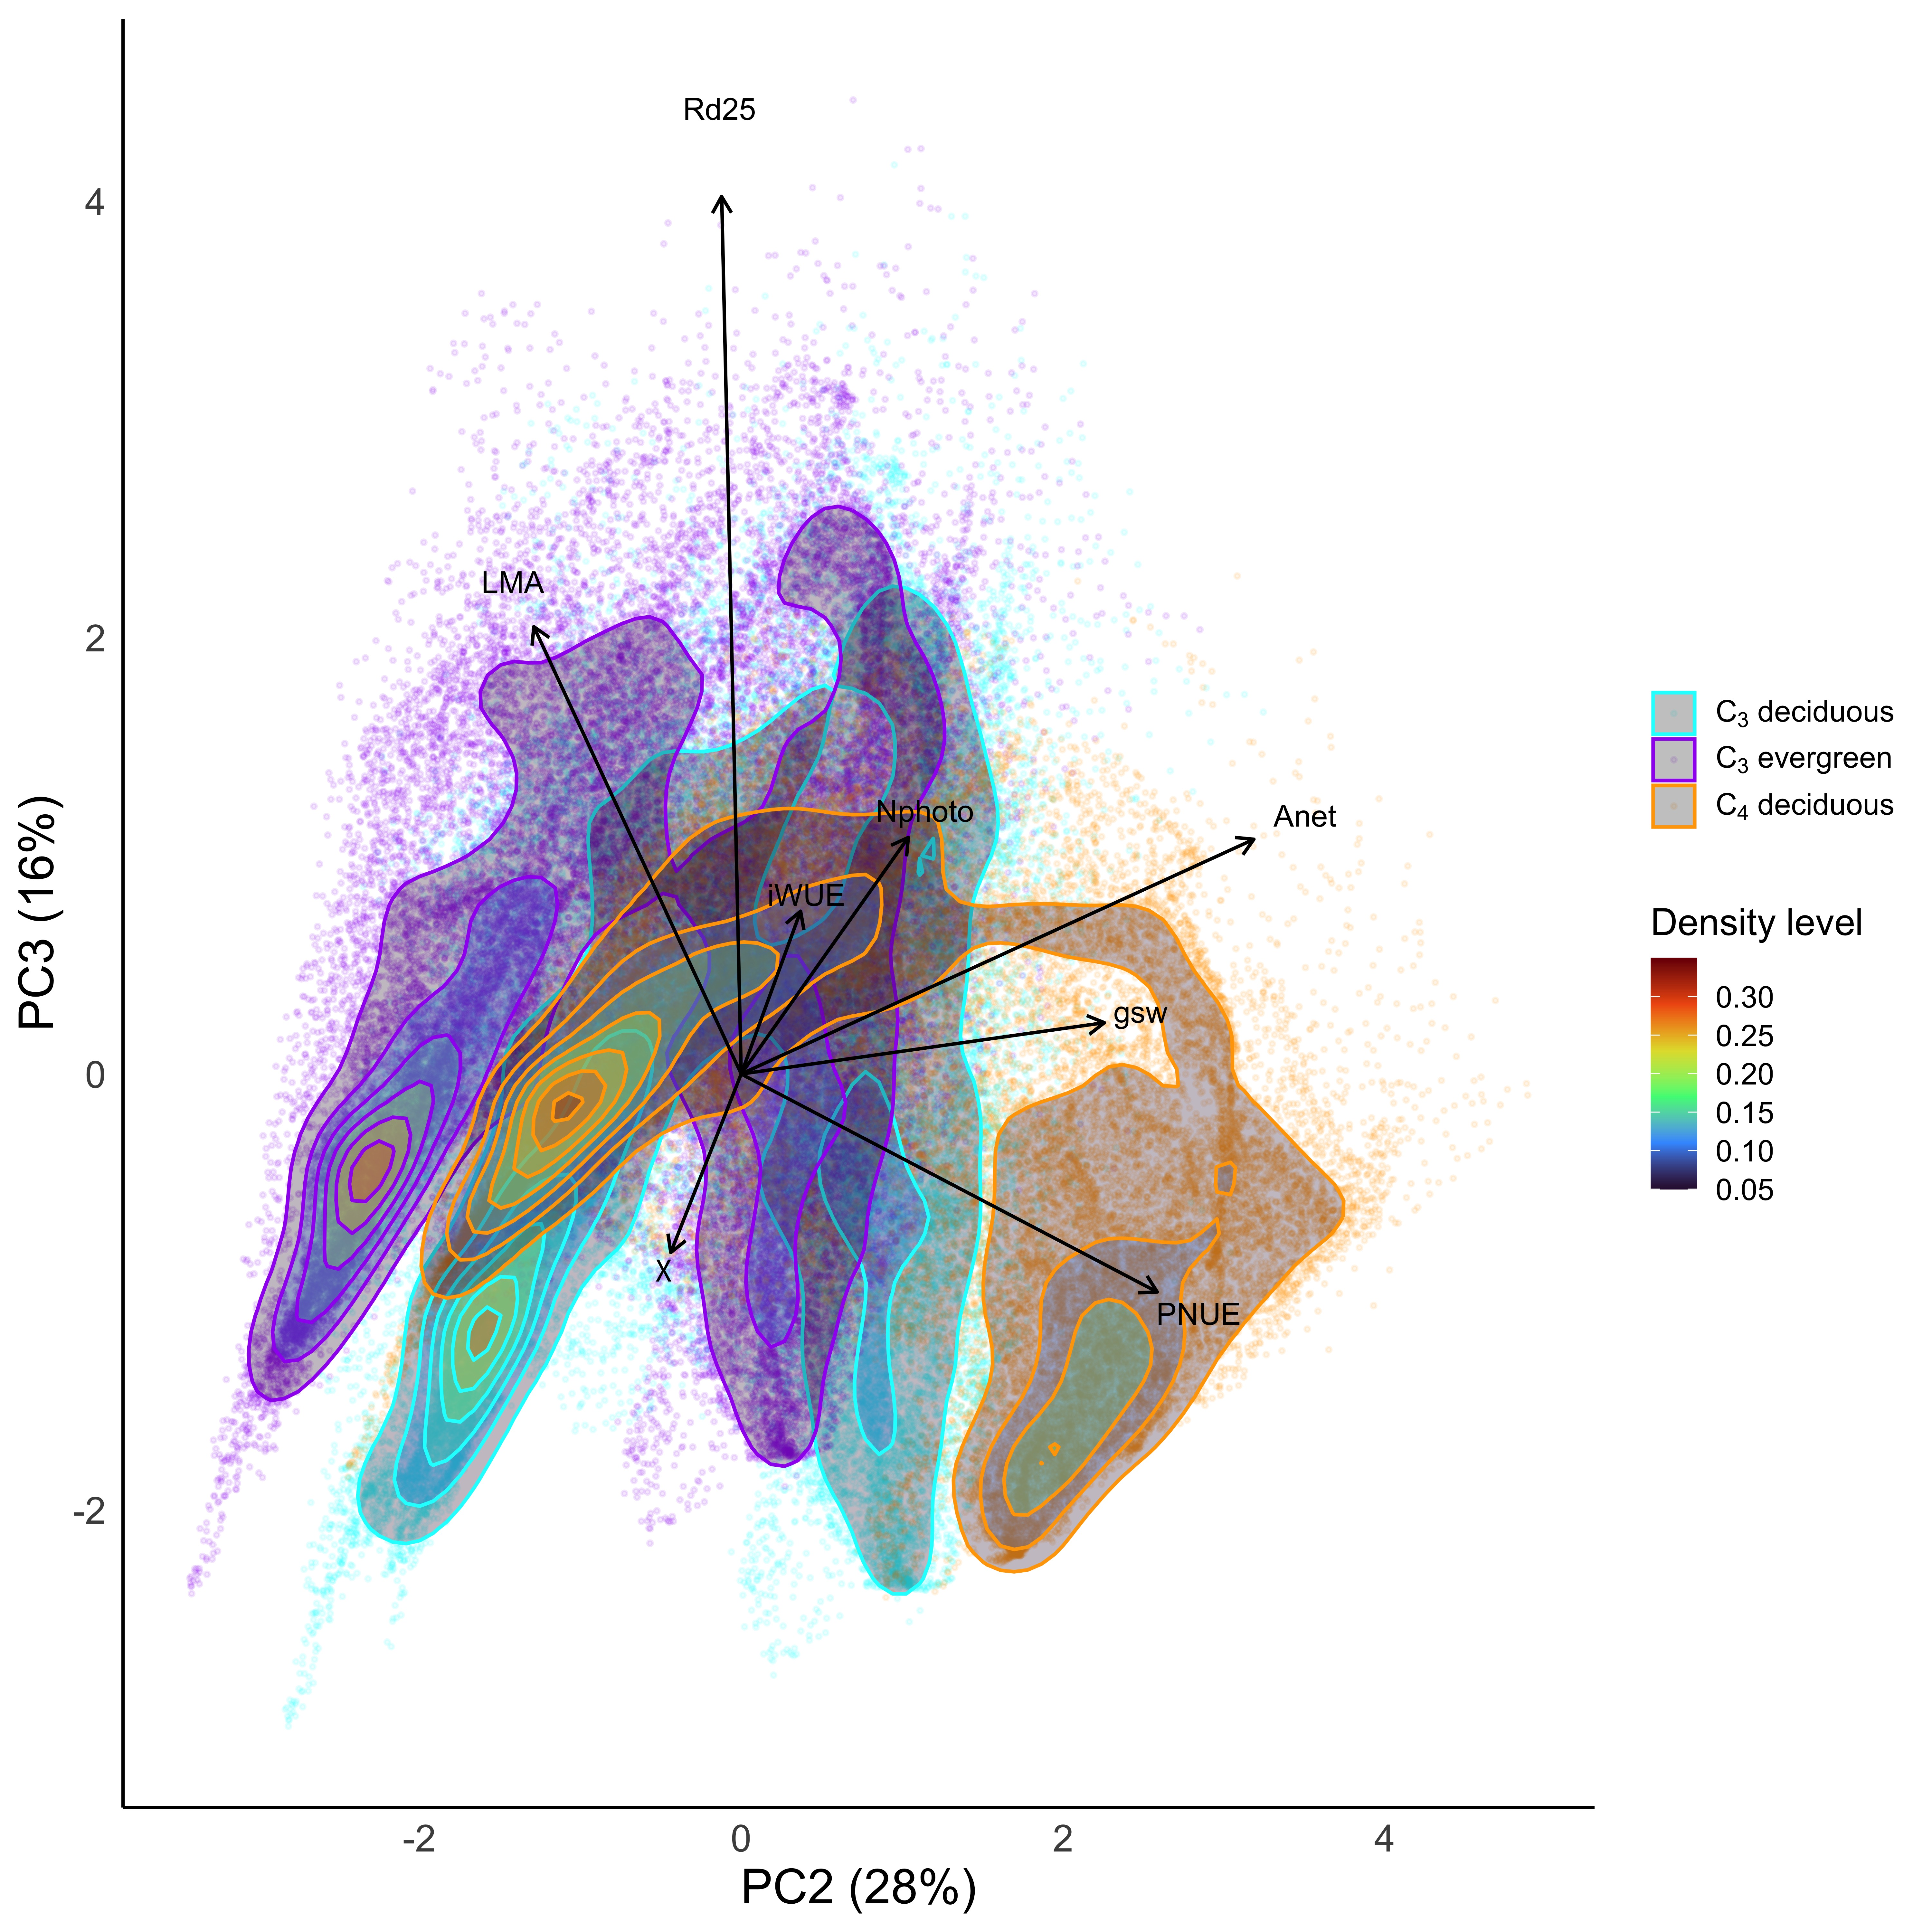
PC3
LMA, R_{d}

Slide 14
Outline
Eco-evolutionary optimality theory
Global optimal photosynthetic traits
Site-level trait variability
Implications

Slide 15
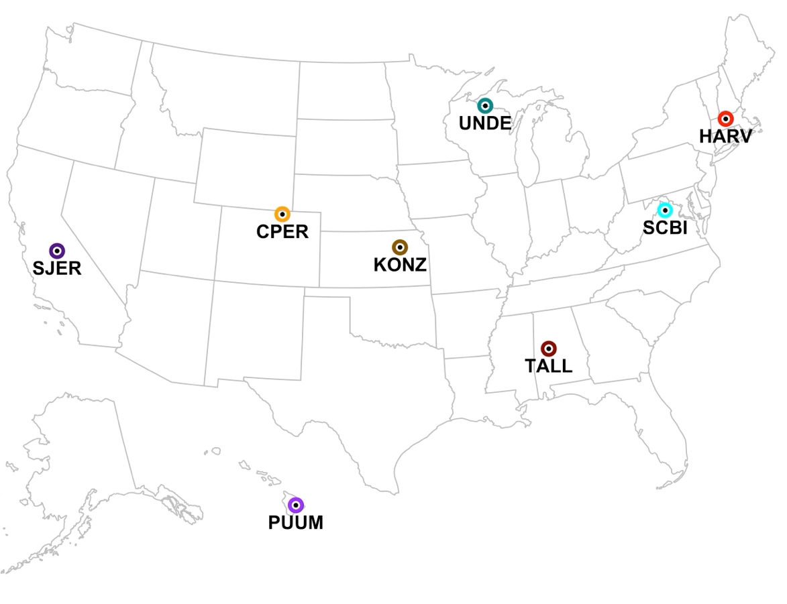
Site-level simulation strategy
Choose sites representing different dominant PFTs
NEON network
Deciduous trees, evergreen trees, mixed forests, C₄ grasses
Simulate optimal traits 10,000x using climate distribution (mean +/- 0.1*mean)

Slide 16
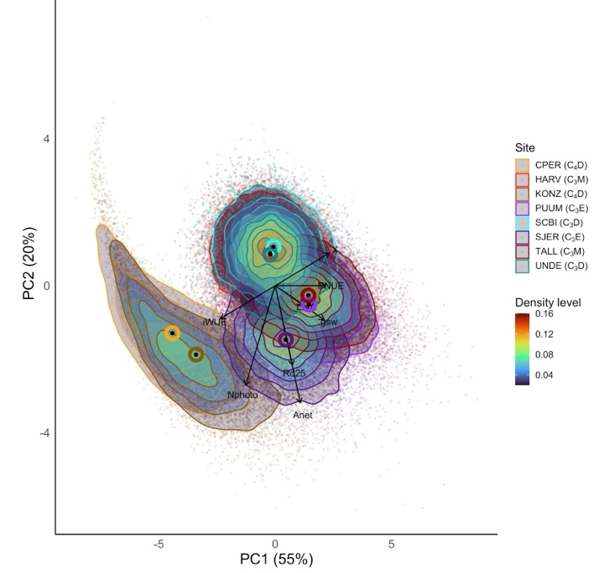
PCs defined similarly to global simulation
A lot of within-site variability

Slide 17
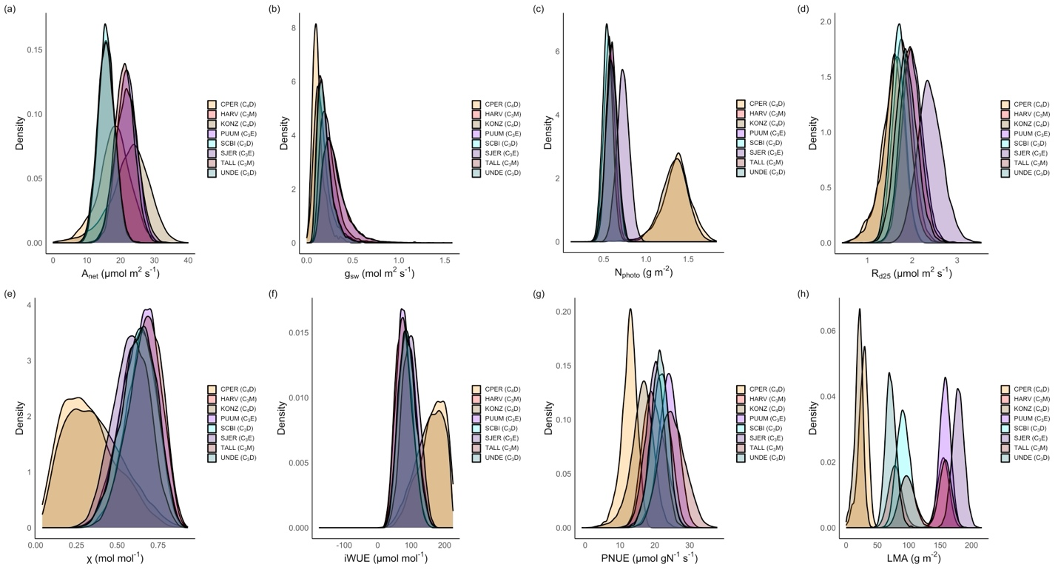
Within-site variability is larger than across-site for many traits

Slide 18
Some traits show separation by photosynthetic type

Slide 19
LMA shows separation by PFT

Slide 20
Outline
Eco-evolutionary optimality theory
Global optimal photosynthetic traits
Site-level trait variability
Implications

Slide 21
Implications
We can simulate optimal photosynthetic strategies

Slide 22
Implications
We can simulate optimal photosynthetic strategies
The three defining axes of optimal photosynthetic strategies:
Nitrogen use-water use efficiency (PFT-driven)
Water use-nitrogen use efficiency (climate-driven)
Tissue costs of photosynthesis

Slide 23
Implications
We can simulate optimal photosynthetic strategies
The three defining axes of optimal photosynthetic strategies:
Nitrogen use-water use efficiency (PFT-driven)
Water use-nitrogen use efficiency (climate-driven)
Tissue costs of photosynthesis
Plant type dictates optimal photosynthetic strategies via some (LMA, WUE, N use), but not all traits

Slide 24
Implications
We can simulate optimal photosynthetic strategies
The three defining axes of optimal photosynthetic strategies:
Nitrogen use-water use efficiency (PFT-driven)
Water use-nitrogen use efficiency (climate-driven)
Tissue costs of photosynthesis
Plant type dictates optimal photosynthetic strategies via some (LMA, WUE, N use), but not all traits
There are many optimal strategies within an environment

Slide 25

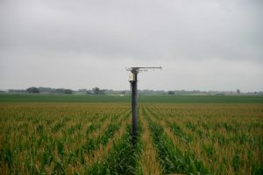
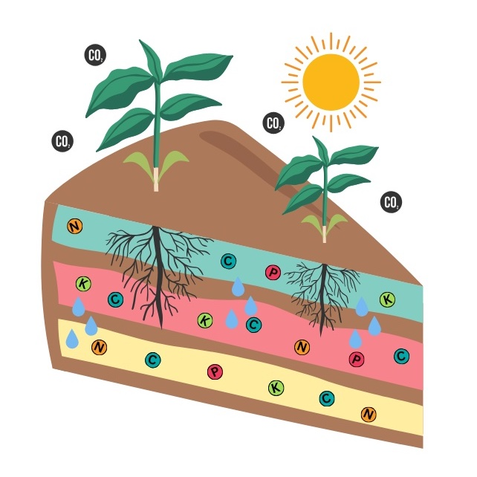
Quick notice
Lab is moving to the University of Nebraska - Lincoln
Starting Fall 2026
Reach out if you are interested in collaborating

Slide 26
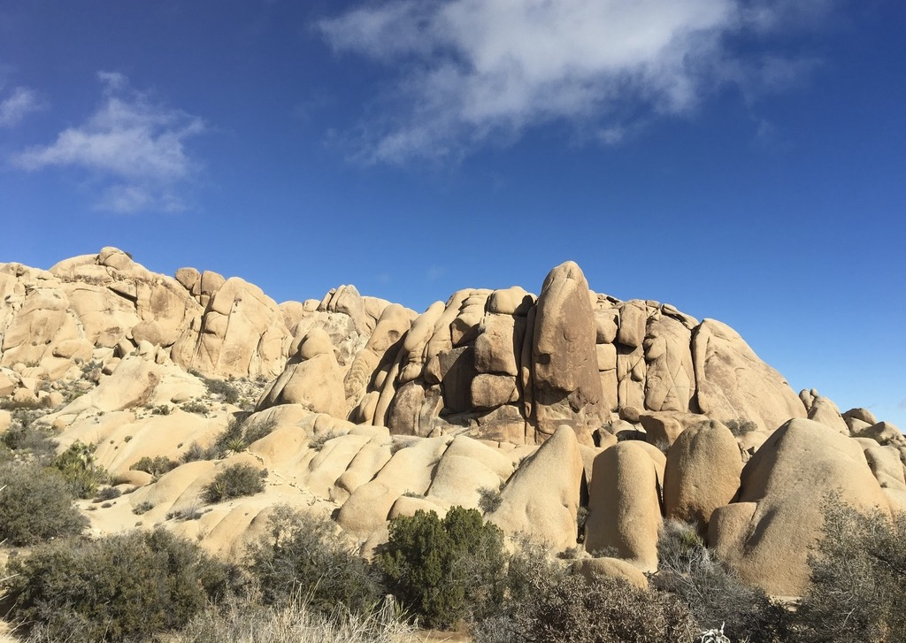
Presentation: github.com/SmithEcophysLab/egu_2026
Model code: github.com/SmithEcophysLab/optimal_vcmax_r
Contact: nick.smith@ttu.edu, nsmith87@unl.edu
Thanks!

Slide 27
