Slide 1
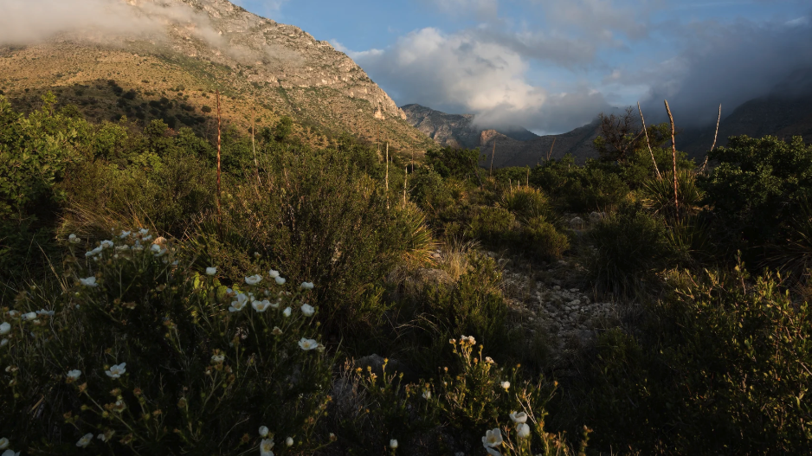
Optimal photosynthetic strategies
Nick Smith
Texas Tech University
nick.smith@ttu.edu

Slide 2
Outline
Eco-evolutionary optimality theory
Study 1: Global optimal photosynthetic strategies
Study 2: Site-level optimal photosynthetic strategies
Implications

Slide 3
Outline
Eco-evolutionary optimality theory
Study 1: Global optimal photosynthetic strategies
Study 2: Site-level optimal photosynthetic strategies
Implications

Slide 4
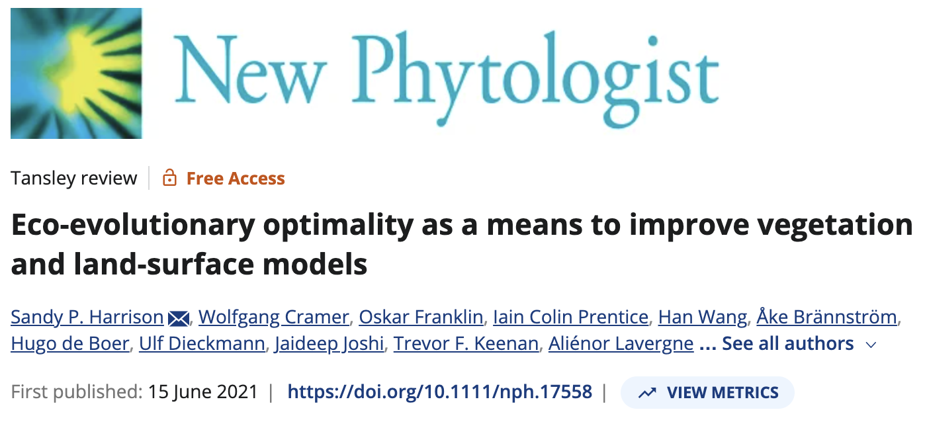
Eco-evolutionary optimality theory
“EEO invokes the power of natural selection to eliminate uncompetitive trait combinations, and thereby shape predictable, general patterns in vegetation”

Slide 5
Photosynthesis optimization: least cost
Optimally, plants will maintain fastest rate of photosynthesis at the lowest summed resource cost (water and nutrient use)

Slide 6
Optimal trait example The maximum rate of RuBisCO carboxylation (V_{cmax})
Smith et al. (2019)

Slide 7
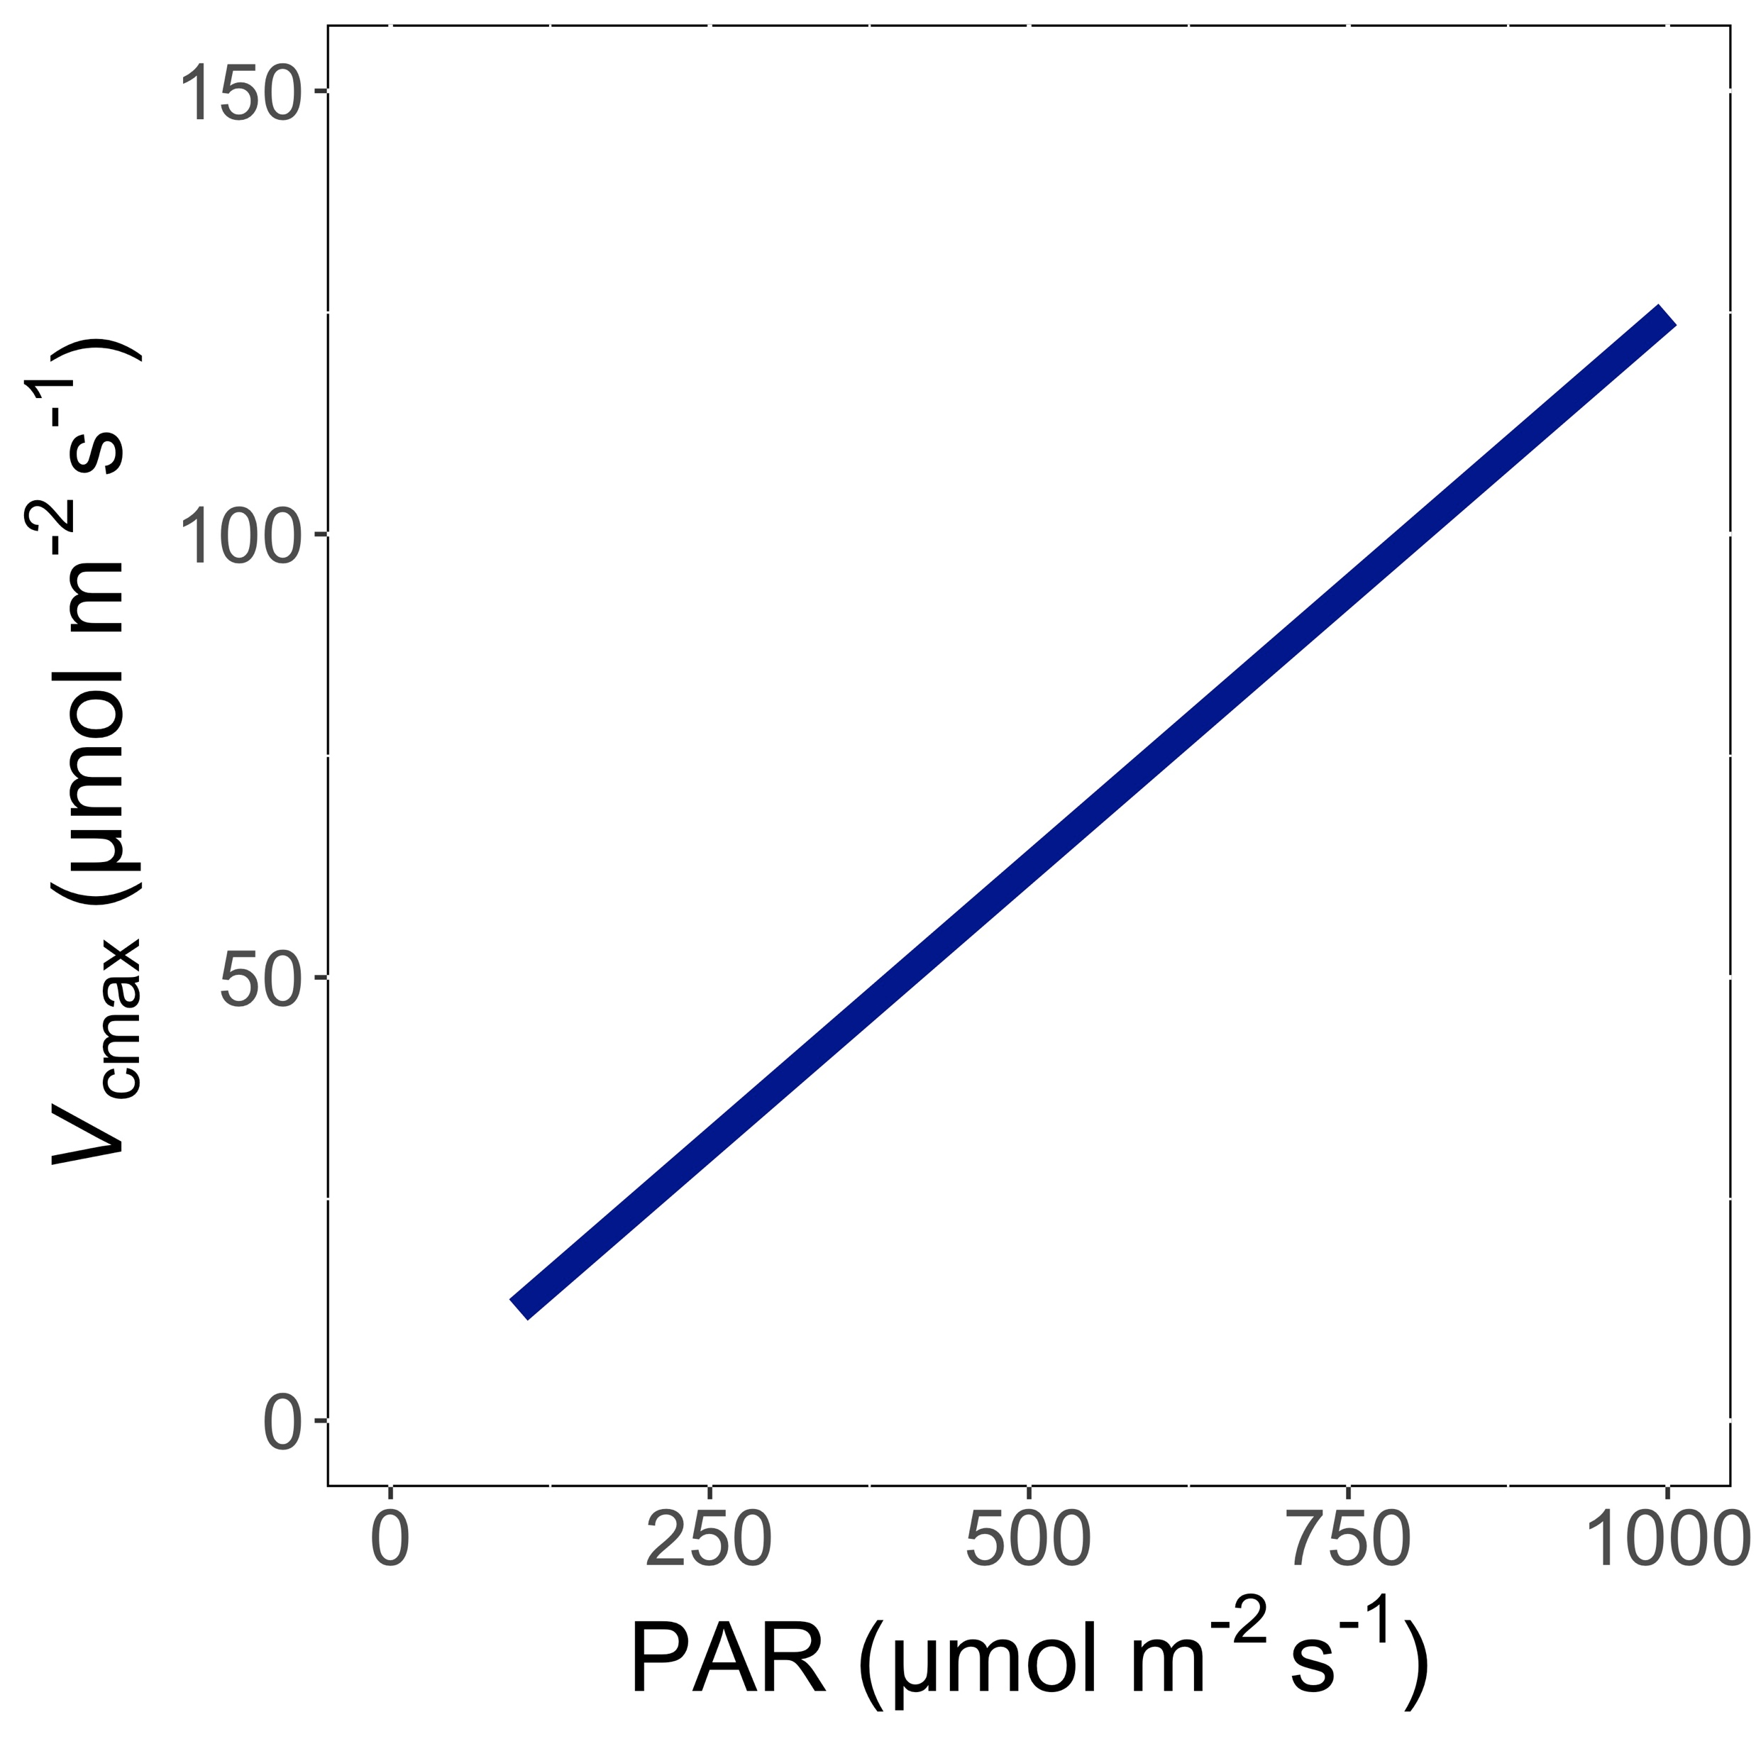
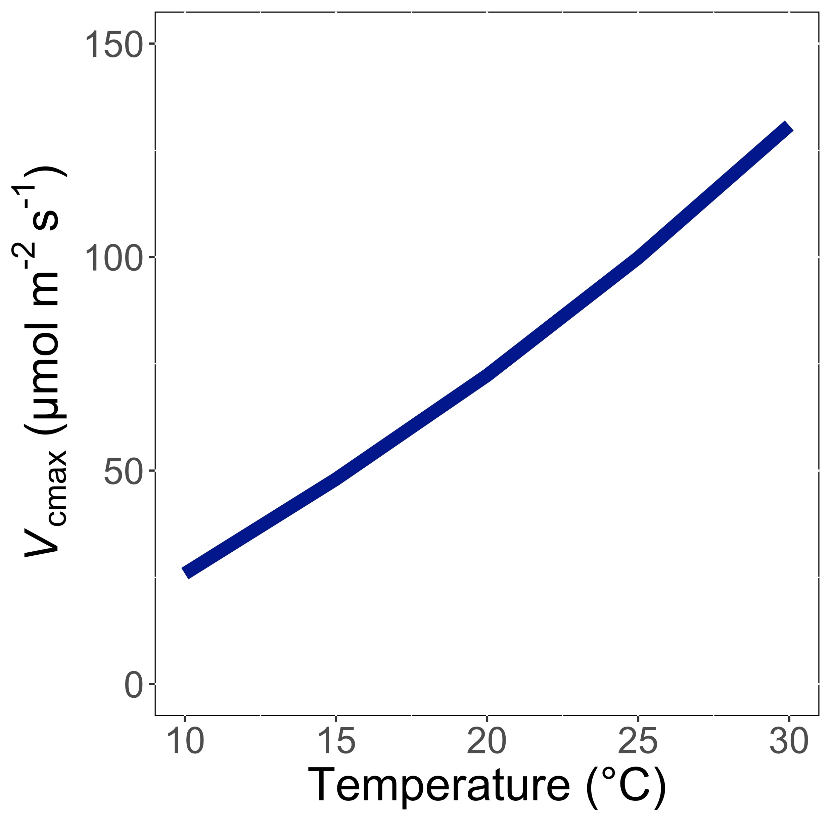
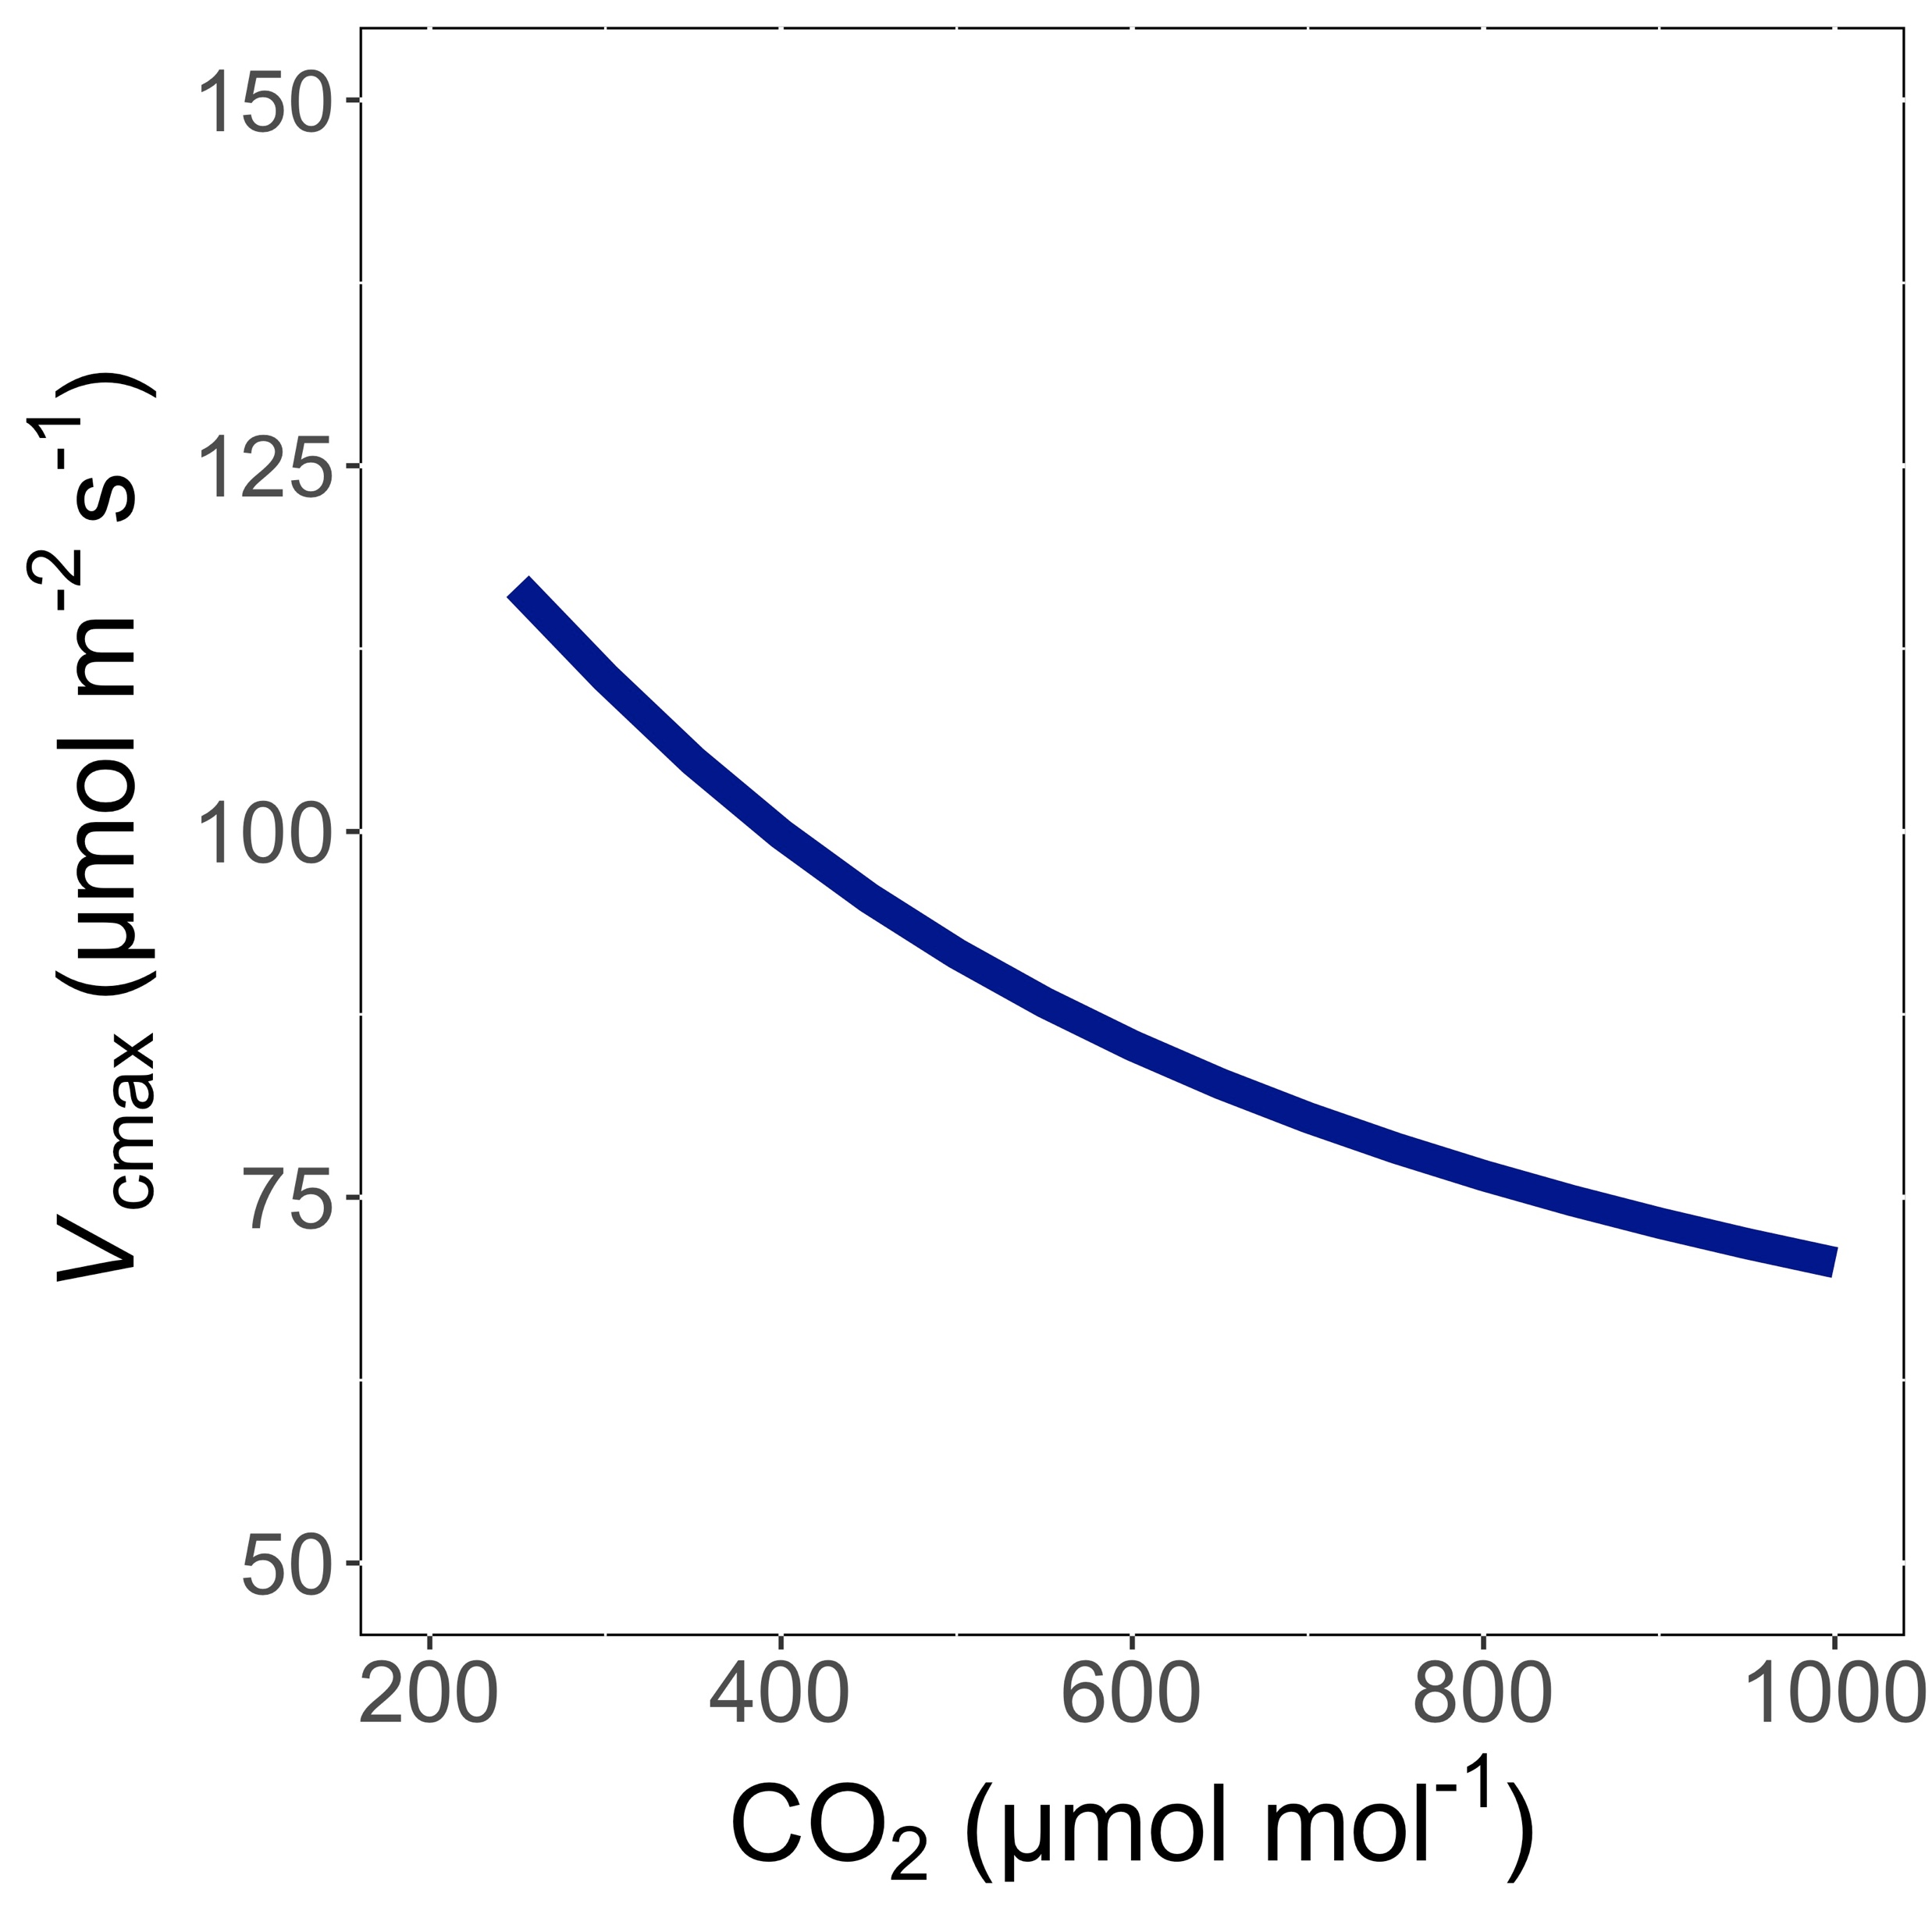
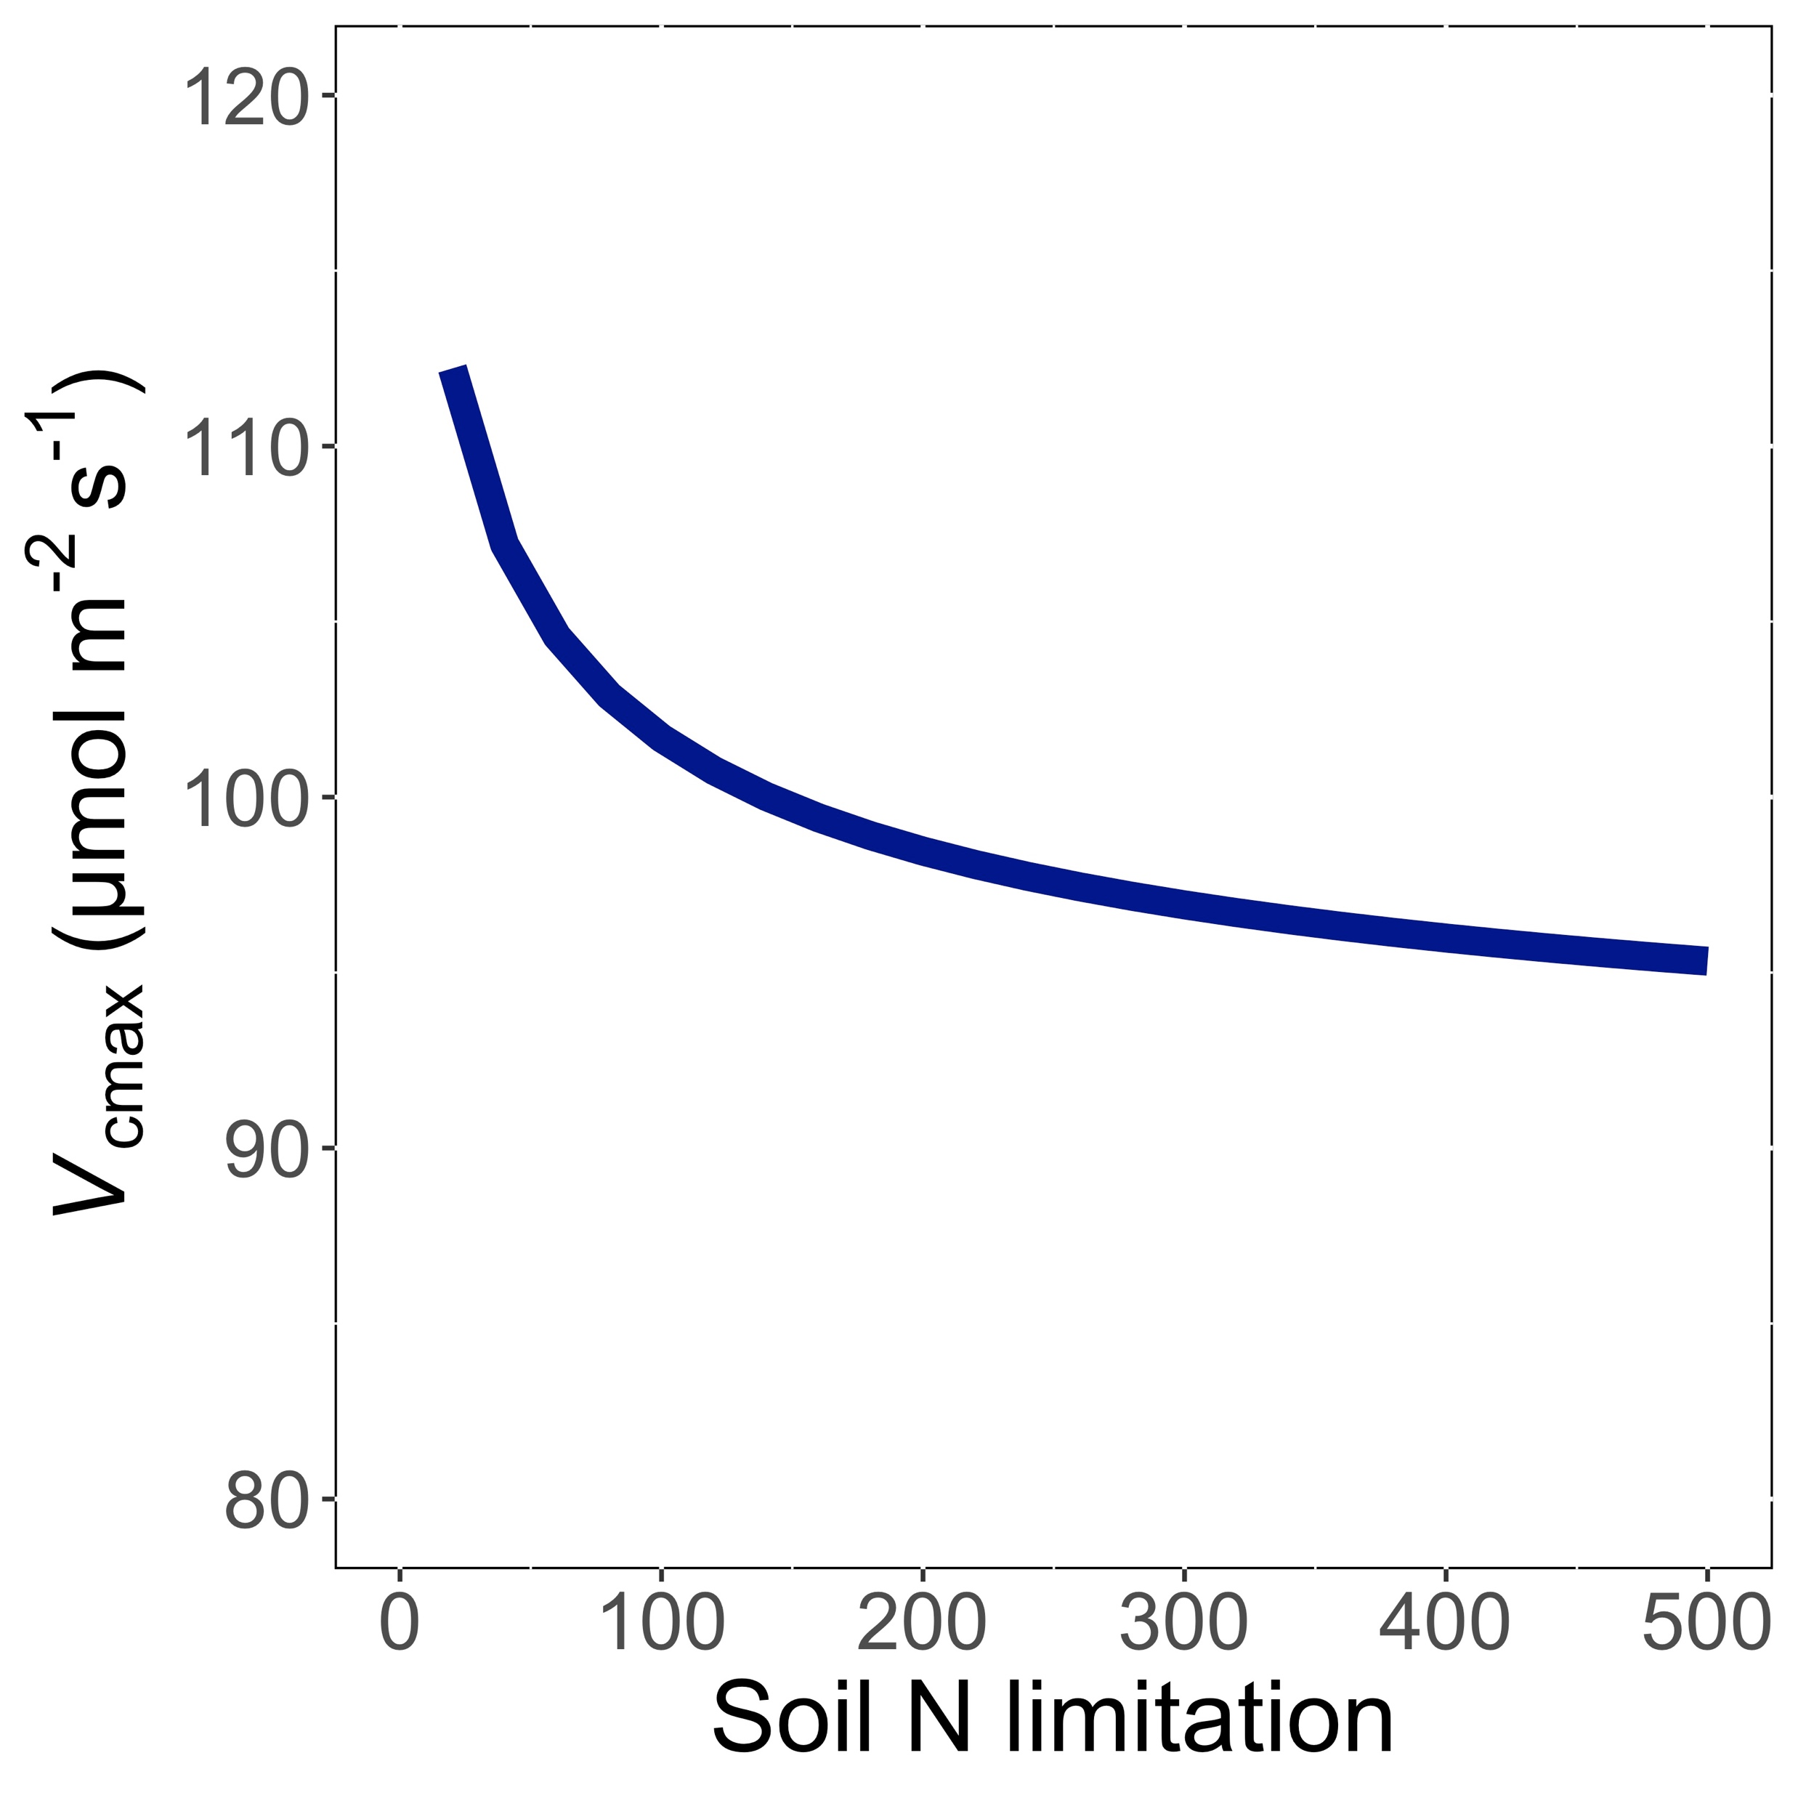
Trait-environment relationships can be predicted in ways that are:
Parameter-sparse
Mechanistically interpretable
Smith et al. (2019)

Slide 8
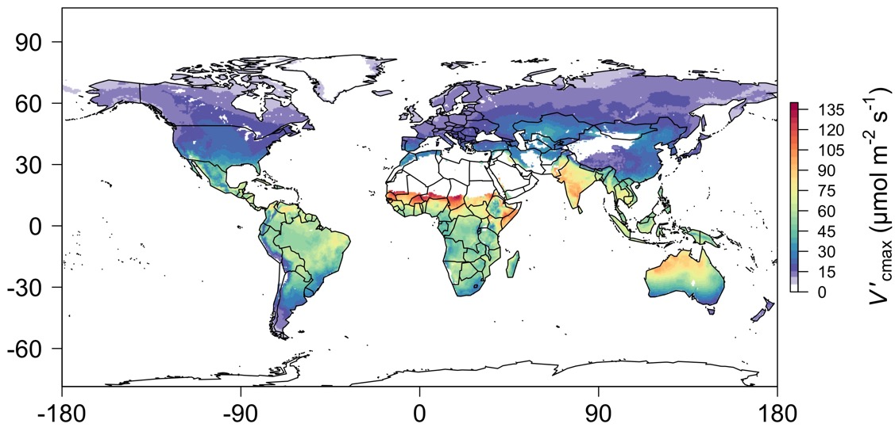
We can predict optimal traits in different environments
Smith et al. (2019)

Slide 9
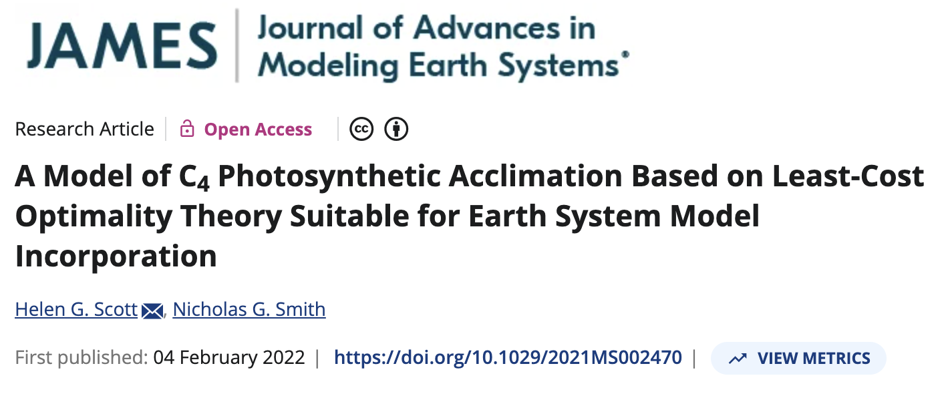
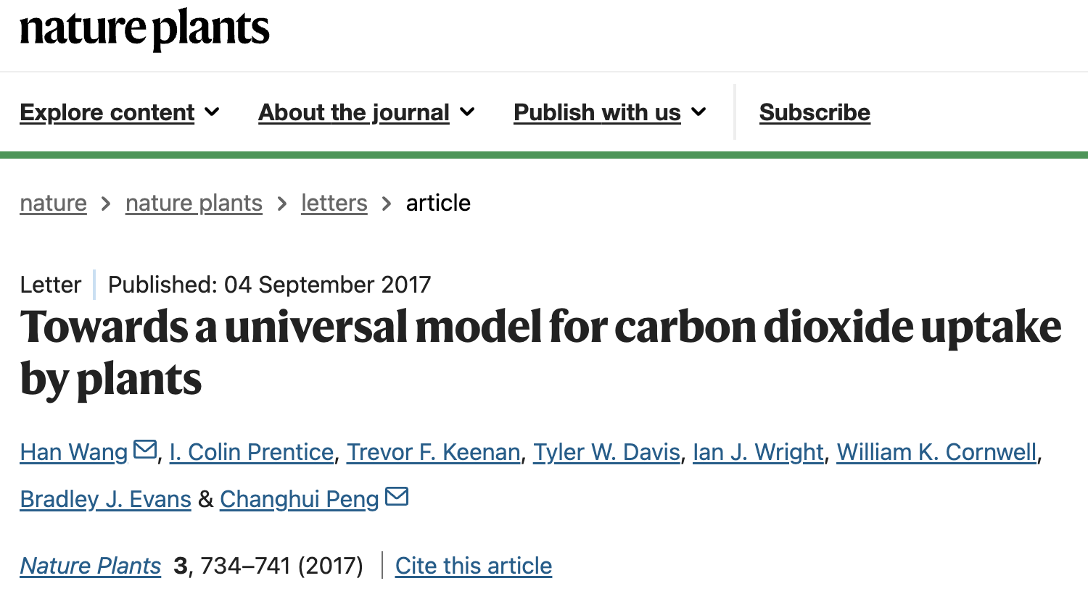
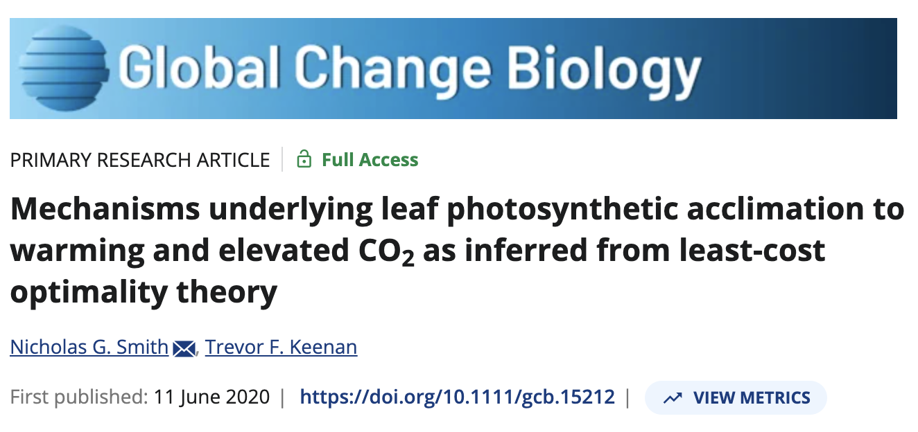
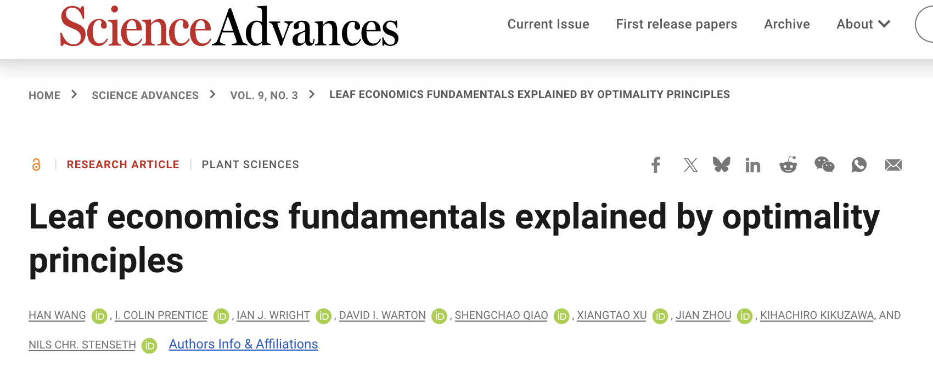
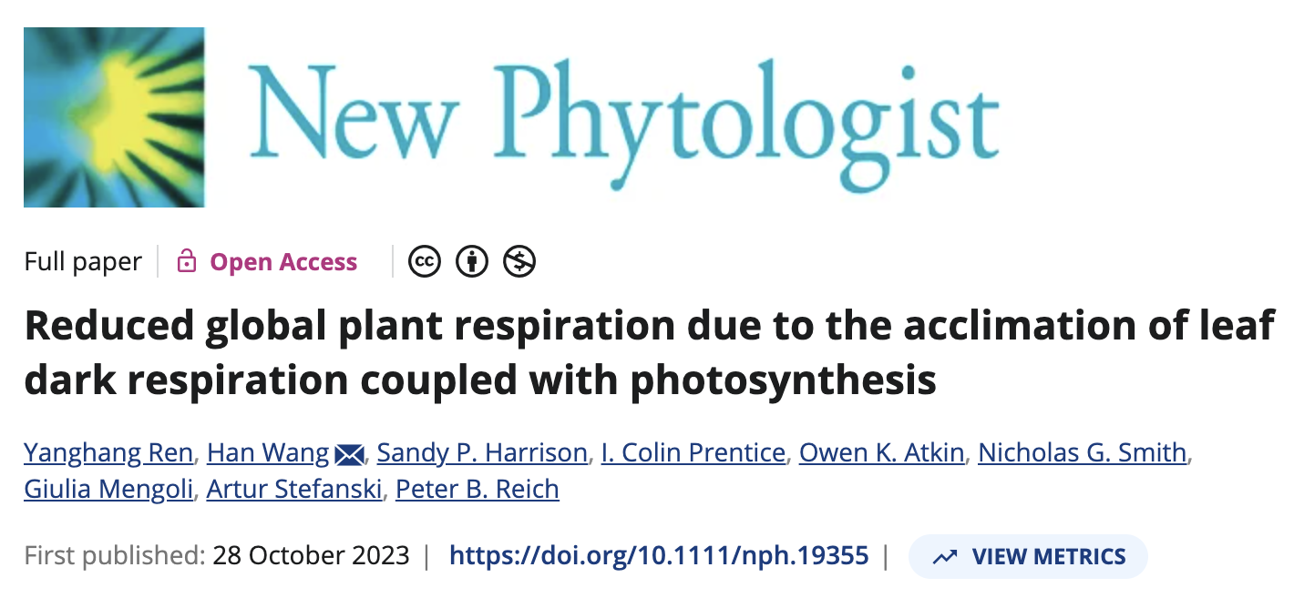
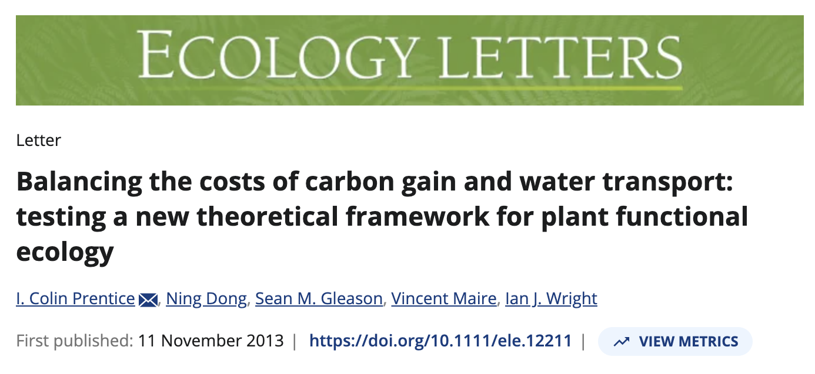
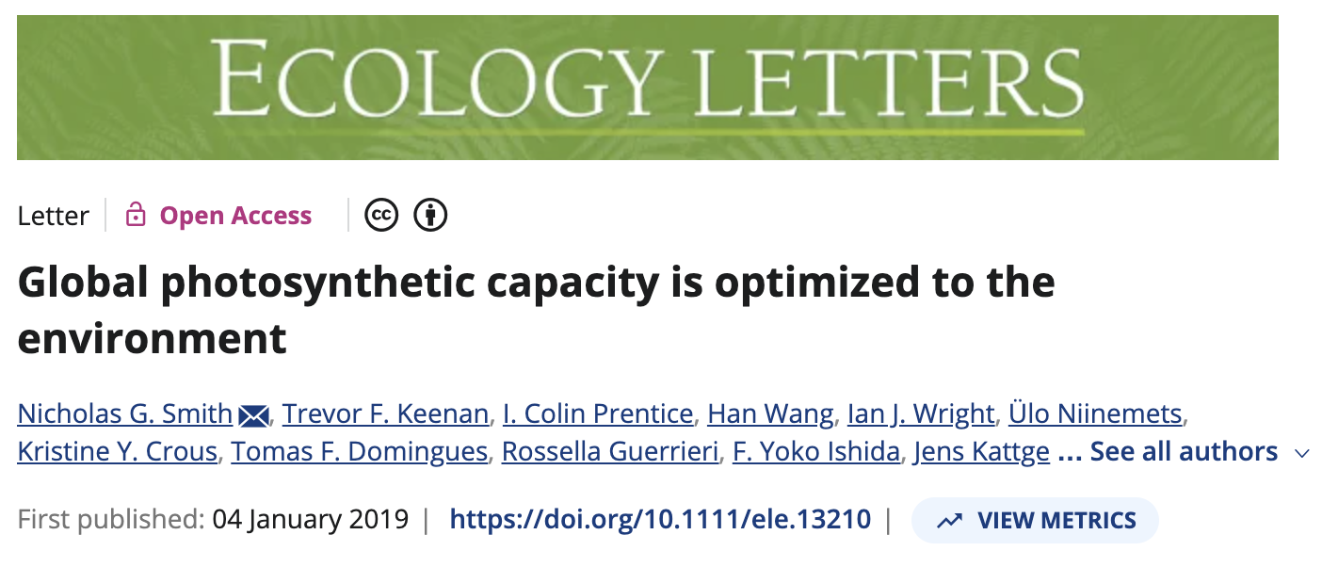
We can predict optimal traits in different environments

Slide 10
How does the environment shape optimal photosynthesis in a multi-trait context?

Slide 11
How does the environment shape optimal photosynthetic strategies?

Slide 12
Outline
Eco-evolutionary optimality theory
Study 1: Global optimal photosynthetic strategies
Study 2: Site-level optimal photosynthetic strategies
Implications

Slide 13
Global simulation strategy

Slide 14
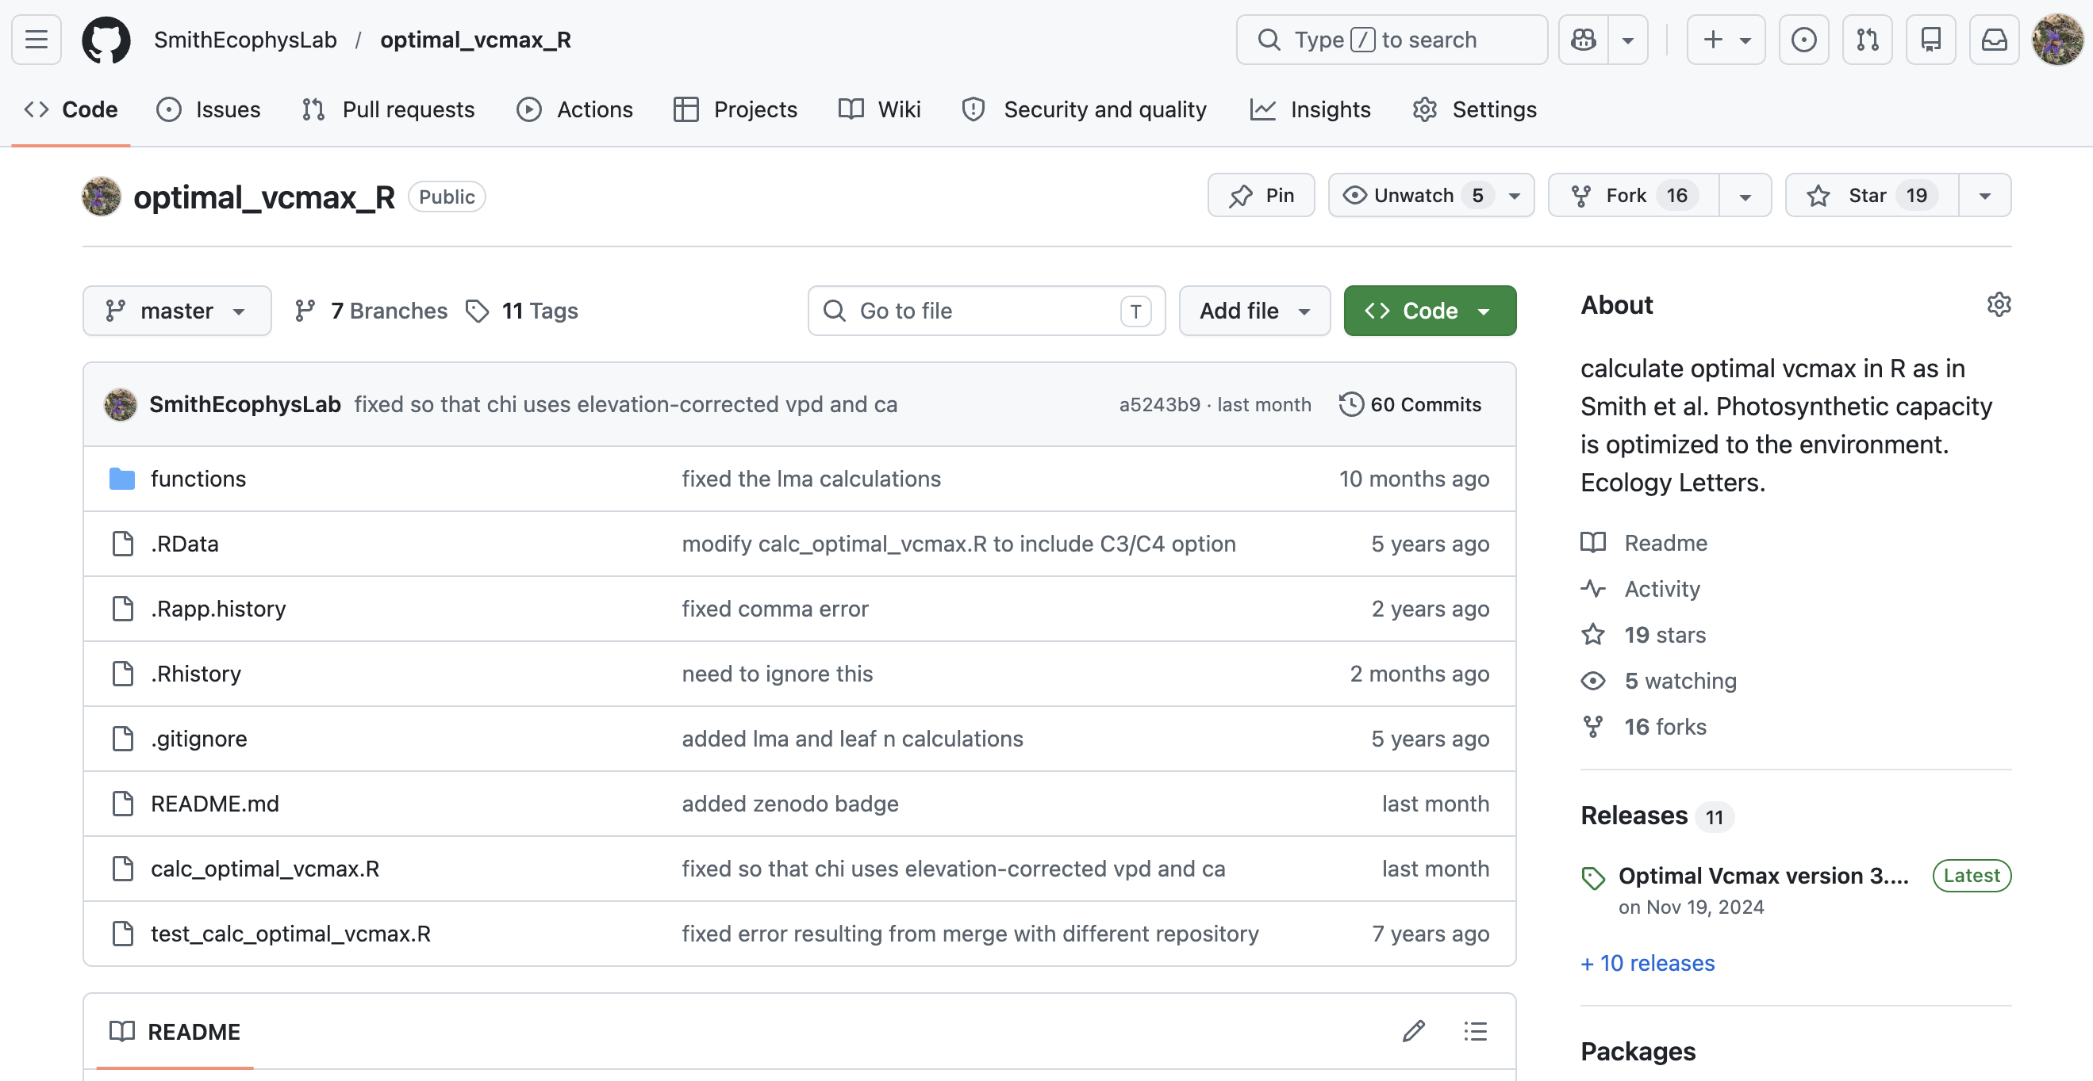
Global simulation strategy
Developed optimal photosynthesis model
github.com/smithecophyslab/optimal_vcmax_r

Slide 15
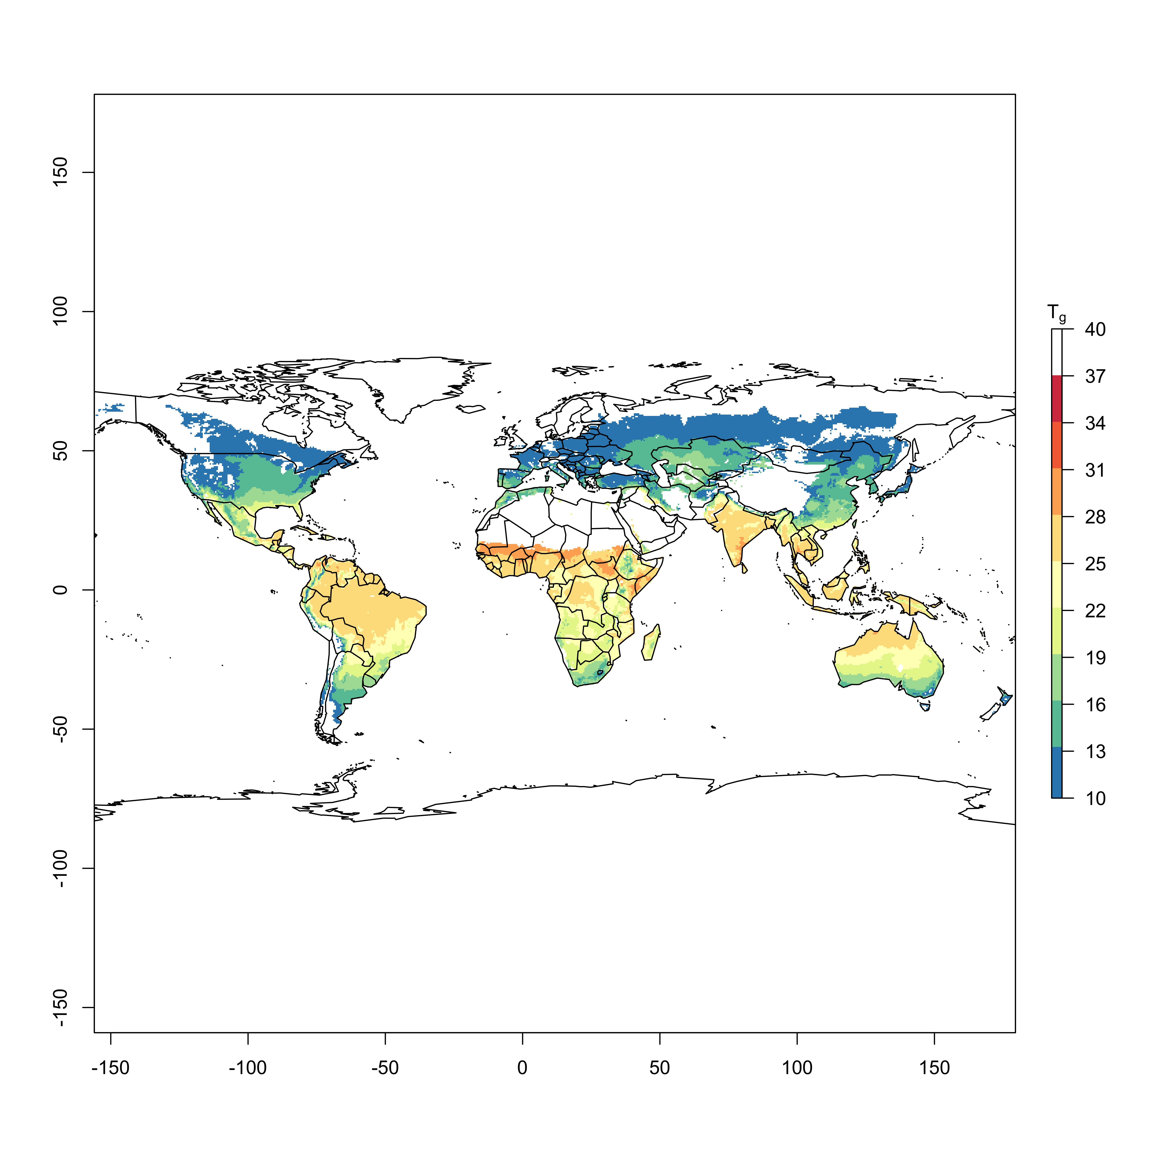
Global simulation approach
Developed optimal photosynthesis model
Used globally gridded climate to simulate traits
github.com/smithecophyslab/optimal_vcmax_r

Slide 16
Global simulation approach
Developed optimal photosynthesis model
Used globally gridded climate to simulate traits
Used PCA to explore trait relationships and clustering
Carbon uptake (A_{net})
Carbon loss (R_{d})
Water use for photosynthesis (g_{sw})
Nitrogen use for photosynthesis (N_{photo})
Leaf economics (LMA)
Least-cost theory (χ)
Photosynthetic efficiency (iWUE, PNUE)
github.com/smithecophyslab/optimal_vcmax_r

Slide 17
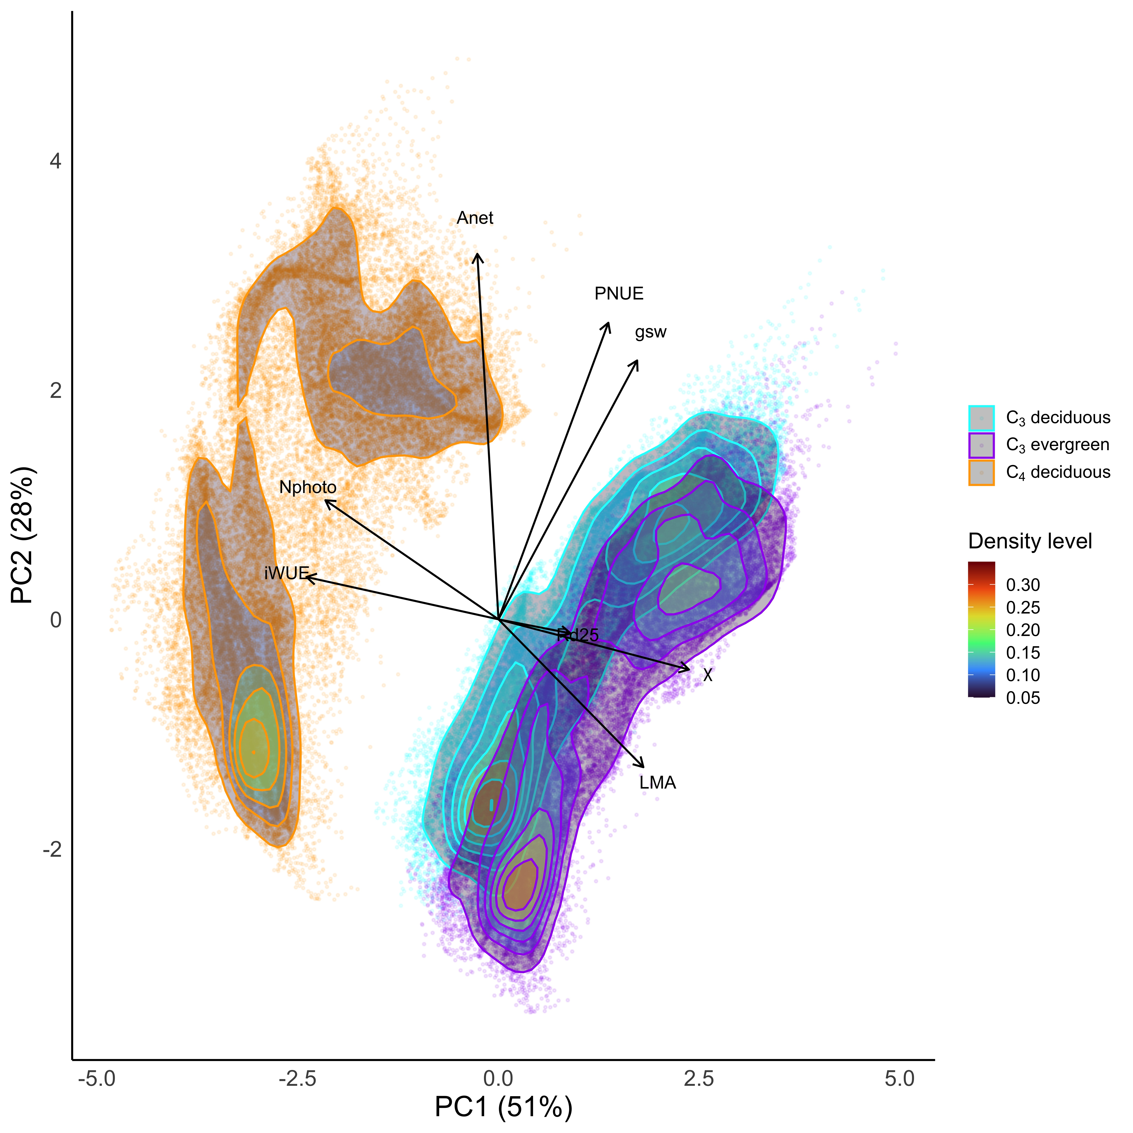

Slide 19
C₄
High WUE
High N use
C₃
Low WUE
Low N use
PC1 (51%)
N use-WUE
C₃-C₄ divide

Slide 20
Warm/Wet
High A_{net}
High H₂O use
High PNUE
PC2 (28%)
H₂O use-PNUE
A_{net}
Warm/wet-Cold/dry divide
Cold/Dry
Low A_{net}
Low H₂O use
Low PNUE

Slide 21
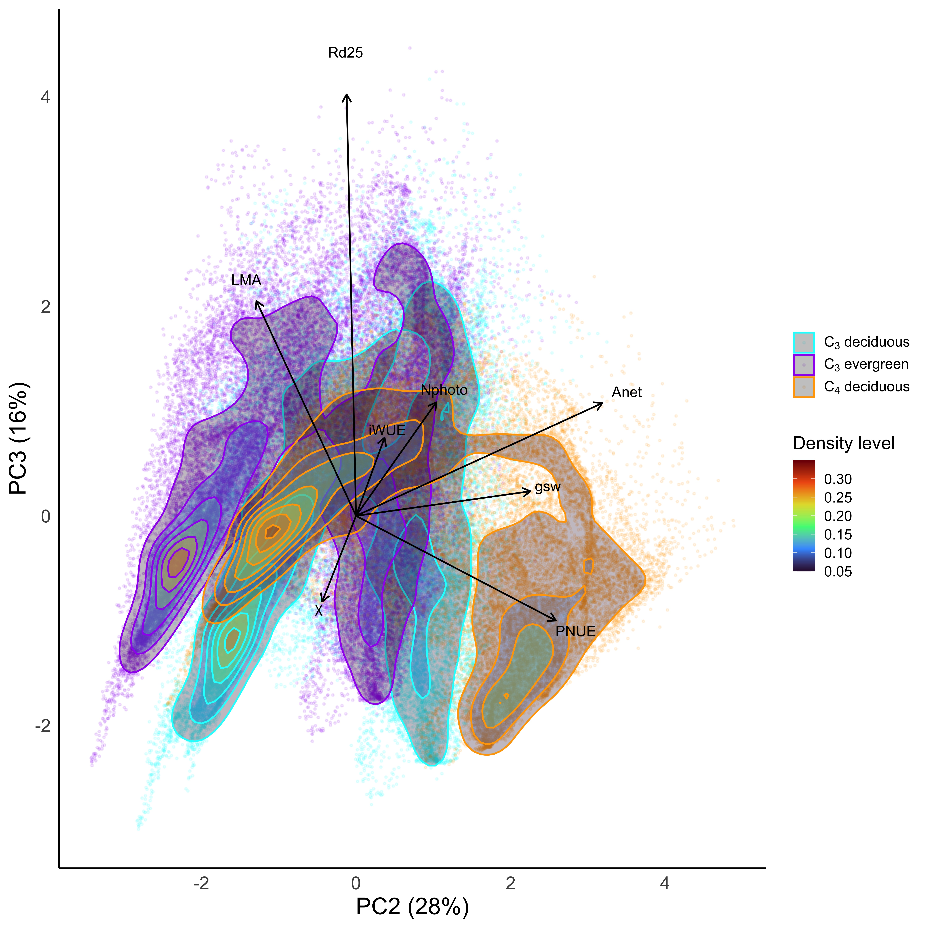

Slide 22
High LMA
High R_{d}
High light
PC3 (16%)
LMA, R_{d} (C costs)
Light intensity
Low LMA
Low R_{d}
Low light

Slide 23
Outline
Eco-evolutionary optimality theory
Study 1: Global optimal photosynthetic strategies
Study 2: Site-level optimal photosynthetic strategies
Implications

Slide 24
Site-level simulation approach

Slide 25
Site-level simulation approach
Chose sites representing different dominant PFTs

Slide 26
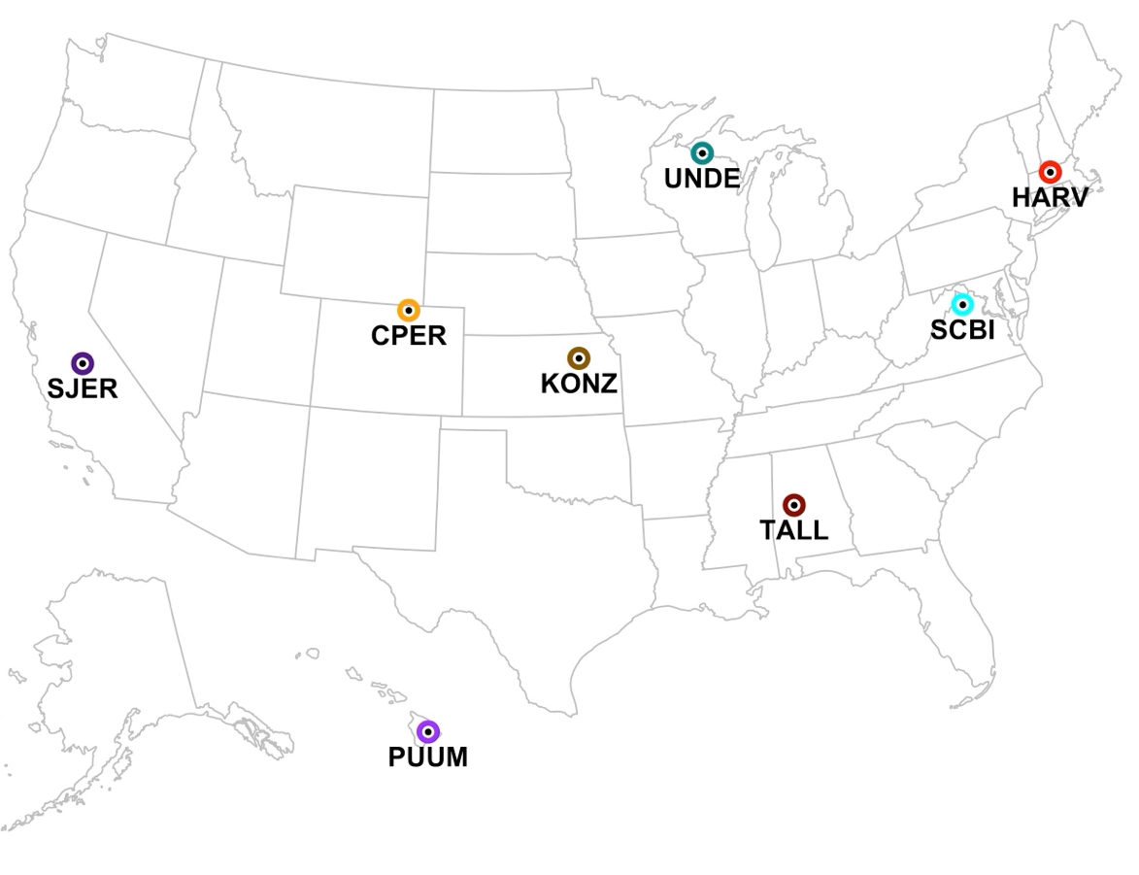
Site-level simulation approach
Chose sites representing different dominant PFTs
NEON network
Deciduous forests
Evergreen forests
Mixed forests
C₄ grasslands

Slide 27
Site-level simulation approach
Chose sites representing different dominant PFTs
NEON network
Deciduous forests
Evergreen forests
Mixed forests
C₄ grasslands
Simulated optimal traits 10,000x using climate distribution
mean +/- 0.1*mean

Slide 28
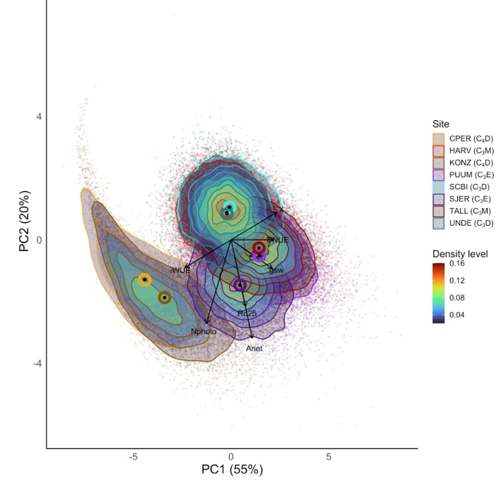

Slide 29
PCs defined similarly to global simulation

Slide 30
PCs defined similarly to global simulation
A lot of within-site variability!

Slide 31
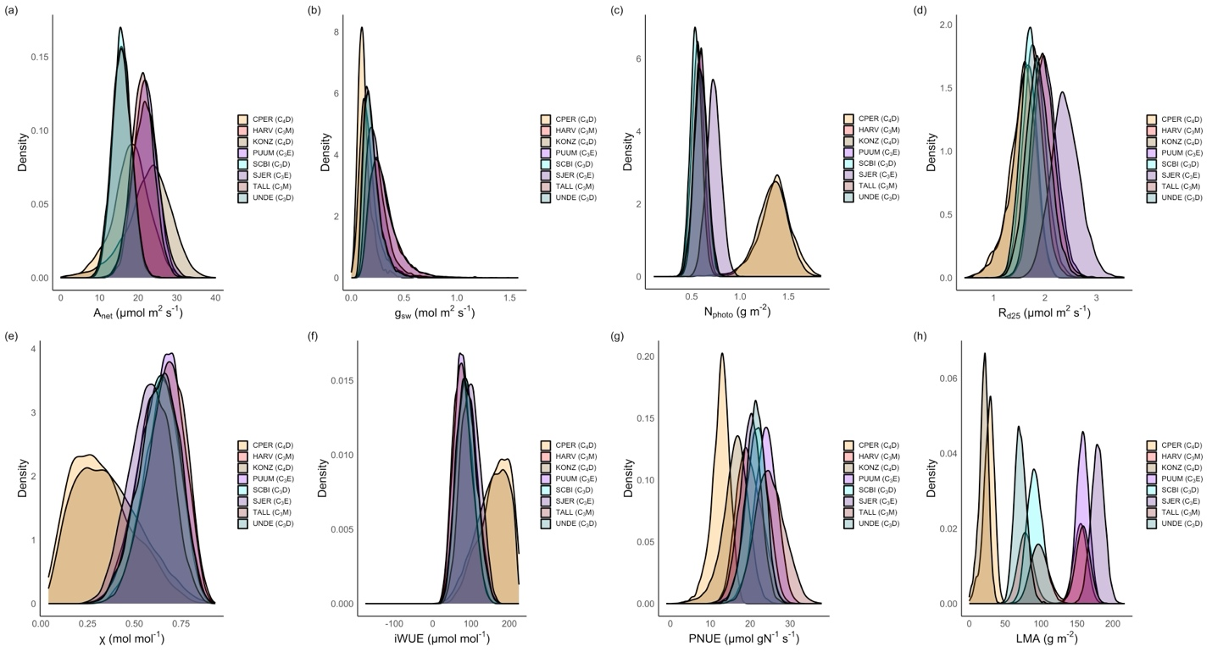
Within-site variability is larger than across-site for many traits

Slide 32
Some traits show separation by photosynthetic type

Slide 33
LMA shows separation by PFT

Slide 34
Outline
Eco-evolutionary optimality theory
Study 1: Global optimal photosynthetic strategies
Study 2: Site-level optimal photosynthetic strategies
Implications

Slide 35
Implications
We can simulate optimal photosynthetic strategies

Slide 36
Implications
We can simulate optimal photosynthetic strategies
Three defining axes (95%) of optimal photosynthetic strategies:

Slide 37
Implications
We can simulate optimal photosynthetic strategies
Three defining axes (95%) of optimal photosynthetic strategies:
Nitrogen use-water use efficiency (51%; PFT-driven)

Slide 38
Implications
We can simulate optimal photosynthetic strategies
Three defining axes (95%) of optimal photosynthetic strategies:
Nitrogen use-water use efficiency (51%; PFT-driven)
Water use-nitrogen use efficiency (28%; climate-driven)

Slide 39
Implications
We can simulate optimal photosynthetic strategies
Three defining axes (95%) of optimal photosynthetic strategies:
Nitrogen use-water use efficiency (51%; PFT-driven)
Water use-nitrogen use efficiency (28%; climate-driven)
Tissue costs of photosynthesis (16%; light-driven)

Slide 40
Implications
We can simulate optimal photosynthetic strategies
Three defining axes (95%) of optimal photosynthetic strategies:
Nitrogen use-water use efficiency (51%; PFT-driven)
Water use-nitrogen use efficiency (28%; climate-driven)
Tissue costs of photosynthesis (16%; light-driven)
Plant type dictates optimal photosynthetic strategies via some (LMA, WUE, N use), but not all traits

Slide 41
Implications
We can simulate optimal photosynthetic strategies
Three defining axes (95%) of optimal photosynthetic strategies:
Nitrogen use-water use efficiency (51%; PFT-driven)
Water use-nitrogen use efficiency (28%; climate-driven)
Tissue costs of photosynthesis (16%; light-driven)
Plant type dictates optimal photosynthetic strategies via some (LMA, WUE, N use), but not all traits
There are many optimal strategies within an environment

Slide 42
There are many ways plants can optimize photosynthesis and we can now quantitatively predict those strategies

Slide 43

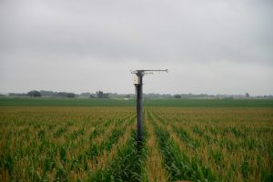
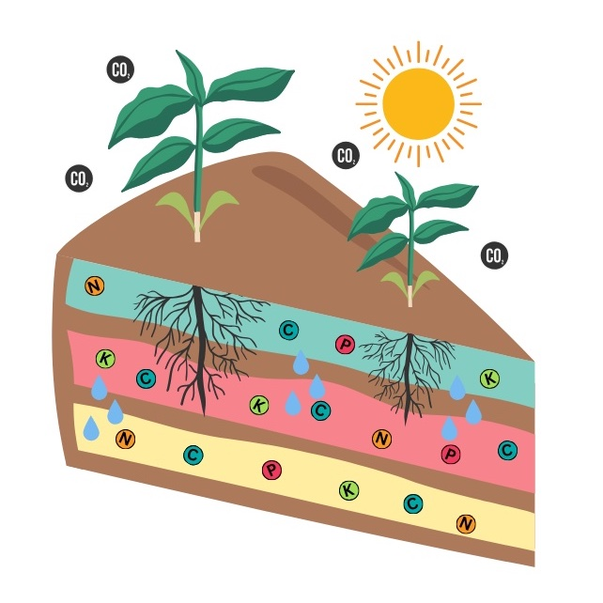
Quick notice
Lab is moving to the University of Nebraska - Lincoln
Starting Fall 2026
Looking for lab manager and graduate students
Reach out if you are interested in collaborating

Slide 44
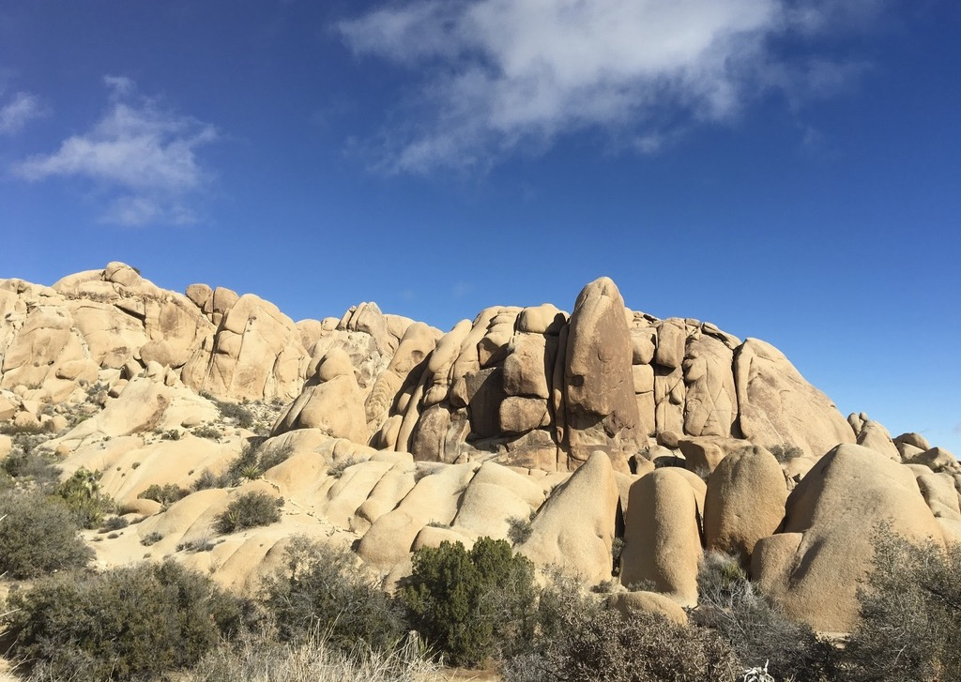


Presentation: github.com/SmithEcophysLab/esa_2026
Model code: github.com/SmithEcophysLab/optimal_vcmax_r
Contact: nick.smith@ttu.edu; nsmith87@unl.edu
Thanks!

Slide 45
