Slide 1
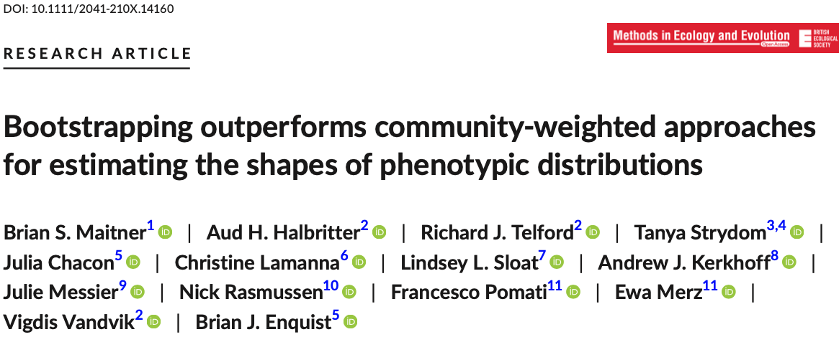

Slide 2
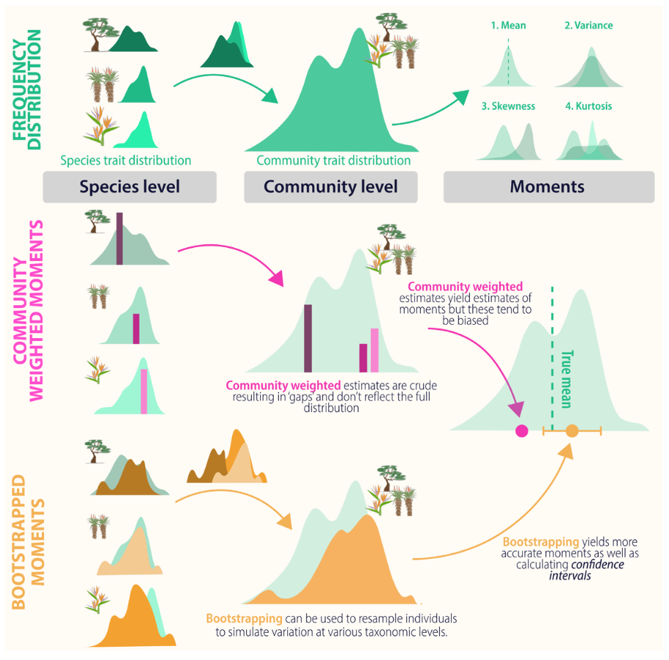

Slide 3
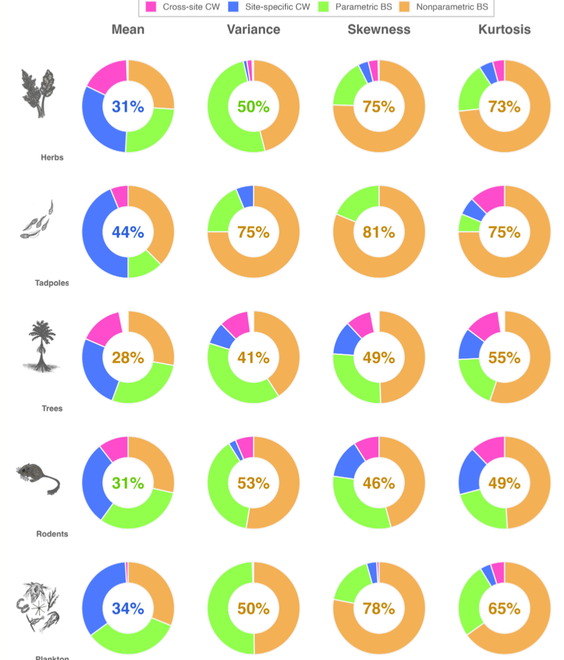

Slide 4
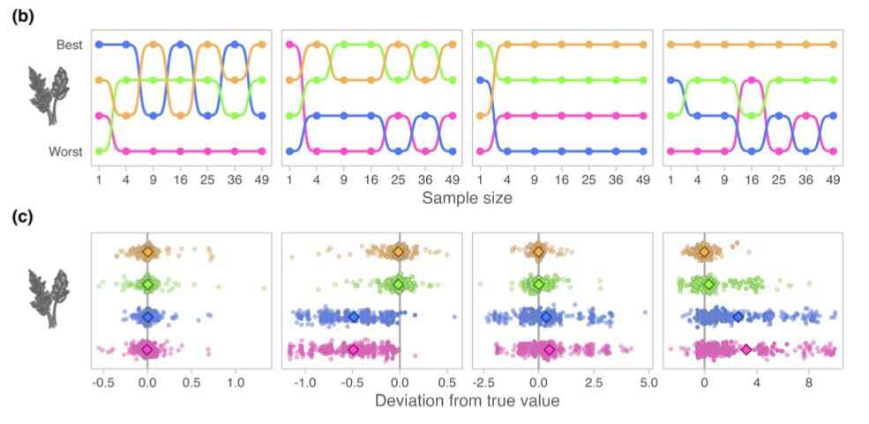

Slide 5
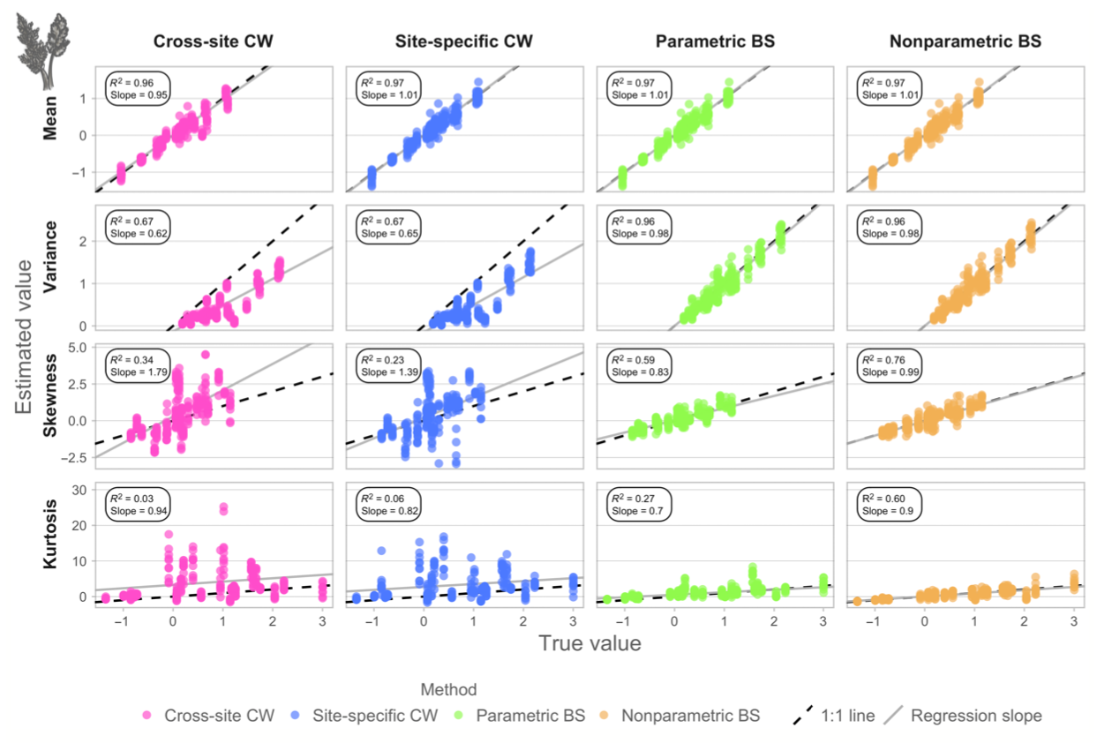

Slide 6
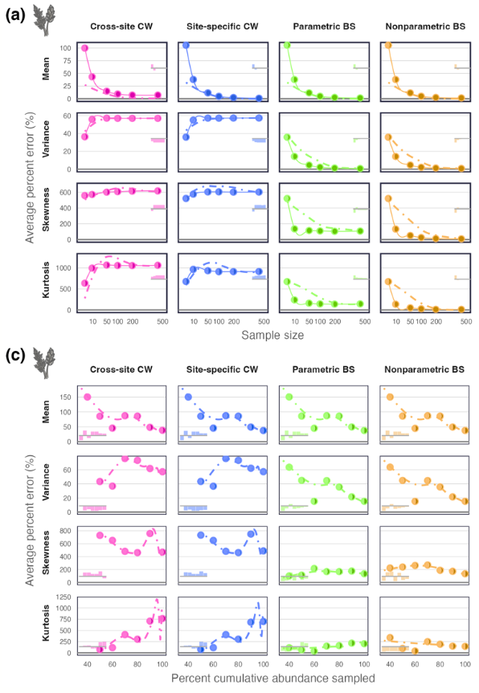

Slide 7
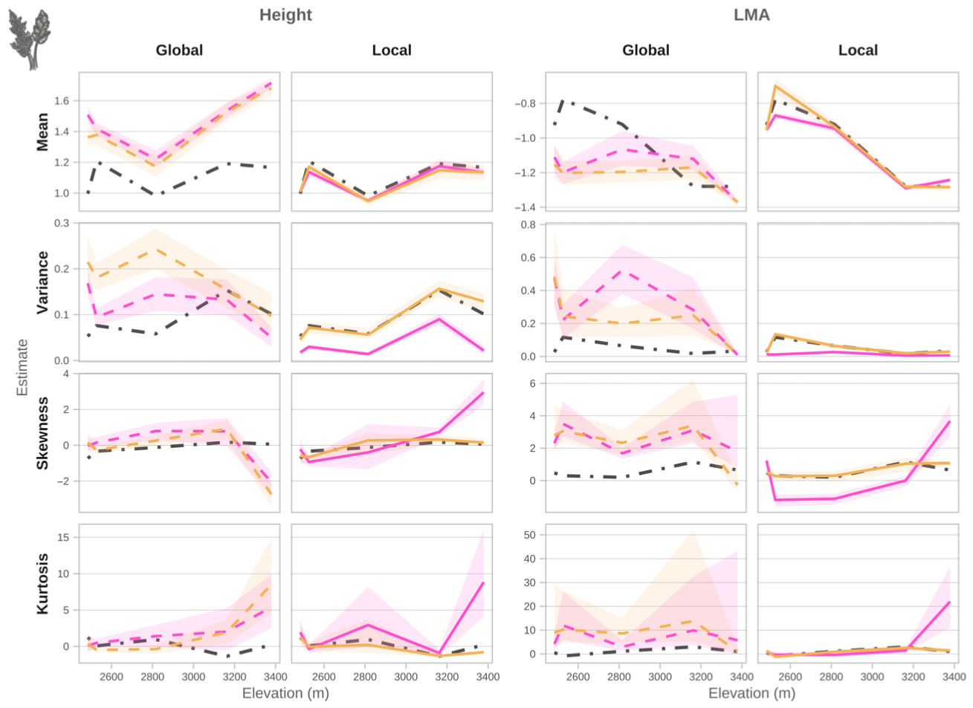

Slide 8
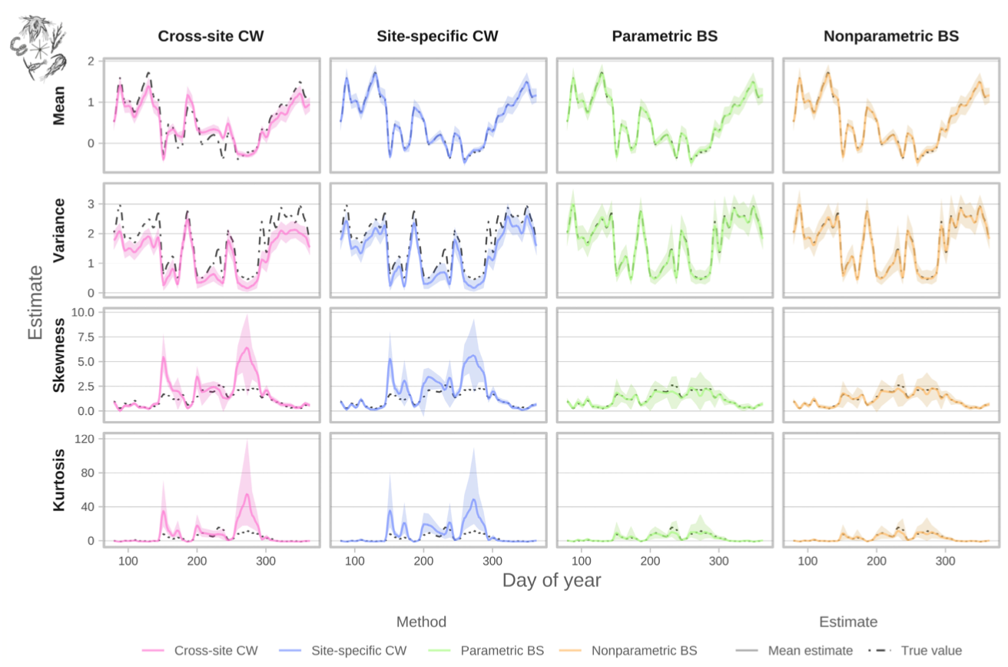

Slide 9
Recommendations
Critically assess trait data needs to address your research question or hypothesis—what is your population of interest, and what scale, resolution and density of trait data will be required for a robust, unbiased assessment of the relevant parameters?

Slide 10
Recommendations
Explicitly include the major environmental drivers or other sources of key ecological or evolutionary variation relevant to the research question or hypothesis in the trait sampling design (e.g. ecological gradients, experimental treatments).

Slide 11
Recommendations
Strive to sample all species (or other taxonomic groupings) of interest within the target communities, with a minimum of nine trait observations per species and study unit (e.g. site, experimental treatment).

Slide 12
Recommendations
For each species and trait sampling unit, collect samples randomly across individuals and organs (e.g. leaves) to represent realized community trait distributions.

Slide 13
Recommendations
Start by using a nonparametric bootstrapping approach to calcu- late the moments of the community trait distribution, explicitly incorporating your data structure, experimental design and re- search question needs into the bootstrapping design.

Slide 14
Recommendations
Depending on the moment of interest and sampling design, con- sider also reporting moment estimates and associated confidence intervals from the other methods. These methods may also better match your system/research design assumptions.

Slide 15
Recommendations
Do not only assess shifts in moments independently. Each mo- ment does not represent independent aspects of an assemblage's trait variation or functional variation. Non-independence gener- ates a mathematical constraint on the possible value moments observed for a community (Gross et al., 2017). Trait diversity can thus be assessed with multiple moments. For example, as the trait–abundance distributions become more skewed, they also become more peaked, indicating a decrease in trait diversity.

Slide 16
Recommendations
For multivariate metrics, make sure the estimators used are efficient, unbiased and consistent.

Slide 17
Recommendations
Read the literature with scepticism. Our results suggest that stud- ies reporting community-weighted moment estimates may be bi- ased depending on the method and sample sizes. For example, our analyses suggest that reports in the literature of (i) CWV are generally biased to lower values (see Figure S5), whereas (ii) CWS and CWK are biased towards higher values (see Figure S5) and (iii) these biases may persist at all sample sizes (see Figure S11). Likewise, our analyses of multivariate metrics suggest that even the rank order of some common metrics cannot be accurately estimated using either a community-weighted or bootstrapping approach (see Figure S17).

Slide 18
Conclusions
it is important to design trait sampling to reliably quantify the distribution of phenotypes within populations and communities of interest (i.e. adhere to the ‘rule of 9’, and sample randomly unless the research question specifically requires otherwise).

Slide 19
Conclusions
make sure to understand and be critical of biases inherent in traditional community-weighted approaches. These approaches bias estimates of variance towards lower values (see Figure S5) and estimates of skewness and kurtosis towards higher values (see Figure S6).

Slide 20
Conclusions
when sampling traits or compiling trait data, it is critical to sample as locally as possible to the study site and/or from similar ecological conditions. Using traits from global trait compilations or more distant samples will increasingly inject error and possible bias to your study. Studies that were based on global trait data should likely be revisited.

Slide 21
Conclusions
robust and accurate measures of trait diversity and multifunctionality necessitate measures of both skewness and skewness and kurtosis of trait distributions (Gross et al., 2017).

Slide 22
Conclusions
none of the multivariate metrics investigated here (FEve, FDis, RaoQ, FRic, FDiv, average functional uniqueness and average functional), or even their relative ordering, could be accurately estimated using a community-weighted approach (Figures S16 and S17).

