Slide 1
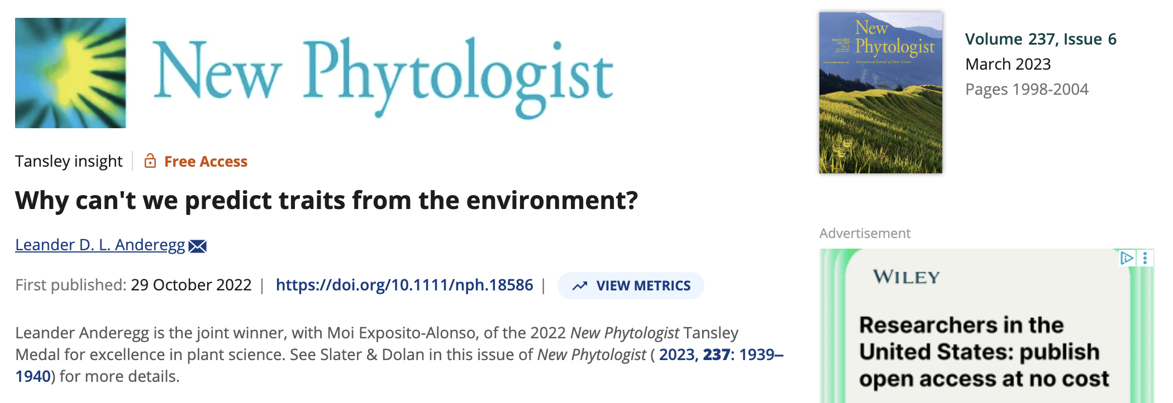

Slide 2
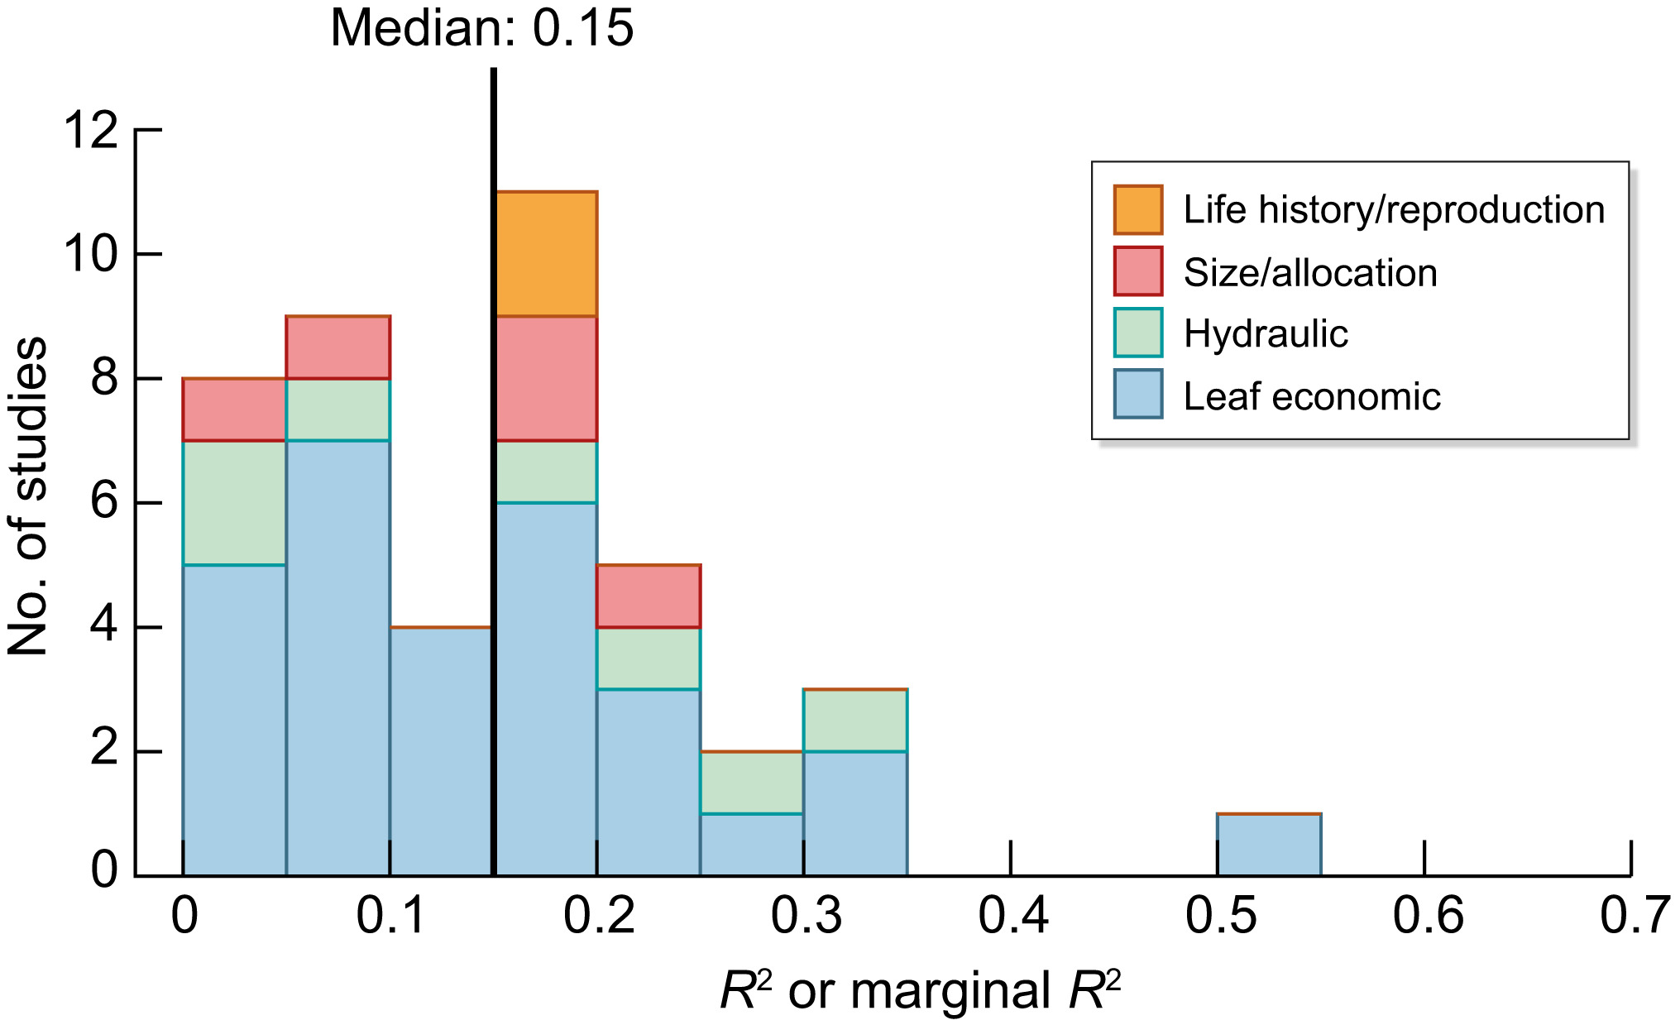
Figure 1: Environment is a poor predictor of traits
Notes:
Trait–climate relationships are typically weak. Histogram of R² values (or marginal R² for models with random effects) from studies that investigated global trait–environment relationships using compiled trait databases and climate from the site of trait observations and that reported goodness-of-fit statistics for climate or soil predictors. Data and associated citations are in Supporting Information Table S1.

Slide 3
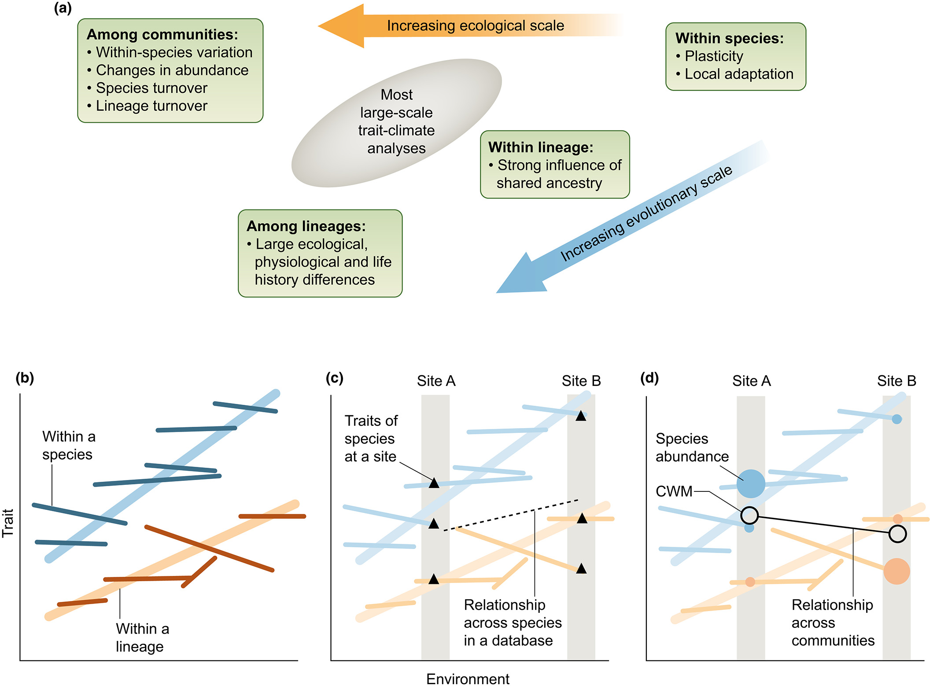
Figure 2: Scales complicate trait-environment predictions
Notes:
Combination of processes at different evolutionary and ecological scales can drastically complicate trait–environment patterns (a) Different evolutionary and ecological processes drive trait changes across scales. Most phylogenetically naïve trait–climate analyses that use site-of-measurement climate values haphazardly and likely nonrandomly sample these various ecological and evolutionary processes. (b) Trait variation within individual species (dark lines) vs among species of a lineage (lighter lines). Differences in evolutionary history and life-history strategies lead to a large trait offset between the two lineages, but the among-species trait–climate relationship is consistent within each lineage. (c) A classic trait study that compiles observations from two different sites (Sites A and B, gray boxes) would find a nonsignificant trait–environment relationship due to the haphazard combination of within-species, within-linage, and among-lineage trait variation. (d) Weighting the same species by their abundance to create ‘community-weighted mean’ (CWM) trait values reveals yet a different trait–environment relationship, largely driven in this case by changes in abundance between the two lineages.

Slide 4
Figure 2: Scales complicate trait-environment predictions
Notes:
Combination of processes at different evolutionary and ecological scales can drastically complicate trait–environment patterns (a) Different evolutionary and ecological processes drive trait changes across scales. Most phylogenetically naïve trait–climate analyses that use site-of-measurement climate values haphazardly and likely nonrandomly sample these various ecological and evolutionary processes. (b) Trait variation within individual species (dark lines) vs among species of a lineage (lighter lines). Differences in evolutionary history and life-history strategies lead to a large trait offset between the two lineages, but the among-species trait–climate relationship is consistent within each lineage. (c) A classic trait study that compiles observations from two different sites (Sites A and B, gray boxes) would find a nonsignificant trait–environment relationship due to the haphazard combination of within-species, within-linage, and among-lineage trait variation. (d) Weighting the same species by their abundance to create ‘community-weighted mean’ (CWM) trait values reveals yet a different trait–environment relationship, largely driven in this case by changes in abundance between the two lineages.

Slide 5
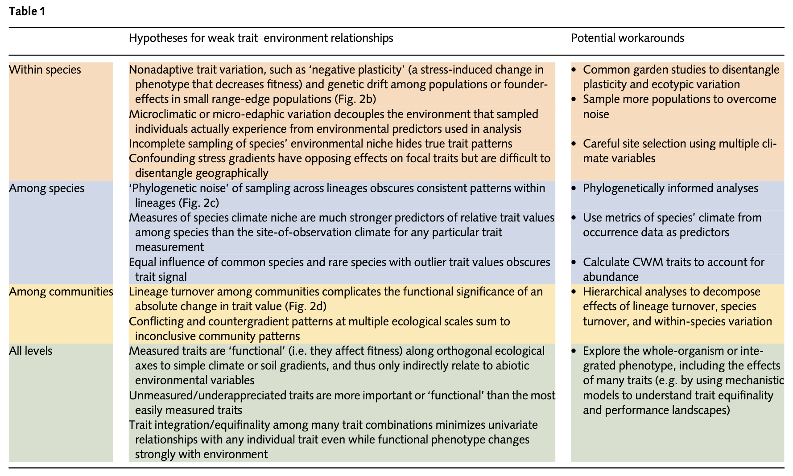

Slide 6
Troublesome traits
“we poorly understand the functional significance of traits themselves”
“our understanding of how plant traits…influence…performance…is still evolving. We may be focusing on the wrong traits”
“There are many successful ways to be a plant in most environments”

Slide 7
Path forward
Hierarchical analysis needed for mechanisms (scale matters)
“Function” of functional traits needs to be better understood
Phenotypes are integrated
Equifinality
Models needed to generate hypotheses

Slide 8
