Slide 1
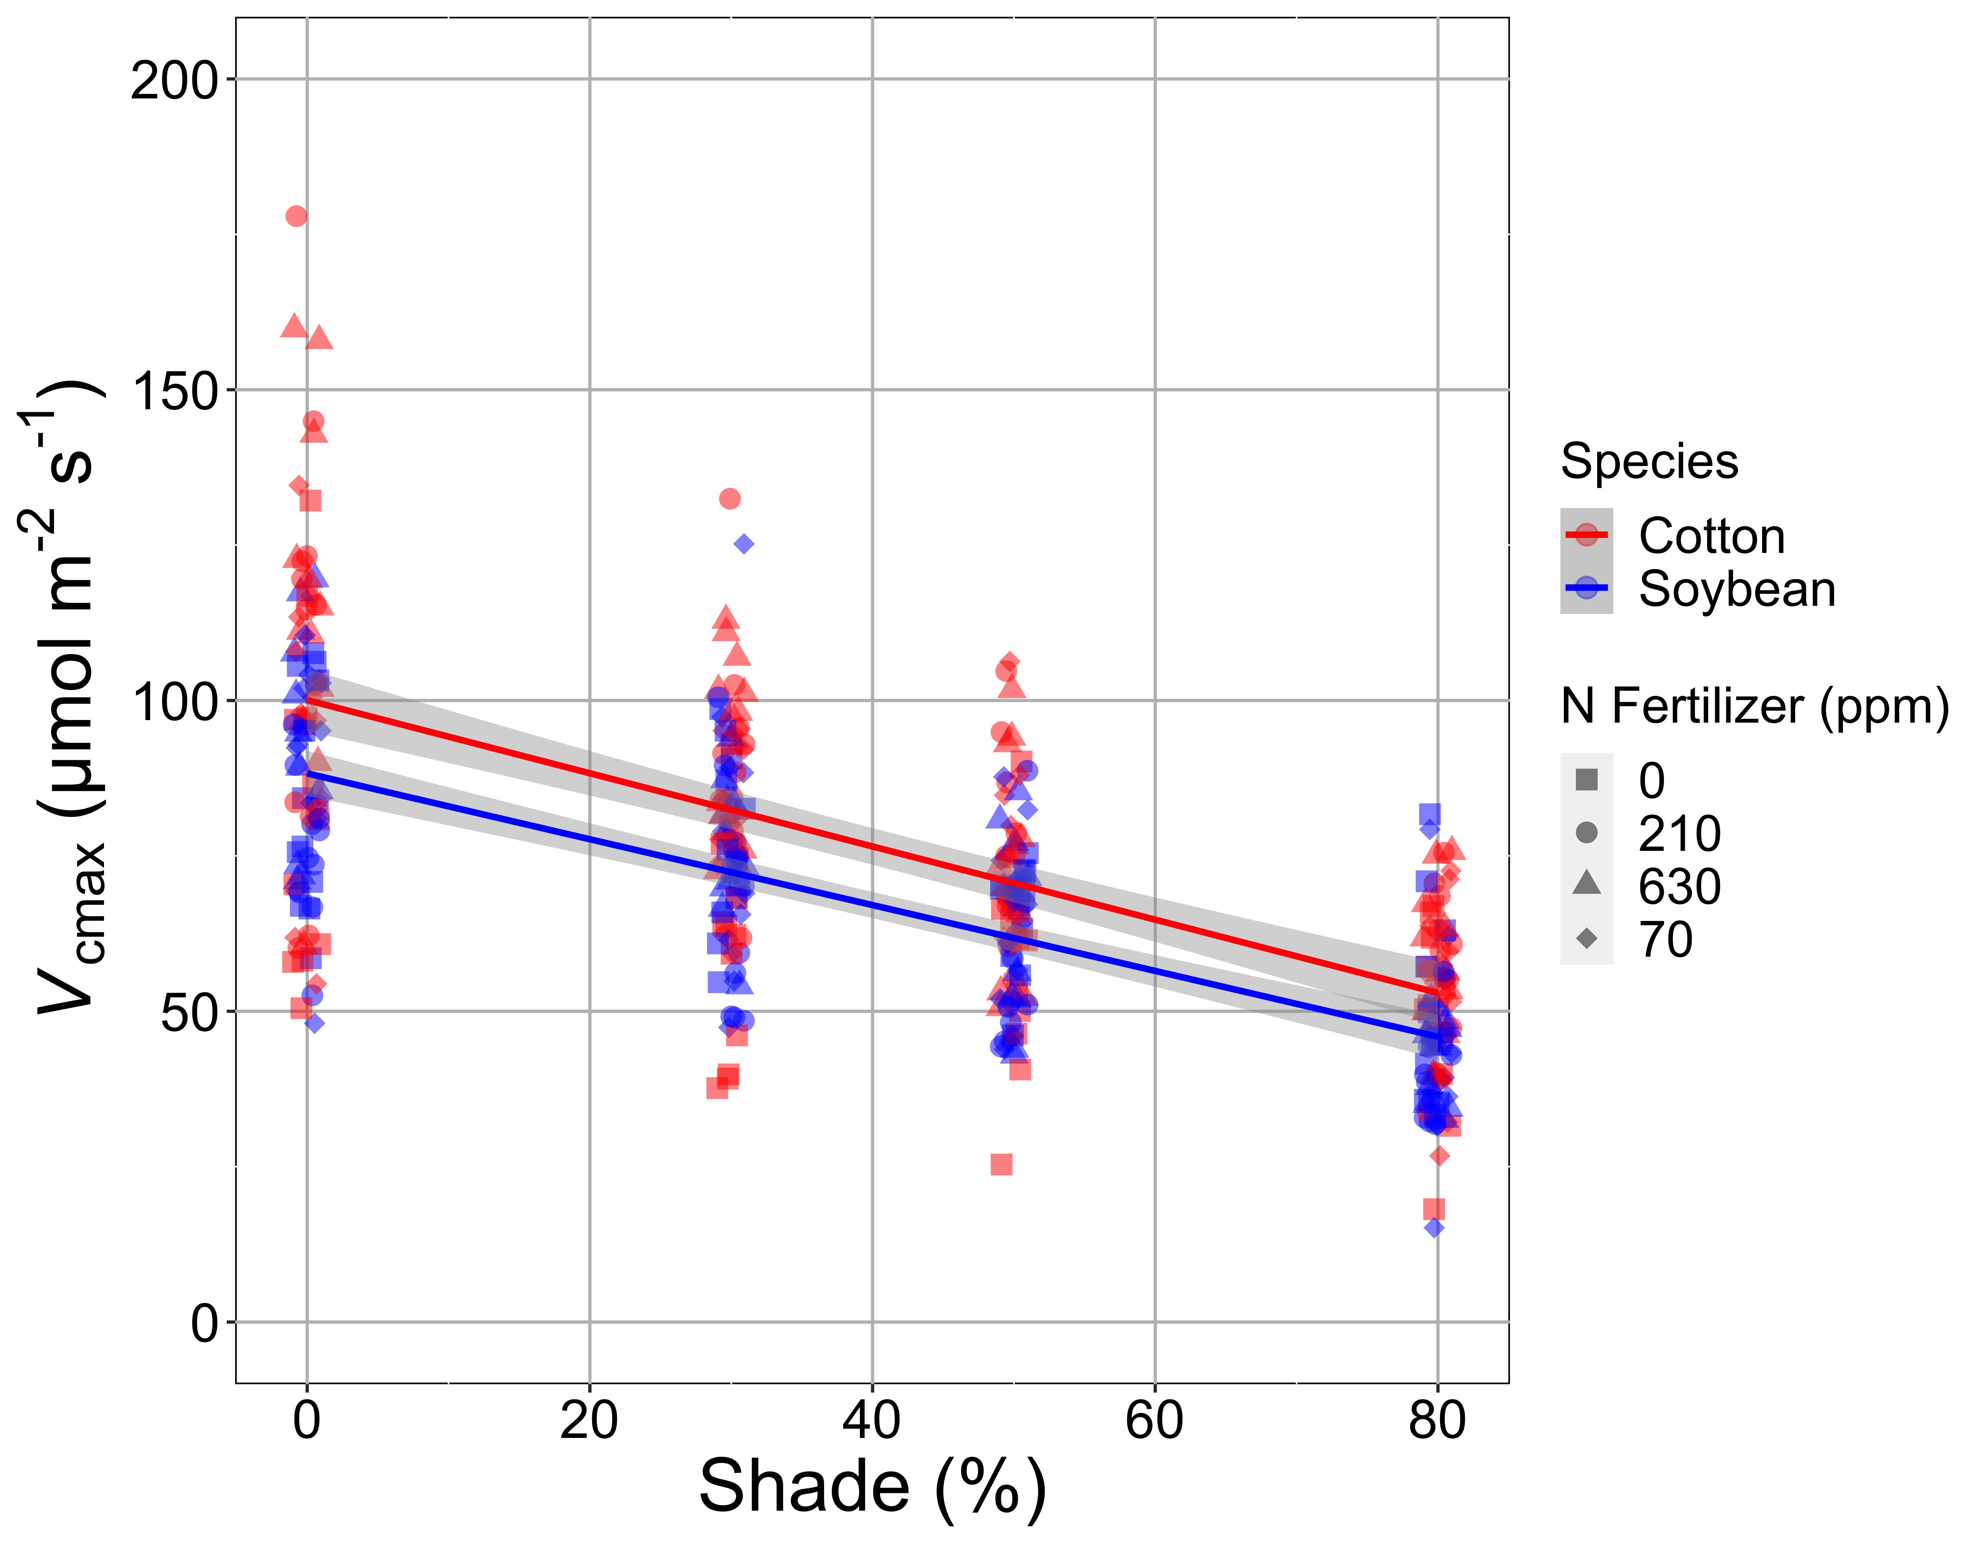
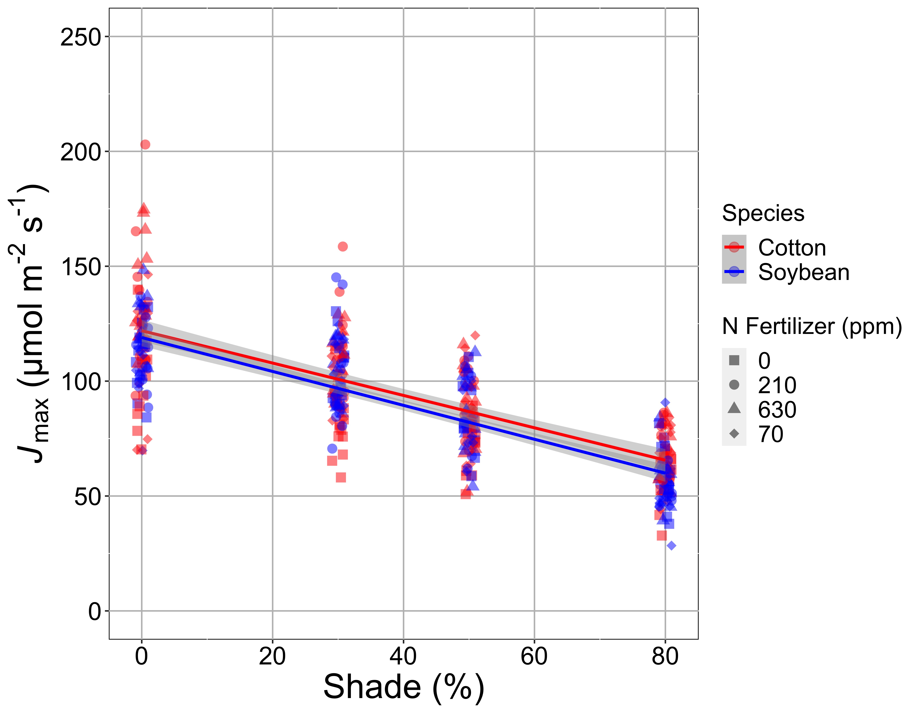
Shading reduces investment in photosynthetic biochemistry
Waring, Perkowski, & Smith (in review)

