Slide 1
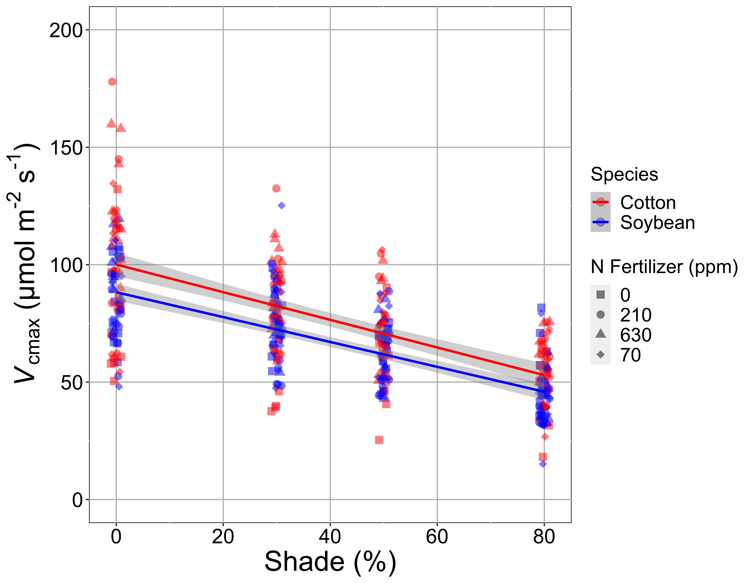
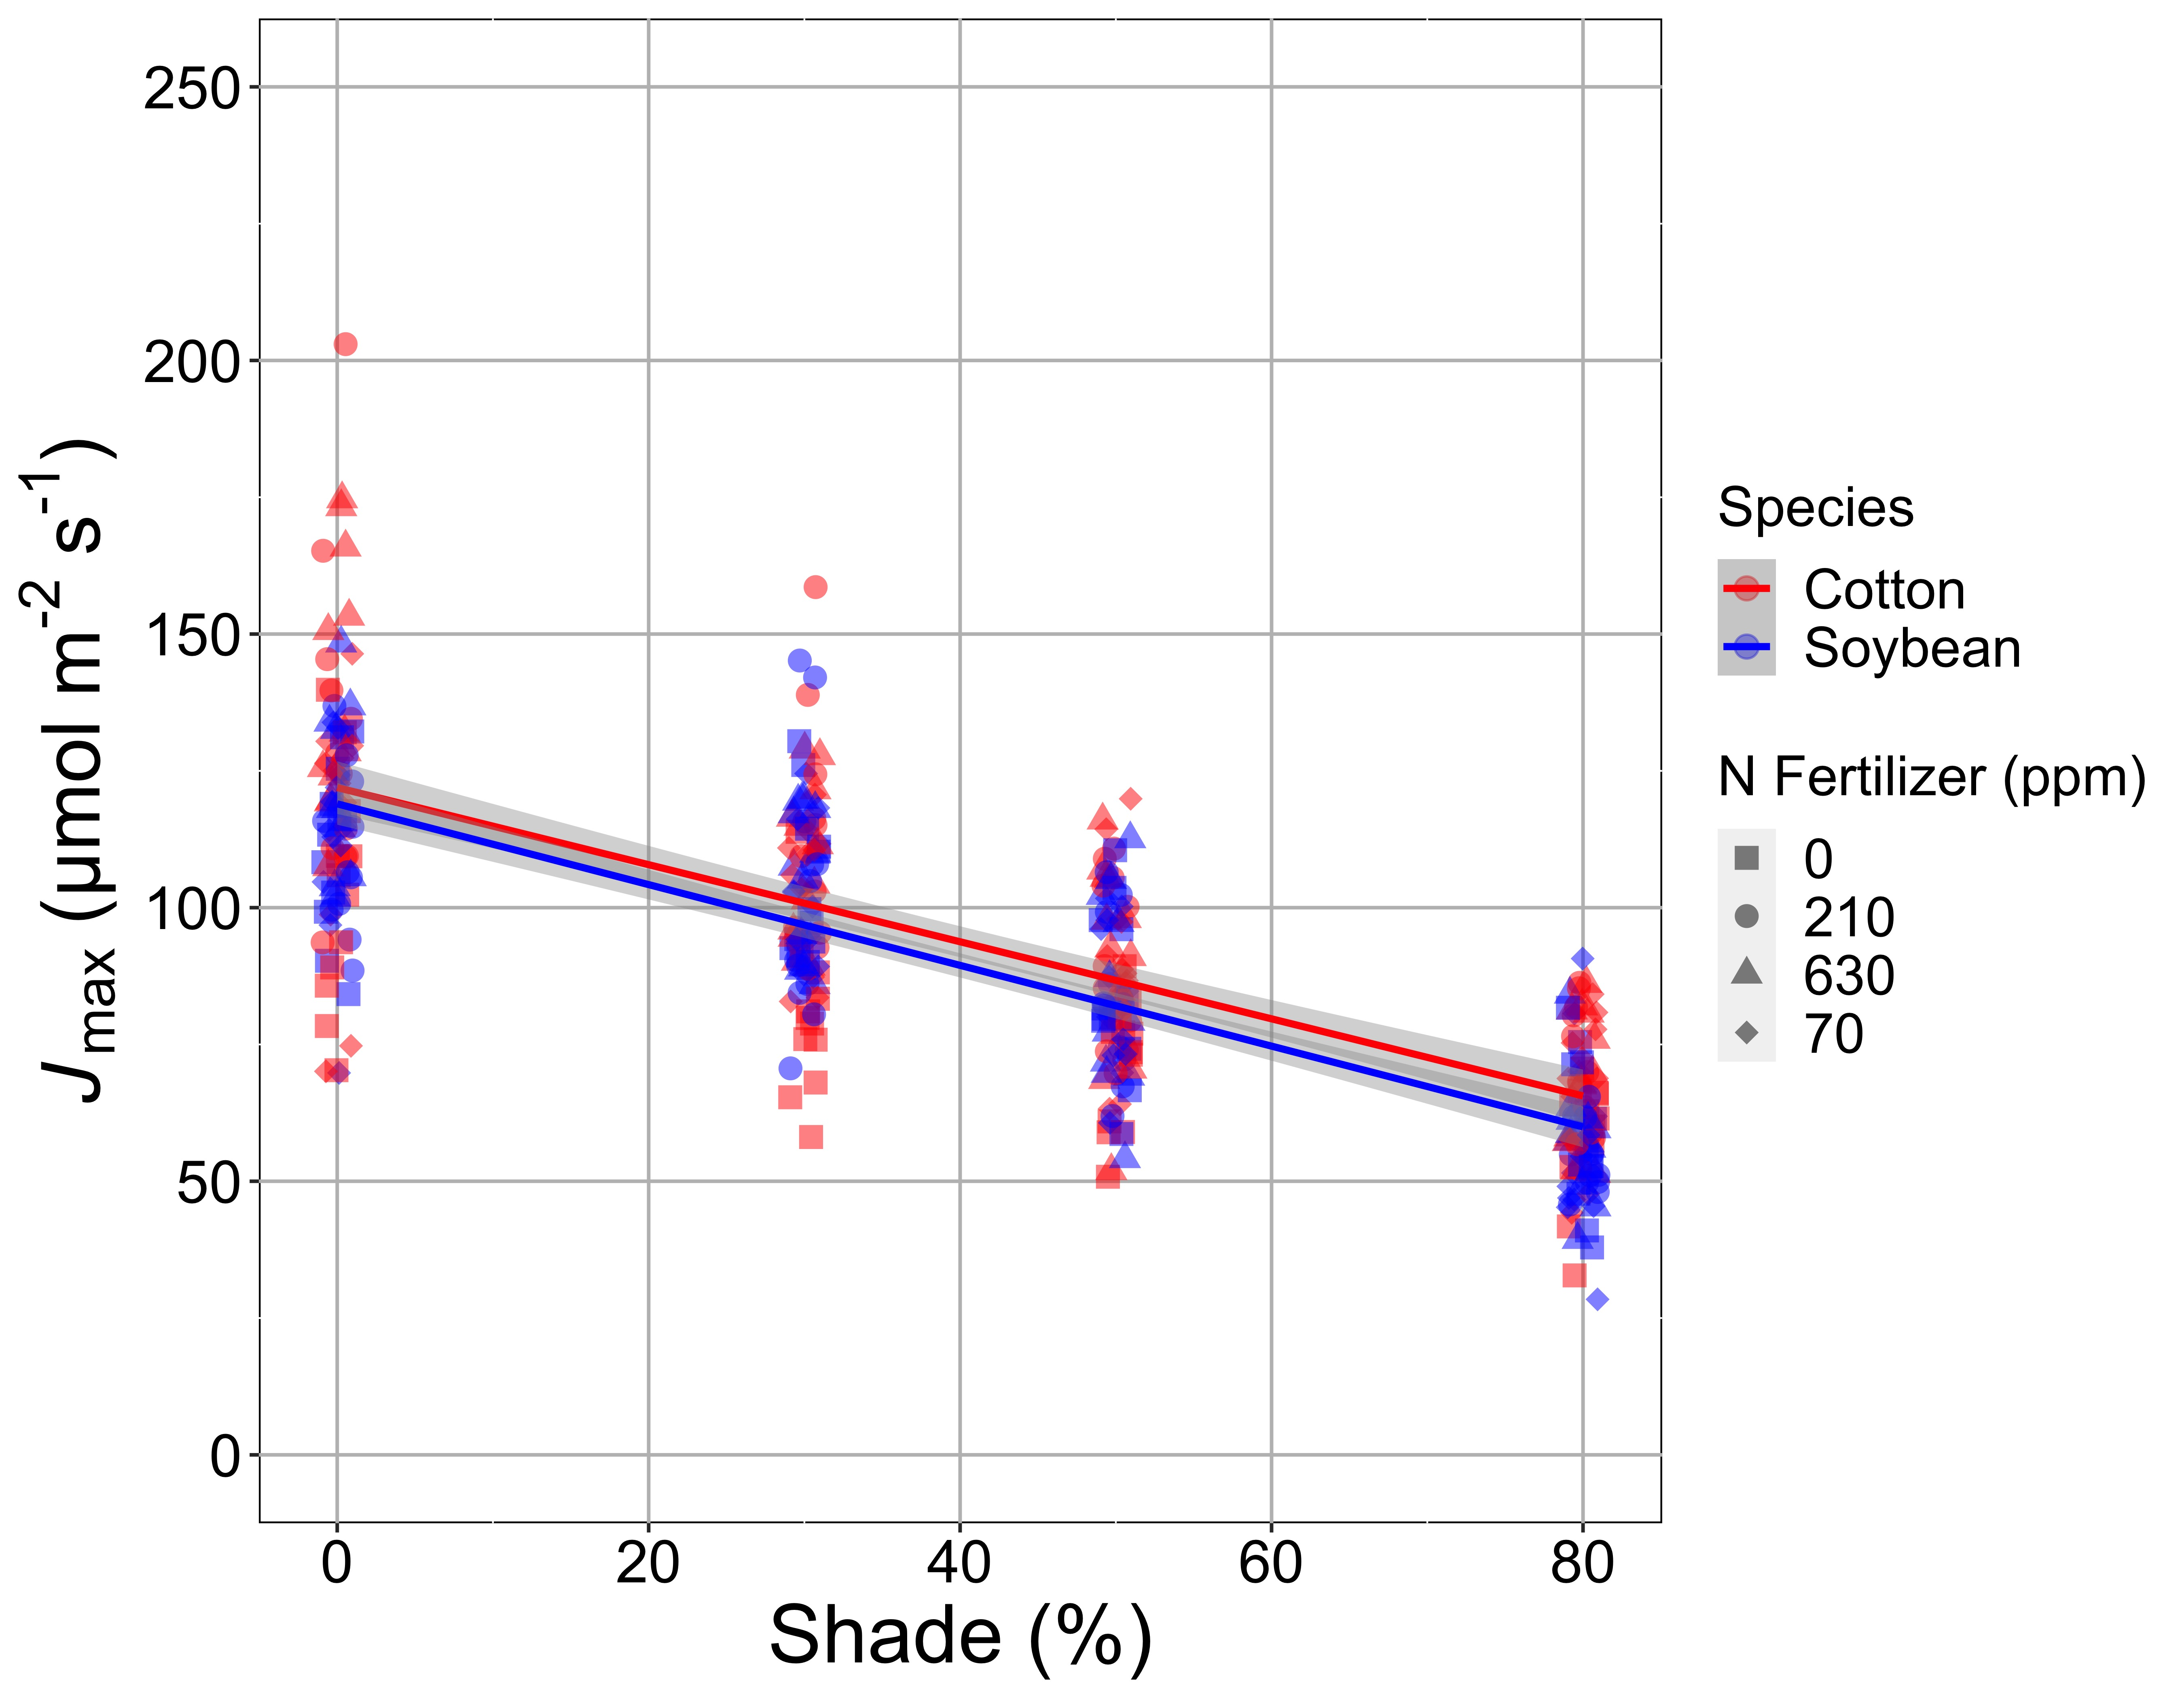
Shading reduces investment in photosynthetic biochemistry
Waring, Perkowski, & Smith (in review)

Slide 2
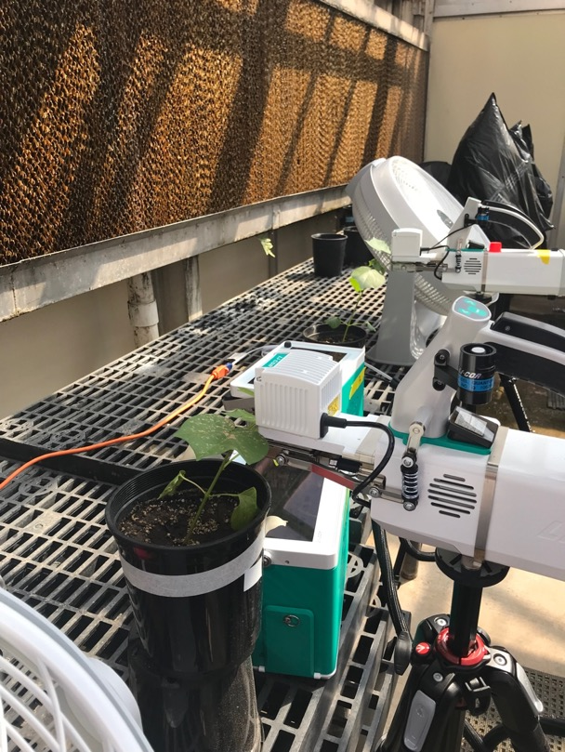
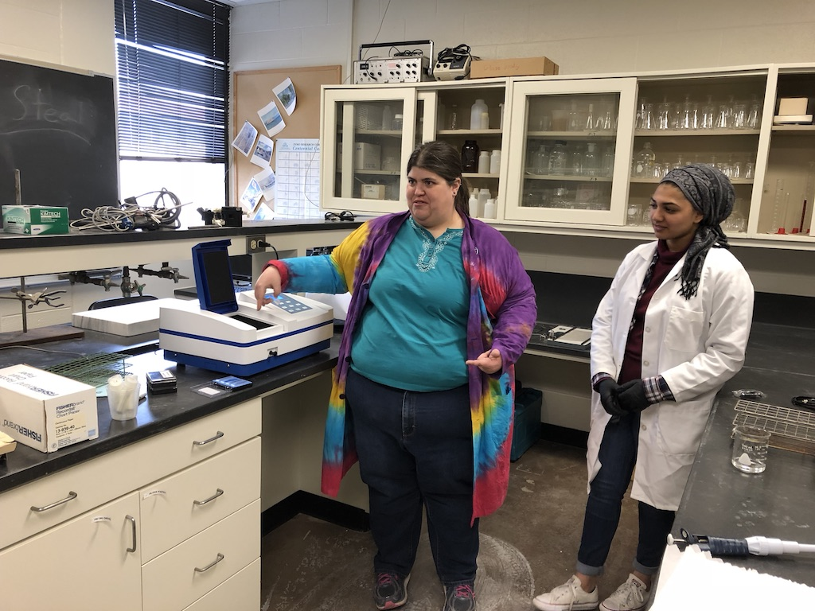
Photosynthetic acclimation to light availability
Experimental setup
4 light treatments (0-80% shading)
4 soil nitrogen treatments (0-630 ppm added N)
2 species (cotton, soybean)
Measurements
A/Ci curves
Leaf chlorophyll, LMA, and N
Whole-plant C and N

