Slide 1
Fitting C4 A/Ci curve

Slide 2
C4 photosynthetic Pathway
Occurs in the mesophyll and bundle sheath cells
Creates 4-carbon sugar molecules
No photorespiration
Additional limitation (PEPc)

Slide 3
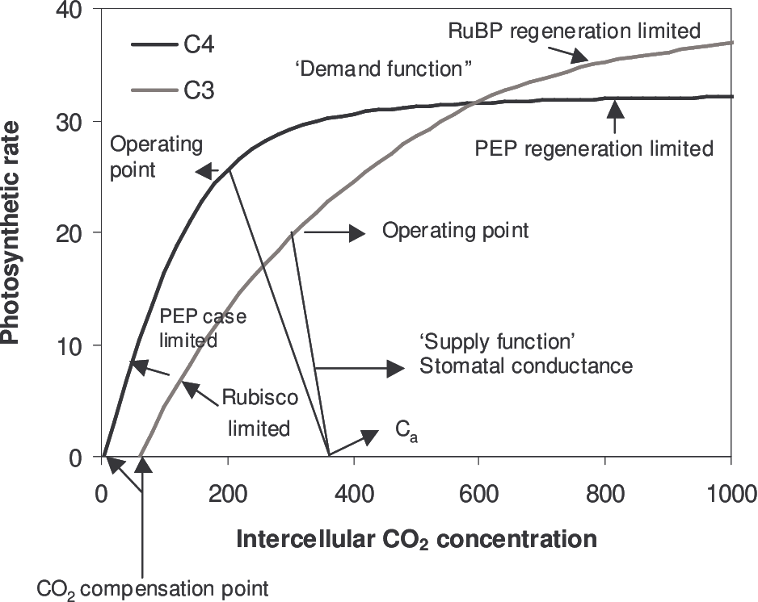
Vcmax
Vpmax
Jmax

Slide 4
Medlyn C4 A/Ci curve
Based on von Caemmerer 2000 (Biochemical models of leaf photosynthesis).
Anisworth and Leakey approach

Slide 5
Schizachyrium Scoparium @ 27.5

Slide 6
ID | Vcmax | Vpmax | Jmax | Rd0 | VcmaxSE | VpmaxSE | JmaxSE | RMSE | trans_pt | ci_trans | emp_RMSE | AmaxLA | VpmaxLA
sch_sco_17 | 135.076144 | 16.4739534 | 79.5509677 | 1.35076144 | 33.8222805 | 0.67038545 | 0.56724103 | 0.45597315 | 27 | 436.984805 | 0.25441678 | 69.1483577 | 33.5610026
sch_sco_18 | 413.248819 | 14.6156484 | 87.8164299 | 4.13248819 | 20.5451805 | 0.43201375 | 0.48097699 | 0.40059549 | 51 | 665.203663 | 3.80616769 | 15.2604485 | 17.7492635
sch_sco_19 | 397.281847 | 26.9686966 | 125.677072 | 3.97281847 | 25.9876787 | 0.63204052 | 0.58808267 | 0.54754712 | 28 | 302.979505 | 0.43227837 | 30.5323321 | 34.5588252

Slide 7
Schizachyrium Scoparium @ 20

Slide 8
No jmax???

