Slide 1
Yield Gaps
Mueller ND, Gerber JS, Johnston M, Ray DK, Ramankutty N, Foley JA. 2012. Closing yield gaps through nutrient and water management. Nature 490: 254.

Slide 2
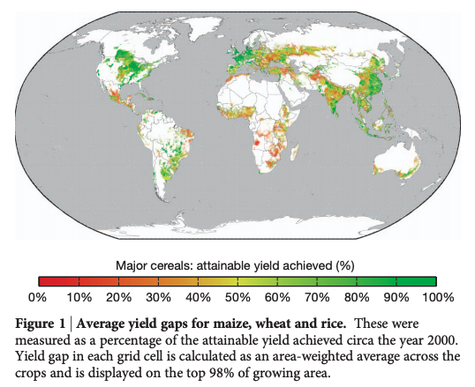
Only some areas obtain max yield

Slide 3
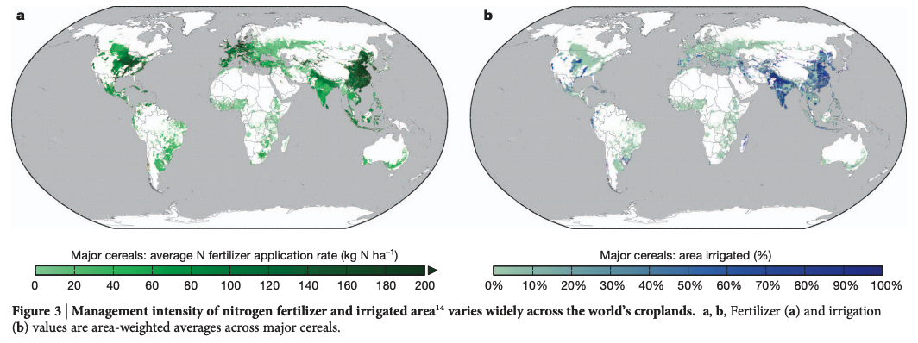
But it takes a lot of resources to get there

Slide 4
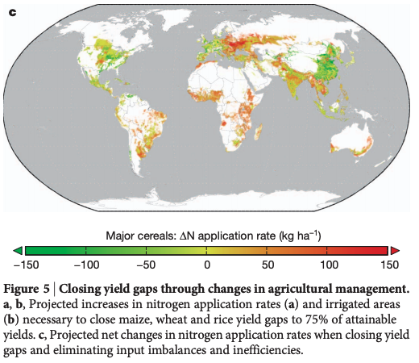
Increased efficiency could reduce N and P use by 28% and 38% globally

Slide 5
(green areas are using more nutrients than necessary)

Slide 6
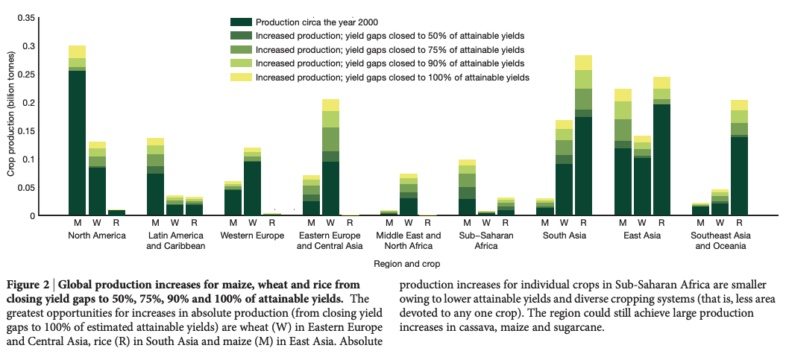
Closing yield gap requires more input (in some place), but mostly better management

