Slide 1
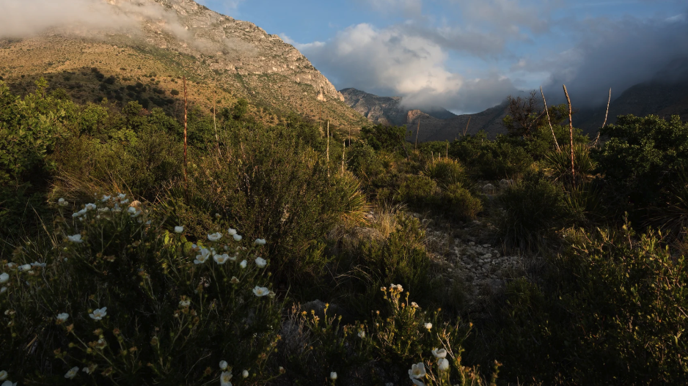
An Introduction to the Smith Ecophysiology Lab: Physiology for Understanding Larger Scale Processes
Nick Smith
School of Biological Sciences
University of Nebraska - Lincoln
nsmith87@unl.edu

Slide 2
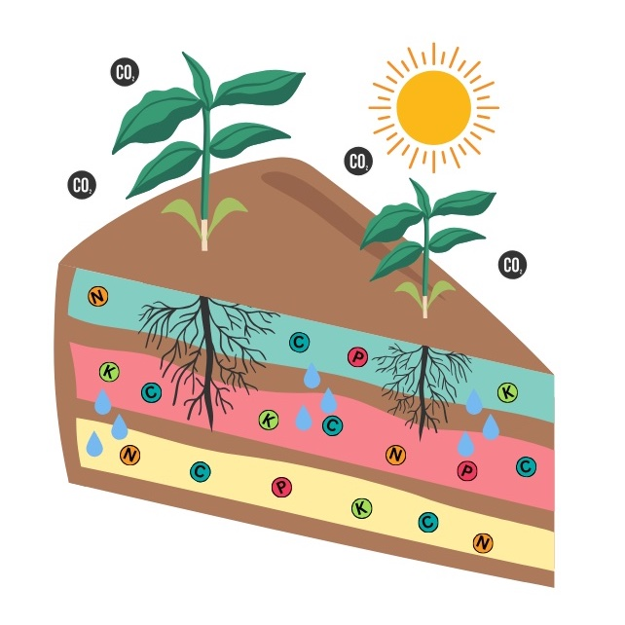
PhUnKY Lab
Physiology for Understanding and Knowledge in EcologY
smithecophyslab.com

Slide 3
Ecological scales
Ecosystem Ecology
Community Ecology
Population Ecology
Physiological Ecology

Slide 4
Perturbation
Physiological Ecology
Smith (2024) Am J Botany

Slide 5
Perturbation
Population Ecology
Physiological Ecology
Smith (2024) Am J Botany

Slide 6
Community Ecology
Perturbation
Population Ecology
Physiological Ecology
Smith (2024) Am J Botany

Slide 7
Ecosystem Ecology
Community Ecology
Perturbation
Population Ecology
Physiological Ecology
Smith (2024) Am J Botany

Slide 8
Structure of the talk
Short vignettes illustrating connections between physiological and larger scale ecological processes under different perturbations
Goal is to highlight different questions and approaches
Would be happy to discuss any in more detail after the talk

Slide 9




Approach icons
Manipulation
experiments
Field
observations
Theory
development
Process-based
modeling

Slide 10
Perturbation vignettes
Temperature → global carbon and energy fluxes
CO₂ → plant-nutrient dynamics
Soil fertility → population dynamics
Environmental heterogeneity → community dynamics
Invasion → mycorrhizal symbioses

Slide 11
Perturbation vignettes
Temperature → global carbon and energy fluxes
CO₂ → soil nutrient dynamics
Soil fertility → population dynamics
Environmental heterogeneity → community dynamics
Invasion → mycorrhizal symbioses

Slide 12
Temperature
Photosynthesis

Slide 13
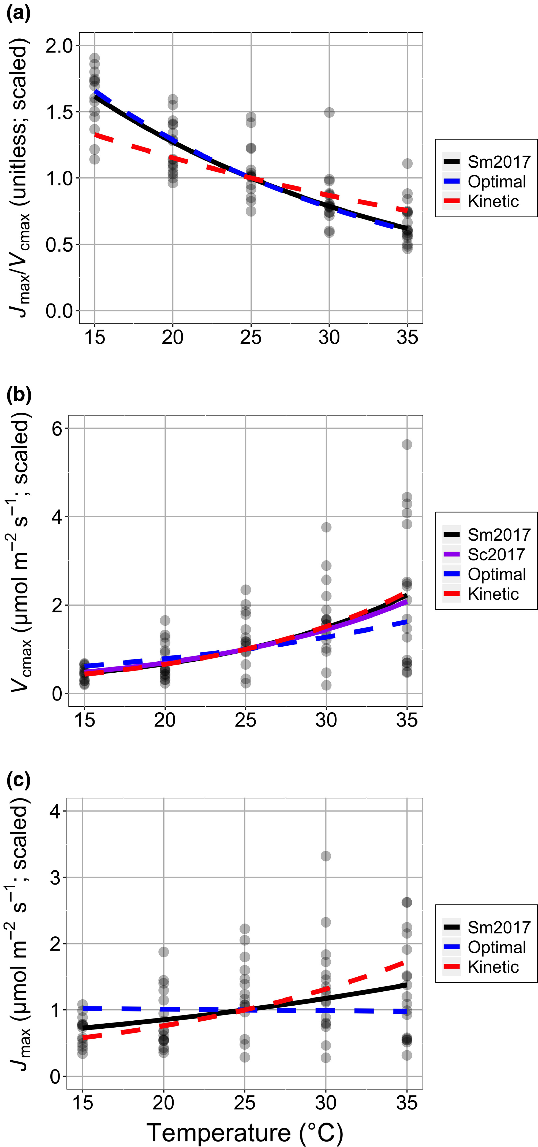
Photosynthesis shows strong and predictable acclimation responses to temperature
Smith and Keenan (2020) Glob Change Bio

Slide 14
Global Carbon Cycling
Temperature
Photosynthesis

Slide 15
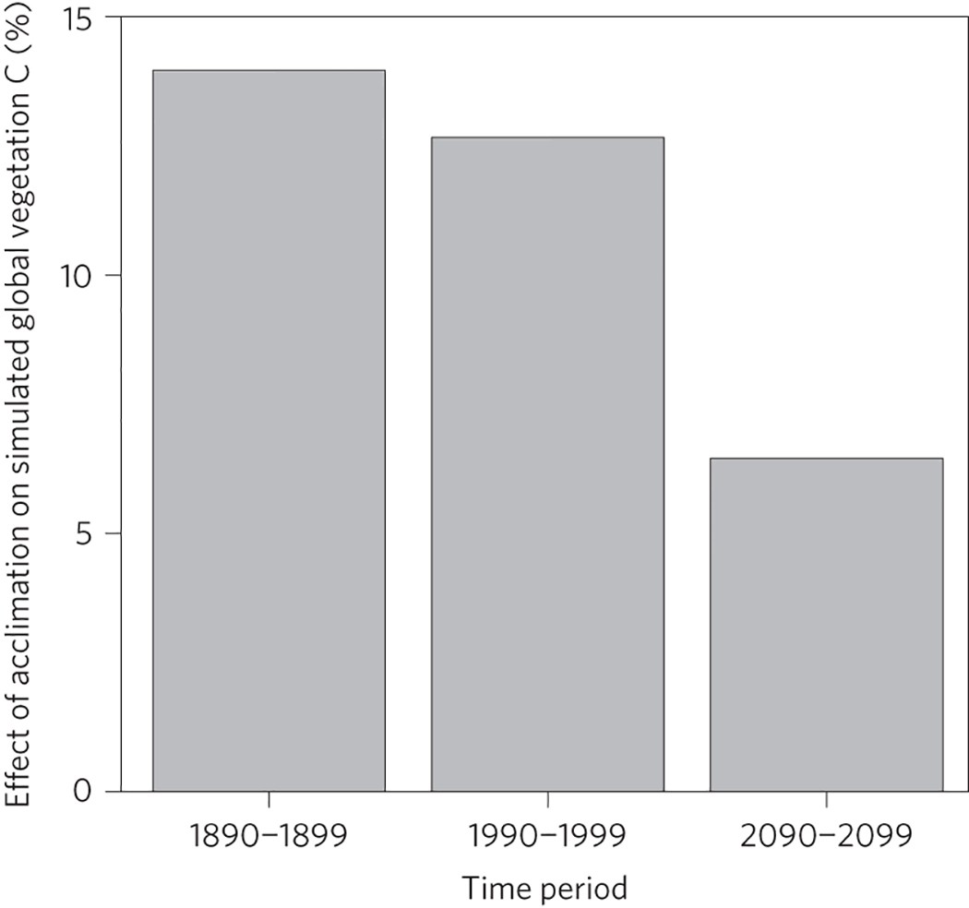
Photosynthetic temperature acclimation increases simulated global vegetation carbon
Smith et al. (2016) Nat Clim Change

Slide 16
Biophysical Feedbacks to Climate
Temperature
Photosynthesis

Slide 17
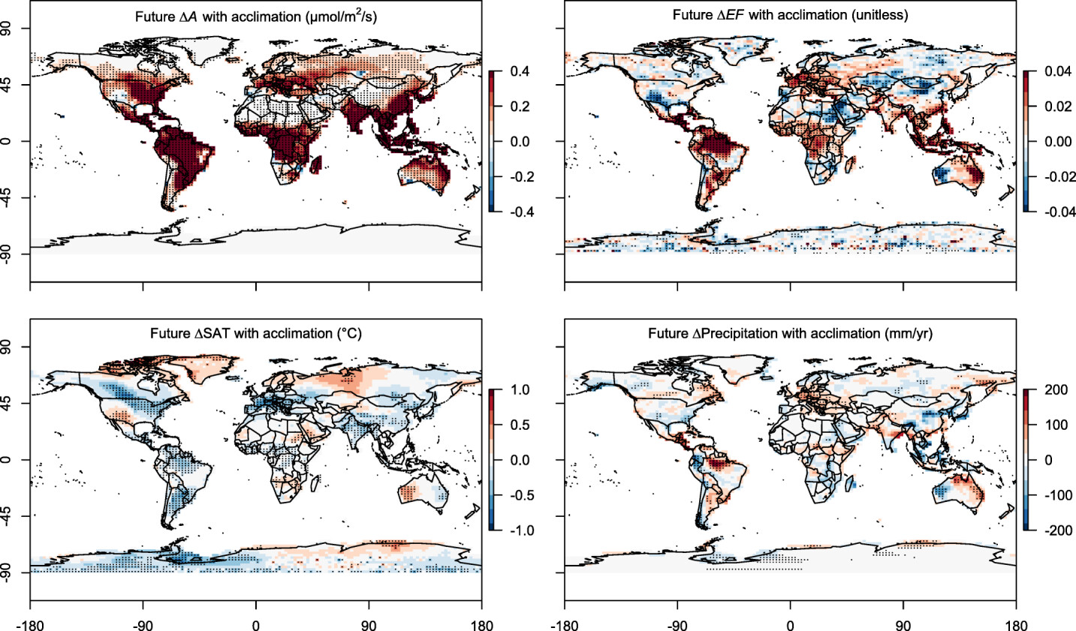
Photosynthetic temperature acclimation changes transpiration and air temperature
Smith et al. (2017) JAMES

Slide 18
Perturbation vignettes
Temperature → global carbon and energy fluxes
CO₂ → plant-nutrient dynamics
Soil fertility → population dynamics
Environmental heterogeneity → community dynamics
Invasion → mycorrhizal symbioses

Slide 19
CO₂
Photosynthesis

Slide 20
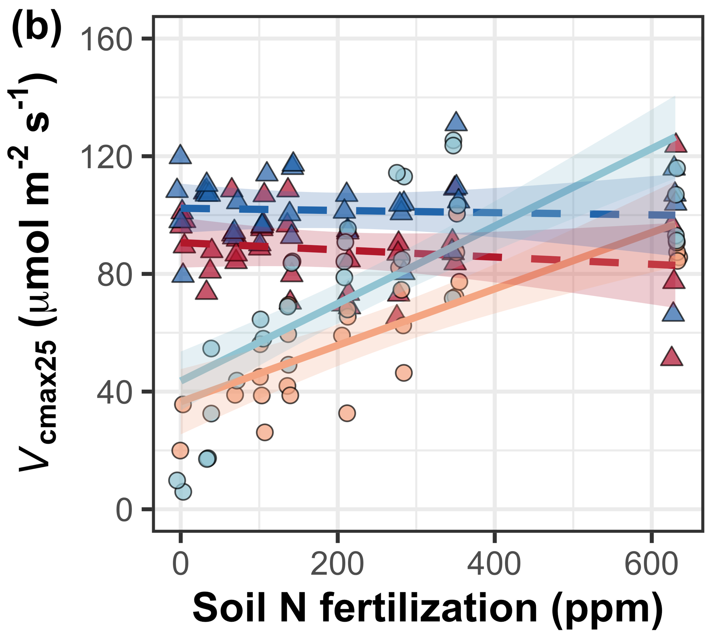
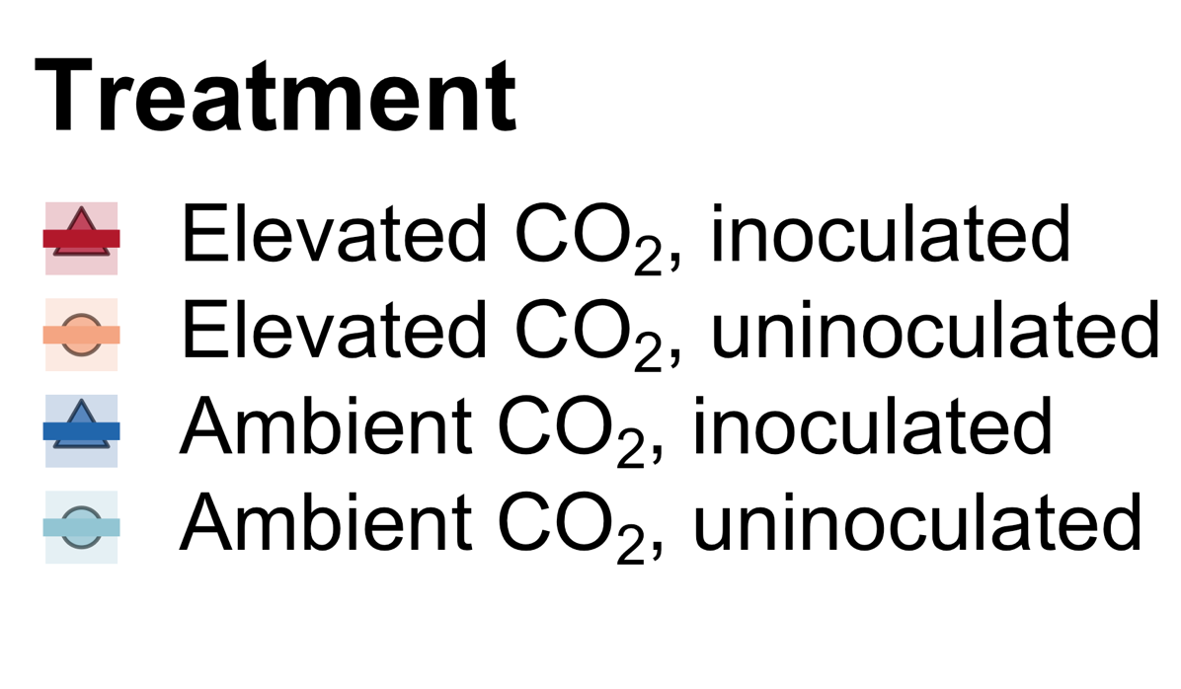
Elevated CO₂ reduces leaf nitrogen demand regardless of nitrogen availability
Perkowski, Ezekannagha, Smith (2025) J Exp Bot

Slide 21
Community-Scale Leaf Nitrogen
CO₂
Photosynthesis

Slide 22
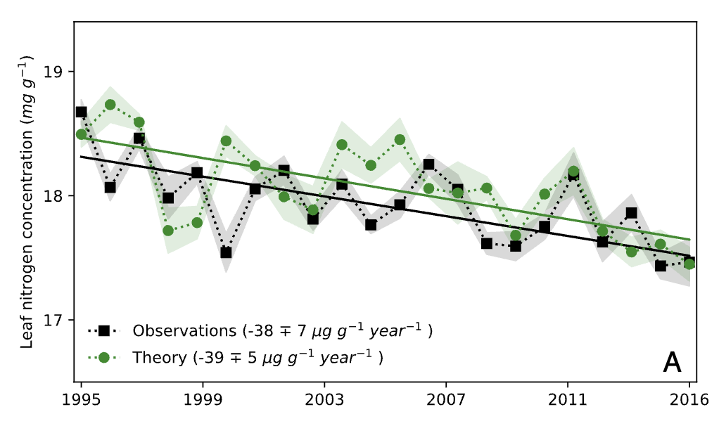
This is predictable over continental gradients
Bassiouni, Smith, et al. (2025) PNAS

Slide 23
Global Carbon Stocks
CO₂
Photosynthesis

Slide 24
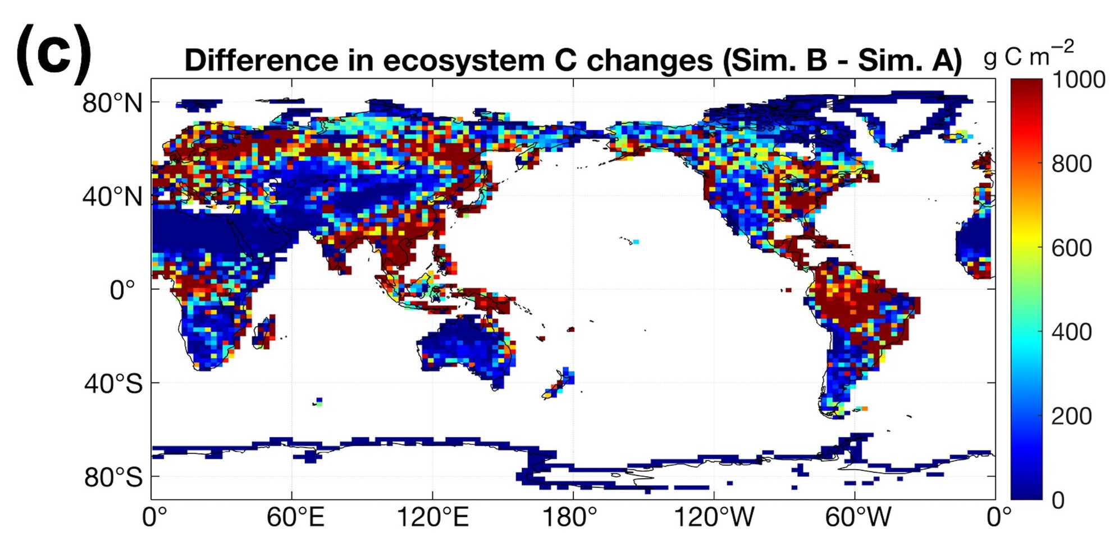
Accounting for this effect in models increases simulated future global carbon stocks
Smith et al. (2024) Glob Change Biol

Slide 25
Perturbation vignettes
Temperature → global carbon and energy fluxes
CO₂ → plant-nutrient dynamics
Soil fertility → population dynamics
Environmental heterogeneity → community dynamics
Invasion → mycorrhizal symbioses

Slide 26
Soil Nutrients
Leaf Nutrients

Slide 27
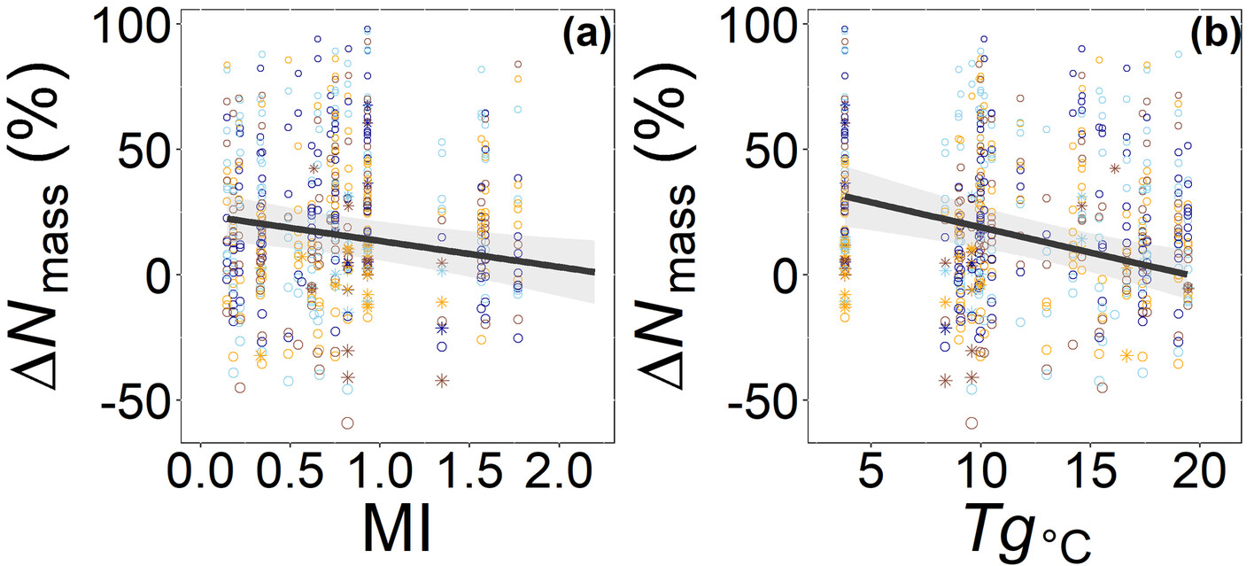
Soil nutrients enhance leaf nutrients where photosynthetic demand is greatest (dry/cold)
Cheaib…and Smith (2025) Ecol Letters

Slide 28
Soil Nutrients
Population Growth
Leaf Nutrients

Slide 29
In cold/dry places, higher leaf nitrogen confers greater species population growth
Cheaib…and Smith (in Prep)

Slide 30
Perturbation vignettes
Temperature → global carbon and energy fluxes
CO₂ → plant-nutrient dynamics
Soil fertility → population dynamics
Environmental heterogeneity → community dynamics
Invasion → mycorrhizal symbioses

Slide 31
Soil Nutrients
Photosynthetic
Strategies

Slide 32
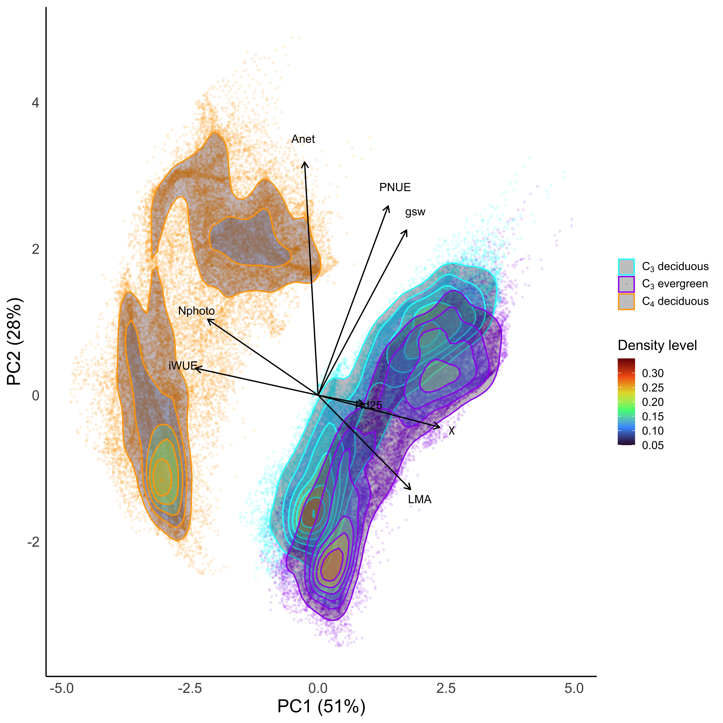
We can predict global and local photosynthetic strategies from theory
Smith (In Review)

Slide 33
Local-scale competition and coexistence
Soil Nutrients
Photosynthetic
Strategies

Slide 34
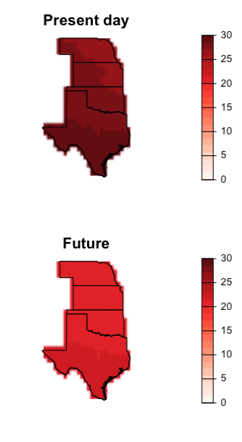
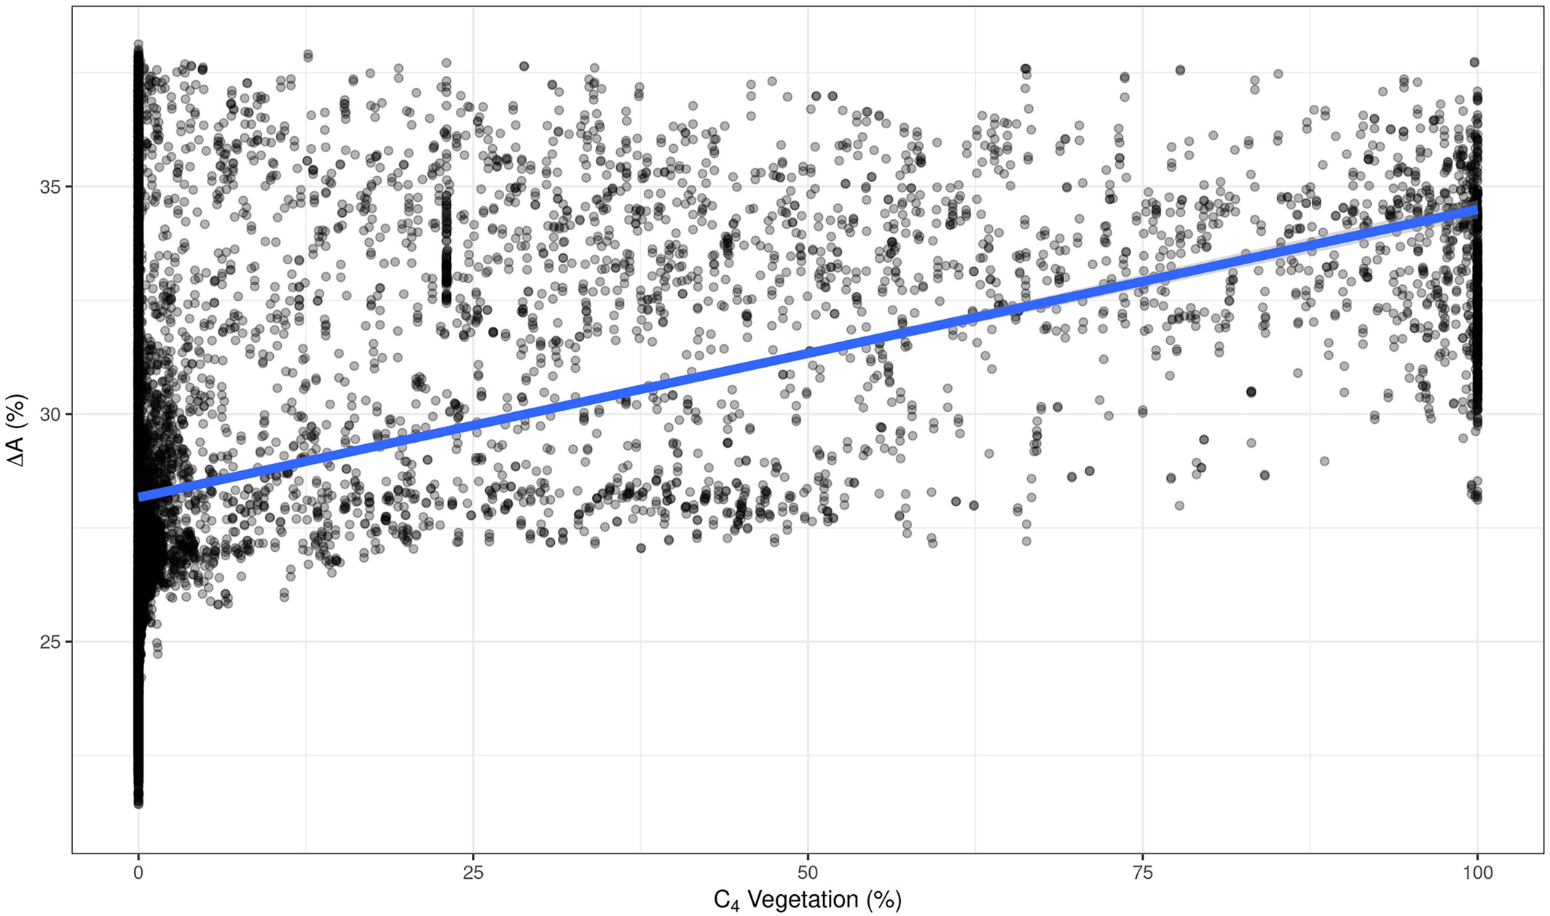
Strategies can predict observable outcomes of competition (broadly)
C₄ advantage (%)
Scott and Smith (2022) JAMES

Slide 35
Perturbation vignettes
Temperature → global carbon and energy fluxes
CO₂ → plant-nutrient dynamics
Soil fertility → population dynamics
Environmental heterogeneity → community dynamics
Invasion → mycorrhizal symbioses

Slide 36
Invasion
Carbon Assimilation

Slide 37
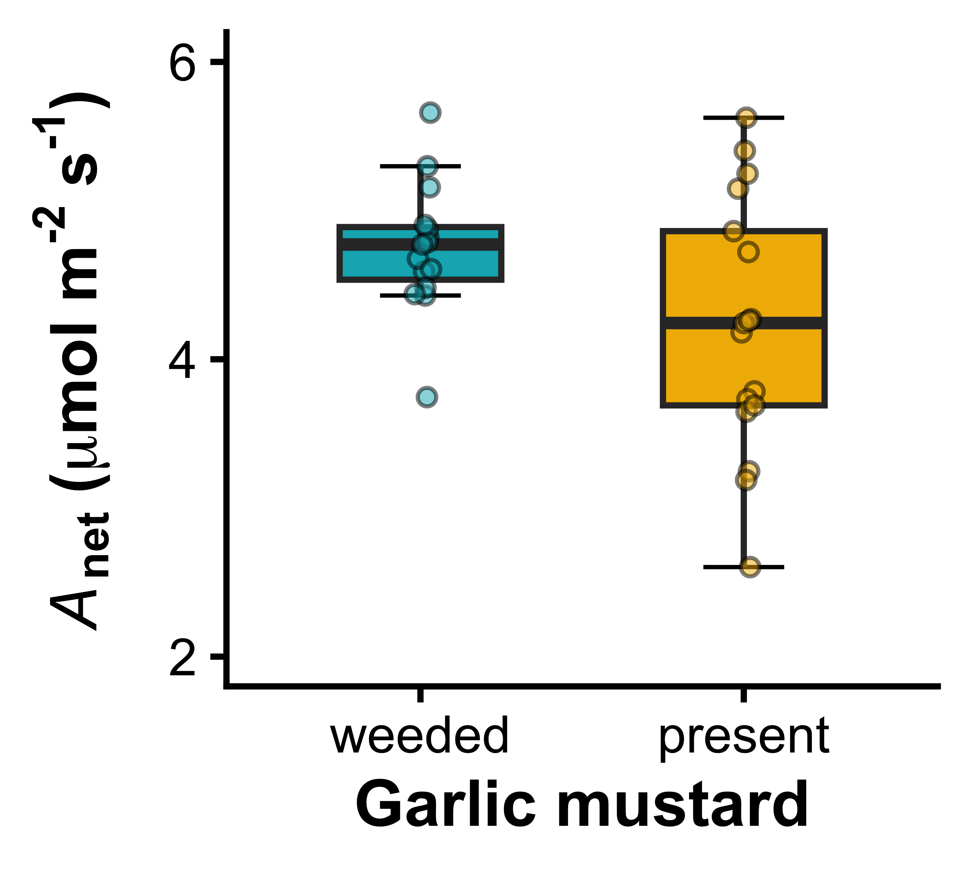
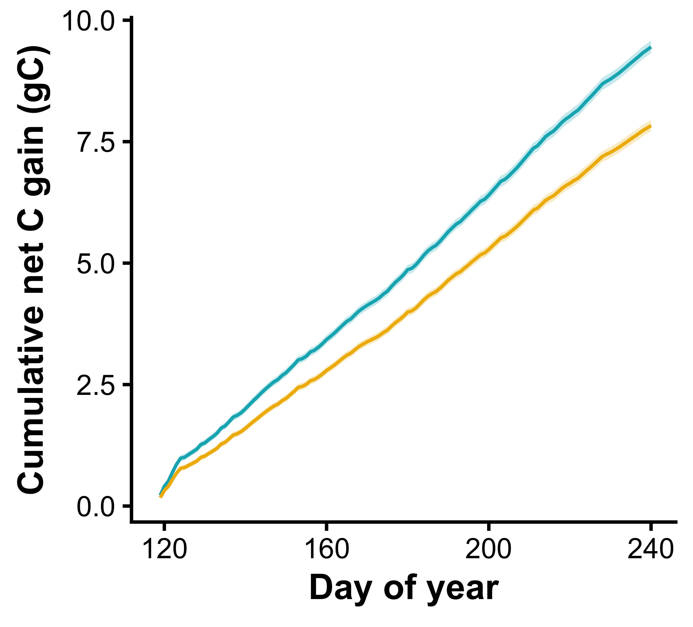
Invasion by garlic mustard reduces native understory plant carbon assimilation
Perkowski…and Smith (2026) Func Ecol

Slide 38
Mycorrhizal Resource Exchange
Invasion
Carbon Assimilation

Slide 39
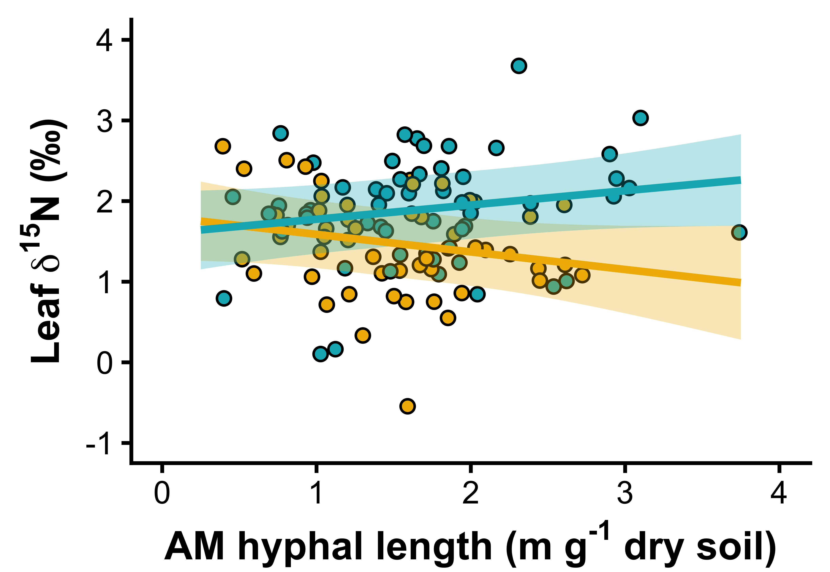
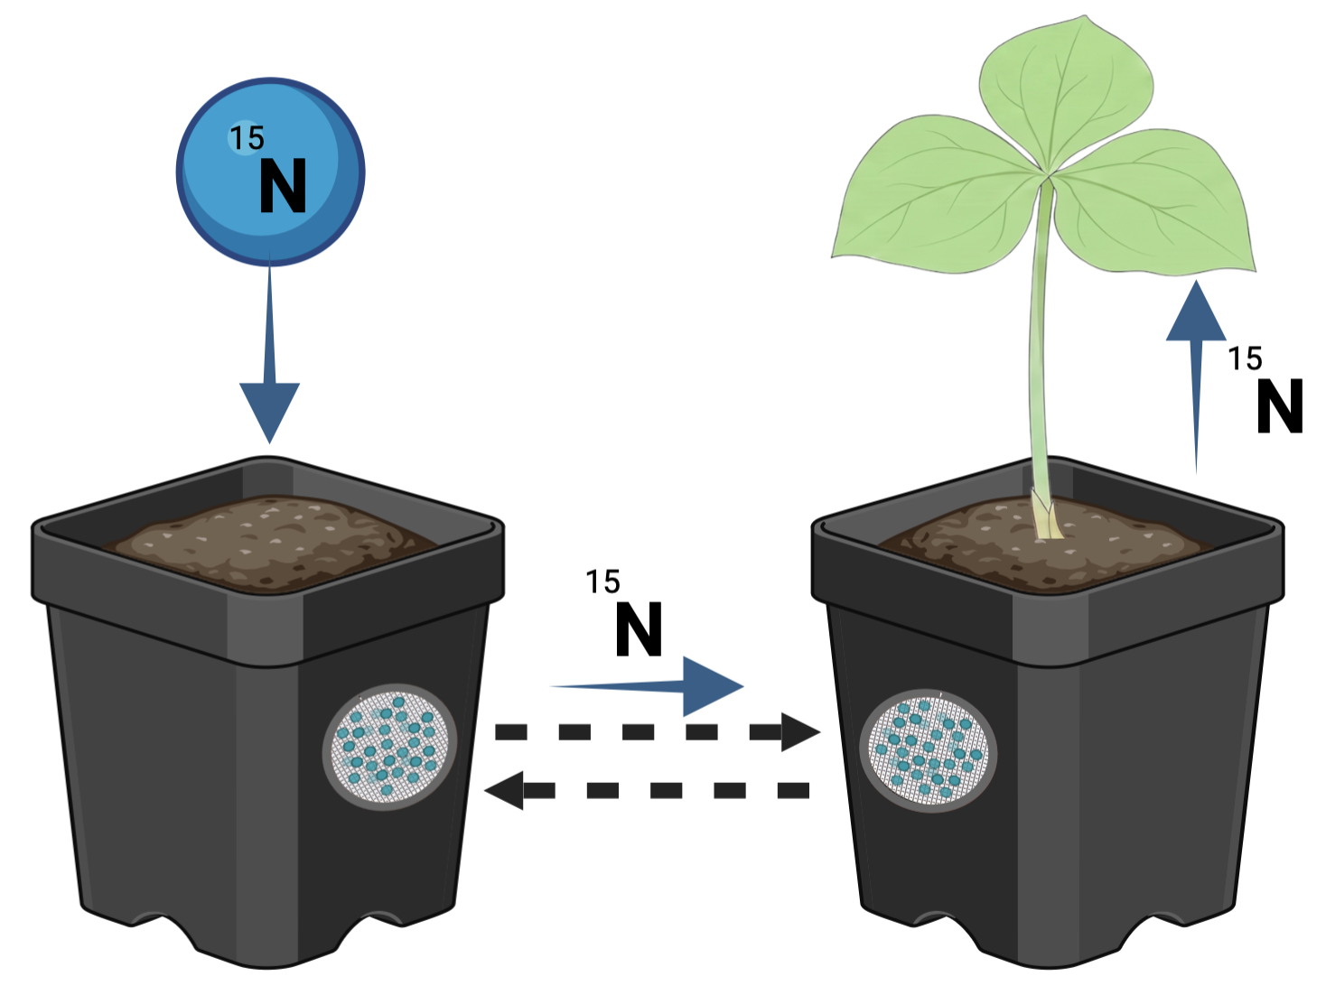

Invasion impacts are due to mycorrhizal mutualism disruption
Greater share of leaf N from
AM fungi
Perkowski…and Smith (In Prep)

Slide 40
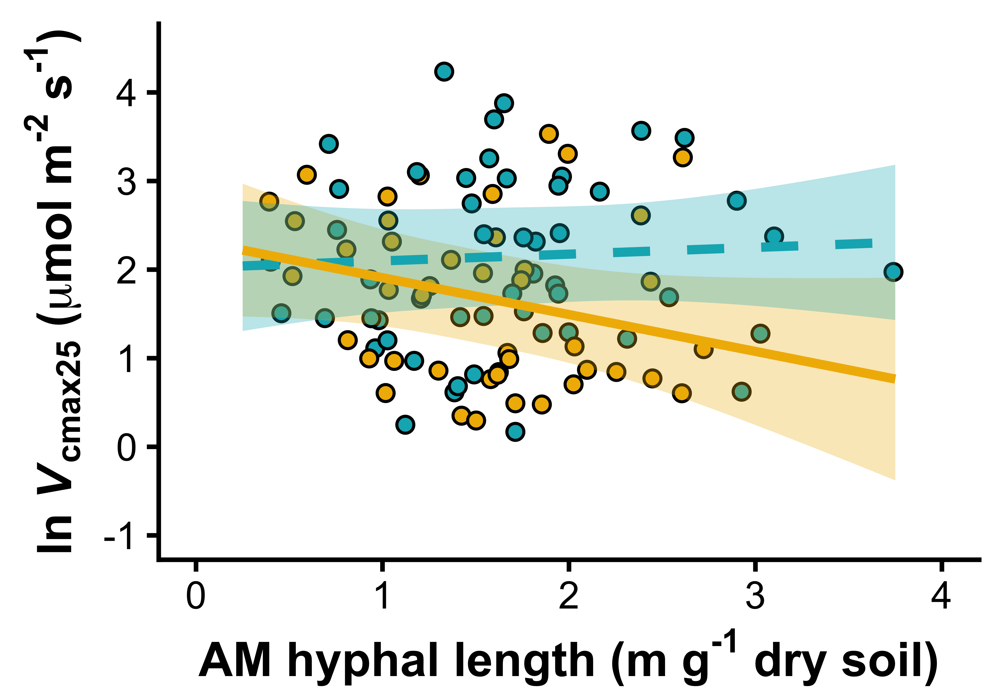
Invasion impacts are due to mycorrhizal mutualism disruption
ln Photosynthetic
capacity
Perkowski…and Smith (In Prep)

Slide 41
Conclusions
Ecosystem Ecology
Plant physiological responses to their environment form the basis of larger-scale responses
Experiments, observations, theory, and modeling are needed to understand and predict these responses across scales
Community Ecology
Population Ecology
Physiological Ecology

Slide 42
Presentation available at: github.com/SmithEcophysLab/seminar/
More about the lab: smithecophyslab.com
Contact: nsmith87@unl.edu

