Slide 1
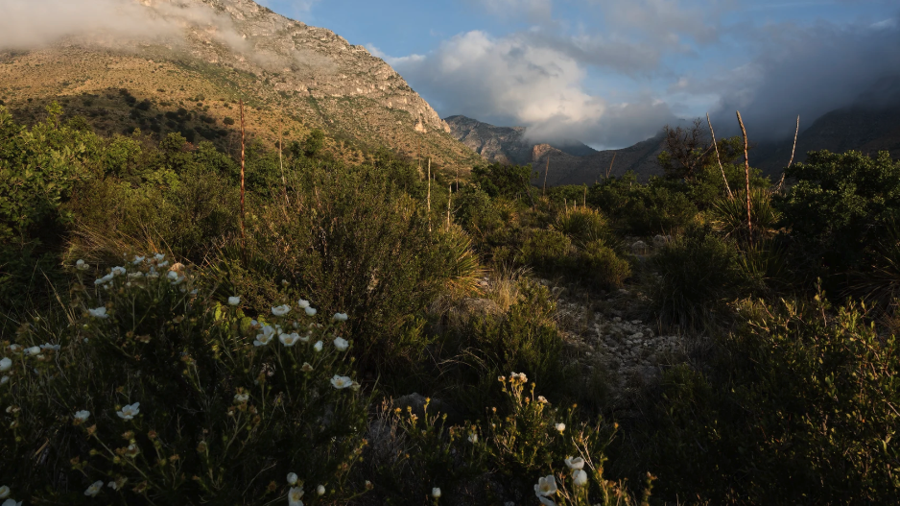

Using experiments to evaluate models of photosynthetic acclimation to global change
Nick Smith
Department of Biological Sciences
Texas Tech University
nick.smith@ttu.edu

Slide 2
What is photosynthetic acclimation?

Slide 3
“A physiological, structural, or biochemical adjustment by an individual plant in response to an experimentally induced environmental stimulus that is manifested as alterations in the short-term response function of a physiological process.”
Smith and Dukes (2013)

Slide 4
Acclimation: an example
Acclimated to high light
Acclimated to low light

Slide 5
Acclimation: an example
Acclimated to high light
Acclimated to low light
Photosynthesis peaks a light level close to the level the leaf is acclimated to

Slide 6
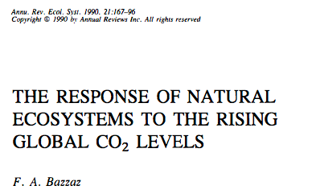
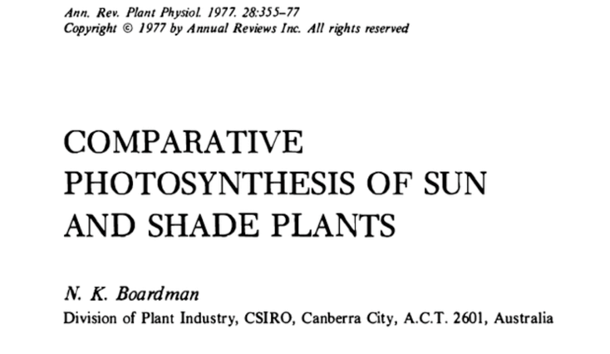
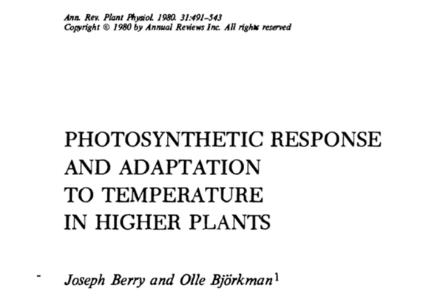
Acclimation is ubiquitous and well known…
Temperature: Berry & Björkman (1980)
CO₂: Bazzaz (1990)
Light: Boardman (1977)

Slide 7
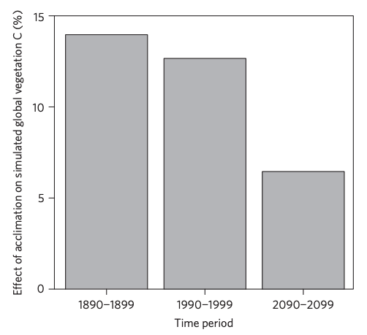
…and can impact carbon cycling and climate
Acclimation increase future C storage by ~6%
Acclimation alters future temperature by >1°C
Smith et al. (2017) Nature Climate Change
Smith et al. (2017) JAMES

Slide 8
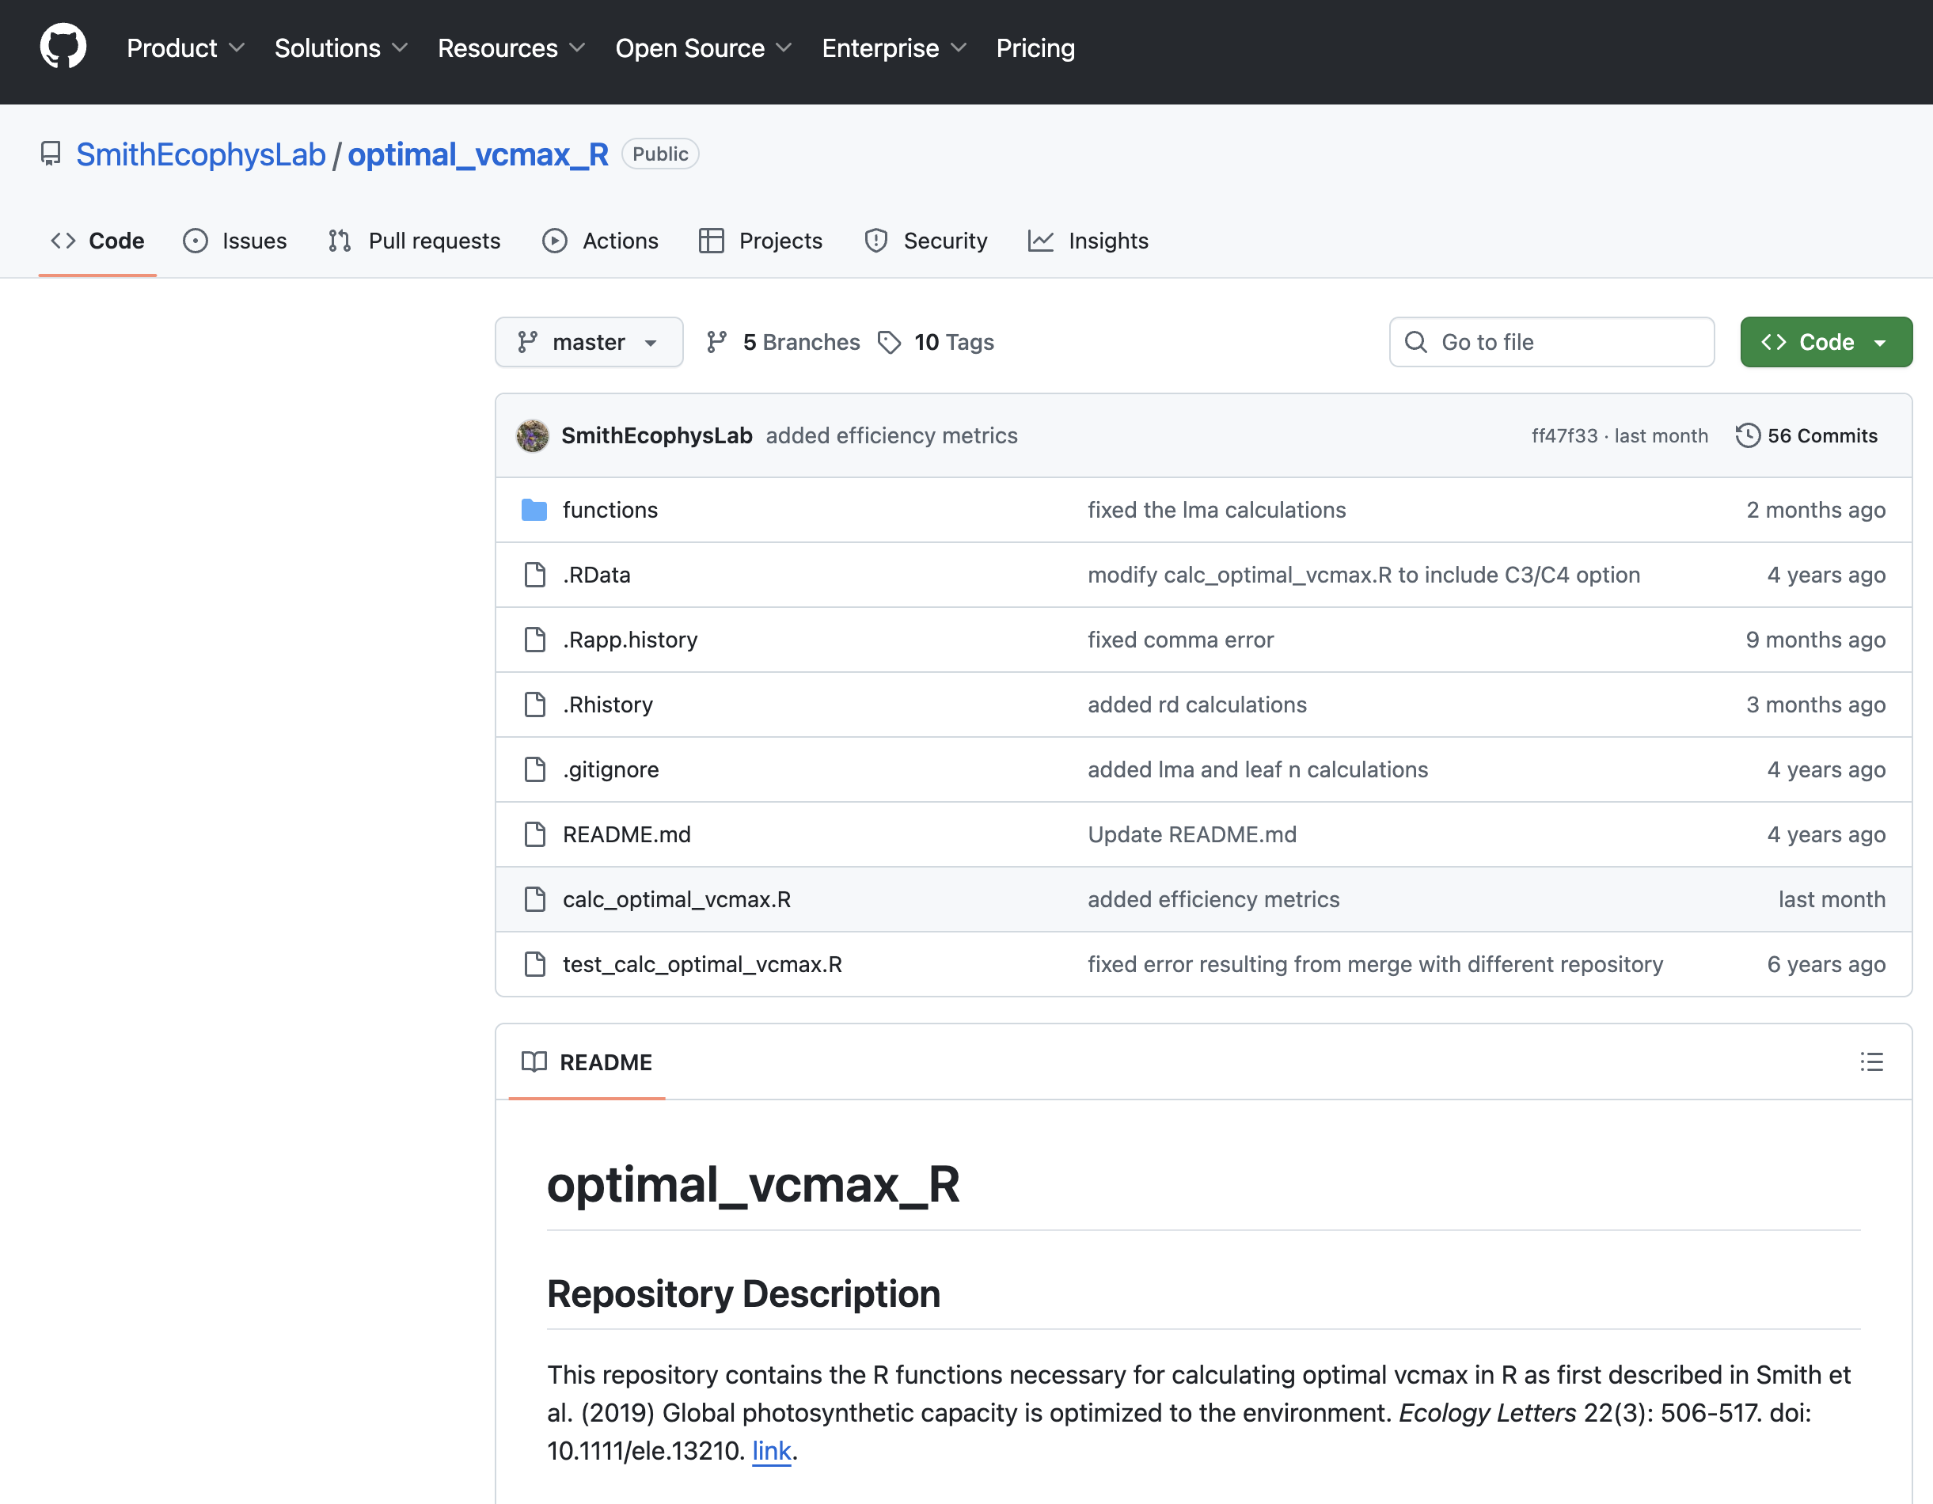
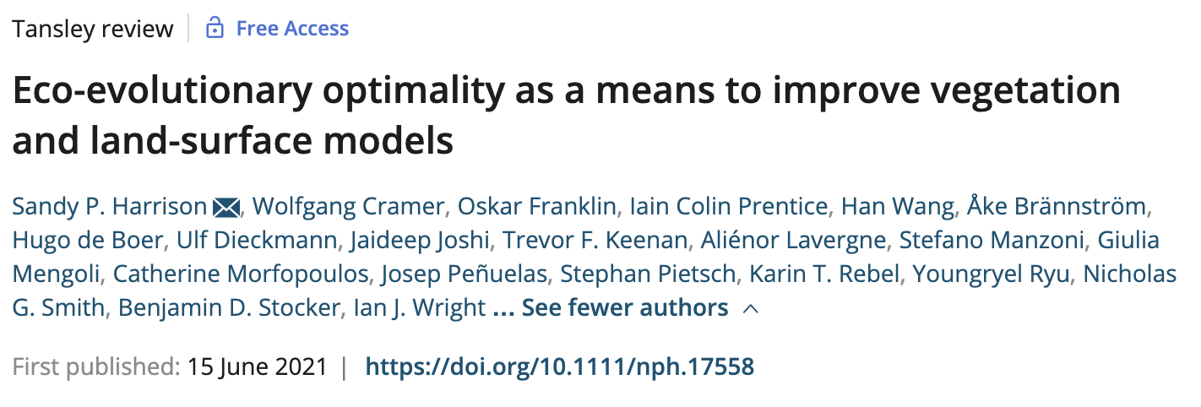

Slide 9
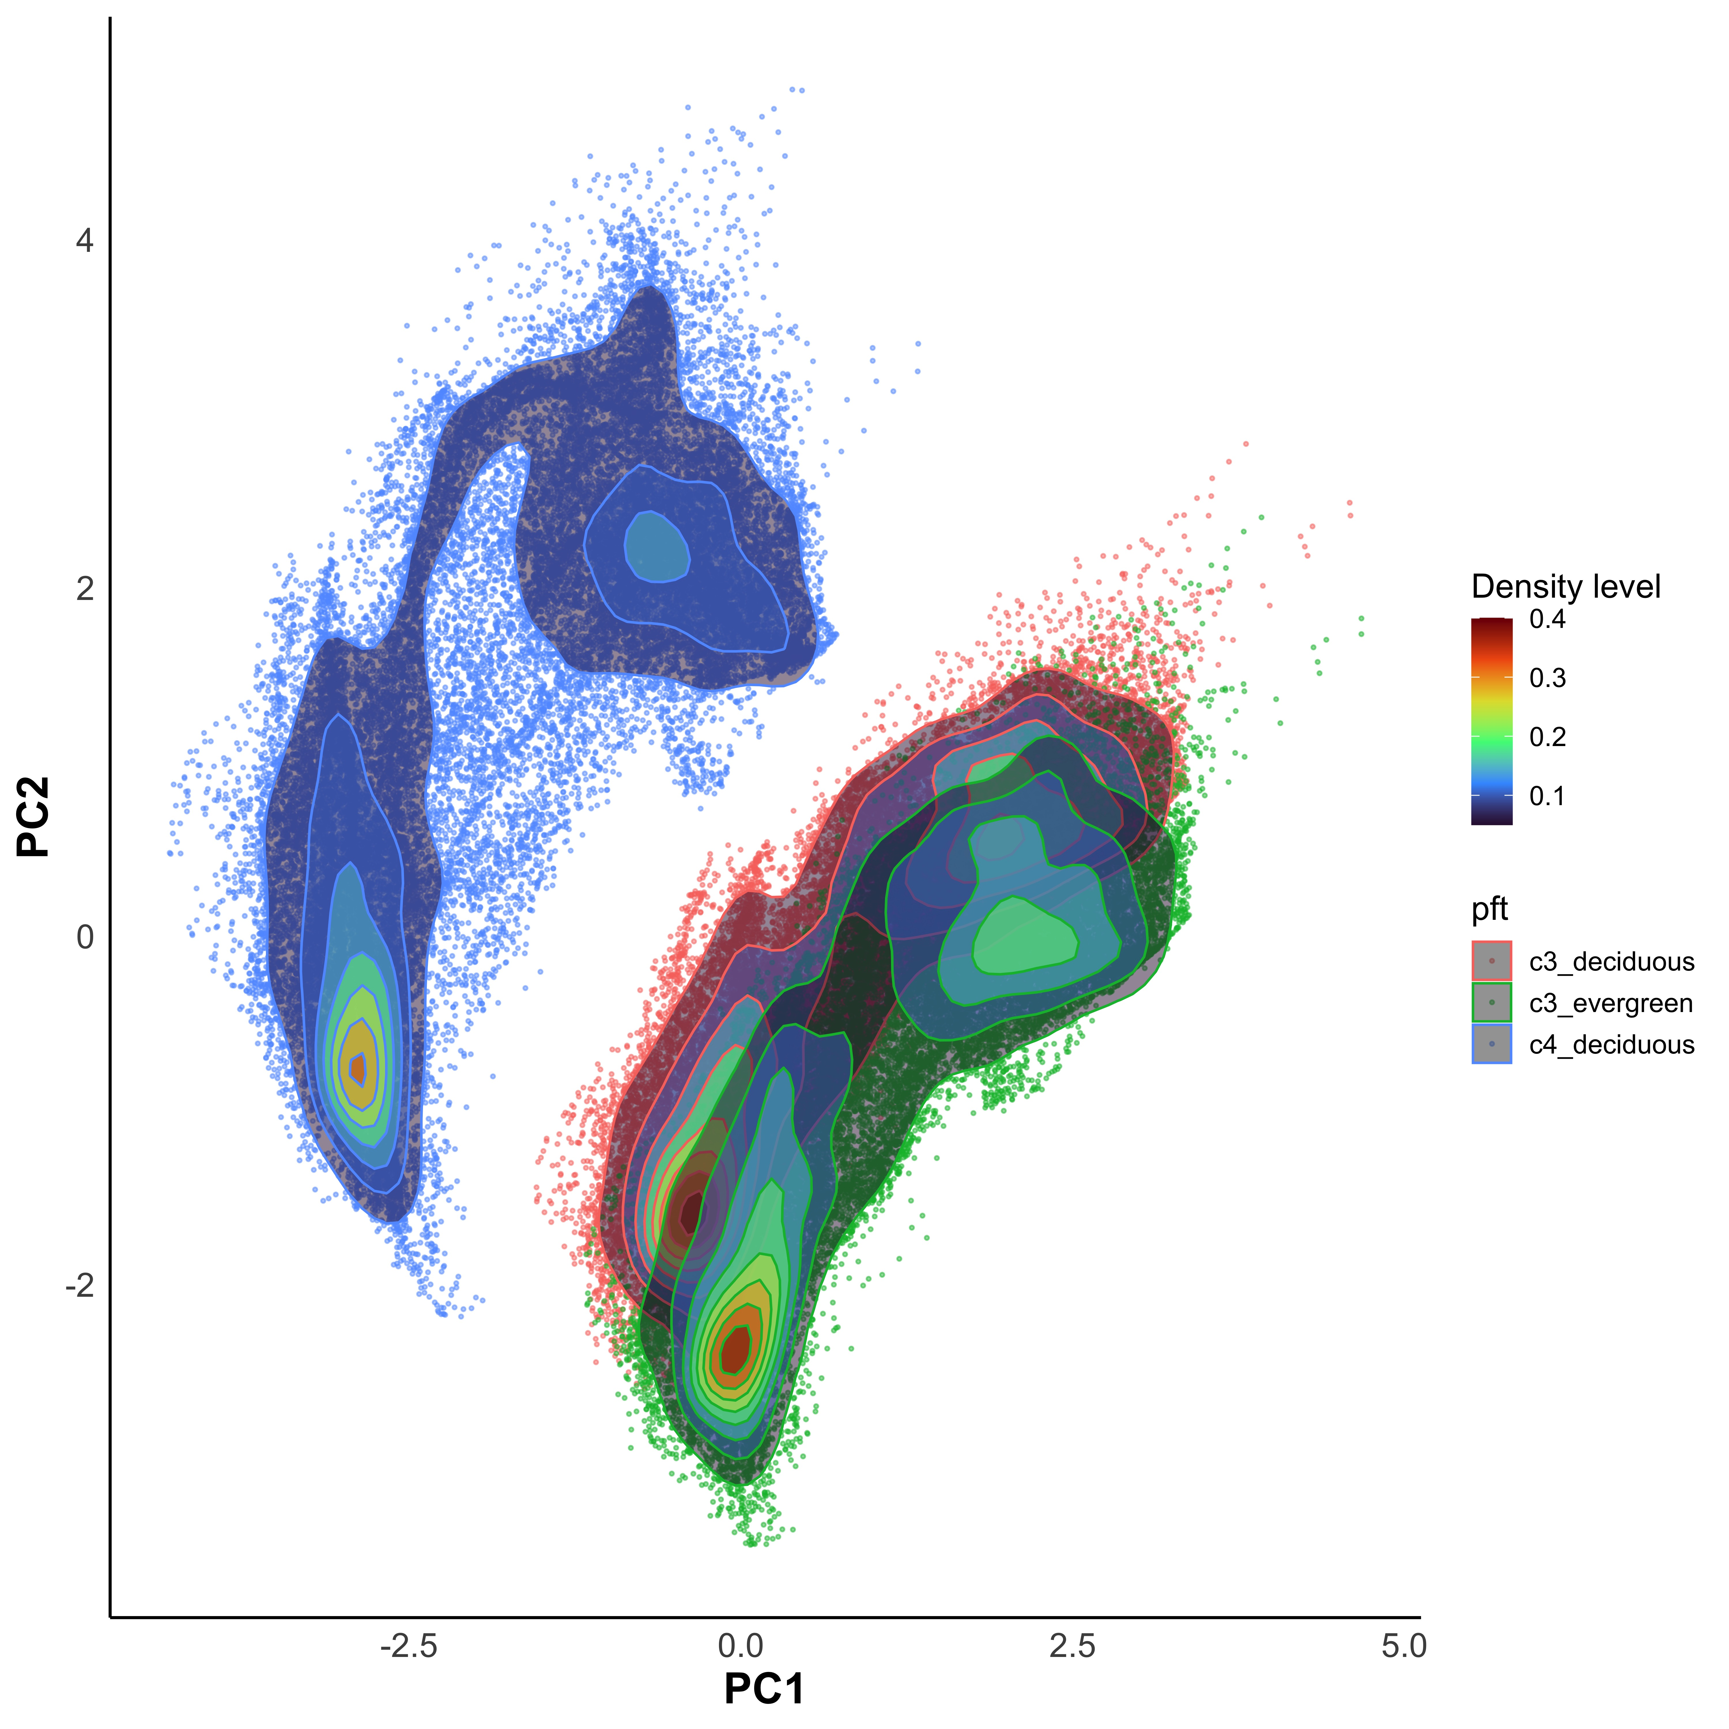
LEMONTREE-developed EEO model of photosynthetic acclimation
Inputs
Environment (T, PAR, VPD, CO₂)
Plant type (C3/C4, decidousness)
Outputs
Photosynthetic capacity
Stomatal conductance
Leaf mass per area
Leaf nitrogen pools
Photosynthetic resource use efficiency
github.com/SmithEcophysLab/optimal_vcmax_R

Slide 10
How do we know if the model is producing reliable simulations?

Slide 11
Testing model predictions
Compare output to observations
Pros: data are from ”real world”
Cons: multiple interacting factors at play

Slide 12
Testing model predictions
Compare output to observations
Pros: data are from ”real world”
Cons: multiple interacting factors at play
Experimentally alter conditions and compare responses
Pros: can test factors directly
Cons: level of “realism” may vary by experiment

Slide 13
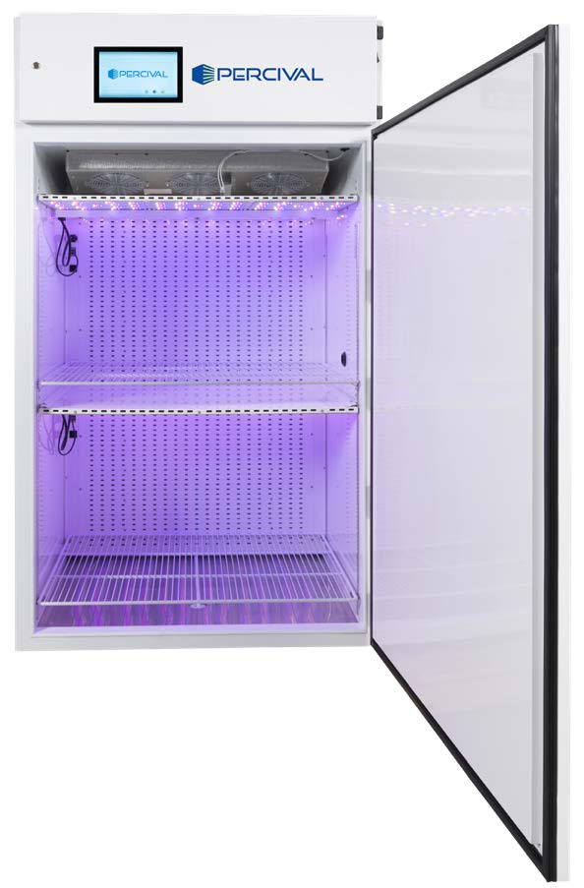
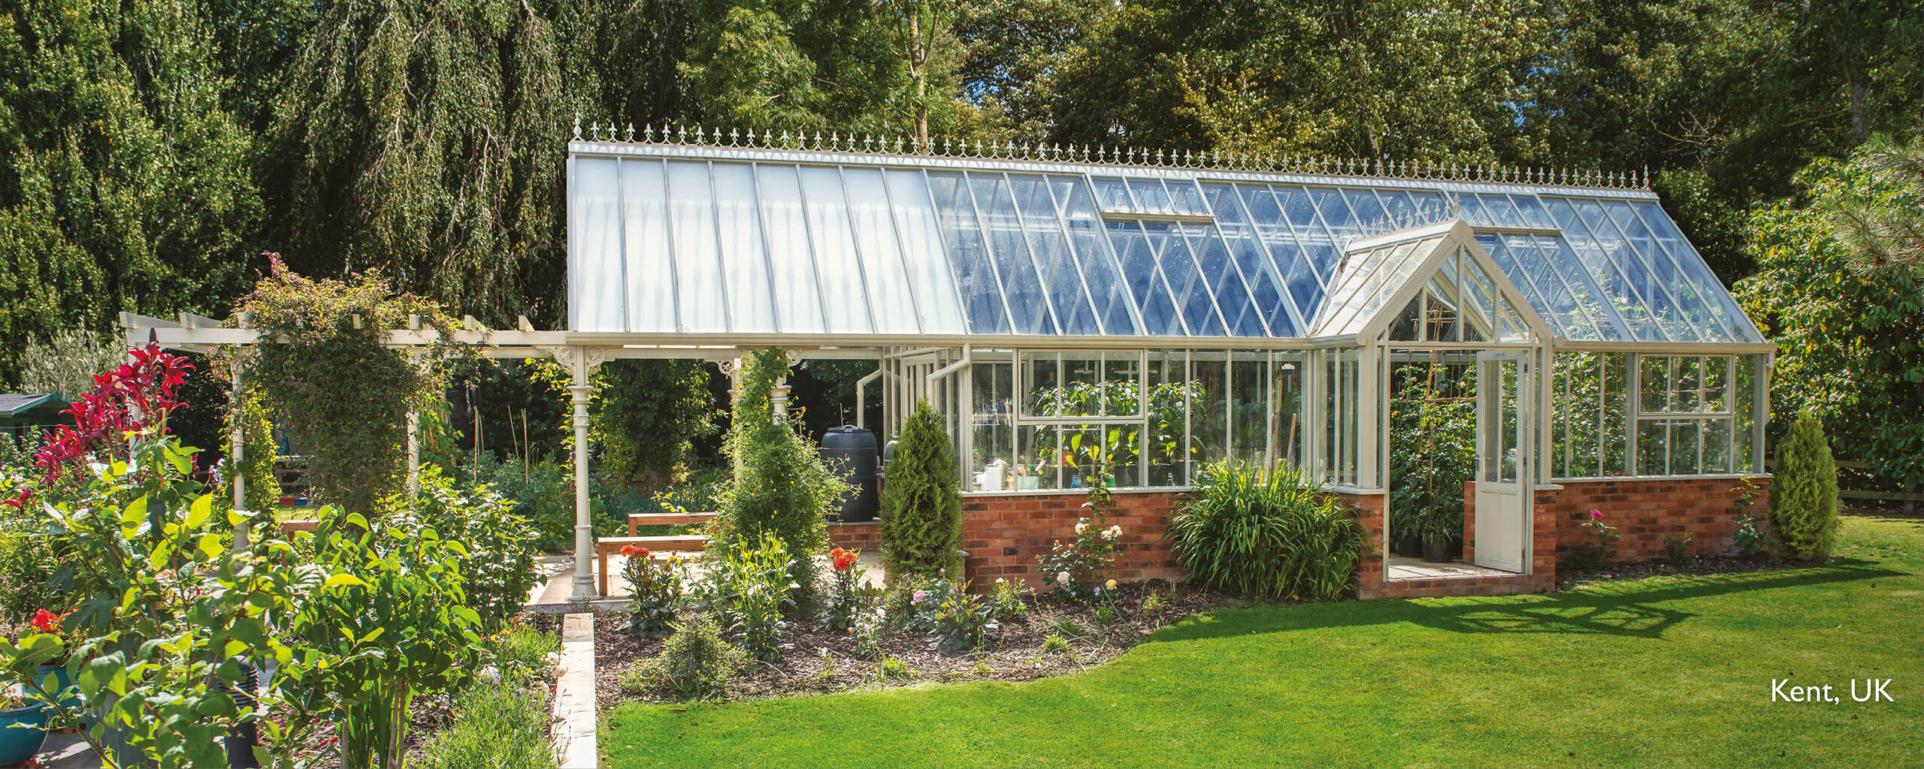
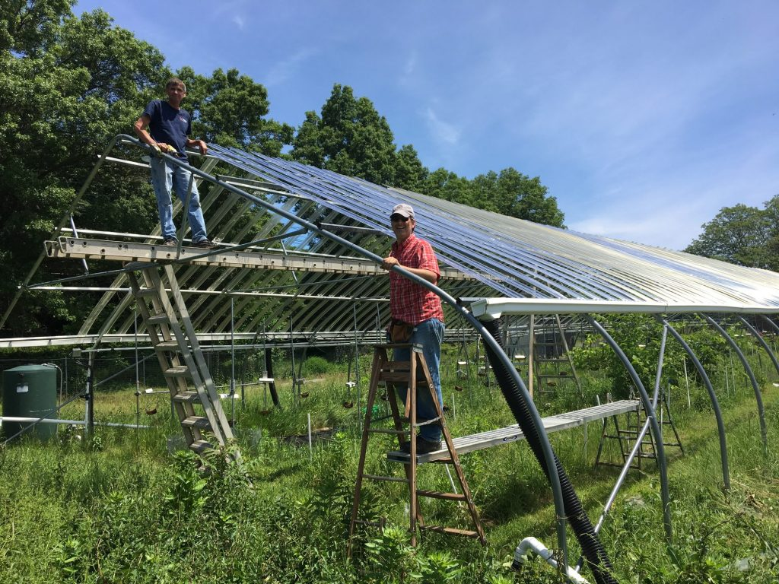
Experiment types
High
Easy
Fake
Growth chamber experiments
Glasshouse experiments
Field manipulation experiments
Level of Control
Logistics
Realism
Low
Hard
Real

Slide 14
Experiment types
High
Easy
Fake
Growth chamber experiments
Glasshouse experiments
Field manipulation experiments
Level of Control
Logistics
Realism
Low
Hard
Real

Slide 15
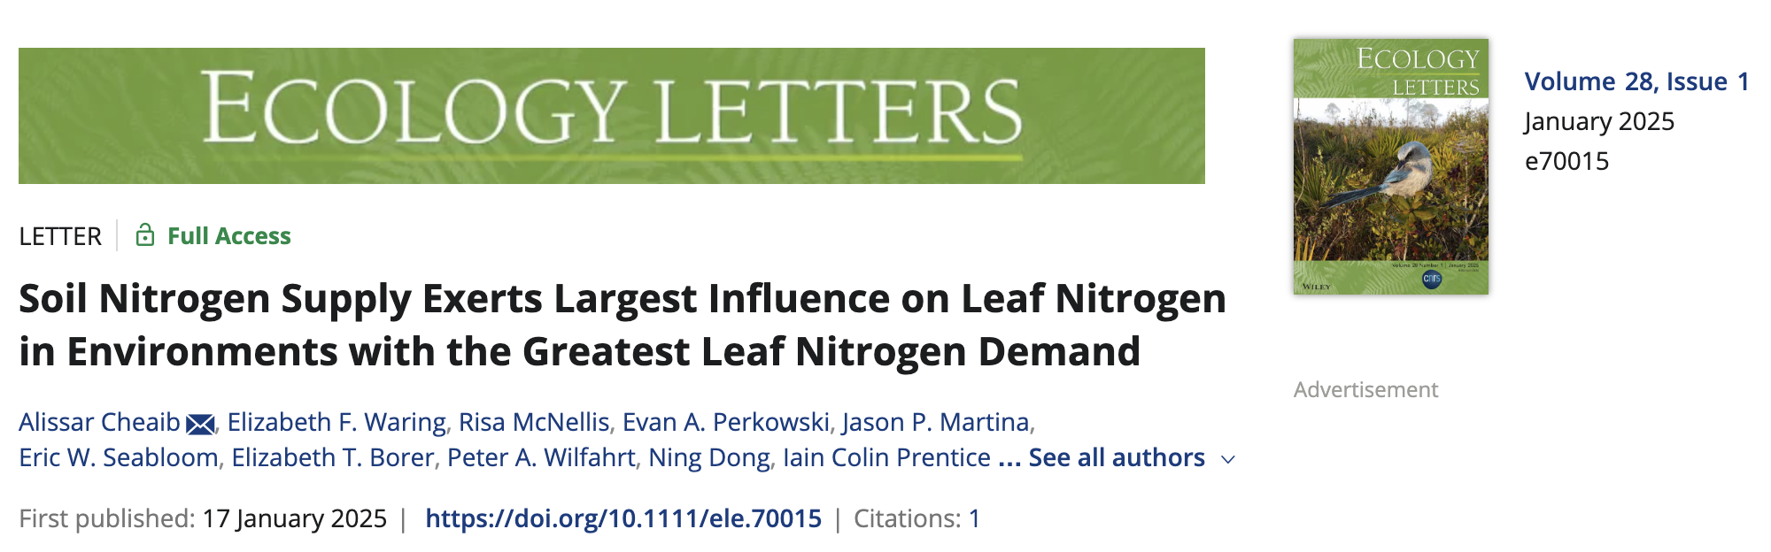
Testing theory with experiments: field manipulation example (Cheaib et al., 2025)

Slide 16
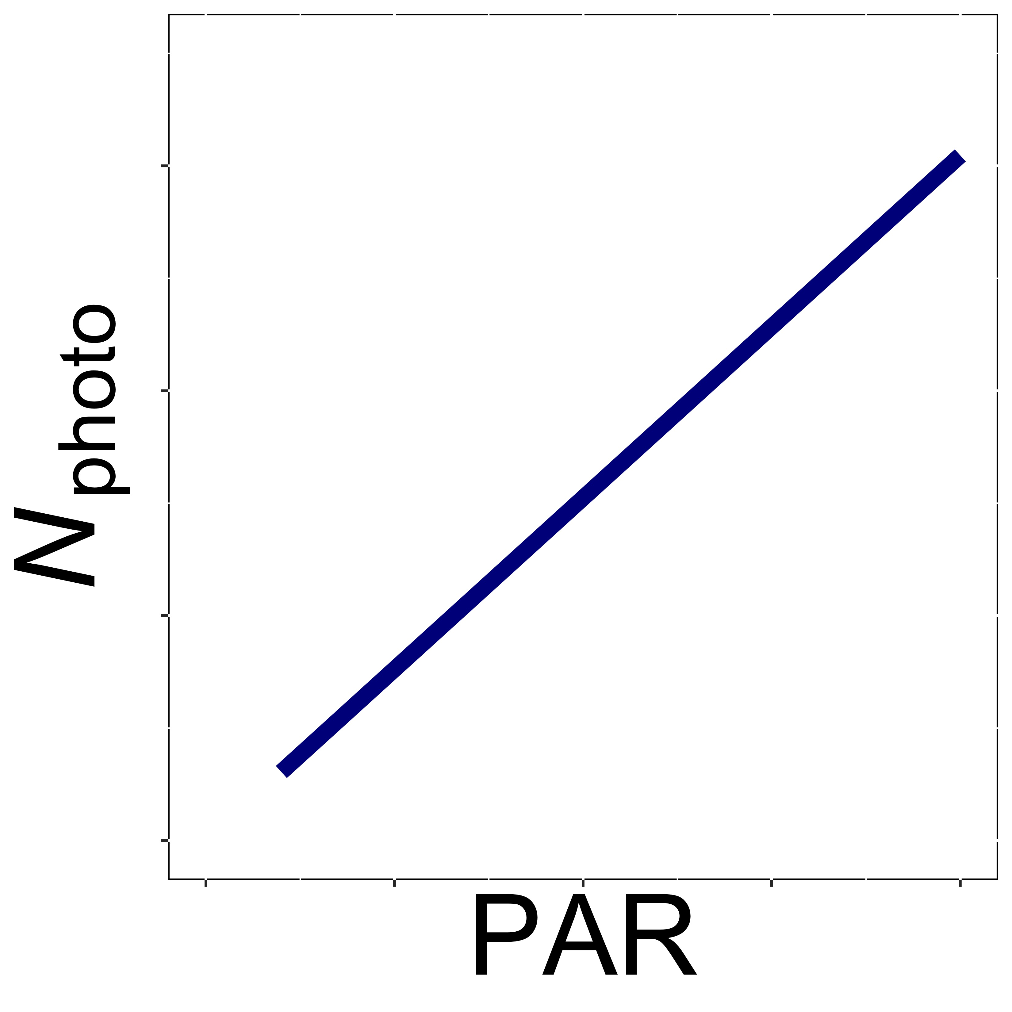
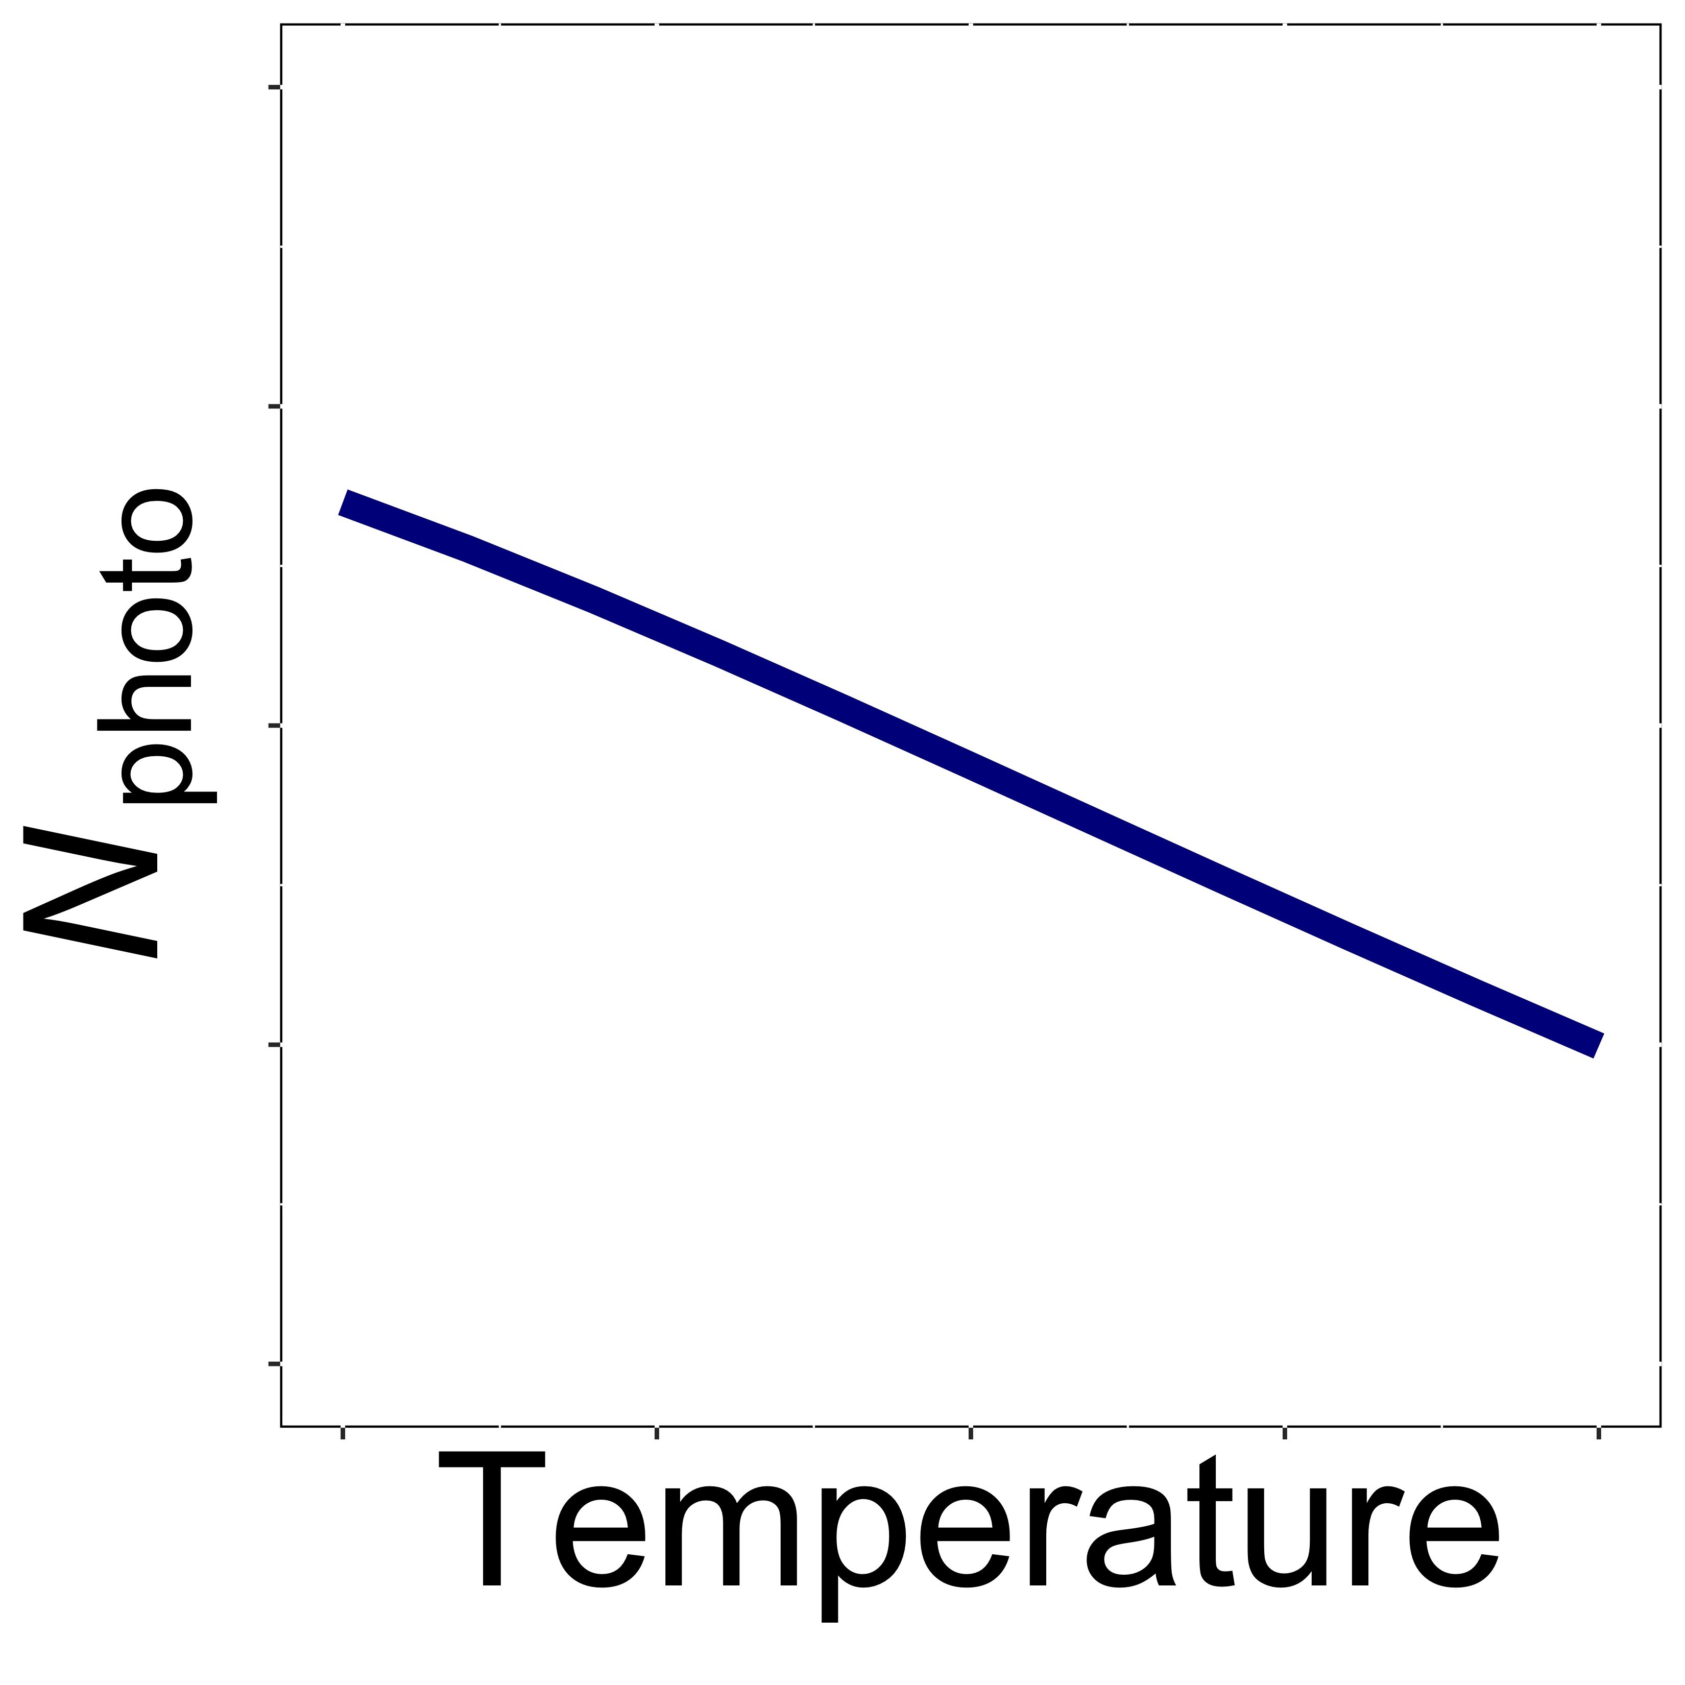
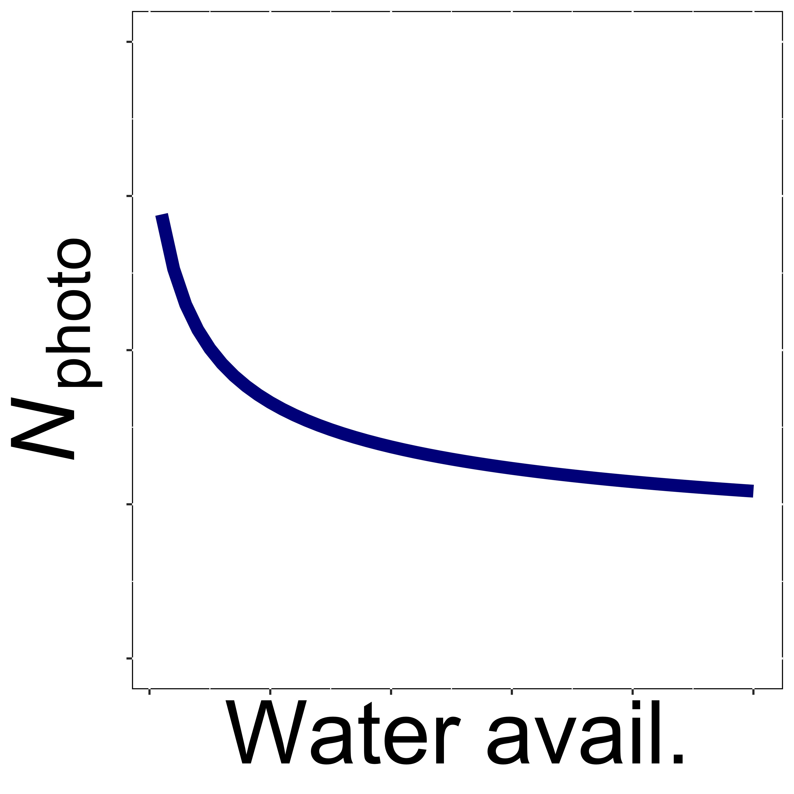
Testing theory with experiments: field manipulation example (Cheaib et al., 2025)
Theory: photosynthetic nitrogen demand should increase with light and decrease with temperature and water availability

Slide 17
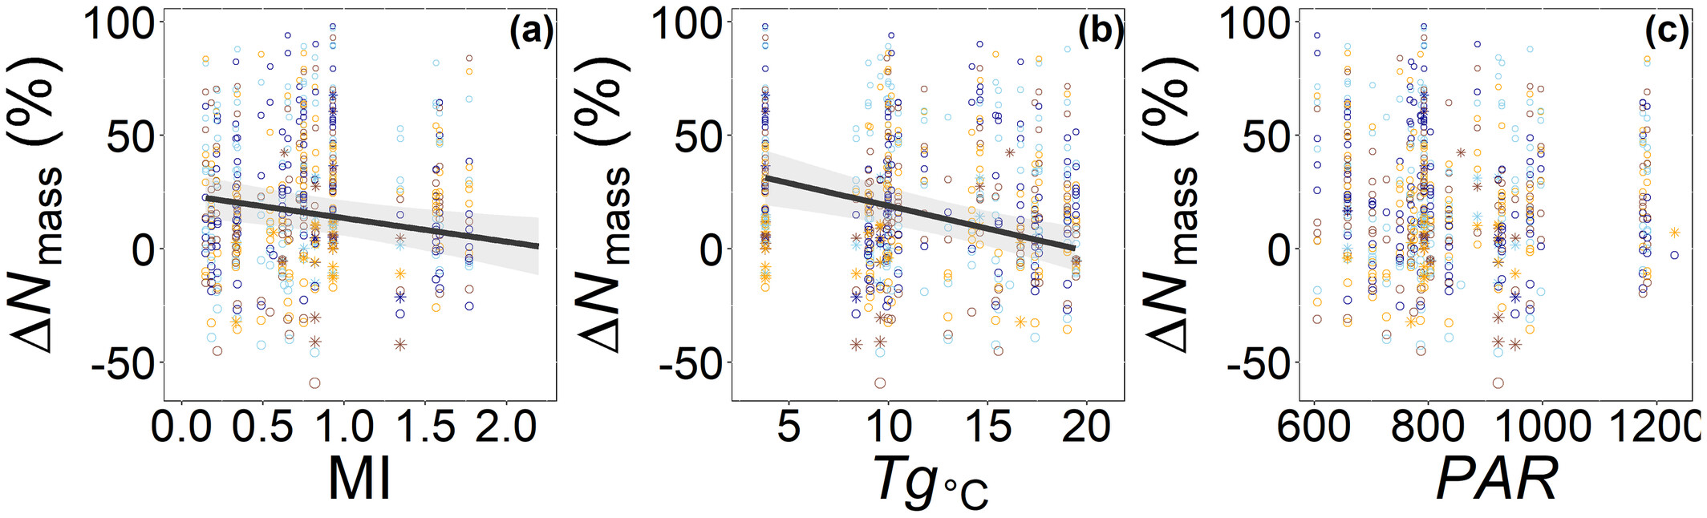
Testing theory with experiments: field manipulation example (Cheaib et al., 2025)
Results: theory confirmed for temperature and water, but not light

Slide 18
Testing theory with experiments: field manipulation example (Cheaib et al., 2025)
Summary
Multi-site field manipulation data can be useful for testing theory
Such large-scale, field data are difficult to obtain
Particularly for “hard” traits
Directly testing mechanisms requires complimentary approaches

Slide 19
Ongoing field manipulation work
Individual and community trait responses to soil resource availability across climatic gradients (PhD Monika Kelley)
Physiological, morphological, and biochemical traits
Connection between plant trait-environment relationships and population dynamics (postdoc Alissar Cheaib)
New approach can explore how trait responses influence population dynamics
Plant trait responses to experimental warming across elevation (postdoc Alissar Cheaib)
Temperature and non-temperature drivers of elevational responses

Slide 20
Experiment types
High
Easy
Fake
Growth chamber experiments
Glasshouse experiments
Field manipulation experiments
Level of Control
Logistics
Realism
Low
Hard
Real

Slide 21
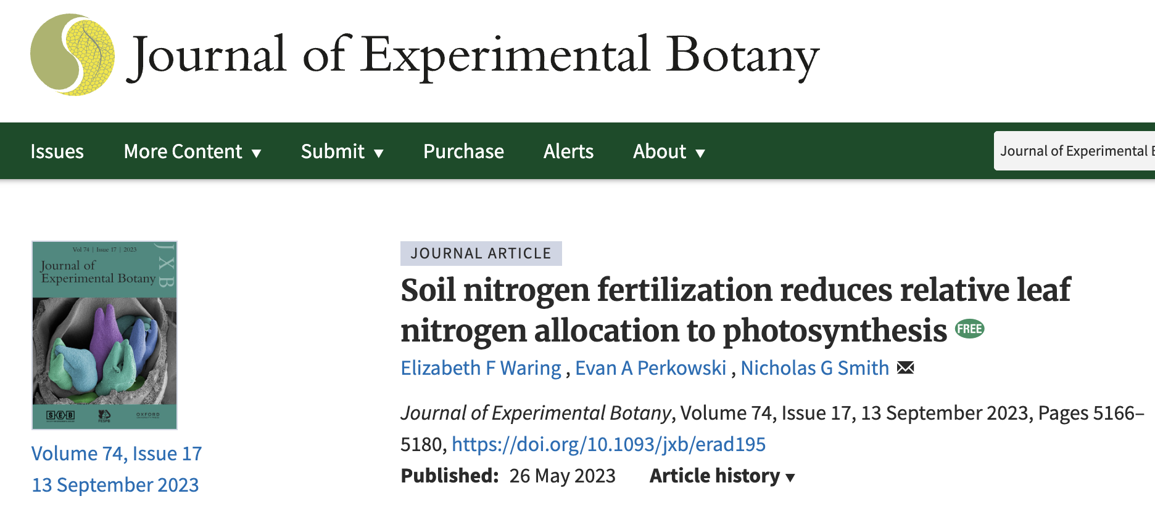
Testing theory with experiments: glasshouse example (Waring et al., 2023)

Slide 22
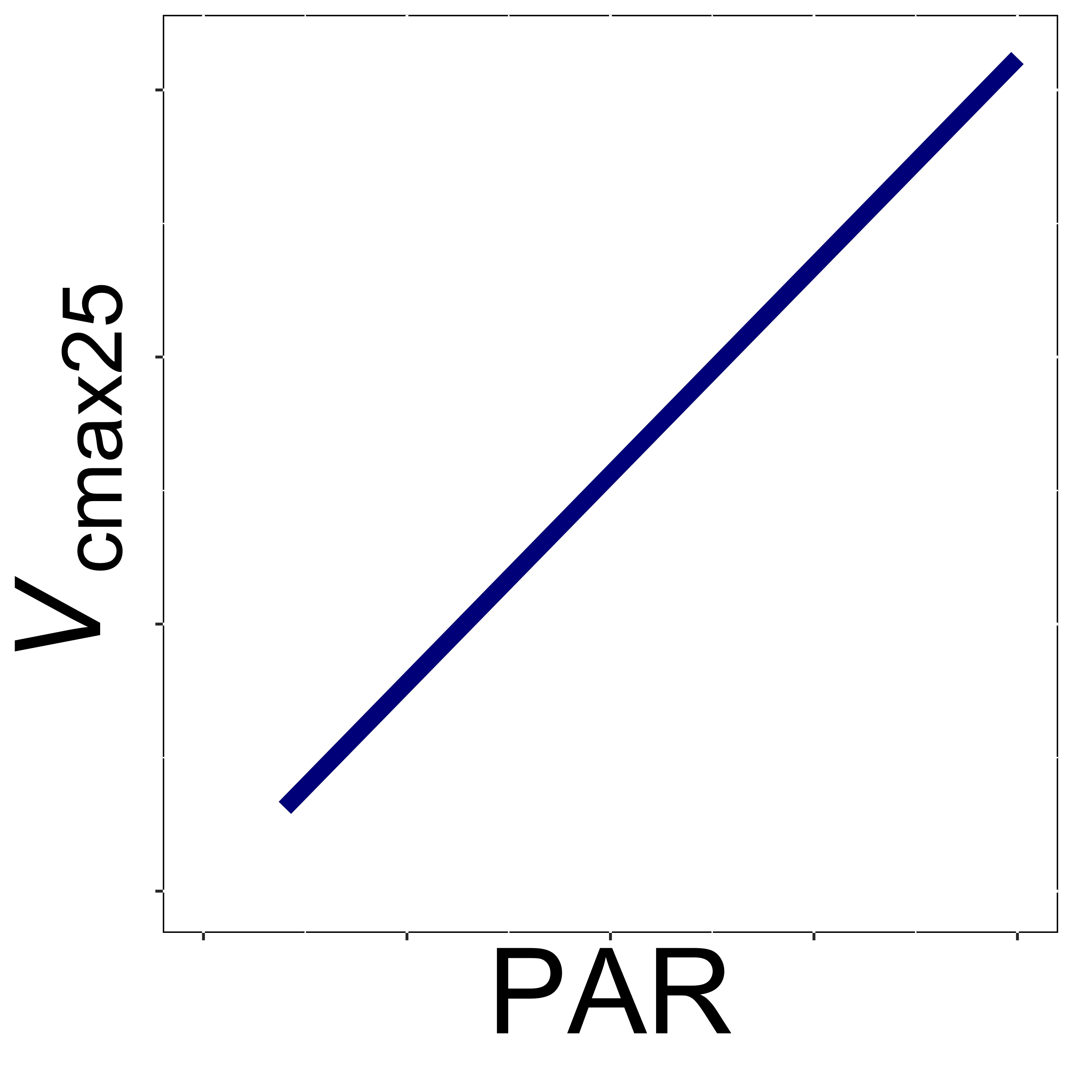
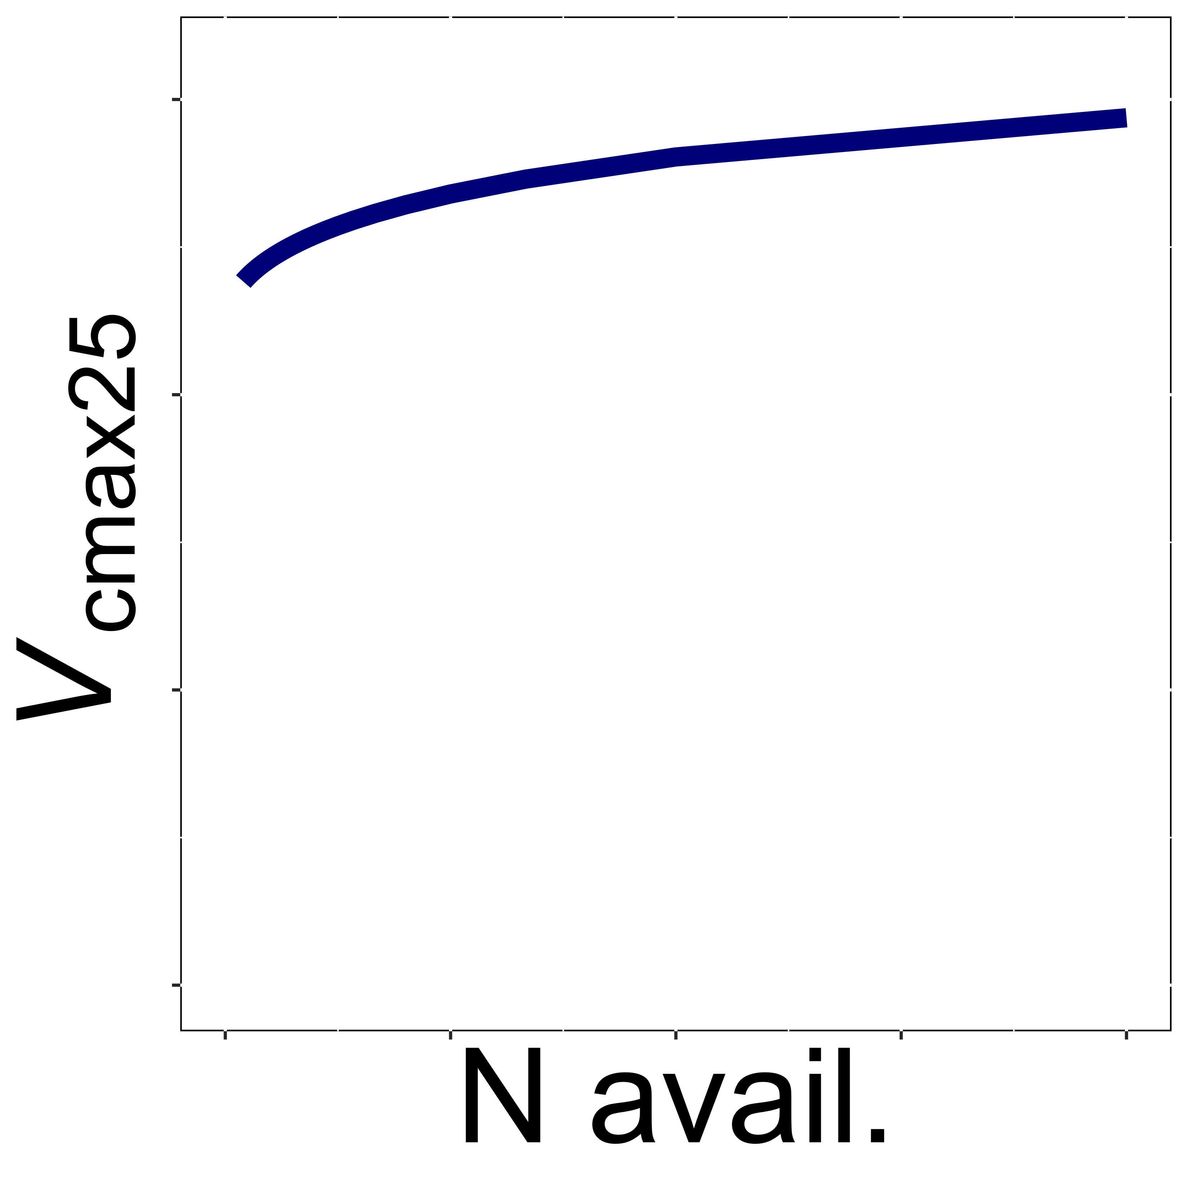
Testing theory with experiments: glasshouse example (Waring et al., 2023)
Theory: photosynthetic capacity increases strongly with light, but weakly with soil nitrogen availability

Slide 23
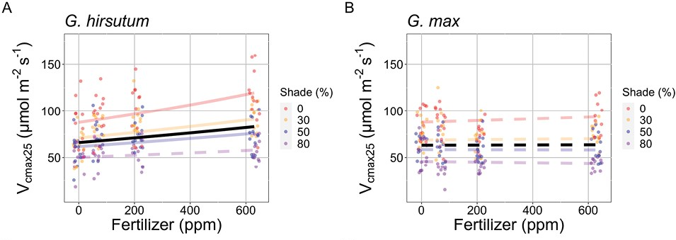
Testing theory with experiments: glasshouse example (Waring et al., 2023)
Results: theory confirmed, with additional insight into species differences

Slide 24
Testing theory with experiments: glasshouse example (Waring et al., 2023)
Summary
Can test direct physiological process responses to altered environmental conditions
Limitation in conditions that can be considered

Slide 25
Ongoing glasshouse work
Separation of soil water and nutrients on plant traits (postdoc Alissar Cheaib)
Explores how water influences nutrient availability and impact on theoretical understanding
Plant trait responses to phosphorus demand and availability in C3/C4 spcies (PhD Monika Kelley)
Will be comparable to Waring et al. (2023) results, but for P
Plant trait responses to environment under mycorrhizal associations (PhD Snehanjana Chatterjee and postdoc Alissar Cheaib)
Multiple projects using different mycorrhizal and environmental treatments

Slide 26
Experiment types
High
Easy
Fake
Growth chamber experiments
Glasshouse experiments
Field manipulation experiments
Level of Control
Logistics
Realism
Low
Hard
Real

Slide 27
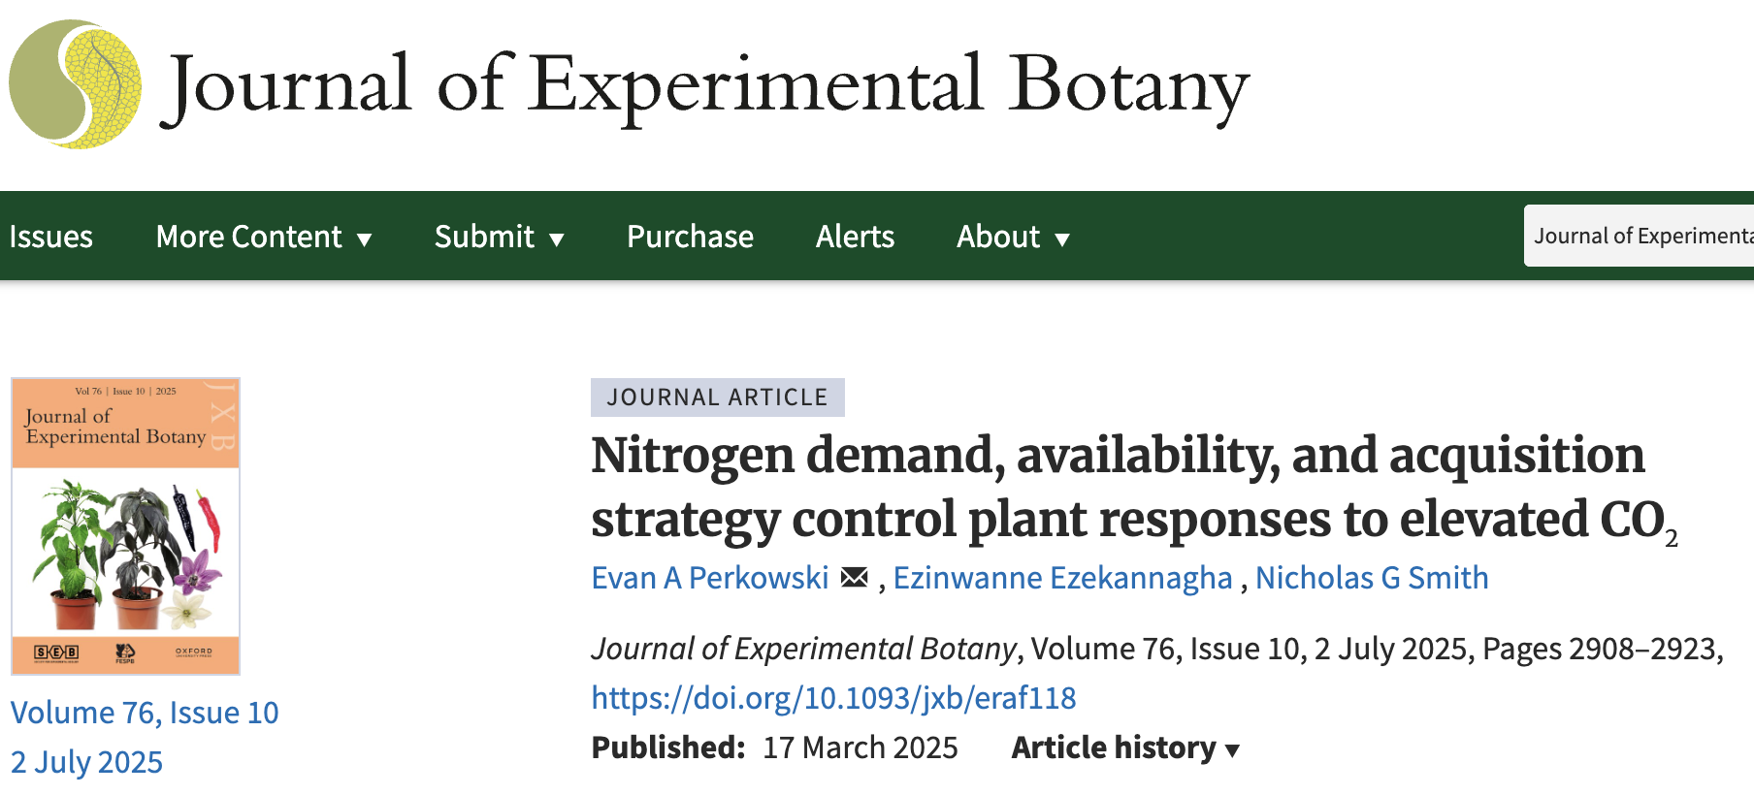
Testing theory with experiments: growth chamber example (Perkowski et al., 2025)

Slide 28
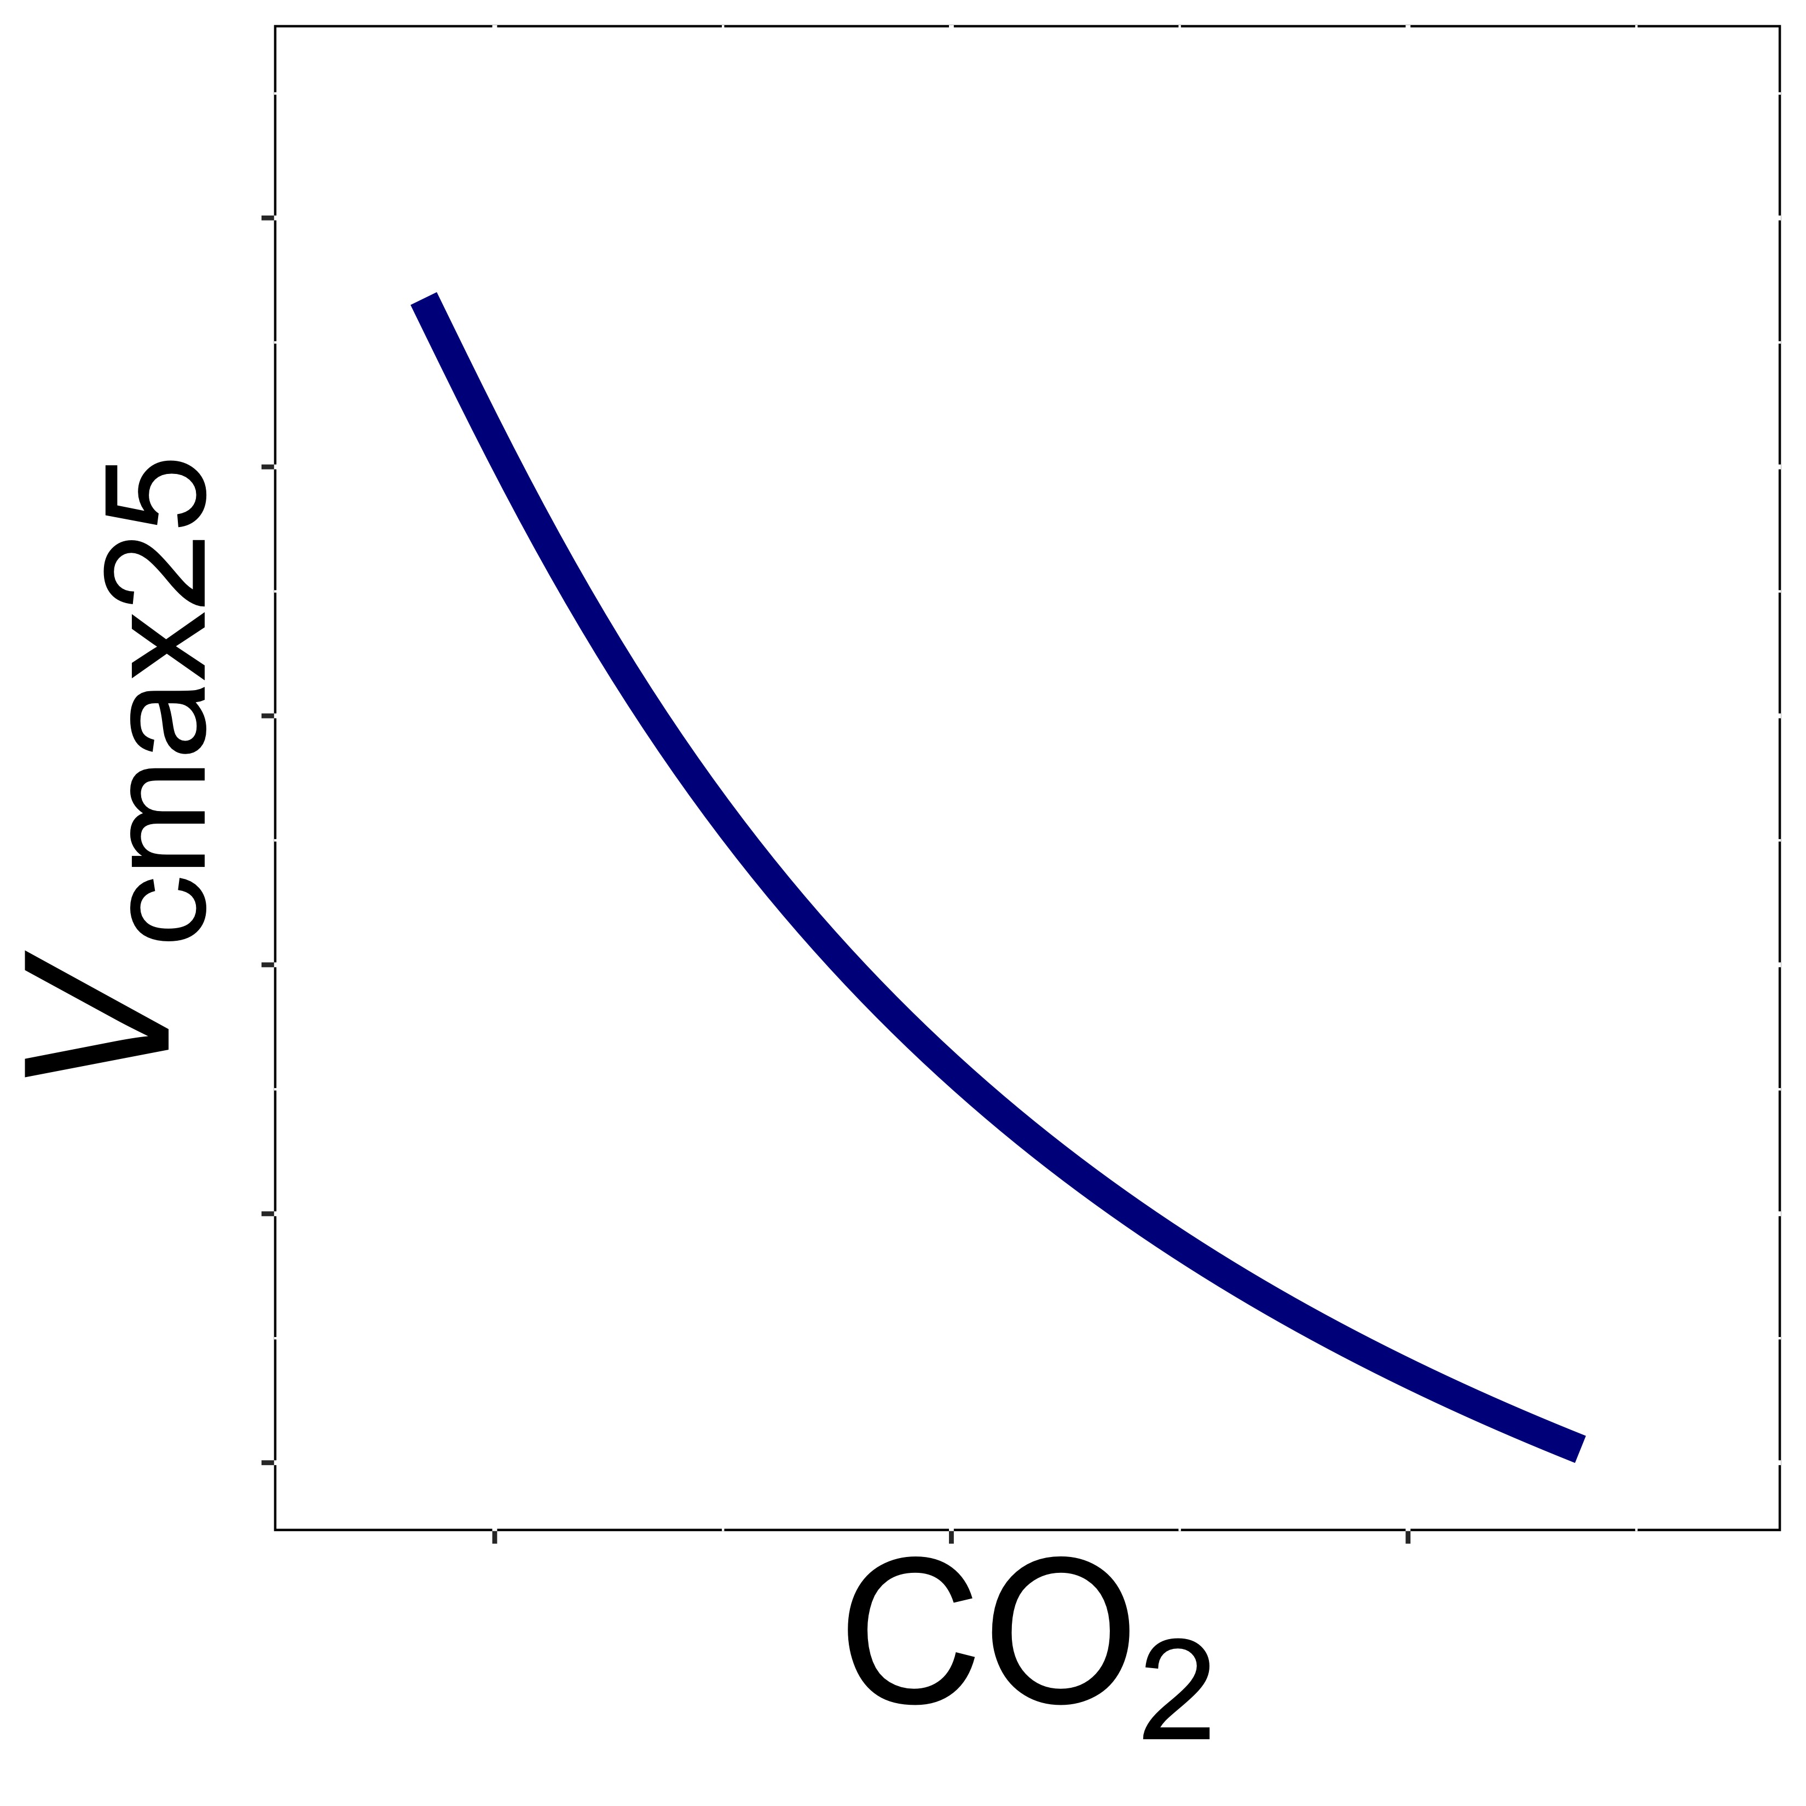
Testing theory with experiments: growth chamber example (Perkowski et al., 2023)
Theory: elevated CO₂ should reduce photosynthetic capacity regardless of context

Slide 29
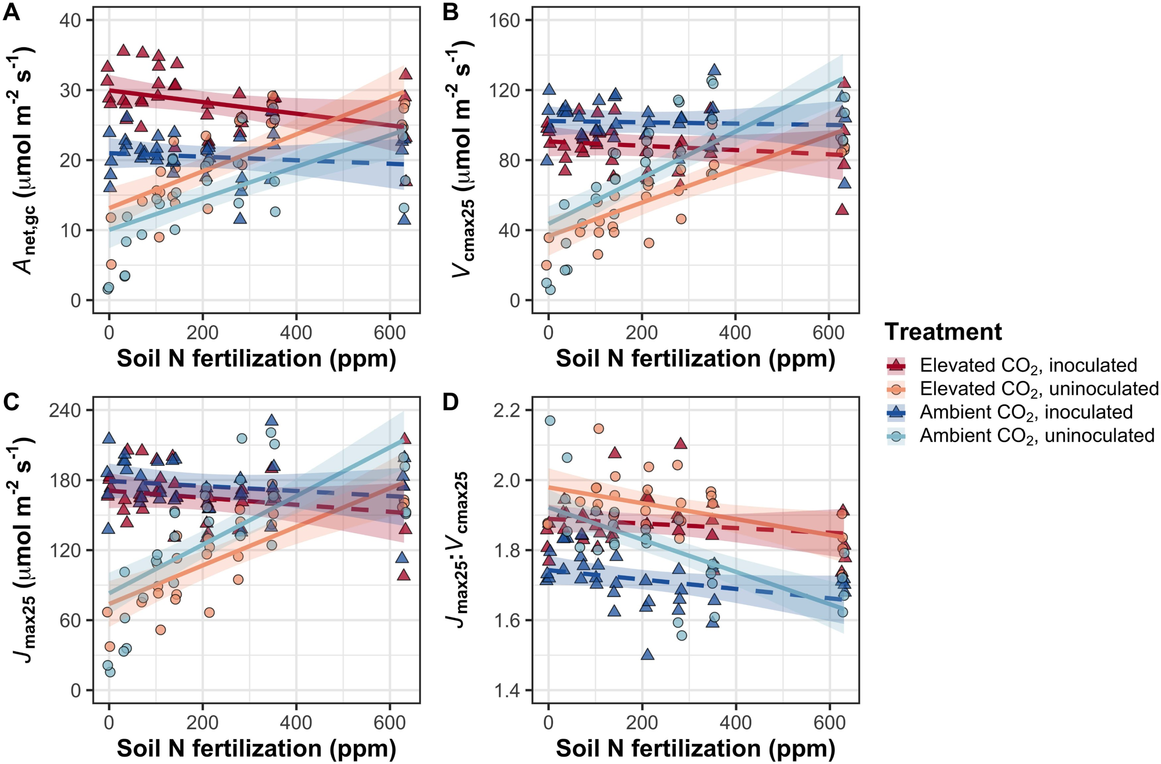
Testing theory with experiments: growth chamber example (Perkowski et al., 2023)
Results: lack of context dependency of CO₂ acclimation confirmed

Slide 30
Testing theory with experiments: growth chamber example (Perkowski et al., 2023)
Summary
Growth chambers allow for theory testing under many different environmental conditions
Realism may need to be checked alongside field data

Slide 31
Ongoing growth chamber work
Testing mechanisms driving temperature acclimation responses, including interactions with nutrients (PhD Dan Owusu Kwakye)
Hope to explain variable responses seen in literature
Testing more mechanistic representations of light reactions and their acclimation responses (PhD Garry Garza)
Including quantum yield and cytochrome b6f
Comparing temperature and CO₂ acclimation between C₃ and C₄ grasses (MS Zinny Ezekannagha)
Both acclimate to temperature, but C₄ shows little response to CO₂
Exploring timescales and responses to variability (MS Eve Gray and Christine Vanginault)

Slide 32
Takehomes
Multiple approaches are needed to test theory
Experiments can complement observational data
Allows for control of different factors
Experiments have tradeoffs
Level of control
Logistics
Realism
Multiple types of experiments may be needed to robustly test mechanisms

Slide 33
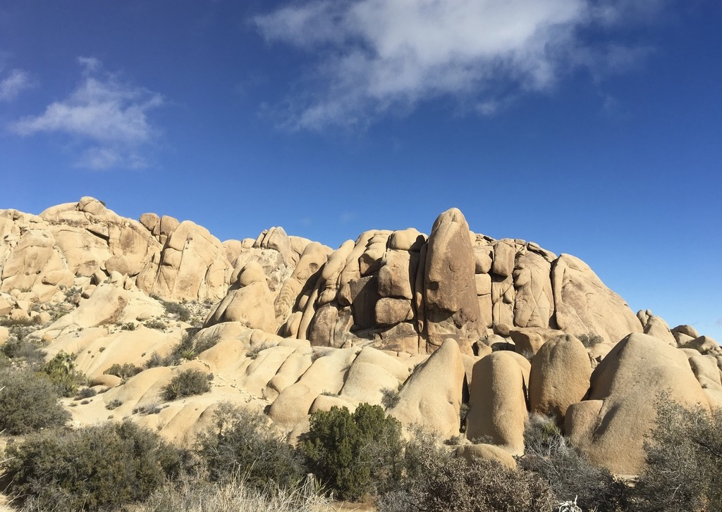
Presentation available at:
www.github.com/SmithEcophysLab/seminar/2025_lemontree
Data and code:
www.github.com/SmithEcophysLab
Contact: nick.smith@ttu.edu
Thanks!

