Slide 1
Allocation results from manipulative experiments
Nick Smith
LEMONTREE Science meeting
May 21, 2026

Slide 2
General approach to measuring allocation in experiments

Slide 3
General approach to measuring allocation in experiments
Within leaves
Nitrogen allocation
Phosphorus allocation

Slide 4
General approach to measuring allocation in experiments
Within leaves
Nitrogen allocation
Structure (LMA)
RuBisCO (V_{cmax})
Light harvesting (chlorophyll)
Bioenergetics (electron transport; J_{max})
Phosphorus allocation

Slide 5
General approach to measuring allocation in experiments
Within leaves
Nitrogen allocation
Phosphorus allocation
Inorganic phosphate
Nucleic acids
Phospholipids
Metabolites
Residual

Slide 6
General approach to measuring allocation in experiments
Within leaves
Nitrogen allocation
Phosphorus allocation
Whole plant

Slide 7
General approach to measuring allocation in experiments
Within leaves
Nitrogen allocation
Phosphorus allocation
Whole plant
Root:Shoot ratio
Total leaf area

Slide 8
Allocation in manipulative contexts
Light availability
CO₂ availability
Vapor pressure deficit
Water availability
Nitrogen availability
Phosphorus availability
N-fixing bacteria presence
Mycorrhizae presence

Slide 9
Allocation in manipulative contexts
Light availability
CO₂ availability
Vapor pressure deficit
Water availability
Nitrogen availability
Phosphorus availability
N-fixing bacteria presence
Mycorrhizae presence
Many interactive combinations!

Slide 10
Allocation in manipulative contexts
Light availability
CO₂ availability
Vapor pressure deficit
Water availability
Nitrogen availability
Phosphorus availability
N-fixing bacteria presence
Mycorrhizae presence

Slide 11
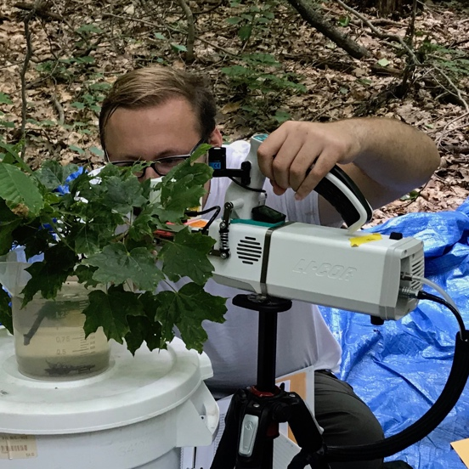


Light availability impacts on allocation
Within leaves
Nitrogen allocation
Phosphorus allocation
Whole plant
Root:Shoot ratio
Total leaf area
Perkowski et al. (2021), Waring et al. (2023), Perkowski et al. (2024), Kelley et al. (in prep)

Slide 12
Light availability impacts on allocation
Within leaves
Nitrogen allocation
Phosphorus allocation
Whole plant
Root:Shoot ratio
Total leaf area
Increasing light increases R:S
Perkowski et al. (2021)

Slide 13
Light availability impacts on allocation
Within leaves
Nitrogen allocation
Phosphorus allocation
Whole plant
Root:Shoot ratio
Total leaf area
Increasing light increases TLA
Perkowski et al. (2021)

Slide 14
Allocation in manipulative contexts
Light availability
CO₂ availability
Vapor pressure deficit
Water availability
Nitrogen availability
Phosphorus availability
N-fixing bacteria presence
Mycorrhizae presence

Slide 15
CO₂ availability impacts on allocation
Within leaves
Nitrogen allocation
Phosphorus allocation
Whole plant
Root:Shoot ratio
Total leaf area
Perkowski et al. (2024)

Slide 16
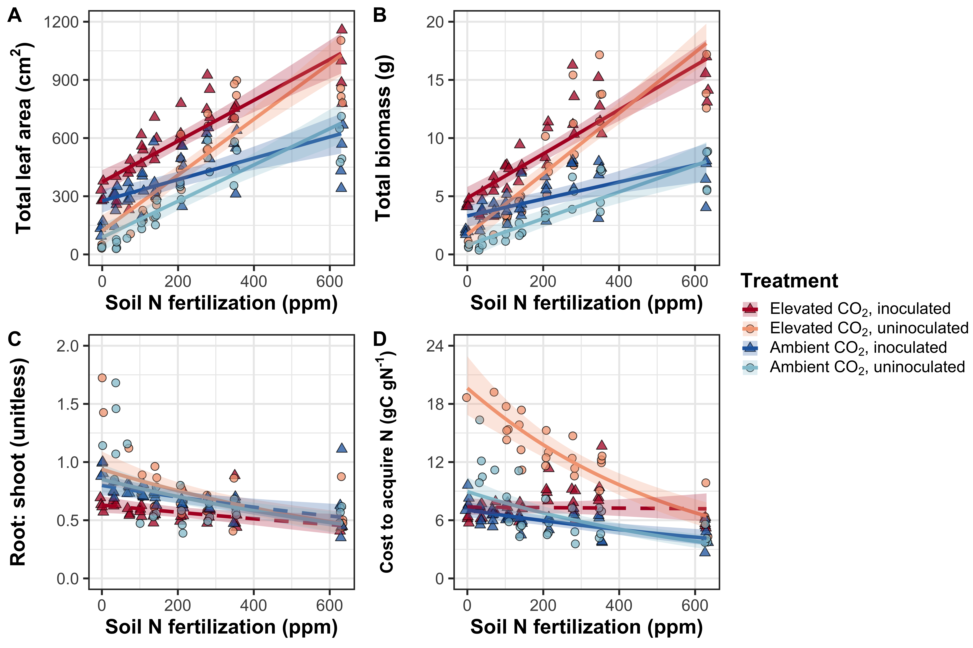
CO₂ availability impacts on allocation
Within leaves
Nitrogen allocation
Phosphorus allocation
Whole plant
Root:Shoot ratio
Total leaf area
Slight R:S decrease in plants inoculated with N-fixing bacteria
Perkowski et al. (2024)

Slide 17
CO₂ availability impacts on allocation
Within leaves
Nitrogen allocation
Phosphorus allocation
Whole plant
Root:Shoot ratio
Total leaf area
TLA increased with CO₂, especially with adequate N
Perkowski et al. (2024)

Slide 18
Allocation in manipulative contexts
Light availability
CO₂ availability
Vapor pressure deficit
Water availability
Nitrogen availability
Phosphorus availability
N-fixing bacteria presence
Mycorrhizae presence

Slide 19

VPD impacts on allocation
Within leaves
Nitrogen allocation
Phosphorus allocation
Whole plant
Root:Shoot ratio
Total leaf area
Freitas et al. (in revision)

Slide 20
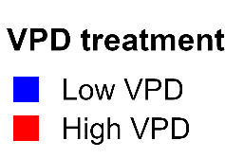
VPD impacts on allocation
Within leaves
Nitrogen allocation
Phosphorus allocation
Whole plant
Root:Shoot ratio
Total leaf area
VPD increases R:S in acquisitive, but not conservative species
Freitas et al. (in revision)

Slide 21
Allocation in manipulative contexts
Light availability
CO₂ availability
Vapor pressure deficit
Water availability
Nitrogen availability
Phosphorus availability
N-fixing bacteria presence
Mycorrhizae presence

Slide 22


Soil water impacts on allocation
Within leaves
Nitrogen allocation
Phosphorus allocation
Whole plant
Root:Shoot ratio
Total leaf area
Cheaib et al. (in revision), Freitas et al. (in revision), Chatterjee et al. (in prep)

Slide 23
Soil water impacts on allocation
Within leaves
Nitrogen allocation
Phosphorus allocation
Whole plant
Root:Shoot ratio
Total leaf area
Water availability not impacting R:S in our experiments
Freitas et al. (in revision)

Slide 24
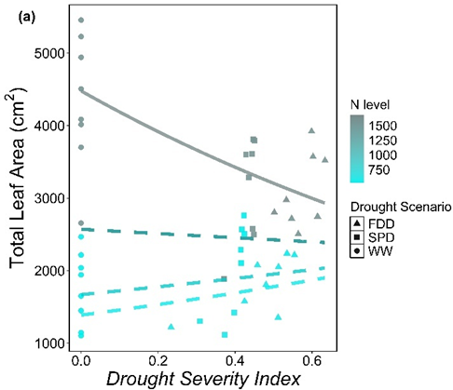
Soil water impacts on allocation
Within leaves
Nitrogen allocation
Phosphorus allocation
Whole plant
Root:Shoot ratio
Total leaf area
Water availability increases TLA when N is available
Cheaib et al. (in revision)

Slide 25
Allocation in manipulative contexts
Light availability
CO₂ availability
Vapor pressure deficit
Water availability
Nitrogen availability
Phosphorus availability
N-fixing bacteria presence
Mycorrhizae presence

Slide 26
Soil nitrogen impacts on allocation
Within leaves
Nitrogen allocation
Phosphorus allocation
Whole plant
Root:Shoot ratio
Total leaf area
Perkowski et al. (2021), Waring et al. (2023), Perkowski et al. (2024)

Slide 27
Soil nitrogen impacts on allocation
Within leaves
Nitrogen allocation
Phosphorus allocation
Whole plant
Root:Shoot ratio
Total leaf area
Soil N decreases R:S
Perkowski et al. (2021)

Slide 28
Soil nitrogen impacts on allocation
Within leaves
Nitrogen allocation
Phosphorus allocation
Whole plant
Root:Shoot ratio
Total leaf area
Soil N increases TLA
Perkowski et al. (2021)

Slide 29
Allocation in manipulative contexts
Light availability
CO₂ availability
Vapor pressure deficit
Water availability
Nitrogen availability
Phosphorus availability
N-fixing bacteria presence
Mycorrhizae presence

Slide 30
Soil phosphorus impacts on allocation
Within leaves
Nitrogen allocation
Phosphorus allocation
Whole plant
Root:Shoot ratio
Total leaf area
P allocation data being collected now!
Kelley et al. (in prep)

Slide 31
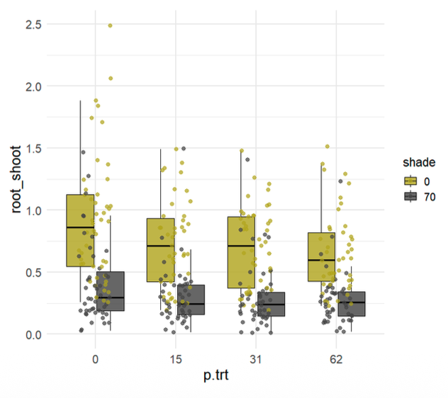
Soil phosphorus impacts on allocation
Within leaves
Nitrogen allocation
Phosphorus allocation
Whole plant
Root:Shoot ratio
Total leaf area
Soil P availability decreases R:S
Kelley et al. (in prep)

Slide 32
Allocation in manipulative contexts
Light availability
CO₂ availability
Vapor pressure deficit
Water availability
Nitrogen availability
Phosphorus availability
N-fixing bacteria presence
Mycorrhizae presence
Happy to chat more about these later

Slide 33
Conclusions
R:S increases with increasing soil resource demand and decreasing soil resource availability
TLA increases with resource demand and availability

Slide 34
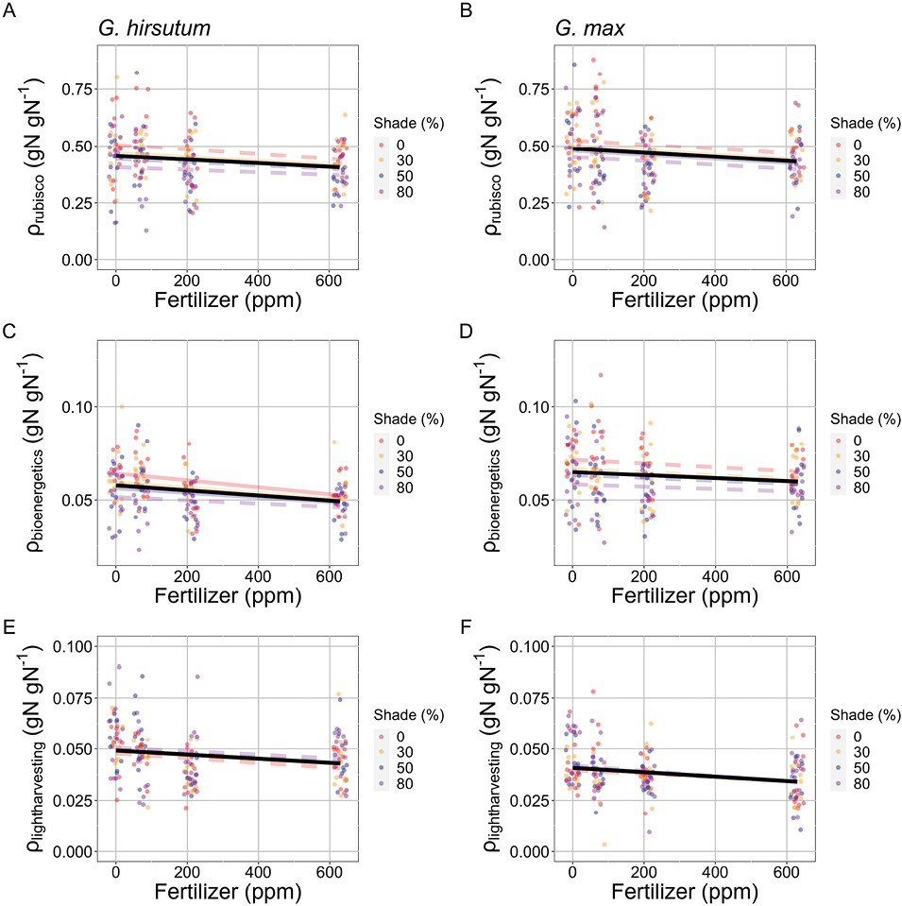
Light availability impacts on allocation
Within leaves
Nitrogen allocation
Phosphorus allocation
Whole plant
Root:Shoot ratio
Total leaf area
Light increases leaf N allocation to photosynthesis
Waring et al. (2023)

Slide 35
Light availability impacts on allocation
Within leaves
Nitrogen allocation
Phosphorus allocation
Whole plant
Root:Shoot ratio
Total leaf area
P allocation data being collected now!
Kelley et al. (in prep)

Slide 36
Soil nitrogen impacts on allocation
Within leaves
Nitrogen allocation
Phosphorus allocation
Whole plant
Root:Shoot ratio
Total leaf area
Soil N decreases leaf N allocation to photosynthesis
Waring et al. (2023)

Slide 37
Soil phosphorus impacts on allocation
Within leaves
Nitrogen allocation
Phosphorus allocation
Whole plant
Root:Shoot ratio
Total leaf area
Kelley et al. (in prep)

