Slide 1
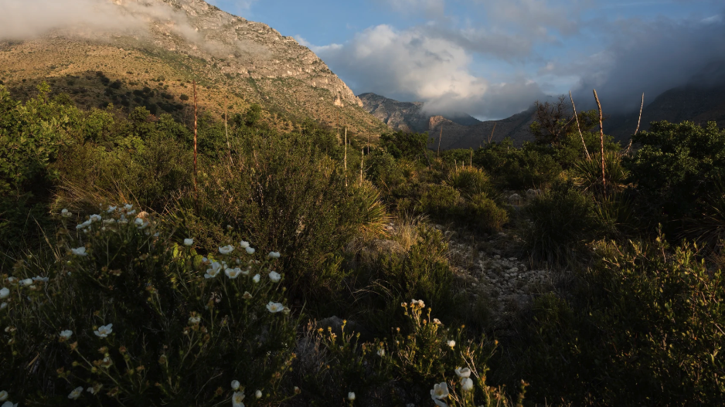
What does photosynthetic acclimation mean for the future of terrestrial biogeochemical cycling? A CO₂ story
Nick Smith
Department of Biological Sciences
Texas Tech University
nick.smith@ttu.edu

Slide 2
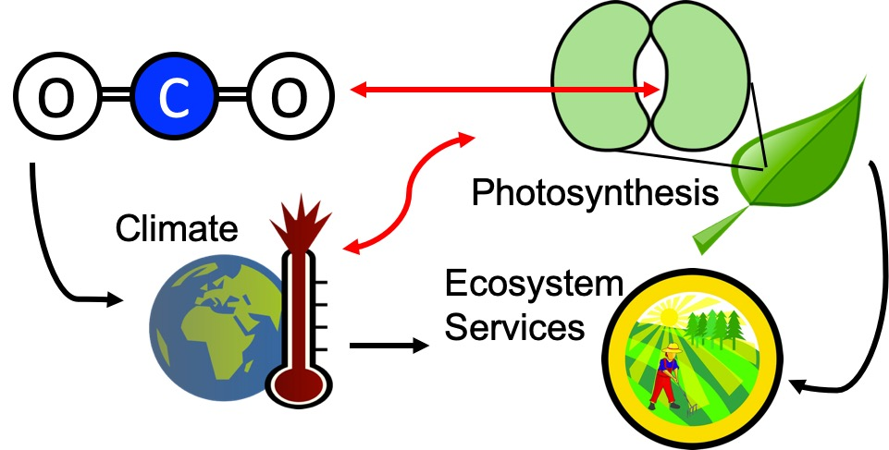
Our lab examines photosynthesis as a regulator of global change impacts on ecosystem services
Smith (2024) Am J Botany

Slide 3
Photosynthesis is important! An example…

Slide 4
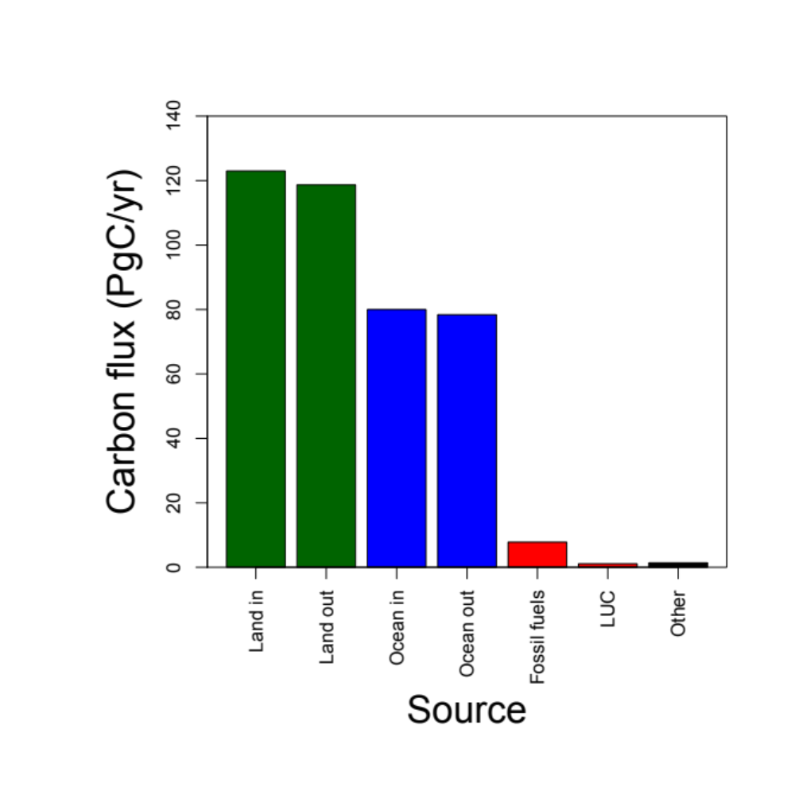
Photosynthesis is important! An example…
Data from IPCC (2013)

Slide 5
Photosynthesis is important! An example…
Photosynthesis
Data from IPCC (2013)

Slide 6
Photosynthesis is important! An example…
Photosynthesis
A small percentage change in photosynthesis can have large consequences for climate
Data from IPCC (2013)

Slide 7
But predictions are uncertain!
Friedlingstein et al. (2014) J Climate

Slide 8
But predictions are uncertain!
Future model uncertainty (14 Pg) > current fossil fuel emissions (9.5 Pg)
Friedlingstein et al. (2014) J Climate

Slide 9
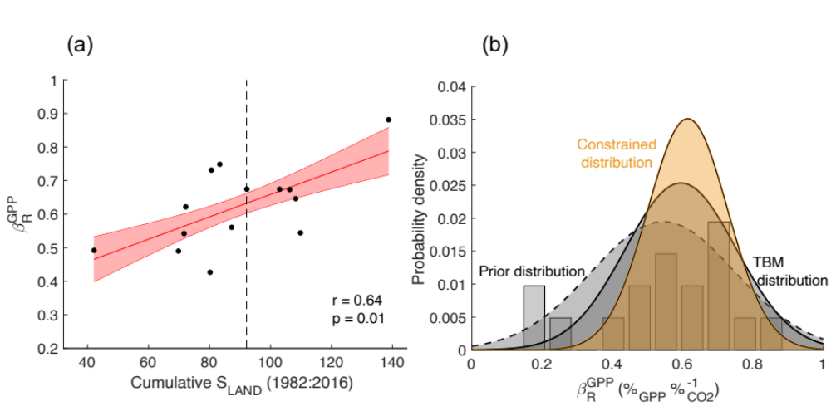
This uncertainty is driven by uncertainty in photosynthesis
Friedlingstein et al. (2014) J Climate
Keenan et al. (2023) Nature Climate Change

Slide 10
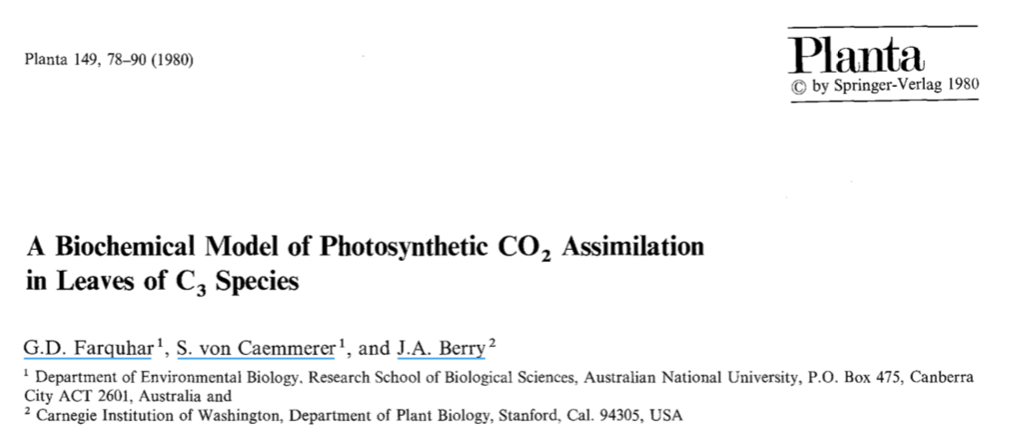
Why the uncertainty? Theoretical models for photosynthesis exist

Slide 11
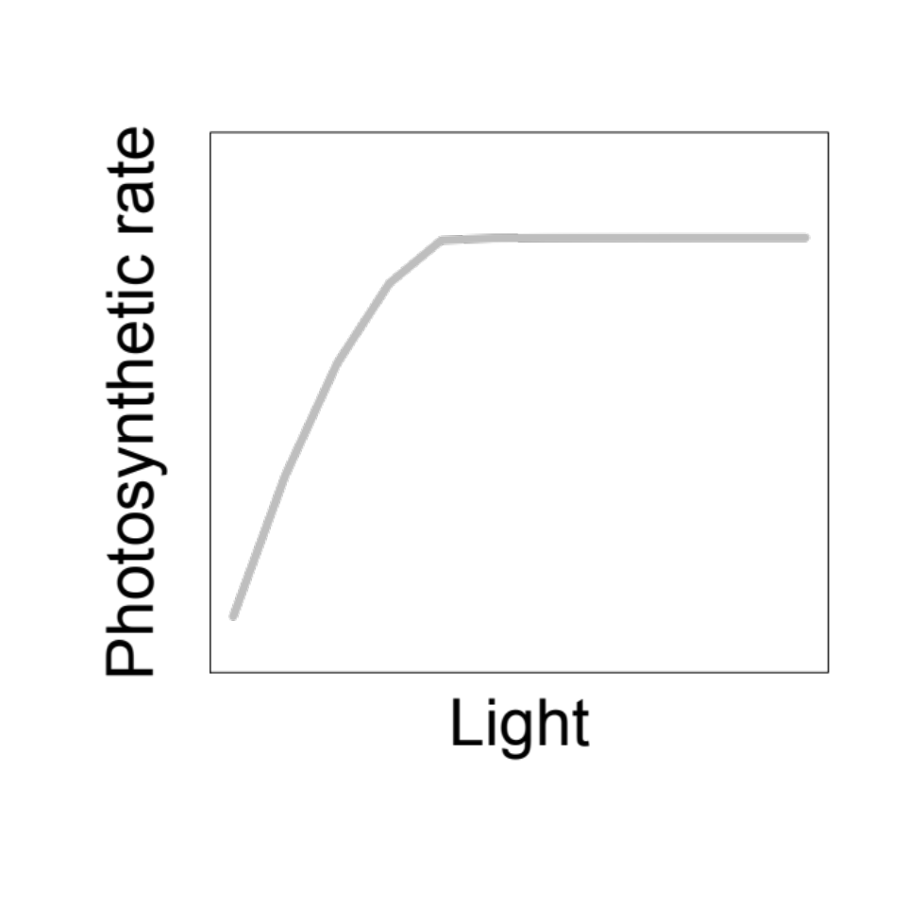
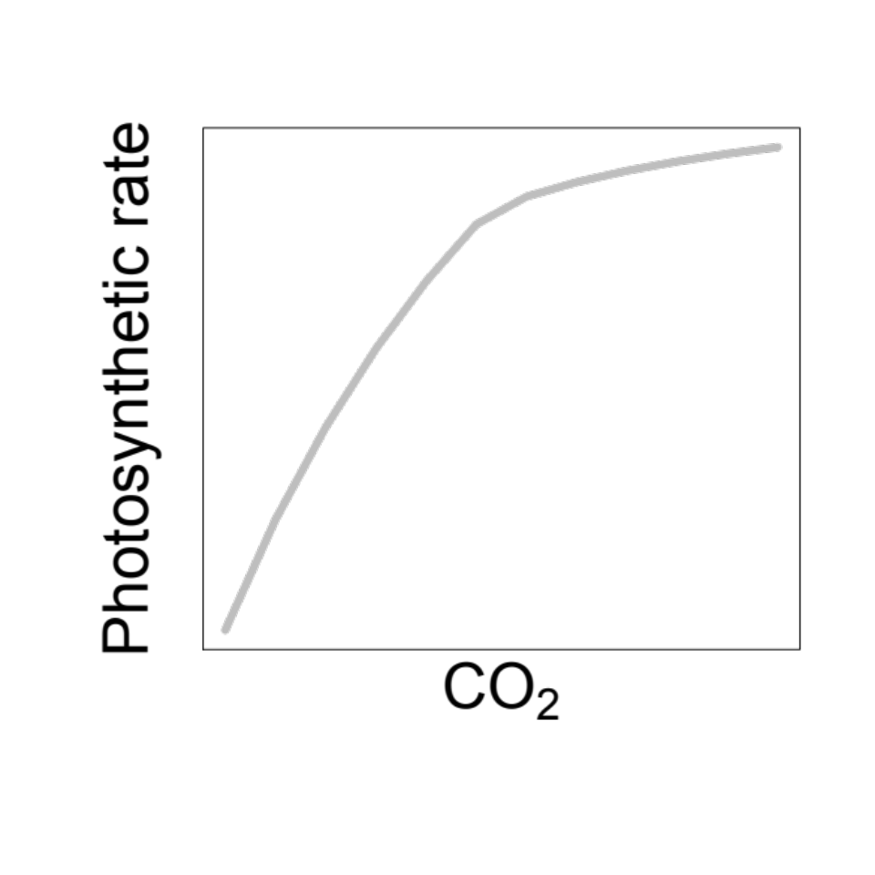
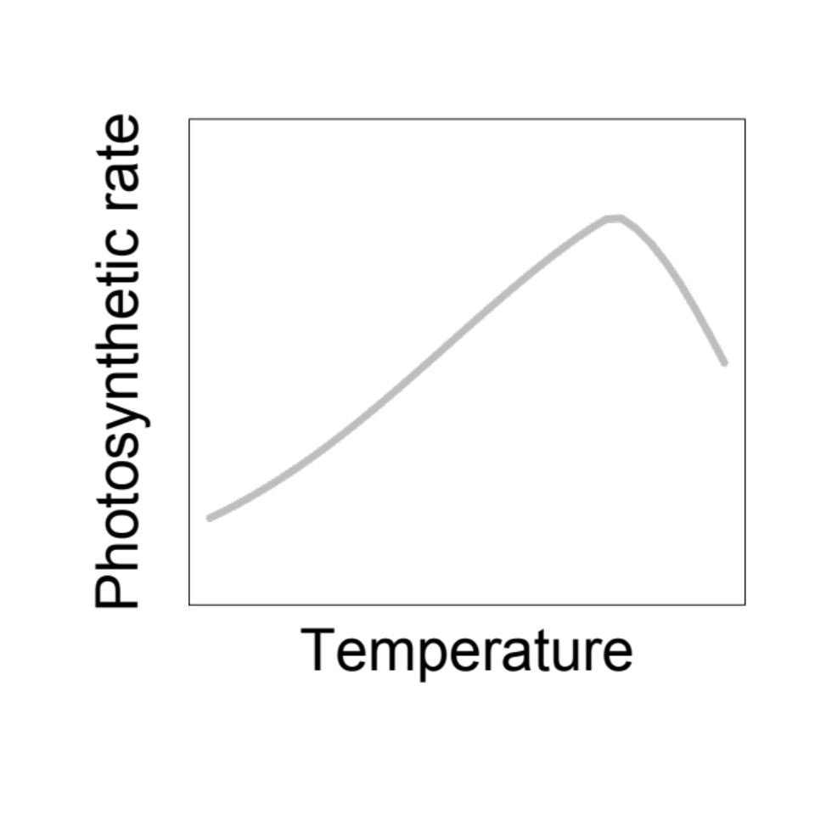
These produce short term responses that match data

Slide 12
Why the uncertainty? Long-term responses differ from short-term responses due to acclimation

Slide 13
Dumb plants

Slide 14
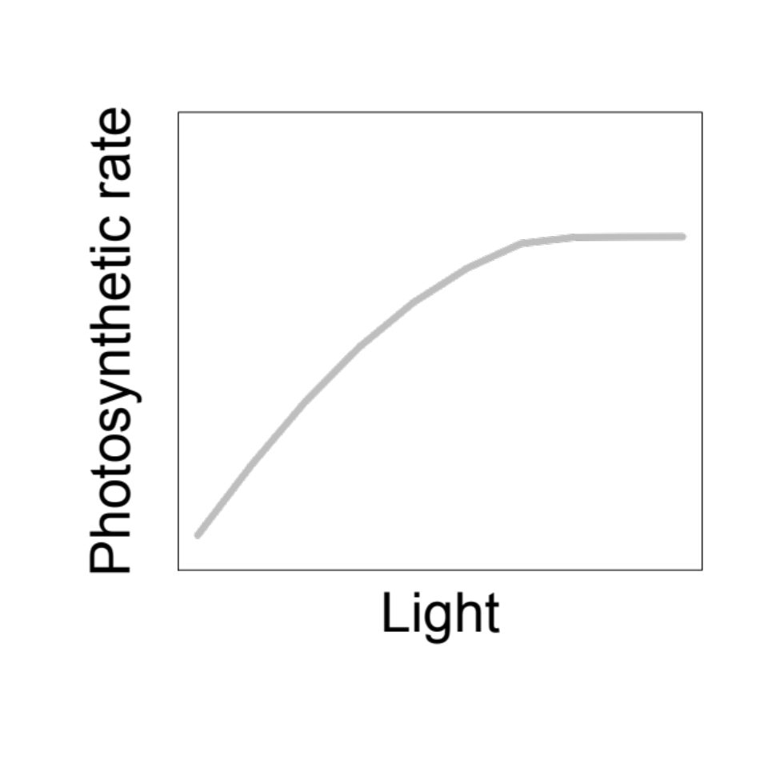
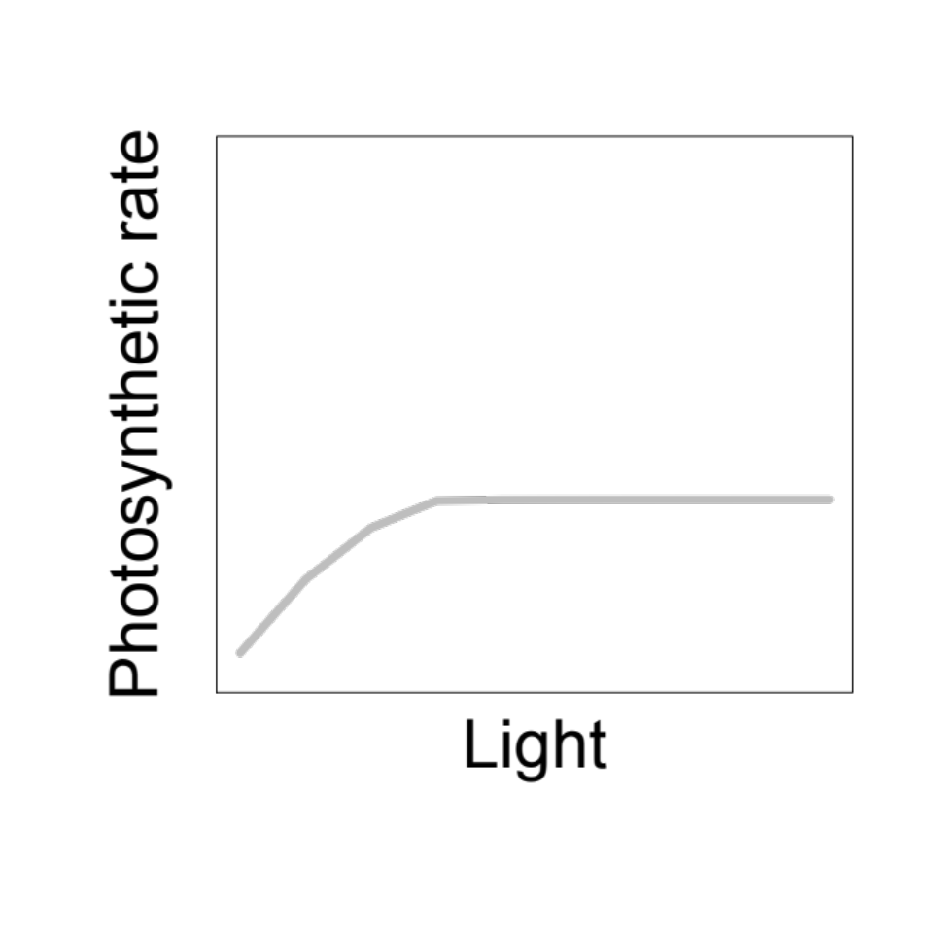
Acclimation: an example
Acclimated to high light
Acclimated to low light

Slide 15
Acclimation: an example
Acclimated to high light
Acclimated to low light
Photosynthesis peaks a light level close to the level the leaf is acclimated to

Slide 16
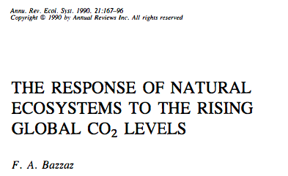
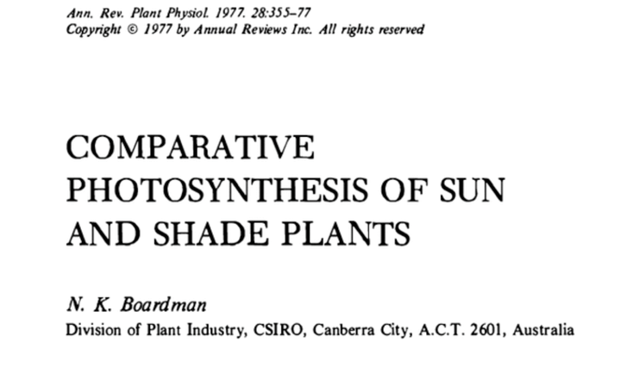
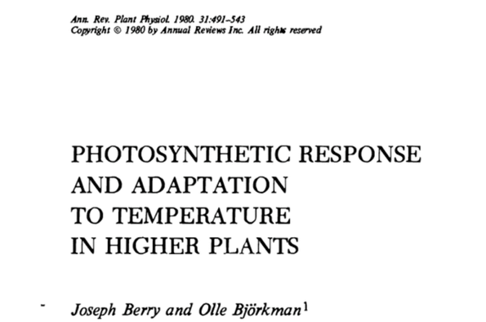
Acclimation is ubiquitous and well known…
Temperature: Berry & Björkman (1980)
CO₂: Bazzaz (1990)
Light: Boardman (1977)

Slide 17
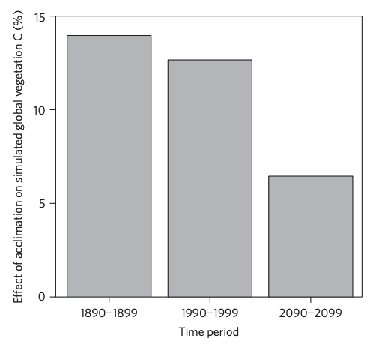
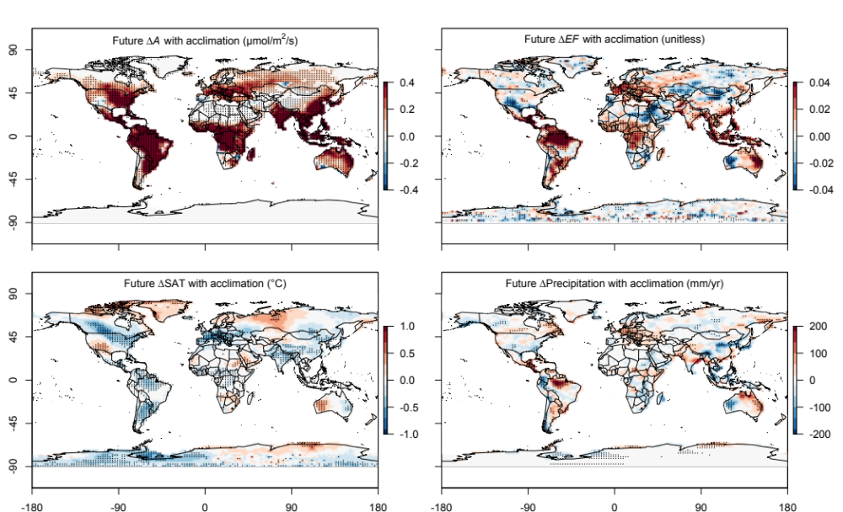
…and can impact carbon cycling and climate
Acclimation increase future C storage by ~6%
Acclimation alters future temperature by >1°C
Smith et al. (2017) Nature Climate Change
Smith et al. (2017) JAMES

Slide 18
Unfortunately, no theoretical model for photosynthetic acclimation exists

Slide 19
Lack of theory results in…

Slide 20
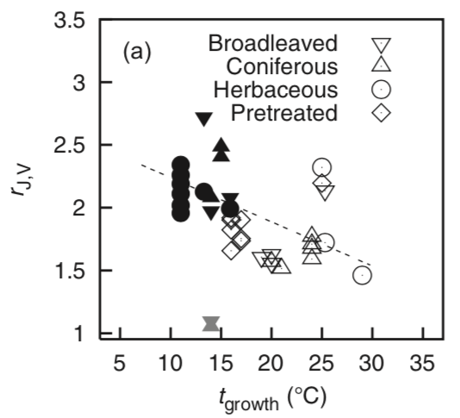
Lack of theory results in…
Unreliable future predictions (overparameterization, tuning)
  Reliance on statistical models
Resulting change in simulated photosynthesis
Physiological parameter
Environmental condition
Kattge and Knorr (2007) PC&E
Smith et al. (2017) JAMES

Slide 21
Lack of theory results in…
Inability to test mechanisms
Resulting change in simulated photosynthesis
Physiological parameter
Environmental condition
Kattge and Knorr (2007) PC&E
Smith et al. (2017) JAMES

Slide 22
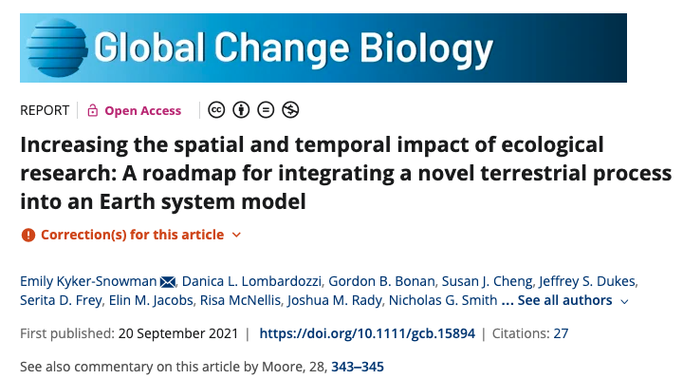
Lack of theory results in…
Inability to test mechanisms
Resulting change in simulated photosynthesis
Physiological parameter
Environmental condition
Kyker-Snowman et al. (2022) Glob Change Biol

Slide 23
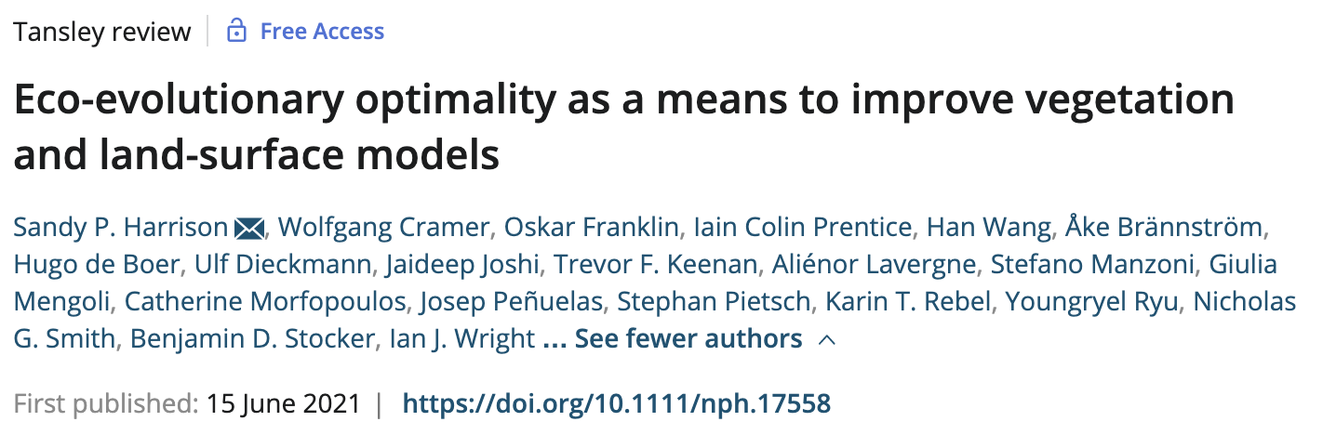
So, we developed a mechanistic model of photosynthetic acclimation
Based on optimization and the first principles of plant physiological theory
Harrison et al. (2021) New Phyt

Slide 24
Optimization: Least cost theory
Optimally, plants will maintain fastest rate of photosynthesis at the lowest summed resource cost (water and nutrient use)
Wright et al. (2003) Am Naturalist

Slide 25
Optimal photosynthesis
Photosynthesis = f{stomatal conductance,
photosynthetic biochemistry}

Slide 26
Optimal photosynthesis
Photosynthesis = f{stomatal conductance,
photosynthetic biochemistry}
Must predict optimal rates of both

Slide 27
Optimal photosynthesis
Photosynthesis = f{stomatal conductance,
photosynthetic biochemistry}
[TALK TO ME LATER ABOUT THIS IF YOU ARE INTERESTED]
Prentice et al. (2014) Ecol Letters; Wang et al. (2017) Nature Plants; Smith et al. (2019) Ecol Letters; Smith and Keenan (2020) Glob Change Biol

Slide 28
Optimal photosynthesis
Photosynthesis = f{stomatal conductance,
photosynthetic biochemistry}

Slide 29
Biochemistry optimization
Plant biochemistry setup will aim for equal limitation by all factors
[TALK TO ME LATER ABOUT THE MATHS]

Slide 30
Biochemistry trait
The maximum rate of Rubisco carboxylation (V_{cmax})

Slide 31
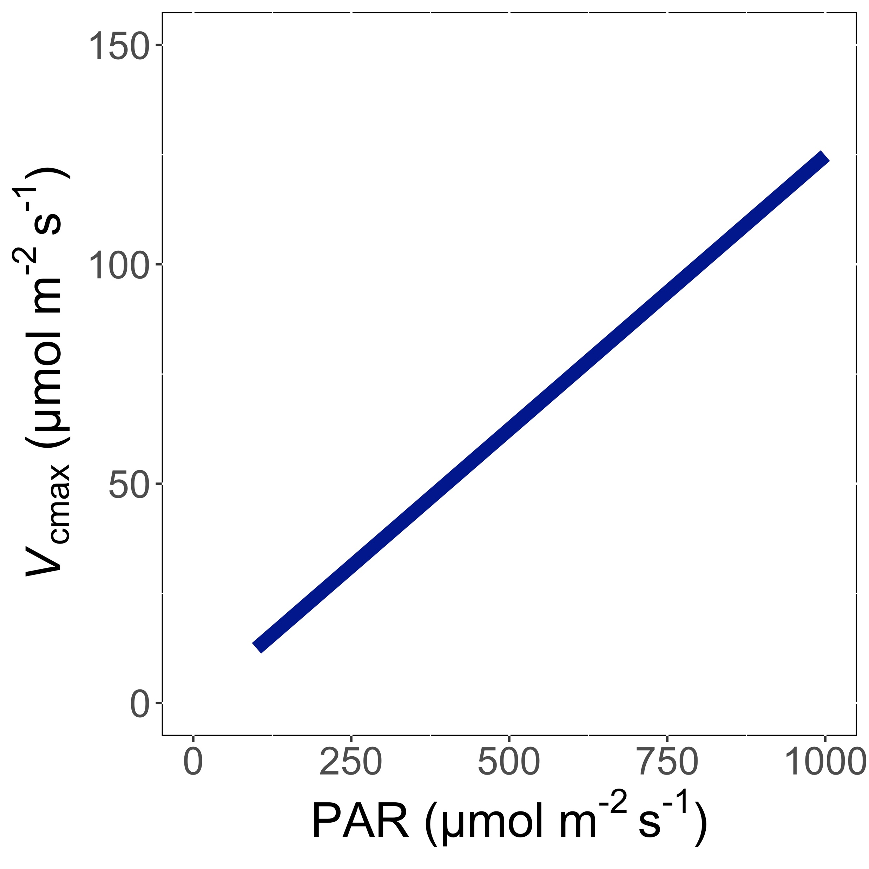
V_{cmax} increases with light because of greater electron transport
Smith et al. (2019) Ecol Letters; Smith and Keenan (2020) Glob Change Biology

Slide 32
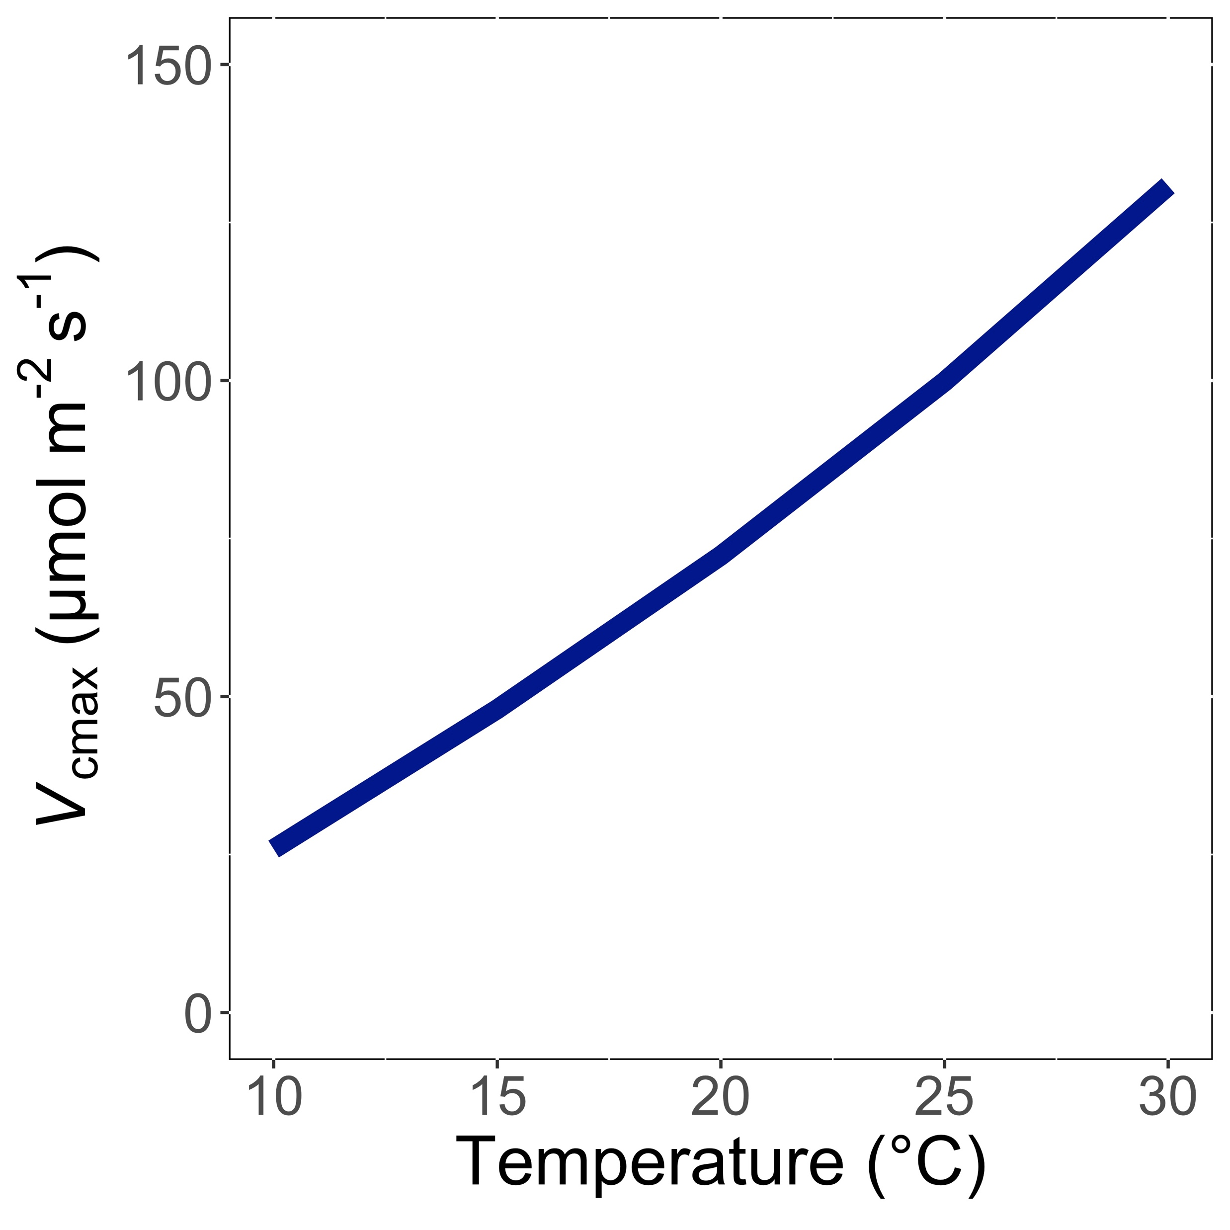
V_{cmax} increases with temperature because of greater electron transport and photorespiration
Smith et al. (2019) Ecol Letters; Smith and Keenan (2020) Glob Change Biology

Slide 33
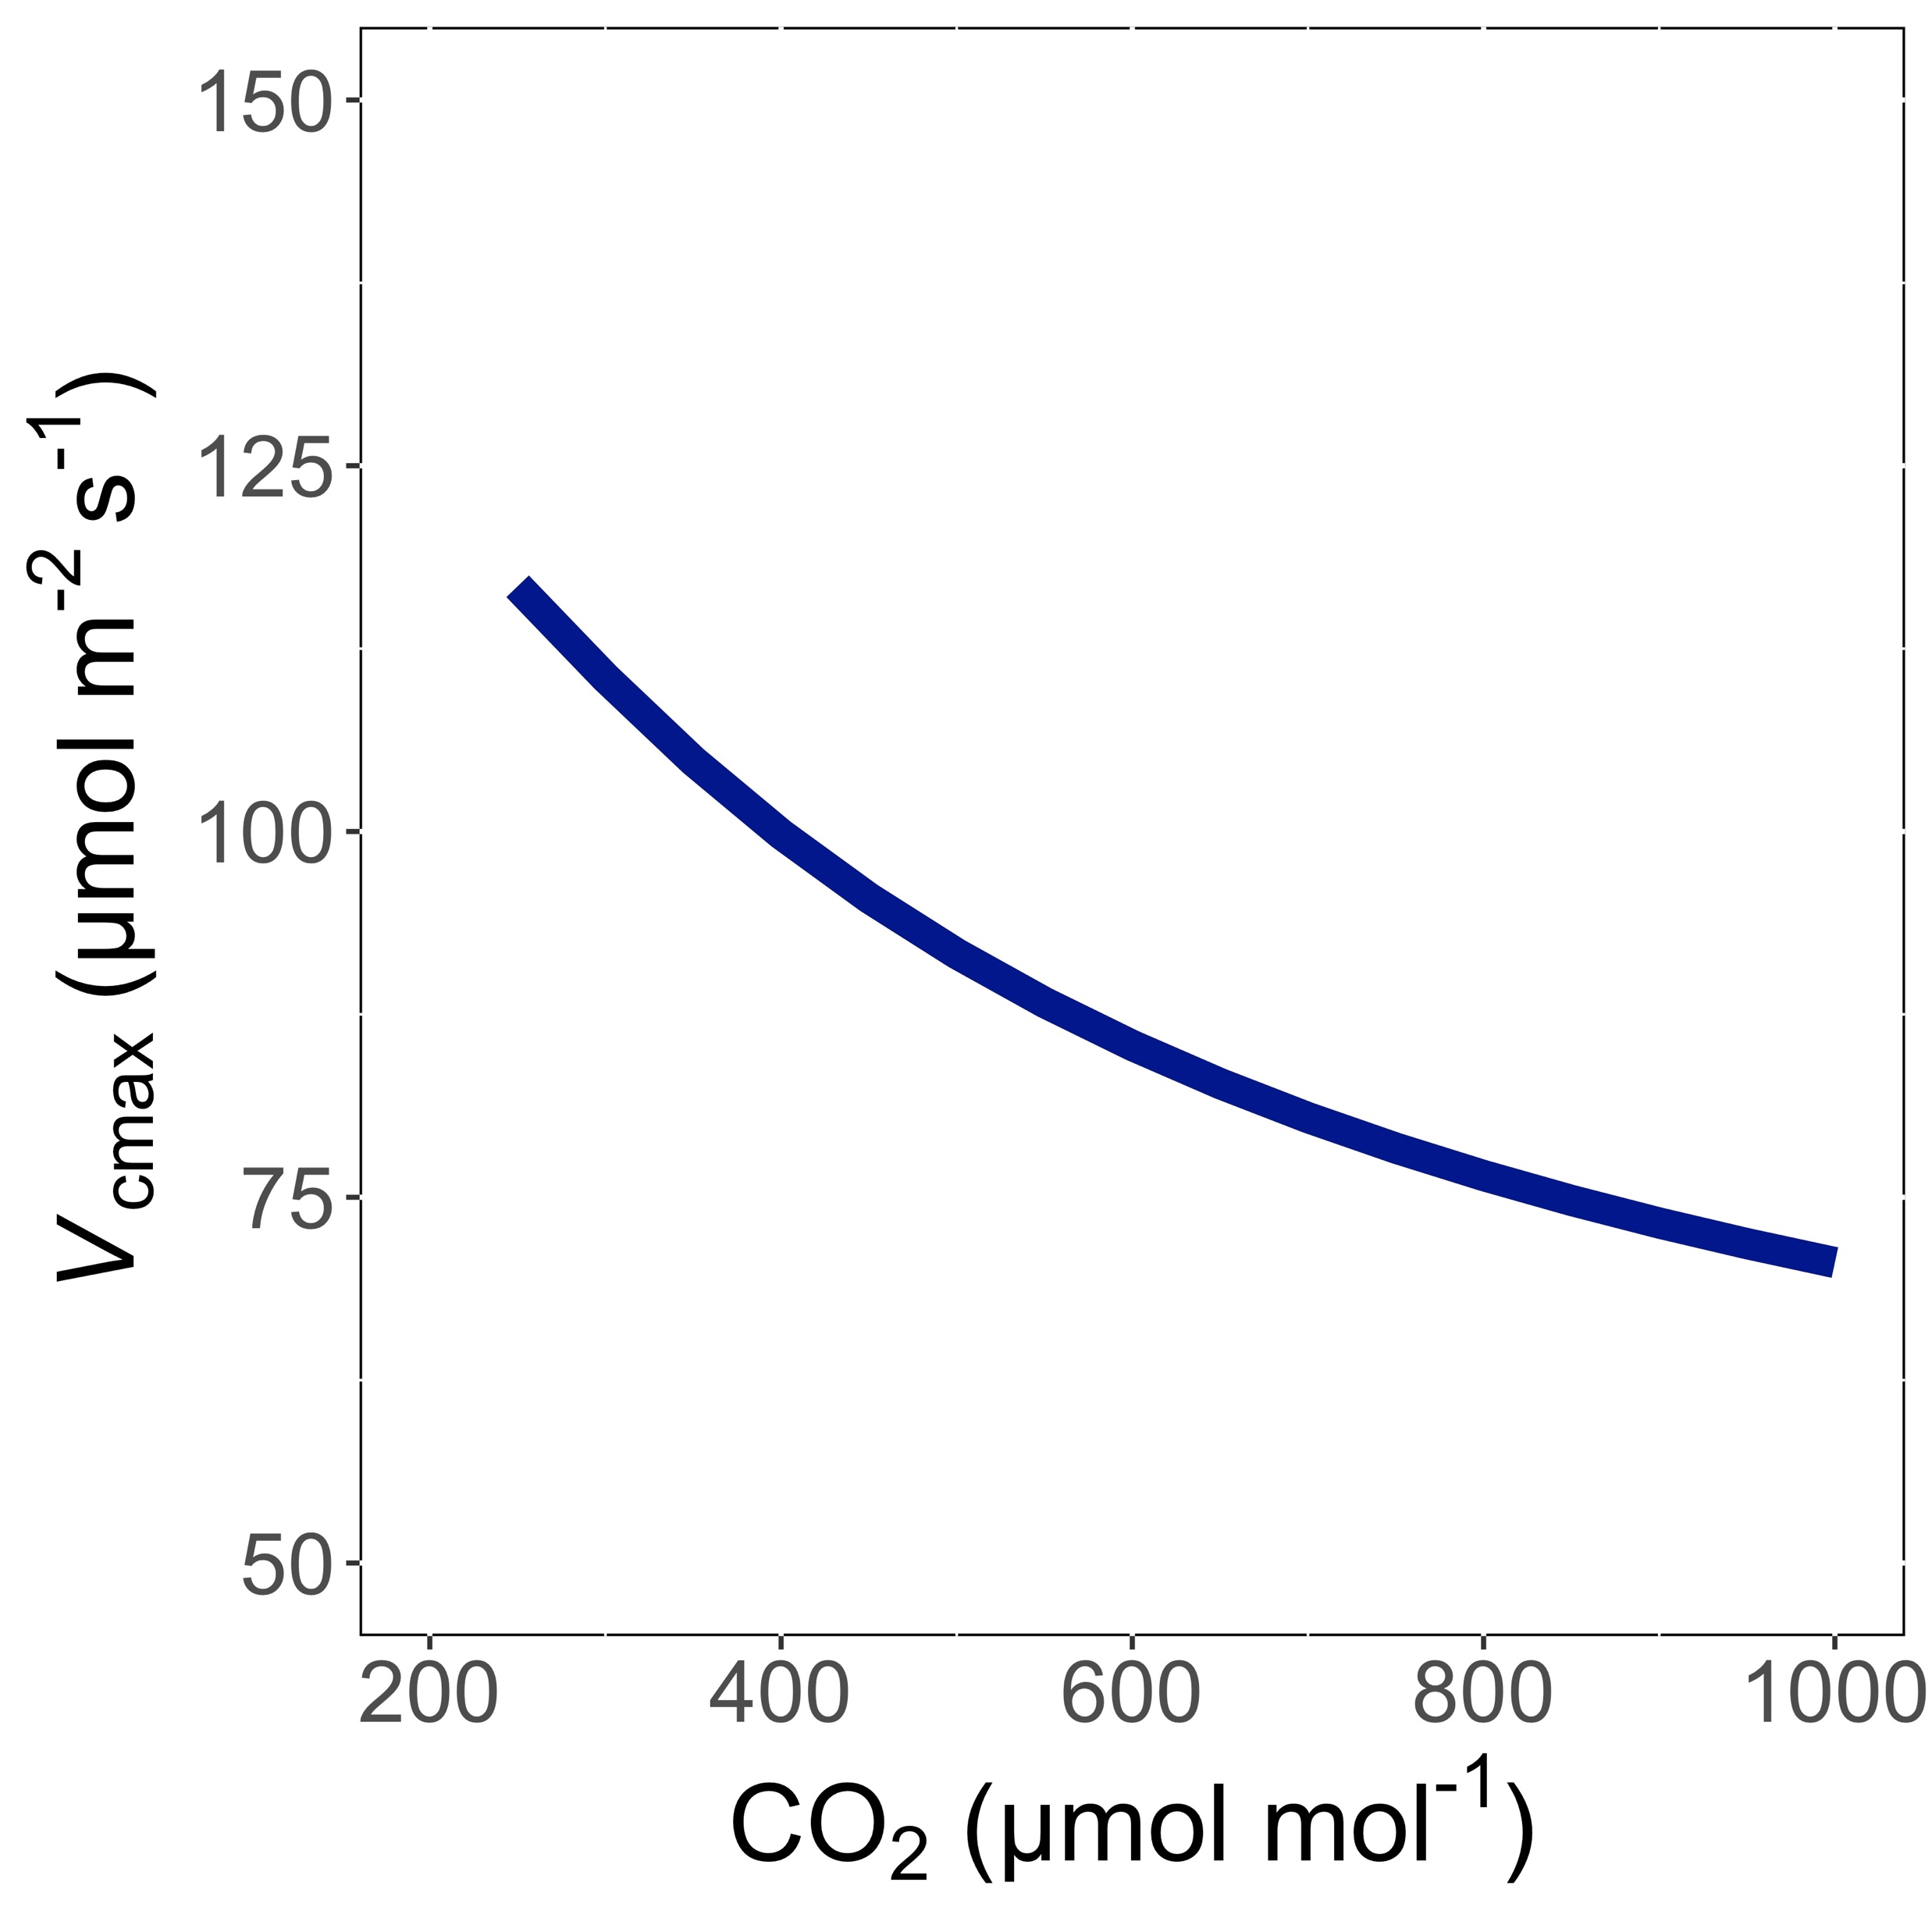
V_{cmax} decreases with CO₂ because of greater CO₂ in the leaf and less photorespiration
Smith et al. (2019) Ecol Letters; Smith and Keenan (2020) Glob Change Biology

Slide 34
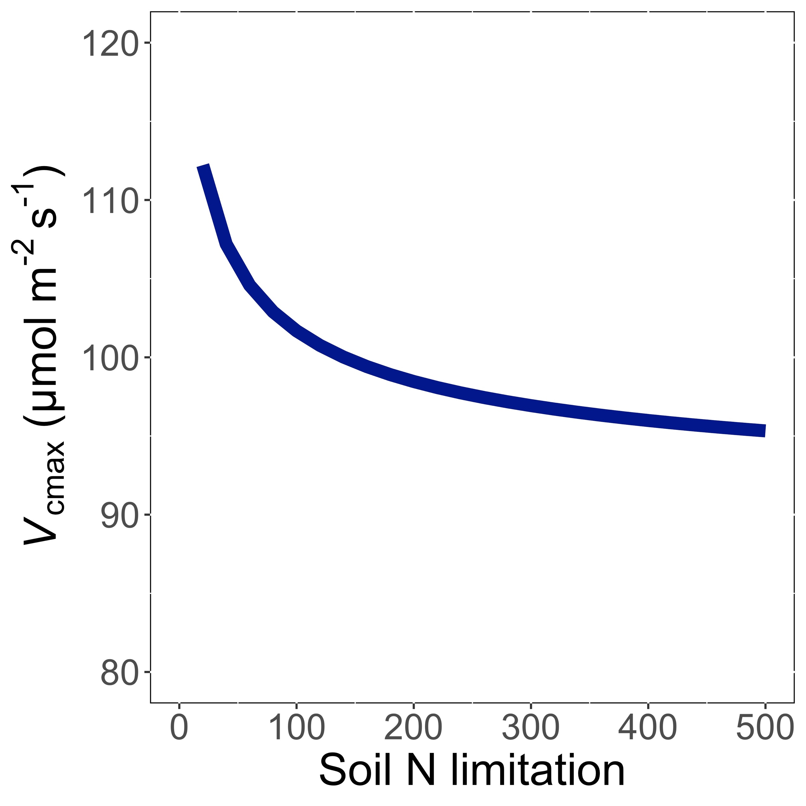
V_{cmax} decreases with soil N limitation because Rubisco requires a lot of N
Smith et al. (2019) Ecol Letters; Smith and Keenan (2020) Glob Change Biology

Slide 35
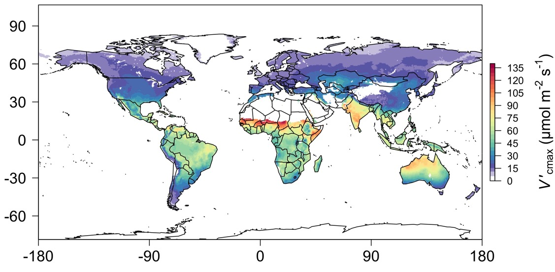
We can predict optimal traits in different environments
Smith et al. (2019) Ecology Letters

Slide 36
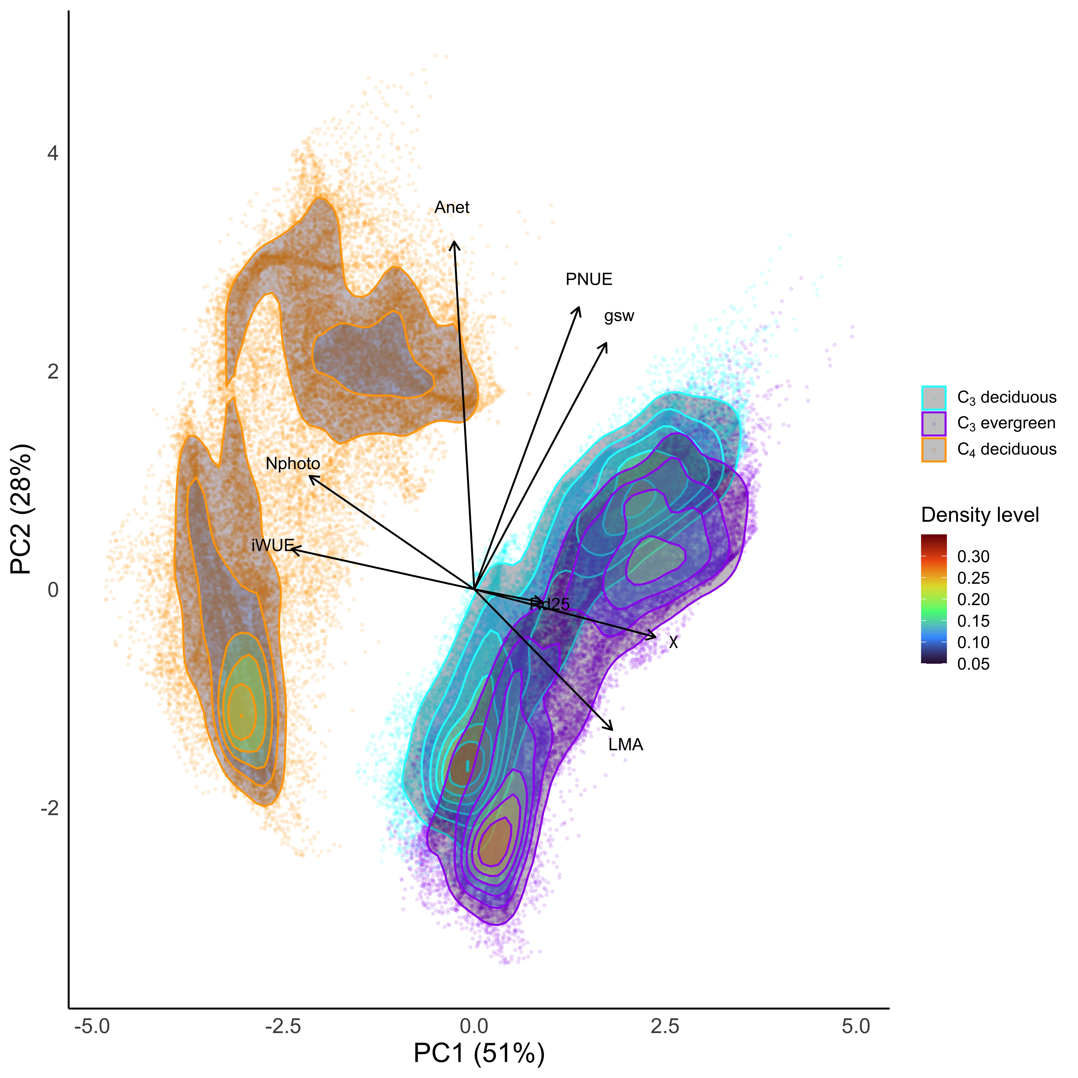
We can even predict optimal trait strategies
Smith (in review)

Slide 37
Ok, great, but now what?

Slide 38
We can use the theory as a null model to explore acclimation mechanisms

Slide 39
Let’s tackle some big questions in plant ecophysiology!

Slide 40
Big questions
Is photosynthesis optimized to the environment?
How do plants acclimate to soil nitrogen?
What does acclimation mean for future terrestrial biogeochemical cycling?
When is C₄ photosynthesis an advantage over C₃ photosynthesis?

Slide 41
Big questions
Is photosynthesis optimized to the environment?
How do plants acclimate to soil nitrogen?
What does acclimation mean for future terrestrial biogeochemical cycling? A CO₂ story
When is C₄ photosynthesis an advantage over C₃ photosynthesis?

Slide 42

Expected future responses
V_{cmax} decreases with CO₂ because of greater CO₂ in the leaf and less photorespiration
Smith et al. (2019) Ecol Letters

Slide 43
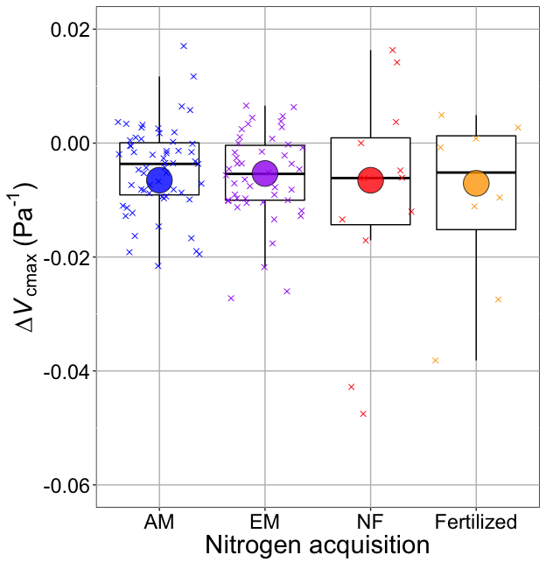
Smith and Keenan (2020) Glob Change Biol

Slide 44
V_{cmax} changes with CO₂ in ways expected from optimization
Boxes = data = -0.0063 Pa⁻¹
Circles = predicted = -0.0066 Pa⁻¹
Smith and Keenan (2020) Glob Change Biol

Slide 45
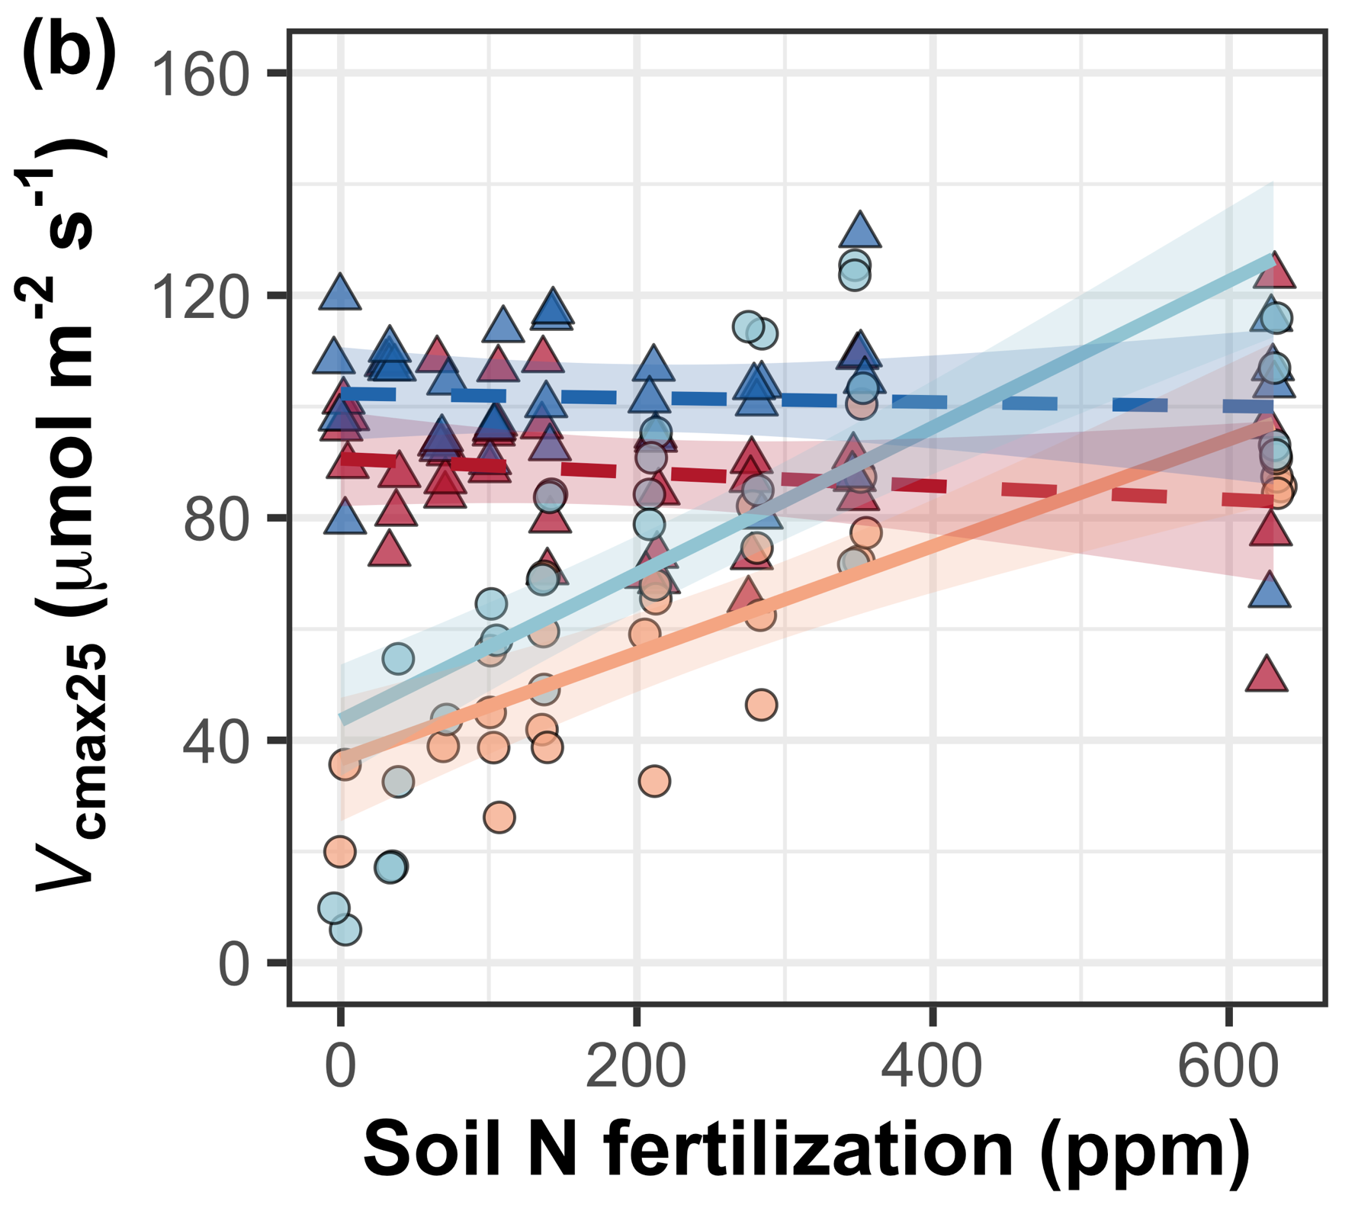
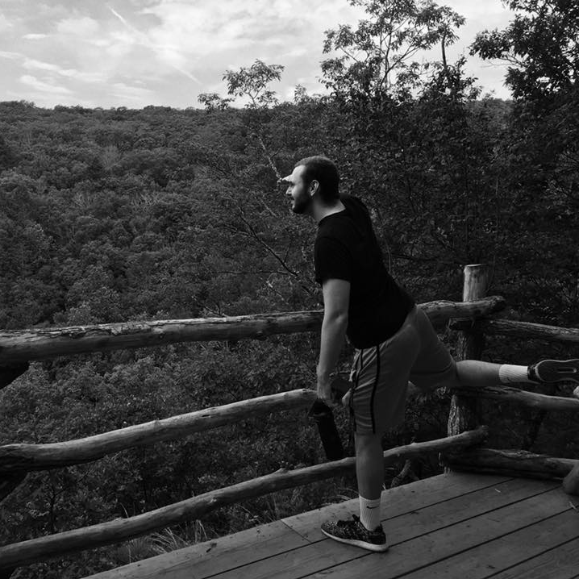
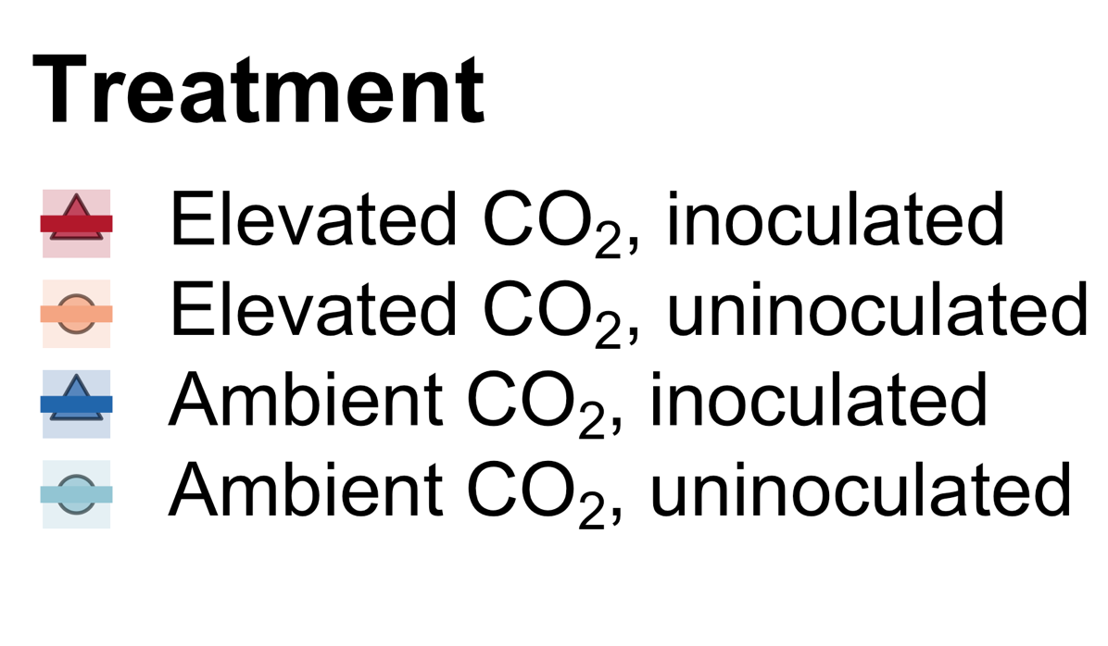

We further confirmed this universality of this response under 18 nitrogen by inoculation treatments
Perkowski, Ezekannagha, and Smith (2025) J Exp Botany

Slide 46
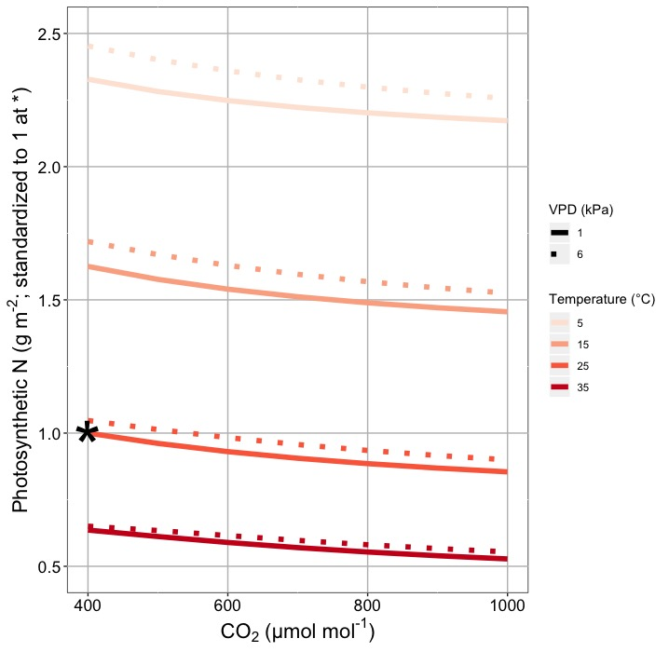
This generally suggests lower nitrogen demand under future conditions
Smith and Keenan (2020) Glob Change Biol

Slide 47

Let’s run a model out into the future!

Slide 48
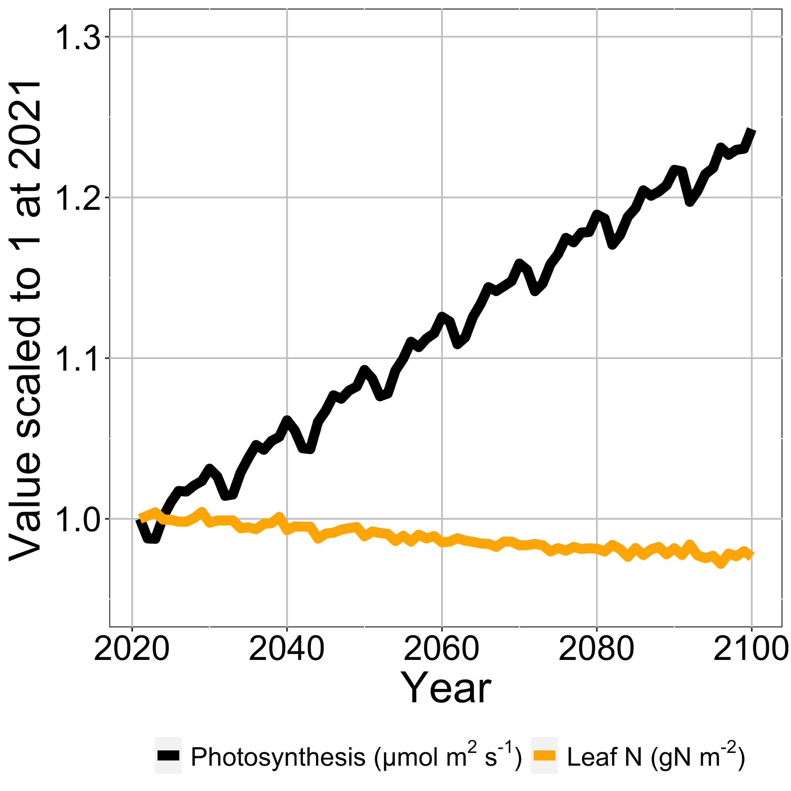
Photosynthesis increases with elevated CO₂ at lower leaf N
Smith et al. (2024) Glob Change Biol

Slide 49
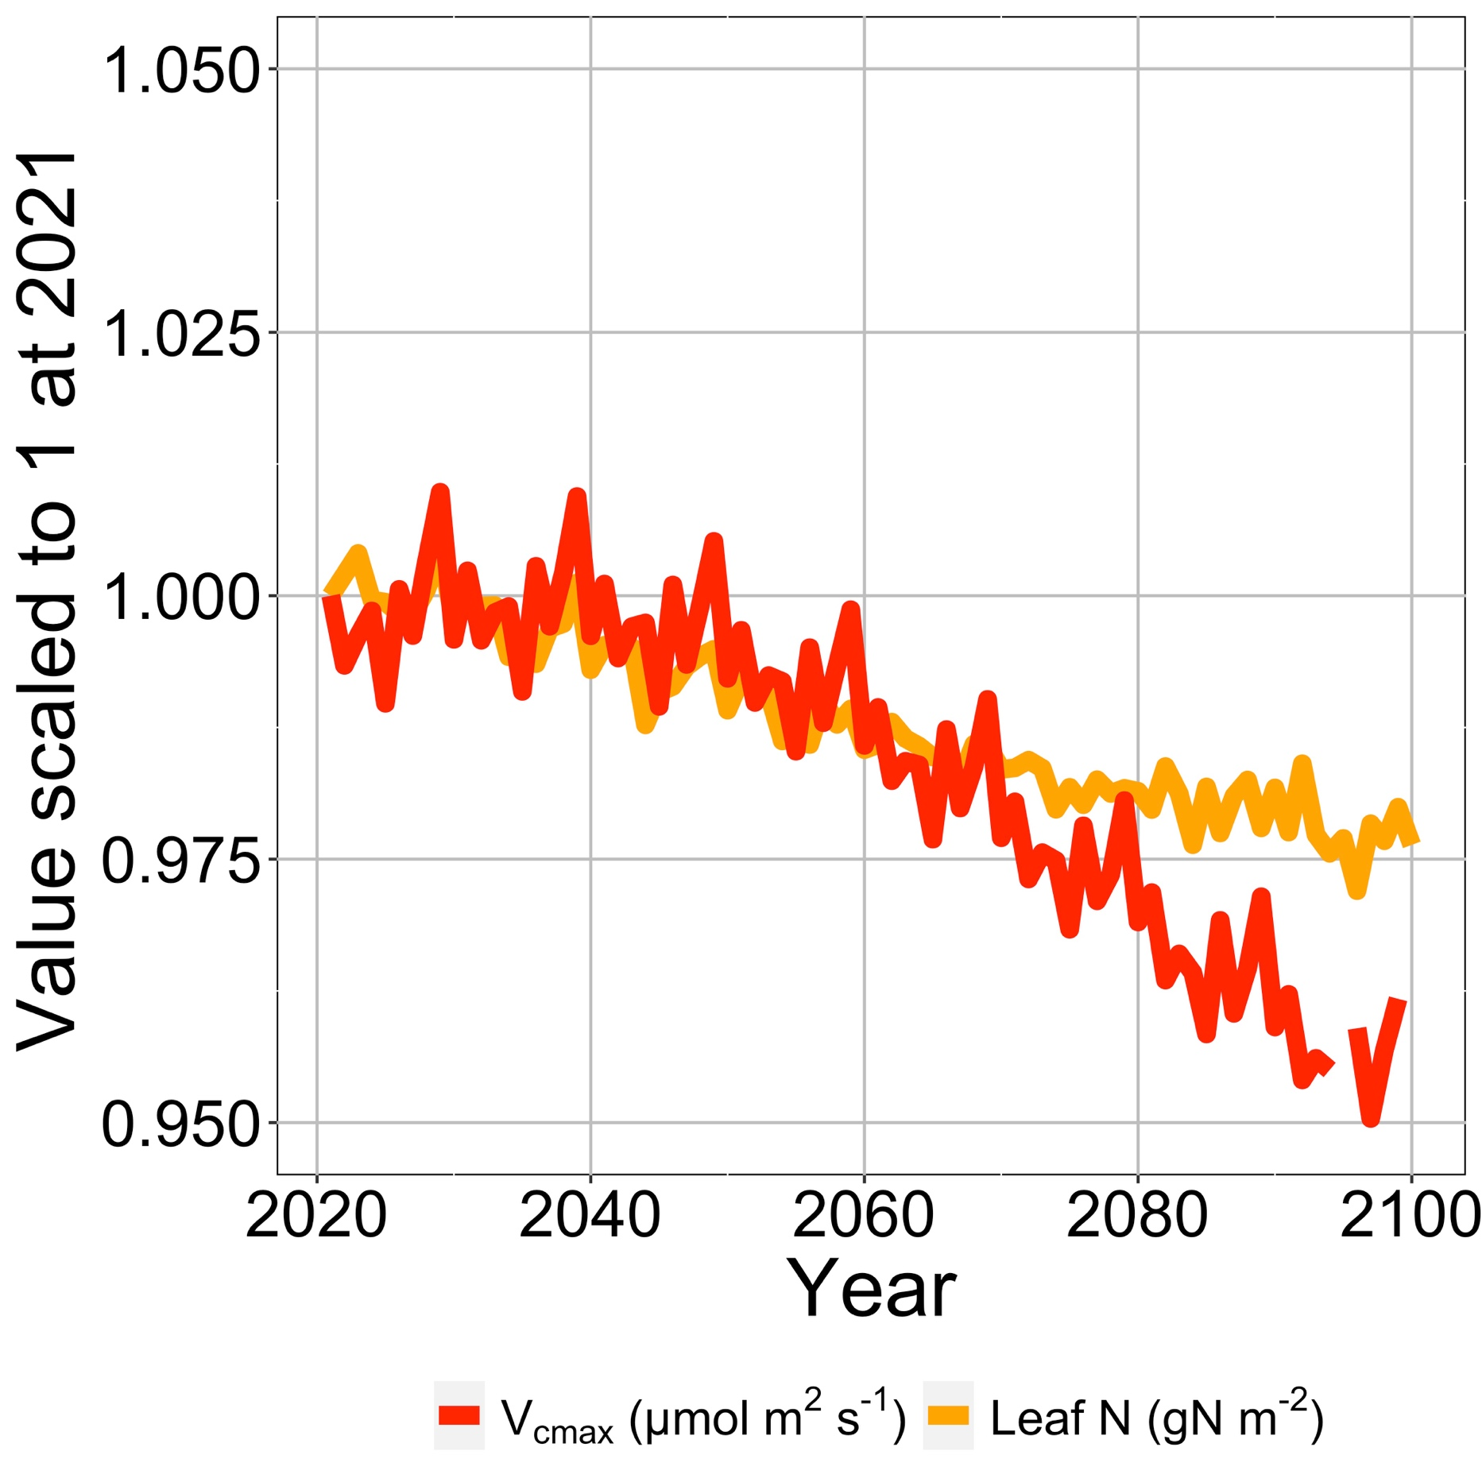
Leaf N reduction is due to a reduction in photosynthetic capacity
Smith et al. (2024) Glob Change Biol

Slide 50
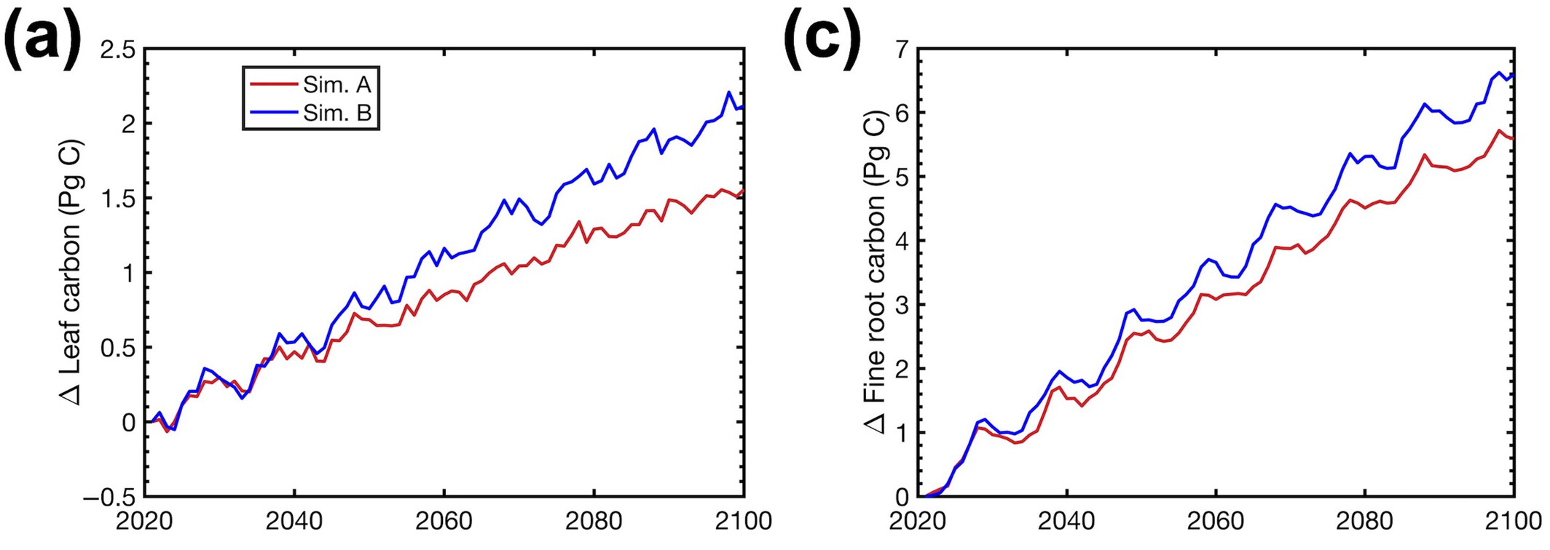
Plants build more leaves and fine roots
Smith et al. (2024) Glob Change Biol

Slide 51
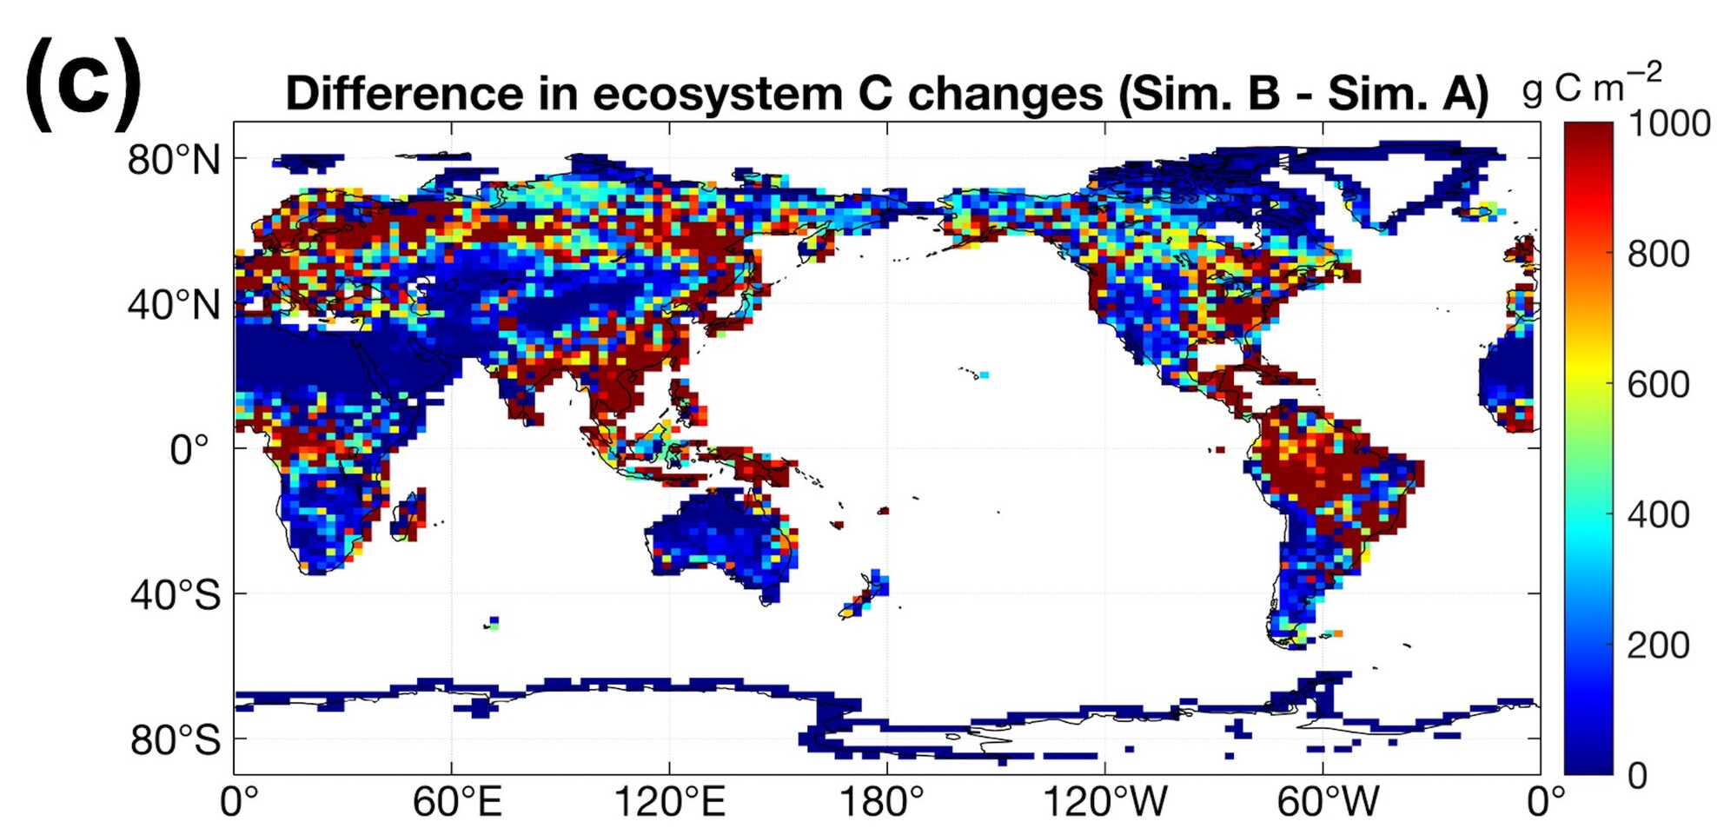
Leaf N savings increases long-term ecosystem carbon stocks
50% increase in ecosystem carbon from CO₂ acclimation
Smith et al. (2024) Glob Change Biol

Slide 52
Need to rethink nutrient limitation in models?
“No limitation” simulation
“Nutrient limitation” simulations
Weider et al. (2015)

Slide 53
What does acclimation mean for future terrestrial biogeochemical cycling?

Slide 54
Photosynthetic acclimation to elevated CO₂ frees up nutrients that enhance ecosystem carbon uptake and storage beyond what is currently simulated in models

Slide 55
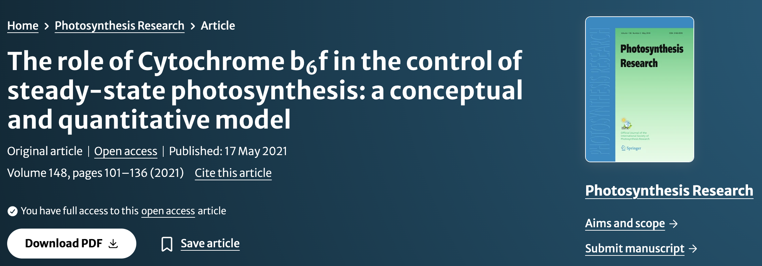
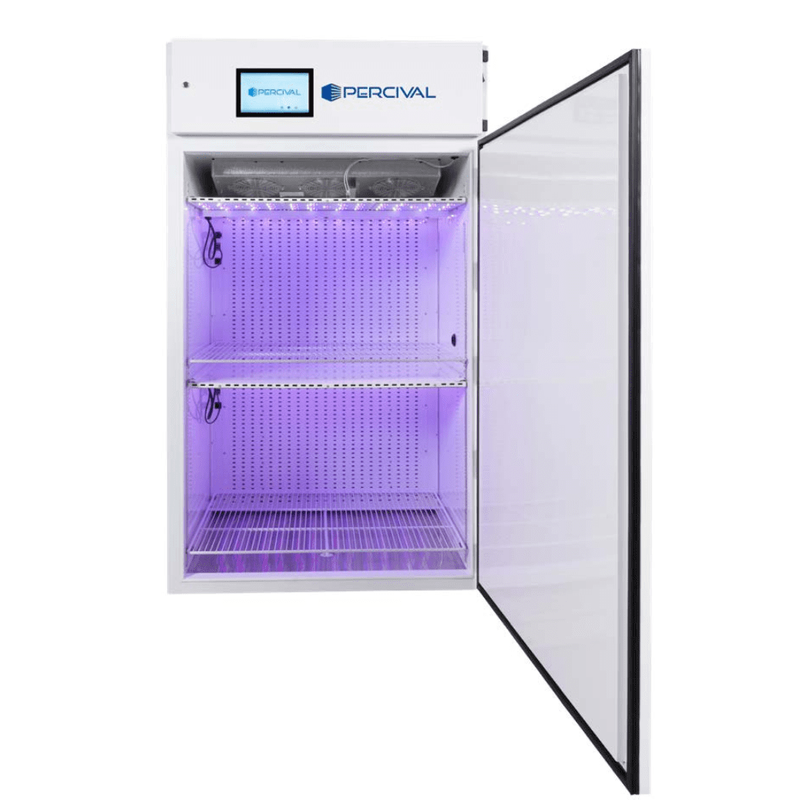
Looking forward: coupling CO₂ responses of light and dark reactions
Garza, Johnson, and Smith (in prep)
Notes:
Replace with Pm results if possible

Slide 56
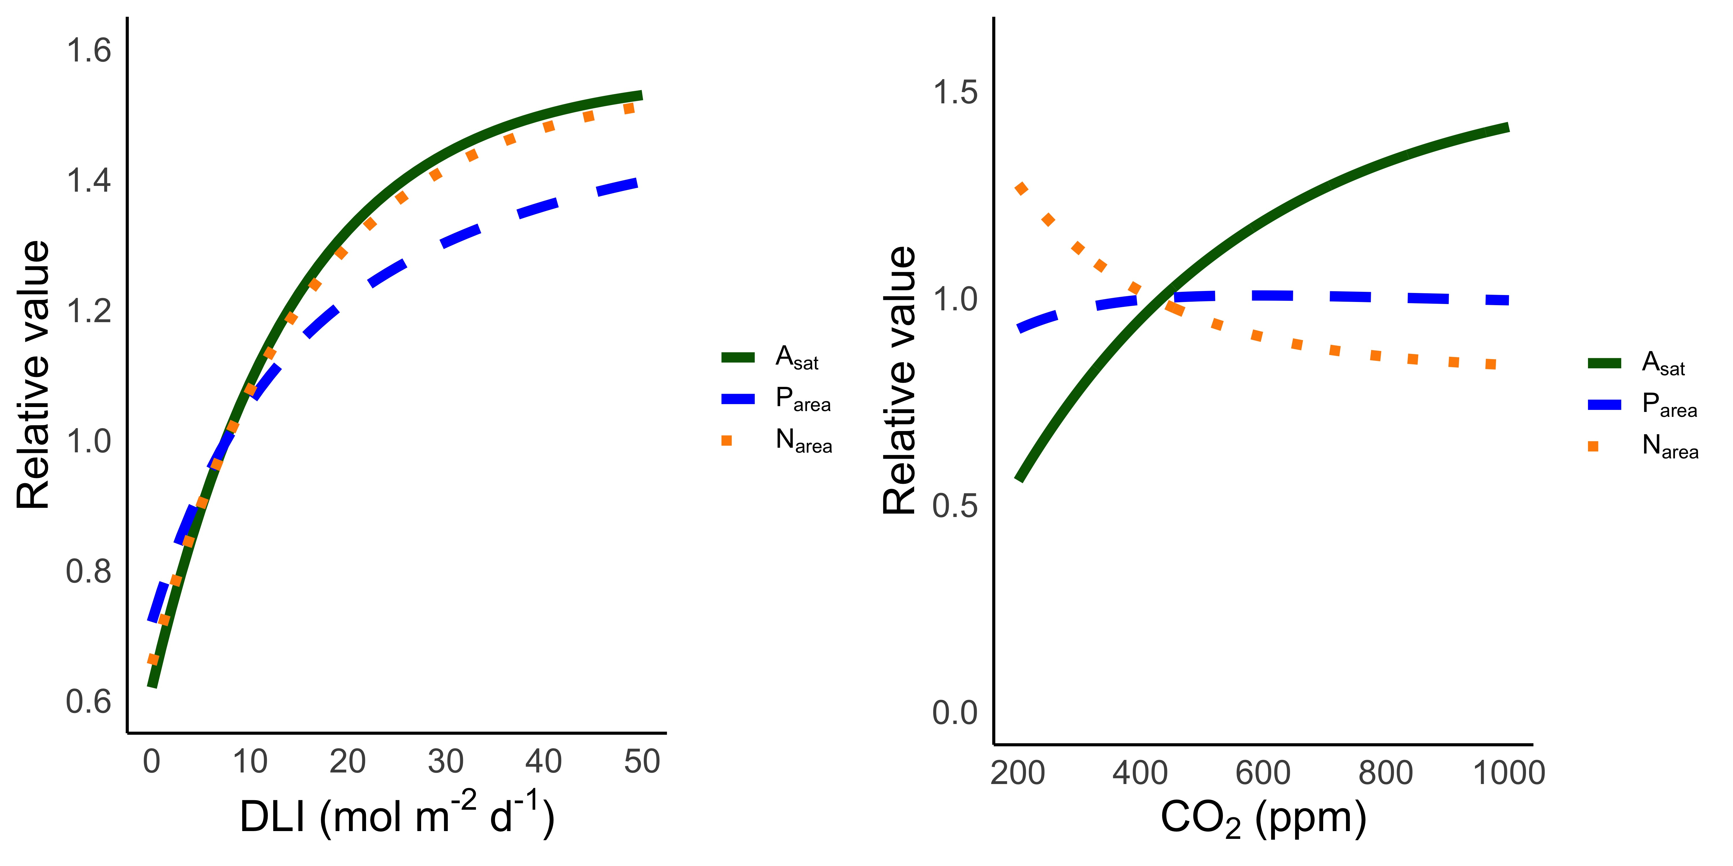
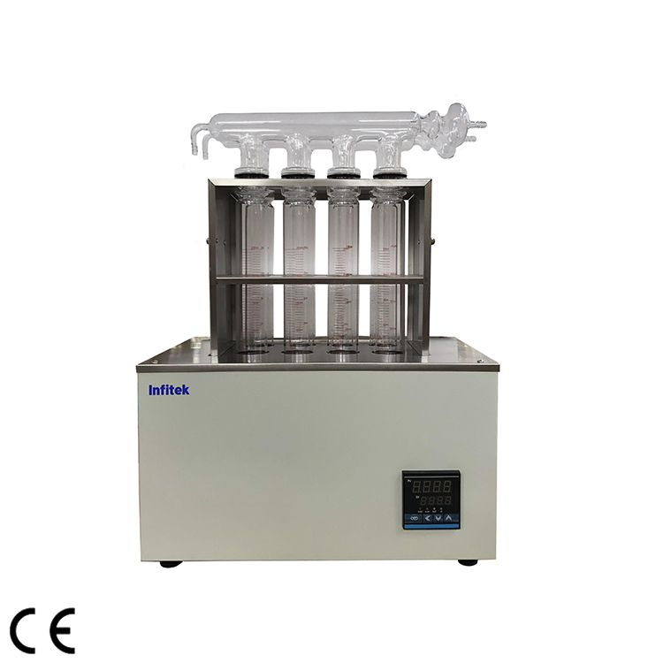
Looking forward: a simple theory for understanding photosynthesis-phosphorus relationships
Fractionation into leaf P pools (metabolic, lipid, nucleic acid, inorganic, residual)
Smith et al. (in prep); Kelley and Smith (in prep)
Notes:
Replace with Pm results if possible

Slide 57
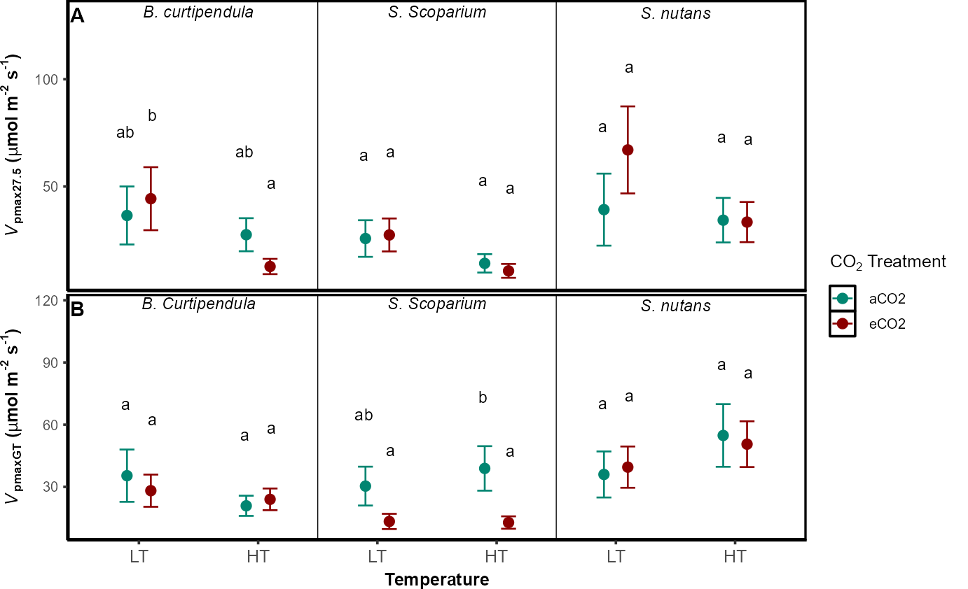
Looking forward: integrating C₄ optimization
Ezekannagha and Smith (in prep); Kelley and Smith (in prep); Smith (in review)

Slide 58
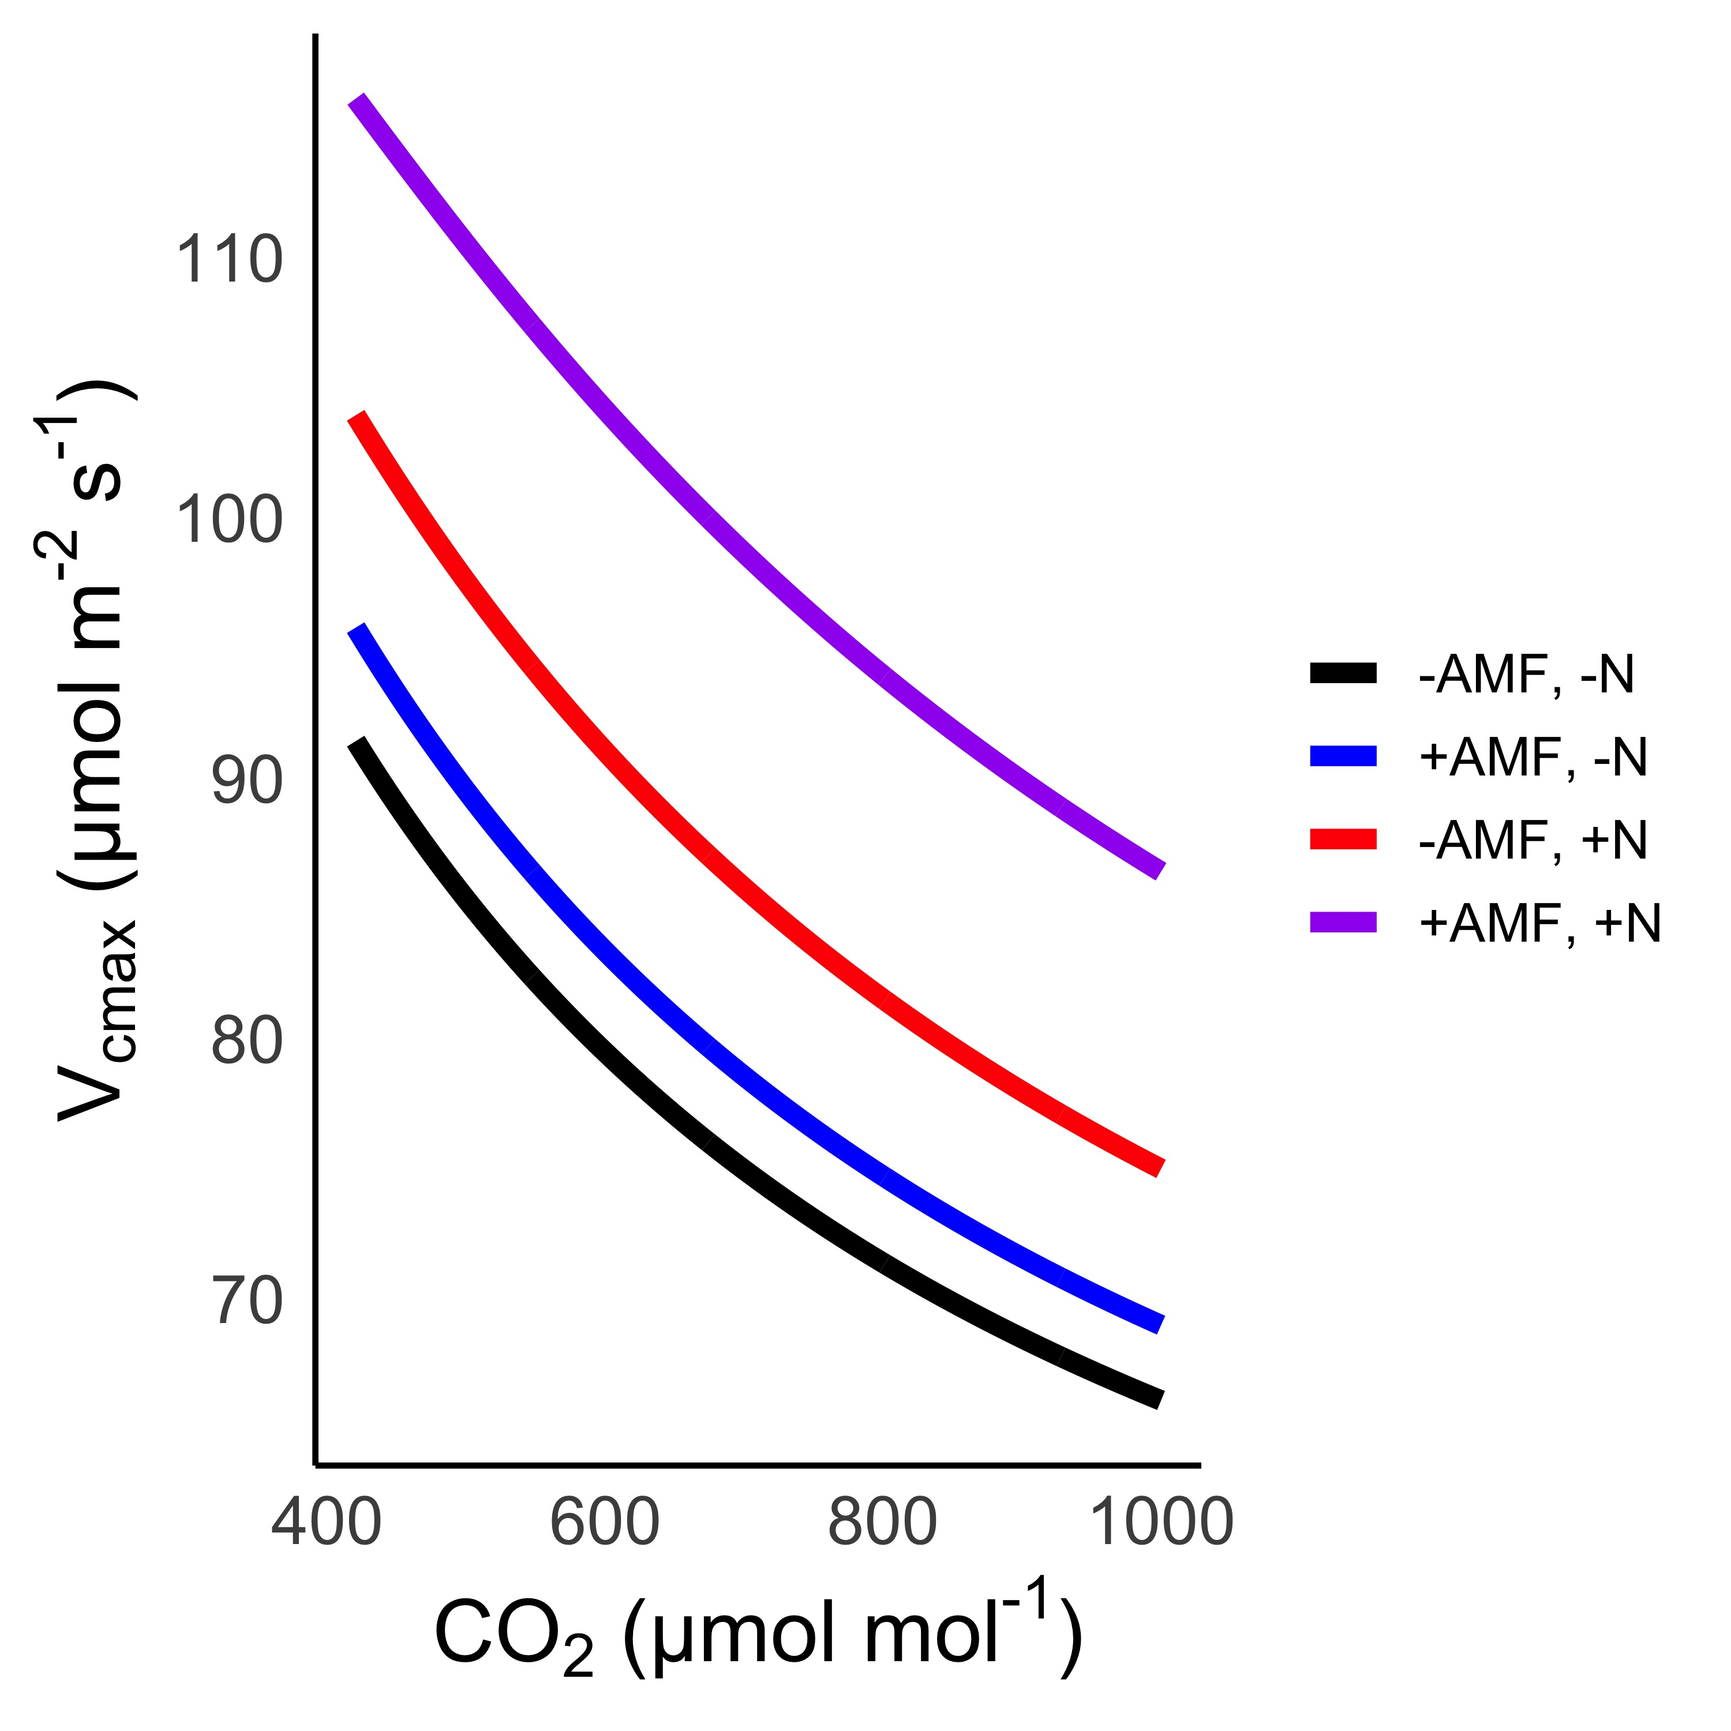
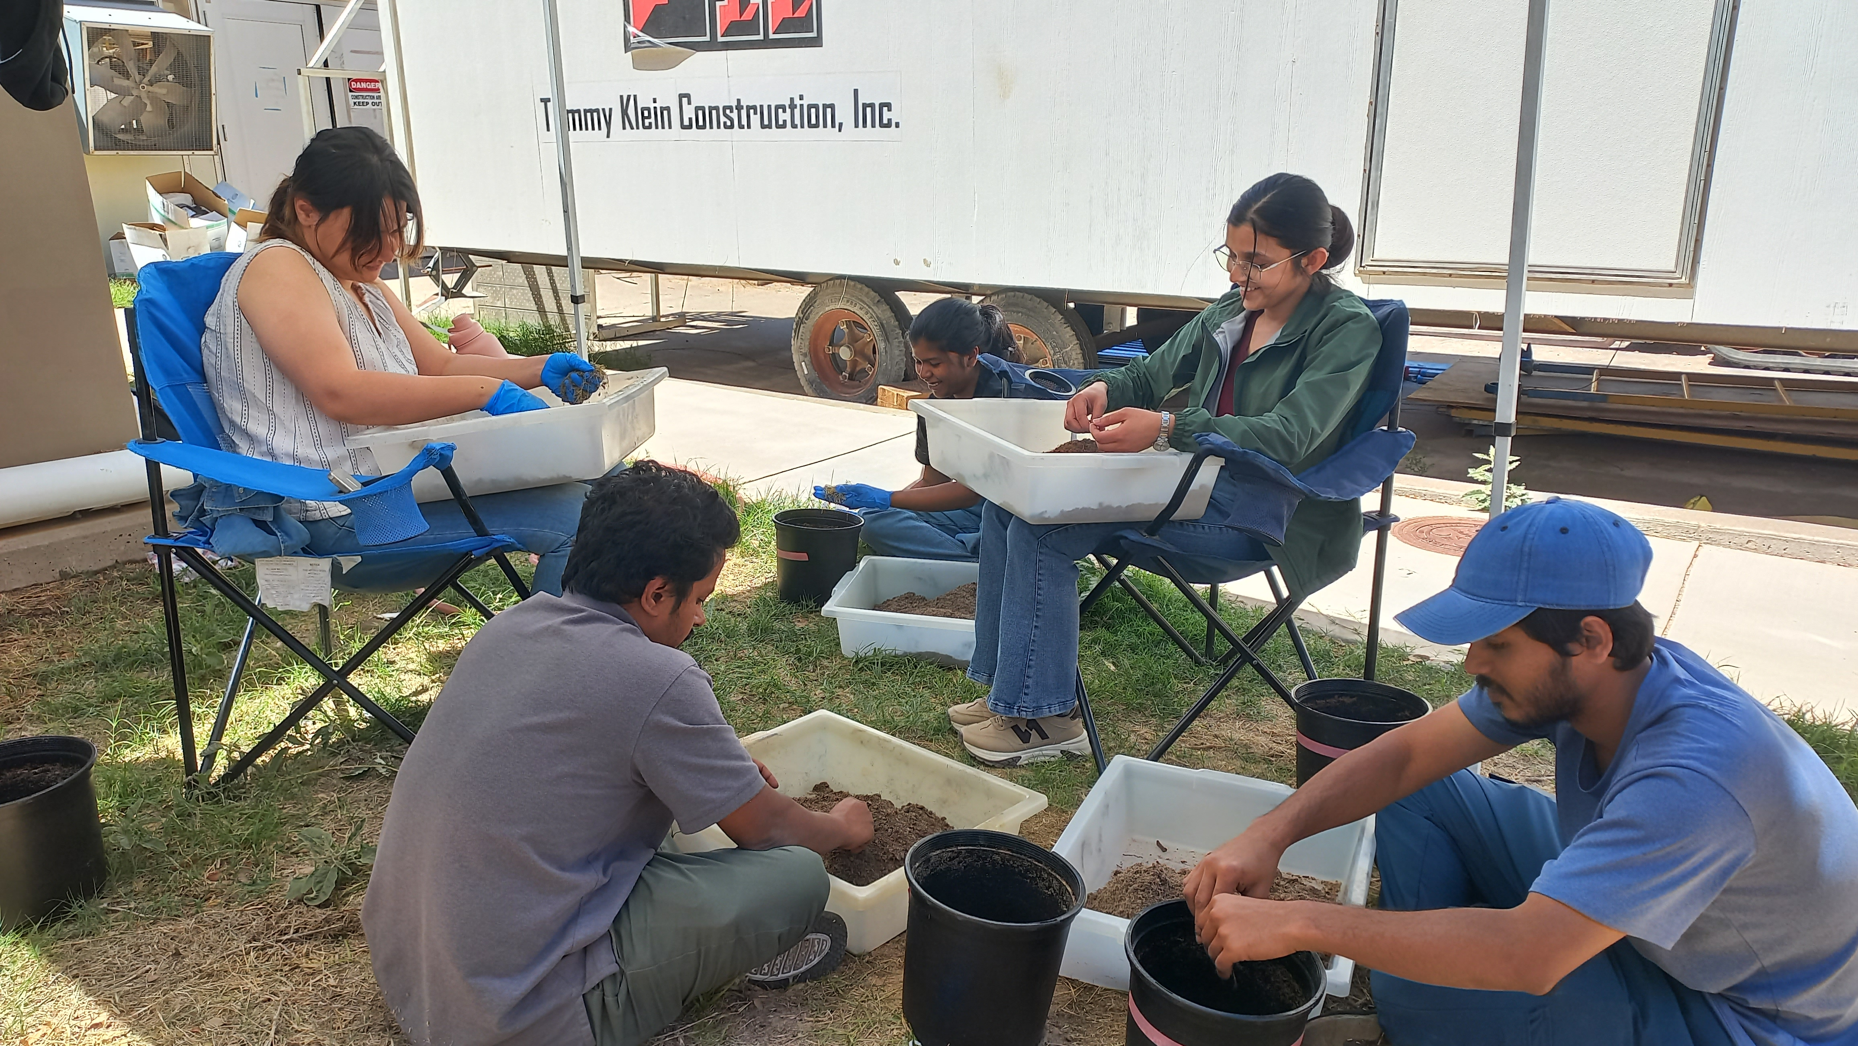
Looking forward: mycorrhizae-CO₂ interactions
Chatterjee and Smith (in prep)

Slide 59
Conclusions

Slide 60
Conclusions
Plants aren’t dumb!
  Assuming plants don’t dynamically respond to their environment can lead to poor understanding of ecological functioning from individuals to the Earth system
Dumb plants

Slide 61
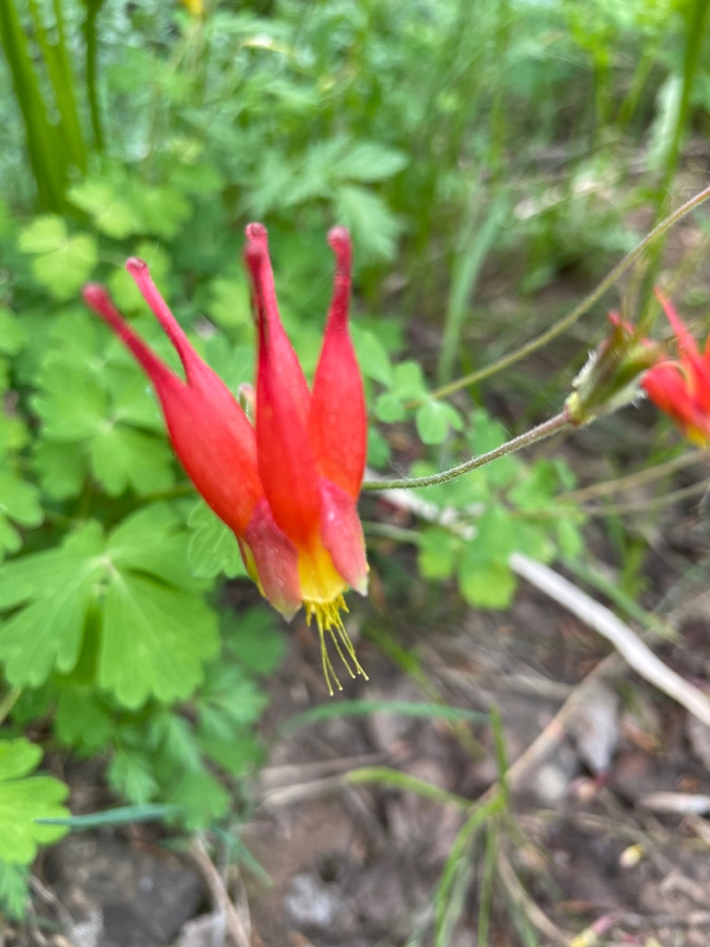
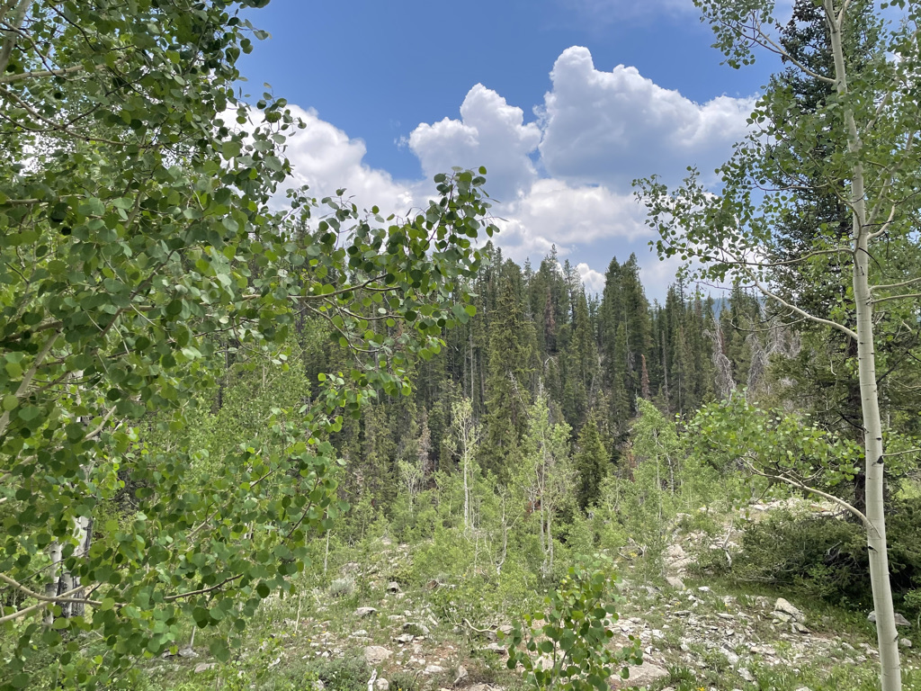
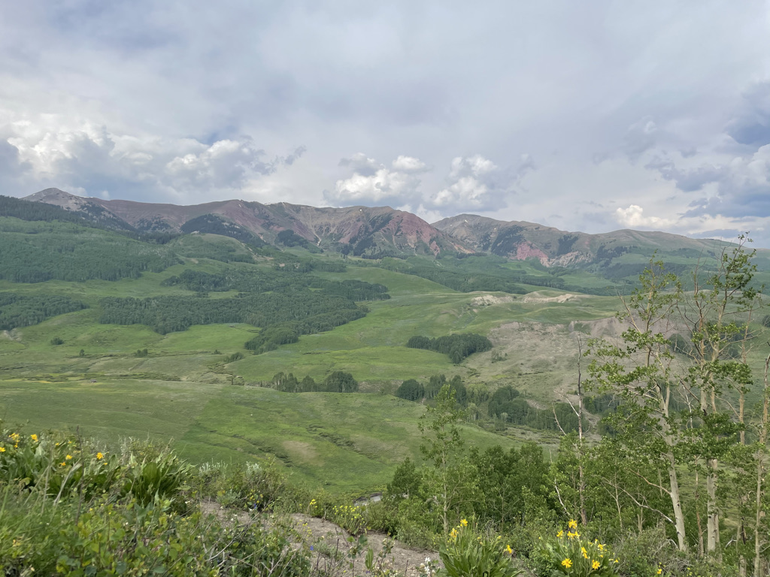
Conclusions
Quantified physiological theory can:
  Improve mechanistic understanding of physiological processes that underlie higher level responses
  Produce more reliable future projections
f(x)
f(x)

Slide 62
And ultimately lead to a better understanding of how future ecosystem services will be impacts by global change
Smith (2024) Am J Botany

Slide 63
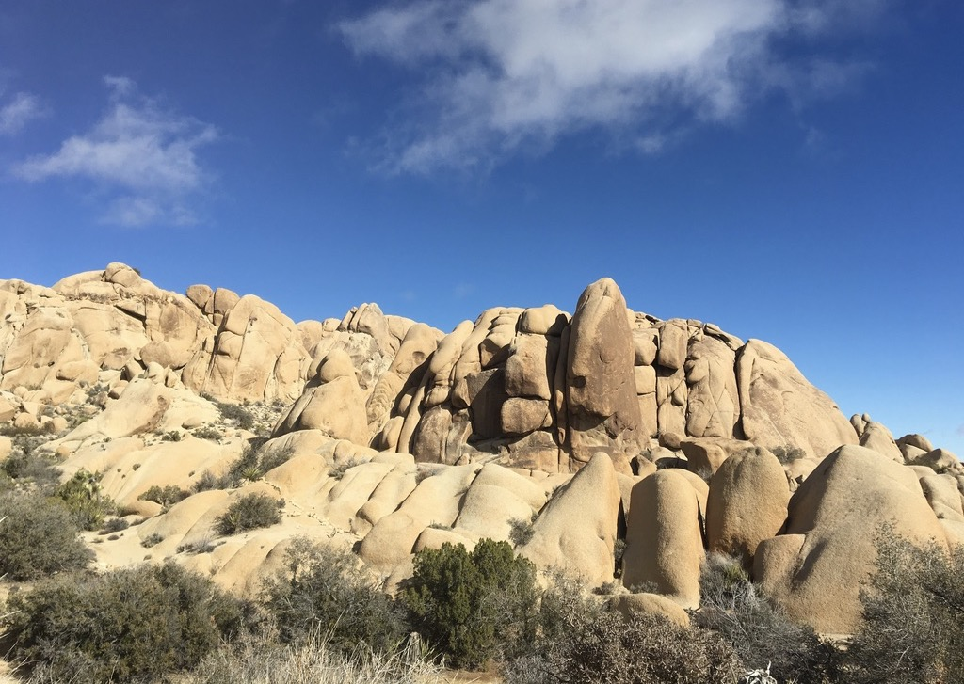
Presentation available at: github.com/SmithEcophysLab/seminar/
Contact: nsmith87@unl.edu
Thanks!

