Slide 1
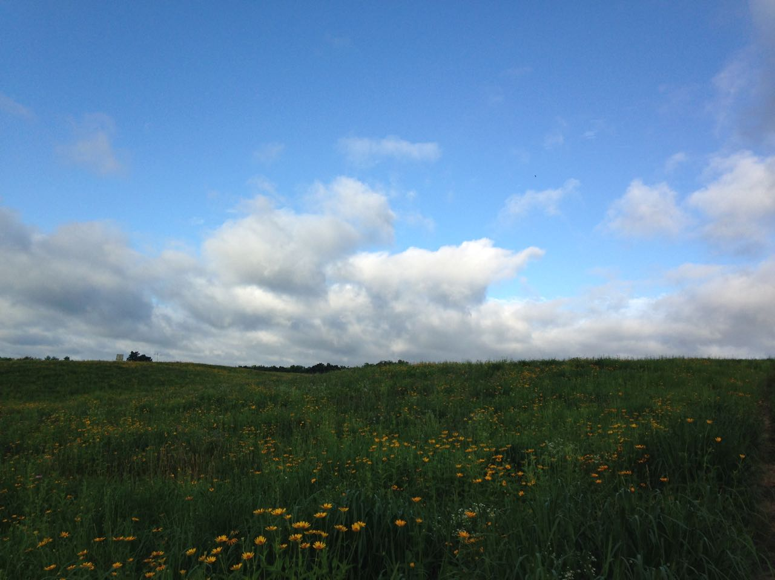
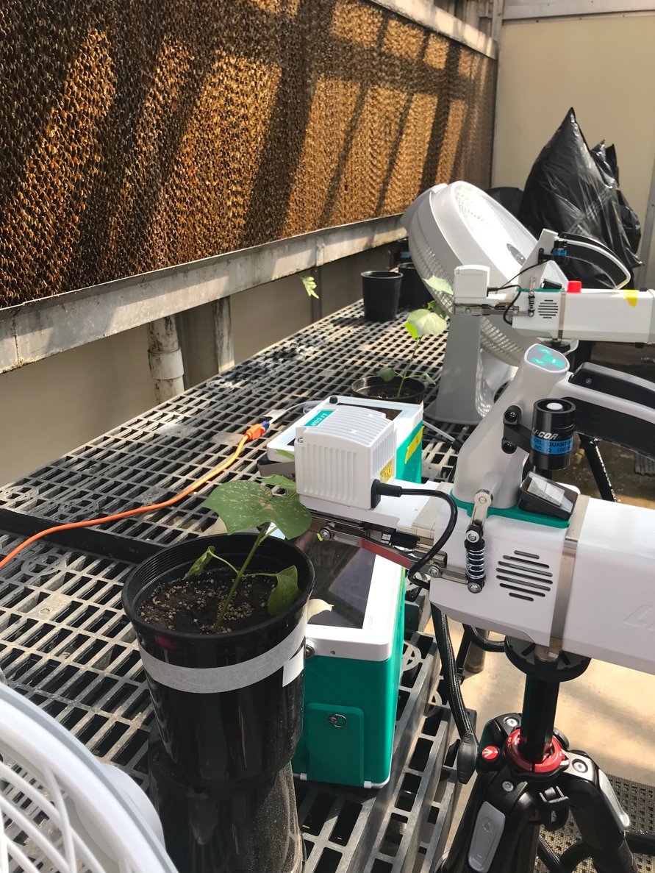
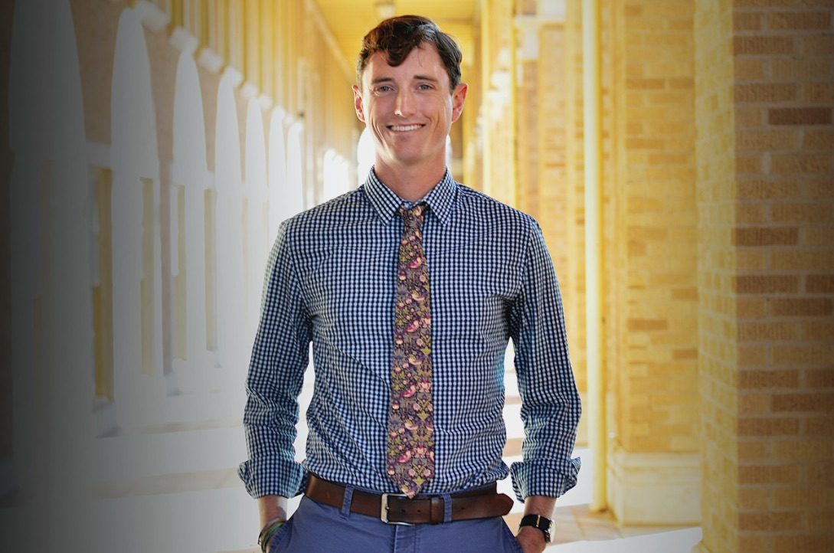
TTU EEB Spring 2020 Seminar Announcement
Plants Aren’t Dumb:
Using Optimality Theory to Under Big Questions in Plant Ecophysiology
Nick Smith
TTU, Department of Biological Sciences
January 22, 2020
12:00 PM
Biology 021

