Slide 1

Using theory and experiments to understand plant physiological responses to nutrient availability
Nick Smith
Department of Biological Sciences
Texas Tech University
nick.smith@ttu.edu

Slide 2
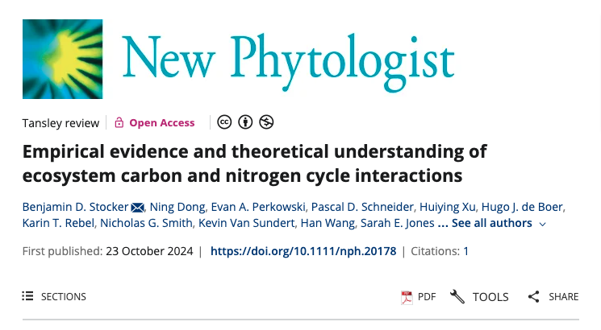
Stocker et al. (2025) New Phyt

Slide 3
Take home: we need to ground our understanding of plant-nutrient relationships in theory
Stocker et al. (2025) New Phyt

Slide 4
Talk outline
Photosynthetic least cost theory and its relation to nutrients
Tests of the theory
The interactions between nutrient supply and demand
Responses to elevated CO₂
Conclusions

Slide 5
Talk outline
Photosynthetic least cost theory and its relation to nutrients
Tests of the theory
The interactions between nutrient supply and demand
Responses to elevated CO₂
Conclusions

Slide 6
Photosynthetic least cost theory
Optimally, plants will maintain fastest rate of photosynthesis at the lowest summed resource cost (water and nutrient use)
Wright et al. (2003) Am Naturalist

Slide 7
Photosynthetic least cost theory
Can be used to predict changes in photosynthetic nitrogen in response to changes in
Supply
Demand

Slide 8
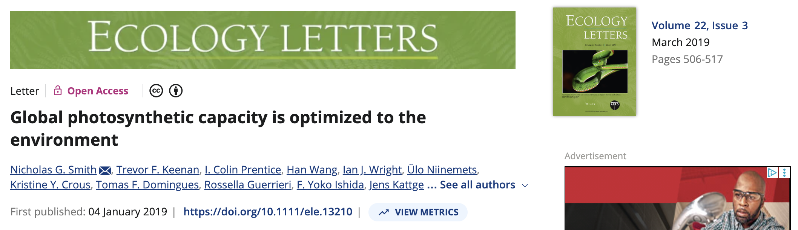
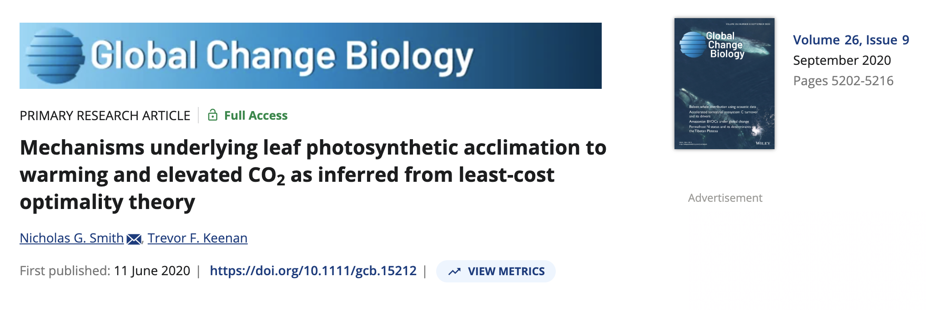

Slide 9
Photosynthetic least cost theory
Can be used to predict changes in photosynthetic nitrogen in response to changes in
Supply
Demand

Slide 10
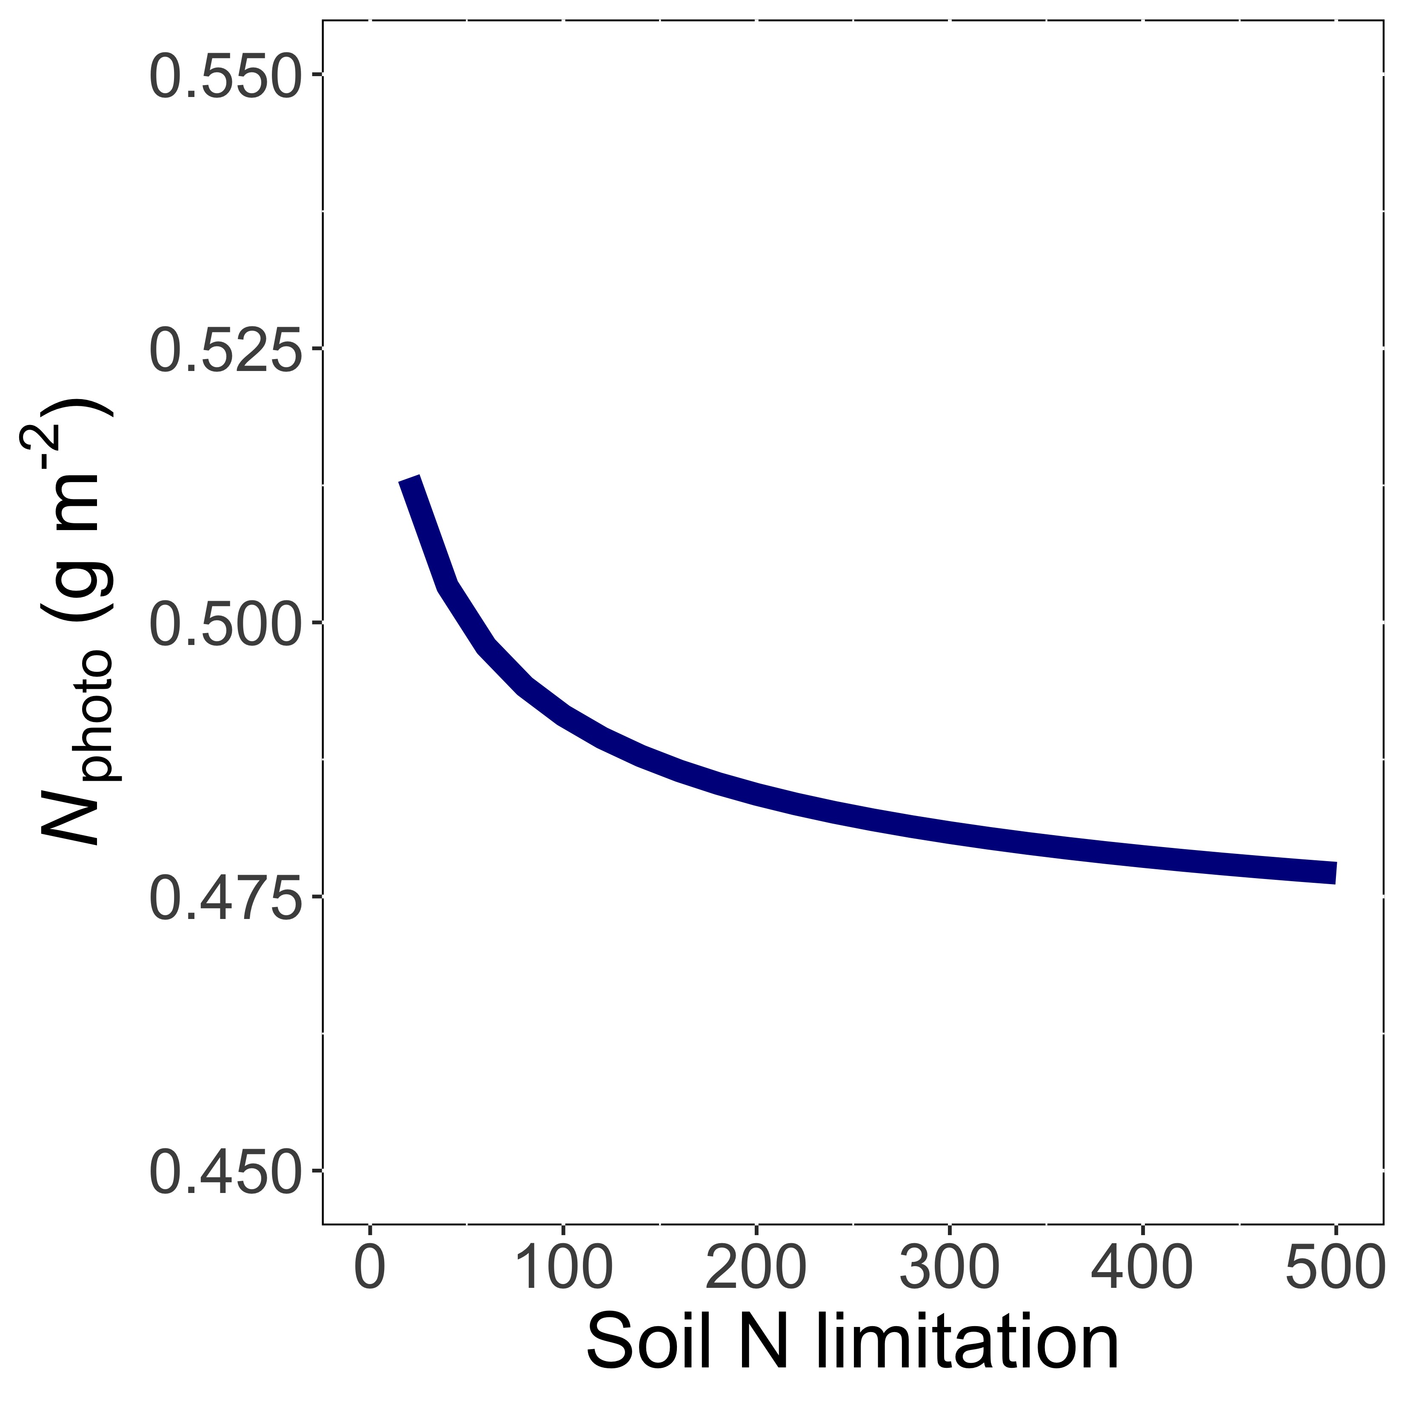
Leaf N decreases with soil N limitation, but…
Smith et al. (2019) Ecol Letters; Smith and Keenan (2020) Glob Change Biology

Slide 11
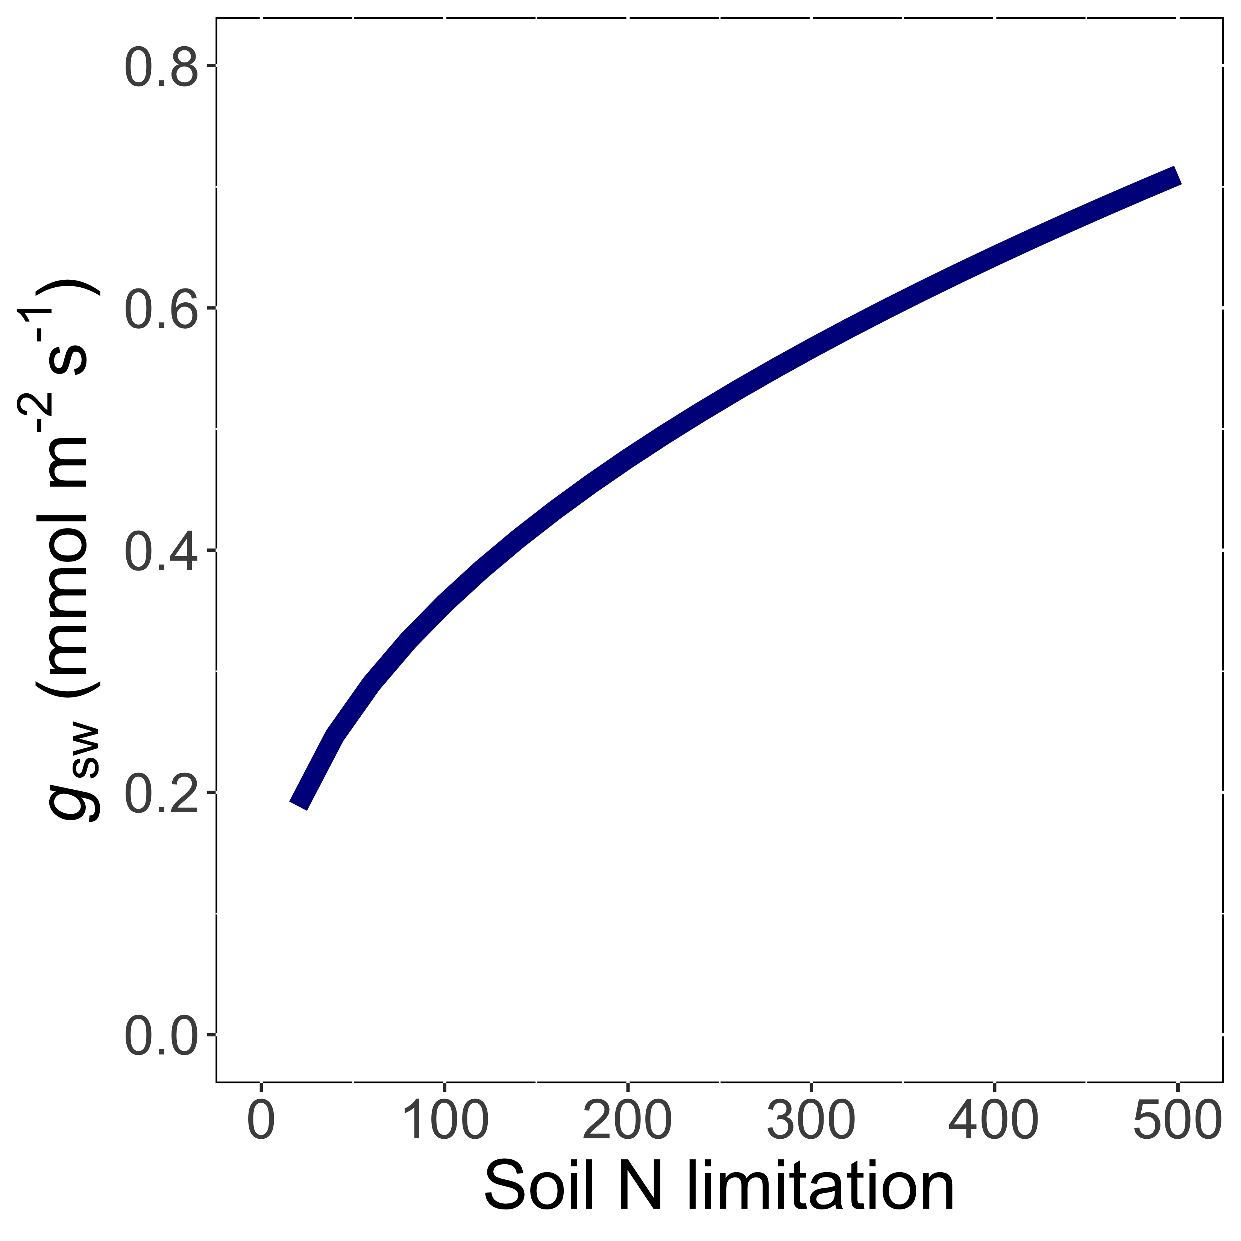
…this requires greater water use (i.e., stomatal conductance) to maintain photosynthesis
Smith et al. (2019) Ecol Letters; Smith and Keenan (2020) Glob Change Biology

Slide 12
Photosynthetic least cost theory
Can be used to predict changes in photosynthetic nitrogen in response to changes in
Supply
Demand

Slide 13
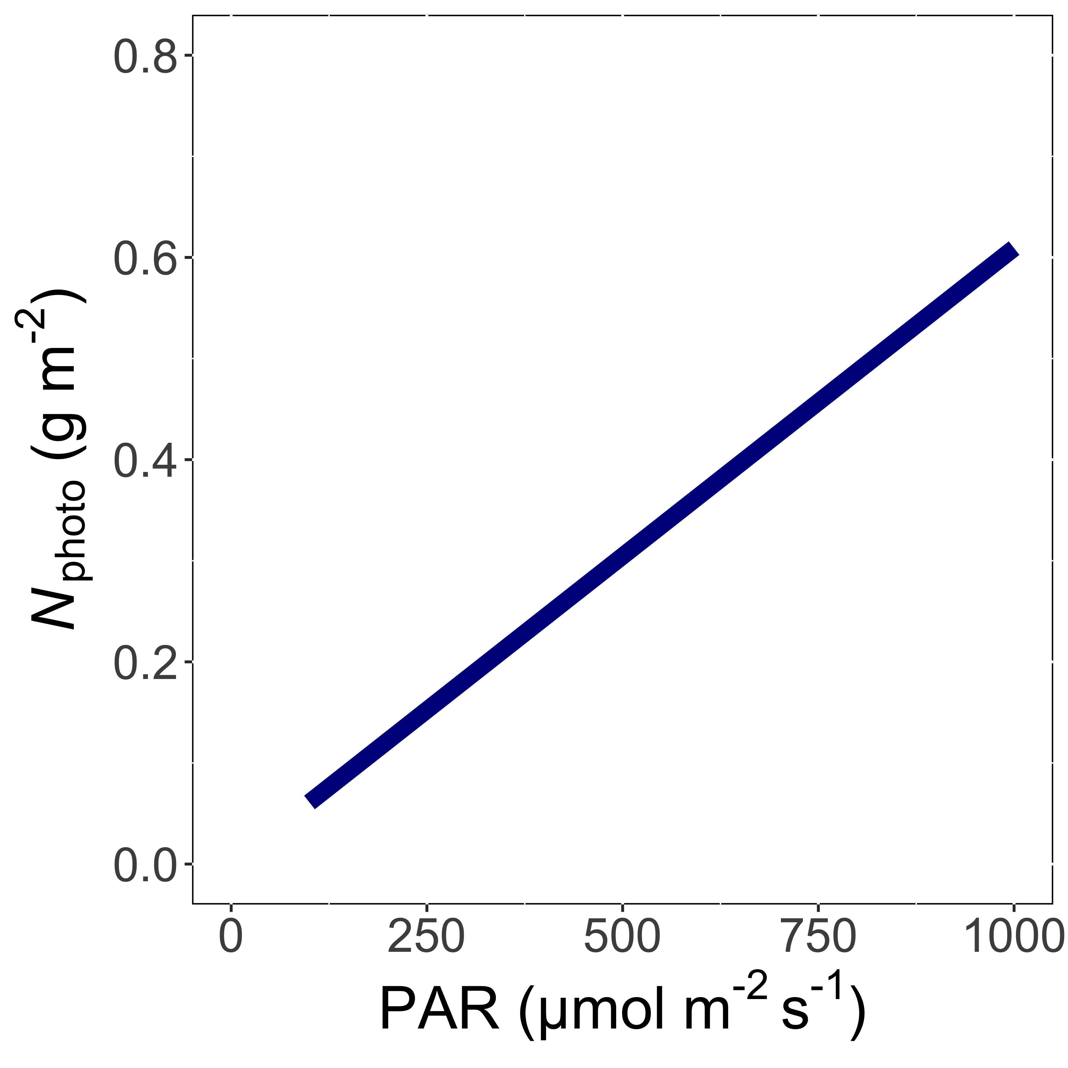
Leaf N demand increases with light because of greater need for photosynthetic enzymes to use light
Smith et al. (2019) Ecol Letters; Smith and Keenan (2020) Glob Change Biology

Slide 14
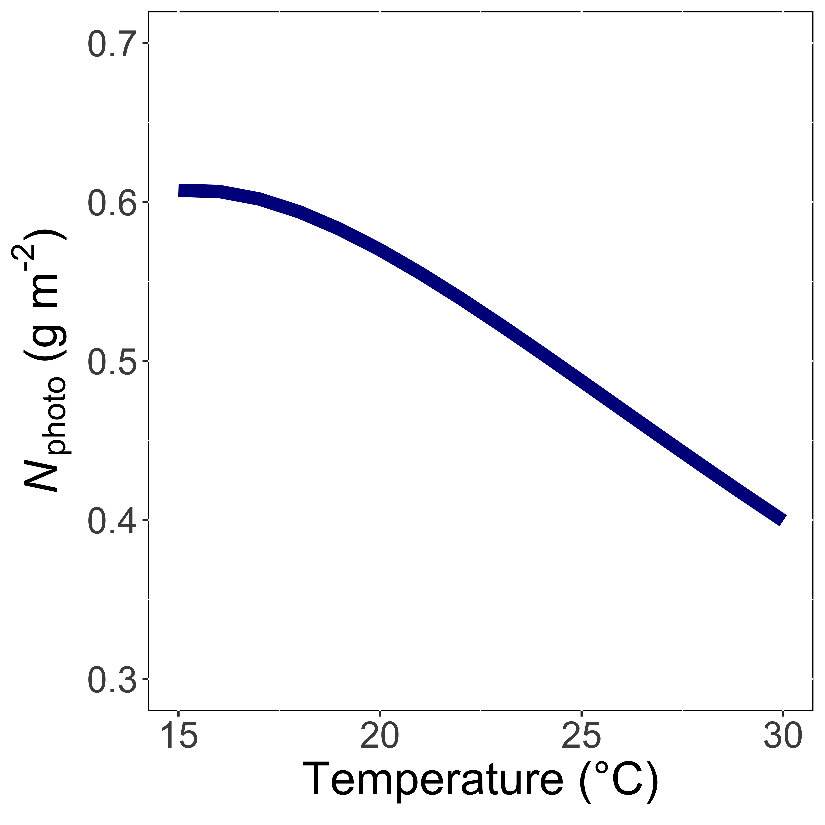
Leaf N demand decreases with temperature because enzymes work faster at higher temperature
Smith et al. (2019) Ecol Letters; Smith and Keenan (2020) Glob Change Biology

Slide 15
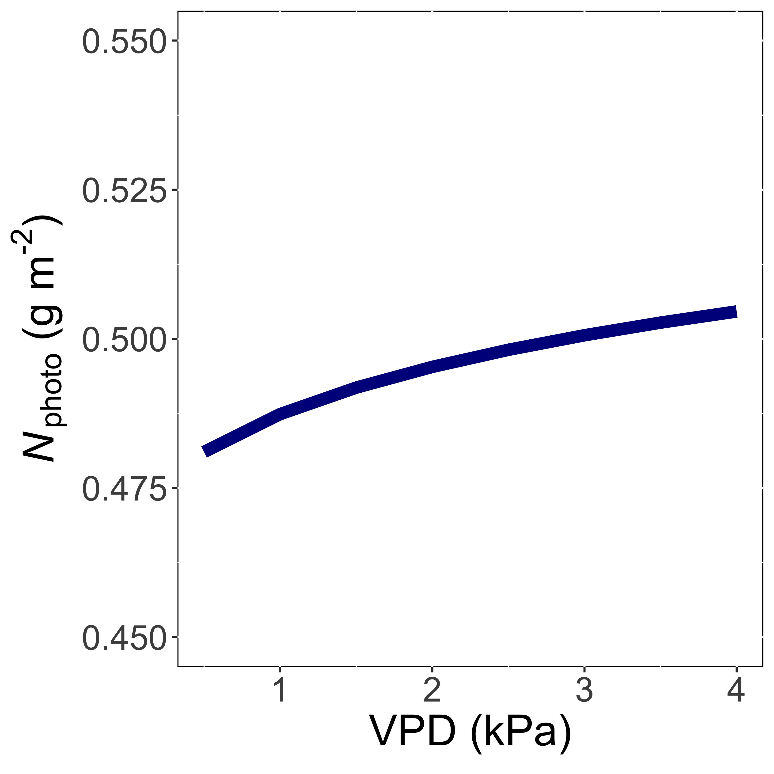
Leaf N demand increases with VPD to allow plants to save water
Smith et al. (2019) Ecol Letters; Smith and Keenan (2020) Glob Change Biology

Slide 16
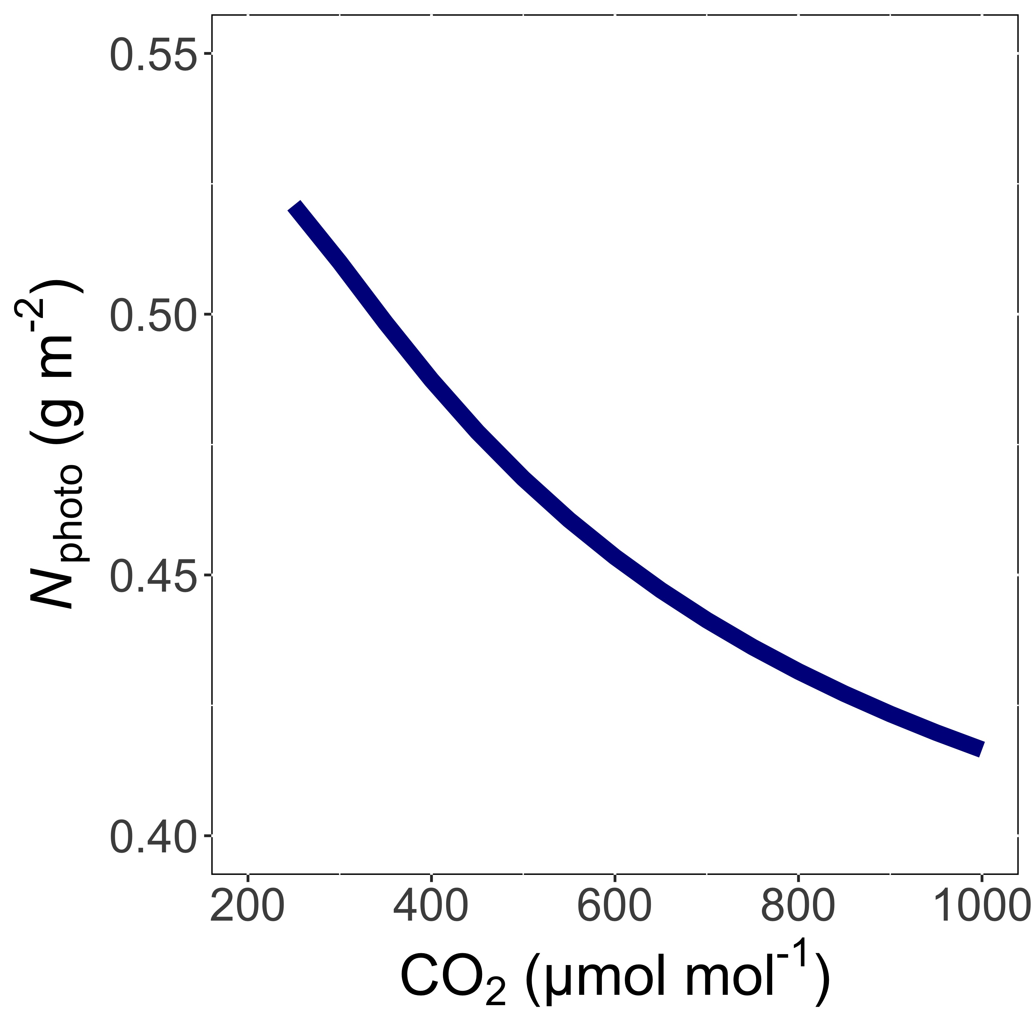
Leaf N demand decreases with CO₂ because less enzymes are needed
Smith et al. (2019) Ecol Letters; Smith and Keenan (2020) Glob Change Biology

Slide 17
Talk outline
Photosynthetic least cost theory and its relation to nutrients
Tests of the theory
The interactions between nutrient supply and demand
Responses to elevated CO₂
Conclusions

Slide 18
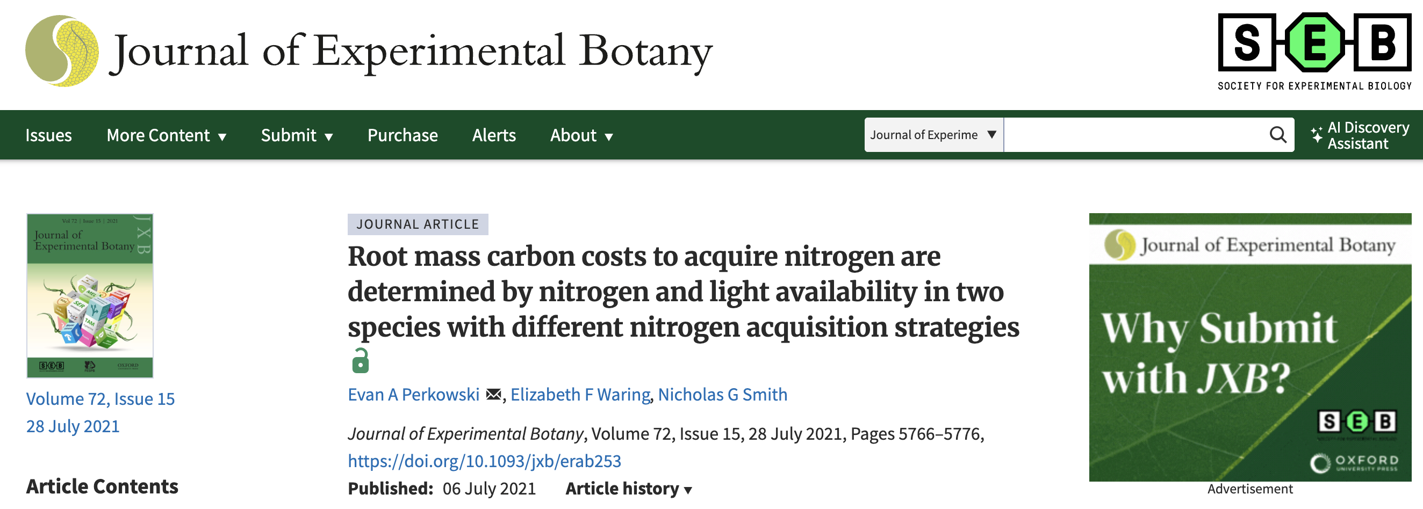
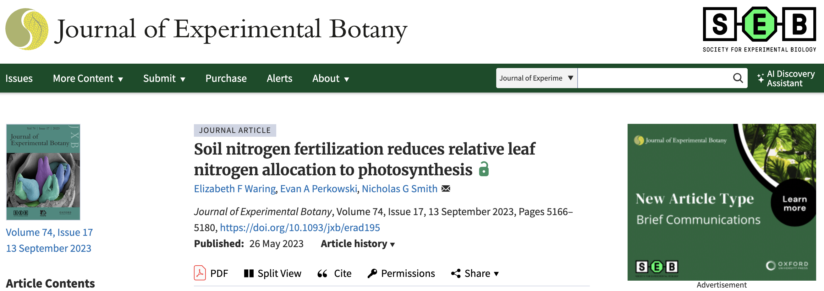

Slide 19
Main questions
How does nitrogen demand and availability jointly control:
Carbon costs to acquire nitrogen?
Leaf-level physiology?
Nitrogen allocation?
Do these responses differ in non-N fixing (i.e., cotton) and N fixing (i.e., soybean) plants?
Perkowski et al. (2021) J Exp Bot
Waring et al. (2023) J Exp Bot

Slide 20
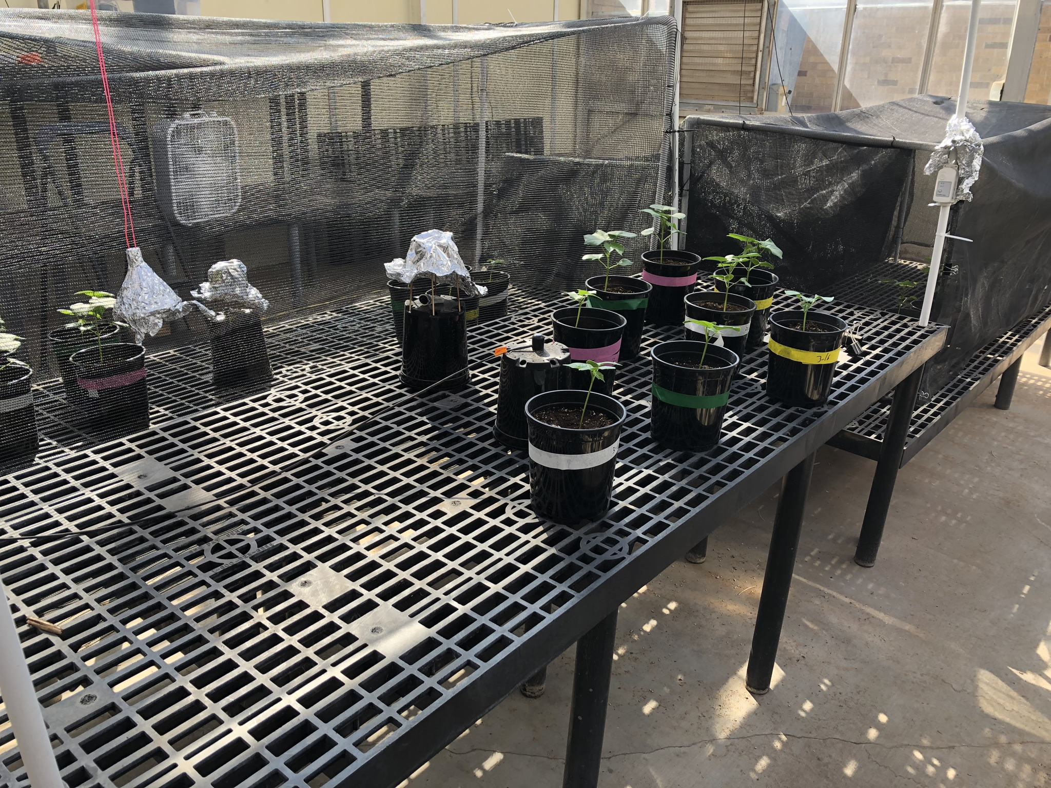
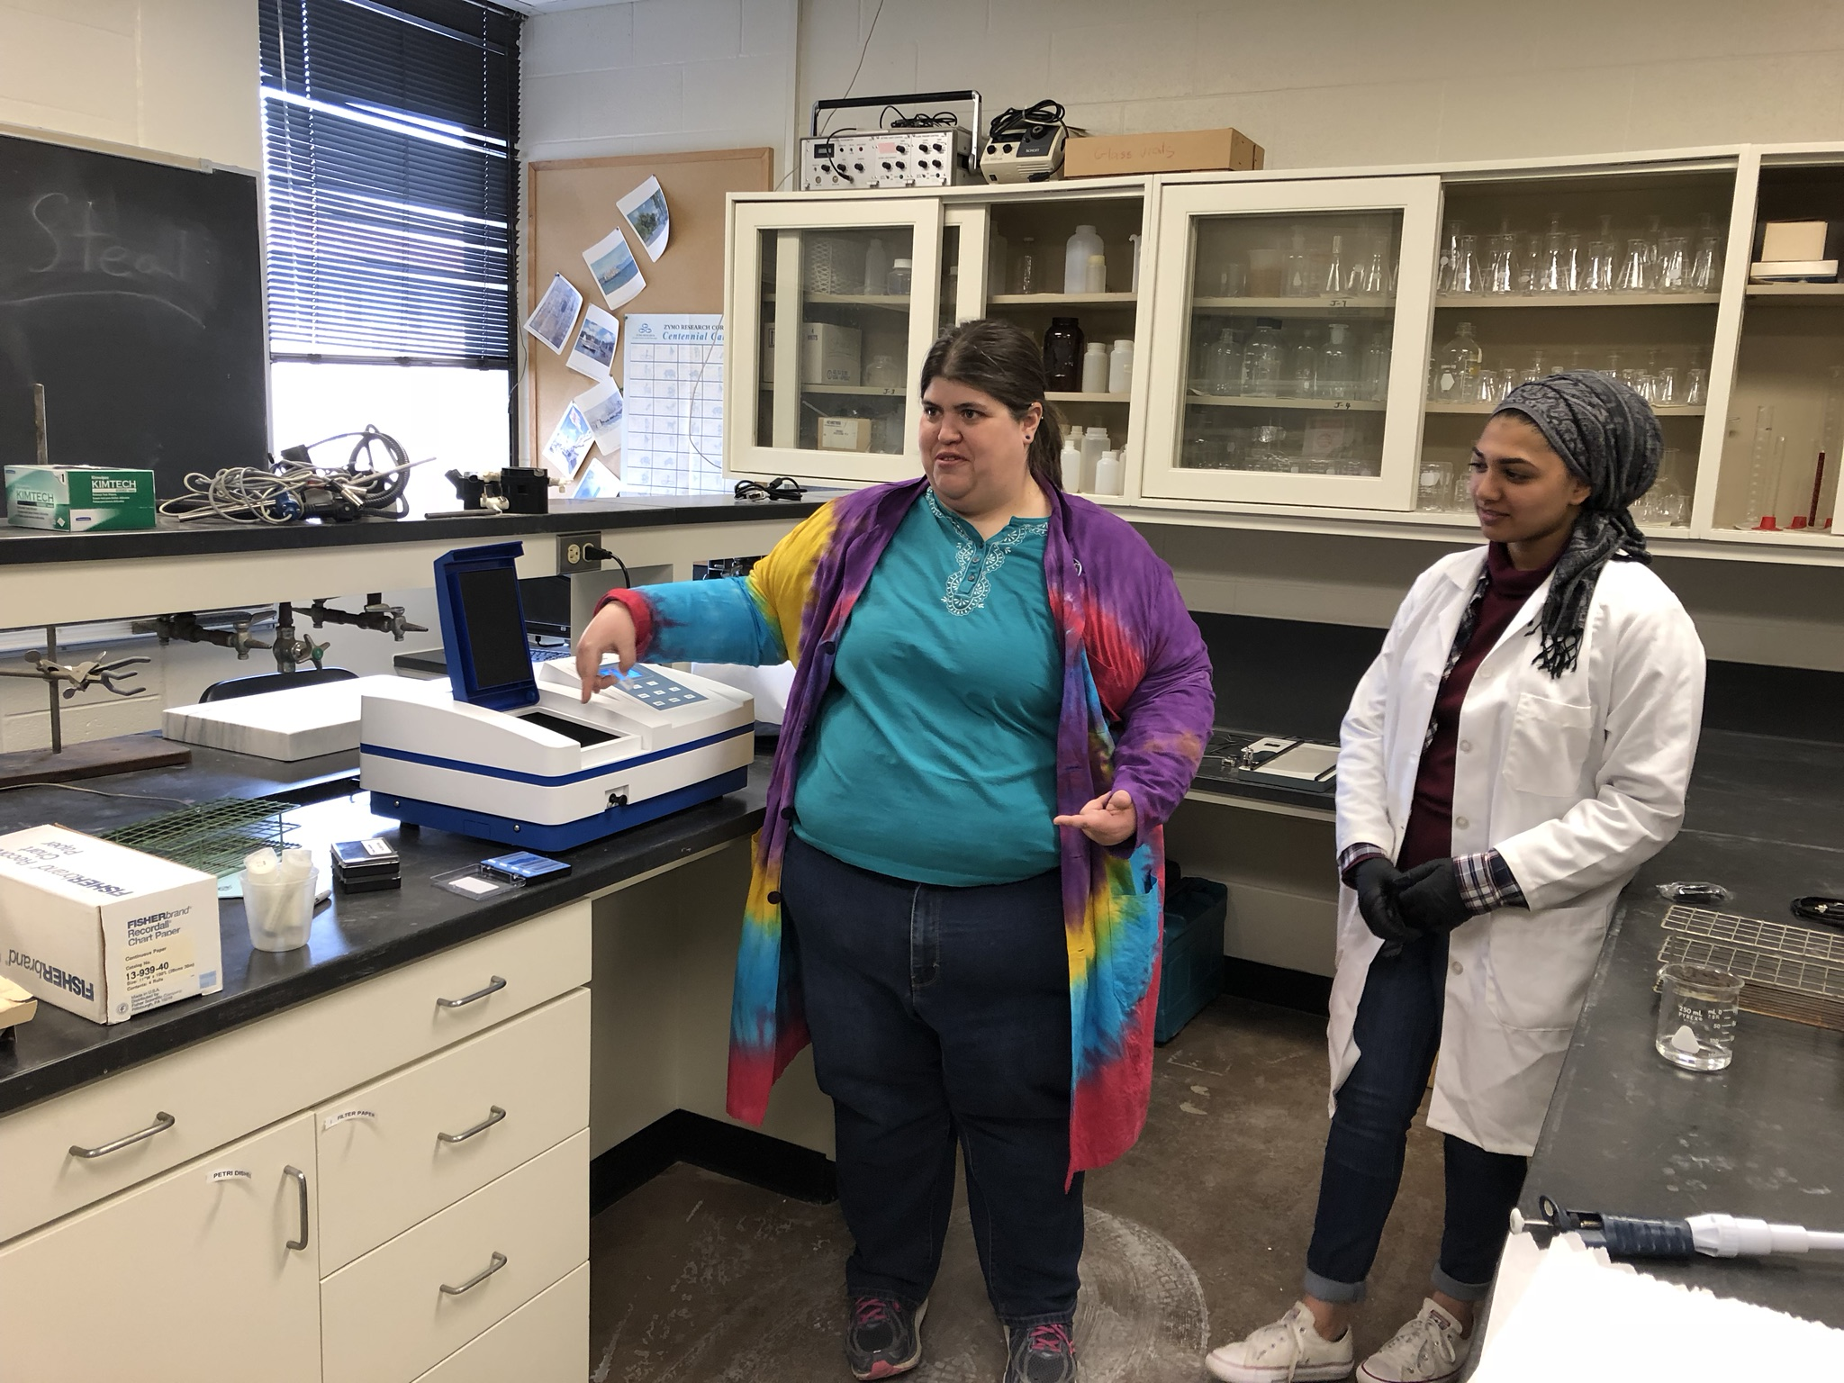
Experimental setup
Full factorial greenhouse experiment
Treatments
Species: cotton and soybean
Light: 4 levels (0%-80% shade)
Nitrogen: 4 levels (0-630 ppm Hoagland’s)
Measurements
Biomass and nutrient partitioning among organs
Leaf gas exchange and chemistry
Perkowski et al. (2021) J Exp Bot
Waring et al. (2023) J Exp Bot

Slide 21
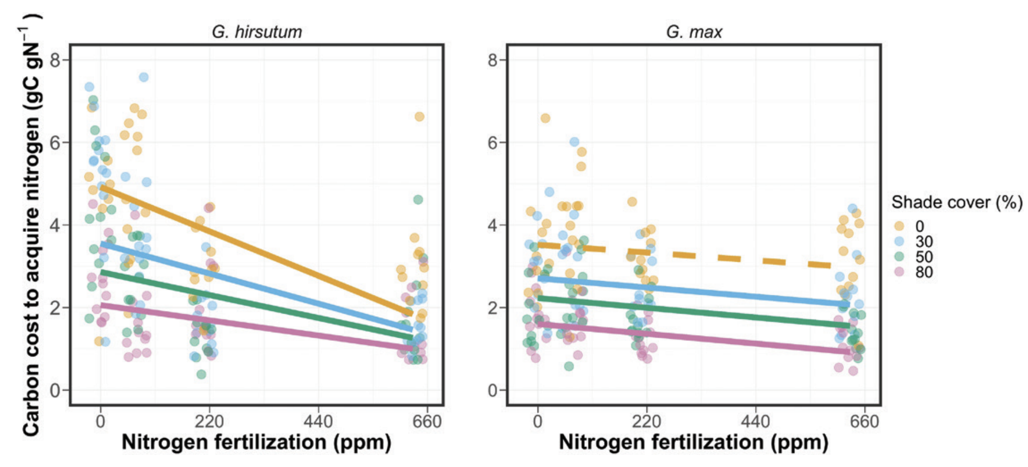
Takehome 1: C cost to acquire N increases with N demand and decreases with N supply*
*Stronger in cotton than soybean
Perkowski et al. (2021) J Exp Bot

Slide 22
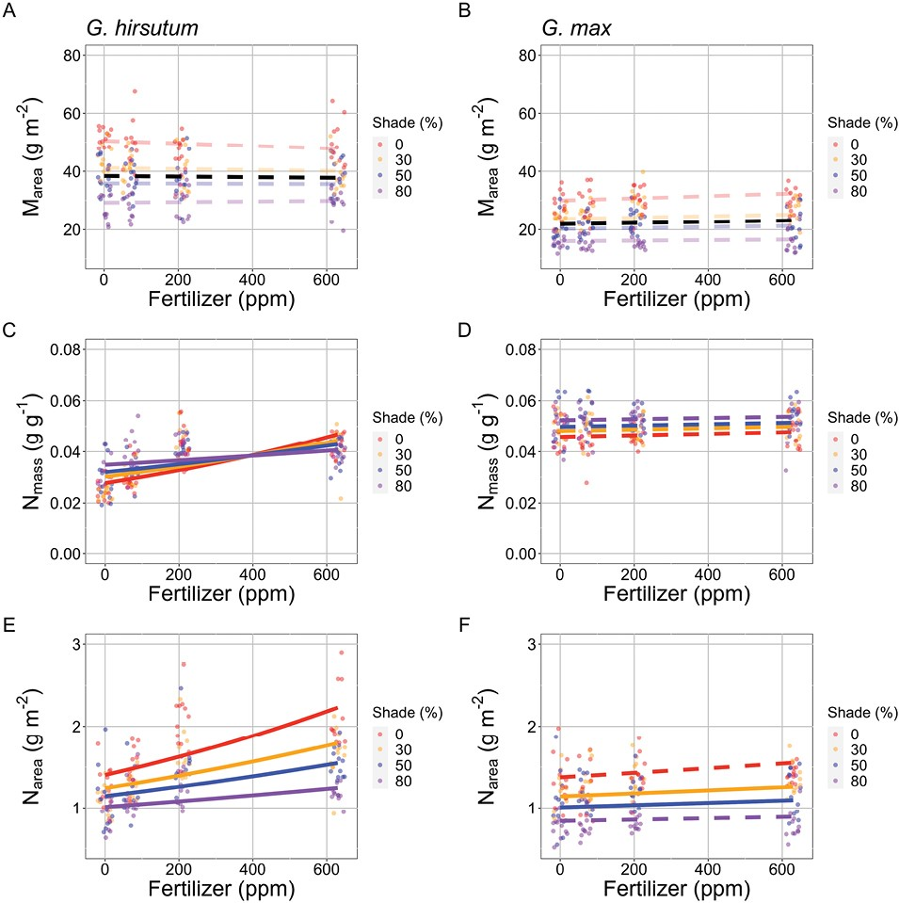
Takehome 2: Leaf N increases with N demand and supply*
*Stronger in cotton than soybean
Waring et al. (2023) J Exp Bot

Slide 23
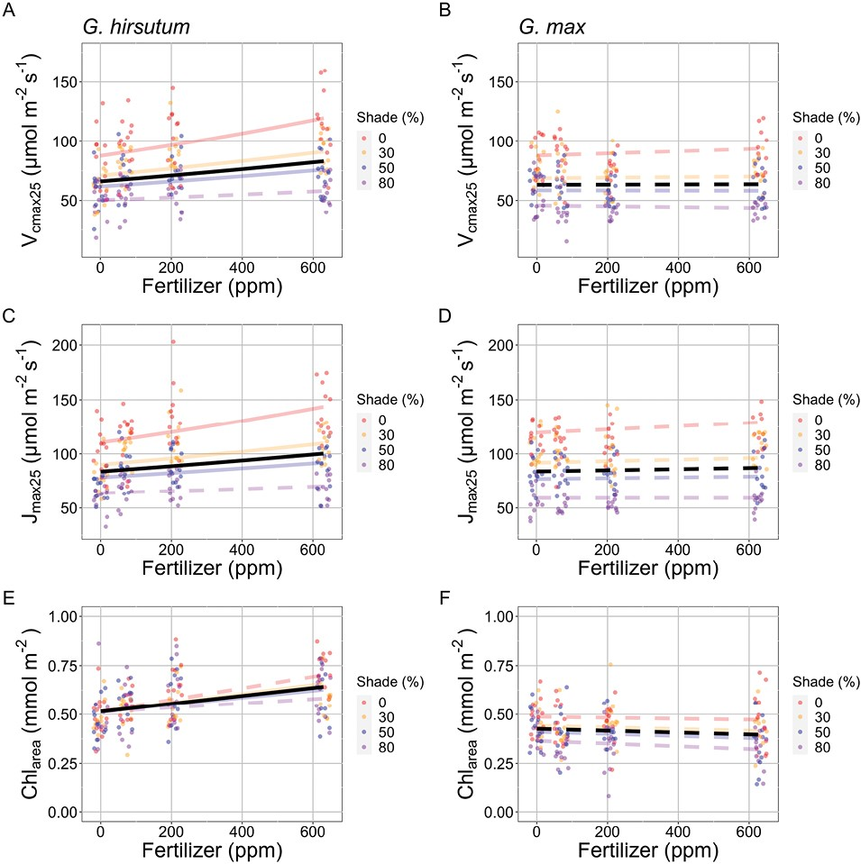
Takehome 3: increased leaf N generally* corresponds to increased photosynthetic capacity
*Stronger in cotton than soybean
Waring et al. (2023) J Exp Bot

Slide 24
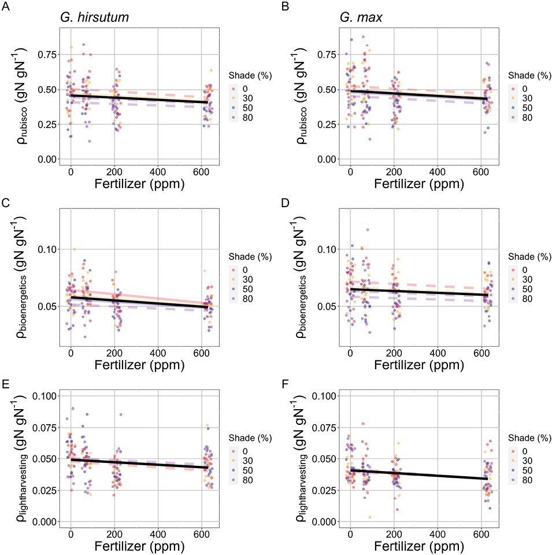
Takehome 4: most of increased leaf N going to non-photosynthetic processes*
*Similar in cotton than soybean!
Waring et al. (2023) J Exp Bot

Slide 25
Nitrogen supply-demand results
Added soil N makes it cheaper for plants to obtain N regardless of demand
Relative impact greatest when demand is greatest
Both supply and demand impact leaf N
Leaf N changes with N demand correspond to photosynthesis
Leaf N changes with N supply do not correspond to photosynthesis
Perkowski et al. (2021) J Exp Bot
Waring et al. (2023) J Exp Bot

Slide 26
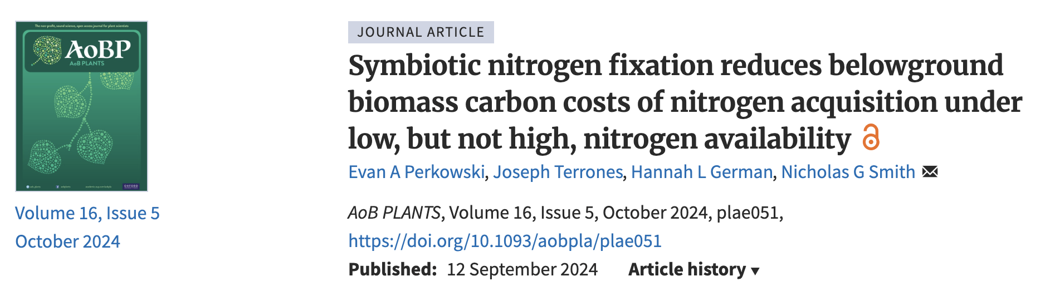
Nitrogen supply-demand results
Added soil N makes it cheaper for plants to obtain N regardless of demand
Relative impact greatest when demand is greatest
Both supply and demand impact leaf N
Leaf N changes with N demand correspond to photosynthesis
Leaf N changes with N supply do not correspond to photosynthesis
All responses stronger in cotton than soybean, confirmed to be due to N fixation (Perkowski et al., 2024)

Slide 27
Talk outline
Photosynthetic least cost theory and its relation to nutrients
Tests of the theory
The interactions between nutrient supply and demand
Responses to elevated CO₂
Conclusions

Slide 28
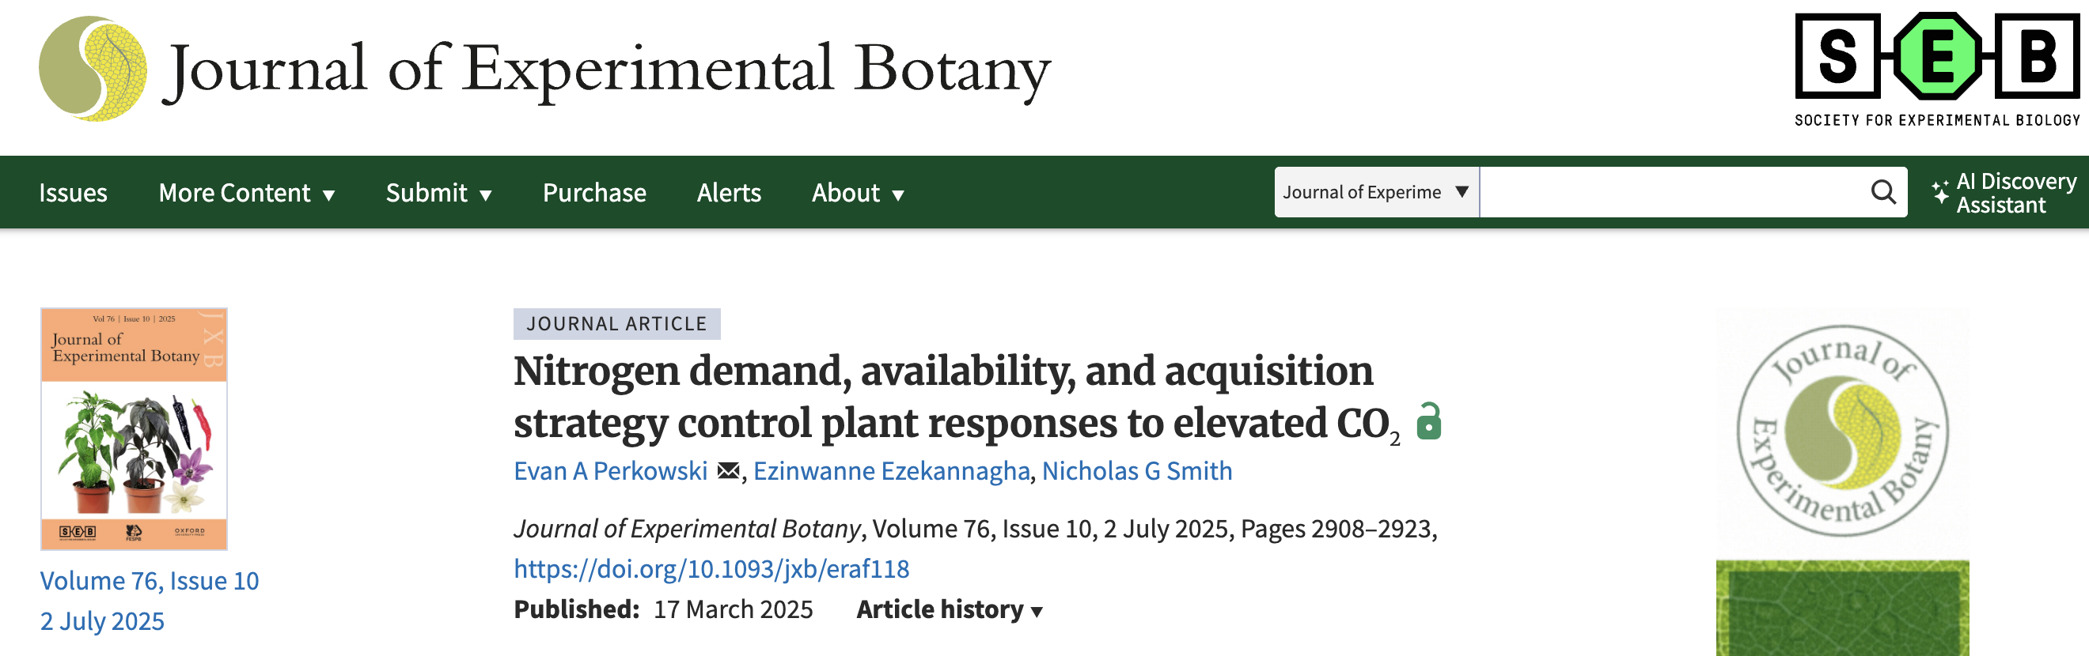
Perkowski et al. (2025) J Exp Bot

Slide 29
Main questions
How does nitrogen supply influence photosynthetic demand-driven responses to changes in in CO₂?
Perkowski et al. (2025) J Exp Bot

Slide 30
Main questions
How does nitrogen supply influence photosynthetic demand-driven responses to changes in in CO₂?
Smith and Keenan (2020) Glob Change Biol
Perkowski et al. (2025) J Exp Bot

Slide 31
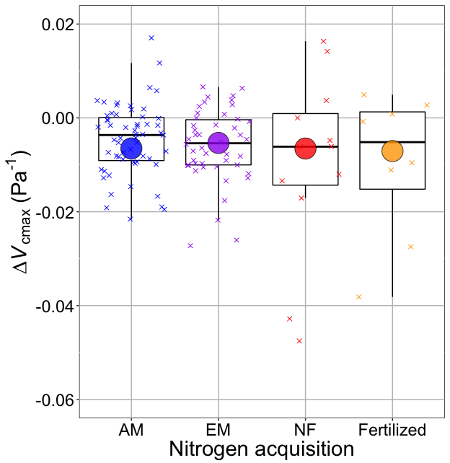
Main questions
How does nitrogen supply influence photosynthetic demand-driven responses to changes in in CO₂?
Boxes = data = -0.0063 Pa⁻¹
Circles = predicted = -0.0066 Pa⁻¹
Smith and Keenan (2020) Glob Change Biol
Perkowski et al. (2025) J Exp Bot

Slide 32

Experimental setup
Full factorial growth chamber experiment
Treatments
Species: soybean w/ and w/o rhizobia
CO₂: 2 levels (400 & 1000 ppm)
Nitrogen: 0 levels (0-630 ppm Hoagland’s)
Measurements
Biomass and nutrient partitioning among organs
Leaf gas exchange and chemistry
Perkowski et al. (2025) J Exp Bot

Slide 33
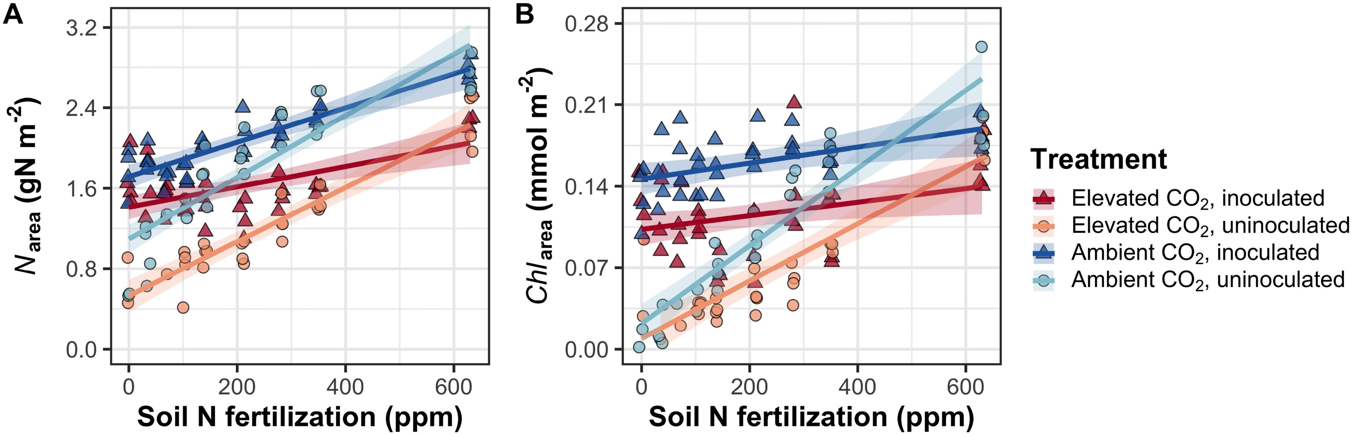
Takehome 1: N supply increases leaf N, CO₂ decreases leaf N
Perkowski et al. (2025) J Exp Bot

Slide 34
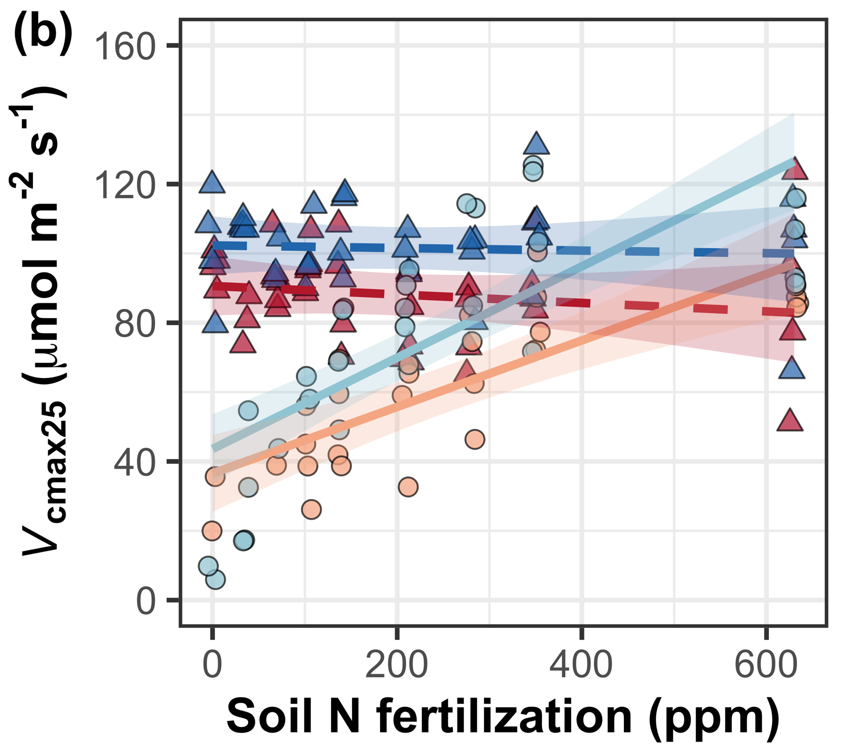
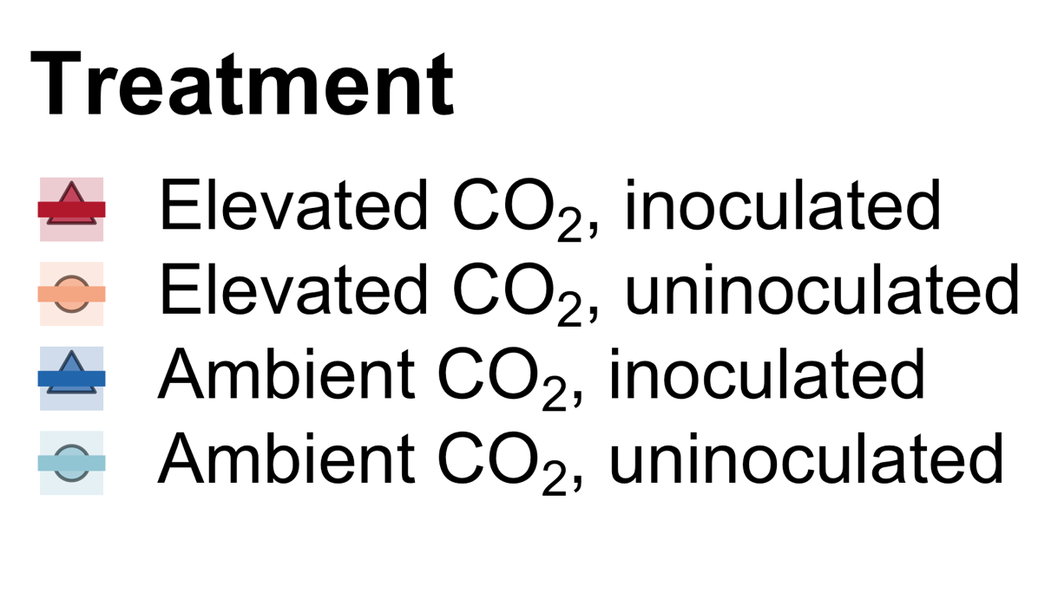
Takehome 2: CO₂ effect is consistent and due to reduction in photosynthetic capacity
Perkowski et al. (2025) J Exp Bot

Slide 35
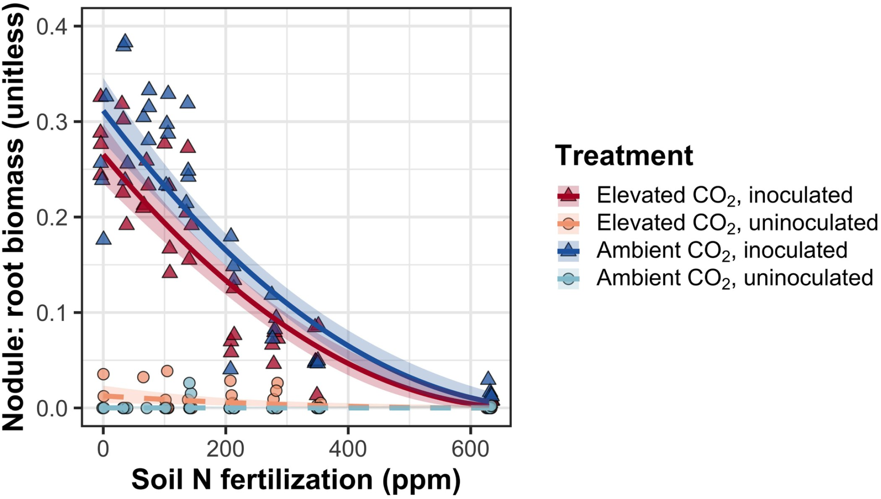
Takehome 3: reliance on N-fixing bacteria decreases with increasing soil N
Perkowski et al. (2025) J Exp Bot

Slide 36
CO₂-N results
Little interaction between soil N supply and CO₂-driven changes in N demand
Soil N supply increases leaf N and photosynthetic capacity
CO₂ reduces photosynthetic demand, leaf N, and photosynthetic capacity (independent of soil N)
As in previous experiment, soil N supply responses are reduced in individuals capable of N fixation
Perkowski et al. (2025) J Exp Bot

Slide 37
What do plants do with this saved N?

Slide 38
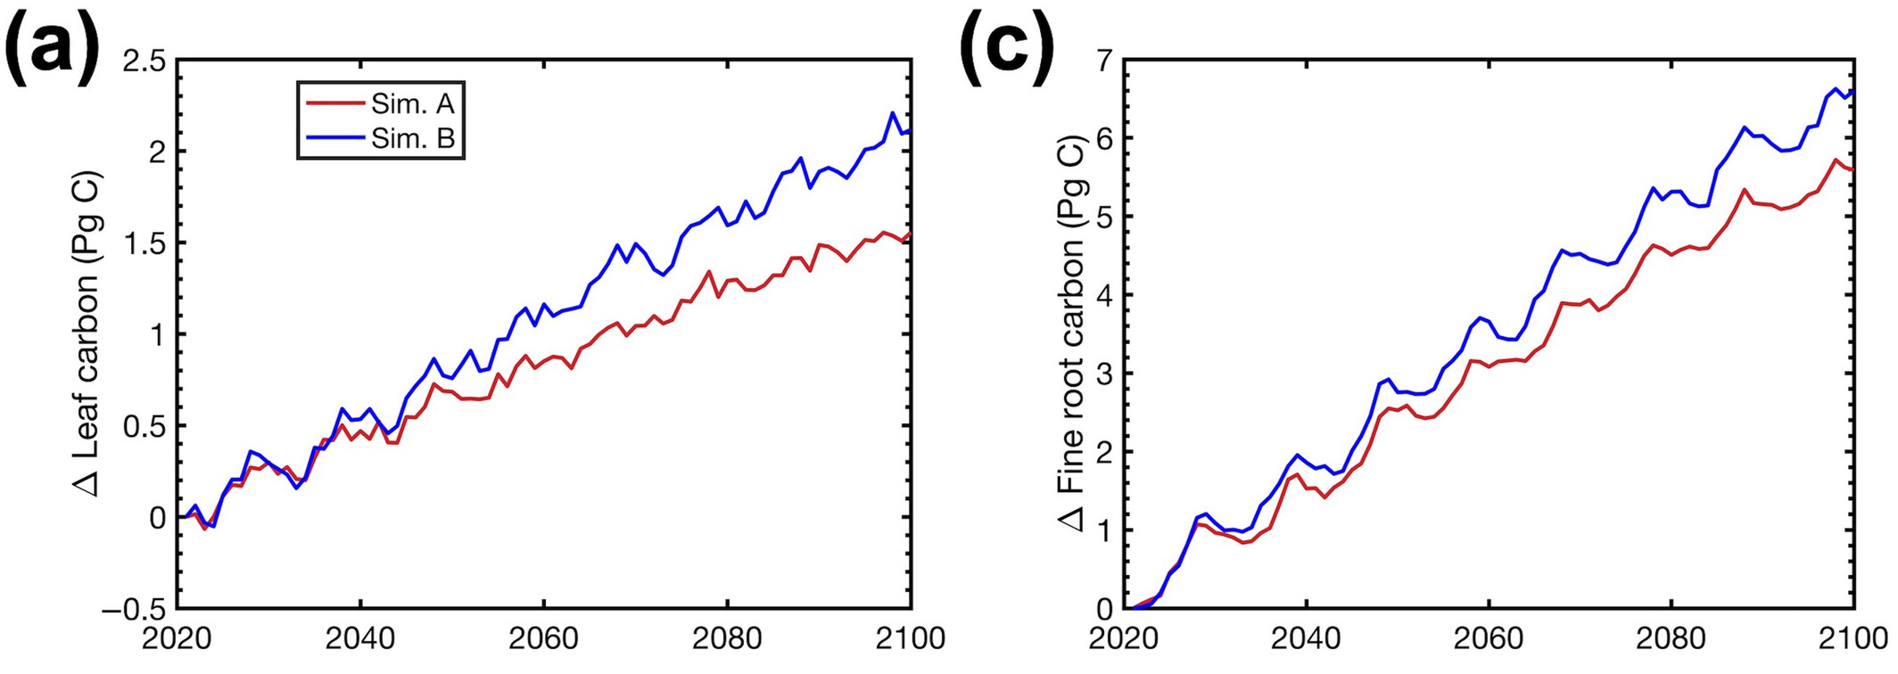
When plants save N under elevated CO₂, they build more leaves and roots
Smith et al. (2024) Glob Change Biol

Slide 39
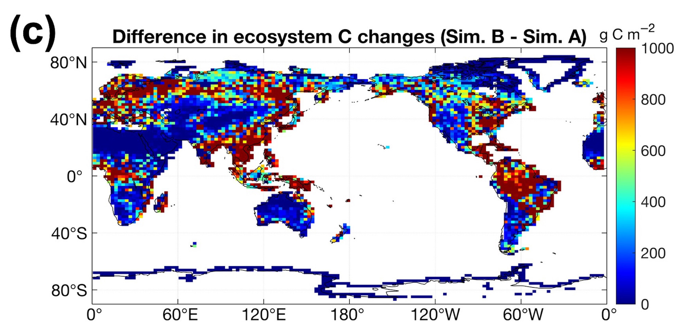
Leaf N savings increases long-term ecosystem carbon stocks
50% increase in ecosystem carbon from CO₂ acclimation
Smith et al. (2024) Glob Change Biol

Slide 40
Talk outline
Photosynthetic least cost theory and its relation to nutrients
Tests of the theory
The interactions between nutrient supply and demand
Responses to elevated CO₂
Conclusions

Slide 41
Conclusions
Plants aren’t dumb!
They respond dynamically to changes in their environment
This includes changes in nutrient availability and nutrient demand
Dumb plants

Slide 42
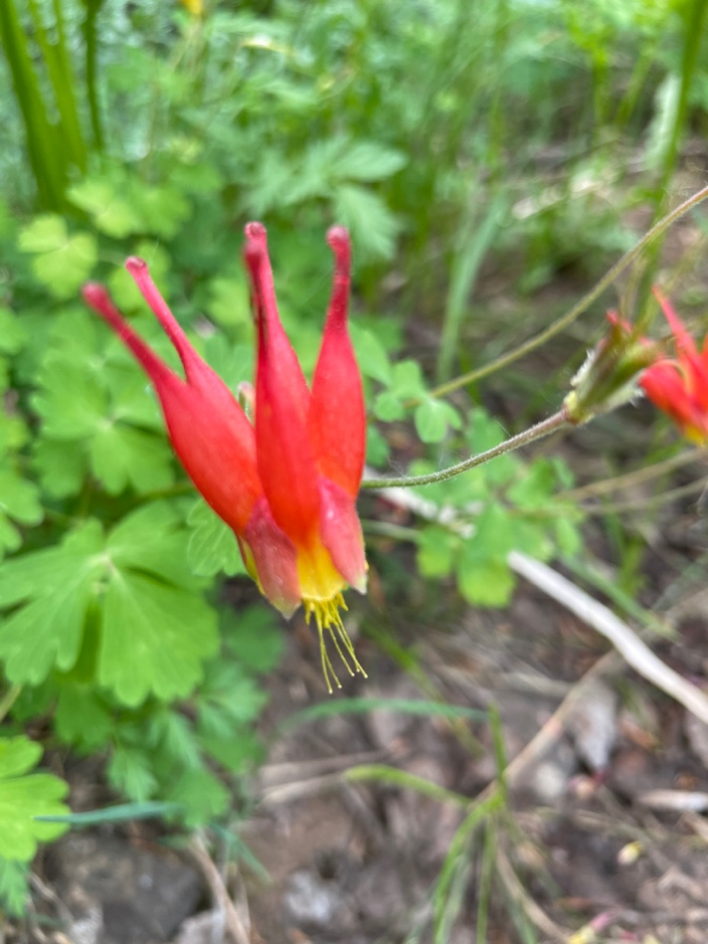


Conclusions
Quantified theory can help to better understand the mechanisms underlying these response dynamics
Can be used to predict plant-to-ecosystem level responses to environmental variability
f(x)
f(x)

Slide 43

Presentation available at:
www.github.com/SmithEcophysLab/seminar/gpsfc_2026
Contact: nick.smith@ttu.edu
Thanks!

