Slide 1
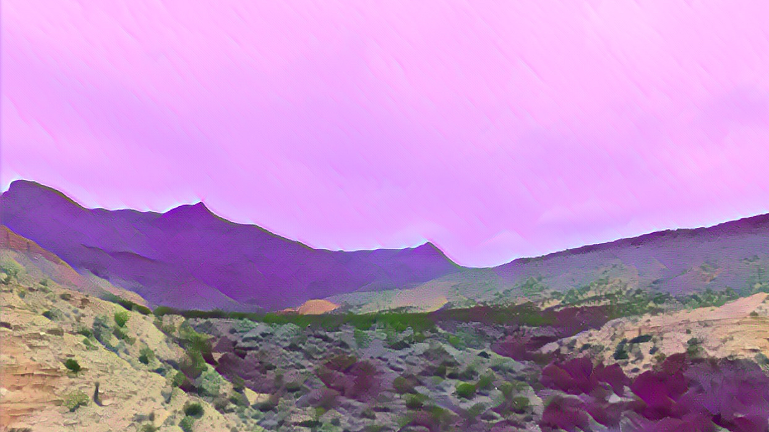
Plants aren’t dumb
Using optimality theory to answer big questions in plant ecophysiology
Nick smith
TTU Biology eeb seminar
January 22, 2020 12:00 pm Biol 021

