Slide 1

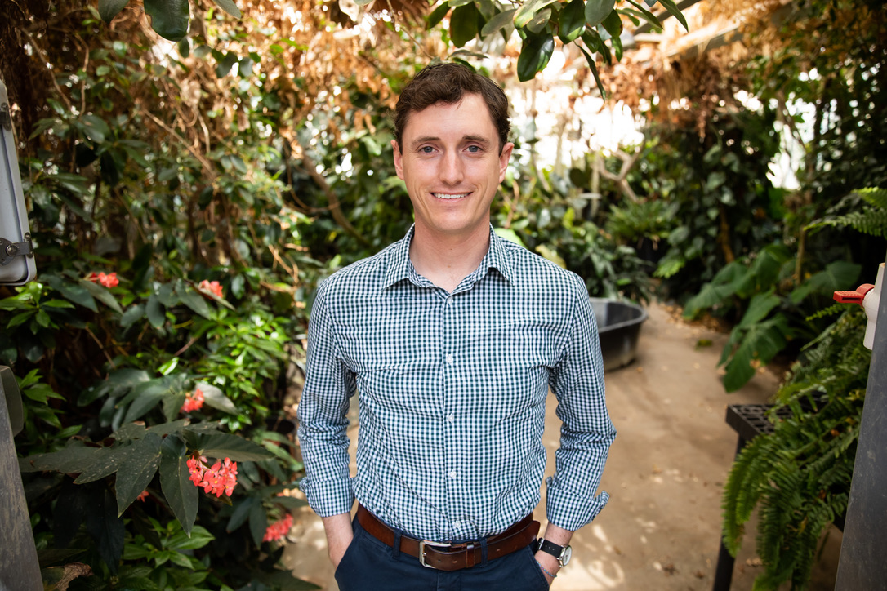
Grab a beer and talk science!
Inaugural Science by the Glass at Goodline Beer Co. presented by the TTU Climate Center
November 15, 2023
5:30 PM
Speaker: Nick Smith, Associate Professor, Biology, TTU
Topic: Why Plants Matter for Climate
Format: Short talk followed by Q&A
Talk summary: Plants provide a wide array of ecosystem services that humans rely on and there is substantial concern that many of these services may be negatively impacted by climate. However, one somewhat under-appreciated ecosystem service that plants provide is their ability to directly impact and regulate climate. This talk will introduce how this plant-climate feedback works and highlight how the Smith Lab is working to better understand it. The talk is designed for a general, possibly beer drinking, audience. The goal of the talk is to foster a greater appreciation for the outsized role that plants play in the global climate system and highlight opportunities for future climate adaptation and mitigation through plants.

