Slide 1


Introduction to the TTU Climate Center and the National Climate Assessment
Nick Smith
Assc. Prof., Department of Biological Sciences, TTU
Director, Climate Center, TTU
nick.smith@ttu.edu

Slide 2
Outline
TTU Climate Center
Who we are
What we do
National Climate Assessment (NCA5)
What is the NCA
NCA5 Ch. 26: Southern Great Plains
nick.smith@ttu.edu

Slide 3
Outline
TTU Climate Center
Who we are
What we do
National Climate Assessment (NCA5)
What is the NCA
NCA5 Ch. 26: Southern Great Plains
nick.smith@ttu.edu

Slide 4
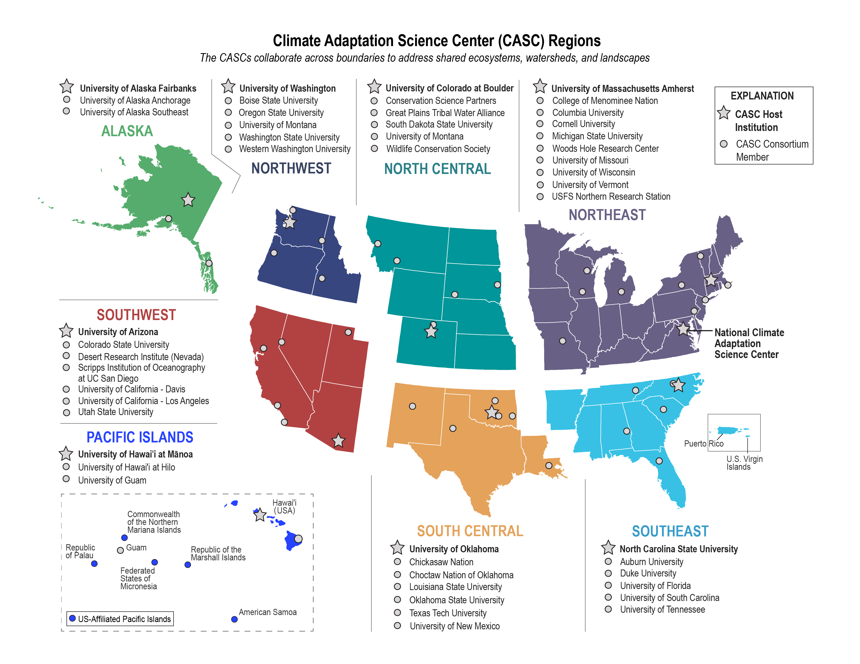
TTU Climate Center: Who we are
Member of USGS-funded Climate Adaptation Science Centers (CASCs)
nick.smith@ttu.edu

Slide 5
TTU Climate Center: Who we are
Consortium institution of the South Central CASC (SC-CASC)
nick.smith@ttu.edu

Slide 6
TTU Climate Center: Who we are
SC-CASC:
Provide decision makers with the science, tools, and information they need to address the impacts of climate variability and change
Transform how climate science is conducted and applied in the south-central US
Support big thinking, including multi-institutional and stakeholder-driven approaches to assessing the impact of climate on natural and cultural resources
nick.smith@ttu.edu

Slide 7
TTU Climate Center: Who we are
>100 active members
Faculty, students and postdocs
12 TTU Colleges
36 TTU Departments
Open to anyone interested in, passionate about, or doing climate-related work
nick.smith@ttu.edu

Slide 8
Outline
TTU Climate Center
Who we are
What we do
National Climate Assessment (NCA5)
What is the NCA
NCA5 Ch. 26: Southern Great Plains
nick.smith@ttu.edu

Slide 9


TTU Climate Center: What we do
Serve as regional hub for climate change
Work with community members and stakeholders
All areas of research that intersect with climate
Monthly research and outreach meetings
Events
Informational events on and off campus
Science by the Glass
nick.smith@ttu.edu

Slide 10
Outline
TTU Climate Center
Who we are
What we do
Where we are going
National Climate Assessment (NCA5)
What is the NCA
NCA5 Ch. 26: Southern Great Plains
nick.smith@ttu.edu

Slide 11
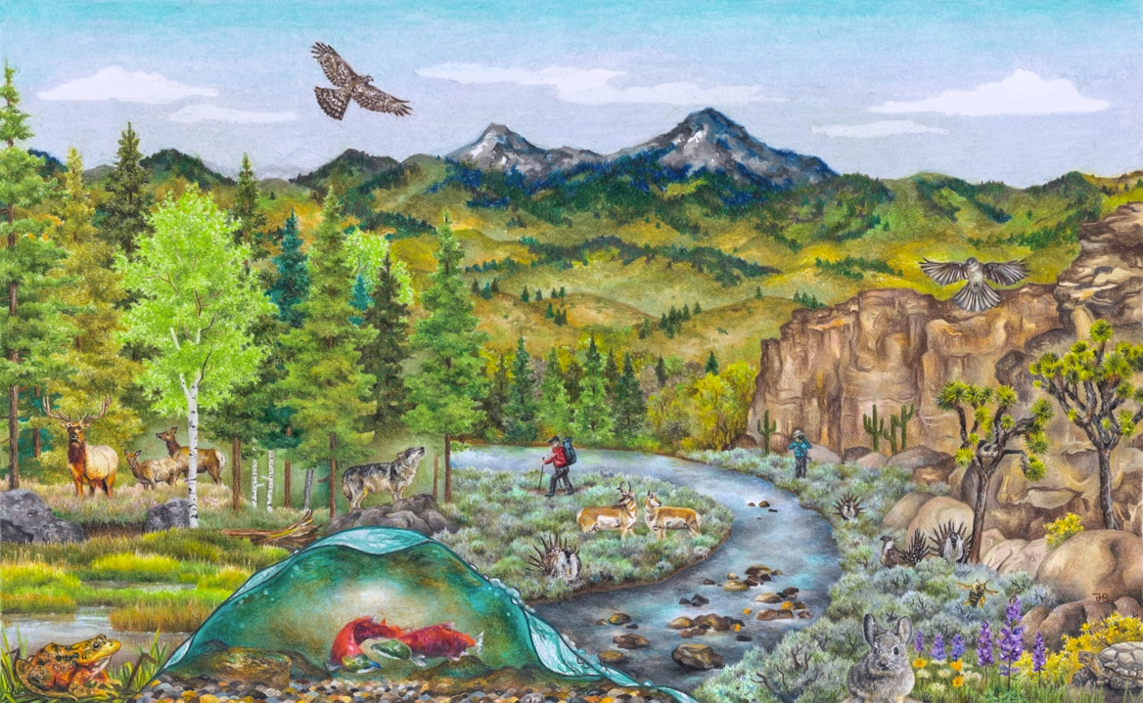
What is the NCA?
US government report
Congressionally mandated and overseen by multiple agencies
Delivered to congress and the president
Climate change impacts, risks, and responses for USA
Provides scientific foundation for decision making
Policy relevant, but policy neutral
nick.smith@ttu.edu

Slide 12

What is NCA? Mandate
Result of the Global Change Research Act of 1990
Every 4 years a report that “analyzes the effects of global change on the natural environment, agriculture, energy production and use, land and water resources, transportation, human health and welfare, human social systems, and biological diversity; and analyzes current trends in global change, both human-induced and natural, and projects major trends for the subsequent 25 to 100 years”
nick.smith@ttu.edu

Slide 13

What is NCA? Review process
Reviewed by:
Federal government experts
External experts
General public
External reviewers from NASEM
Review by each group multiple times throughout the process
All reviews responded to
nick.smith@ttu.edu

Slide 14

What is NCA? Audience
Audience: decision makers
national, state, local, and Tribal governments, city planners, public health officials, adaptation specialists, nurses, farmers, business owners, community organizers, researchers, water utilities, ecosystem managers, educators, students, the media, and concerned individuals
nick.smith@ttu.edu

Slide 15

What is NCA? Structure
Each chapter has list of key messages
Conclusions based on authors’ expert judgment and synthesis of the assessed information sources
Often present findings in the context of risks to natural and/or human systems
nick.smith@ttu.edu

Slide 16
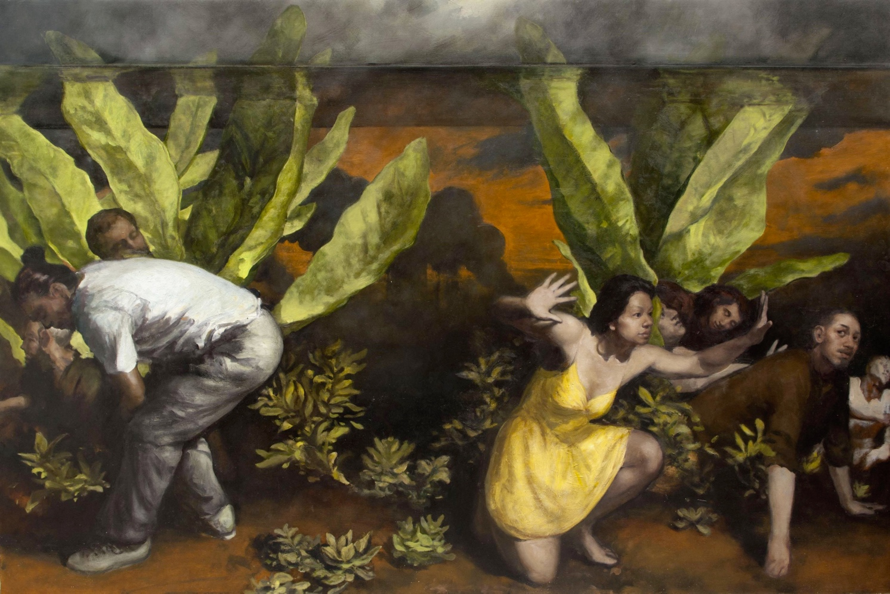
What is NCA? Confidence and Likelihood
Calibrated terms in key messages
Confidence: based on the type, amount, quality, strength, and consistency of evidence; the skill, range, and consistency of methods to detect, evaluate, attribute, and interpret climate trends; and the degree of agreement across scientific information sources
Likelihood: based on measures of certainty expressed probabilistically
nick.smith@ttu.edu

Slide 17

What is NCA? Content
Four categories of chapters
Overview chapter (Ch. 1)
Physical science chapters (Ch. 2-3)
National topics chapters (Ch. 4-20)
Regional chapters (Ch. 21-30)
Response chapters (Ch. 31-32)
nick.smith@ttu.edu

Slide 18
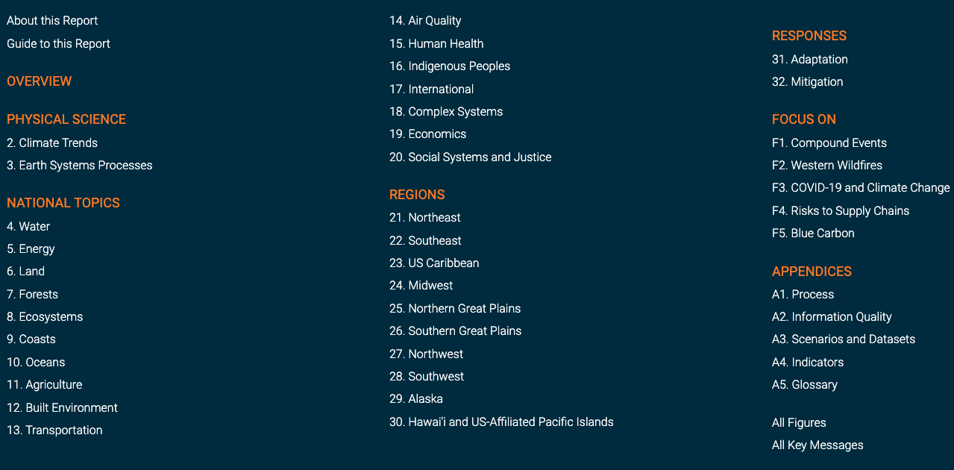
nick.smith@ttu.edu

Slide 19

What is NCA5? Content
Four categories of chapters
Overview chapter (Ch. 1)
Physical science chapters (Ch. 2-3)
National topics chapters (Ch. 4-20)
Regional chapters (Ch. 21-30)
Response chapters (Ch. 31-32)
nick.smith@ttu.edu

Slide 20
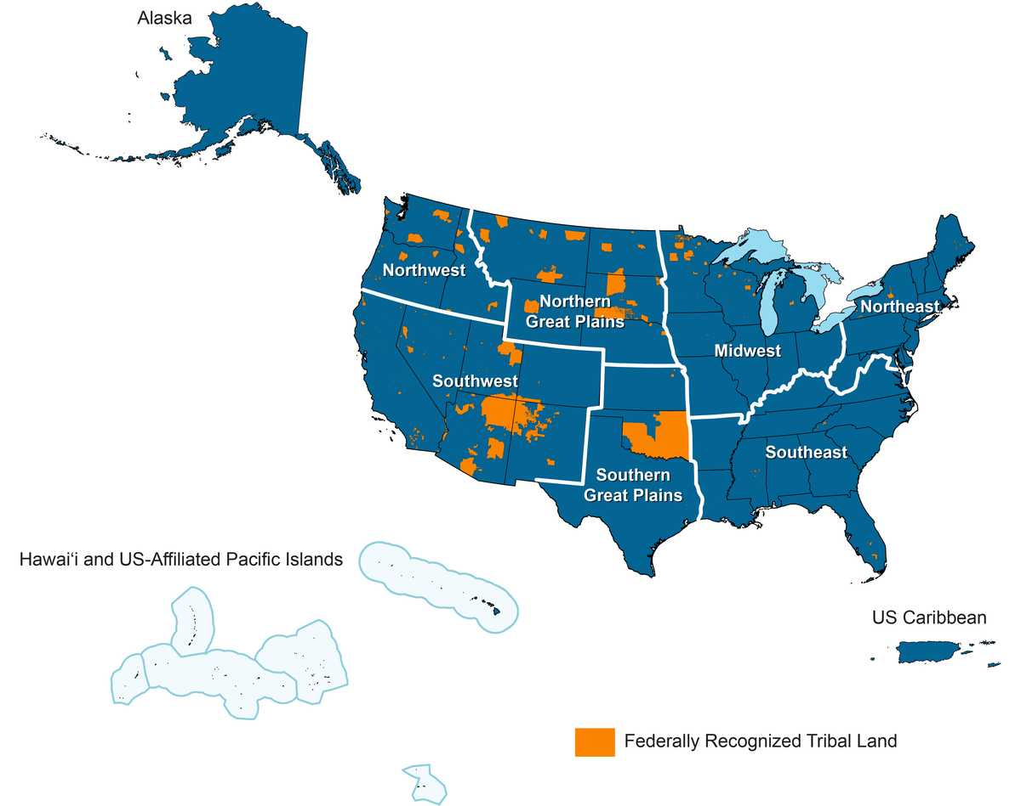
nick.smith@ttu.edu

Slide 21
Outline
TTU Climate Center
Who we are
What we do
Where we are going
National Climate Assessment (NCA5)
What is the NCA
NCA5 Ch. 26: Southern Great Plains
nick.smith@ttu.edu

Slide 22
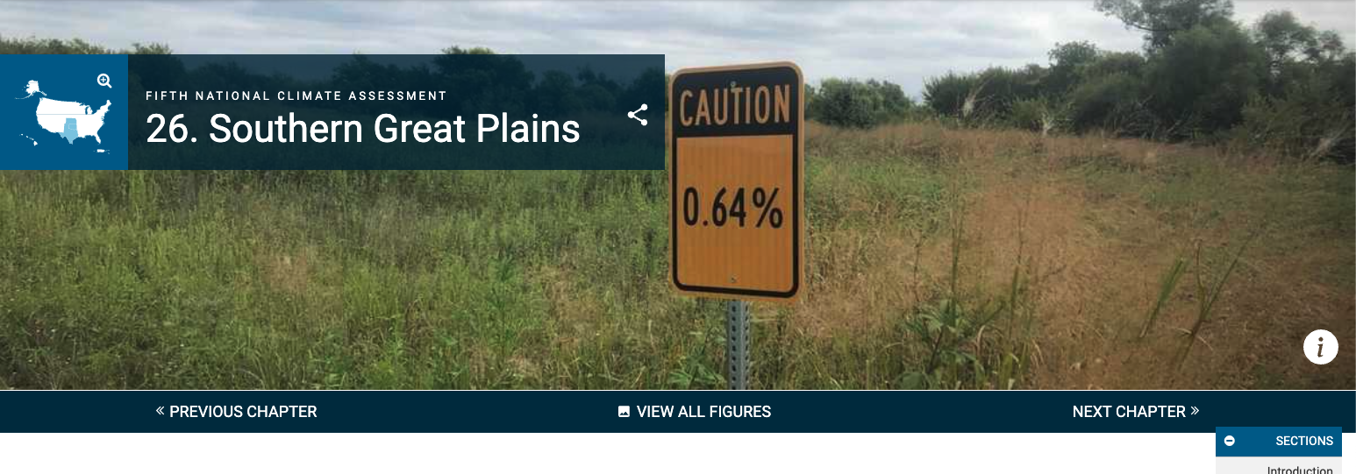
nick.smith@ttu.edu

Slide 23
Health-related Key Messages from NCA5 SGP chapter
Climate change is putting us at risk from climate hazards that degrade our health and well-being (high confidence).
Climate change is expected to increase heat-related illness and death (very likely, high confidence).
Climate change will compound existing burdens, with the greatest impact on people with the fewest resources to prepare and adapt (very high confidence).
The institutions that serve our communities have been challenged to respond and adapt (medium confidence).
nick.smith@ttu.edu

Slide 24
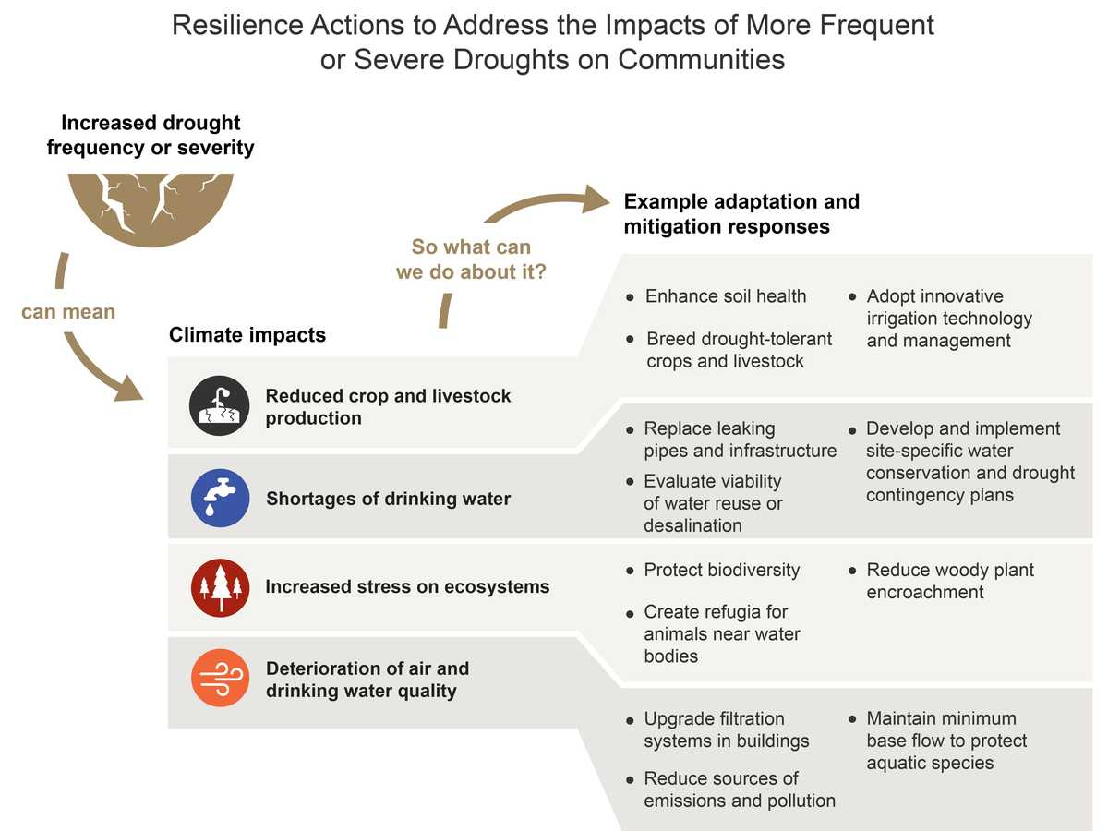
nick.smith@ttu.edu

Slide 25
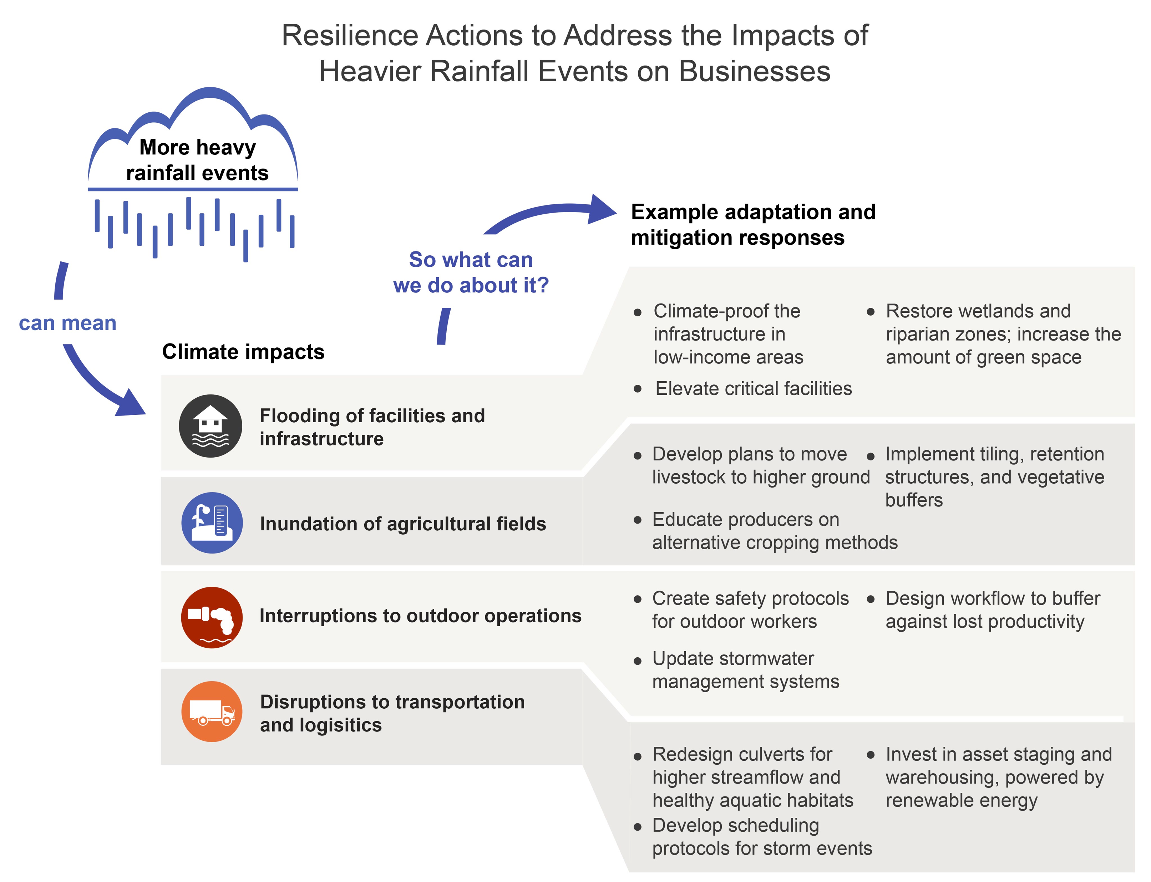
nick.smith@ttu.edu

Slide 26
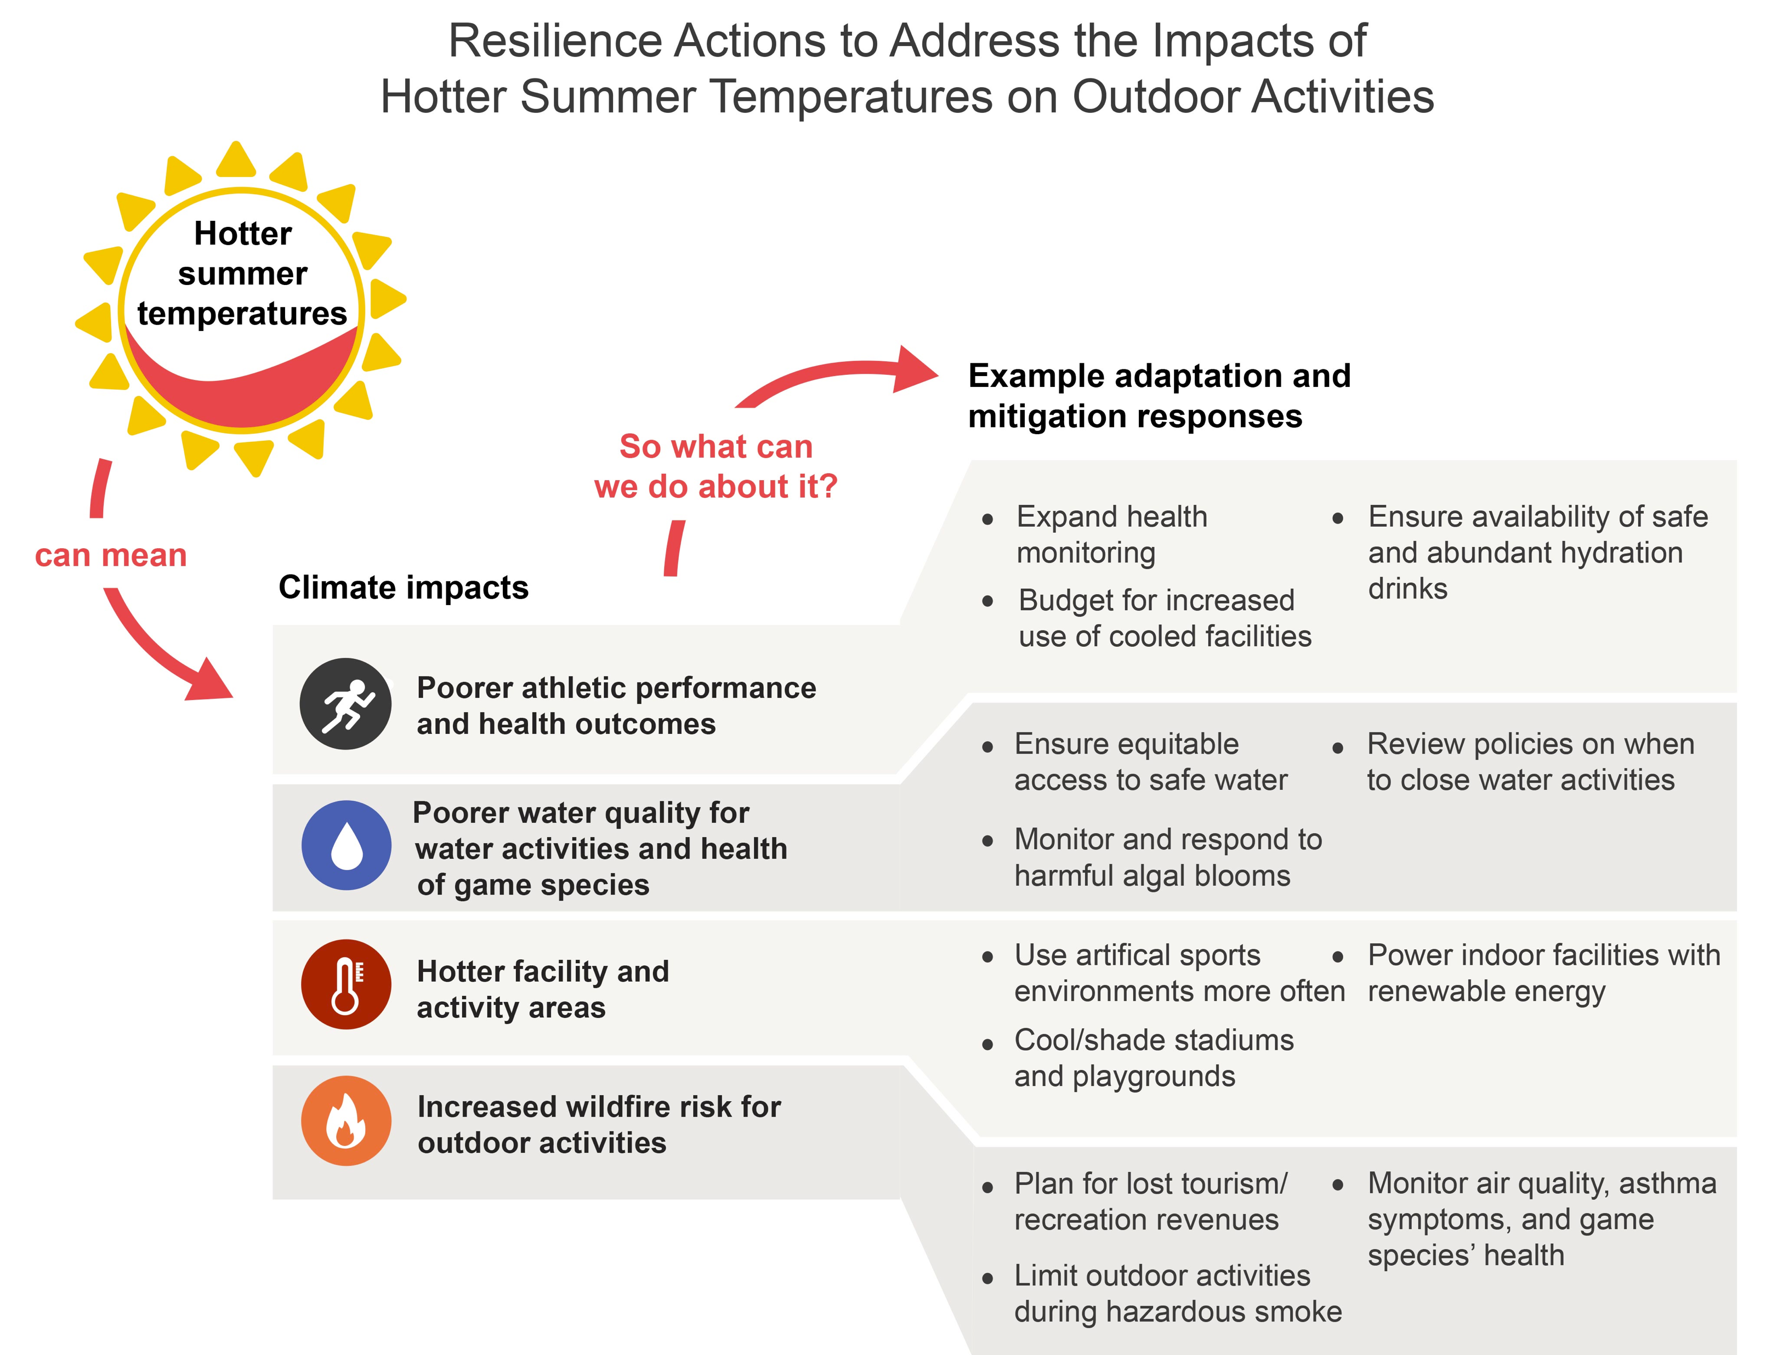
nick.smith@ttu.edu

Slide 27
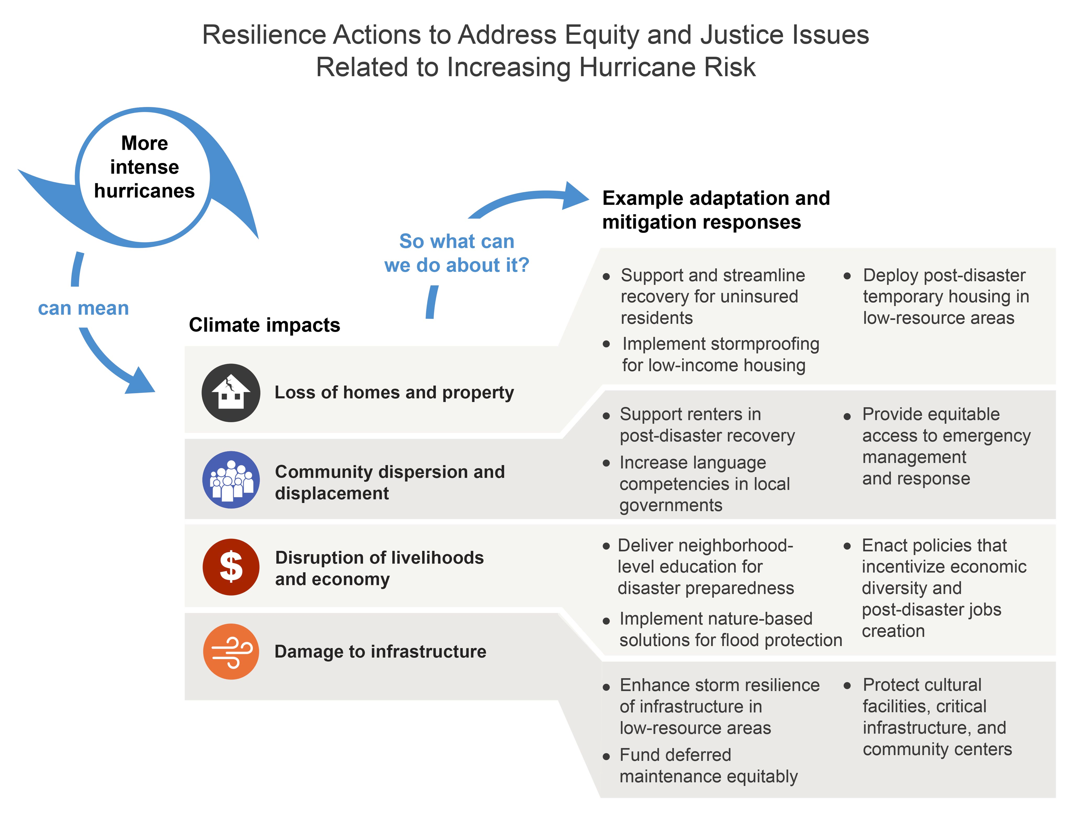
nick.smith@ttu.edu

Slide 28
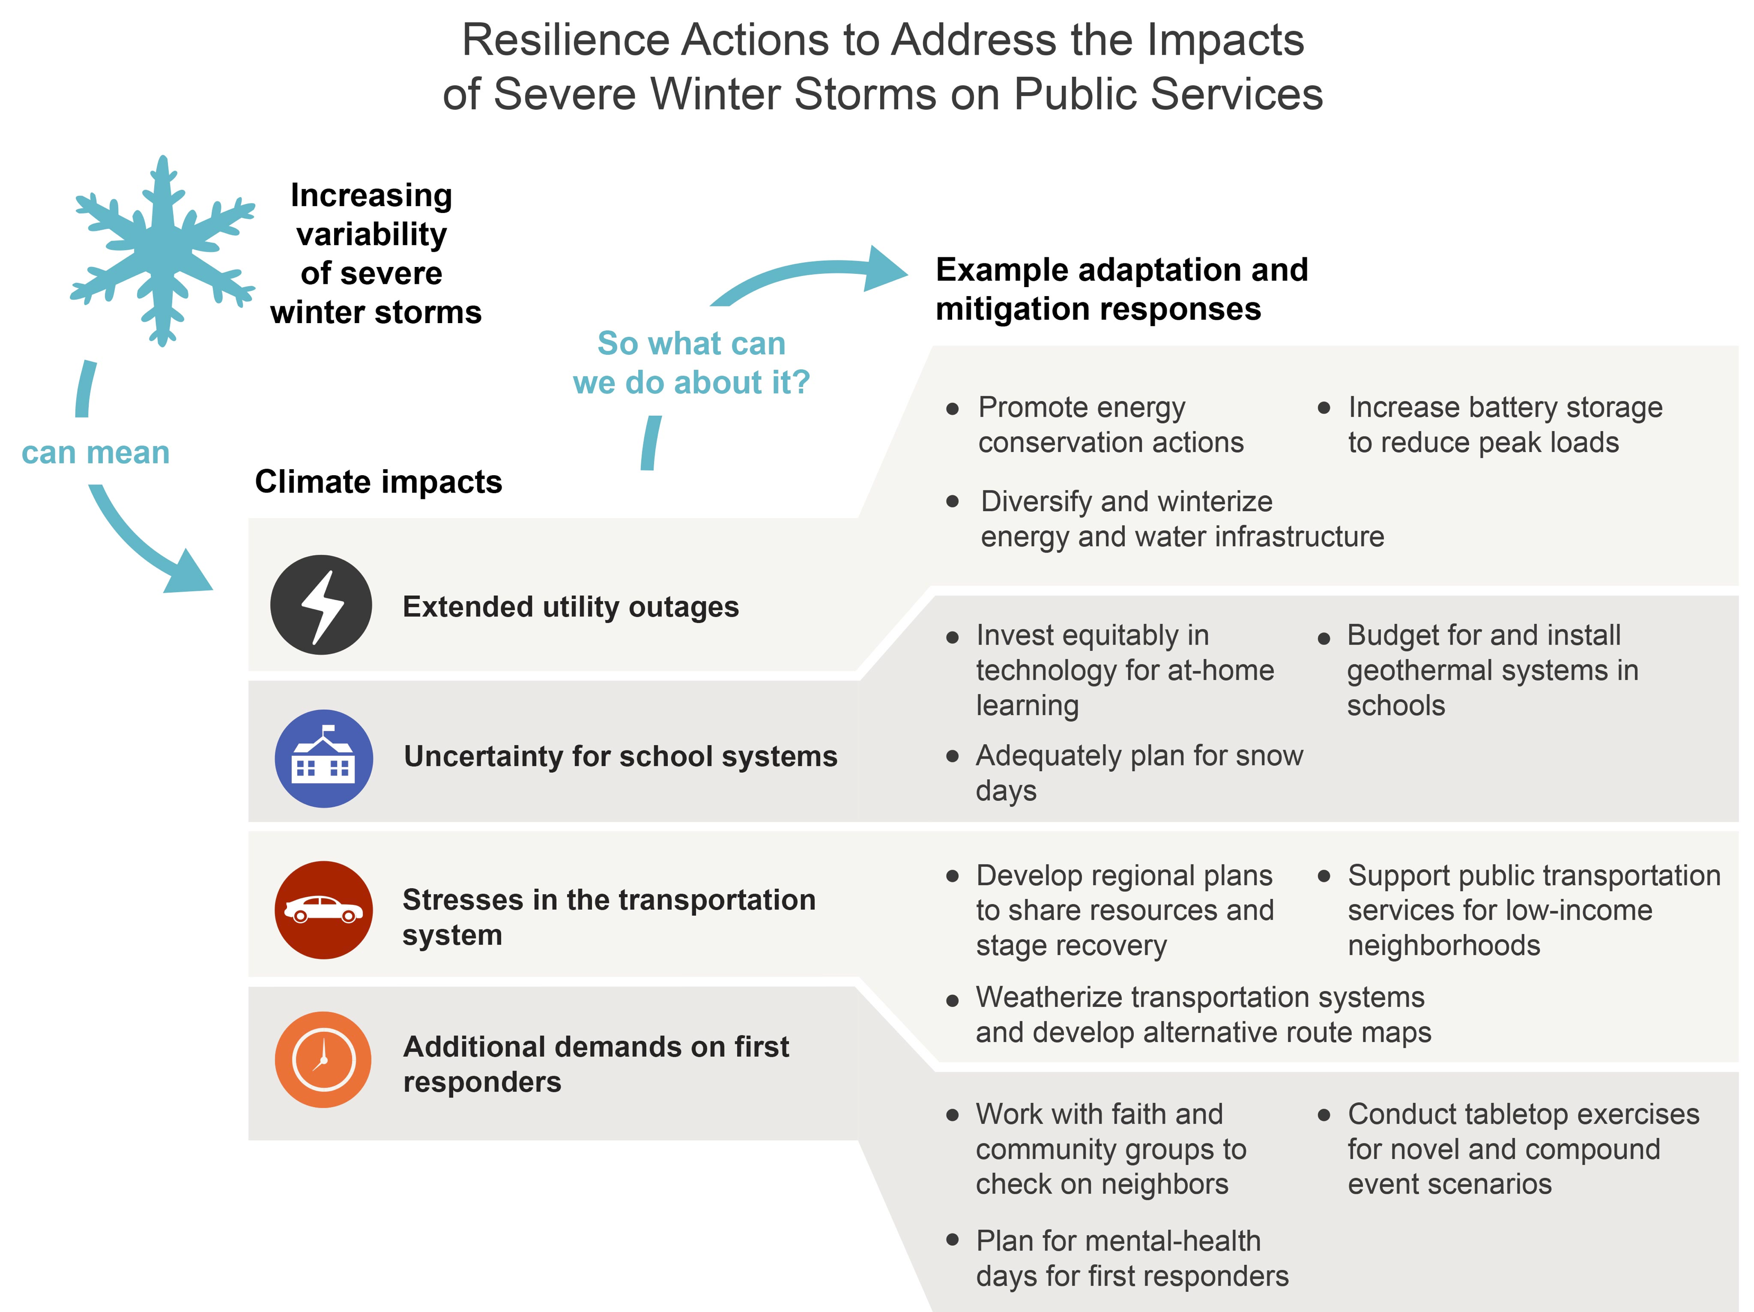
nick.smith@ttu.edu

Slide 29
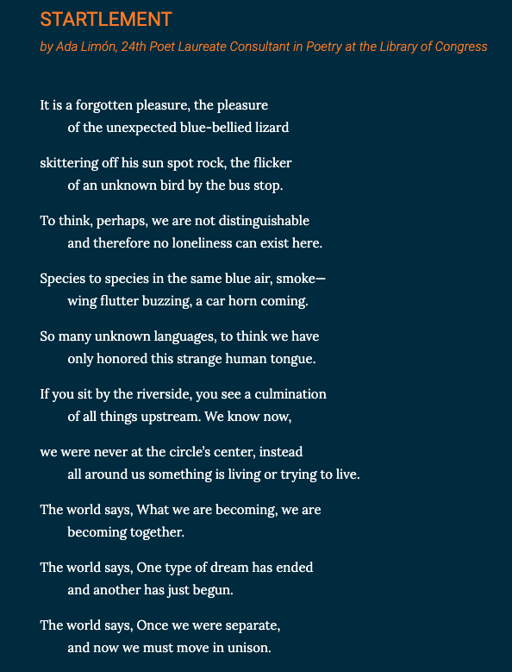


Ada Limón, 24th US Poet Laureate

Slide 30
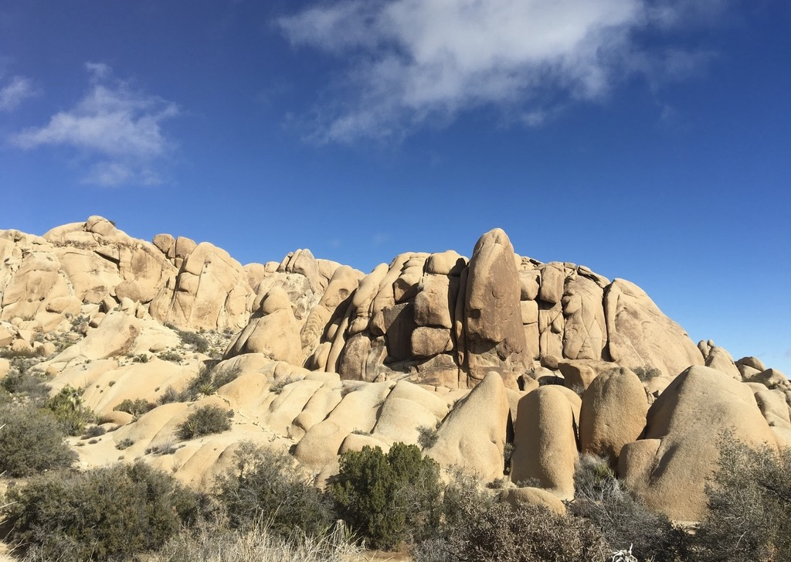
Presentation available at:
www.github.com/SmithEcophysLab/seminar/2025_hsc
nick.smith@ttu.edu
Thanks!

