Slide 1
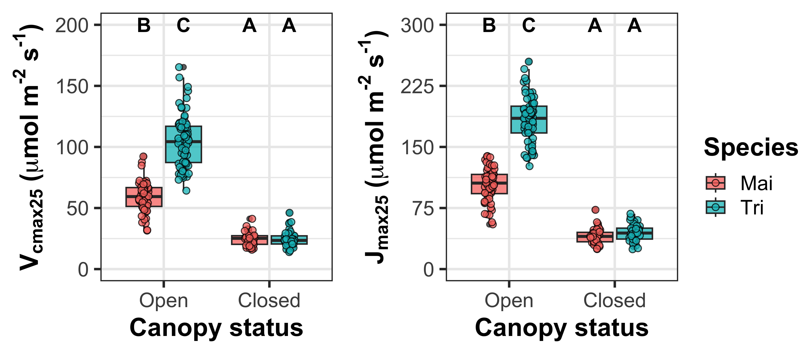
Canopy openness is a stronger determinant of plant physiology than garlic mustard invasion

Slide 2
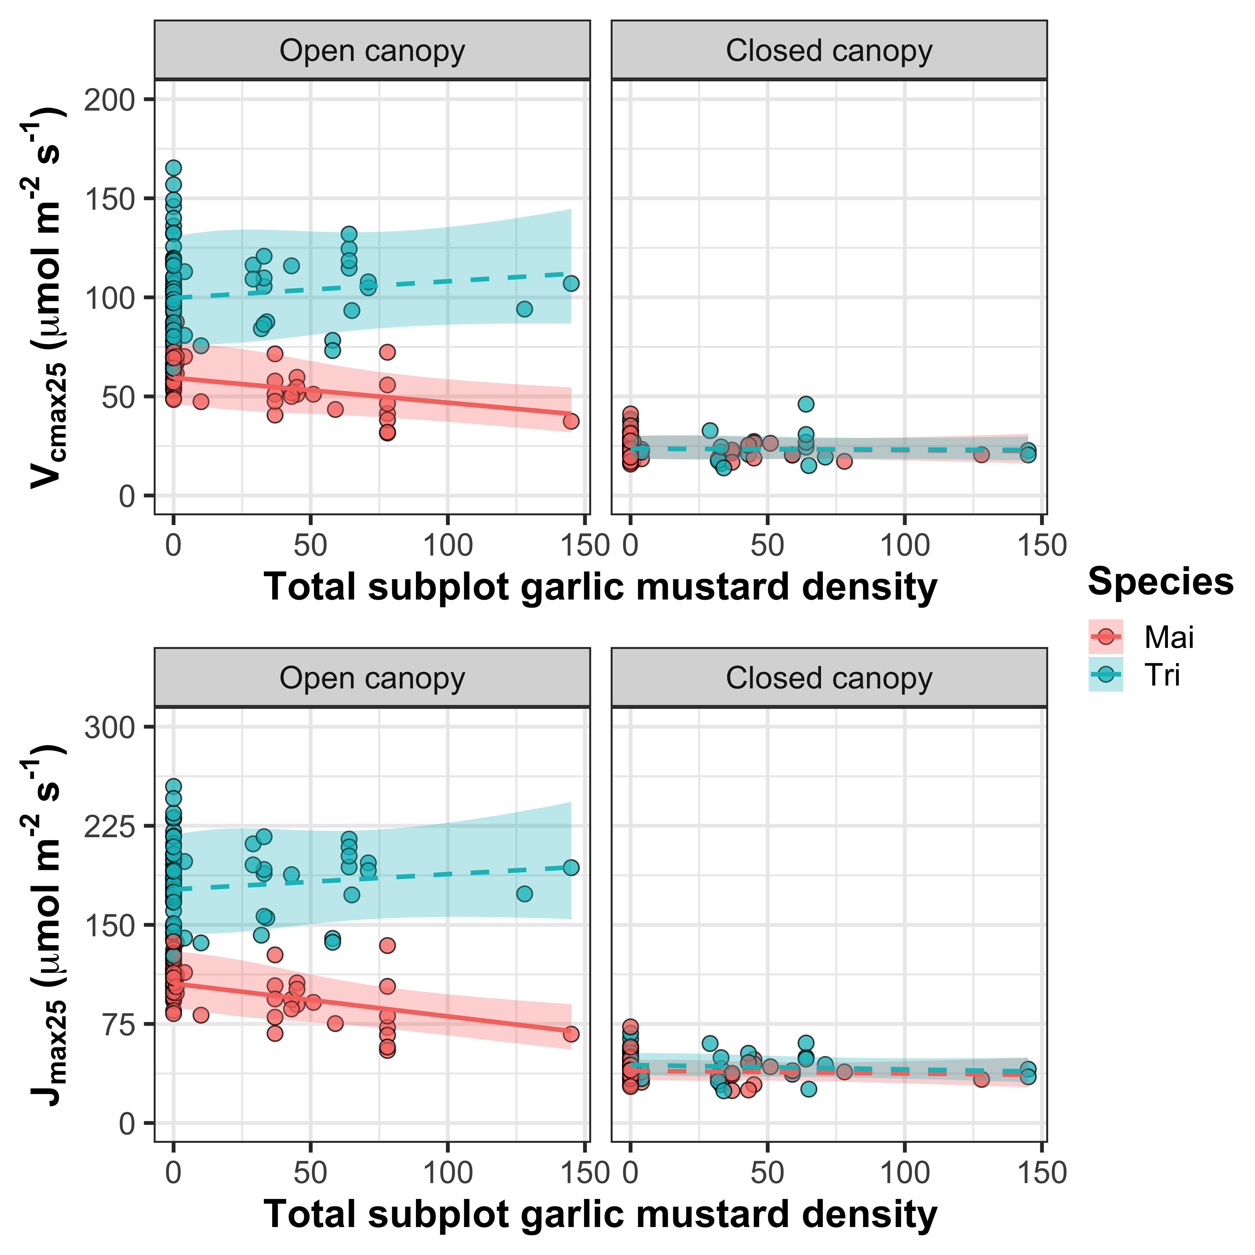
GM density decreased Mai photosynthetic capacity, but only when the canopy was open

