Slide 1
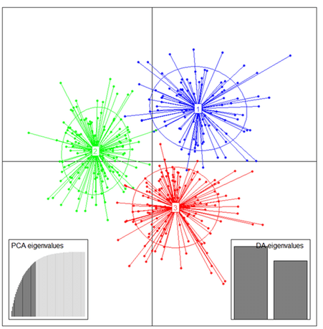
Unsupervised Machine Learning: Clustering
BIO 4990/6990
Dr. Megan Smith
April 3, 2024

Slide 2
Outline
Unsupervised Learning
Clustering
Hierarchical Clustering
K-Means Clustering
Probabilistic Clustering
Major challenge
Iris Example

Slide 3
Unsupervised Machine Learning
Uses machine learning algorithms to analyze and cluster unlabeled datasets
Algorithms discover hidden patterns or groupings without the need for training data

Slide 4
Unsupervised Machine Learning
Three main tasks:
Clustering: find groups of unlabeled data based on similarities.
Association Rules: finds relationships between variables in an unlabeled dataset.
Dimensionality reduction: used to reduce the number of inputs to a manageable size while preserving the integrity of the dataset.

Slide 5
Outline
Unsupervised Learning
Clustering
Hierarchical Clustering
K-Means Clustering
Probabilistic Clustering
Major challenge
Iris Example

Slide 6
Clustering
Groups unlabeled data based on difference of similarities.
Some commonly used methods:
Hierarchical clustering: data are organized into a hierarchy of clusters.
K-means clustering: data are assigned to k groups, where k represents the number of clusters, based on similarities.
Probabilistic clustering: clusters are created using probability distributions.

Slide 7
Outline
Unsupervised Learning
Clustering
Hierarchical Clustering
K-Means Clustering
Probabilistic Clustering
Major challenge
Iris Example

Slide 8
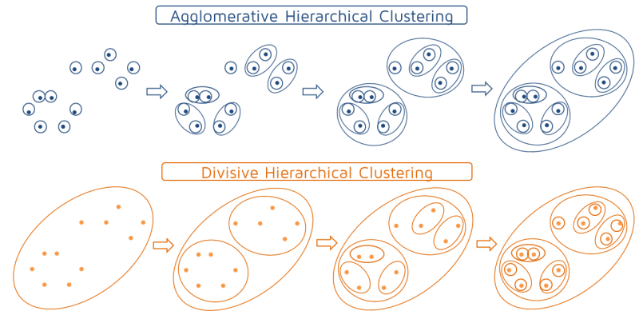
Hierarchical Clustering

Slide 9
Agglomerative Hierarchical Clustering
Step 1: Calculate distances between pairs of points.
Step 2: Cluster the closest points together.
Step 3: Return to step 1, treating the new cluster as a single point.
Repeat until there is a single cluster.

Slide 10
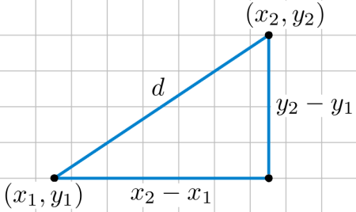

Agglomerative Hierarchical Clustering
Calculating distances between points:
Euclidean Distance
$d\left(p,q\right)= \sqrt{\sum_{i=1}^{n}{{(q_{i}−p_{i})}^{2}}}$
In two dimensions: $d\left(p,q\right)=\sqrt{{(q_{1}−p_{1})}^{2}+{(q_{2}−p_{2})}^{2}}$

Slide 11
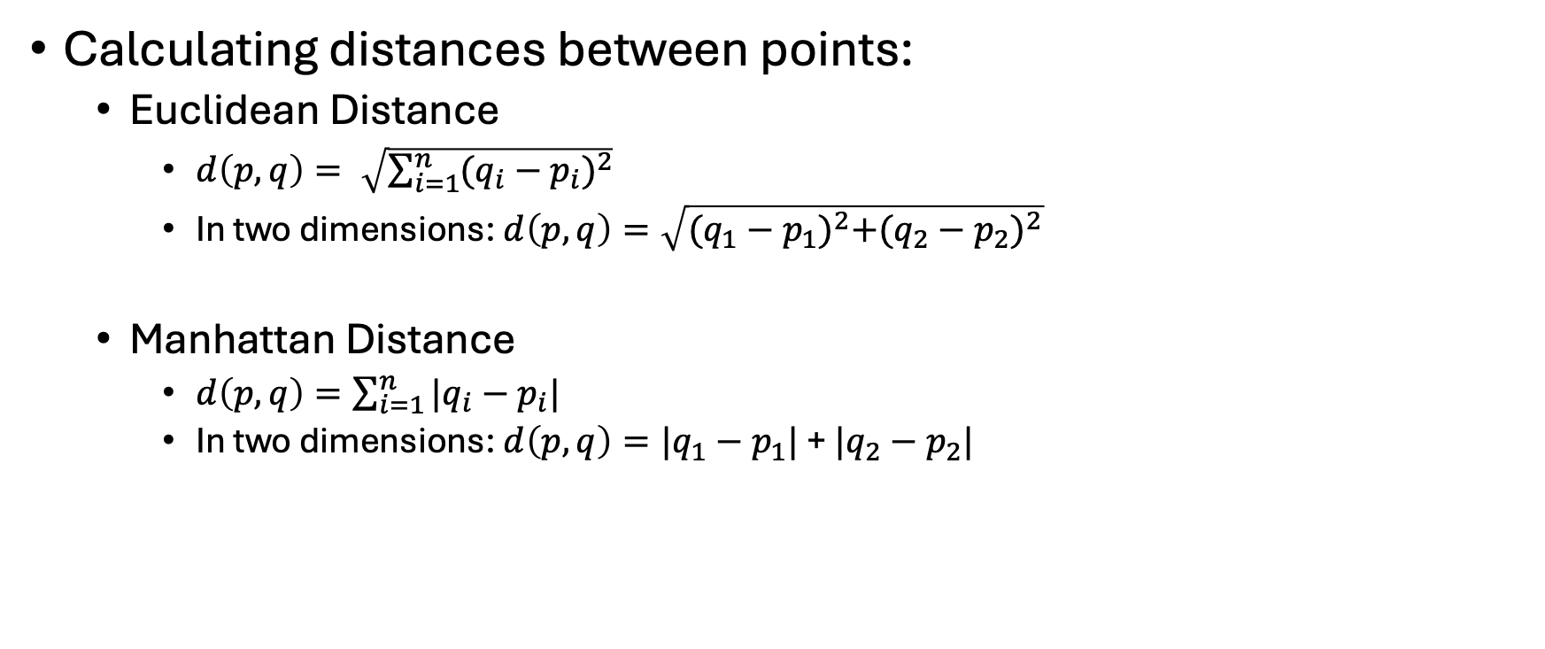
Agglomerative Hierarchical Clustering
Calculating distances between points:
Euclidean Distance
$d\left(p,q\right)= \sqrt{\sum_{i=1}^{n}{{(q_{i}−p_{i})}^{2}}}$
In two dimensions: $d\left(p,q\right)=\sqrt{{(q_{1}−p_{1})}^{2}+{(q_{2}−p_{2})}^{2}}$
Manhattan Distance
$d\left(p,q\right)=\sum_{i=1}^{n}{|q_{i}−p_{i}|}$
In two dimensions: $d\left(p,q\right)=|q_{1}−p_{1}|$ + $|q_{2}−p_{2}|$

Slide 12
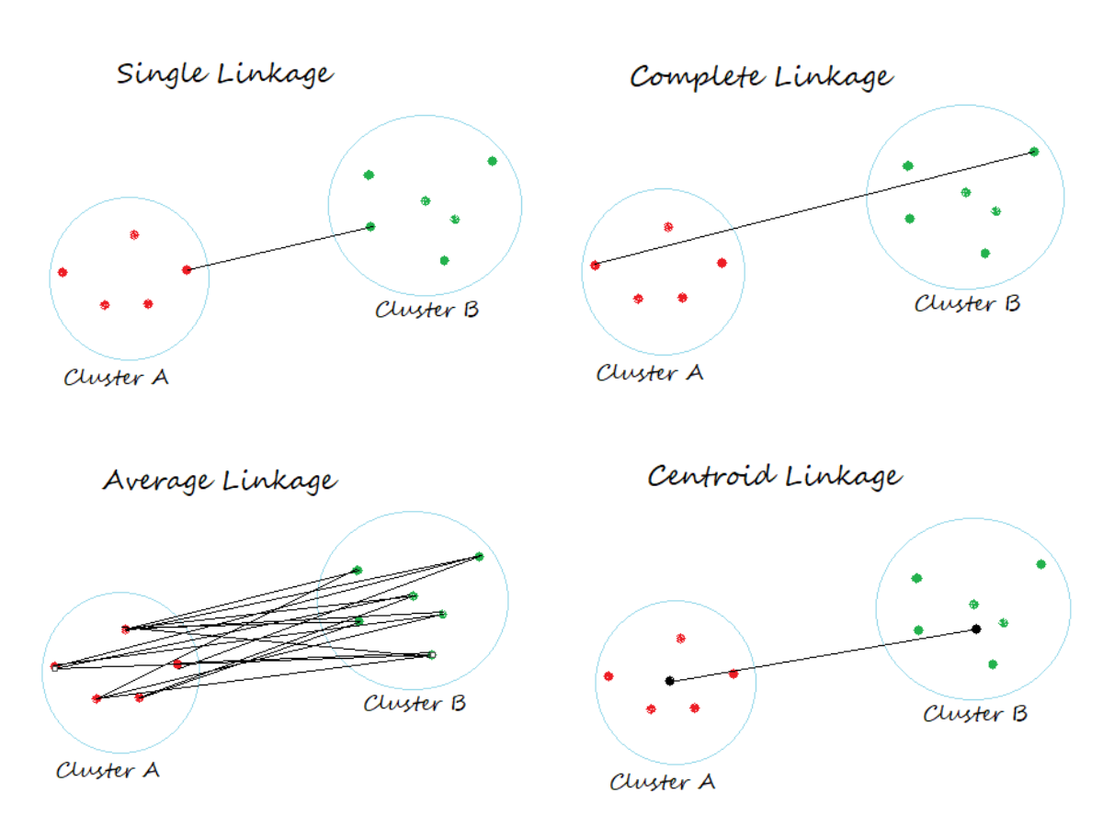
Agglomerative Hierarchical Clustering
Calculating distances between clusters
Single Linkage: minimum distance between points in the clusters

Slide 13
Agglomerative Hierarchical Clustering
Calculating distances between clusters
Single Linkage: minimum distance between points in the clusters
Complete Linkage: maximum distance between points in the clusters

Slide 14
Agglomerative Hierarchical Clustering
Calculating distances between clusters
Single Linkage: minimum distance between points in the clusters
Complete Linkage: maximum distance between points in the clusters
Average Linkage: average distance between points in the clusters

Slide 15
Agglomerative Hierarchical Clustering
Calculating distances between clusters
Single Linkage: minimum distance between points in the clusters
Complete Linkage: maximum distance between points in the clusters
Average Linkage: average distance between points in the clusters
Centroid Linkage: distance between cluster centroids

Slide 16
Agglomerative Hierarchical Clustering
Calculating distances between clusters
Single Linkage: minimum distance between points in the clusters
Advantages: can separate non-elliptical shapes
Disadvantages: does not work well with noisy clusters
Complete Linkage: maximum distance between points in the clusters
Advantages: works well with noisy clusters
Disadvantages : biased towards globular clusters, breaks up large clusters
Average Linkage: average distance between points in the clusters
Advantages: works well with noisy data
Disadvantages: biased towards globular clusters
Centroid Linkage: distance between cluster centroids
Advantages: works well with noisy data
Disadvantages : biased towards globular clusters

Slide 17
Agglomerative Hierarchical Clustering
Step 1: Calculate distances between pairs of points.
Step 2: Cluster the closest points together.
Step 3: Return to step 1, treating the new cluster as a single point.
Repeat until there is a single cluster.

Slide 18
Agglomerative Hierarchical Clustering
Use Euclidean or Manhattan distances.
Use single-linkage, complete linkage, average linkage, or centroid linkage
Step 1: Calculate distances between pairs of points.
Step 2: Cluster the closest points together.
Step 3: Return to step 1, treating the new cluster as a single point.
Repeat until there is a single cluster.

Slide 19
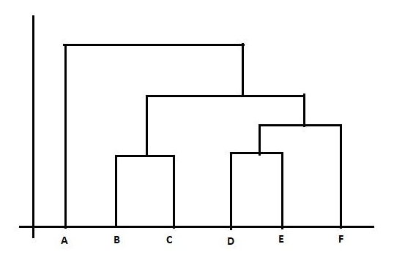
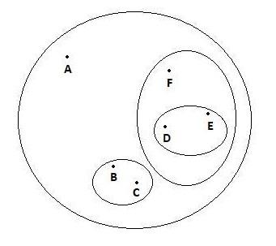
Dendrograms

Slide 20
Hierarchical Clustering summary
Creates a hierarchical organization of points.
Agglomerative or divisive (usually agglomerative)
Procedure:
Step 1: Calculate distances between points.
Step 2: Cluster the most nearby points.
Step 3: Repeat steps 1 and 2, treating the cluster as a single point.
Repeat until there is a single cluster.
Details
Use Euclidean or Manhattan distances.
Calculate distances between cluster using one of several approaches.

Slide 21
Outline
Unsupervised Learning
Clustering
Hierarchical Clustering
K-Means Clustering
Probabilistic Clustering
Major challenge
Iris Example

Slide 22
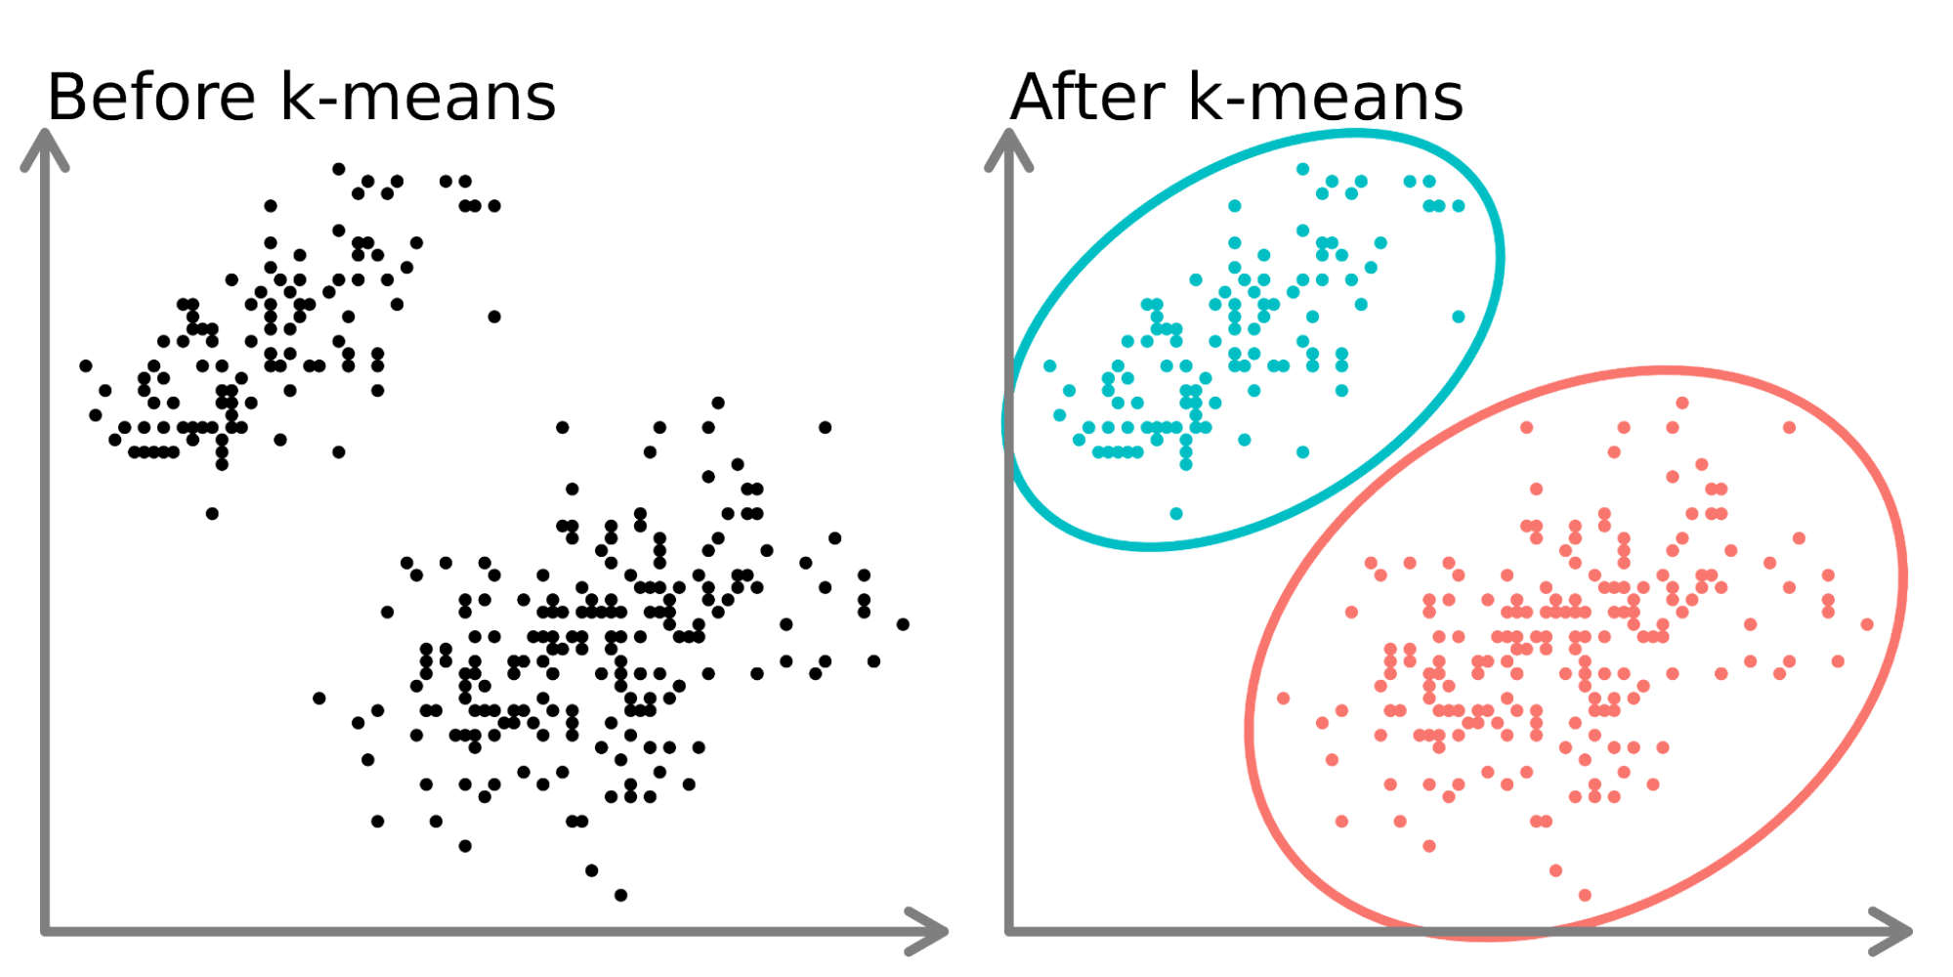
K-Means Clustering
Data points are assigned to k-groups, where k represents the number of clusters, based on the distance from each groups centroid.

Slide 23
K-Means Clustering
Step 1: Randomly initialize centroids.
Step 2: Assign points to the nearest centroid
Step 3: Adjust centroids to the center of each cluster.
Step 3: Repeat steps 2 and three until:
The centroids stop moving.
The assignments stop changing.
The maximum number of iterations is reached.

Slide 24
K-means clustering visualization
https://www.naftaliharris.com/blog/visualizing-k-means-clustering/

Slide 25
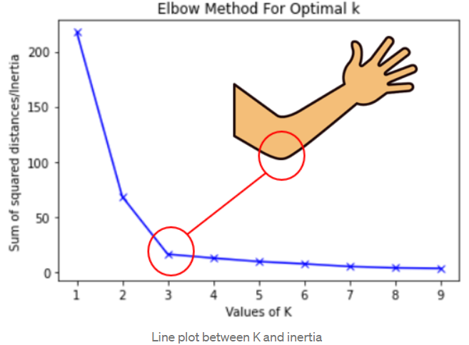
K-means clustering: choosing k
We can calculate some metric (e.g., the average distance between data points in a cluster and the centroid.)
The more clusters you have, the lower this value will be.
We plot this against the number of clusters, and find the elbow!

Slide 26
K-means clustering
Advantages
All points are assigned to a cluster
Easy to tune: only parameter is k
Easy to implement.
Disadvantages
Cannot model all patterns well
Heavily affected by outliers
Must choose the number of clusters
No uncertainty

Slide 27
K-means clustering summary
Clusters data into a user-specified number of groups based on distances between points and centroids.
Very easy to tune and implement.
Can use the elbow plot to choose an appropriate value of k.

Slide 28
Outline
Unsupervised Learning
Clustering
Hierarchical Clustering
K-Means Clustering
Probabilistic Clustering
Major challenge
Iris Example

Slide 29
Probabilistic clustering
K-means clustering is hard-clustering, meaning that there is no uncertainty measure or probability that tells us how much a data point is associated with a particular cluster.
Gaussian mixture models are a probabilistic clustering approach that relaxes this.

Slide 30
Gaussian Mixture Models
A Gaussian mixture is a function comprised of k Gaussians (normal distributions).
Each Gaussian has the parameters:
Mean (μ)
Covariance (Σ)
Mixing probability (π) which defines the size of the cluster
We can compute the likelihood of our data given a particular set of parameters, and the optimal values of the parameters are the maximum likelihood values.
We find these using an algorithm called Expectation-Maximization.

Slide 31
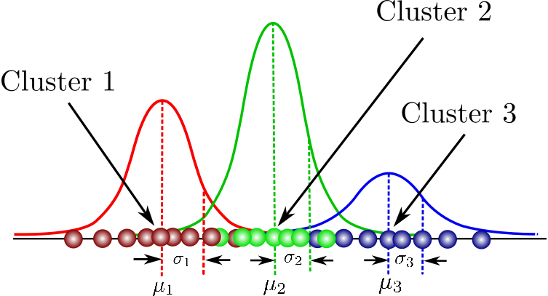
Gaussian Mixture Models

Slide 32
Gaussian Matrix
We end up with:
Estimates of our parameters (mean, covariance, size).
The ability to calculate the probability that a particular data point belongs to each cluster.
A model that can be used to generate new data.

Slide 33
Outline
Unsupervised Learning
Clustering
Hierarchical Clustering
K-Means Clustering
Probabilistic Clustering
Major challenge
Iris Example

Slide 34
Major challenge with clustering
We will always infer k clusters, but it is challenging to know whether these are meaningful, or how they should be interpreted.

Slide 35
Outline
Unsupervised Learning
Clustering
Hierarchical Clustering
K-Means Clustering
Probabilistic Clustering
Major challenge
Iris Example

Slide 36
Clustering summary
Finding groups in unlabeled data
We discussed three major types:
Hierarchical Clustering
K-means clustering
Probabilistic clustering
Interpreting clusters can be challenging.

