Slide 1
Dimensionality Reduction
BIO 4990/6990
April 8, 2024
Dr. Megan Smith

Slide 2
Outline
Why do we need dimensionality reduction?
Common approaches
Principal Component Analysis
t-SNE
Variational Autoencoders

Slide 3
Why do we need dimensionality reduction?

Slide 4
Why do we need dimensionality reduction?
Having a lot of data seems like a great thing!
But, too much data can actually negatively impact machine learning approaches
Curse-of-dimensionality: high-dimensionality data leads to sparse data, which can be challenging in many supervised machine learning contexts
Risk of overfitting: The risk of overfitting can increase with high-dimensional data.
And it makes visualizing our data impossible!

Slide 5
Outline
Why do we need dimensionality reduction?
Common approaches
Principal Component Analysis
t-SNE
Variational Autoencoders

Slide 6
Principal Component Analyses
Principal components are new variables that are constructed as linear combinations or mixtures of the initial variables.
These combinations are done in such a way that new variables are uncorrelated and most of the information within the initial variables is compressed into the first components.
We can then retain only those components with a substantial amount of information, reducing the dimensionality of our data.

Slide 7
Example
Imagine we are interested in identifying different cell-types in complex tissues (e.g., healthy and malignant cells).
To do this, we need some information about the cells. We might use single-cell RNA sequencing to get information about which genes are expressed in each cell.
We end up with transcription levels for many different genes for each cell!

Slide 8
Example
Cell | Gene 1 | Gene 2 | Gene 3 | Gene 4
1 | 10 | 6 | 12 | 5
2 | 11 | 4 | 9 | 7
3 | 8 | 5 | 10 | 6
4 | 3 | 3 | 2.5 | 2
5 | 2 | 2.8 | 1.3 | 4
6 | 1 | 1 | 2 | 7

Slide 9
Example
Cell | Gene 1 | Gene 2 | Gene 3 | Gene 4
1 | 10 | 6 | 12 | 5
2 | 11 | 4 | 9 | 7
3 | 8 | 5 | 10 | 6
4 | 3 | 3 | 2.5 | 2
5 | 1 | 2.8 | 1.3 | 4
6 | 2 | 1 | 2 | 7

Slide 10
Example
Cell | Gene 1 | Gene 2 | Gene 3 | Gene 4
1 | 10 | 6 | 12 | 5
2 | 11 | 4 | 9 | 7
3 | 8 | 5 | 10 | 6
4 | 3 | 3 | 2.5 | 2
5 | 1 | 2.8 | 1.3 | 4
6 | 2 | 1 | 2 | 7

Slide 11
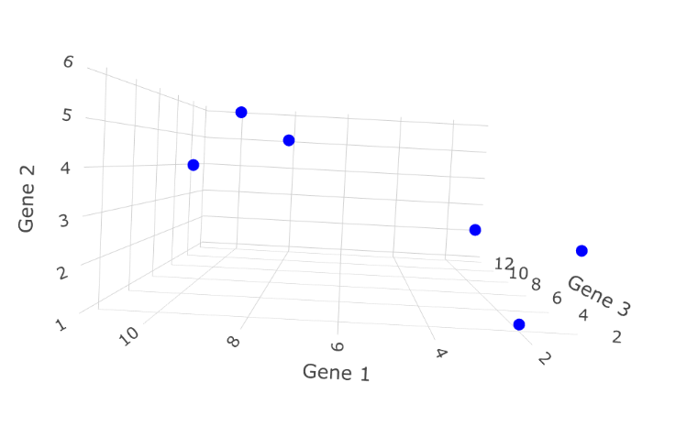
Example
Cell | Gene 1 | Gene 2 | Gene 3 | Gene 4
1 | 10 | 6 | 12 | 5
2 | 11 | 4 | 9 | 7
3 | 8 | 5 | 10 | 6
4 | 3 | 3 | 2.5 | 2
5 | 1 | 2.8 | 1.3 | 4
6 | 2 | 1 | 2 | 7

Slide 12
Example
Cell | Gene 1 | Gene 2 | Gene 3 | Gene 4
1 | 10 | 6 | 12 | 5
2 | 11 | 4 | 9 | 7
3 | 8 | 5 | 10 | 6
4 | 3 | 3 | 2.5 | 2
5 | 1 | 2.8 | 1.3 | 4
6 | 2 | 1 | 2 | 7
We can’t plot in more than three dimensions!
PCA can take four or more features and make a two-dimensional plot.
PCA can also tell us which variable is the most valuable for clustering the data.
PCA can tell us how accurate the 2D graph is.

Slide 13
PCA: Finding Eigenvectors and Eigenvalues
Find the average values of each feature to find the center of the data.

Slide 14

PCA: Finding Eigenvectors and Eigenvalues
Find the average values of each feature to find the center of the data.

Slide 15


PCA: Finding Eigenvectors and Eigenvalues
Find the average values of each feature to find the center of the data.

Slide 16
PCA: Finding Eigenvectors and Eigenvalues

Slide 17
PCA: Finding Eigenvectors and Eigenvalues
Shift the data such that the center is on the origin.

Slide 18
PCA: Finding Eigenvectors and Eigenvalues
Find the best fit line that passes through the origin.

Slide 19
PCA: Finding Eigenvectors and Eigenvalues
Try to minimize the distances from the data to the line.

Slide 20
PCA: Finding Eigenvectors and Eigenvalues
Equivalently, find the line that maximizes the distances from the projected points to the origin.
Notes:
Draw on board!

Slide 21
PCA: Finding Eigenvectors and Eigenvalues
PCA finds the best fitting line by maximizing the sum of the squared distances from the projected points to the origin

Slide 22
PCA: Finding Eigenvectors and Eigenvalues
This line is Principal Component 1 (PC1)

Slide 23
PCA: Finding Eigenvectors and Eigenvalues
PC1 has a slope of 0.25.
1
4

Slide 24
PCA: Finding Eigenvectors and Eigenvalues
The data are mostly spread out along the Gene 1 axis, and only a little bit along the Gene 2 axis.
1
4

Slide 25
PCA: Finding Eigenvectors and Eigenvalues
To make PC1
Mix 4 parts Gene 1
With 1 part Gene 2
1
4

Slide 26
PCA: Finding Eigenvectors and Eigenvalues
PC1 is a linear combination of Gene 1 and Gene 2.
1
4

Slide 27
PCA: Finding Eigenvectors and Eigenvalues
Solve for the length of the red line using the Pythagorean theorem.
4.12
1
4

Slide 28
PCA: Finding Eigenvectors and Eigenvalues
Scale everything such that the length of the red line is 1 (by dividing by 4.12).
4.12
1
4

Slide 29
PCA: Finding Eigenvectors and Eigenvalues
To make PC1
Mix 0.97 parts Gene 1
with 0.242 parts Gene 2
1
0.242
0.97

Slide 30
PCA: Finding Eigenvectors and Eigenvalues
The unit vector is the “Singular Vector” or the “Eigenvector” of PC1.

Slide 31
PCA: Finding Eigenvectors and Eigenvalues
The proportions of each gene (0.97 and 0.242) are the loading scores.

Slide 32
PCA: Finding Eigenvectors and Eigenvalues
The average of the sums of square distances for the best fit line are the eigenvalue for PC1.

Slide 33
PCA: Finding Eigenvectors and Eigenvalues
The square root of the sums of squared distances is the singular value for PC1.

Slide 34
PCA: Finding Eigenvectors and Eigenvalues
Now, we need to find PC2!

Slide 35
PCA: Finding Eigenvectors and Eigenvalues
PC2 is the line through the origin that is perpendicular to PC1 (since there are only two variables).

Slide 36
PCA: Finding Eigenvectors and Eigenvalues
To get PC2:
Mix -1 parts Gene 1
With 4 parts Gene 2.
-1
4

Slide 37
PCA: Finding Eigenvectors and Eigenvalues
After scaling to get a unit vector
To get PC2:
Mix -0.242 parts Gene 1
With 0.7 parts Gene 2.

Slide 38
PCA: Finding Eigenvectors and Eigenvalues
This is the Singular Vector or Eigenvector for PC2.

Slide 39
PCA: Finding Eigenvectors and Eigenvalues
-0.242 (Gene 1) and 0.97 (Gene 2) are the loading scores for PC2.
Gene 2 is four times as important as Gene 1 for PC2.

Slide 40
PCA: Finding Eigenvectors and Eigenvalues
We can also calculate the average sum of squared distances between the projected points and the origin to get the Eigenvalues.

Slide 41
PCA: Finding Eigenvectors and Eigenvalues
To draw the PCA plot, rotate the PC axes.

Slide 42
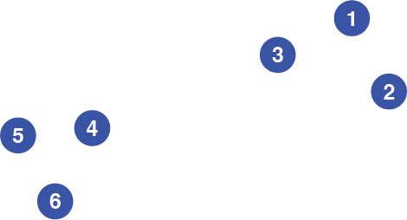
PCA: Finding Eigenvectors and Eigenvalues
Then, project the points onto the PC axes.
Notes:
Draw on board

Slide 43
PCA: Finding Eigenvectors and Eigenvalues
Remember, eigenvalues are the average sum of square distances from the points to the origin for each PC.
In our example, imagine the eigenvalues are:
PC1 = 15
PC2 = 3
This means PC1 accounts for 15/18=0.83 = 83% of the total variation around the PCs.
PC2 accounts for 3/18 = 17% of the variation around the PCs.

Slide 44
PCA: Finding Eigenvectors and Eigenvalues
Remember, eigenvalues are the average sum of square distances from the points to the origin for each PC.
In our example, imagine the eigenvalues are:
PC1 = 15
PC2 = 3
This means PC1 accounts for 15/18=0.83 = 83% of the total variation around the PCs.
PC2 accounts for 3/18 = 17% of the variation around the PCs.
A scree plot shows how much variation is accounted for by each PC.

Slide 45
PCA: Steps
Usually, we do this for far more than 2 variables.
Steps of PC:
Standardize the range of initial variables.
Compute the covariance matrix.
Compute the eigenvectors and eigenvalues of the covariance matrix to identify the principal components.
The number of eigenvectors and eigenvalues is equal to the number of variables.
Use eigenvalues to compute the amount of variance explained by each principal component.
Create a feature vector to decide which principal components to keep.
Project the data onto the principal components.

Slide 46
PCA: Important things to remember
The number of PCs will equal the number of variables.
The first PC will explain the most variance, the second PC the second most, and so on.
Eigenvalues allow us to determine the percent variance explained by each PC, and this allows us to decide which PCs to keep.
Knowing the percentage of variance explained by each PC helps us understand how much information we lose by using fewer components.
Loading values can help us understand how different variables contribute to different PCs.

Slide 47
How do I use these PCs?
To visualize data.
As input into supervised machine learning or other analytical approaches.

Slide 48
Outline
Why do we need dimensionality reduction?
Common approaches
Principal Component Analysis
t-SNE
Variational Autoencoders

Slide 49
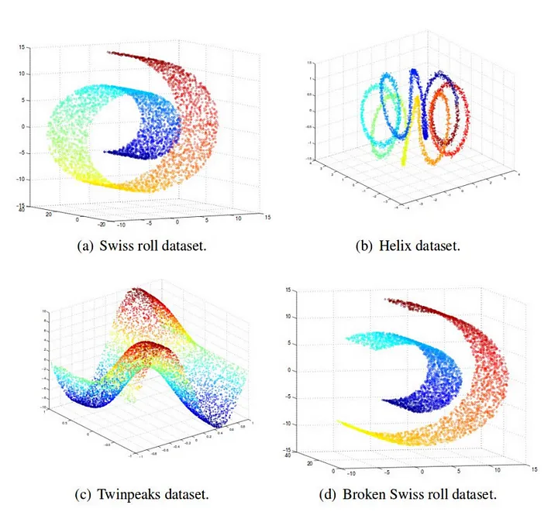
t-Distributed Stochastic Neighbor Embedding
PCA may not work as well with non-linear variance.
T-SNE is a non-linear dimensionality reduction technique that is well-suited for embedding high-dimensional data into low-dimensional data for visualization.

Slide 50
t-Distributed Stochastic Neighbor Embedding
Stochastic: random element
Neighbor: concerned with similarities between nearby points
Embedding: embedding data into lower dimensions.

Slide 51


tSNE Simplified Example
How can we transform this graph into a flat one-dimensional plot on a number line?

Slide 52
tSNE Simplified Example
Projecting onto one of the two axes would sacrifice a lot of information, and would not preserve the original structure of the data.

Slide 53
tSNE Simplified Example
Projecting onto one of the two axes would sacrifice a lot of information, and would not preserve the original structure of the data.

Slide 54
tSNE Simplified Example
t-SNE finds a way to project data into a low-dimensional space such that the clustering in the high-dimensional space is preserved.

Slide 55



tSNE Simplified Example
Start with the original scatterplot.
Put the points on the number line in a random order.
Move the points a little bit at a time until they are clustered as in the original data.

Slide 56
tSNE Simplified Example
Start with the original scatterplot.
Put the points on the number line in a random order.
Move the points a little bit at a time until they are clustered as in the original data.
Which way should this point move?

Slide 57



tSNE Simplified Example
Start with the original scatterplot.
Put the points on the number line in a random order.
Move the points a little bit at a time until they are clustered as in the original data.
Which way should this point move?

Slide 58


tSNE Simplified Example
Start with the original scatterplot.
Put the points on the number line in a random order.
Move the points a little bit at a time until they are clustered as in the original data.
Which way should this point move?

Slide 59
tSNE Simplified Example
Start with the original scatterplot.
Put the points on the number line in a random order.
Move the points a little bit at a time until they are clustered as in the original data.
Which way should this point move?
These points attract.
These points repel.

Slide 60
tSNE Simplified Example
Start with the original scatterplot.
Put the points on the number line in a random order.
Move the points a little bit at a time until they are clustered as in the original data.
The point moves a little to the right!
These points attract.
These points repel.

Slide 61
tSNE Simplified Example
Start with the original scatterplot.
Put the points on the number line in a random order.
Move the points a little bit at a time until they are clustered as in the original data.
Keep doing it!

Slide 62
tSNE Simplified Example
Start with the original scatterplot.
Put the points on the number line in a random order.
Move the points a little bit at a time until they are clustered as in the original data.
Keep doing it!

Slide 63
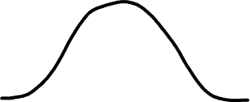
tSNE Simplified Example—The details
Step 1: Determine the similarity of all the points in the scatterplot.
Measure the distance between two points.
Plot that distance on a normal curve centered on the point of interest.
Draw a line from the point to the curve, and this is the ‘unscaled similarity’.
Repeat 1-3 for all pairs of points.
Scale such that the sum of distances from any single point is 1.

Slide 64
tSNE Simplified Example—The details
Step 1: Determine the similarity of all the points in the scatterplot.
Measure the distance between two points.
Plot that distance on a normal curve centered on the point of interest.
Draw a line from the point to the curve, and this is the ‘unscaled similarity’.
Repeat 1-3 for all pairs of points.
Scale such that the sum of distances from any single point is 1.

Slide 65
tSNE Simplified Example—The details
Step 1: Determine the similarity of all the points in the scatterplot.
Measure the distance between two points.
Plot that distance on a normal curve centered on the point of interest.
Draw a line from the point to the curve, and this is the ‘unscaled similarity’.
Repeat 1-3 for all pairs of points.
Scale such that the sum of distances from any single point is 1.

Slide 66
tSNE Simplified Example—The details
Step 1: Determine the similarity of all the points in the scatterplot.
Measure the distance between two points.
Plot that distance on a normal curve centered on the point of interest.
Draw a line from the point to the curve, and this is the ‘unscaled similarity’.
Repeat 1-3 for all pairs of points.
Scale such that the sum of distances from any single point is 1.
Nearby points have high similarity values, while distant points have low similarity values.

Slide 67
tSNE Simplified Example—The details
Step 1: Determine the similarity of all the points in the scatterplot.
Note: average the two scores from different directions.

Slide 68
tSNE Simplified Example—The details
Step 1: Determine the similarity of all the points in the scatterplot.
Step 2: Place points randomly on number line.

Slide 69
tSNE Simplified Example—The details
Step 1: Determine the similarity of all the points in the scatterplot.
Step 2: Place points randomly on number line.
Step 3: Calculate similarity scores for points on line, and determine the similarity after scaling.

Slide 70
tSNE Simplified Example—The details
Step 1: Determine the similarity of all the points in the scatterplot.
Step 2: Place points randomly on number line.
Step 3: Calculate similarity scores for points on line, and determine the similarity after scaling.
Difference: Use a t-distribution instead of a normal-distribution.

Slide 71
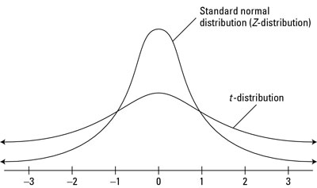
tSNE Simplified Example—The details
Step 1: Determine the similarity of all the points in the scatterplot.
Step 2: Place points randomly on number line.
Step 3: Calculate similarity scores for points on line, and determine the similarity after scaling.

Slide 72
tSNE Simplified Example—The details
t-SNE moves the points a little bit at a time, with the goal of making the matrix on the right more similar to the matrix on the left.

Slide 73
tSNE—Algorithm summary
t-SNE constructs a probability distribution on pairs of points in higher dimensions such that similar points are assigned a higher probability and dissimilar points are assigned a lower probability.
t-SNE replicates the probability distribution on lower dimensions iteratively until the Kullback-Leibler divergence (a measure of differences between distributions) is low.
The projected data can be easily visualized.

Slide 74
tSNE parameters
The number of iterations for moving points in the lower dimension.
The ‘perplexity’ parameter, which determines the number of neighboring points t-SNE considers (related to the width of the normal distribution).
More dense datasets require larger perplexities, as the perplexity is related to how many nearby neighbors each point has.

Slide 75
Outline
Why do we need dimensionality reduction?
Common approaches
Principal Component Analysis
t-SNE
Variational Autoencoders

Slide 76
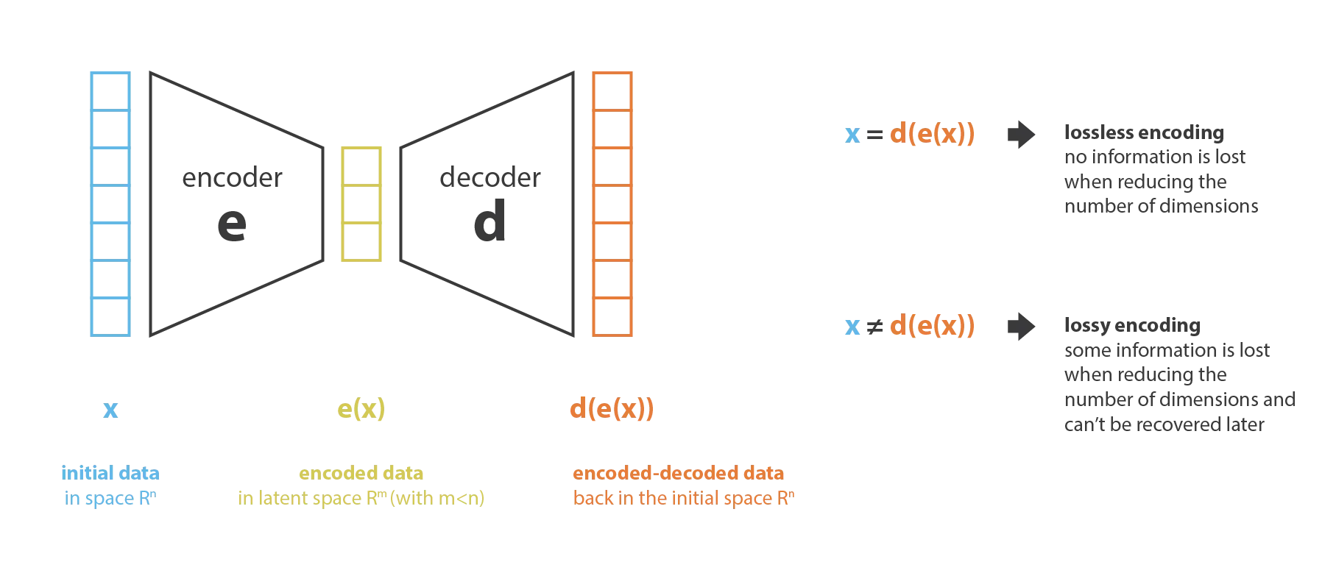
Variational Autoencoders

Slide 77
Variational Autoencoders
Find the encoder, decoder pair that keeps the maximum amount of information when encoding, and therefore has the minimum reconstruction error when decoding.
For VAEs, the encoder and decoder are neural networks.
At each iteration, we compare the input and the decoded output and backpropagate the error through the architecture to update the weights of the network.

Slide 78
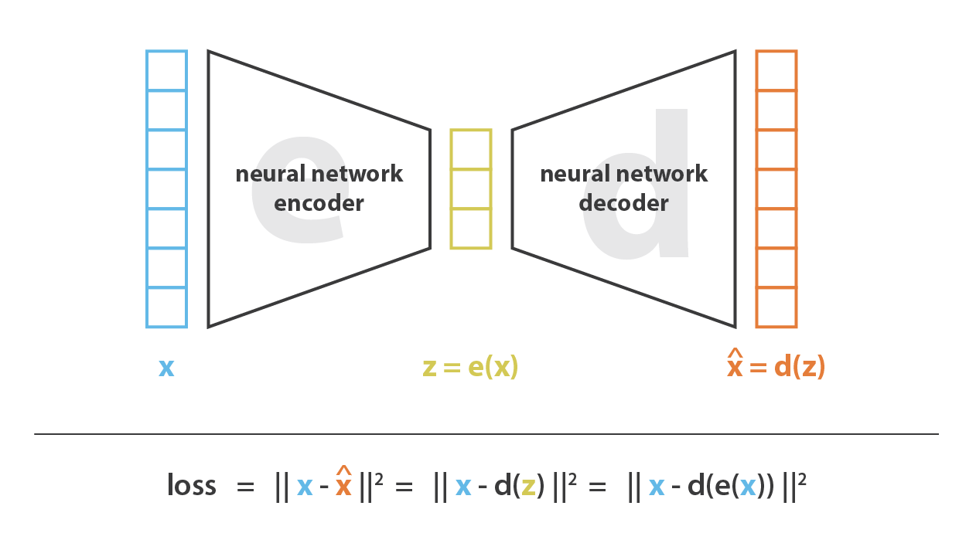
Variational Autoencoders

Slide 79
Variational Autoencoders
We can use the encoded space as our new dataset with reduced dimensions.
We control the number of dimensions when we design our networks.
We can then use this encoded space just as we used axes of the PCA.

Slide 80
Outline
Why do we need dimensionality reduction?
Common approaches
Principal Component Analysis
t-SNE
Variational Autoencoders

