Slide 1
Unsupervised Learning
BIO 4990/6990
April 10, 2024
Dr. Megan Smith

Slide 2
Outline
Additional Algorithms
PAM Clustering
Unsupervised Random Forests
Multidimensional Scaling (MDS)
Discriminant Analysis of Principal Components
Unsupervised Learning Review
Unsupervised Machine Learning for Species Delimitation

Slide 3
PAM Clustering
Partitioning Among Mediods (PAM)
Also known as k-mediods
A clustering approach similar to k-means

Slide 4
PAM Clustering vs k-means clustering
k-Means clustering review
Randomly initialize centroids.
Assign points to the nearest centroid.
Adjust centroids to the center of each cluster.
Repeat steps 2-3 until:
The centroids stop moving.
The assignments stop changing.
The maximum number of iterations is reached.

Slide 5
PAM Clustering vs. k-means clustering
Differences between k-means and PAM:
Centroids are now always points in the data (medians).
The initial placements are no longer random, but are found during the BUILD phase.
The first mediod is the one with the lowest distance to all other points.
The second mediod is the one with the lowest distance to all other non-mediod points.
And so on.
The update stage (where we previously moved centroids to the center of the cluster), is replaced with the SWAP phase.
Consider swapping the current mediod with all other points.
We minimize the sum of the distances of all points in the cluster to the new mediod (the cost).
Terminate when the cost can no longer be decreased.

Slide 6
PAM Steps
Build: initialize the mediods to minimize the costs (i.e., distances to all other non-mediods).
Assign points to clusters based on the nearest mediod.
Swap: Consider swapping the mediod with all other points, selecting the point that has the lowest cost (i.e., distance to all points in the cluster).
Repeat until the cost can no longer be decreased.

Slide 7
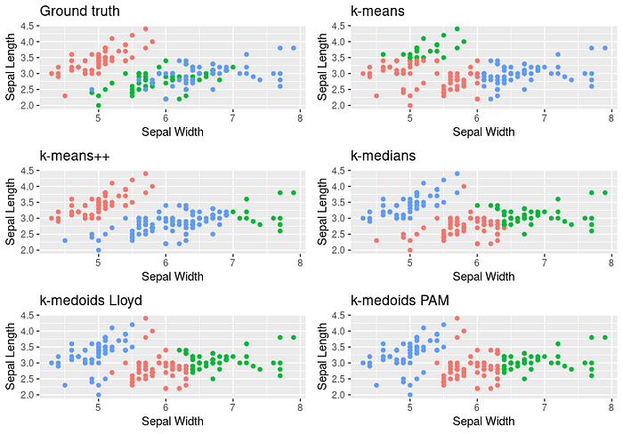
PAM Performance

Slide 8
Outline
Additional Algorithms
PAM Clustering
Unsupervised Random Forests
Multidimensional Scaling (MDS)
Discriminant Analysis of Principal Components
Unsupervised Learning Review
Unsupervised Machine Learning for Species Delimitation

Slide 9
Supervised Random Forest Classifier
For each iteration i:
Step 1: Create a bootstrapped dataset.
Step 2: Train a decision tree using the boostrapped data, and use only a random subset of variables when constructing each node.
Raining?
Stream?
Logs >1?
F
T
F
T
F
T
Stream?
Yes
Raining?
Logs > 1.5?
Yes
Stream?
F
T
F
T
F
T
F
T
No
Yes
No
Yes
No
Yes
No
Yes

Slide 10
Unsupervised Random Forests
In an unsupervised setting, we do not know the labels.
Unsupervised Random Forest:
Construct a joint distribution of explanatory variables, and draw from this distribution to create synthetic data.
The real and synthetic data are combined and a label set is created (synthetic = 0, real = 1).
Train a Random Forest Classifier.
Calculate the proximity matrix

Slide 11
Unsupervised Random Forests: proximity matrix
The proximity matrix for a dataset with n observations is an n x n matrix.
Entry n_{i,j} contains the proportion of times observations i and j were in the same leaf node.
Used as input into clustering algorithms.
Raining?
Stream?
Logs >1?
F
T
F
T
F
T
Stream?
Yes
Raining?
Logs > 1.5?
Yes
Stream?
F
T
F
T
F
T
F
T
No
Yes
No
Yes
No
Yes
No
Yes

Slide 12
Outline
Additional Algorithms
PAM Clustering
Unsupervised Random Forests
Multidimensional Scaling (MDS)
Discriminant Analysis of Principal Components
Unsupervised Learning Review
Unsupervised Machine Learning for Species Delimitation

Slide 13
Multidimensional Scaling (MDS)
Goal: Given pairwise dissimilarities or similarities, reconstruct a map that preserves distances.
Very similar to PCA but with distances or similarities between points as input.
Can be used to cluster output from unsupervised Random Forests, for example.

Slide 14
Outline
Additional Algorithms
PAM Clustering
Unsupervised Random Forests
Multidimensional Scaling (MDS)
Discriminant Analysis of Principal Components
Unsupervised Learning Review
Unsupervised Machine Learning for Species Delimitation

Slide 15
Discriminant Analysis of Principal Components (DAPC)
Goal: To find variables that minimize within group variance and maximize between group variance.
Steps:
Transform data using PCA.
Use k-means clustering to identify clusters.
Use Discriminant Analysis to find variables that minimize within group variance and maximize between group variance.

Slide 16
Outline
Additional Algorithms
PAM Clustering
Unsupervised Random Forests
Multidimensional Scaling (MDS)
Discriminant Analysis of Principal Components
Unsupervised Learning Review
Unsupervised Machine Learning for Species Delimitation

Slide 17
Summary of Unsupervised Learning
Clustering
Agglomerative Hierarchical Clustering
k-means Clustering
Probabilistic Clustering
PAM Clustering
Dimensionality Reduction
PCA
t-SNE
Variational Autoencoders
Multi-dimensional Scaling
Other
Unsupervised Random Forests
Generative Adversarial Networks
Hybrid
1. DAPC

Slide 18
Outline
Additional Algorithms
PAM Clustering
Unsupervised Random Forests
Multidimensional Scaling (MDS)
Discriminant Analysis of Principal Components
Unsupervised Learning Review
Unsupervised Machine Learning for Species Delimitation

Slide 19
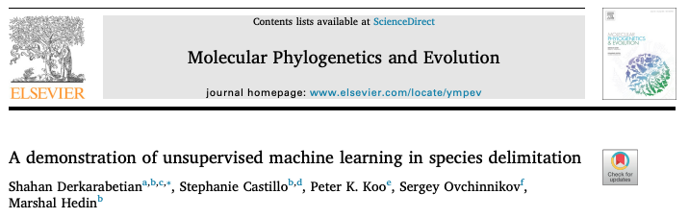
A demonstration of unsupervised machine learning in species delimitation

Slide 20
A demonstration of unsupervised machine learning in species delimitation
Goal: to delimit species using genetic data
Given genetic from across the range of a taxonomic group, can we identify meaningful clusters of individuals, which may correspond to species.
Traditional approaches make assumptions (e.g., Hardy Weinberg Equilibrium—no mutation, random mating, no gene flow, infinite population size, no selection)

Slide 21
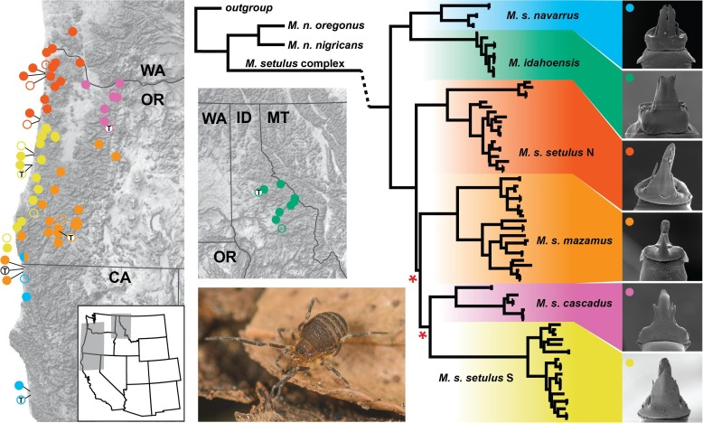
A demonstration of unsupervised machine learning in species delimitation

Slide 22
A demonstration of unsupervised machine learning in species delimitation
The authors collected genetic data from across the range of this group, resulting in up to 1000 SNPs depending on data filtering.
Using these data, how could you use unsupervised learning to delimit species (i.e., find clusters of similar groups of individuals?
Pair up and come up with an idea (there are lots of ways to do this, so there’s no right answer!)
Focus on these questions:
What method would you use to find clusters?
What data would you use as the input to this method? Would you use genetic data directly, calculate statistics from genetic data, or perhaps use a dimensionality reduction approach to summarize genetic data?

Slide 23
Method 1: DAPC
Input: SNP data
Steps:
Perform PCA to reduce dimensionality.
Use k-means to find clusters.
Use DAPC to find variables that minimize within population variation and maximize between population variation.
Output: clusters and a plot of DAPC variables.

Slide 24
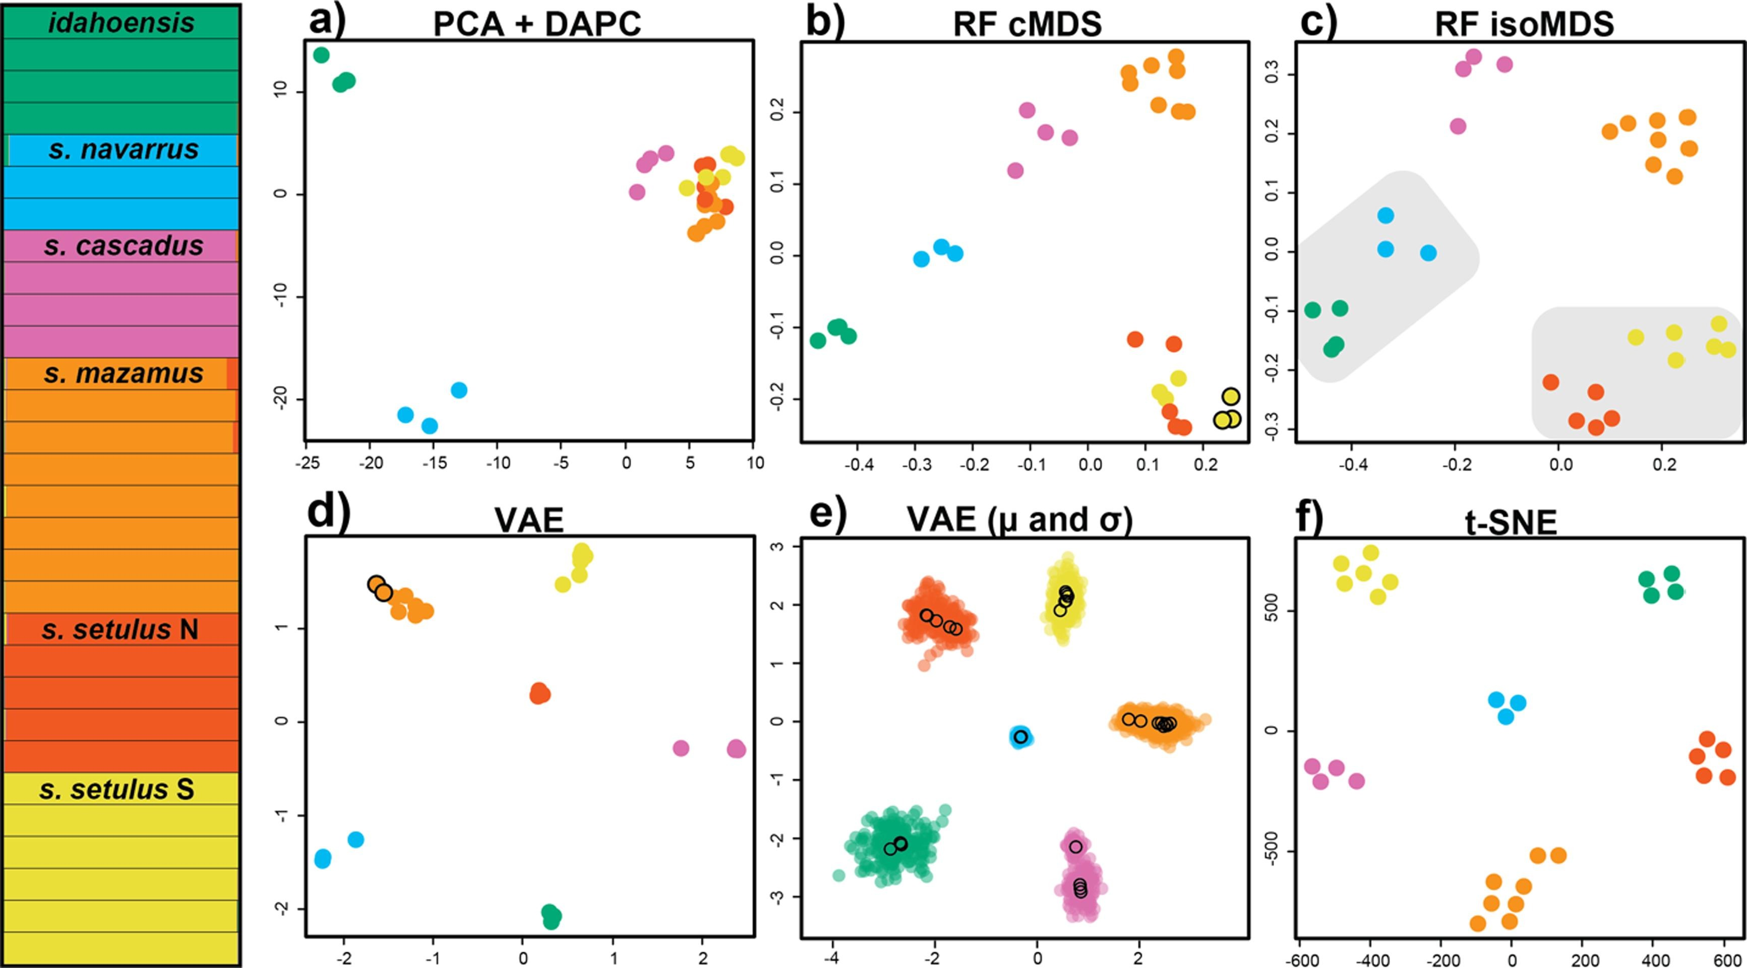
Method 1: DAPC

Slide 25
Method 2: Random Forests
Input: Features from DAPC
Steps:
Generate synthetic data.
Create labels (0=synthetic, 1=real)
Build classifier.
Get proximity matrix.
Use MDS for dimensionality reduction.
Use PAM to find clusters.

Slide 26
Method 2: Random Forests

Slide 27
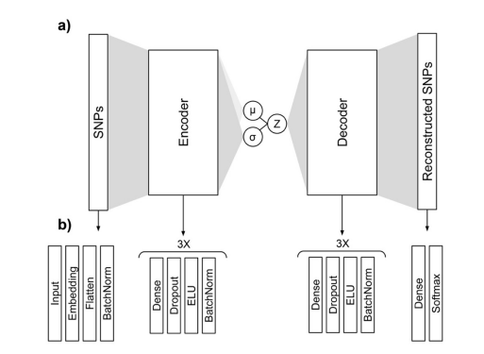
Method 3: Variational Autoencoder
Input: SNP data (one-hot encoded)
Steps:
Train VAE by minimizing the categorical cross-entropy.
Use encoded data as input into PAM clustering.
Output:
Encoded space and PAM clusters.

Slide 28
Method 3: Variational Autoencoder

Slide 29
Method 4: t-SNE
Input: PCA axes
Steps:
Use t-SNE to project data into 2 dimensions.
Use embedded data as input into PAM clustering.
Output: embedded space and PAM clusters

Slide 30
Method 3: t-SNE

Slide 31
Summary
There are lots of ways to combine dimensionality reduction and clustering techniques to cluster and visualize high-dimensional data.
Many of them lead to similar conclusions!
We could probably come up with a lot more.
Are these clusters meaningful, and do they correspond to species?

