Slide 1
Overview of Algorithms
BIO 4990/6990
Dr. Megan Smith

Slide 2
Algorithms
Supervised Learning
Linear Regression
Logistic Regression
Softmax Regression
Support Vector Machines
Decision-Tree Classifiers
Fully Connected Neural Networks
Convolutional Neural Networks
Recurrent Neural Networks
Long Short-Term Memory Networks
Transformers
Graph Neural Networks
Unsupervised Learning
Clustering Approaches
Dimensionality Approaches
Generative Adversarial Networks
Unsupervised Random Forests

Slide 3
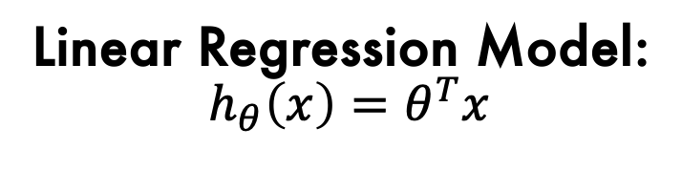
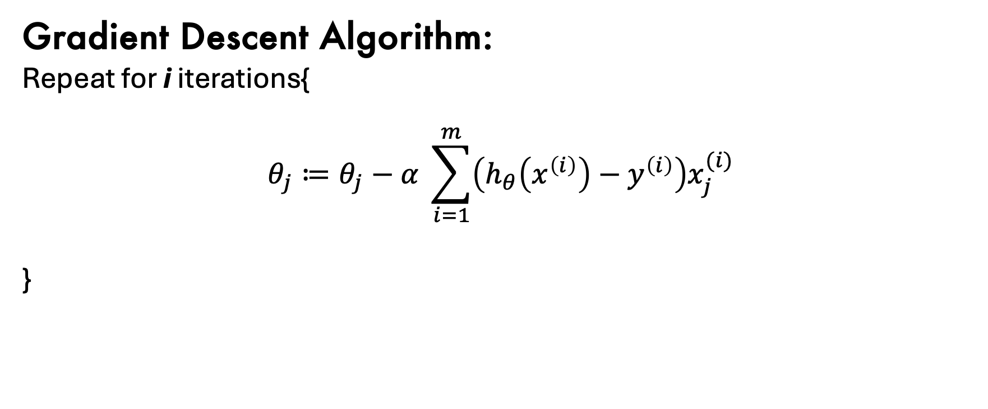
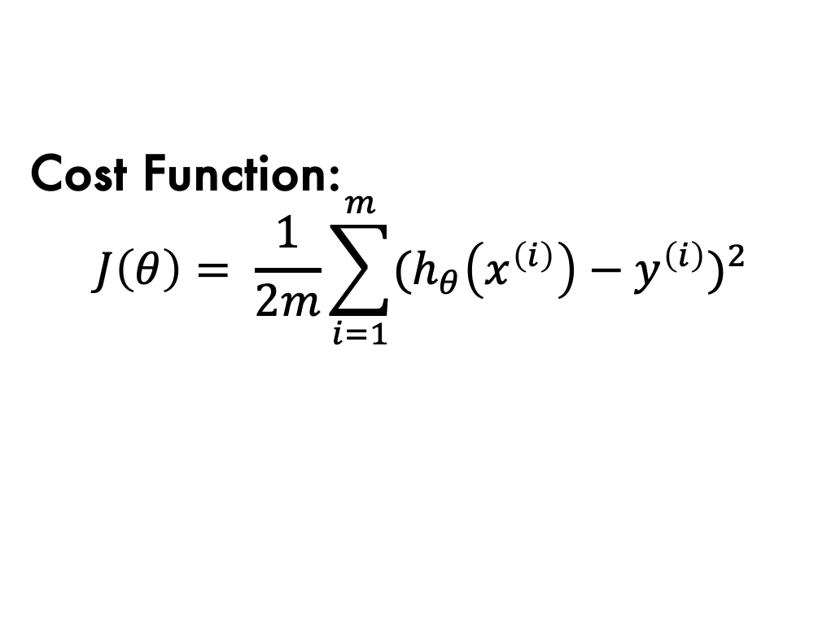
Linear Regression
Linear Regression Model:
$$h_{θ}\left(x\right)=θ^{T}x$$
Cost Function:
$$J\left(θ\right)= \frac{1}{2m}\sum_{i=1}^{m}{{{(h}_{θ}\left(x^{\left(i\right)}\right)−y^{\left(i\right)})}^{2}}$$
Gradient Descent Algorithm:
Repeat for i iterations{
$$θ_{j}≔θ_{j}−α \sum_{i=1}^{m}{\left(h_{θ}\left(x^{\left(i\right)}\right)−y^{\left(i\right)}\right)x_{j}^{(i)}}$$
}

Slide 4
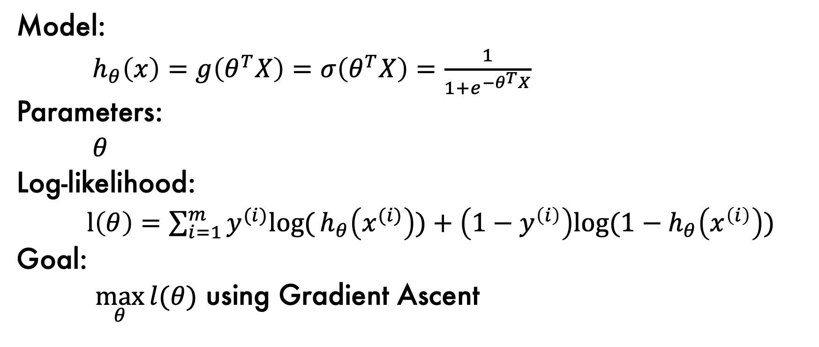
Logistic Regression
Model:
$h_{θ}\left(x\right)=g\left(θ^{T}X\right)=σ\left(θ^{T}X\right)=\frac{1}{1+e^{−θ^{T}X}}$
Parameters:
$θ$
Log-likelihood:
$l\left(θ\right)=\sum_{i=1}^{m}{y^{(i)}log⁡(}h_{θ}\left(x^{(i)}\right))+\left(1−y^{\left(i\right)}\right)log⁡{(1−h}_{θ}\left(x^{\left(i\right)}\right))$
Goal:
$\max_{θ}{l(θ)}$ using Gradient Ascent

Slide 5
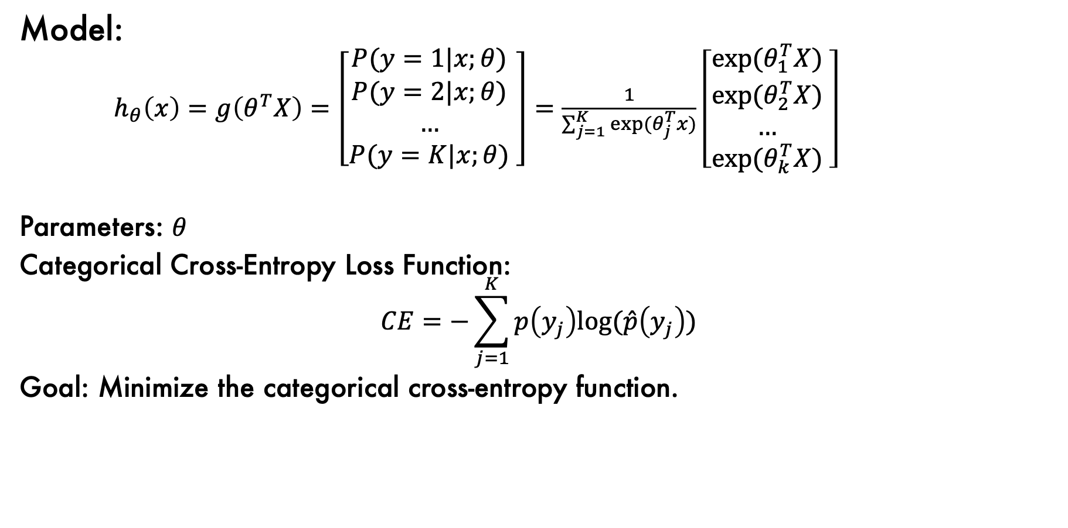
Softmax Regression
Model:
$h_{θ}\left(x\right)=g\left(θ^{T}X\right)=\left[\begin{matrix}P(y=1|x;θ) \\ P(y=2|x;θ) \\ … \\ P(y=K|x;θ)\end{matrix} \right]=\frac{1}{\sum_{j=1}^{K}{exp⁡(θ_{j}^{T}x)}}$ $\left[\begin{matrix}exp⁡(θ_{1}^{T}X) \\ exp⁡(θ_{2}^{T}X) \\ … \\ exp⁡(θ_{k}^{T}X)\end{matrix} \right]$
Parameters: $θ$
Categorical Cross-Entropy Loss Function:
$$CE=−\sum_{j=1}^{K}{p\left(y_{j}\right)log⁡(\hat{p}\left(y_{j}\right))}$$
Goal: Minimize the categorical cross-entropy function.

Slide 6
Support Vector Machines
Support Vector Machines allow us to find non-linear decision boundaries for classification tasks.
We use Support Vector Classifiers, which allow for some misclassifications.
Support Vector machines project our data into higher dimensional space and allow us to find non-linear decision boundaries.
They are powerful classifiers, particularly when boundaries are non-linear.

Slide 7
Decision-Tree Classifiers
Use collections of Decision Trees to build powerful classifiers and regressors.
Include Random Forests and AdaBoost.
Allow you to easily learn about which variables are important!
Raining?
Stream?
Logs >1?
F
T
F
T
F
T
Stream?
Yes
Raining?
Logs > 1.5?
Yes
Stream?
F
T
F
T
F
T
F
T
No
Yes
No
Yes
No
Yes
No
Yes

Slide 8
Fully Connected Neural Networks
wx+b
𝜎
sepal
length
wx+b
sm
pr(versicolor)
wx+b
𝜎
petal
length
wx+b
sm
pr(virginica)
wx+b
𝜎
petal
width
wx+b
sm
pr(setosa)
wx+b
𝜎

Slide 9
Convolutional Neural Networks
Input: Image
Apply Convolutional Filter (or filters!)
Overlay filter on input image.
Calculate dot product between weights and pixels.
Add bias term.
Populate feature map.
Slide filter, and repeat.
Activate Feature Map.
Perform Pooling.
Flatten into vector.
Feed into fully connected neural network.

Slide 10
Recurrent Neural Networks
Just like FCNNs, RNNs have weights, biases, layers, and activation functions.
Major difference: RNNs also have feedback loops, which allow them to take as input sequential values.
input
output
w₁
b₁
w₃
b₂
x1.8
sum
+0.0
ReLU
x1.1
+0.0
w₂
x-0.5

Slide 11






















Long Short-Term Memory Networks
Long-term memory
New Long-term memory
2
$$×$$
1.99
sum
2.96
$$0.997$$
$$0.97$$
% Long-Term
To remember
tanh
$$1.0$$
$$0.97$$
tanh
$$×$$
sigmoid
sigmoid
sigmoid
$$0.99$$
$$0.99$$
$$+ 1.62$$
$$+ 0.62$$
$$−0.32$$
$$+0.59$$
$$×$$
sum
sum
sum
sum
$$× 2.70$$
$$× 2.00$$
$$× 1.41$$
$$× 4.38$$
1
$$0.98$$
$$× 1.63$$
$$× 1.65$$
$$× 0.94$$
$$× −0.19$$
Potential Short-Term Memory
Short-term memory
Input
% Potential Memory to Remember
Potential Long-Term Memory
% Potential Memory to Remember
1

Slide 12
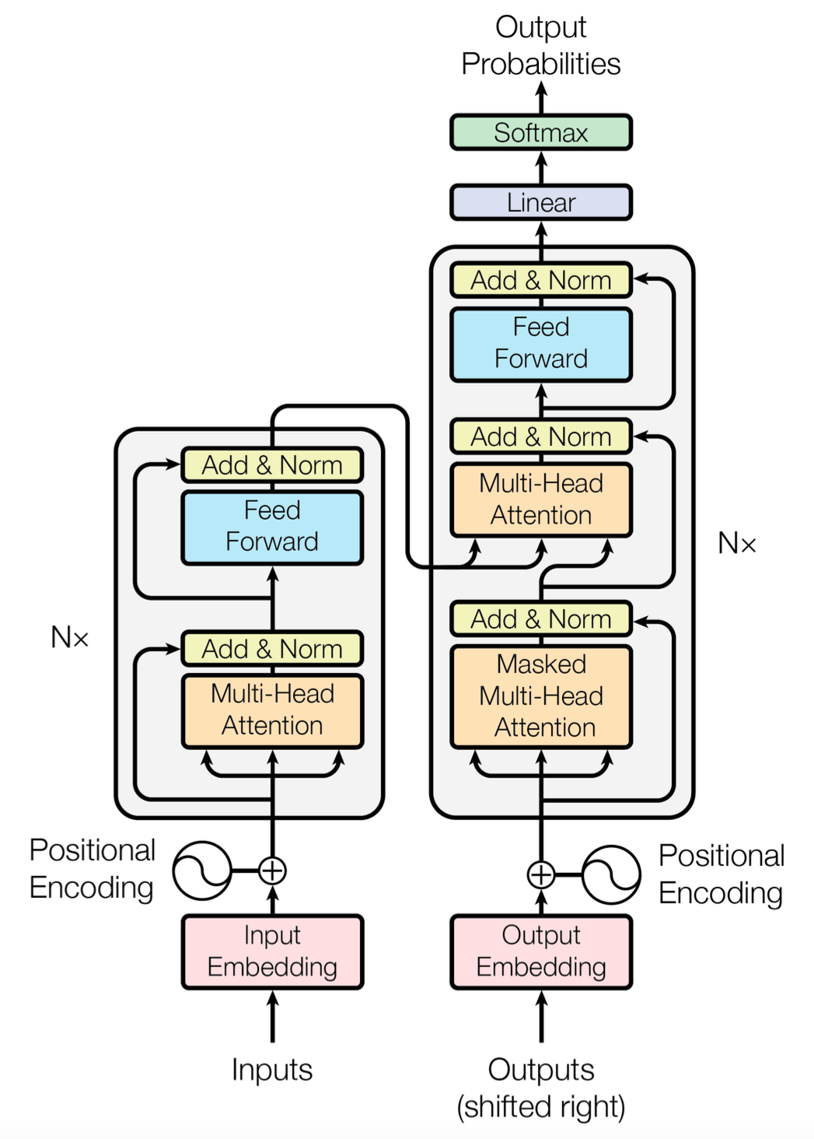
Transformers
Transformers consist of encoders and decoders.
Words can be passed into the input simultaneously, allowing transformers to work for long sentences.
Transformers accept variable-sized input and create variable-sized output.

Slide 13
Graph Neural Networks
GNNs are used to analyze data that is naturally represented as a graph.
Shallow-layers consider nearby connections, while deeper layers incorporate information for further away connections.
GNNs can be used to make predictions about the entire graph, specific nodes, or to predict edges (amongst other things)!

Slide 14
Clustering Approaches
Hierarchical Clustering
K-means clustering
PAM Clustering
Probabilistic Clustering

Slide 15
Dimensionality Reduction
Principal Component Analysis (PCA)
t-SNE
Variational Autoencoders (VAE)
Multidimensional Scaling (MDS)

Slide 16
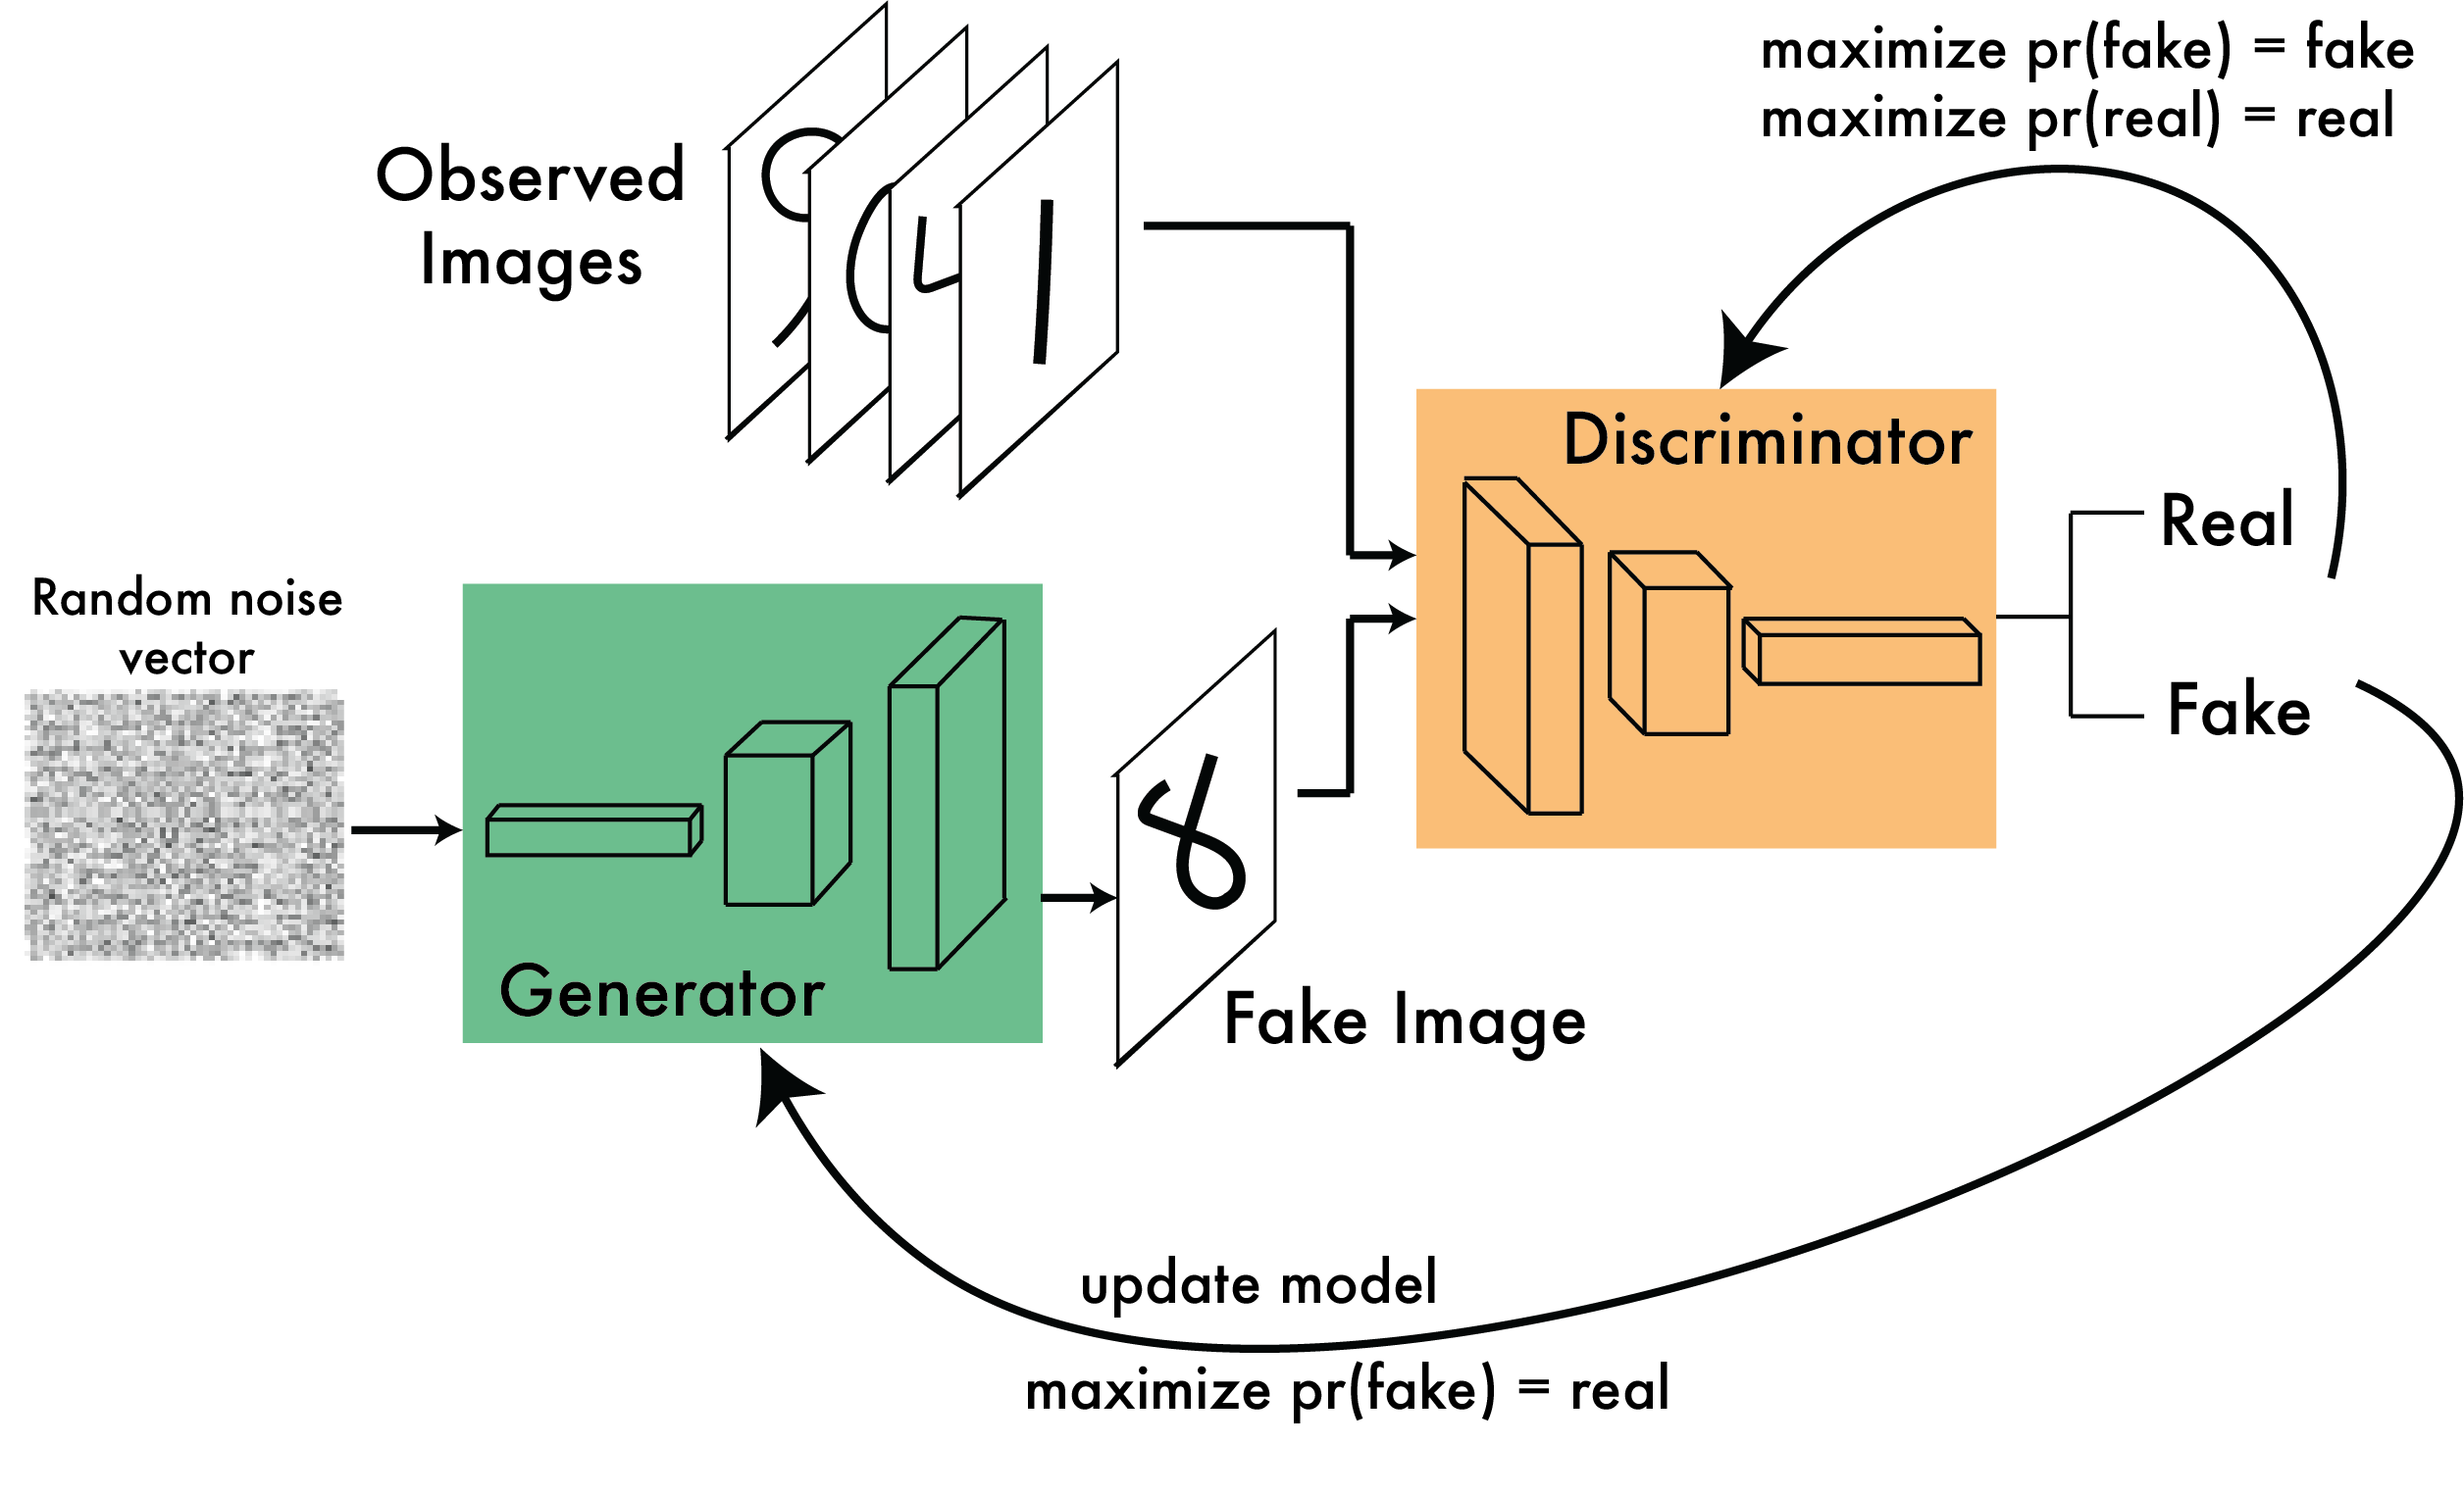
Generative Adversarial Networks

Slide 17
Unsupervised Random Forests
In an unsupervised setting, we do not know the labels.
Unsupervised Random Forest:
Construct a joint distribution of explanatory variables, and draw from this distribution to create synthetic data.
The real and synthetic data are combined and a label set is created (synthetic = 0, real = 1).
Train a Random Forest Classifier.
Calculate the proximity matrix

Slide 18
Algorithms
Supervised Learning
Linear Regression
Logistic Regression
Softmax Regression
Support Vector Machines
Decision-Tree Classifiers
Fully Connected Neural Networks
Convolutional Neural Networks
Recurrent Neural Networks
Long Short-Term Memory Networks
Transformers
Graph Neural Networks
Unsupervised Learning
Clustering Approaches
Dimensionality Approaches
Generative Adversarial Networks
Unsupervised Random Forests

