Slide 1
Challenges Part 2
BIO 4990/6990
Dr. Megan Smith
April 24, 2024

Slide 2
Challenges in Machine Learning
Quality of Training Data
Transfer Learning
Domain Shifts
Ethical Challenges
Interpretability and the Black Box
Hyperparameter Optimization
Overfitting

Slide 3
Interpretability and the Black Box
Black Box: We know what goes in and what comes out, but not why!
Unlike traditional statistical approaches, there is not an interpretable statistical model underlying predictions made using machine learning approaches.
This limits the interpretability of models, the trust that users have in models, and can prevent us from recognizing when models are biased.

Slide 4
Interpretability and the Black Box
Techniques for increasing transparency:
Use simpler models: In general, it is good practice to use the simplest model possible for a predictive task.
Model explanation techniques
Transparency measures: Be transparent about the data used, the preprocessing steps, and the model architecture.

Slide 5
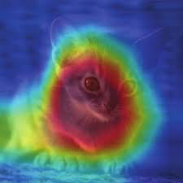
Model explanation techniques
Feature Importance
Mean Decrease in GINI and Mean Decrease Accuracy in Random Forests
Permutation Importance: Shuffle feature values and measure the impact on model performance. Features with the largest drop in performance when shuffled are considered important.
Class Activation Mapping (CAM)

Slide 6
Model explanation techniques
These techniques tell us about which features drive predictions, but do they really solve the black box problem?
We still lack well-understood statistical models underlying our predictions like we might have in standard Likelihood and Bayesian frameworks.

Slide 7
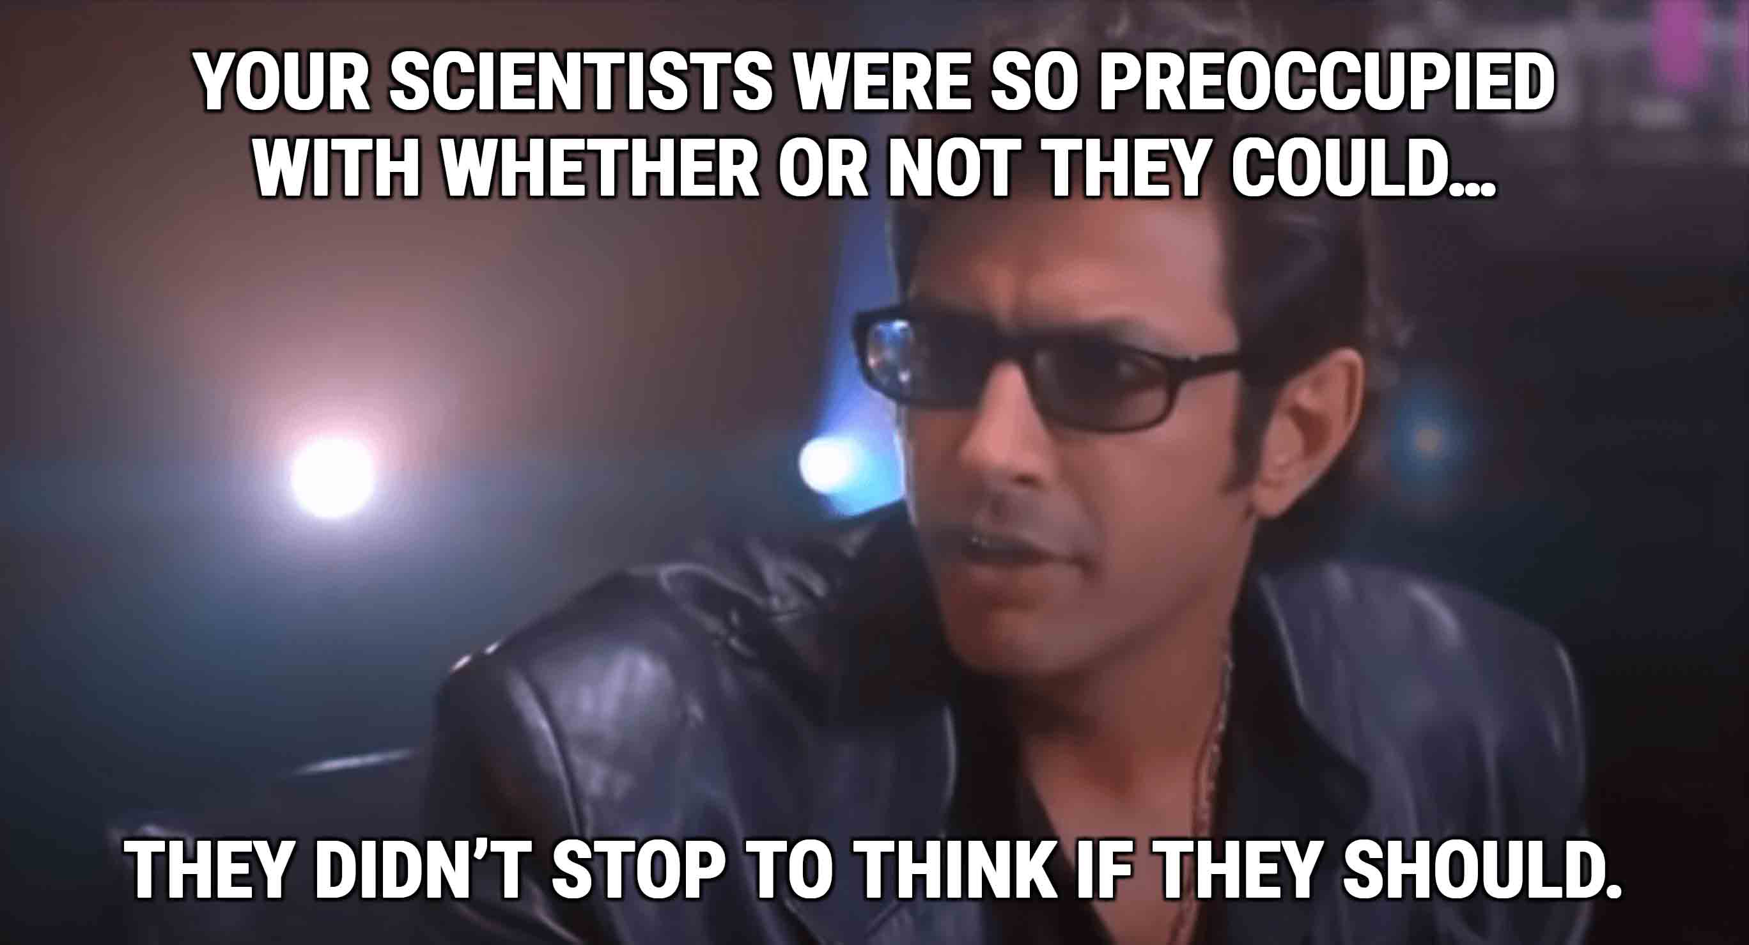
The Black Box

Slide 8
The Black Box
Machine learning approaches are incredibly powerful, and can be applied to tasks for which standard approaches are not available.
For example, it is not possible right now for me to use Bayesian inference to detect migration in the presence of background selection, but I can do it using supervised machine learning!
I think this is incredibly useful, but as with any inference technique, we need to be cognizant and open about the limitations of the approaches we use.

Slide 9
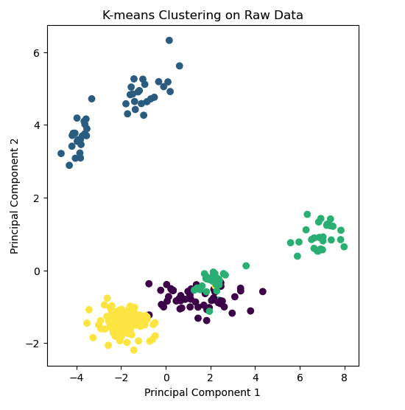
Interpretability in Unsupervised Machine Learning
Clustering approaches do not tell us anything about the nature of the clusters.

Slide 10
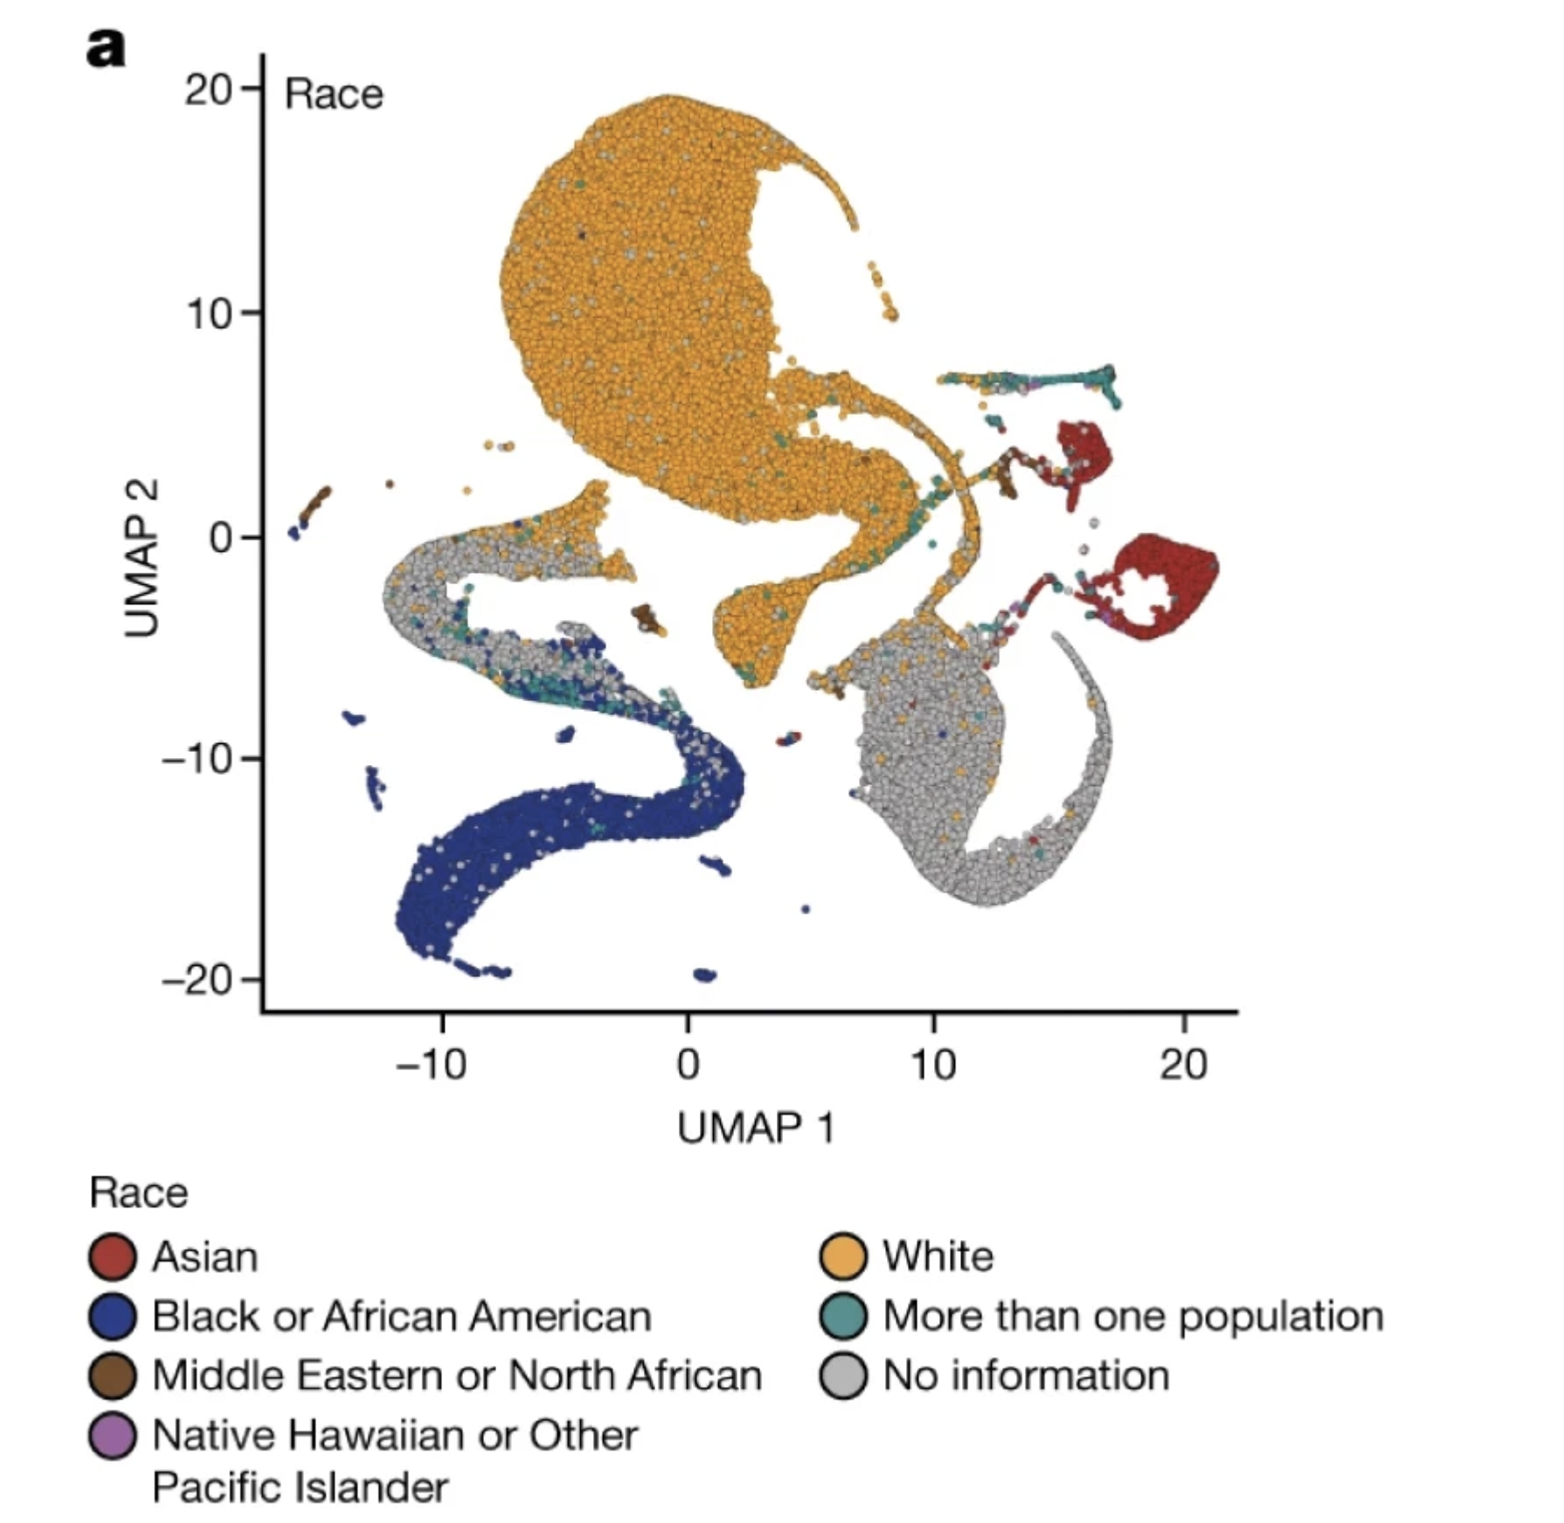
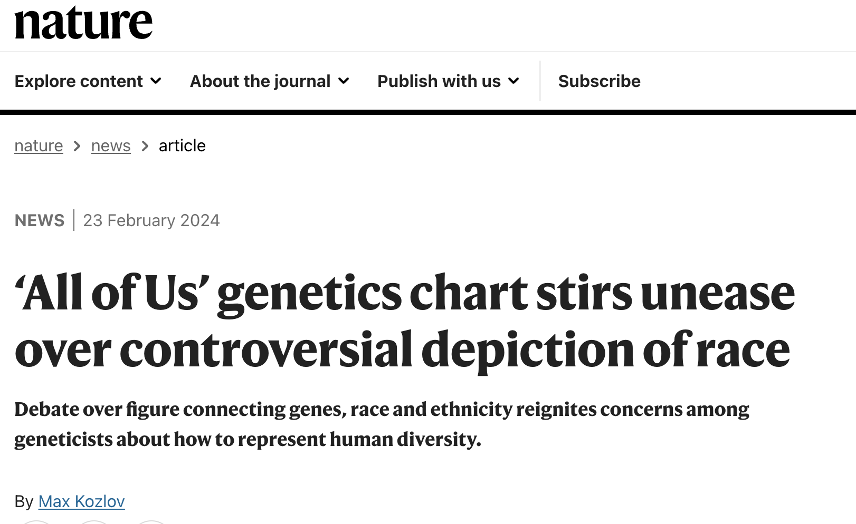
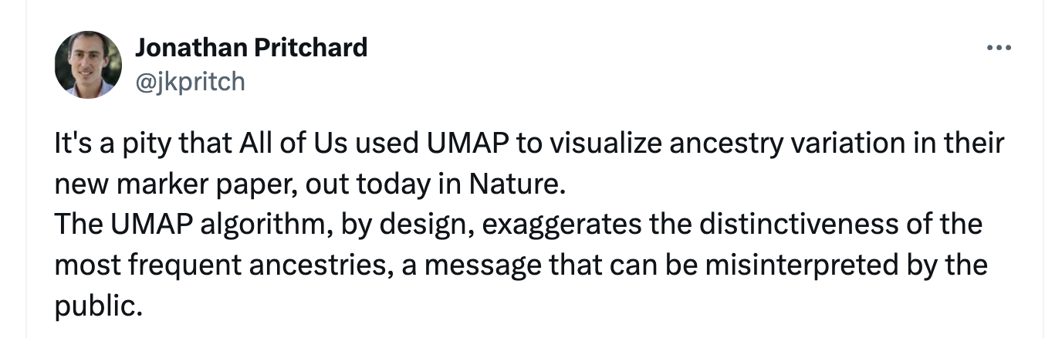
Interpretability in Unsupervised Machine Learning

Slide 11
Challenges in Machine Learning
Quality of Training Data
Transfer Learning
Domain Shifts
Ethical Challenges
Interpretability and the Black Box
Hyperparameter Optimization
Overfitting

Slide 12
Hyperparameter optimization
Many machine learning algorithms require that we make decisions about many hyperparameters.
These hyperparameters can have major impacts on how well our models work.
How do we choose them?

Slide 13
Hyperparameter optimization
Manual
Explore different combinations in a non-systematic way
Pros: Use your own expertise to adjust your hyperparameters
Cons: Not replicable, non-exhaustive, challenging

Slide 14
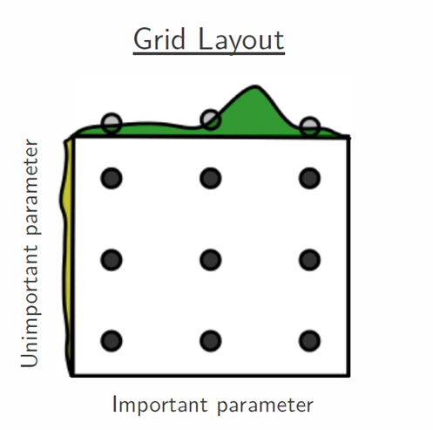
Hyperparameter optimization
Grid Search
Exhaustively search through a manually specified subset of hyperparameter combinations.
Pros: Simple, easy to understand, and exhaustive
Cons: Computationally expensive

Slide 15
Hyperparameter optimization
Random Search
Randomly sample hyperparameters from predefined ranges
Pros: More efficient than a grid search
Cons: Less likely to find the best combination

Slide 16
Hyperparameter optimization
Bayesian Hyperparameter Optimization
Develop a probabilistic model mapping hyperparameters to a probability of a score on the objective (i.e., loss) function, and use this to decide which hyperparameters to explore.
Pros: Computationally efficient
Cons: Difficult to implement, has its own hyperparameters

Slide 17
Challenges in Machine Learning
Quality of Training Data
Transfer Learning
Domain Shifts
Ethical Challenges
Interpretability and the Black Box
Hyperparameter Optimization
Overfitting

Slide 18
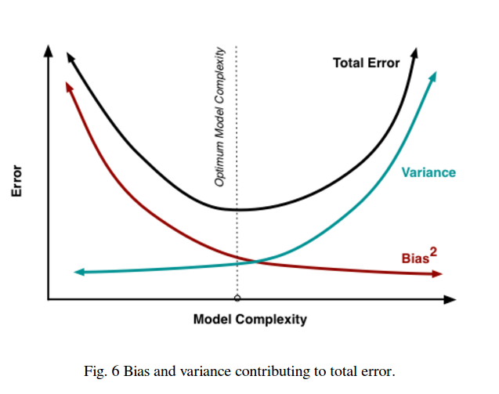
Overfitting
This Photo by Unknown Author is licensed under CC BY-SA

Slide 19
Overfitting
Managing the bias-variance tradeoff is always challenging.
Approaches:
Use as simple a model as possible!
Pruning in decision-tree based approaches.
Dropout in neural networks.
L1 and L2 regularization (often used in linear and logistic regression).

Slide 20



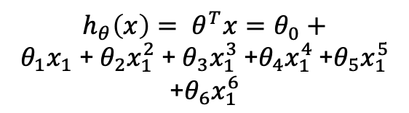

Using a simple model
If a linear regression will make accurate predictions in your domain, don’t use a fully-connected neural network.
$h_{θ}\left(x\right)= θ^{T}x=θ_{0}+θ_{1}x_{1} \text{+} θ_{2}x_{1}^{2} \text{+} θ_{3}x_{1}^{3}$ +$θ_{4}x_{1}^{4}$ $\text{+}θ_{5}x_{1}^{5}$ $\text{+}θ_{6}x_{1}^{6}$
$$h_{θ}\left(x\right)= θ^{T}x=θ_{0}+θ_{1}x_{1}$$
$h_{θ}\left(x\right)= θ^{T}x=θ_{0}+θ_{1}x_{1}$+$θ_{2}x_{1}^{2}$
Volume
(cm³)
Diameter (cm)
Diameter (cm)
Diameter (cm)

Slide 21
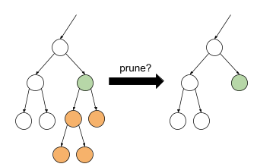
Pruning

Slide 22
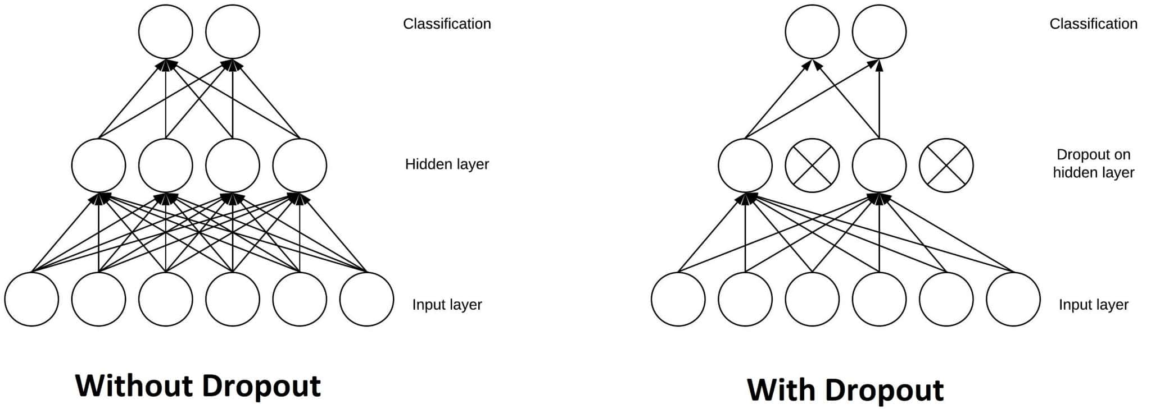
Dropout

Slide 23
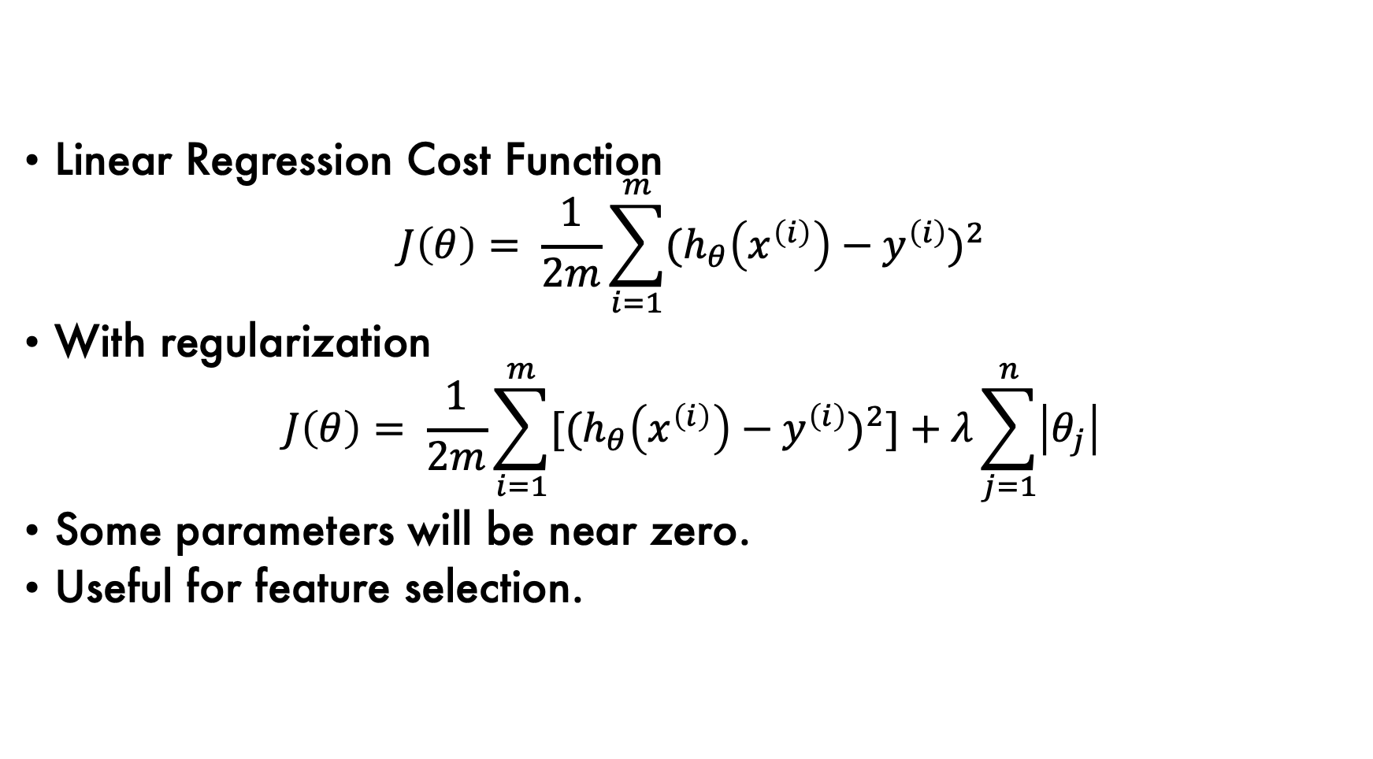
L1 (Lasso) Regularization
Linear Regression Cost Function
$$J\left(θ\right)= \frac{1}{2m}\sum_{i=1}^{m}{{{(h}_{θ}\left(x^{\left(i\right)}\right)−y^{\left(i\right)})}^{2}}$$
With regularization
$$J\left(θ\right)= \frac{1}{2m}\sum_{i=1}^{m}{{[{(h}_{θ}\left(x^{\left(i\right)}\right)−y^{\left(i\right)})}^{2}]+λ\sum_{j=1}^{n}{\left|θ_{j}\right|}}$$
Some parameters will be near zero.
Useful for feature selection.

Slide 24
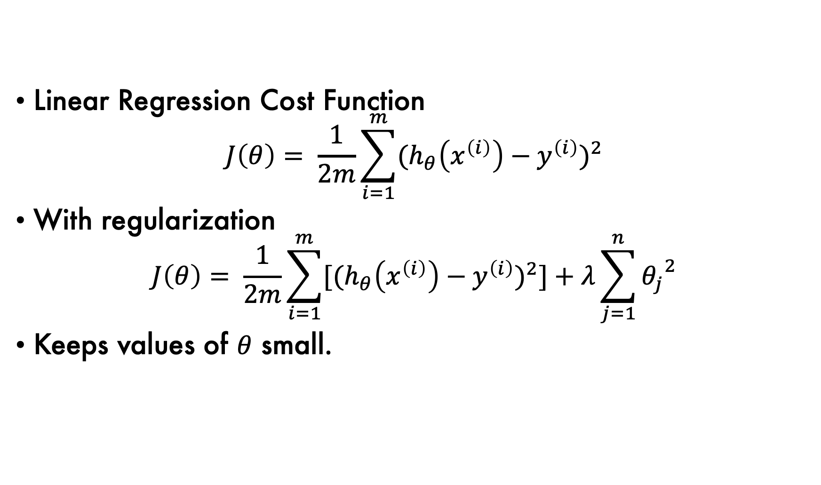
L2 (Ridge) Regularization
Linear Regression Cost Function
$$J\left(θ\right)= \frac{1}{2m}\sum_{i=1}^{m}{{{(h}_{θ}\left(x^{\left(i\right)}\right)−y^{\left(i\right)})}^{2}}$$
With regularization
$$J\left(θ\right)= \frac{1}{2m}\sum_{i=1}^{m}{{[{(h}_{θ}\left(x^{\left(i\right)}\right)−y^{\left(i\right)})}^{2}]+λ\sum_{j=1}^{n}{{θ_{j}}^{2}}}$$
Keeps values of $θ$ small.

Slide 25
Training, Validation, and Test sets
S = original dataset
S_{train}: Used to train models (e.g., 60%)
S_{val}: Used to compare models (e.g., 20%)
S_{test}: Used for final measure of error (e.g., 20%)
Make sure you can identify overfitting by using these datasets!

Slide 26
Challenges in Machine Learning
Quality of Training Data
Transfer Learning
Domain Shifts
Ethical Challenges
Interpretability and the Black Box
Hyperparameter Optimization
Overfitting

