Slide 1

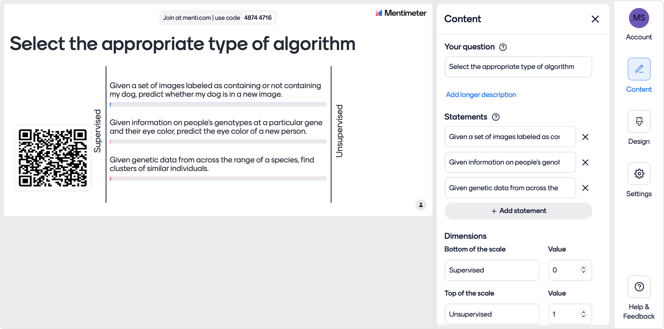
Mentimeter for PowerPoint

Slide 2
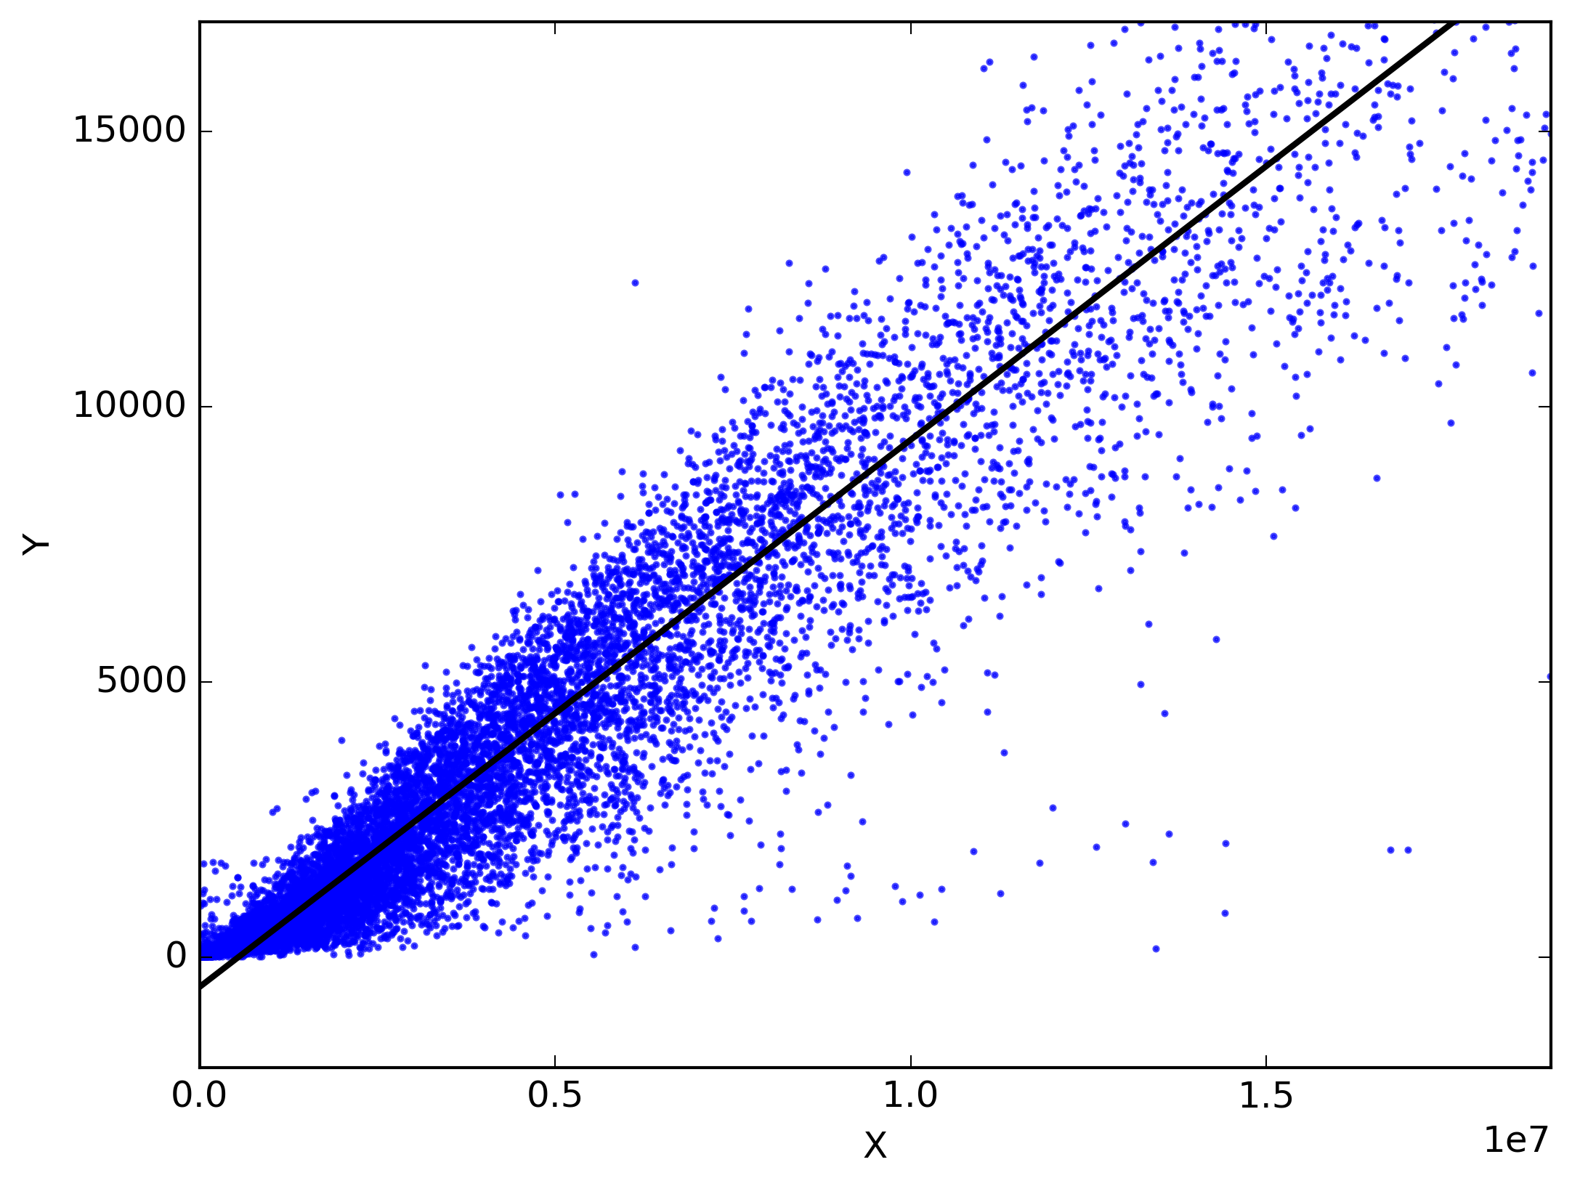
Supervised Machine Learning and Linear Regression
BIO 4990/6990
January 22, 2024
Dr. Megan Smith
Mississippi State University
This Photo by Unknown Author is licensed under CC BY-SA
from craiyon

Slide 3
Outline
Supervised machine learning components
The linear regression model
The linear regression cost function
Gradient Descent
Multiple linear regression

Slide 4
Outline
Supervised machine learning components
The linear regression model
The linear regression cost function
Gradient Descent
Multiple linear regression

Slide 5
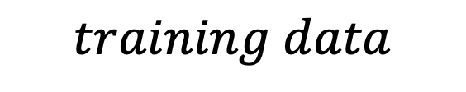


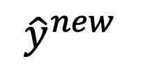

Supervised Machine Learning
Learn the mapping from input to output from data with known answers.
$$training data$$
$$learning algorithm$$
$$x^{(new)}$$
$$Model$$
$${\hat{y}}^{new}$$
Notes:
Remind definition

Slide 6
Predicting Lumber Volume

Slide 7
Predicting Lumber Volume

Slide 8
Predicting Lumber Volume

Slide 9
Predicting Lumber Volume
Why is this a supervised machine learning approach?

Slide 10
Predicting Lumber Volume
Diameter | Volume
8.3 | 10.3
8.6 | 10.3
8.8 | 10.2
10.5 | 16.4
10.7 | 18.8
10.8 | 19.7
11.0 | 15.6
… | …
20.6 | 77.0

Slide 11
Predicting Lumber Volume
Training Set
Diameter | Volume
8.3 | 10.3
8.6 | 10.3
8.8 | 10.2
10.5 | 16.4
10.7 | 18.8
10.8 | 19.7
11.0 | 15.6
… | …
20.6 | 77.0

Slide 12
Terminology and Notation
Training Set
x = “input” variable / ”features”
y = “output” or “target” variable
m = number of training examples
(x,y) = single training example
(x^{(i)},y^{(i)}) = i^{th} training example
Diameter | Volume
8.3 | 10.3
8.6 | 10.3
8.8 | 10.2
10.5 | 16.4
10.7 | 18.8
10.8 | 19.7
11.0 | 15.6
… | …
20.6 | 77.0

Slide 13
Terminology and Notation
Training Set
x = “input” variable / ”features”
y = “output” or “target” variable
m = number of training examples
(x,y) = single training example
(x^{(i)},y^{(i)}) = i^{th} training example
What is x⁽¹⁾?
Diameter | Volume
8.3 | 10.3
8.6 | 10.3
8.8 | 10.2
10.5 | 16.4
10.7 | 18.8
10.8 | 19.7
11.0 | 15.6
… | …
20.6 | 77.0

Slide 14
Outline
Supervised machine learning components
The linear regression model
The linear regression cost function
Gradient Descent
Multiple linear regression

Slide 15

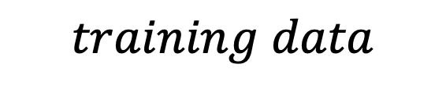


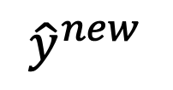
Linear Model
$$training data$$
$$learning algorithm$$
$$x^{(new)}$$
$$Model$$
$${\hat{y}}^{new}$$

Slide 16
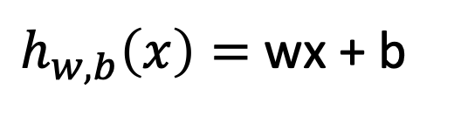

Linear Model
$$training data$$
$$learning algorithm$$
$$x^{(new)}$$
$$h(x)$$
$${\hat{y}}^{new}$$
$h_{w,b}\left(x\right)=$ wx + b
Notes:
Give intuition for linear model parameters by drawing on board

Slide 17
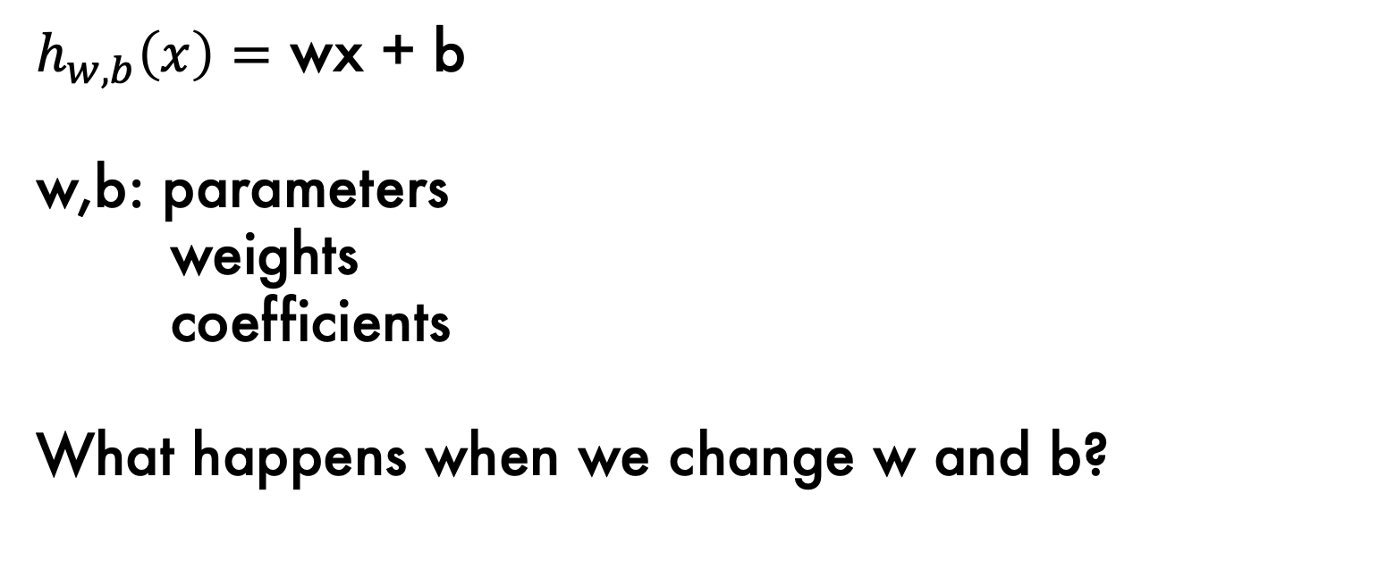
Linear Model
$h_{w,b}\left(x\right)=$ wx + b
w,b: parameters
weights
coefficients
What happens when we change w and b?
Notes:
Show on the board how to expand to more variables
Fw,b(X) = w1x1 + w2x2 + b
Show how to simplify the notation
F(x) = sum j=0 to 2 of wjxj, where x0 = 1.
Theta is three dim theta0, theta1, theta2, and X is three dim x0, x1, x2, x3

Slide 18
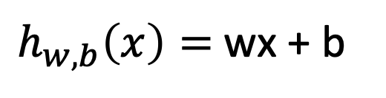
Linear Model
$h_{w,b}\left(x\right)=$ wx + b
3
3
3
2
2
2
1
1
1
0
0
0
0
1
2
3
0
1
2
3
0
1
2
3
w = 0
b = 1.5
w = 1
b = 0
w = -1
b = 3
Notes:
Give intuition for linear model parameters by drawing on board.
Write linear model and indicate the parameters on the board too.

Slide 19
Outline
Supervised machine learning components
The linear regression model
The linear regression cost function
Gradient Descent
Multiple linear regression

Slide 20
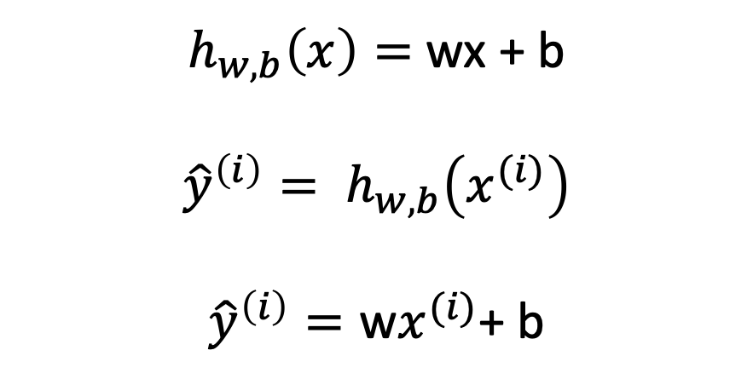
Linear Model
$h_{w,b}\left(x\right)=$ wx + b
$${\hat{y}}^{\left(i\right)}= h_{w,b}\left(x^{(i)}\right)$$
$${\hat{y}}^{\left(i\right)}=\text{w}x^{(i)}\text{+ }\text{b}$$
Notes:
Give intuition for linear model parameters by drawing on board.
Write linear model and indicate the parameters on the board too.

Slide 21
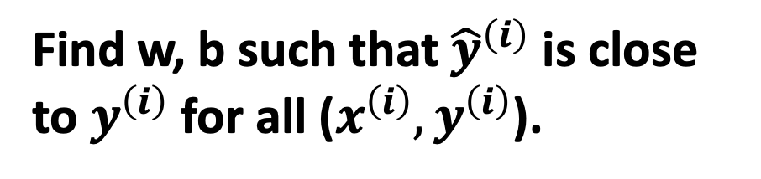
Linear Model
$h_{w,b}\left(x\right)=$ wx + b
$${\hat{y}}^{\left(i\right)}= h_{w,b}\left(x^{(i)}\right)$$
$${\hat{y}}^{\left(i\right)}=\text{w}x^{(i)}\text{+ }\text{b}$$
Find w, b such that ${\hat{y}}^{\left(i\right)}$ is close to $y^{\left(i\right)}$ for all ($x^{\left(i\right)},y^{\left(i\right)}$).
Notes:
Give intuition for linear model parameters by drawing on board.
Write linear model and indicate the parameters on the board too.

Slide 22
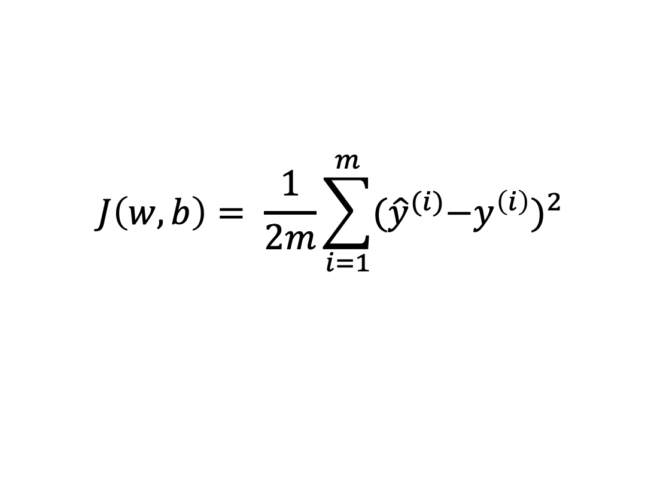

Cost Function
$$J\left(w,b\right)= \frac{1}{2m}\sum_{i=1}^{m}{{{(\hat{y}}^{(i)}−y^{\left(i\right)})}^{2}}$$
Find w, b such that ${\hat{y}}^{\left(i\right)}$ is close to $y^{\left(i\right)}$ for all ($x^{\left(i\right)},y^{\left(i\right)}$).
Notes:
Give intuition for linear model parameters by drawing on board.
Write linear model and indicate the parameters on the board too.

Slide 23
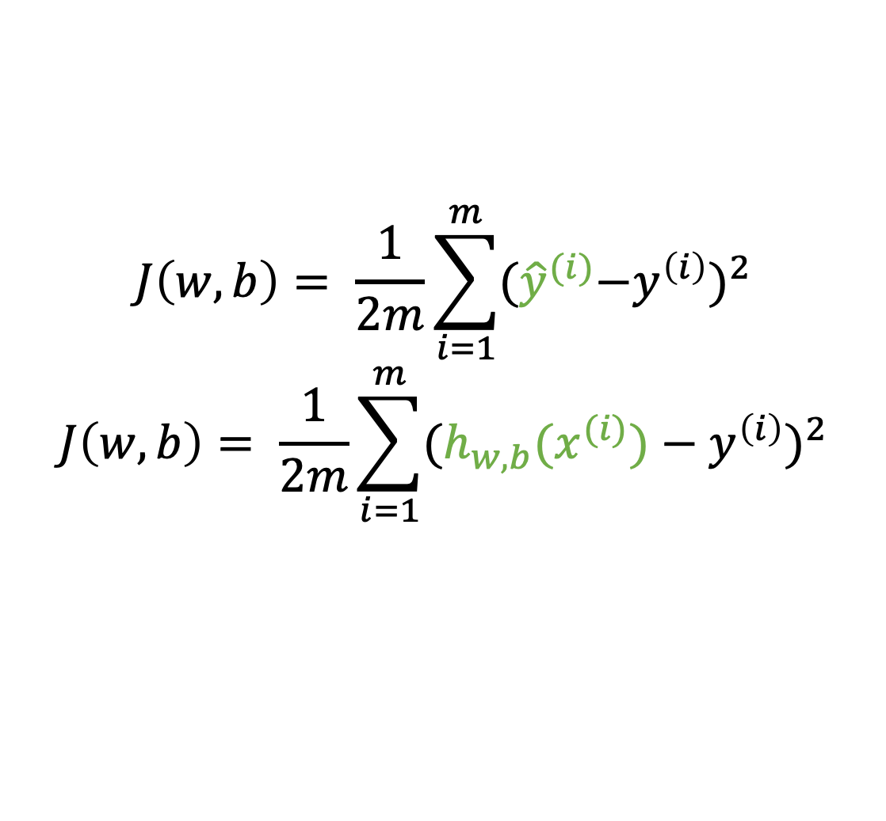
Cost Function
$$J\left(w,b\right)= \frac{1}{2m}\sum_{i=1}^{m}{{{(\hat{y}}^{(i)}−y^{\left(i\right)})}^{2}}$$
$$J\left(w,b\right)= \frac{1}{2m}\sum_{i=1}^{m}{{(h_{w,b}(x^{(i)})−y^{\left(i\right)})}^{2}}$$
Find w, b such that ${\hat{y}}^{\left(i\right)}$ is close to $y^{\left(i\right)}$ for all ($x^{\left(i\right)},y^{\left(i\right)}$).
Notes:
Give intuition for linear model parameters by drawing on board.
Write linear model and indicate the parameters on the board too.

Slide 24
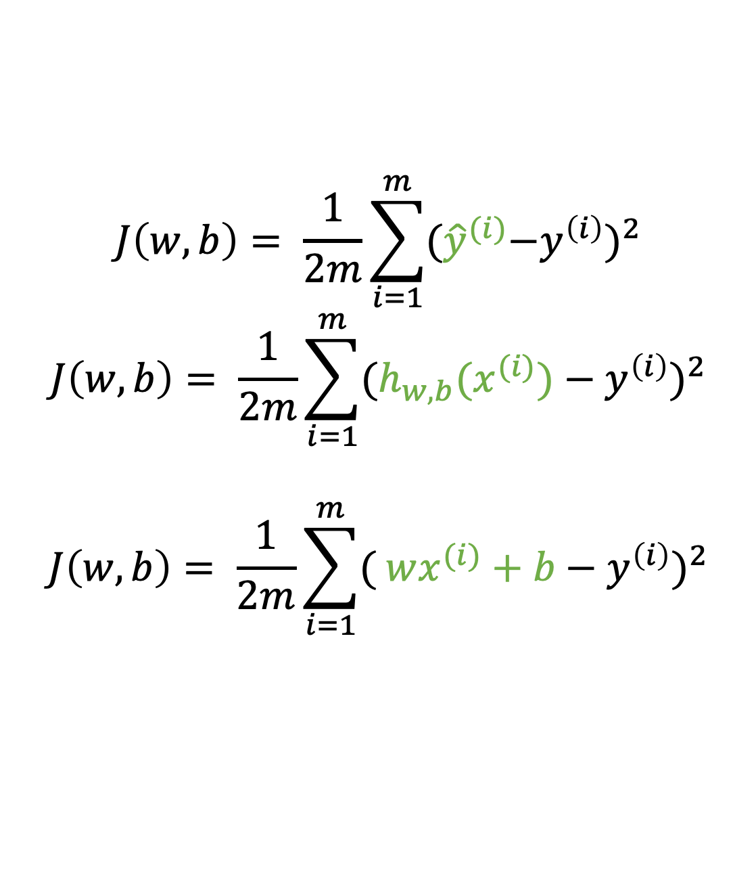
Cost Function
$$J\left(w,b\right)= \frac{1}{2m}\sum_{i=1}^{m}{{{(\hat{y}}^{(i)}−y^{\left(i\right)})}^{2}}$$
$$J\left(w,b\right)= \frac{1}{2m}\sum_{i=1}^{m}{{(h_{w,b}(x^{(i)})−y^{\left(i\right)})}^{2}}$$
$$J\left(w,b\right)= \frac{1}{2m}\sum_{i=1}^{m}{{( wx^{(i)}+b−y^{\left(i\right)})}^{2}}$$
Find w, b such that ${\hat{y}}^{\left(i\right)}$ is close to $y^{\left(i\right)}$ for all ($x^{\left(i\right)},y^{\left(i\right)}$).
Notes:
Give intuition for linear model parameters by drawing on board.
Write linear model and indicate the parameters on the board too.

Slide 25
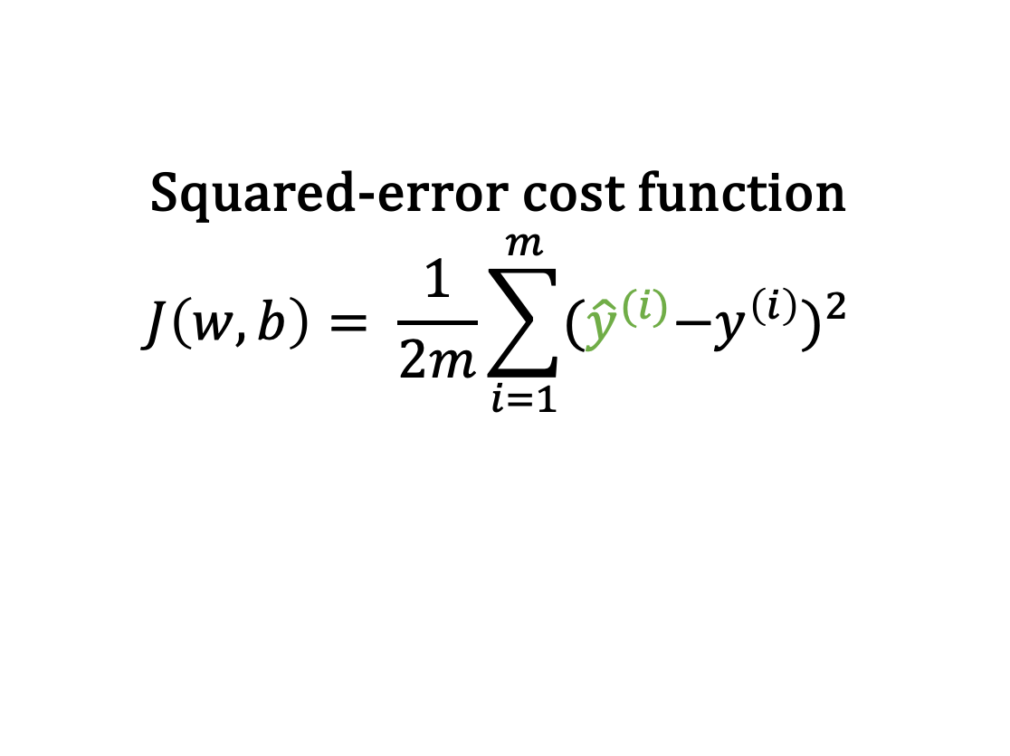
Cost Function
Squared-error cost function
$$J\left(w,b\right)= \frac{1}{2m}\sum_{i=1}^{m}{{{(\hat{y}}^{(i)}−y^{\left(i\right)})}^{2}}$$
Find w, b such that ${\hat{y}}^{\left(i\right)}$ is close to $y^{\left(i\right)}$ for all ($x^{\left(i\right)},y^{\left(i\right)}$).
Notes:
Give intuition for linear model parameters by drawing on board.
Write linear model and indicate the parameters on the board too.

Slide 26

Summary
Model:
$h_{w,b}\left(x\right)=$ wx + b
Parameters:
w, b
Cost Function:
$J\left(w,b\right)= \frac{1}{2m}\sum_{i=1}^{m}{{({\hat{y}}^{(i)}−y^{\left(i\right)})}^{2}}$
Goal:
$\min_{w,b}{J\left(w,b\right)}$

Slide 27
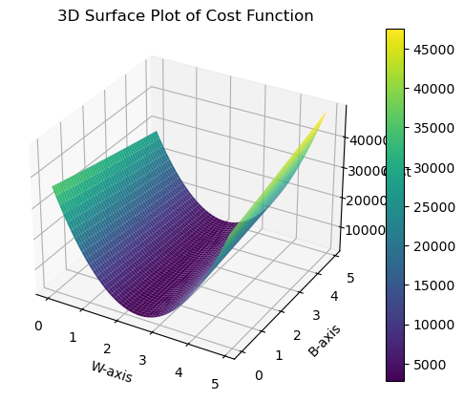
Cost Functions and Optima

Slide 28
Outline
Supervised machine learning components
The linear regression model
The linear regression cost function
Gradient Descent
Multiple linear regression

Slide 29
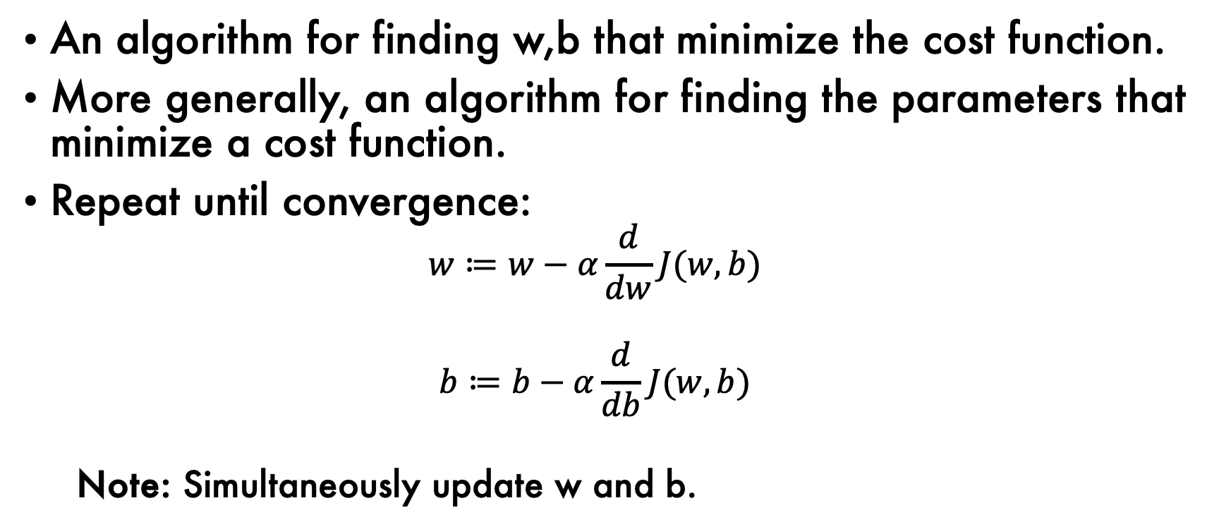
Gradient Descent Algorithm
An algorithm for finding w,b that minimize the cost function.
More generally, an algorithm for finding the parameters that minimize a cost function.
Repeat until convergence:
$$w≔w−α\frac{d}{dw}J(w,b)$$
$$b≔b−α\frac{d}{db}J(w,b)$$
Note: Simultaneously update w and b.

Slide 30
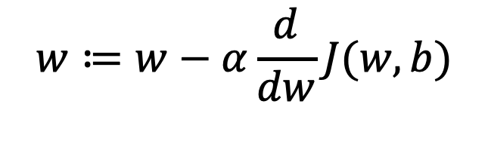
Gradient Descent Algorithm
derivative of the cost function with respect to w
$$w≔w−α\frac{d}{dw}J(w,b)$$
previous w
learning rate

Slide 31
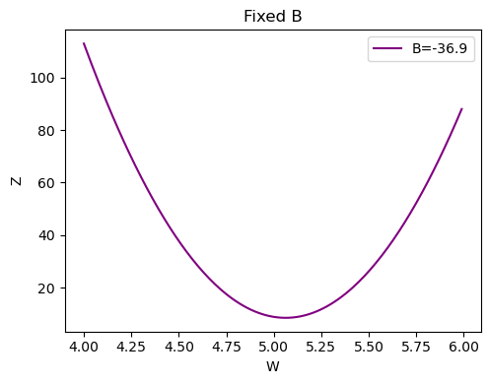
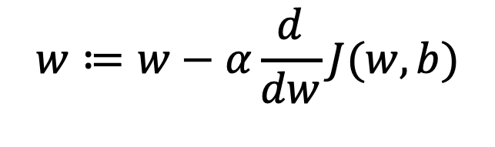
Gradient Descent Algorithm
$$w≔w−α\frac{d}{dw}J(w,b)$$
Initialize at w=4.25

Slide 32
Gradient Descent Algorithm
$$w≔w−α\frac{d}{dw}J(w,b)$$
Initialize at w=4.25
derivative: slope of line tangential to the curve
negative and large
How does this change w?

Slide 33
Gradient Descent Algorithm
$$w≔w−α\frac{d}{dw}J(w,b)$$
Initialize at w=4.00
Is the derivative larger or smaller?
Will we change w less or more?

Slide 34
Gradient Descent Algorithm
$$w≔w−α\frac{d}{dw}J(w,b)$$
Initialize at w=5.6
Is the derivative negative or positive?
How will we change w?

Slide 35
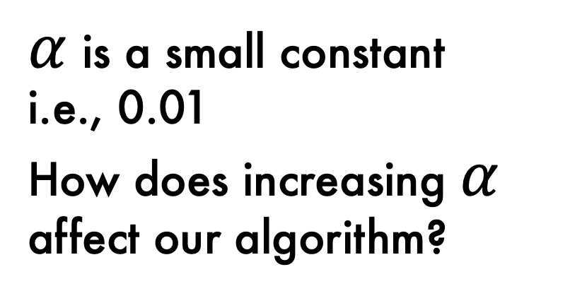
Gradient Descent Algorithm
$$w≔w−α\frac{d}{dw}J(w,b)$$
$α$ is a small constant
i.e., 0.01
How does increasing $α$ affect our algorithm?

Slide 36
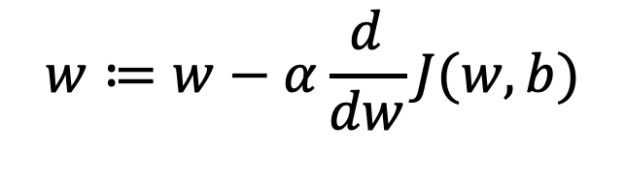
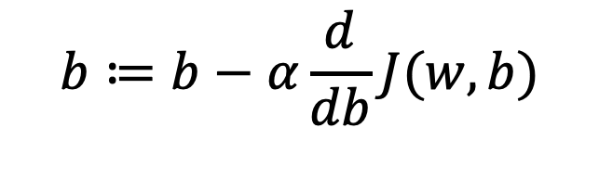
Gradient Descent Algorithm
$$w≔w−α\frac{d}{dw}J(w,b)$$
$$b≔b−α\frac{d}{db}J(w,b)$$

Slide 37
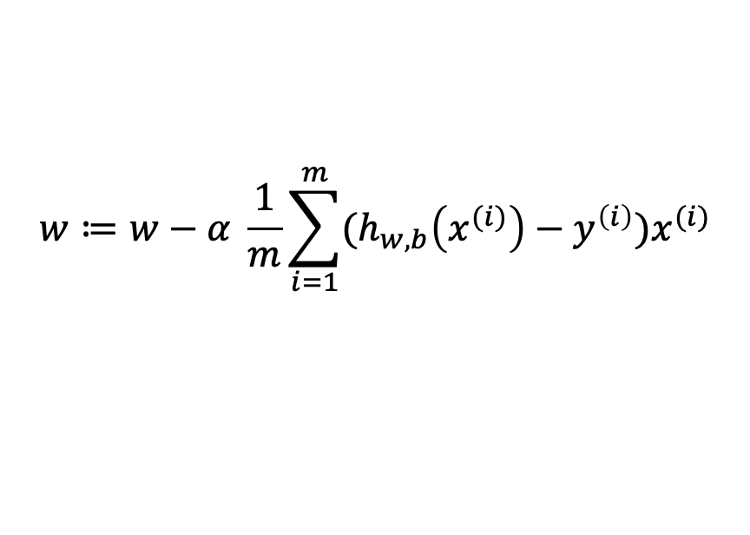
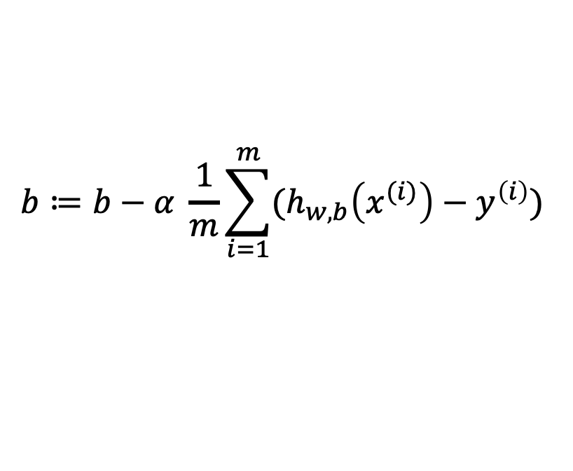
Gradient Descent Algorithm
$$w≔w−α\frac{d}{dw}J(w,b)$$
$$w≔w−α \frac{1}{m}\sum_{i=1}^{m}{(h_{w,b}\left(x^{(i)}\right)−y^{\left(i\right)})x^{(i)}}$$
$$b≔b−α\frac{d}{db}J(w,b)$$
$$b≔b−α \frac{1}{m}\sum_{i=1}^{m}{(h_{w,b}\left(x^{(i)}\right)−y^{\left(i\right)}) }$$

Slide 38
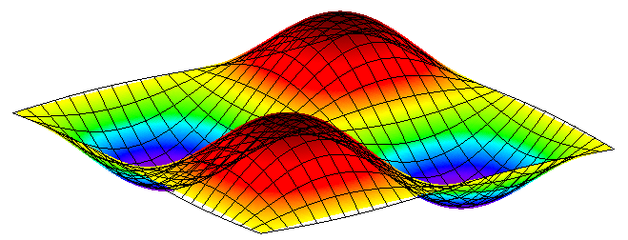
A Note Regarding Gradient Descent

Slide 39
Types of Gradient Descent
Batch Gradient Descent: Calculate the derivative over all training samples at each step.
Stochastic Gradient Descent: For each iteration, consider only a single training example.
Mini-batch Gradient Descent: For each iteration, consider a subset of training examples.
Why might you sometimes use stochastic gradient descent instead of batch gradient descent?

Slide 40
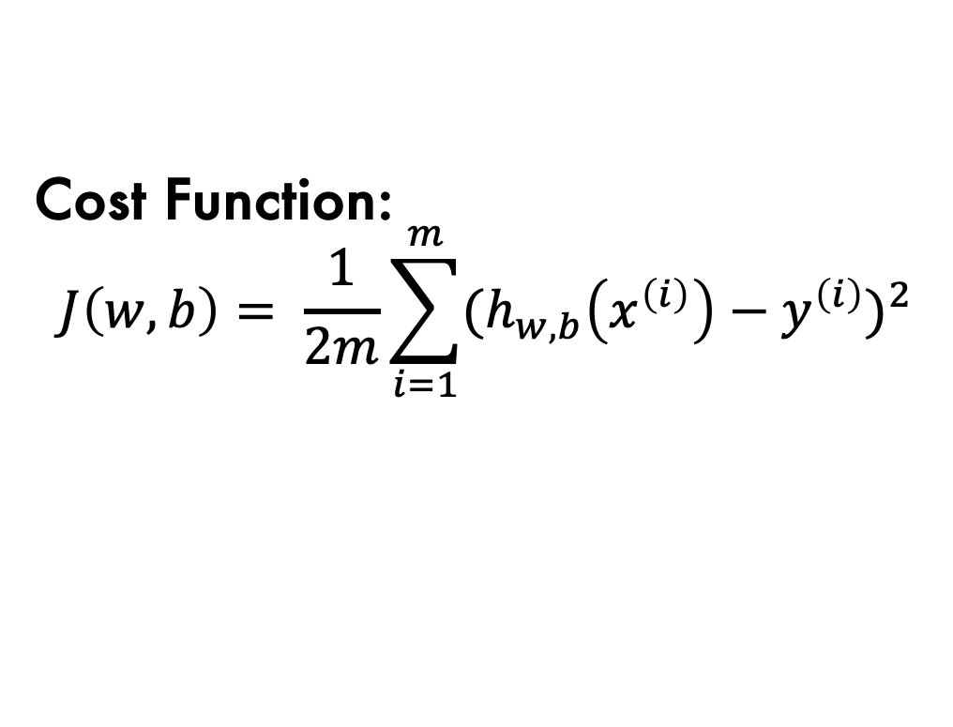
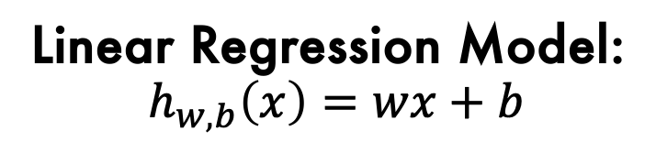
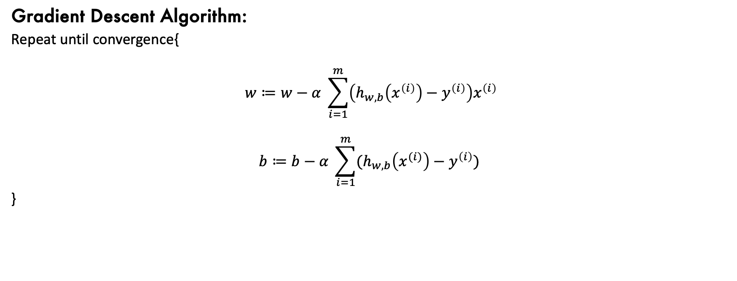
Linear Regression and Gradient Descent
Linear Regression Model:
$$h_{w,b}\left(x\right)=wx+b$$
Cost Function:
$$J\left(w,b\right)= \frac{1}{2m}\sum_{i=1}^{m}{{{(h}_{w,b}\left(x^{\left(i\right)}\right)−y^{\left(i\right)})}^{2}}$$
Gradient Descent Algorithm:
Repeat until convergence{
$$w≔w−α \sum_{i=1}^{m}{\left(h_{w,b}\left(x^{\left(i\right)}\right)−y^{\left(i\right)}\right)x^{\left(i\right)}}$$
$$b≔b−α \sum_{i=1}^{m}{(h_{w,b}\left(x^{(i)}\right)−y^{\left(i\right)}) }$$
}

Slide 41
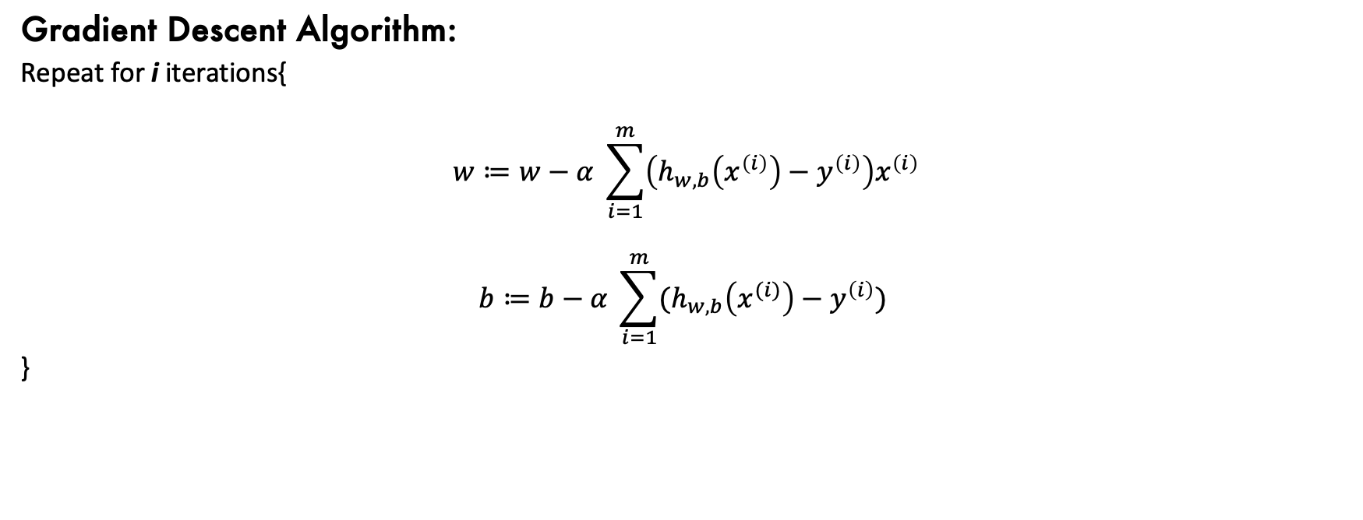
Linear Regression and Gradient Descent
Linear Regression Model:
$$h_{w,b}\left(x\right)=wx+b$$
Cost Function:
$$J\left(w,b\right)= \frac{1}{2m}\sum_{i=1}^{m}{{{(h}_{w,b}\left(x^{\left(i\right)}\right)−y^{\left(i\right)})}^{2}}$$
Gradient Descent Algorithm:
Repeat for i iterations{
$$w≔w−α \sum_{i=1}^{m}{\left(h_{w,b}\left(x^{\left(i\right)}\right)−y^{\left(i\right)}\right)x^{\left(i\right)}}$$
$$b≔b−α \sum_{i=1}^{m}{(h_{w,b}\left(x^{(i)}\right)−y^{\left(i\right)}) }$$
}

Slide 42
Outline
Supervised machine learning components
The linear regression model
The linear regression cost function
Gradient Descent
Multiple linear regression

Slide 43
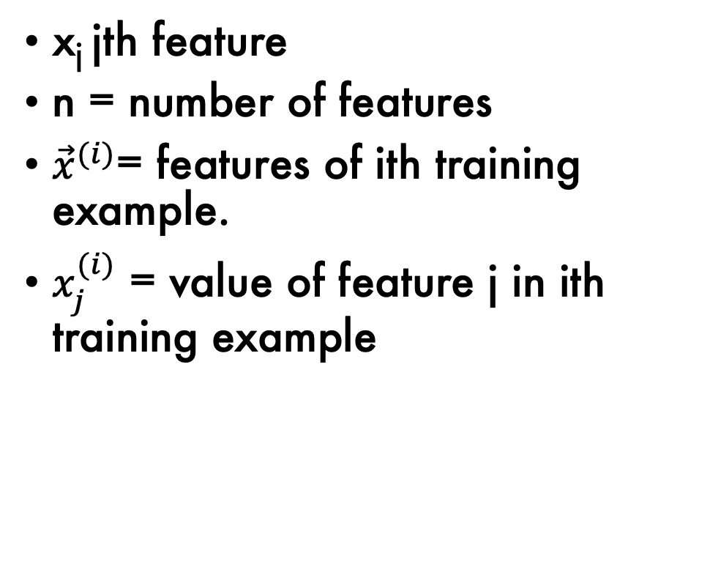
Multiple Linear Regression
X₁
X₂
x_{j} jth feature
n = number of features
${\vec{x}}^{(i)}$= features of ith training example.
$x_{j}^{(i)}$ = value of feature j in ith training example
Diameter | Height | Volume
8.3 | 70 | 10.3
8.6 | 65 | 10.3
8.8 | 63 | 10.2
10.5 | 72 | 16.4
10.7 | 81 | 18.8
10.8 | 83 | 19.7
11.0 | 66 | 15.6
… |  | …
20.6 | 87 | 77.0

Slide 44
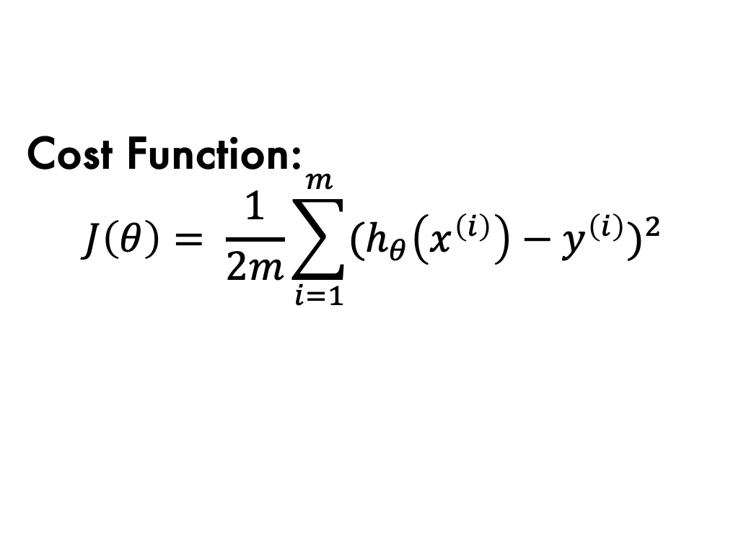

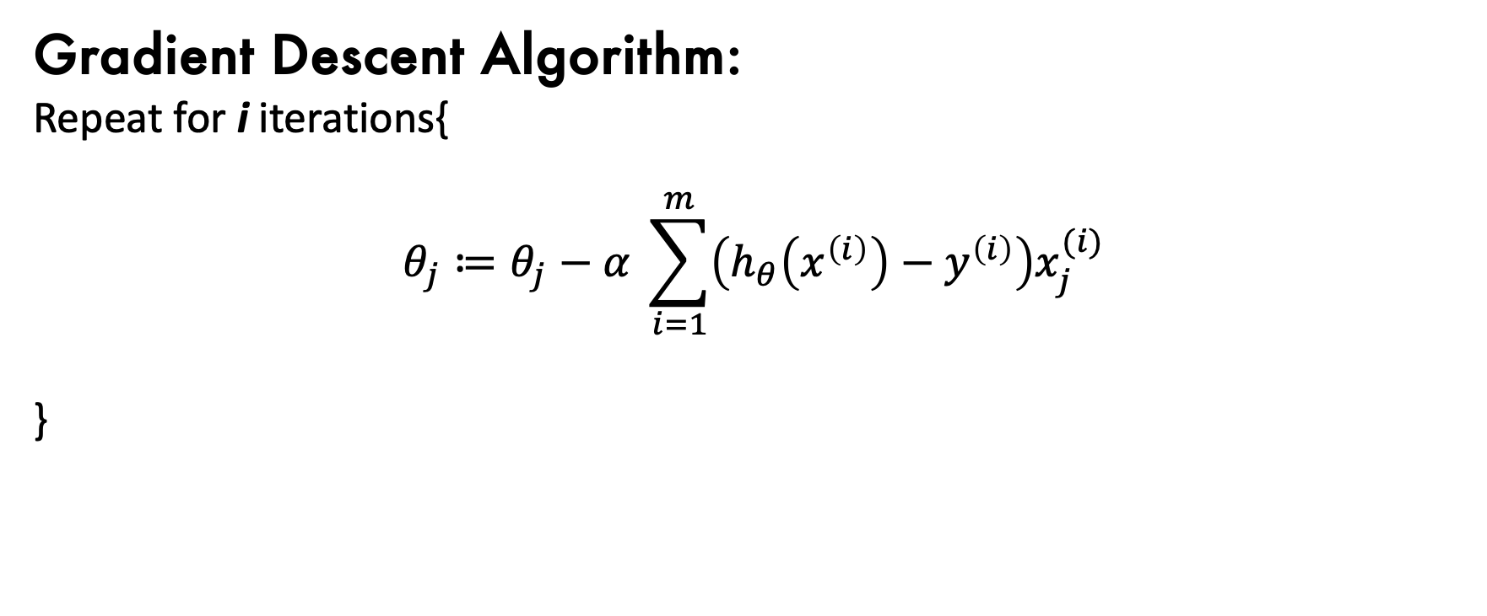
Linear Regression and Gradient Descent
Linear Regression Model:
$$h_{θ}\left(x\right)=θ^{T}x$$
Cost Function:
$$J\left(θ\right)= \frac{1}{2m}\sum_{i=1}^{m}{{{(h}_{θ}\left(x^{\left(i\right)}\right)−y^{\left(i\right)})}^{2}}$$
Gradient Descent Algorithm:
Repeat for i iterations{
$$θ_{j}≔θ_{j}−α \sum_{i=1}^{m}{\left(h_{θ}\left(x^{\left(i\right)}\right)−y^{\left(i\right)}\right)x_{j}^{(i)}}$$
}

Slide 45
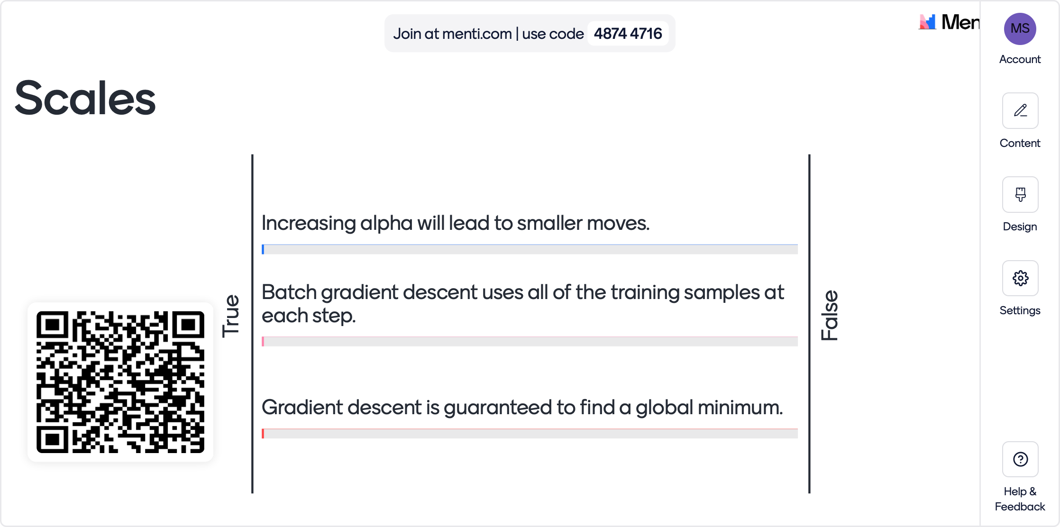
Mentimeter for PowerPoint

