Slide 1
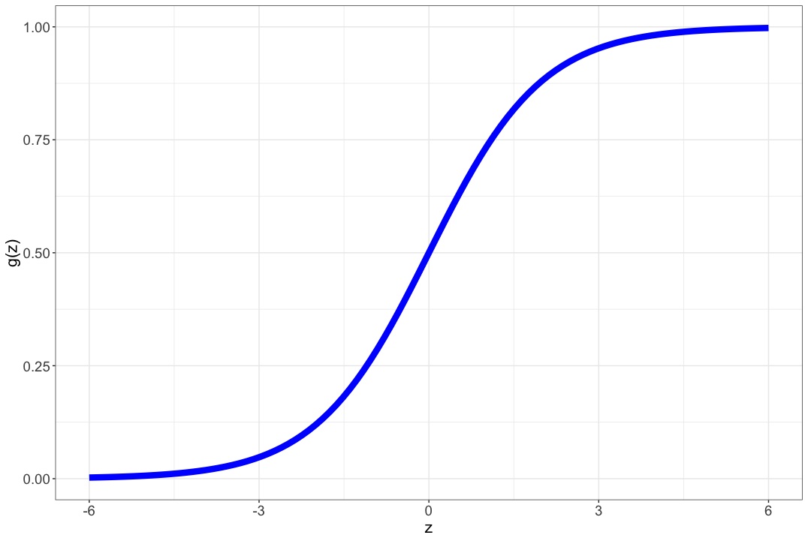
Logisitic Regression
BIO 4990/6990
January 26, 2024
Dr. Megan Smith
Mississippi State University
from craiyon

Slide 2

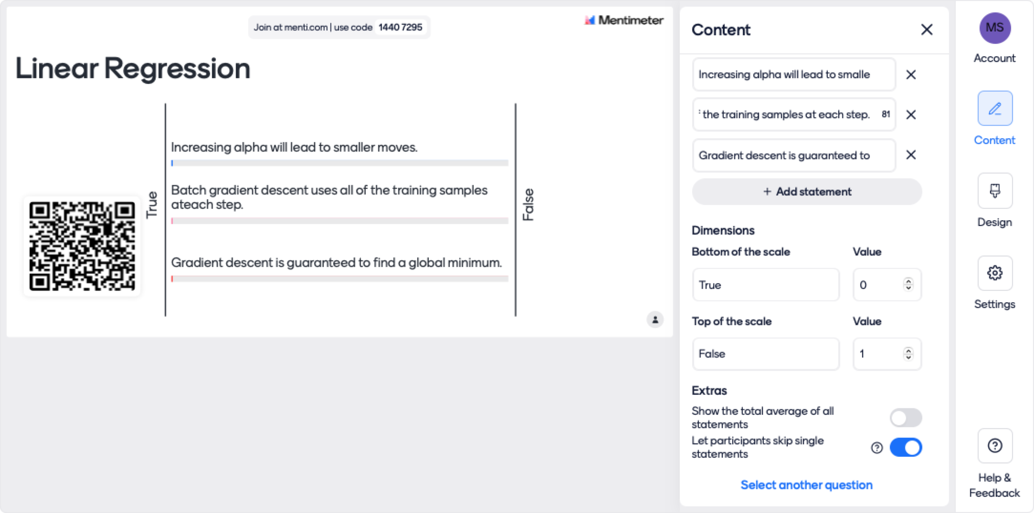
Mentimeter for PowerPoint

Slide 3
Outline
A probabilistic interpretation of linear regression.
Logistic Regression
Gradient Ascent

Slide 4
Outline
A probabilistic interpretation of linear regression.
Logistic Regression
Gradient Ascent

Slide 5
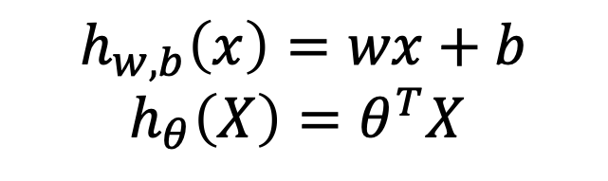





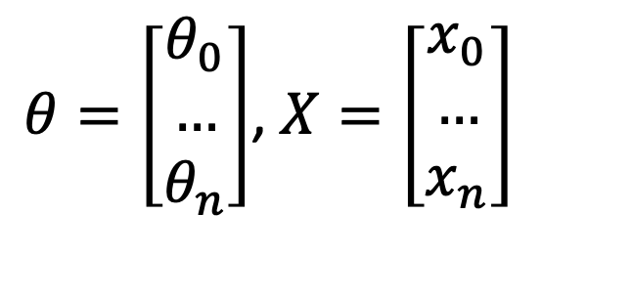
Linear Regression
$$training data$$
$$learning algorithm$$
$$x^{(new)}$$
$$h(x)$$
$${\hat{y}}^{new}$$
$θ=\left[\begin{matrix}θ_{0} \\ … \\ θ_{n}\end{matrix}\right]$, $X=\left[\begin{matrix}x_{0} \\ … \\ x_{n}\end{matrix}\right]$
$$h_{w,b}\left(x\right)=wx+b$$
$$h_{θ}\left(X\right)=θ^{T}X$$
Notes:
Give intuition for linear model parameters by drawing on board

Slide 6
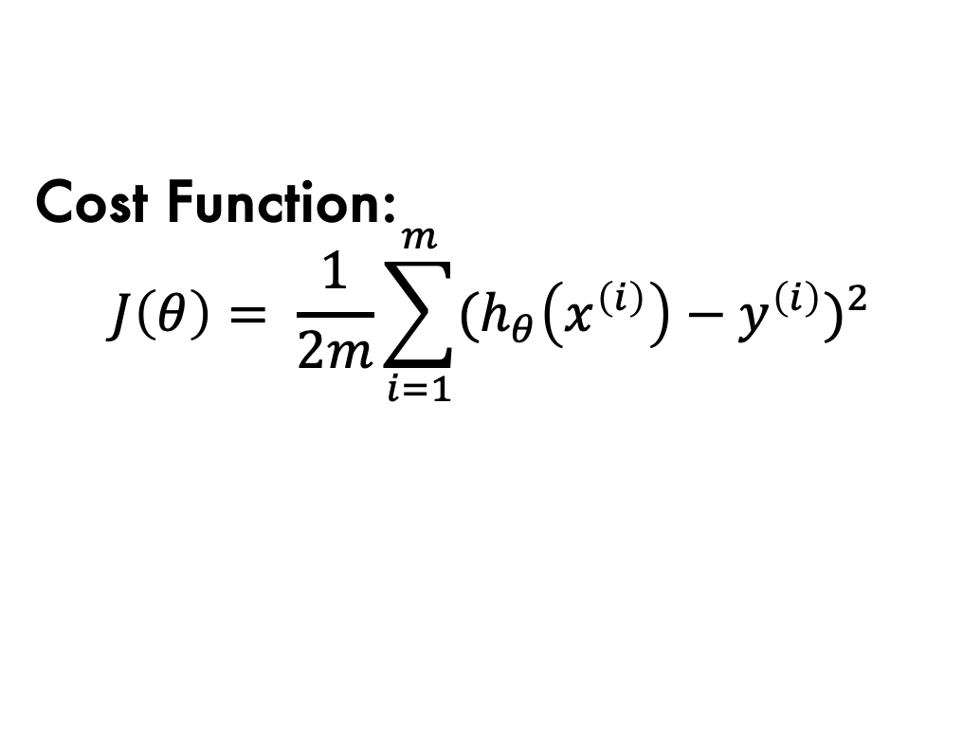

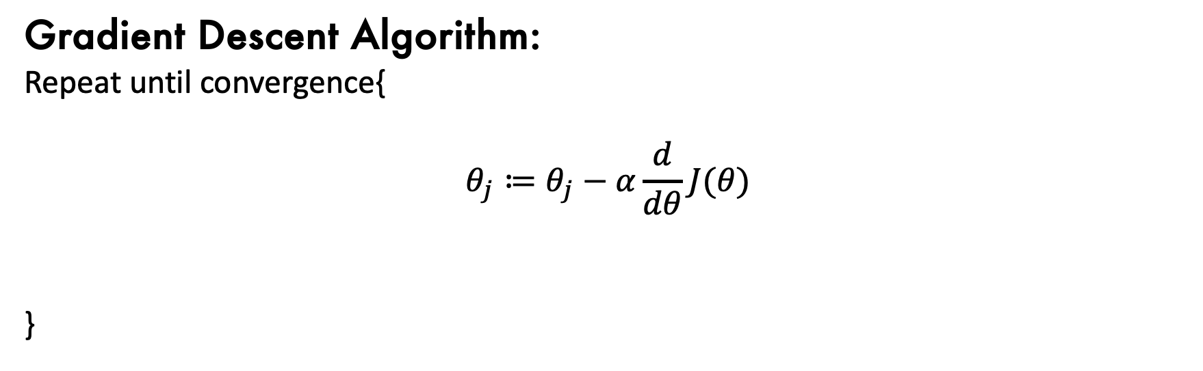
Linear Regression and Gradient Descent
Linear Regression Model:
$$h_{θ}\left(x\right)=θ^{T}x$$
Cost Function:
$$J\left(θ\right)= \frac{1}{2m}\sum_{i=1}^{m}{{{(h}_{θ}\left(x^{\left(i\right)}\right)−y^{\left(i\right)})}^{2}}$$
Gradient Descent Algorithm:
Repeat until convergence{
$$θ_{j}≔θ_{j}−α\frac{d}{dθ}J(θ)$$
}

Slide 7
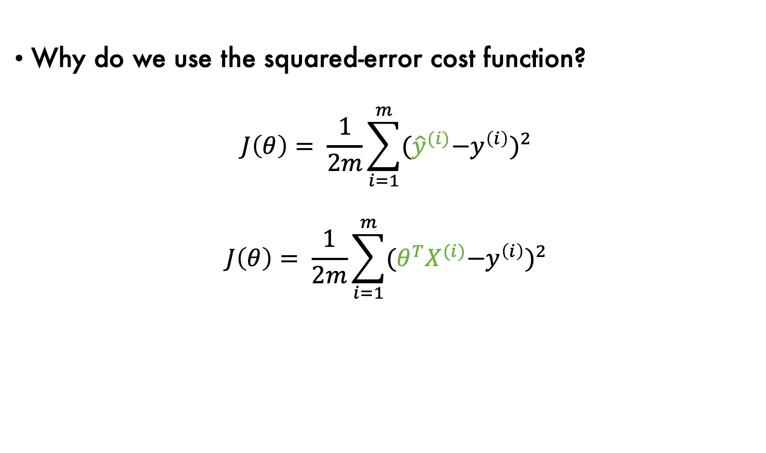
Probabilistic Interpretation
Why do we use the squared-error cost function?
$$J\left(θ\right)= \frac{1}{2m}\sum_{i=1}^{m}{{{(\hat{y}}^{(i)}−y^{\left(i\right)})}^{2}}$$
$$J\left(θ\right)= \frac{1}{2m}\sum_{i=1}^{m}{{{(θ^{T}X}^{(i)}−y^{\left(i\right)})}^{2}}$$

Slide 8

Probabilistic Interpretation
Assumptions of linear regression
Assume $y^{(i)}=$ ${θ^{T}X}^{(i)}+ ε^{(i)}$
error term:
unmodelled effects,
random noise

Slide 9

Probabilistic Interpretation
Assumptions of linear regression
Assume $y^{(i)}=$ ${θ^{T}X}^{(i)}+ ε^{(i)}$
Assume $ε^{(i)}\sim N(0, σ^{2})$
error term:
unmodelled effects,
random noise

Slide 10
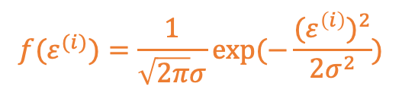
Probabilistic Interpretation
Assumptions of linear regression
Assume $y^{(i)}=$ ${θ^{T}X}^{(i)}+ ε^{(i)}$
Assume $ε^{(i)}\sim N(0, σ^{2})$
error term:
unmodelled effects,
random noise
$${f(ε}^{(i)})=\frac{1}{\sqrt{2π}σ}exp⁡(−\frac{({ε^{\left(i\right)})}^{2}}{2σ^{2}})$$

Slide 11
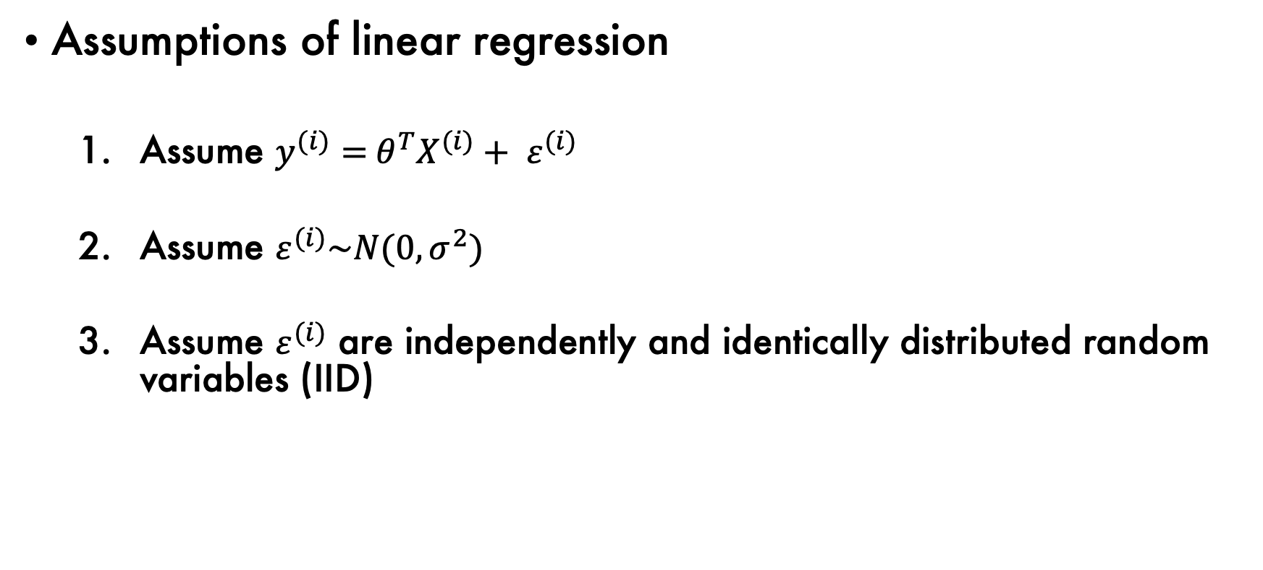
Probabilistic Interpretation
Assumptions of linear regression
Assume $y^{(i)}=$ ${θ^{T}X}^{(i)}+ ε^{(i)}$
Assume $ε^{(i)}\sim N(0, σ^{2})$
Assume $ε^{(i)}$ are independently and identically distributed random variables (IID)
error term:
unmodelled effects,
random noise
$${f(ε}^{(i)})=\frac{1}{\sqrt{2π}σ}exp⁡(−\frac{({ε^{\left(i\right)})}^{2}}{2σ^{2}})$$

Slide 12

Probabilistic Interpretation
The assumptions imply:
$y^{\left(i\right)}|x^{\left(i\right)}\sim N(θ^{T}X$, $σ^{2}$)

Slide 13

Probabilistic Interpretation
The assumptions imply:
$y^{\left(i\right)}|x^{\left(i\right)}\sim N(θ^{T}X$, $σ^{2}$)
$$P\left(y^{\left(i\right)} | x^{\left(i\right)};θ\right)=\frac{1}{\sqrt{2π}σ}exp⁡(−\frac{({y^{\left(i\right)}−θ^{T}X)}^{2}}{2σ^{2}})$$

Slide 14
Probabilistic Interpretation
Likelihood: the probability of the data, given the parameters

Slide 15

Probabilistic Interpretation
Likelihood: the probability of the data, given the parameters
$L\left(θ\right)=P\left(y^{\left(i\right)} | x^{\left(i\right)};θ\right)=\frac{1}{\sqrt{2π}σ}exp⁡(−\frac{({y^{\left(i\right)}−θ^{T}X)}^{2}}{2σ^{2}})$

Slide 16
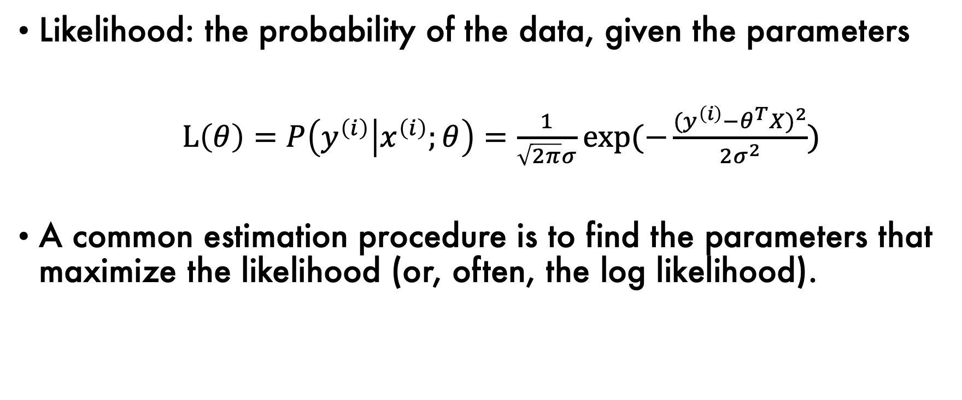
Probabilistic Interpretation
Likelihood: the probability of the data, given the parameters
$L\left(θ\right)=P\left(y^{\left(i\right)} | x^{\left(i\right)};θ\right)=\frac{1}{\sqrt{2π}σ}exp⁡(−\frac{({y^{\left(i\right)}−θ^{T}X)}^{2}}{2σ^{2}})$
A common estimation procedure is to find the parameters that maximize the likelihood (or, often, the log likelihood).

Slide 17
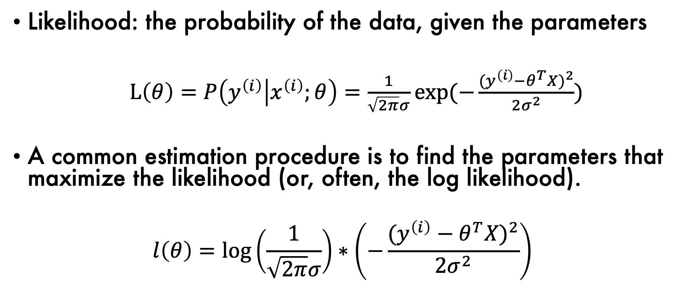
Probabilistic Interpretation
Likelihood: the probability of the data, given the parameters
$L\left(θ\right)=P\left(y^{\left(i\right)} | x^{\left(i\right)};θ\right)=\frac{1}{\sqrt{2π}σ}exp⁡(−\frac{({y^{\left(i\right)}−θ^{T}X)}^{2}}{2σ^{2}})$
A common estimation procedure is to find the parameters that maximize the likelihood (or, often, the log likelihood).
$$l\left(θ\right)=log\left(\frac{1}{\sqrt{2π}σ}\right)∗\left(−\frac{({y^{\left(i\right)}−θ^{T}X)}^{2}}{2σ^{2}}\right)$$

Slide 18
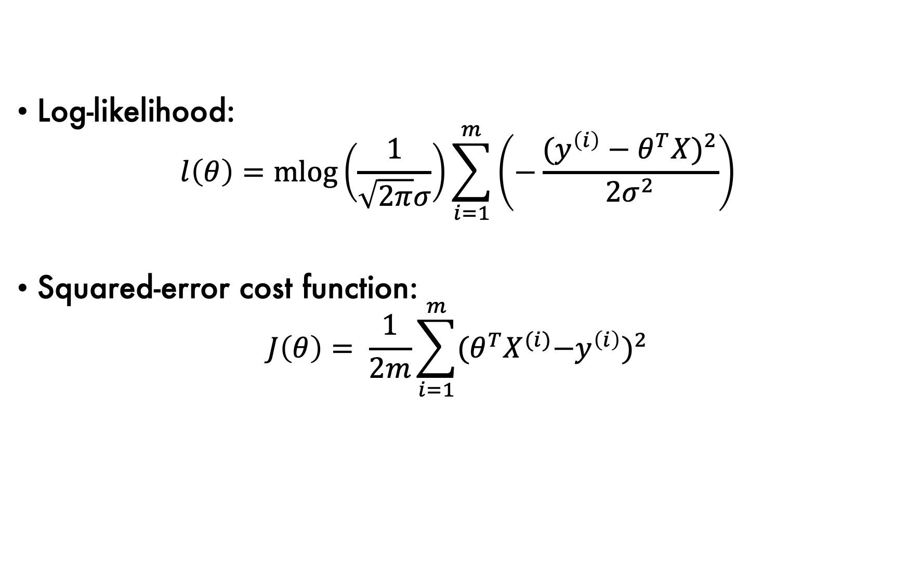
Probabilistic Interpretation
Log-likelihood:
$$l\left(θ\right)=mlog\left(\frac{1}{\sqrt{2π}σ}\right)\sum_{i=1}^{m}{\left(−\frac{({y^{\left(i\right)}−θ^{T}X)}^{2}}{2σ^{2}}\right)}$$
Squared-error cost function:
$$J\left(θ\right)= \frac{1}{2m}\sum_{i=1}^{m}{{{(θ^{T}X}^{(i)}−y^{\left(i\right)})}^{2}}$$

Slide 19
Probabilistic Interpretation
Take-away:
For linear regression, maximizing the log-likelihood is equivalent to minimizing the squared-error cost function.

Slide 20

Using this framework for classification
Steps
Make an assumption about$P\left(y | X;θ\right).$
Figure out how to perform maximum likelihood estimation.

Slide 21
Outline
A probabilistic interpretation of linear regression.
Logistic Regression
Gradient Ascent

Slide 22
Classification: plant species prediction

Slide 23
Classification: plant species prediction
setosa = 0
virginica = 1

Slide 24

Logistic Regression
We would like to have $h_{θ}\left(x\right)ε\left[0,1\right].$
Model:
$$h_{θ}\left(x\right)=g(θ^{T}X)$$

Slide 25
Logistic Regression
We would like to have $h_{θ}\left(x\right)ε\left[0,1\right].$
Model:
$$h_{θ}\left(x\right)=g(θ^{T}X)$$
linear regression

Slide 26

Logistic Regression
We would like to have $h_{θ}\left(x\right)ε\left[0,1\right].$
Model:
$$h_{θ}\left(x\right)=g\left(θ^{T}X\right)=σ\left(θ^{T}X\right)$$
linear regression

Slide 27

Logistic Regression
We would like to have $h_{θ}\left(x\right)ε\left[0,1\right].$
Model:
$$h_{θ}\left(x\right)=g\left(θ^{T}X\right)=σ\left(θ^{T}X\right)$$
$$g\left(z\right)=σ(z)= \frac{1}{1+e^{−z}}$$
linear regression
“sigmoid” or “logistic” function

Slide 28
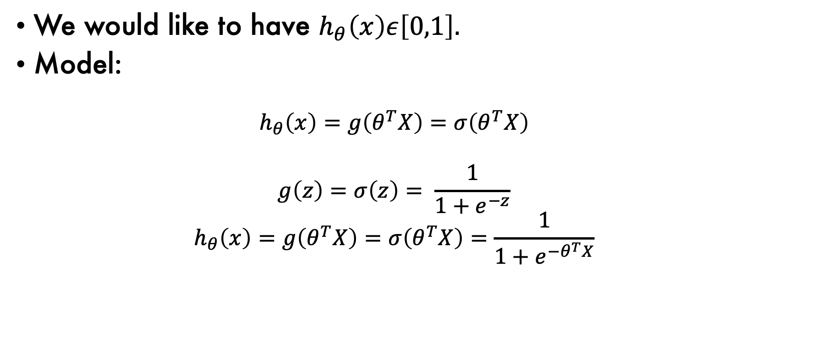
Logistic Regression
We would like to have $h_{θ}\left(x\right)ε\left[0,1\right].$
Model:
$$h_{θ}\left(x\right)=g\left(θ^{T}X\right)=σ\left(θ^{T}X\right)$$
$$g\left(z\right)=σ\left(z\right)= \frac{1}{1+e^{−z}}$$
$$h_{θ}\left(x\right)=g\left(θ^{T}X\right)=σ\left(θ^{T}X\right)=\frac{1}{1+e^{−θ^{T}X}}$$
linear regression
“sigmoid” or “logistic” function

Slide 29
Logistic Regression

Slide 30
Logistic Regression

Slide 31
Logistic Regression

Slide 32
Logistic Regression

Slide 33

Assumptions of Logistic Regression
Assume $P\left(y^{(i)}=1 | x^{(i)};θ\right)=h_{θ}\left(x^{(i)}\right)$

Slide 34

Assumptions of Logistic Regression
Assume $P\left(y^{(i)}=1 | x^{(i)};θ\right)=h_{θ}\left(x^{(i)}\right)$
By definition $P\left(y^{(i)}=0 | x^{(i)};θ\right)={1−h}_{θ}\left(x^{(i)}\right)$

Slide 35
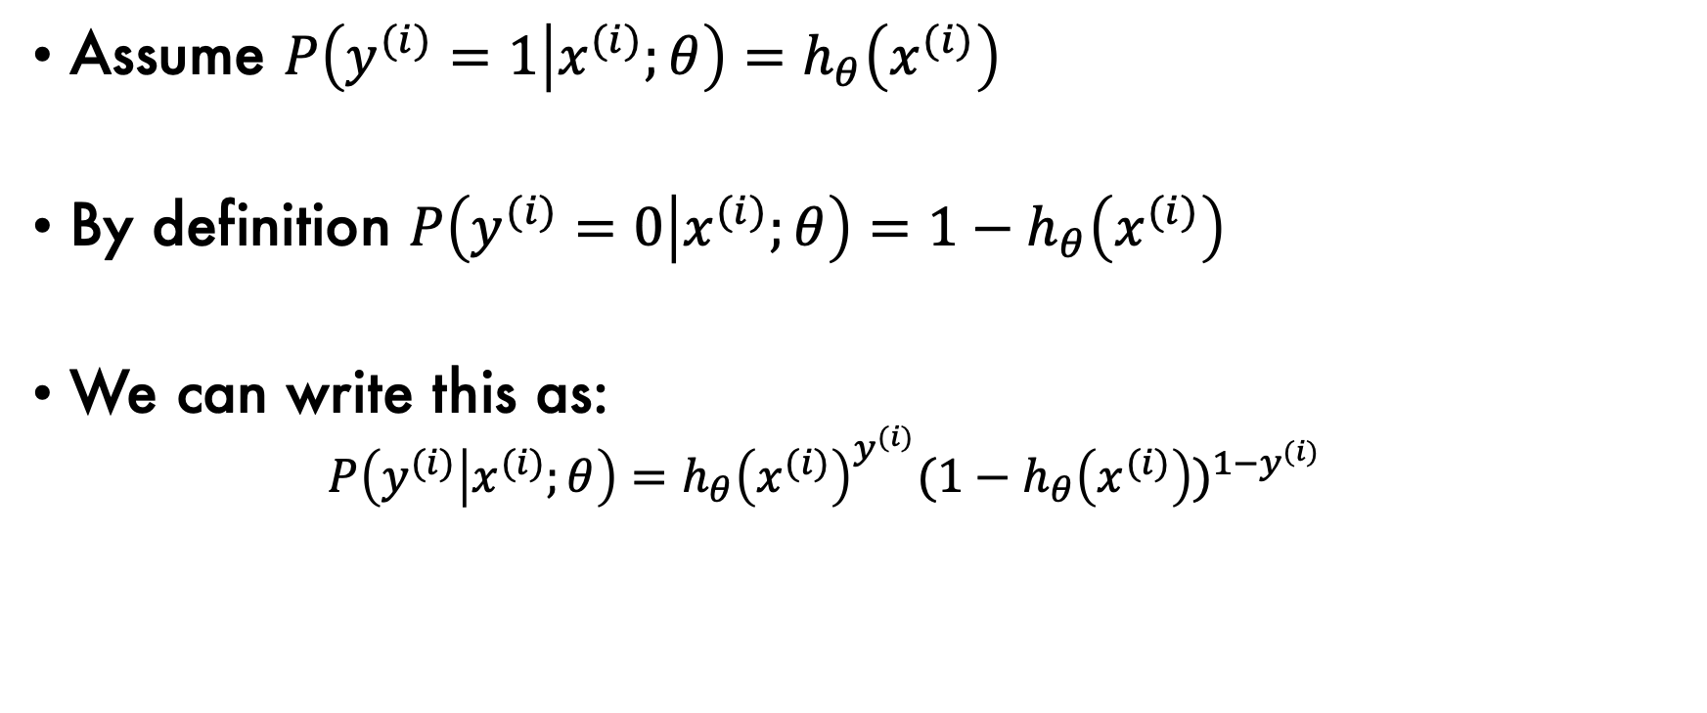
Assumptions of Logistic Regression
Assume $P\left(y^{(i)}=1 | x^{(i)};θ\right)=h_{θ}\left(x^{(i)}\right)$
By definition $P\left(y^{(i)}=0 | x^{(i)};θ\right)={1−h}_{θ}\left(x^{(i)}\right)$
We can write this as:
$$P\left(y^{(i)} | x^{(i)};θ\right)={h_{θ}\left(x^{(i)}\right)}^{y^{(i)}}{{(1−h}_{θ}\left(x^{(i)}\right))}^{1−y^{(i)}}$$

Slide 36

Likelihood for Logistic Regression
Likelihood: probability of the data, given the parameters
$$L\left(θ\right)=P\left(y^{(i)} | x^{(i)};θ\right)={h_{θ}\left(x^{(i)}\right)}^{y^{(i)}}{{(1−h}_{θ}\left(x^{(i)}\right))}^{1−y^{(i)}}$$

Slide 37
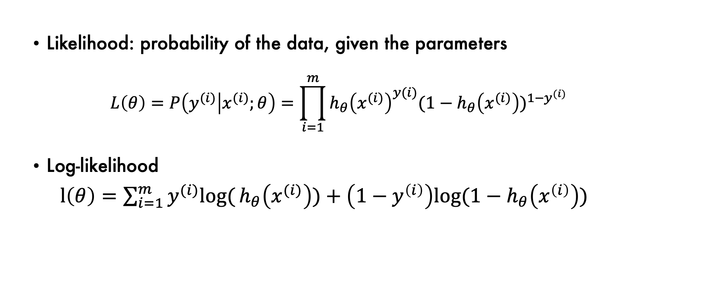
Likelihood for Logistic Regression
Likelihood: probability of the data, given the parameters
$$L\left(θ\right)=P\left(y^{(i)} | x^{(i)};θ\right)=\prod_{i=1}^{m}{{h_{θ}\left(x^{(i)}\right)}^{y(i)}{{(1−h}_{θ}\left(x^{(i)}\right))}^{1−y^{(i)}}}$$
Log-likelihood
$l\left(θ\right)=\sum_{i=1}^{m}{y^{(i)}log⁡(}h_{θ}\left(x^{(i)}\right))+\left(1−y^{\left(i\right)}\right)log⁡{(1−h}_{θ}\left(x^{\left(i\right)}\right))$

Slide 38
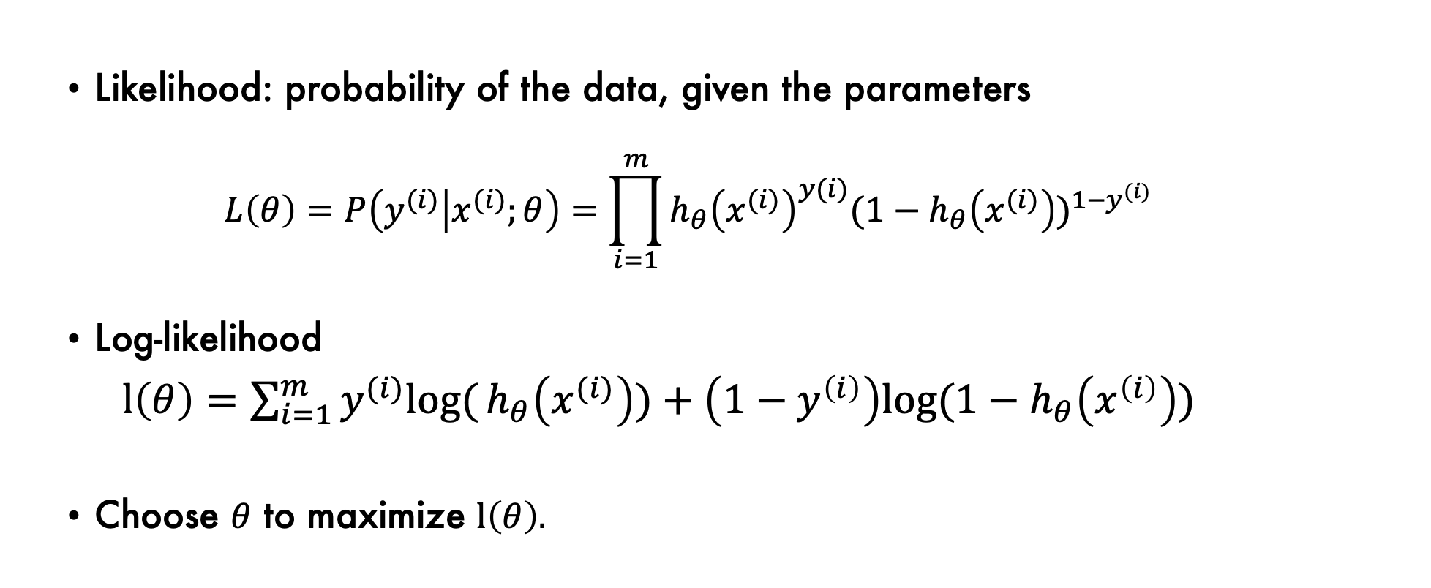
Likelihood for Logistic Regression
Likelihood: probability of the data, given the parameters
$$L\left(θ\right)=P\left(y^{(i)} | x^{(i)};θ\right)=\prod_{i=1}^{m}{{h_{θ}\left(x^{(i)}\right)}^{y(i)}{{(1−h}_{θ}\left(x^{(i)}\right))}^{1−y^{(i)}}}$$
Log-likelihood
$l\left(θ\right)=\sum_{i=1}^{m}{y^{(i)}log⁡(}h_{θ}\left(x^{(i)}\right))+\left(1−y^{\left(i\right)}\right)log⁡{(1−h}_{θ}\left(x^{\left(i\right)}\right))$
Choose $θ$ to maximize $l\left(θ\right).$

Slide 39
Outline
A probabilistic interpretation of linear regression.
Logistic Regression
Gradient Ascent

Slide 40

Gradient Ascent Algorithm
Batch Gradient Ascent
$$θ_{j}:=θ_{j}+α\frac{d}{dθ_{j}}l(θ)$$

Slide 41
Gradient Ascent Algorithm
Batch Gradient Ascent
$$θ_{j}:=θ_{j}+α\frac{d}{dθ_{j}}l(θ)$$
maximize
Log-likelihood

Slide 42

Gradient Ascent Algorithm
Plug-in the definition of $l(θ)$ and find the derivative to get:
$$θ_{j}:=θ_{j}+α\sum_{i=1}^{m}{(y^{\left(i\right)}−h_{θ}}(x^{(i)}))x_{j}^{(i)}$$
[Derivative is available on Canvas]

Slide 43
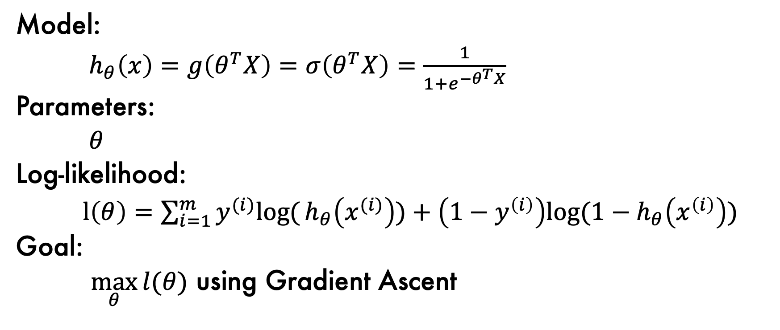
Summary
Model:
$h_{θ}\left(x\right)=g\left(θ^{T}X\right)=σ\left(θ^{T}X\right)=\frac{1}{1+e^{−θ^{T}X}}$
Parameters:
$θ$
Log-likelihood:
$l\left(θ\right)=\sum_{i=1}^{m}{y^{(i)}log⁡(}h_{θ}\left(x^{(i)}\right))+\left(1−y^{\left(i\right)}\right)log⁡{(1−h}_{θ}\left(x^{\left(i\right)}\right))$
Goal:
$\max_{θ}{l(θ)}$ using Gradient Ascent

Slide 44
Classification: plant species prediction
setosa = 0
virginica = 1

Slide 45
Classification: plant species prediction
setosa = 0
virginica = 1

Slide 46
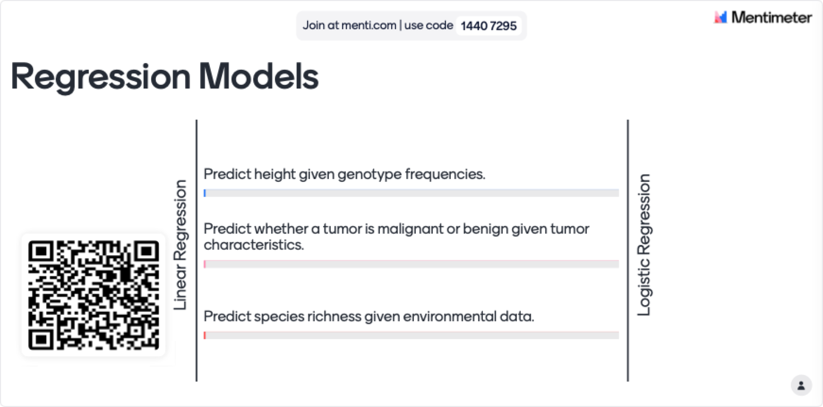
Mentimeter for PowerPoint

