Slide 1
Softmax Regression
BIO 4990/6990
January 31, 2024
Dr. Megan Smith
Mississippi State University
from craiyon

Slide 2
Outline
Logistic Regression Recap and Decision Boundaries
Softmax Regression
Categorical Cross Entropy

Slide 3
Outline
Logistic Regression Recap and Decision Boundaries
Softmax Regression
Categorical Cross Entropy

Slide 4
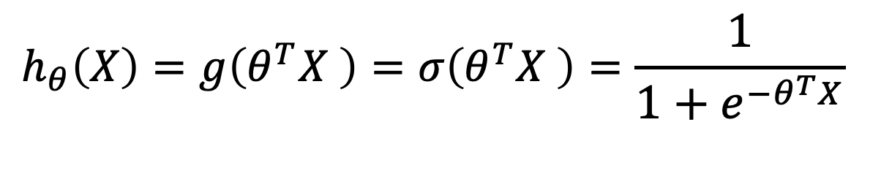
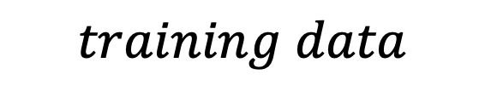


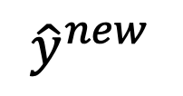

Recap: Logistic Regression
$$training data$$
$$learning algorithm$$
$$x^{(new)}$$
$$h_{θ}\left(X\right)$$
$${\hat{y}}^{new}$$
$$h_{θ}\left(X\right)=g\left(θ^{T}X \right)=σ\left(θ^{T}X \right)=\frac{1}{1+e^{−θ^{T}X}}$$
Notes:
Draw sigmoid function on board.

Slide 5
Decision Boundaries

Slide 6
Decision Boundaries
x₂
x₁
Notes:
Draw on board to explain

Slide 7

Decision Boundaries
x₂
$$θ_{o}^{T}X=0$$
x₁
Notes:
Draw on board to explain

Slide 8


Decision Boundaries
x₂
$$θ_{o}^{T}X>0$$
$$θ_{o}^{T}X<0$$
$$θ_{o}^{T}X=0$$
x₁
Notes:
Draw on board to explain

Slide 9
More than two classes?

Slide 10
More than two classes?
x₂
x₁
Notes:
Draw on board to explain

Slide 11
More than two classes?
x₂
$$θ_{o}^{T}X=0$$
x₁
Notes:
Draw on board to explain

Slide 12

More than two classes?
x₂
$$θ_{o}^{T}X=0$$
x₁
$$θ_{Δ}^{T}X=0$$

Slide 13

More than two classes?
x₂
$$θ_{⊡}^{T}X=0$$
$$θ_{o}^{T}X=0$$
x₁
$$θ_{Δ}^{T}X=0$$

Slide 14
Outline
Logistic Regression Recap and Decision Boundaries
Softmax Regression
Categorical Cross Entropy

Slide 15
Example
x₂
$$θ_{⊡}^{T}X=0$$
$$θ_{o}^{T}X=0$$
x₁
$$θ_{Δ}^{T}X=0$$

Slide 16

Example
$$θ_{c}^{T}x$$

Slide 17

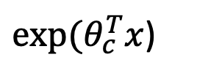

Example
$exp⁡(θ_{c}^{T}x$)
$exp⁡(θ_{c}^{T}x$)
$$θ_{c}^{T}x$$

Slide 18
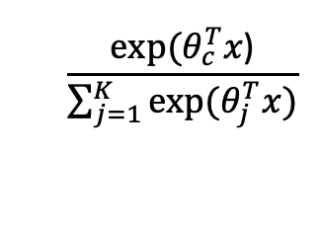
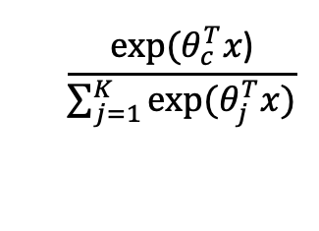
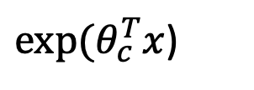
Example
K=# classes
$$\frac{exp⁡(θ_{c}^{T}x\text{)}}{\sum_{j=1}^{K}{exp⁡(θ_{j}^{T}x)}}$$
$exp⁡(θ_{c}^{T}x$)
$$\frac{exp⁡(θ_{c}^{T}x\text{)}}{\sum_{j=1}^{K}{exp⁡(θ_{j}^{T}x)}}$$

Slide 19

Softmax Regression
Model:
$h_{θ}\left(x\right)=g\left(θ^{T}X\right)=\left[\begin{matrix}P(y=1|x;θ) \\ P(y=2|x;θ) \\ … \\ P(y=K|x;θ)\end{matrix} \right]=\frac{1}{\sum_{j=1}^{K}{exp⁡(θ_{j}^{T}x)}}$ $\left[\begin{matrix}exp⁡(θ_{1}^{T}X) \\ exp⁡(θ_{2}^{T}X) \\ … \\ exp⁡(θ_{K}^{T}X)\end{matrix} \right]$

Slide 20
Outline
Logistic Regression Recap and Decision Boundaries
Softmax Regression
Categorical Cross Entropy

Slide 21

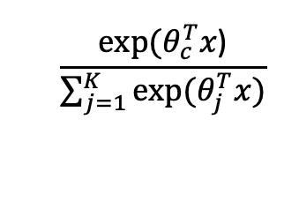
Categorical Cross-entropy Cost Function
$$\frac{exp⁡(θ_{c}^{T}x\text{)}}{\sum_{j=1}^{K}{exp⁡(θ_{j}^{T}x)}}$$
$$P(y)$$

Slide 22
Categorical Cross-entropy Cost Function
$$\frac{exp⁡(θ_{c}^{T}x\text{)}}{\sum_{j=1}^{K}{exp⁡(θ_{j}^{T}x)}}$$
$$P(y)$$
Goal: Minimize the difference between these two distributions.

Slide 23
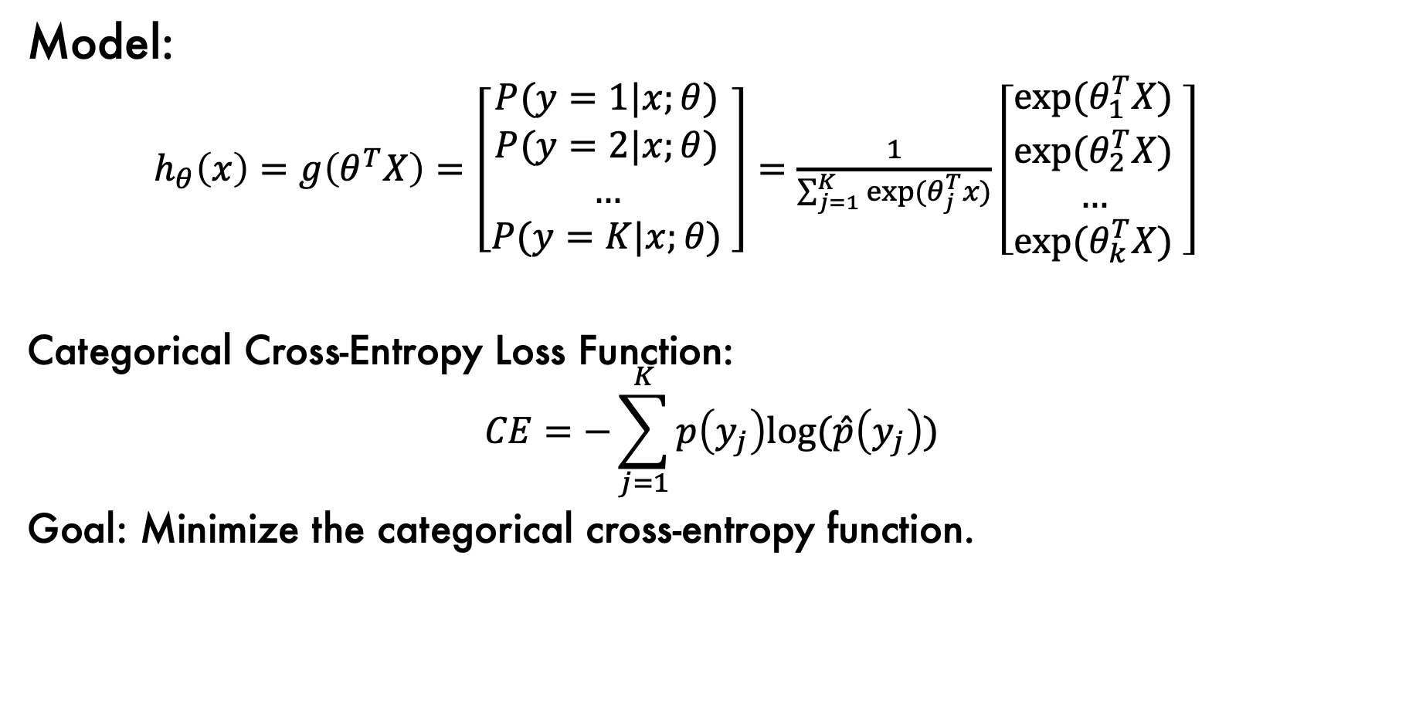
Softmax Regression
Model:
$h_{θ}\left(x\right)=g\left(θ^{T}X\right)=\left[\begin{matrix}P(y=1|x;θ) \\ P(y=2|x;θ) \\ … \\ P(y=K|x;θ)\end{matrix} \right]=\frac{1}{\sum_{j=1}^{K}{exp⁡(θ_{j}^{T}x)}}$ $\left[\begin{matrix}exp⁡(θ_{1}^{T}X) \\ exp⁡(θ_{2}^{T}X) \\ … \\ exp⁡(θ_{k}^{T}X)\end{matrix} \right]$
Categorical Cross-Entropy Loss Function:
$$CE=−\sum_{j=1}^{K}{p\left(y_{j}\right)log⁡(\hat{p}\left(y_{j}\right))}$$
Goal: Minimize the categorical cross-entropy function.

Slide 24
Softmax: Irises

Slide 25
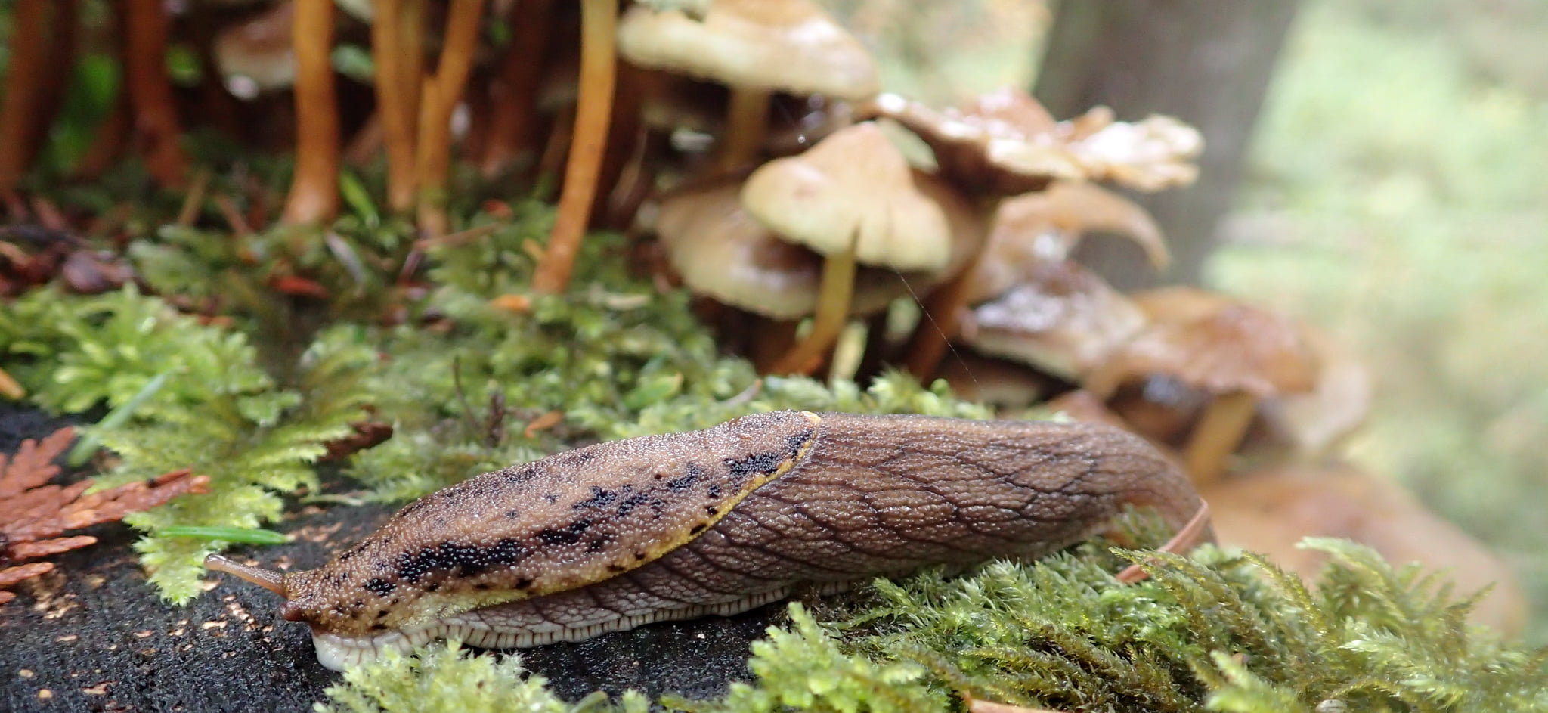
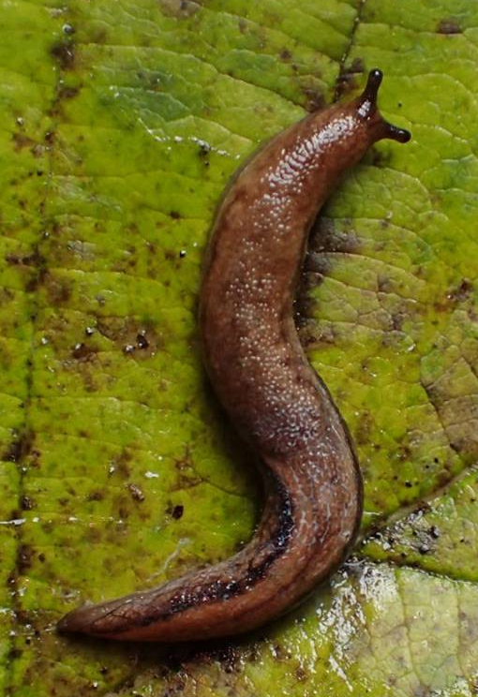
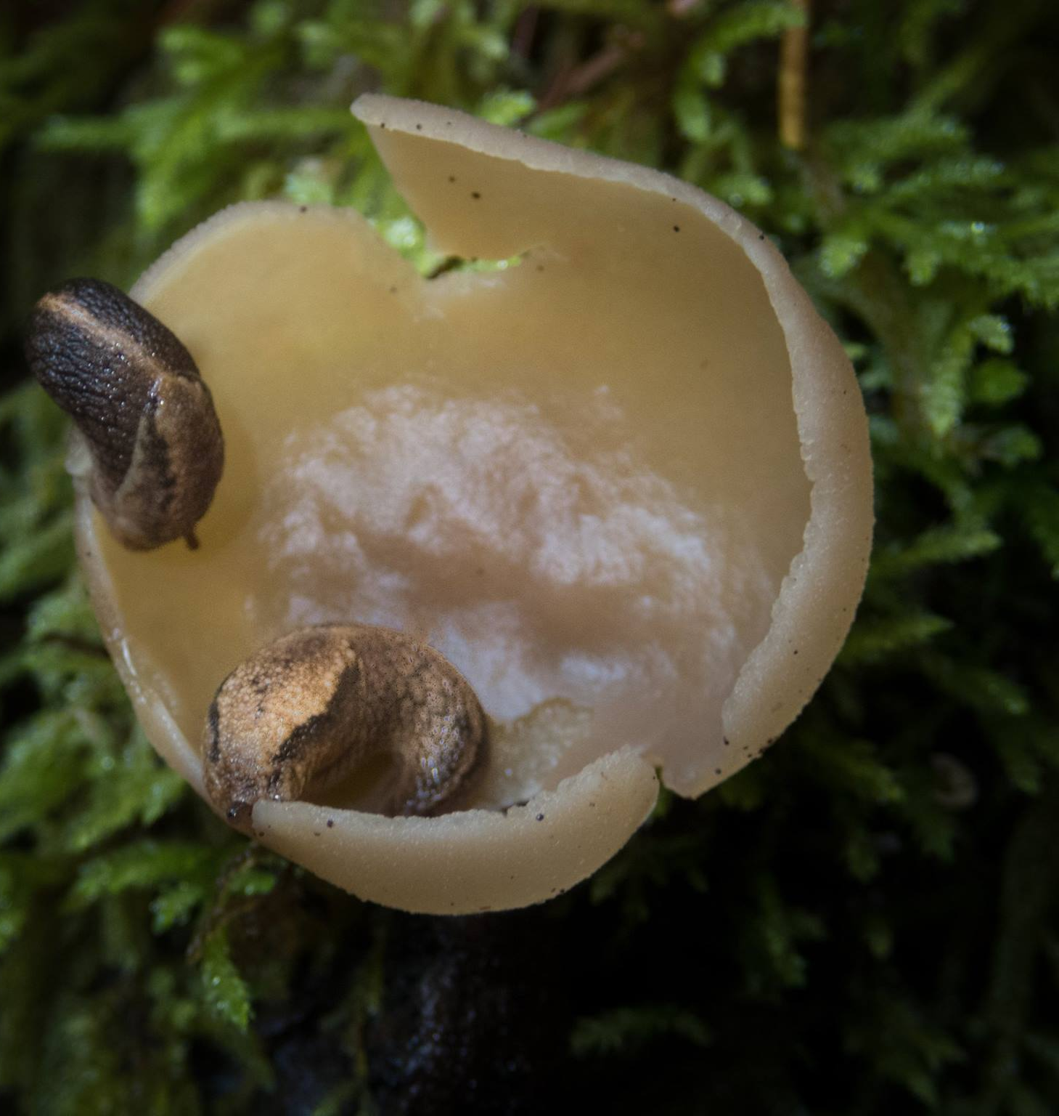
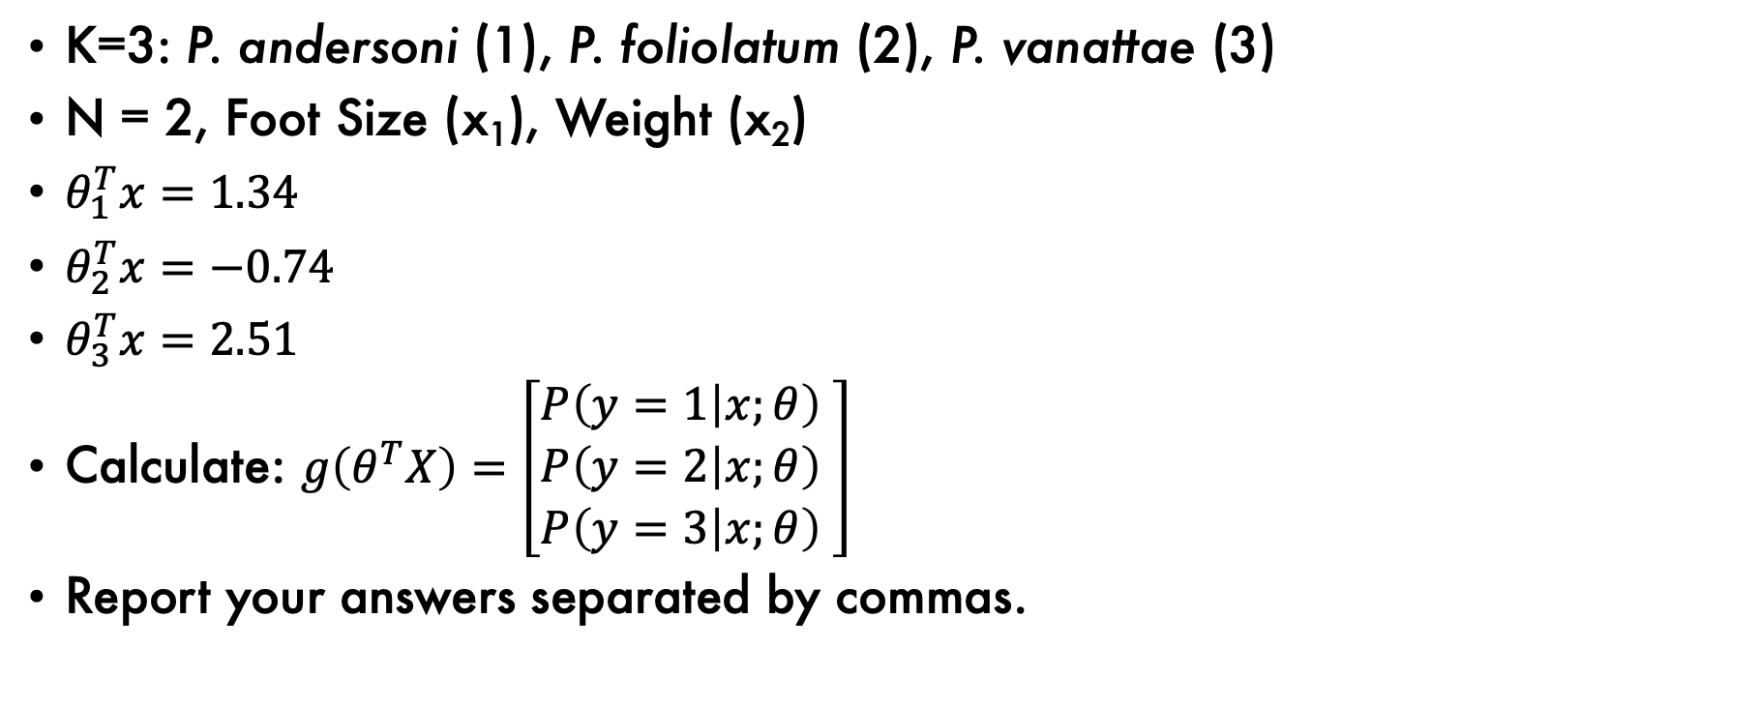
Softmax Problem (Pair up!)
K=3: P. andersoni (1), P. foliolatum (2), P. vanattae (3)
N = 2, Foot Size (x₁), Weight (x₂)
$θ_{1}^{T}x=1.34$
$θ_{2}^{T}x=−0.74$
$θ_{3}^{T}x=2.51$
Calculate: $g\left(θ^{T}X\right)=\left[\begin{matrix}P\left(y=1 | x;θ\right) \\ P\left(y=2 | x;θ\right) \\ P\left(y=3 | x;θ\right)\end{matrix} \right]$
Report your answers separated by commas.

Slide 26

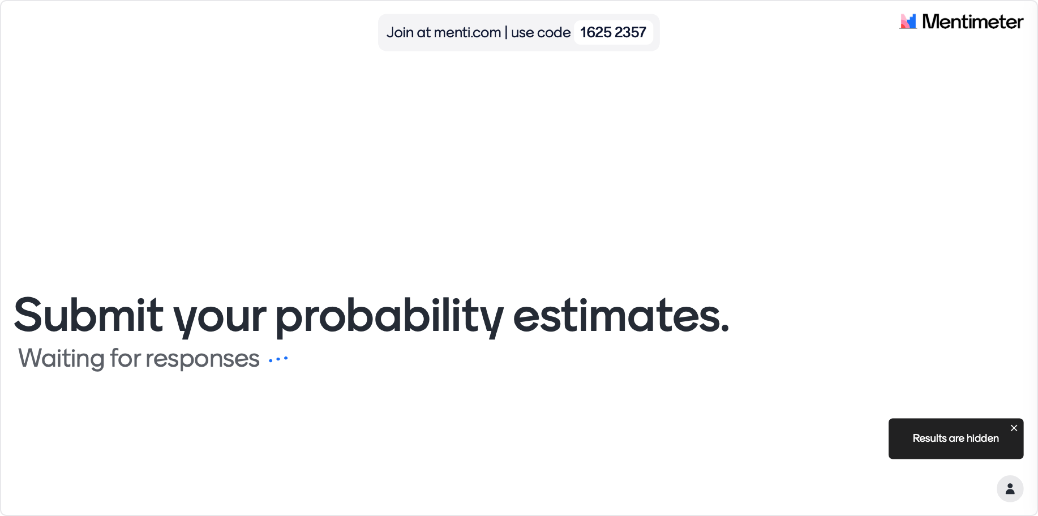
Mentimeter for PowerPoint

