Slide 1
Support Vector Machines
BIO 4990/6990
January 31, 2024
Dr. Megan Smith
Mississippi State University
from craiyon

Slide 2
Outline
Review of Supervised Machine Learning Overview
Need for non-linear decision boundaries
Maximal Margin Classifiers
Support Vector Classifiers
Kernels and Support Vector Machines
Examples

Slide 3
Outline
Review of Supervised Machine Learning Overview
Need for non-linear decision boundaries
Maximal Margin Classifiers
Support Vector Classifiers
Kernels and Support Vector Machines
Examples

Slide 4
Supervised Machine Learning
Collect your training data.
Choose a model with parameters.
Find the parameters that provide the best fit to your training data.
Use the model and parameters you estimated above to make predictions on new data.

Slide 5

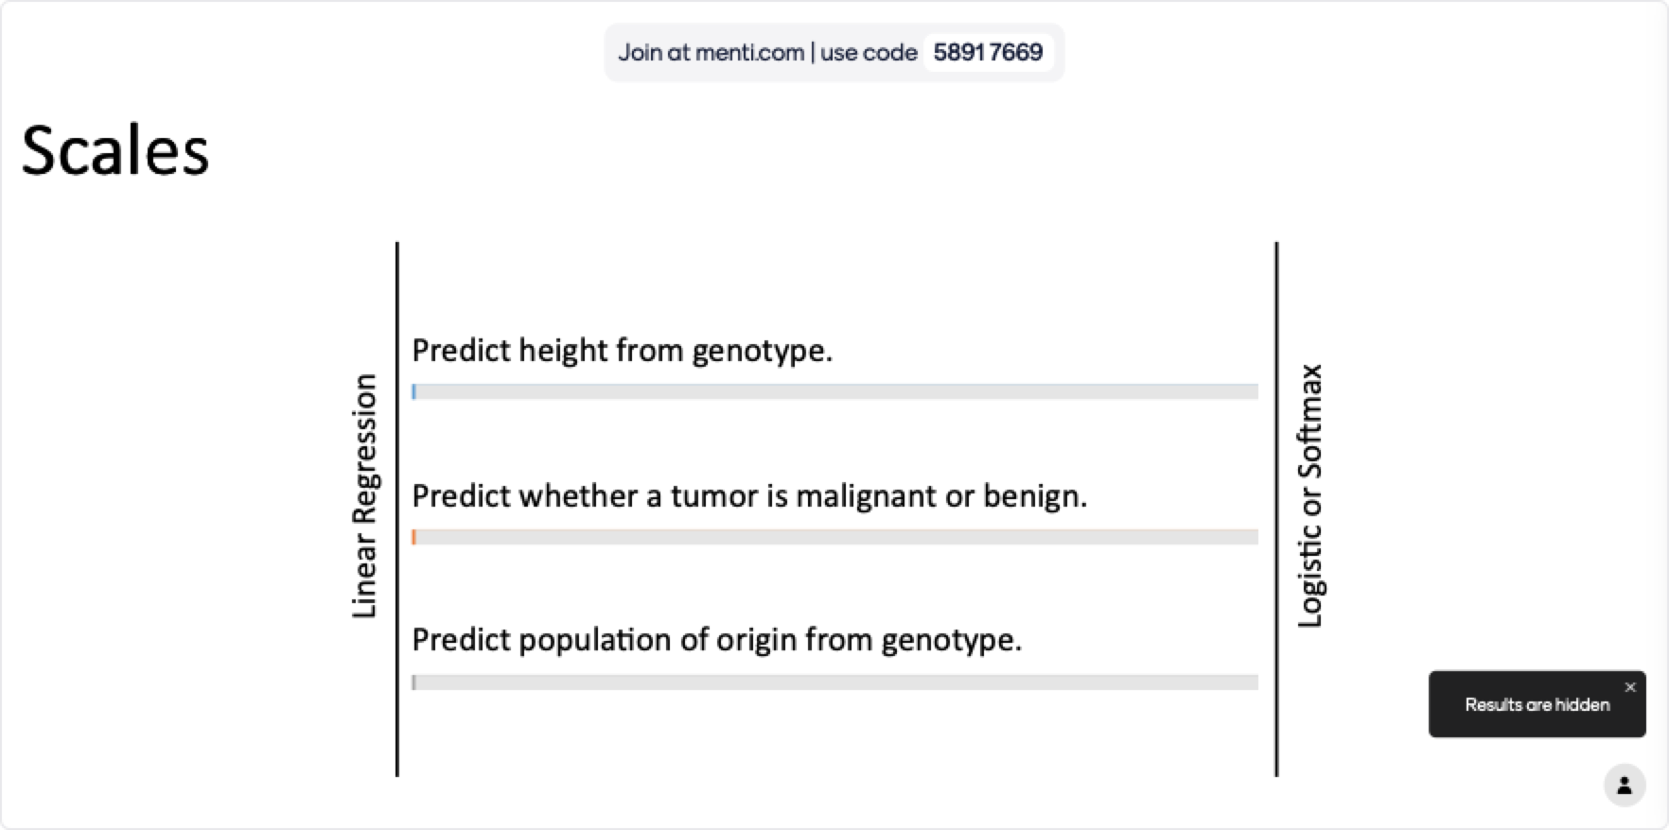
Mentimeter for PowerPoint

Slide 6
Outline
Review of Supervised Machine Learning Overview
Need for non-linear decision boundaries
Maximal Margin Classifiers
Support Vector Classifiers
Kernels and Support Vector Machines
Examples

Slide 7
Limits of Linear Decision Boundaries
x₂
x₁

Slide 8

Limits of Linear Decision Boundaries
x₂
x₁
$$Θ^{T}X$$

Slide 9
Limits of Linear Decision Boundaries
x₂
x₁

Slide 10
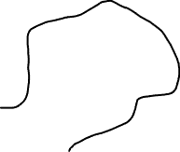
Limits of Linear Decision Boundaries
x₂
x₁

Slide 11
Beyond Linear Decision Boundaries

Slide 12
Beyond Linear Decision Boundaries

Slide 13
Beyond Linear Decision Boundaries

Slide 14
Outline
Review of Supervised Machine Learning Overview
Need for non-linear decision boundaries
Maximal Margin Classifiers
Support Vector Classifiers
Kernels and Support Vector Machines
Examples

Slide 15


Maximal Marginal Classifiers
x₂
x₂
x₁
x₁
$$Θ^{T}X$$
$$Θ^{T}X$$

Slide 16
Maximal Marginal Classifiers
x₂
x₂
Margin
x₁
x₁
$$Θ^{T}X$$
$$Θ^{T}X$$

Slide 17
Maximal Marginal Classifiers
x₂
x₂
x₁
x₁
$$Θ^{T}X$$
$$Θ^{T}X$$

Slide 18
Maximal Margin Classifiers

Slide 19
Maximal Margin Classifiers

Slide 20
Maximal Margin Classifiers

Slide 21
Outline
Review of Supervised Machine Learning Overview
Need for non-linear decision boundaries
Maximal Margin Classifiers
Support Vector Classifiers
Kernels and Support Vector Machines
Examples

Slide 22
Support Vector Classifiers

Slide 23
Support Vector Classifiers

Slide 24
Support Vector Classifiers

Slide 25
Support Vector Classifiers

Slide 26
Support Vector Classifiers

Slide 27
Support Vector Classifiers

Slide 28



Support Vector Classifiers
Support Vectors

Slide 29
Support Vector Classifiers
x₂
x₁

Slide 30
Support Vector Classifiers
x₂
x₁

Slide 31
Support Vector Classifiers
x₂
x₁

Slide 32


Support Vector Classifiers
x₂
Support Vectors
x₁

Slide 33
Support Vector Classifiers
x₂
Soft Margin
Support Vectors
x₁

Slide 34
How do we choose a soft margin?
The parameter C determines the trade-off between maximizing the margin and minimizing the number of mistakes.
The larger C is, the larger the penalty for misclassification.
We use cross-validation to determine how many points we should allow inside the soft margin.

Slide 35
Cross-validation
For each value of c that we wish to consider:
Train a Support Vector Classifier using a portion of your dataset.
Test the Support Vector Classifier using the remainder of your dataset.
Choose the value of c that leads to the Support Vector Classifier with the lowest error rate!

Slide 36
Outline
Review of Supervised Machine Learning Overview
Need for non-linear decision boundaries
Maximal Margin Classifiers
Support Vector Classifiers
Kernels and Support Vector Machines
Examples

Slide 37
Support Vector Machines: Motivation
x₂
x₁

Slide 38
Support Vector Machines
Support Vector Machines map features to higher dimensional spaces to find non-linear decision boundaries.

Slide 39
Support Vector Machines
Support Vector Machines map features to higher dimensional spaces to find non-linear decision boundaries.
They use the kernel trick to do this efficiently.

Slide 40
Support Vector Machines
Support Vector Machines map features to higher dimensional spaces to find non-linear decision boundaries.
They use the kernel trick to do this efficiently.
Examples: polynomial kernel, radial basis function

Slide 41
Polynomial Kernel

Slide 42
Polynomial Kernel

Slide 43
Polynomial Kernel

Slide 44
Polynomial Kernel
Support Vector Machines
Start with data in a relatively low dimension.
Move the data into a higher dimension.
Find a Support Vector classifier that separates the higher dimensional data into groups.

Slide 45
Polynomial Kernel
How do we find the best way to transform the data?
Support Vector Machines use kernel functions for this task.
The polynomial kernel has a parameter d that represents the degree of the polynomial.

Slide 46
Polynomial Kernel
d=1
Compute relationships between each pair of observations in one dimension, and then find a SVC.
d=2
Compute the relationships between each pair of observations in the first and second dimensions, and then find a SVC.
d=3
Compute the relationships between each pair of observations in the first, second, and third dimensions, and then find a SVC. (i.e., add X³)

Slide 47
Polynomial Kernel
The polynomial kernel systematically increases dimensions by setting d, the degree of the polynomial.
The relationships between points are used to find the Support Vector Classifiers.
We can find a good value of d using cross-validation.

Slide 48

Polynomial Kernel
$${(a×b+r)}^{d}$$
a,b = two o bservations in the dataset
r = coefficient of polynomial
d = degree of polynomial

Slide 49
Polynomial Kernel
To calculate the high-dimensional relationships needed to find the Support Vector Classifier, we only need to calculate the dot products between pairs of points.
The kernel can be written as a dot product between pairs of points, so we only need to plug values into the kernel!
This means that SVMs are very computationally efficient.

Slide 50
Radial Basis Function

Slide 51
Radial Basis Function
weighted-nearest neighbor function

Slide 52
Outline
Review of Supervised Machine Learning Overview
Need for non-linear decision boundaries
Maximal Margin Classifiers
Support Vector Classifiers
Kernels and Support Vector Machines
Examples

Slide 53
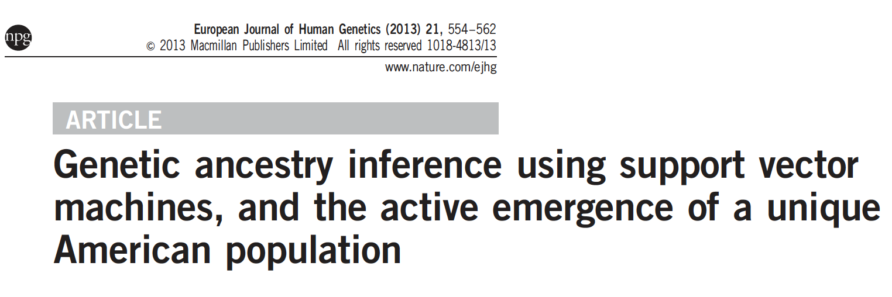
Example: Ancestry Inference

Slide 54
Example: Ancestry Inference
Goal: Predict an individual’s ancestry
Training data:
X: Genomic data (projected onto a principal component axis)
Y: The region in Europe from which the individual was sampled
Input for making predictions:
X^{(new)}: Genomic data from an individual whose ancestry is unknown.
Prediction output:
The predicted ancestry of the individual.

Slide 55

Example: Disease Prediction

Slide 56
Example: Disease Prediction
Goal: Predict whether a patient has diabetes.
Training data:
X: variables related to risk of diabetes (e.g., smoking, family history)
Y: whether the patient has been diagnosed with diabetes
Input for making predictions:
X^{(new)}: risk factors for a new patient
Prediction output:
Whether the patient is likely to have diabetes or not.

Slide 57

Example: Pathogen Distribution Prediction

Slide 58
Example: Pathogen Distribution Prediction
Goal: Predict whether a pathogen is present in a location
Training data:
X: environmental variables at a location
Y: whether the pathogen was found at the location
Input for making predictions:
X^{(new)}: environmental variables from a new location
Prediction output:
Whether the pathogen is likely present at the new location.

Slide 59
Summary
Maximal Marginal Classifiers find the classifier with the largest margin (i.e., distance from the boundary to the nearest point).
Support Vector Classifiers relax the requirement that all points are correctly classified.
Support Vector Machines essentially project our data into higher dimensional space and allow us to find non-linear decision boundaries.

Slide 60

Polynomial Kernel (extra: for interest only)
$${(a×b+r)}^{d}$$
$$d=2, r=\frac{1}{2}$$

Slide 61

Polynomial Kernel (extra: for interest only)
$${(a×b+r)}^{d}$$
$$d=2, r=\frac{1}{2}$$
$$=\left(a×b+\frac{1}{2}\right)\left(a×b+\frac{1}{2}\right)$$
$$=a^{2}b^{2}+ab+\frac{1}{4}$$
$$=(a,a^{2},\frac{1}{2})∙(b,b^{2},\frac{1}{2})$$

Slide 62

Polynomial Kernel
Polynomial Kernel (extra: for interest only)
$${(a×b+r)}^{d}$$
$$d=2, r=\frac{1}{2}$$
$$=\left(a×b+\frac{1}{2}\right)\left(a×b+\frac{1}{2}\right)$$
$$=a^{2}b^{2}+ab+\frac{1}{4}$$
$$=(a,a^{2},\frac{1}{2})∙(b,b^{2},\frac{1}{2})$$
First-dimension coordinates

Slide 63


Polynomial Kernel
Polynomial Kernel (extra: for interest only)
$${(a×b+r)}^{d}$$
$$d=2, r=\frac{1}{2}$$
$$=\left(a×b+\frac{1}{2}\right)\left(a×b+\frac{1}{2}\right)$$
$$=a^{2}b^{2}+ab+\frac{1}{4}$$
$$=(a,a^{2},\frac{1}{2})∙(b,b^{2},\frac{1}{2})$$
Second-dimension coordinates

Slide 64

Polynomial Kernel
Polynomial Kernel (extra: for interest only)
$${(a×b+r)}^{d}$$
$$d=2, r=\frac{1}{2}$$
$$=\left(a×b+\frac{1}{2}\right)\left(a×b+\frac{1}{2}\right)$$
$$=a^{2}b^{2}+ab+\frac{1}{4}$$
$$=(a,a^{2},\frac{1}{2})∙(b,b^{2},\frac{1}{2})$$
Third-dimension coordinates

