Slide 1
Bias, Variance, and More
BIO 4990/6900
February 7, 2023
Dr. Megan Smith
Mississippi State University

Slide 2
Outline
Bias and Variance
Regularization
Training, validation, and testing sets
Model Selection and Cross-Validation

Slide 3
Outline
Bias and Variance
Regularization
Training, validation, and testing sets
Model Selection and Cross-Validation

Slide 4
Linear Regression
Volume
(cm³)
Diameter (cm)

Slide 5

Bias and Variance
$$h_{θ}\left(x\right)= θ^{T}x=θ_{0}+θ_{0}x_{1}$$
Volume
(cm³)
Diameter (cm)

Slide 6



Bias and Variance
$$h_{θ}\left(x\right)= θ^{T}x=θ_{0}+θ_{1}x_{1}$$
$h_{θ}\left(x\right)= θ^{T}x=θ_{0}+θ_{1}x_{1}$+ ${θ_{2}x}_{1}^{2}$
Volume
(cm³)
Volume
(cm³)
Diameter (cm)
Diameter (cm)

Slide 7



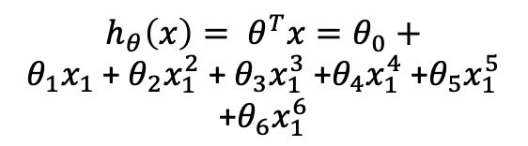

Bias and Variance
$h_{θ}\left(x\right)= θ^{T}x=θ_{0}+θ_{1}x_{1} \text{+} θ_{2}x_{1}^{2} \text{+} θ_{3}x_{1}^{3}$ +$θ_{4}x_{1}^{4}$ $\text{+}θ_{5}x_{1}^{5}$ $\text{+}θ_{6}x_{1}^{6}$
$$h_{θ}\left(x\right)= θ^{T}x=θ_{0}+θ_{1}x_{1}$$
$h_{θ}\left(x\right)= θ^{T}x=θ_{0}+θ_{1}x_{1}$+$θ_{2}x_{1}^{2}$
Volume
(cm³)
Diameter (cm)
Diameter (cm)
Diameter (cm)

Slide 8

Bias and Variance
$h_{θ}\left(x\right)= θ^{T}x=θ_{0}+θ_{1}x_{1} \text{+} θ_{2}x_{1}^{2} \text{+} θ_{3}x_{1}^{3}$ +$θ_{4}x_{1}^{4}$ $\text{+}θ_{5}x_{1}^{5}$ $\text{+}θ_{6}x_{1}^{6}$
$$h_{θ}\left(x\right)= θ^{T}x=θ_{0}+θ_{1}x_{1}$$
$h_{θ}\left(x\right)= θ^{T}x=θ_{0}+θ_{1}x_{1}$+$θ_{2}x_{1}^{2}$
Volume
(cm³)
Diameter (cm)
Diameter (cm)
Diameter (cm)
High Bias
High Variance

Slide 9
Bias and Variance
$h_{θ}\left(x\right)= θ^{T}x=θ_{0}+θ_{1}x_{1} \text{+} θ_{2}x_{1}^{2} \text{+} θ_{3}x_{1}^{3}$ +$θ_{4}x_{1}^{4}$ $\text{+}θ_{5}x_{1}^{5}$ $\text{+}θ_{6}x_{1}^{6}$
$$h_{θ}\left(x\right)= θ^{T}x=θ_{0}+θ_{1}x_{1}$$
$h_{θ}\left(x\right)= θ^{T}x=θ_{0}+θ_{1}x_{1}$+$θ_{2}x_{1}^{2}$
Volume
(cm³)
Diameter (cm)
Diameter (cm)
Diameter (cm)
High Bias
High Variance

Slide 10
Bias and Variance
$h_{θ}\left(x\right)= θ^{T}x=θ_{0}+θ_{1}x_{1} \text{+} θ_{2}x_{1}^{2} \text{+} θ_{3}x_{1}^{3}$ +$θ_{4}x_{1}^{4}$ $\text{+}θ_{5}x_{1}^{5}$ $\text{+}θ_{6}x_{1}^{6}$
$$h_{θ}\left(x\right)= θ^{T}x=θ_{0}+θ_{1}x_{1}$$
$h_{θ}\left(x\right)= θ^{T}x=θ_{0}+θ_{1}x_{1}$+$θ_{2}x_{1}^{2}$
Volume
(cm³)
Diameter (cm)
Diameter (cm)
Diameter (cm)
High Bias
Underfitting
High Variance
Overfitting

Slide 11

Bias and Variance
$h_{θ}\left(x\right)= θ^{T}x=θ_{0}+θ_{1}x_{1} \text{+} θ_{2}x_{1}^{2} \text{+} θ_{3}x_{1}^{3}$ +$θ_{4}x_{1}^{4}$ $\text{+}θ_{5}x_{1}^{5}$ $\text{+}θ_{6}x_{1}^{6}$
$$h_{θ}\left(x\right)= θ^{T}x=θ_{0}+θ_{1}x_{1}$$
$h_{θ}\left(x\right)= θ^{T}x=θ_{0}+θ_{1}x_{1}$+$θ_{2}x_{1}^{2}$
Volume
(cm³)
Diameter (cm)
Diameter (cm)
Diameter (cm)
High Bias
Underfitting
High Variance
Overfitting

Slide 12

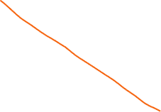
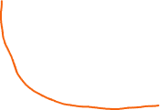
Bias and Variance

Slide 13
Bias and Variance
High Variance
Overfitting
High Bias
Underfitting

Slide 14
Bias and Variance
Bias
Systematic error due to incorrect assumptions in the ML model.
Model underfits the training data, and does not make accurate predictions
Training error and error on new data is high.
Variance
Variability of model prediction for a given data point.
Model overfits the training data, and does not generalize well.
Training error is low, but error on new data is high.

Slide 15

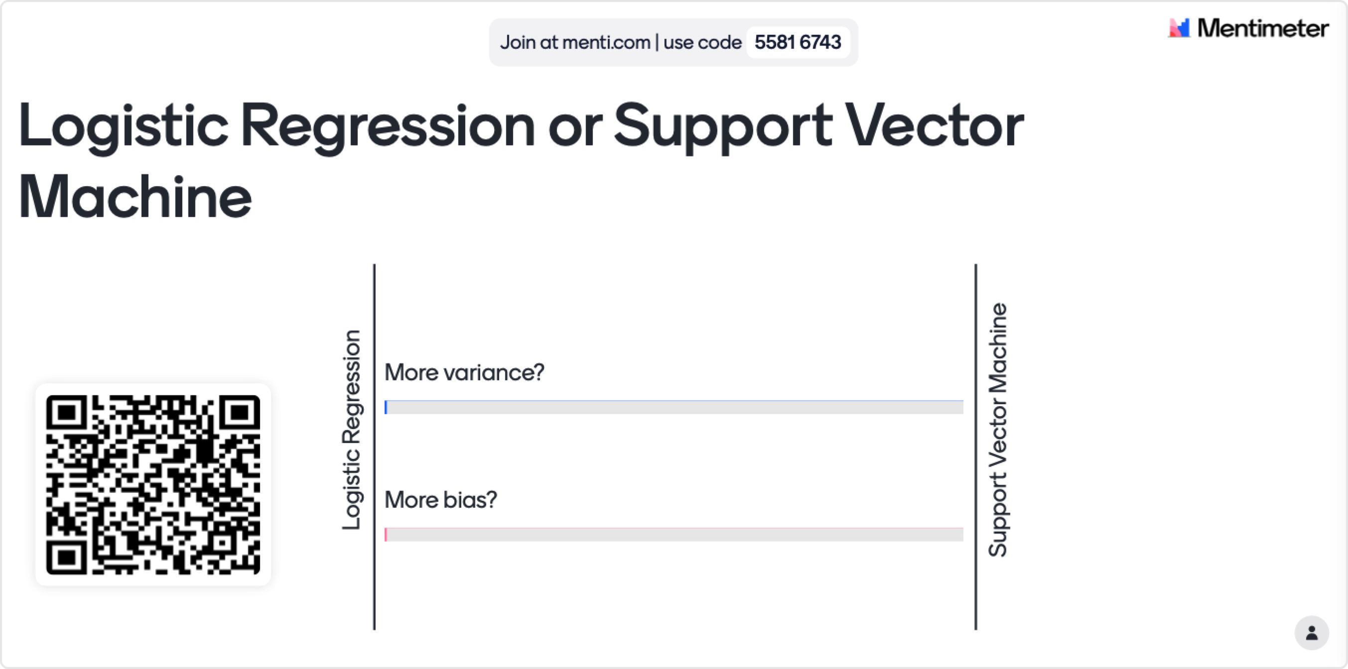
Mentimeter for PowerPoint

Slide 16
Bias and Variance
A general work-flow when designing models
Fit a model.
Ask whether the model is over-fitting or under-fitting by analyzing the bias and variance.
Use that insight to decide how to improve your model.

Slide 17
Outline
Bias and Variance
Regularization
Training, validation, and testing sets
Model Selection and Cross-Validation

Slide 18
Regularization
The goal of regularization is to keep our parameters (𝛉) small.
This helps to prevent overfitting.
There are several common types of regularization:
L1 (Lasso) Regularization
L2 (Ridge) Regularization

Slide 19
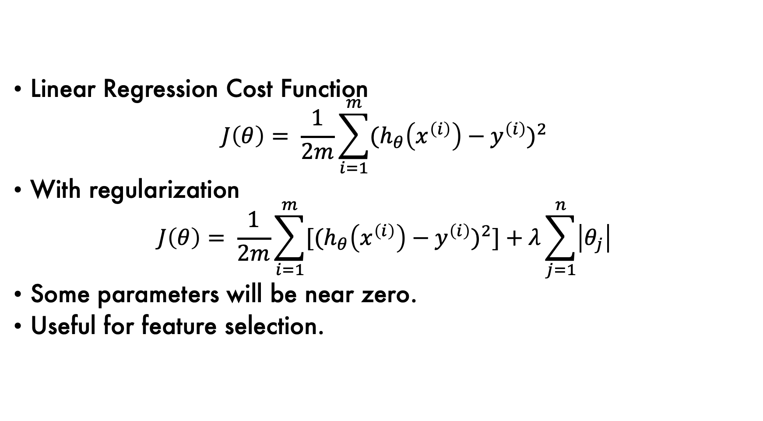
L1 (Lasso) Regularization
Linear Regression Cost Function
$$J\left(θ\right)= \frac{1}{2m}\sum_{i=1}^{m}{{{(h}_{θ}\left(x^{\left(i\right)}\right)−y^{\left(i\right)})}^{2}}$$
With regularization
$$J\left(θ\right)= \frac{1}{2m}\sum_{i=1}^{m}{{[{(h}_{θ}\left(x^{\left(i\right)}\right)−y^{\left(i\right)})}^{2}]+λ\sum_{j=1}^{n}{\left|θ_{j}\right|}}$$
Some parameters will be near zero.
Useful for feature selection.

Slide 20
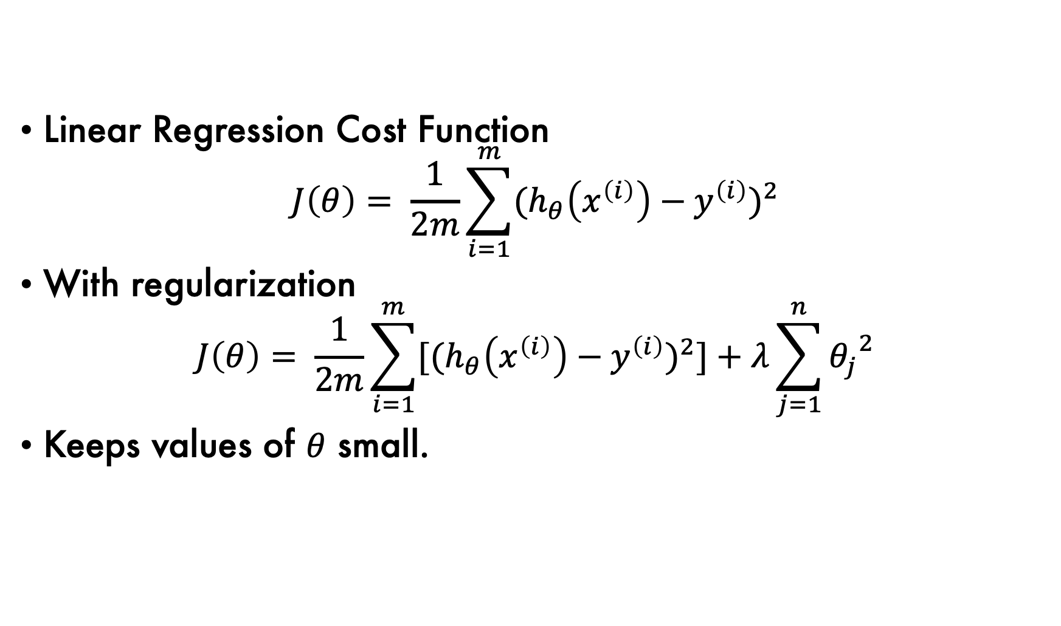
L2 (Ridge) Regularization
Linear Regression Cost Function
$$J\left(θ\right)= \frac{1}{2m}\sum_{i=1}^{m}{{{(h}_{θ}\left(x^{\left(i\right)}\right)−y^{\left(i\right)})}^{2}}$$
With regularization
$$J\left(θ\right)= \frac{1}{2m}\sum_{i=1}^{m}{{[{(h}_{θ}\left(x^{\left(i\right)}\right)−y^{\left(i\right)})}^{2}]+λ\sum_{j=1}^{n}{{θ_{j}}^{2}}}$$
Keeps values of $θ$ small.

Slide 21
Regularization
Avoid overfitting by adding a regularization term that keeps our parameters closer to zero.
An important note: Scaling features to be between zero and one becomes very important when using regularization techniques.

Slide 22
Outline
Bias and Variance
Regularization
Training, validation, and testing sets
Model Selection and Cross-Validation

Slide 23
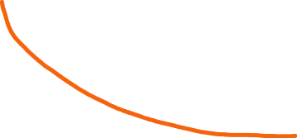
Training, testing, and validation
Error
Training Error
Model Complexity
(e.g., degree of polynomial)

Slide 24

Training, testing, and validation
Generalization Error
Error
Training Error
Model Complexity
(e.g., degree of polynomial)

Slide 25
Training, testing, and validation
High Variance
High Bias
Generalization Error
Error
Training Error
Model Complexity
(e.g., degree of polynomial)

Slide 26
Training, Validation, and Test sets
S = original dataset
S_{train}: Used to train models (e.g., 60%)
S_{val}: Used to compare models (e.g., 20%)
S_{test}: Used for final measure of error (e.g., 20%)

Slide 27
Outline
Bias and Variance
Regularization
Training, validation, and testing sets
Model Selection and Cross-Validation

Slide 28
Model Selection and Cross-Validation
Choose the optimal degree of polynomial to use.
Choices = {1, 2, 3, 4, 5}
For each choice:
Train the model on S_{train}.
Measure the error on S_{val}.
Choose the model with the lowest error.
Calculate the final error of your selected model on S_{test}.

Slide 29
Simple Hold-Out Cross-Validation
Choose the optimal degree of polynomial to use.
Choices = {1, 2, 3, 4, 5}
For each choice:
Train the model on S_{train}.
Measure the error on S_{val}.
Choose the model with the lowest error.
Calculate the final error of your selected model on S_{test}.

Slide 30
K-Fold Cross-Validation
m=100 (a very small number of examples)
Assume we have a separate test set.
If we used 70/30 for training and validation, we only have 70 samples to train with (and not much data to use for validation)!
In this case, we can use k-fold cross-validation.

Slide 31
K-Fold Cross-Validation
k=5
Divide your dataset into 5 subsets.
For i = 1,…,k.
Train your model on k-1 pieces.
Evaluate on the remaining piece.
Average the error over the k datasets.

Slide 32
K-Fold Cross-Validation
Choose the optimal degree of polynomial to use.
Choices = {1, 2, 3, 4, 5}
k=5
For each choice:
For each i in 1,…,k:
Train the on k-1 pieces.
Evaluate the model on the remaining piece.
Average the error.
Choose the model with the lowest average error.
Retrain the selected model on the entire training set.
Calculate the final error of your selected model on S_{test}.

Slide 33
Leave-one out cross-validation
Choose the optimal degree of polynomial to use.
Choices = {1, 2, 3, 4, 5}
k=m
For each choice:
For each i in 1,…,k:
Train the on k-1 pieces.
Evaluate the model on the remaining piece.
Average the error.
Choose the model with the lowest average error.
Retrain the selected model on the entire training set.
Calculate the final error of your selected model on S_{test}.

Slide 34
Feature Selection
Imagine you have 10,000 features, but you suspect only a few are relevant to your problem.
One approach to reduce overfitting is to select only a subset of features to include.

Slide 35

Feature Selection via forward-search
Start with $Ϝ=∅.$
Repeat:
For each feature i:
Try adding feature i to F.
Evaluate the model on S_{val}.
Add the feature that led to the largest improvement

Slide 36

Pair up, and design your own cross-validation
Design a cross-validation approach to choose the best value of $λ$ to use for Lasso Regression.
Hint: Consider $λ$ values [0.01, 0.1, 1, 10, 100]

Slide 37
Summary
ML models may have high error due to high bias or high variance.
Regularization is a simple technique for reducing overfitting.
It is essential to evaluate models on independent validation and testing data sets.
Cross-validation can be used to select the best model.

