Slide 1
Decision Trees
BIO 4990/6900
February 16, 2023
Dr. Megan Smith
Mississippi State University

Slide 2
Outline
Decision Trees
Issues with Decision Trees

Slide 3
Outline
Decision Trees
Issues with Decision Trees

Slide 4
Motivation for Decision Trees
Can I find slugs?
Yes
No
6”
Precipitation
3”
0”
15℉
100℉
Temperature

Slide 5
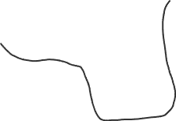
Motivation for Decision Trees
Can I find slugs?
Yes
No
6”
Precipitation
3”
0”
15℉
100℉
Temperature

Slide 6
Motivation for Decision Trees
Can I find slugs?
Yes
No
6”
Precipitation
3”
0”
15℉
100℉
Temperature

Slide 7
Motivation for Decision Trees
Can I find slugs?
Yes
No
6”
Precipitation
3”
0”
15℉
100℉
Temperature

Slide 8
Motivation for Decision Trees
Can I find slugs?
Yes
No
6”
Precipitation
3”
0”
15℉
100℉
Temperature

Slide 9
Motivation for Decision Trees
Can I find slugs?
Yes
No
6”
Precipitation
3”
0”
15℉
100℉
Temperature

Slide 10
Motivation for Decision Trees
Can I find slugs?
Yes
No
6”
Precipitation
3”
0”
15℉
100℉
Temperature

Slide 11
Motivation for Decision Trees
Can I find slugs?
Yes
No
6”
Precipitation
3”
0”
15℉
100℉
Temperature

Slide 12
What is a decision tree?
Can I find slugs?
Precipitation > 3.2”
F
T
Temperature < 35℉
Yes.
F
T
No.
Yes.

Slide 13
What is a decision tree?
Categorical decision tree
Can I find slugs?
root node
Precipitation > 3.2”
intermediate nodes
F
T
Temperature < 35℉
Yes.
F
T
Leaf nodes
No.
Yes.

Slide 14
What is a decision tree?
Regression decision tree
How many slugs can I find?
root node
Precipitation > 3.2”
intermediate nodes
F
T
Temperature < 35℉
11
F
T
Leaf nodes
0
5

Slide 15
What is a decision tree?
Precipitation > 3.2”
F
T
Temperature < 35℉
Deciduous trees nearby?
F
T
F
T
No
Yes
Temperature > 50℉
Yes
F
T
Yes
No

Slide 16
How do we build decision trees?
Raining? | Stream? | # Logs | Slug?
yes | no | 2 | yes
yes | yes | 2 | yes
yes | yes | 4 | yes
no | yes | 1 | yes
yes | no | 0 | no
no | no | 1 | no
no | yes | 2 | no
no | yes | 2 | no
Which variable should we begin with at the root?

Slide 17
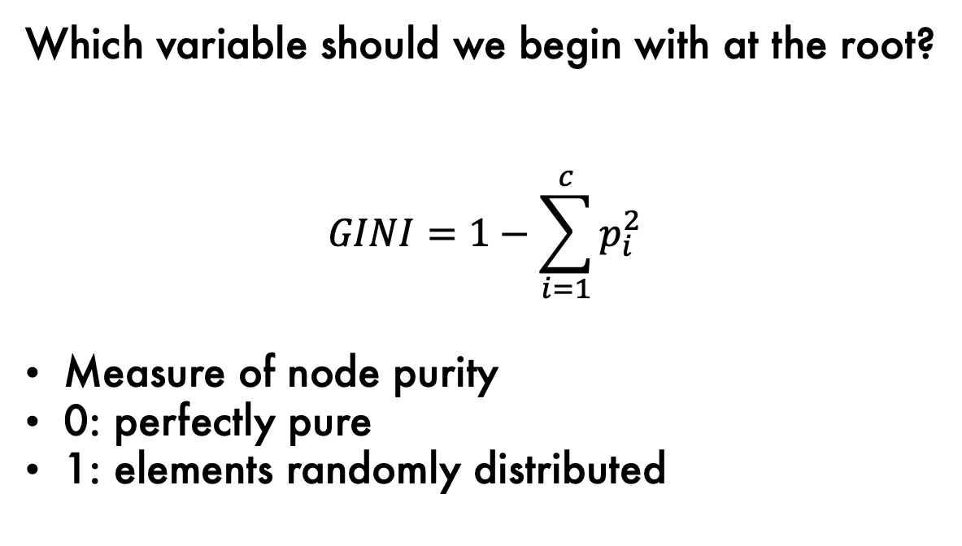
How do we build decision trees?
Raining? | Stream? | # Logs | Slug?
yes | no | 2 | yes
yes | yes | 2 | yes
yes | yes | 4 | yes
no | yes | 1 | yes
yes | no | 0 | no
no | no | 1 | no
no | yes | 2 | no
no | yes | 2 | no
Which variable should we begin with at the root?
$$GINI=1−\sum_{i=1}^{c}{p_{i}^{2}}$$
Measure of node purity
0: perfectly pure
1: elements randomly distributed

Slide 18


Mentimeter for PowerPoint

Slide 19
How do we build decision trees?
Raining?
Raining? | Stream? | # Logs | Slug?
yes | no | 2 | yes
yes | yes | 2 | yes
yes | yes | 4 | yes
no | yes | 1 | yes
yes | no | 0 | no
no | no | 1 | no
no | yes | 2 | no
no | yes | 2 | no
F
T
slug | no
1 | 3
slug | no
3 | 1

Slide 20
How do we build decision trees?
Raining?
Raining? | Stream? | # Logs | Slug?
yes | no | 2 | yes
yes | yes | 2 | yes
yes | yes | 4 | yes
no | yes | 1 | yes
yes | no | 0 | no
no | no | 1 | no
no | yes | 2 | no
no | yes | 2 | no
F
T
slug | no
1 | 3
slug | no
3 | 1

Slide 21
How do we build decision trees?
Raining?
Raining? | Stream? | # Logs | Slug?
yes | no | 2 | yes
yes | yes | 2 | yes
yes | yes | 4 | yes
no | yes | 1 | yes
yes | no | 0 | no
no | no | 1 | no
no | yes | 2 | no
no | yes | 2 | no
F
T
slug | no
1 | 3
slug | no
3 | 1
Logs>1.5
F
T
slug | no
1 | 1
slug | no
0 | 2

Slide 22
How do we build decision trees?
Raining?
Raining? | Stream? | # Logs | Slug?
yes | no | 2 | yes
yes | yes | 2 | yes
yes | yes | 4 | yes
no | yes | 1 | yes
yes | no | 0 | no
no | no | 1 | no
no | yes | 2 | no
no | yes | 2 | no
F
T
slug | no
1 | 3
slug | no
3 | 1
Logs>1.5
F
T
slug | no
1 | 1
slug | no
0 | 2
No

Slide 23
How do we build decision trees?
Raining?
Raining? | Stream? | # Logs | Slug?
yes | no | 2 | yes
yes | yes | 2 | yes
yes | yes | 4 | yes
no | yes | 1 | yes
yes | no | 0 | no
no | no | 1 | no
no | yes | 2 | no
no | yes | 2 | no
F
T
slug | no
1 | 3
slug | no
3 | 1
Logs>1.5
F
T
slug | no
1 | 1
slug | no
0 | 2
Stream?
No
F
T
slug | no
0 | 1
slug | no
1 | 0

Slide 24
How do we build decision trees?
Raining?
Raining? | Stream? | # Logs | Slug?
yes | no | 2 | yes
yes | yes | 2 | yes
yes | yes | 4 | yes
no | yes | 1 | yes
yes | no | 0 | no
no | no | 1 | no
no | yes | 2 | no
no | yes | 2 | no
F
T
slug | no
1 | 3
slug | no
3 | 1
Logs>1.5
F
T
slug | no
1 | 1
slug | no
0 | 2
Stream?
No
F
T
slug | no
0 | 1
slug | no
1 | 0
No
Yes

Slide 25
How do we build decision trees?
Raining?
Raining? | Stream? | # Logs | Slug?
yes | no | 2 | yes
yes | yes | 2 | yes
yes | yes | 4 | yes
no | yes | 1 | yes
yes | no | 0 | no
no | no | 1 | no
no | yes | 2 | no
no | yes | 2 | no
F
T
slug | no
1 | 3
slug | no
3 | 1
Logs>1.5
Logs>1
F
T
F
T
slug | no
1 | 1
slug | no
0 | 2
slug | no
0 | 1
slug | no
3 | 0
Stream?
No
No
Yes
F
T
slug | no
0 | 1
slug | no
1 | 0
No
Yes

Slide 26
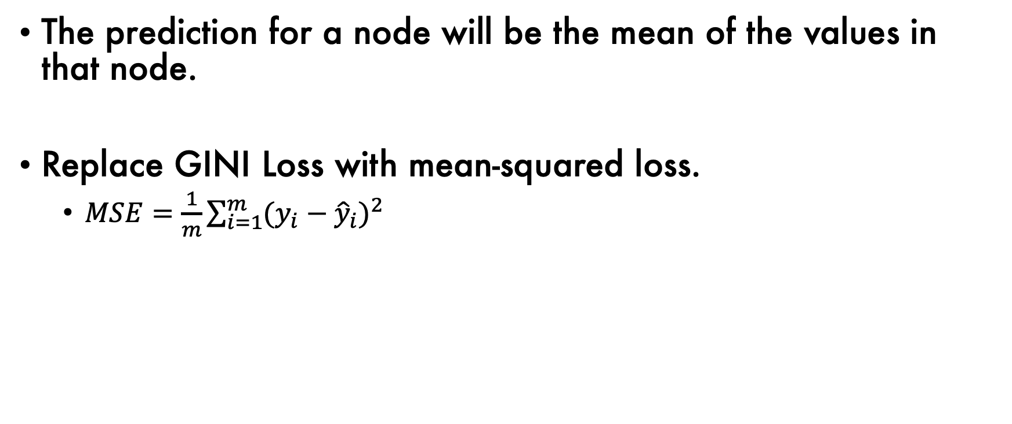
Regression Trees
The prediction for a node will be the mean of the values in that node.
Replace GINI Loss with mean-squared loss.
$MSE=\frac{1}{m}\sum_{i=1}^{m}{{{(y_{i}−\hat{y}}_{i})}^{2}}$

Slide 27
Outline
Decision Trees
Issues with Decision Trees

Slide 28
Issues with Decision Trees
Raining?
F
T
Decision trees are prone to over-fitting.
This means they are a high-variance estimator.
slug | no
1 | 3
slug | no
3 | 1
Logs>1.5
Logs>1
F
T
F
T
slug | no
1 | 1
slug | no
0 | 2
slug | no
0 | 1
slug | no
3 | 0
Stream?
No
No
Yes
F
T
slug | no
0 | 1
slug | no
1 | 0
No
Yes

Slide 29
Regularization in Decision Trees
Limit Growth
Minimum leaf size
Maximum depth
Maximum number of nodes
Minimum decrease in accuracy.
Prune (i.e., grow the entire tree, and then remove nodes).

Slide 30
Challenges with Additive Structure
Precipitation
Temperature

Slide 31
Challenges with Additive Structure
Precipitation
Temperature

Slide 32
Challenges with Additive Structure
Precipitation
Temperature

Slide 33
Decision Trees: Recap
Pros | Cons
Easy to explain | High variance
Interpretable | Bad with additive structure
Categorical variables easily handled | Low predictive accuracy
Fast

