Slide 1
Decision Trees and Ensemble Methods
BIO 4990/6900
February 19, 2023
Dr. Megan Smith
Mississippi State University

Slide 2
Outline
Recap: Issues with Decision Trees
Random Forests
AdaBoost

Slide 3
Outline
Recap: Issues with Decision Trees
Random Forests
AdaBoost

Slide 4
Motivation for Decision Trees
Can I find slugs?
6”
Precipitation
3”
0”
15℉
100℉
Temperature

Slide 5
Decision Trees: Recap
Pros | Cons
Easy to explain | High variance
Interpretable | Bad with additive structure
Categorical variables easily handled | Low predictive accuracy
Fast

Slide 6
Outline
Recap: Issues with Decision Trees
Random Forests
AdaBoost

Slide 7
The Need for Random Forests
Decision trees are prone to overfitting, and generally have low predictive accuracy.
To address these issues, we can use collections of decision trees, rather than a single tree.
Ensemble methods create multiple models and combine them to improve results.
Examples: Random Forest, AdaBoost, ExtraTrees

Slide 8
Random Forest Classifiers
Step 1: Create a bootstrapped dataset.
Bootstrapped dataset: Dataset sampled with replacement from the training data. Each boostrapped dataset will be the same size as the training data.
Raining? | Stream? | # Logs | Slug?
yes | no | 2 | yes
yes | yes | 2 | yes
yes | yes | 4 | yes
no | yes | 1 | yes
yes | no | 0 | no
no | no | 1 | no
no | yes | 2 | no
no | yes | 2 | no
Raining? | Stream? | # Logs | Slug?

Slide 9
Random Forest Classifiers
Step 1: Create a bootstrapped dataset.
Bootstrapped dataset: Dataset sampled with replacement from the training data. Each boostrapped dataset will be the same size as the training data.
Raining? | Stream? | # Logs | Slug?
yes | no | 2 | yes
yes | yes | 2 | yes
yes | yes | 4 | yes
no | yes | 1 | yes
yes | no | 0 | no
no | no | 1 | no
no | yes | 2 | no
no | yes | 2 | no
Raining? | Stream? | # Logs | Slug?
yes | yes | 2 | yes

Slide 10

Random Forest Classifiers
Step 1: Create a bootstrapped dataset.
Bootstrapped dataset: Dataset sampled with replacement from the training data. Each boostrapped dataset will be the same size as the training data.
Raining? | Stream? | # Logs | Slug?
yes | no | 2 | yes
yes | yes | 2 | yes
yes | yes | 4 | yes
no | yes | 1 | yes
yes | no | 0 | no
no | no | 1 | no
no | yes | 2 | no
no | yes | 2 | no
Raining? | Stream? | # Logs | Slug?
yes | yes | 2 | yes
no | yes | 2 | no

Slide 11




Random Forest Classifiers
Step 1: Create a bootstrapped dataset.
Bootstrapped dataset: Dataset sampled with replacement from the training data. Each boostrapped dataset will be the same size as the training data.
Raining? | Stream? | # Logs | Slug?
yes | no | 2 | yes
yes | yes | 2 | yes
yes | yes | 4 | yes
no | yes | 1 | yes
yes | no | 0 | no
no | no | 1 | no
no | yes | 2 | no
no | yes | 2 | no
Raining? | Stream? | # Logs | Slug?
yes | yes | 2 | yes
no | yes | 2 | no
yes | yes | 4 | yes
yes | no | 2 | yes
yes | yes | 4 | yes
yes | no | 2 | yes
no | yes | 2 | no
yes | yes | 4 | yes

Slide 12
Random Forest Classifiers
Step 1: Create a bootstrapped dataset.
Bootstrapped dataset: Dataset sampled with replacement from the training data. Each boostrapped dataset will be the same size as the training data.
Step 2: Train a decision tree using the boostrapped data, and use only a random subset of variables when constructing each node.

Slide 13
Random Forest Classifiers
For each iteration i:
Step 1: Create a bootstrapped dataset.
Step 2: Train a decision tree using the boostrapped data, and use only a random subset of variables when constructing each node.
Raining?
Stream?
Logs >1?
F
T
F
T
F
T
Stream?
Yes
Raining?
Logs > 1.5?
Yes
Stream?
F
T
F
T
F
T
F
T
No
Yes
No
Yes
No
Yes
No
Yes

Slide 14





Random Forest Classifiers
How do we use the classifier to make predictions?
Run the new data point down all trees and select the category with the most ‘votes’.
Raining?
Stream?
Logs >1?
F
T
F
T
F
T
Stream?
Yes
Raining?
Logs > 1.5?
Yes
Stream?
F
T
F
T
F
T
F
T
No
Yes
No
Yes
No
Yes
No
Yes

Slide 15
Random Forest Classifiers
Boostrapping + Aggregating = “Bagging”
Raining?
Stream?
Logs >1?
F
T
F
T
F
T
Stream?
Yes
Raining?
Logs > 1.5?
Yes
Stream?
F
T
F
T
F
T
F
T
No
Yes
No
Yes
No
Yes
No
Yes

Slide 16
Error in Random Forest Classifiers
“Out-of-bag” samples: samples not used to build a decision tree in the random forest.
”Out-of-bag” error: error rate when samples are classified using only those trees constructed without reference to said sample.

Slide 17
Variable Importance in Random Forest Classifiers
Mean Decrease Accuracy
Compute the out-of-bag error.
For each variable:
Shuffle the values of the variable in the out-of-bag samples.
Recalculate the out-of-bag error.
Record the decrease in accuracy (accuracy is 1-error).

Slide 18
Variable Importance in Random Forest Classifiers
Mean Decrease Accuracy
Compute the out-of-bag error.
For each variable:
Shuffle the values of the variable in the out-of-bag samples.
Recalculate the out-of-bag error.
Record the decrease in accuracy (i.e., 1- the increase in error).
Mean Decrease Gini (Importance)
The total decrease in node impurity weighted by the proportion of samples reaching that node over all trees in the Forest.

Slide 19
Outline
Recap: Issues with Decision Trees
Random Forests
AdaBoost

Slide 20
AdaBoost vs. Random Forests
Difference 1:
Each decision tree in a Random Forest is a full classifier.
In AdaBoost, each decision tree is a weak classifier (usually a stump).
Stream?
Stream?
F
T
F
T
Raining?
Logs > 1.5?
No
Yes
F
T
F
T
No
Yes
No
Yes

Slide 21
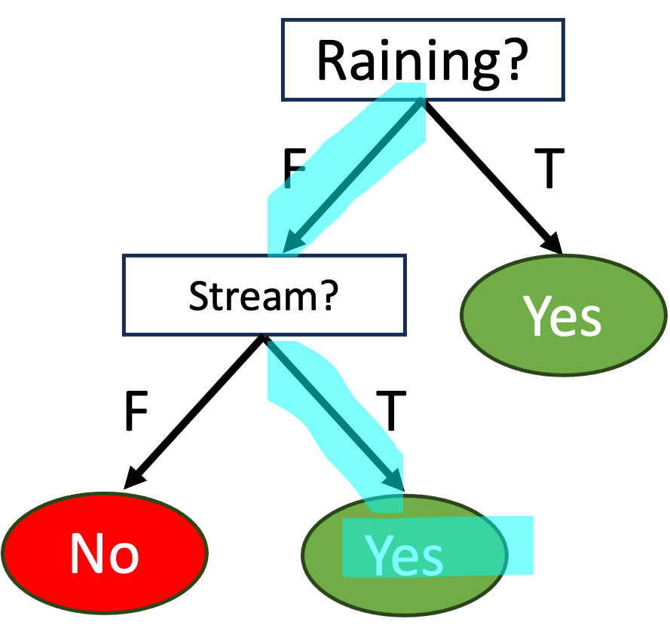
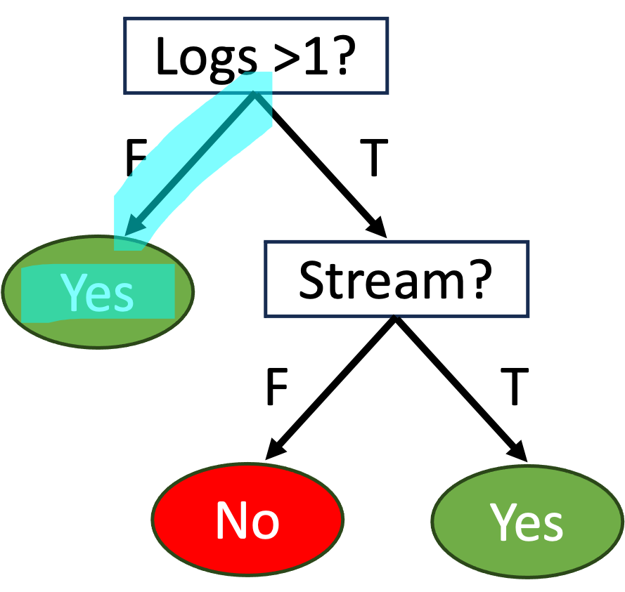
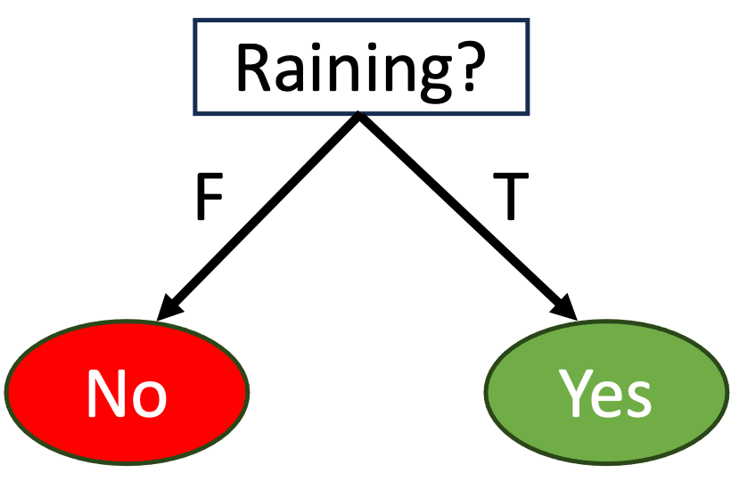
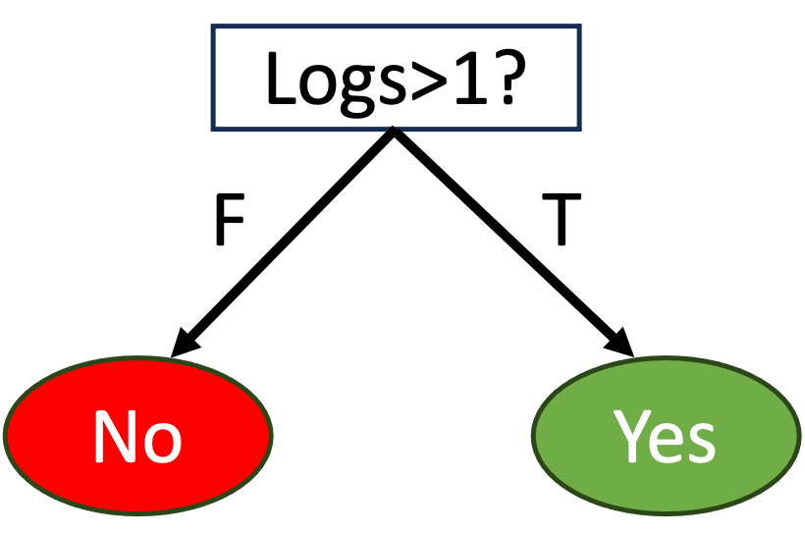
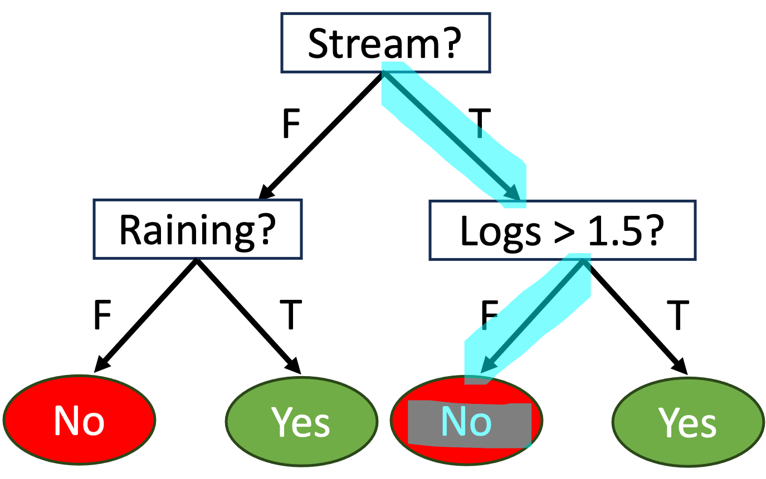
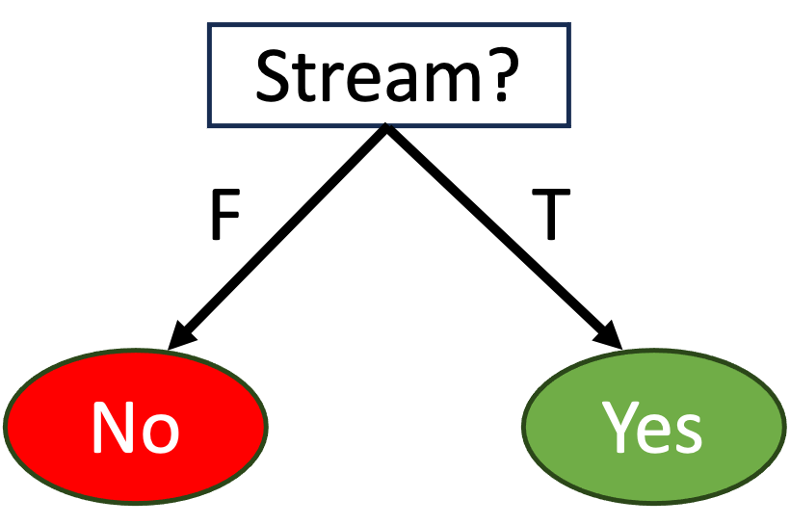
AdaBoost versus Random Forests
Difference 2:
In Random Forests, each decision tree gets one vote.
In AdaBoost, decision trees have different ‘Amounts of Say’ in the final classification.
x1
x0.8
x1.2

Slide 22


AdaBoost vs. Random Forests
Difference 3:
In Random Forests, decision trees are independent.
In AdaBoost, each stump is made by taking the previous stumps errors into account.

Slide 23
AdaBoost vs. Random Forests
AdaBoost combines many weak learners (usually stumps) to make classifications.
Some stumps get more say in classification than others.
Each stump is made by taking the previous stump’s mistakes into account.

Slide 24
How to build a forest of stumps
Step 1: Assign sample weights.
Raining? | Stream? | # Logs | Slug? | weight
yes | no | 2 | yes | 1/8
yes | yes | 2 | yes | 1/8
yes | yes | 4 | yes | 1/8
no | yes | 1 | yes | 1/8
yes | no | 0 | no | 1/8
no | no | 1 | no | 1/8
no | yes | 2 | no | 1/8
no | yes | 2 | no | 1/8

Slide 25
How to build a forest of stumps
Step 2: Build a stump by selecting the variable and split with the lowest GINI Index.
Raining? | Stream? | # Logs | Slug? | weight
yes | no | 2 | yes | 1/8
yes | yes | 2 | yes | 1/8
yes | yes | 4 | yes | 1/8
no | yes | 1 | yes | 1/8
yes | no | 0 | no | 1/8
no | no | 1 | no | 1/8
no | yes | 2 | no | 1/8
no | yes | 2 | no | 1/8
Stream?
F
T
Slug | No
1 | 2
Slug | No
3 | 2

Slide 26
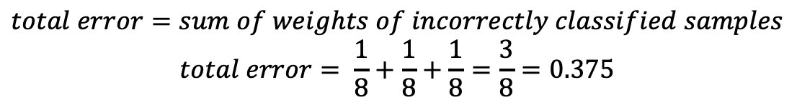
How to build a forest of stumps
Step 3. Calculate the “Amount of Say” for the stump.
Stream?
F
T
Raining? | Stream? | # Logs | Slug? | weight
yes | no | 2 | yes | 1/8
yes | yes | 2 | yes | 1/8
yes | yes | 4 | yes | 1/8
no | yes | 1 | yes | 1/8
yes | no | 0 | no | 1/8
no | no | 1 | no | 1/8
no | yes | 2 | no | 1/8
no | yes | 2 | no | 1/8
Slug | No
1 | 2
Slug | No
3 | 2
$$total error=sum of weights of incorrectly classified samples$$
$$total error= \frac{1}{8}+\frac{1}{8}+\frac{1}{8}=\frac{3}{8}=0.375$$

Slide 27
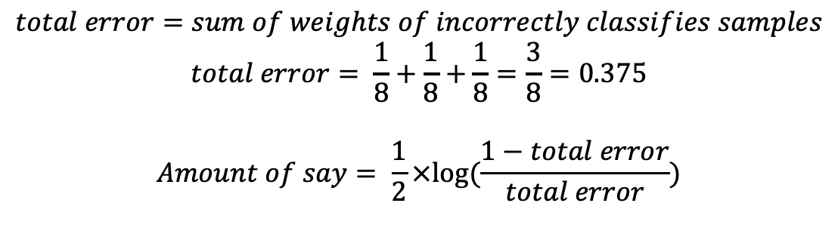
How to build a forest of stumps
Step 3. Calculate the “Amount of Say” for the stump.
Stream?
F
T
Raining? | Stream? | # Logs | Slug? | weight
yes | no | 2 | yes | 1/8
yes | yes | 2 | yes | 1/8
yes | yes | 4 | yes | 1/8
no | yes | 1 | yes | 1/8
yes | no | 0 | no | 1/8
no | no | 1 | no | 1/8
no | yes | 2 | no | 1/8
no | yes | 2 | no | 1/8
Slug | No
1 | 2
Slug | No
3 | 2
$$total error=sum of weights of incorrectly classifies samples$$
$$total error= \frac{1}{8}+\frac{1}{8}+\frac{1}{8}=\frac{3}{8}=0.375$$
$$Amount of say= \frac{1}{2}×log⁡(\frac{1−total error}{total error})$$

Slide 28
How to build a forest of stumps
Step 3. Calculate the “Amount of Say” for the stump.
Stream?
F
T
Slug | No
1 | 2
Slug | No
3 | 2
$$total error=sum of weights of incorrectly classifies samples$$
$$total error= \frac{1}{8}+\frac{1}{8}+\frac{1}{8}=\frac{3}{8}=0.375$$
$$Amount of say= \frac{1}{2}×log⁡(\frac{1−total error}{total error})$$

Slide 29
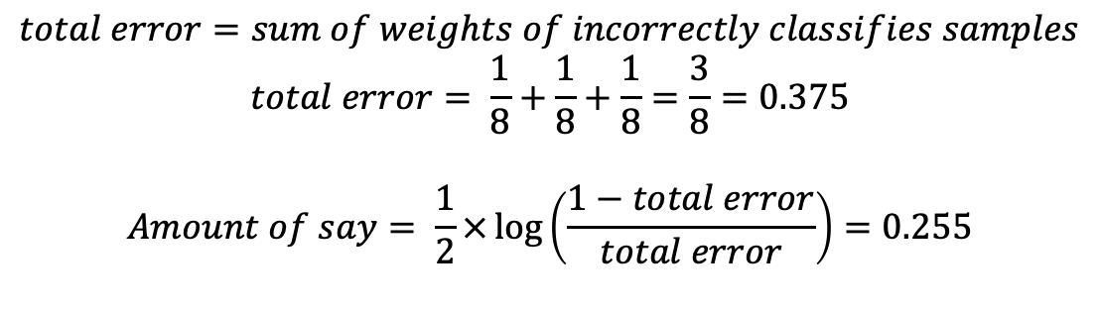
How to build a forest of stumps
Step 3. Calculate the “Amount of Say” for the stump.
Stream?
F
T
Slug | No
1 | 2
Slug | No
3 | 2
$$total error=sum of weights of incorrectly classifies samples$$
$$total error= \frac{1}{8}+\frac{1}{8}+\frac{1}{8}=\frac{3}{8}=0.375$$
$$Amount of say= \frac{1}{2}×\log\left(\frac{1−total error}{total error}\right)=0.255$$

Slide 30
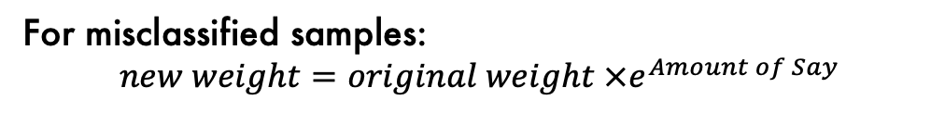
How to build a forest of stumps
Stream?
F
T
Slug | No
1 | 2
Slug | No
3 | 2
Step 4. Modify the weights.
Raining? | Stream? | # Logs | Slug? | weight
yes | no | 2 | yes | 1/8
yes | yes | 2 | yes | 1/8
yes | yes | 4 | yes | 1/8
no | yes | 1 | yes | 1/8
yes | no | 0 | no | 1/8
no | no | 1 | no | 1/8
no | yes | 2 | no | 1/8
no | yes | 2 | no | 1/8
For misclassified samples:
$$new weight=original weight ×e^{Amount of Say}$$

Slide 31
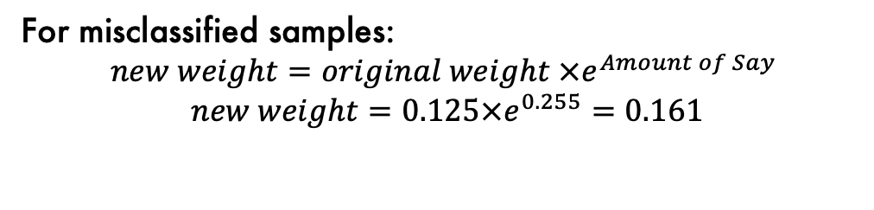
How to build a forest of stumps
Stream?
F
T
Slug | No
1 | 2
Slug | No
3 | 2
Step 4. Modify the weights.
For misclassified samples:
$$new weight=original weight ×e^{Amount of Say}$$
$$new weight=0.125×e^{0.255}=0.161$$

Slide 32
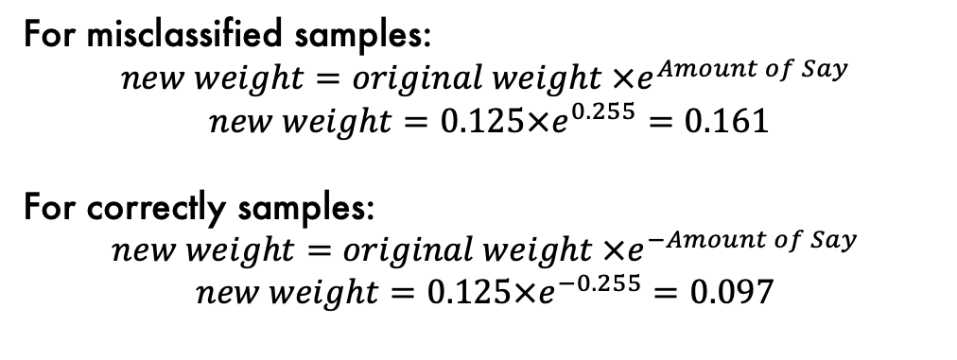
How to build a forest of stumps
Stream?
F
T
Slug | No
1 | 2
Slug | No
3 | 2
Step 4. Modify the weights.
For misclassified samples:
$$new weight=original weight ×e^{Amount of Say}$$
$$new weight=0.125×e^{0.255}=0.161$$
For correctly samples:
$$new weight=original weight ×e^{−Amount of Say}$$
$$new weight=0.125×e^{−0.255}=0.097$$

Slide 33
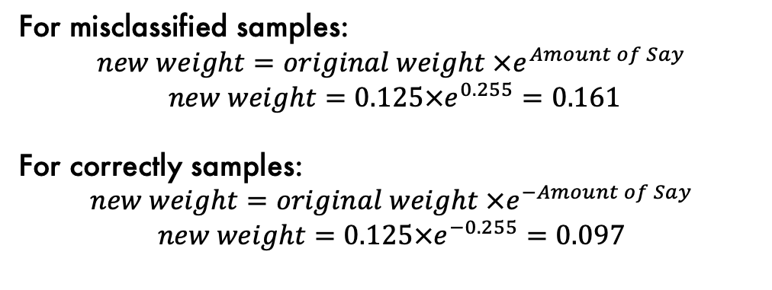
How to build a forest of stumps
Stream?
F
T
Slug | No
1 | 2
Slug | No
3 | 2
Step 4. Modify the weights.
Raining? | Stream? | # Logs | Slug? | weight | new
yes | no | 2 | yes | 1/8 | 0.161
yes | yes | 2 | yes | 1/8 | 0.097
yes | yes | 4 | yes | 1/8 | 0.097
no | yes | 1 | yes | 1/8 | 0.097
yes | no | 0 | no | 1/8 | 0.097
no | no | 1 | no | 1/8 | 0.097
no | yes | 2 | no | 1/8 | 0.161
no | yes | 2 | no | 1/8 | 0.161
For misclassified samples:
$$new weight=original weight ×e^{Amount of Say}$$
$$new weight=0.125×e^{0.255}=0.161$$
For correctly samples:
$$new weight=original weight ×e^{−Amount of Say}$$
$$new weight=0.125×e^{−0.255}=0.097$$

Slide 34
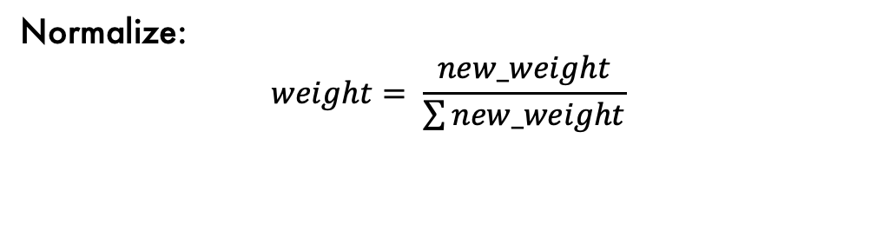
How to build a forest of stumps
Stream?
F
T
Slug | No
1 | 2
Slug | No
3 | 2
Step 4. Modify the weights.
Raining? | Stream? | # Logs | Slug? | weight | new | weight
yes | no | 2 | yes | 0.125 | 0.161 | 0.166
yes | yes | 2 | yes | 0.125 | 0.097 | 0.100
yes | yes | 4 | yes | 0.125 | 0.097 | 0.100
no | yes | 1 | yes | 0.125 | 0.097 | 0.100
yes | no | 0 | no | 0.125 | 0.097 | 0.100
no | no | 1 | no | 0.125 | 0.097 | 0.100
no | yes | 2 | no | 0.125 | 0.161 | 0.166
no | yes | 2 | no | 0.125 | 0.161 | 0.166
Normalize:
$$weight= \frac{new_weight}{\sum{new_weight}}$$

Slide 35
How to build a forest of stumps
Stream?
F
T
Slug | No
1 | 2
Slug | No
3 | 2
Step 4. Modify the weights.
Raining? | Stream? | # Logs | Slug? | weight
yes | no | 2 | yes | 0.166
yes | yes | 2 | yes | 0.100
yes | yes | 4 | yes | 0.100
no | yes | 1 | yes | 0.100
yes | no | 0 | no | 0.100
no | no | 1 | no | 0.100
no | yes | 2 | no | 0.166
no | yes | 2 | no | 0.166
Normalize:
$$weight= \frac{new_weight}{\sum{new_weight}}$$

Slide 36
How to build a forest of stumps
Step 5. Create new collection of samples with duplicate copies of the samples with the largest weights.
Raining? | Stream? | # Logs | Slug? | weight
yes | no | 2 | yes | 0.166
yes | yes | 2 | yes | 0.100
yes | yes | 4 | yes | 0.100
no | yes | 1 | yes | 0.100
yes | no | 0 | no | 0.100
no | no | 1 | no | 0.100
no | yes | 2 | no | 0.166
no | yes | 2 | no | 0.166
Create a new empty dataset of the same size as the original dataset.
Pick a random number between 0 and 1.
See where the number falls when using the sample weights as a distribution.
Populate the new dataset.

Slide 37
How to build a forest of stumps
Step 6. Repeat!
Amount of Say = 1.1
Amount of Say = -1
Amount of Say = 2

Slide 38
How to build a forest of stumps
For i iterations:
Create dataset based on sample weights.
Build a stump.
Calculate “Amount of Say”.
Calculate updated sample weights

Slide 39



Making Predictions with AdaBoost
Amount of Say = 1.1
Amount of Say = -1
Total Amount of Say (Yes): 2 +-1=1
Total Amount of Say (No): 1.1 = 1.1
Amount of Say = 2

Slide 40
AdaBoost Summary
AdaBoost combines many weak learners (usually stumps) to make classifications.
Some stumps get more say in classification than others.
Each stump is made by taking the previous stump’s mistakes into account.

Slide 41
Summary
Decision Trees are weak classifiers with high variance.
Ensemble methods help with this by decreasing the variance of the classifier.
RandomForest and AdaBoost are two popular ensemble decision tree methods.

Slide 42
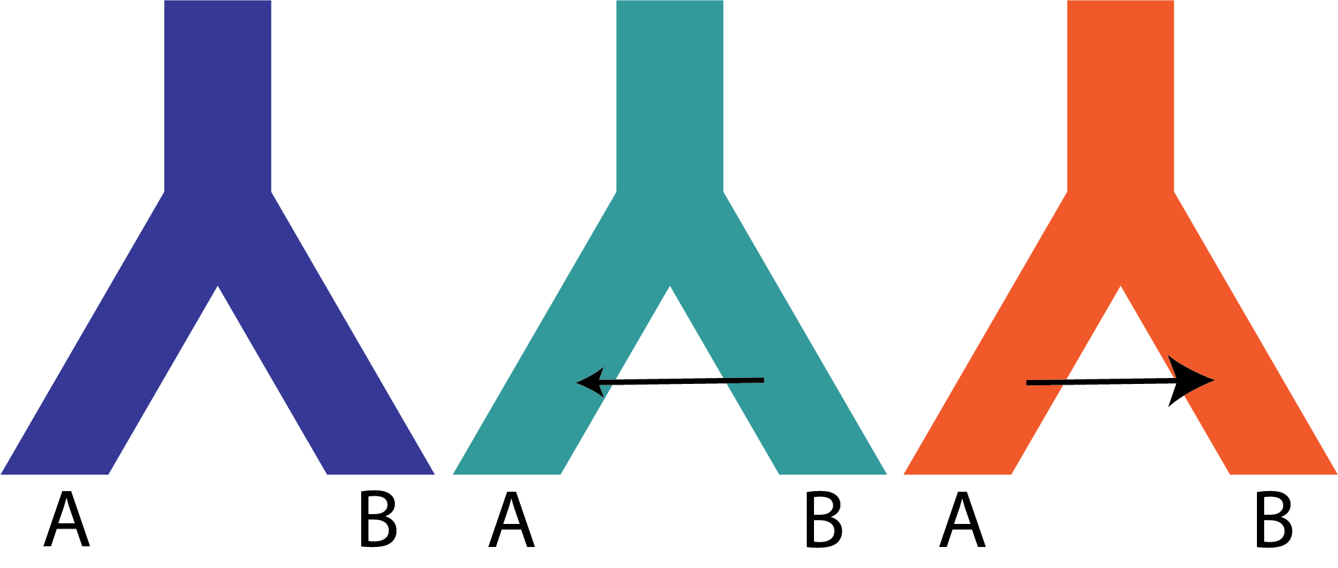
Example: Demographic model selection
Goal: Predict the best model to describe the history of populations.

Slide 43
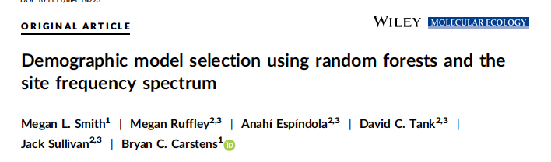
Example: Demographic model selection
Goal: Predict the best model to describe the history of populations.
Training data: Simulated under each model.
Features: Bins of the Site Frequency Spectrum (a summary of genetic data)
Algorithm: Random Forest Classifier

Slide 44
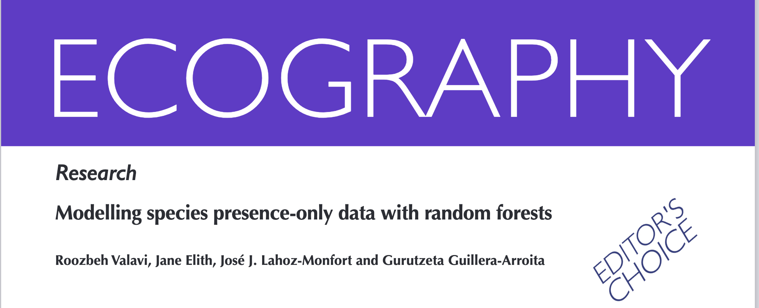
Example: Species Distributions
Goal: Predict suitable habitat for a species.
Training data: Occurrence data (Y) and associated environmental data (X).
Algorithm: Random Forests

