Slide 1
Neural Networks: Part 1
BIO 4990/6990
February 26, 2024
Dr. Megan Smith
Mississippi State University

Slide 2
Outline
Deep Learning
Logistic Regression as a Neural Network
Generalizations to other activations
Design your own Neural Network

Slide 3
Outline
Deep Learning
Logistic Regression as a Neural Network
Generalizations to other activations
Design your own Neural Network

Slide 4
Deep Learning
A subset of methods in machine learning that aim to extract high-level features from data.
Growing popularity in industry due to several factors:
High computational requirements.
Access to large amounts of data.
New algorithms.
Wide array of uses
Computer vision
Natural Language Processing
Speech Recognition

Slide 5
Outline
Deep Learning
Logistic Regression as a Neural Network
Generalizations to other activations
Design your own Neural Network

Slide 6
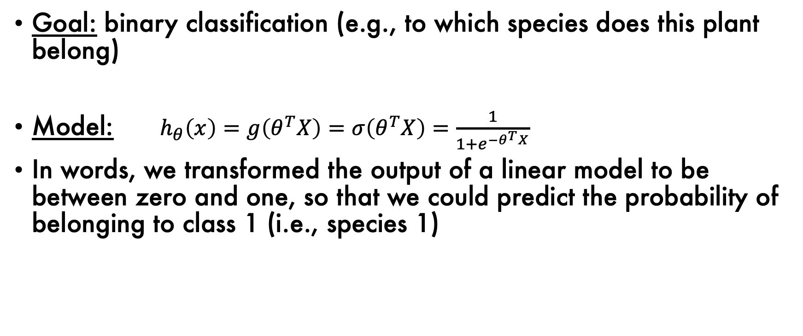
Logistic Regression Model
Goal: binary classification (e.g., to which species does this plant belong)
Model: $h_{θ}\left(x\right)=g\left(θ^{T}X\right)=σ\left(θ^{T}X\right)=\frac{1}{1+e^{−θ^{T}X}}$
In words, we transformed the output of a linear model to be between zero and one, so that we could predict the probability of belonging to class 1 (i.e., species 1)

Slide 7
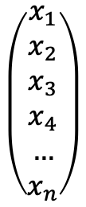
Network Representation
Features: sepal length, petal length, petal width, etc.
$$\left(\begin{matrix}x_{1} \\ x_{2} \\ x_{3} \\ x_{4} \\ … \\ x_{n}\end{matrix}\right)$$

Slide 8


Network Representation
Features: sepal length, petal length, petal width, etc.
$$\left(\begin{matrix}x_{1} \\ x_{2} \\ x_{3} \\ x_{4} \\ … \\ x_{n}\end{matrix}\right)$$
$$θ^{T}X$$
$$σ$$

Slide 9

Network Representation
Features: sepal length, petal length, petal width, etc.
$$\left(\begin{matrix}x_{1} \\ x_{2} \\ x_{3} \\ x_{4} \\ … \\ x_{n}\end{matrix}\right)$$
$$θ^{T}X$$
$$σ$$
$$\hat{y}$$

Slide 10


Network Representation
Features: sepal length, petal length, petal width, etc.
$$\left(\begin{matrix}x_{1} \\ x_{2} \\ x_{3} \\ x_{4} \\ … \\ x_{n}\end{matrix}\right)$$
$$wx+b$$
$$σ$$
$$\hat{y}$$

Slide 11

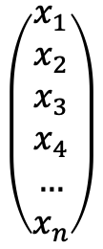


Network Representation
$$\left(\begin{matrix}x_{1} \\ x_{2} \\ x_{3} \\ x_{4} \\ … \\ x_{n}\end{matrix}\right)$$
$$wx+b$$
$$σ$$
$$\hat{y}$$
input layer
hidden layer
output layer

Slide 12

Network Representation
$$\left(\begin{matrix}x_{1} \\ x_{2} \\ x_{3} \\ x_{4} \\ … \\ x_{n}\end{matrix}\right)$$
$$wx+b$$
$$σ$$
$$\hat{y}$$
input layer
hidden layer
output layer
In the hidden layer, $σ$ is our activation function.

Slide 13
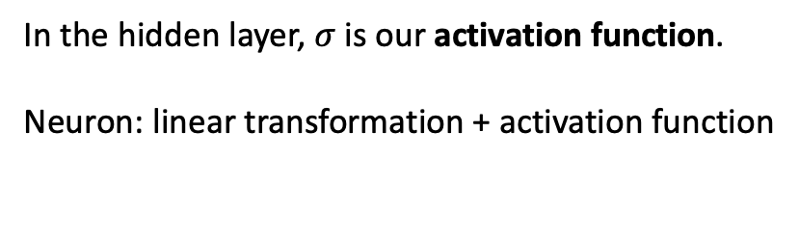
Network Representation
$$\left(\begin{matrix}x_{1} \\ x_{2} \\ x_{3} \\ x_{4} \\ … \\ x_{n}\end{matrix}\right)$$
$$wx+b$$
$$σ$$
$$\hat{y}$$
input layer
hidden layer
output layer
In the hidden layer, $σ$ is our activation function.
Neuron: linear transformation + activation function

Slide 14
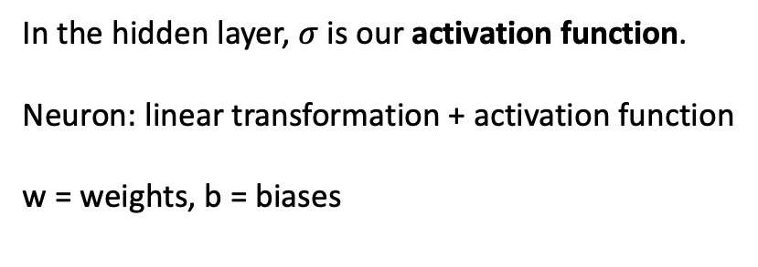
Network Representation
$$\left(\begin{matrix}x_{1} \\ x_{2} \\ x_{3} \\ x_{4} \\ … \\ x_{n}\end{matrix}\right)$$
$$wx+b$$
$$σ$$
$$\hat{y}$$
input layer
hidden layer
output layer
In the hidden layer, $σ$ is our activation function.
Neuron: linear transformation + activation function
w = weights, b = biases

Slide 15
Network Representation
$$\left(\begin{matrix}x_{1} \\ x_{2} \\ x_{3} \\ x_{4} \\ … \\ x_{n}\end{matrix}\right)$$
$$wx+b$$
$$σ$$
$$\hat{y}$$
input layer
hidden layer
output layer
How many parameters does this network have?

Slide 16
Network Representation
$$\left(\begin{matrix}x_{1} \\ x_{2} \\ x_{3} \\ x_{4} \\ … \\ x_{n}\end{matrix}\right)$$
$$wx+b$$
$$σ$$
$$\hat{y}$$
input layer
hidden layer
output layer
How many parameters does this network have?
n weights and 1 bias!

Slide 17
Network Representation
$$\left(\begin{matrix}x_{1} \\ x_{2} \\ x_{3} \\ x_{4} \\ … \\ x_{n}\end{matrix}\right)$$
$$wx+b$$
$$σ$$
$$\hat{y}$$
input layer
hidden layer
output layer
How do we estimate the weights and biases?

Slide 18
Network Representation
$$\left(\begin{matrix}x_{1} \\ x_{2} \\ x_{3} \\ x_{4} \\ … \\ x_{n}\end{matrix}\right)$$
$$wx+b$$
$$σ$$
$$\hat{y}$$
input layer
hidden layer
output layer
How do we estimate the weights and biases?

Slide 19
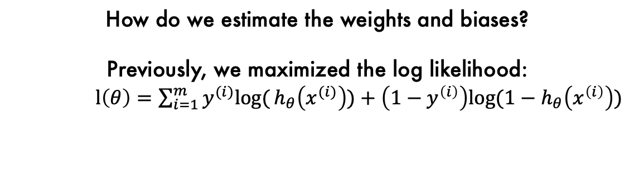
Network Representation
$$\left(\begin{matrix}x_{1} \\ x_{2} \\ x_{3} \\ x_{4} \\ … \\ x_{n}\end{matrix}\right)$$
$$wx+b$$
$$σ$$
$$\hat{y}$$
input layer
hidden layer
output layer
How do we estimate the weights and biases?
Previously, we maximized the log likelihood:
$l\left(θ\right)=\sum_{i=1}^{m}{y^{(i)}log⁡(}h_{θ}\left(x^{(i)}\right))+\left(1−y^{\left(i\right)}\right)log⁡{(1−h}_{θ}\left(x^{\left(i\right)}\right))$

Slide 20
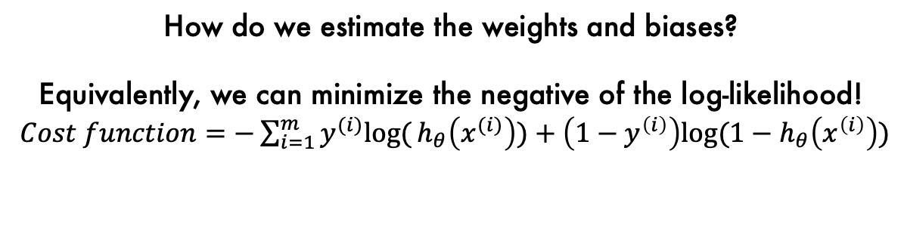
Network Representation
$$\left(\begin{matrix}x_{1} \\ x_{2} \\ x_{3} \\ x_{4} \\ … \\ x_{n}\end{matrix}\right)$$
$$wx+b$$
$$σ$$
$$\hat{y}$$
input layer
hidden layer
output layer
How do we estimate the weights and biases?
Equivalently, we can minimize the negative of the log-likelihood!
$Cost function=−\sum_{i=1}^{m}{y^{(i)}log⁡(}h_{θ}\left(x^{(i)}\right))+\left(1−y^{\left(i\right)}\right)log⁡{(1−h}_{θ}\left(x^{\left(i\right)}\right))$

Slide 21
Network Representation
$$\left(\begin{matrix}x_{1} \\ x_{2} \\ x_{3} \\ x_{4} \\ … \\ x_{n}\end{matrix}\right)$$
$$wx+b$$
$$σ$$
$$\hat{y}$$
input layer
hidden layer
output layer
How do we estimate the weights and biases?
Equivalently, we can minimize the negative of the log-likelihood!
We do this using gradient descent.

Slide 22
Outline
Deep Learning
Logistic Regression as a Neural Network
Generalizations to other activations
Design your own Neural Network

Slide 23
A general description of networks
Architecture:
Input layer: our features, x
Hidden layers: have neurons, which include a linear function and an activation function.
Output layer: our response, y.
Cost-Function:
e.g., the negative log likelihood
Method to minimize the cost function:
e.g., gradient descent

Slide 24




A new goal:
Predict to which of three species a flower belongs.
$$\left(\begin{matrix}x_{1} \\ x_{2} \\ x_{3} \\ x_{4} \\ … \\ x_{n}\end{matrix}\right)$$
$$wx+b$$
$$σ$$
$$\hat{y}$$
input layer
hidden layer
output layer

Slide 25









A new goal:
Predict to which of three species a flower belongs.
hidden layer
output layer
$$wx+b$$
$$sm$$
$$p(y=1)$$
$$\left(\begin{matrix}x_{1} \\ x_{2} \\ x_{3} \\ x_{4} \\ … \\ x_{n}\end{matrix}\right)$$
$$wx+b$$
$$sm$$
$$p(y=2)$$
input layer
$$wx+b$$
$$sm$$
$$p(y=3)$$

Slide 26
A new goal:
Predict to which of three species a flower belongs.
hidden layer
output layer
$$wx+b$$
$$sm$$
$$p(y=1)$$
$$\left(\begin{matrix}x_{1} \\ x_{2} \\ x_{3} \\ x_{4} \\ … \\ x_{n}\end{matrix}\right)$$
How many neurons are in the hidden layer?
How many parameters are in our network?
$$wx+b$$
$$sm$$
$$p(y=2)$$
input layer
$$wx+b$$
$$sm$$
$$p(y=3)$$

Slide 27
A new goal:
Predict to which of three species a flower belongs.
hidden layer
output layer
$$wx+b$$
$$sm$$
$$p(y=1)$$
$$\left(\begin{matrix}x_{1} \\ x_{2} \\ x_{3} \\ x_{4} \\ … \\ x_{n}\end{matrix}\right)$$
How many neurons are in the hidden layer? 3
How many parameters are in our network? 3*n+3
$$wx+b$$
$$sm$$
$$p(y=2)$$
input layer
$$wx+b$$
$$sm$$
$$p(y=3)$$

Slide 28
A new goal:
Predict to which of three species a flower belongs.
hidden layer
output layer
$$wx+b$$
$$sm$$
$$p(y=1)$$
$$\left(\begin{matrix}x_{1} \\ x_{2} \\ x_{3} \\ x_{4} \\ … \\ x_{n}\end{matrix}\right)$$
Which cost function will we use?
$$wx+b$$
$$sm$$
$$p(y=2)$$
input layer
$$wx+b$$
$$sm$$
$$p(y=3)$$

Slide 29
A new goal:
Predict to which of three species a flower belongs.
hidden layer
output layer
$$wx+b$$
$$sm$$
$$p(y=1)$$
$$\left(\begin{matrix}x_{1} \\ x_{2} \\ x_{3} \\ x_{4} \\ … \\ x_{n}\end{matrix}\right)$$
Which cost function will we use?
Categorical cross-entropy
How will we minimize it?
$$wx+b$$
$$sm$$
$$p(y=2)$$
input layer
$$wx+b$$
$$sm$$
$$p(y=3)$$

Slide 30
A new goal:
Predict to which of three species a flower belongs.
hidden layer
output layer
$$wx+b$$
$$sm$$
$$p(y=1)$$
$$\left(\begin{matrix}x_{1} \\ x_{2} \\ x_{3} \\ x_{4} \\ … \\ x_{n}\end{matrix}\right)$$
Which cost function will we use?
Categorical cross-entropy
How will we minimize it?
Gradient Descent
$$wx+b$$
$$sm$$
$$p(y=2)$$
input layer
$$wx+b$$
$$sm$$
$$p(y=3)$$

Slide 31
A general description of networks
Architecture:
Input layer: our features, x
Hidden layers: have neurons, which include a linear function and an activation function.
Output layer: our response, y.
Cost-Function:
e.g., the negative log likelihood
Method to minimize the cost function:
e.g., gradient descent

Slide 32
Pair-up
Design a network architecture to predict whether a tumor is malignant or benign given several tumor characteristics.
Input
Output
Activation Function
Cost Function
Draw a diagram!
How many parameters does your network have?

